Slide 1
Presentation Topic:
Propositional Equivalence Identity
Prove Tautology Using Equivalence Identity
WELCOME
TO MY PRESENTATION
NAME : S. A. A. SAFI AHMED
ID : 251311003
SEMESTER : 2nd
SECTION : A
BATCH : 36
DEPARTMENT OF CSE
VARENDRA UNIVERSITY.
COURSE TITLE : DISCRETE MATHEMATICS
COURSE CODE : CSE 1203
COURSE TEACHER : SANJOY KUMAR CHAKRAVARTY
ASSOCIATE PROFESSOR
DEPARTMENT OF CSE
RAJSHAHI UNIVERSITY
DATE : 19/08/2025

Slide 2
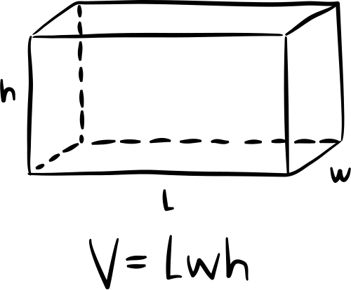
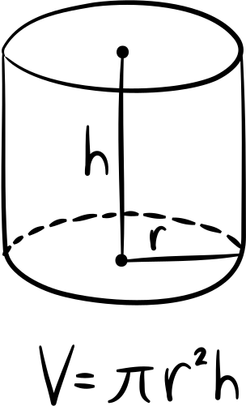
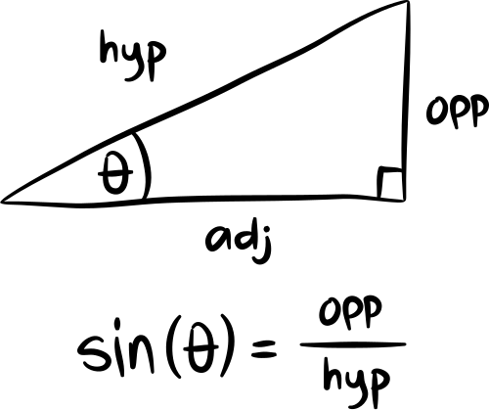
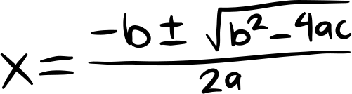
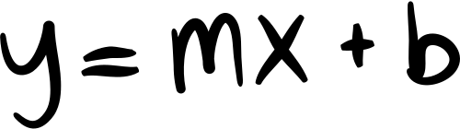
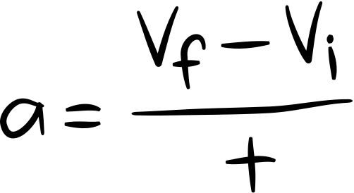
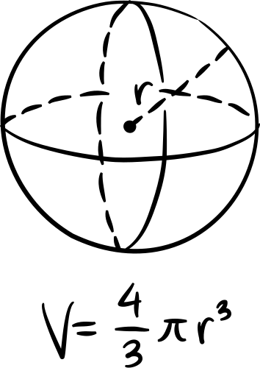
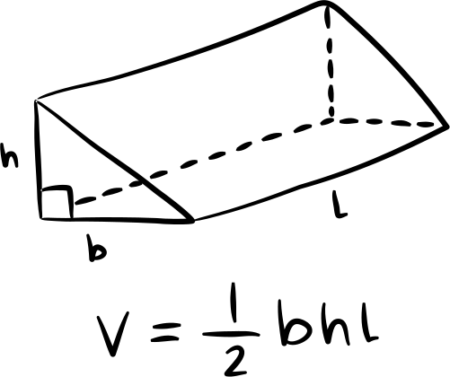
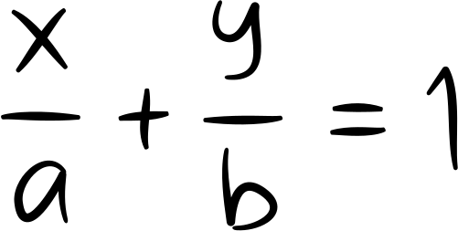

Equivalence Identity
Discrete Mathematics

Slide 3
Concept of Equivalence Identity
  Two propositions are equivalent if they always have the same truth value.
  Denoted as: P≡Q
  Example: ¬(P∧Q)≡¬P∨¬Q (De Morgan’s Law).

Slide 4
Proving a Tautology (Example):
Step 1:
Step 2:
Apply Law of Excluded Middle → Always true.
Construct Truth Table → All rows show “T”.
Step 3:
Conclude → It’s a Tautology.

Slide 5
Proving a Tautology Using Equivalent Identity
Show that (p ∧ q) → (p ∨ q) is a Tautology. (Proof)
(p ∧ q) → (p ∨ q)
≡¬ (p ∧ q) ∨ (p ∨ q) Implication
≡ (¬ p ∨ ¬ q) ∨ (p ∨ q) De Morgan
≡ (¬ p ∨ p) ∨ (¬ q ∨ q) Commutative, Associative
≡ T ∨ T Negation
≡ T Identity

Slide 6
Key Equivalence Laws
Identity Law:
Domination Law:
Idempotent Law:
  P∨F≡P
  P∧T≡P
  P∨T≡T
  P∧F≡F
  P∨P≡P, P∧P≡P

Slide 7
THANK YOU

Slide 8


