Slide 1
Topic: Making truth table for compound proposition and prove Tautology, Contradiction and Contingency using truth table.
Welcome
to my presentation
  Presented by
  Md. Salauddin
  Id: 251311005
  CSE dept. Varendra University

Slide 2
Truth table
A truth table is a table that shows the output for every possible input.

Slide 3
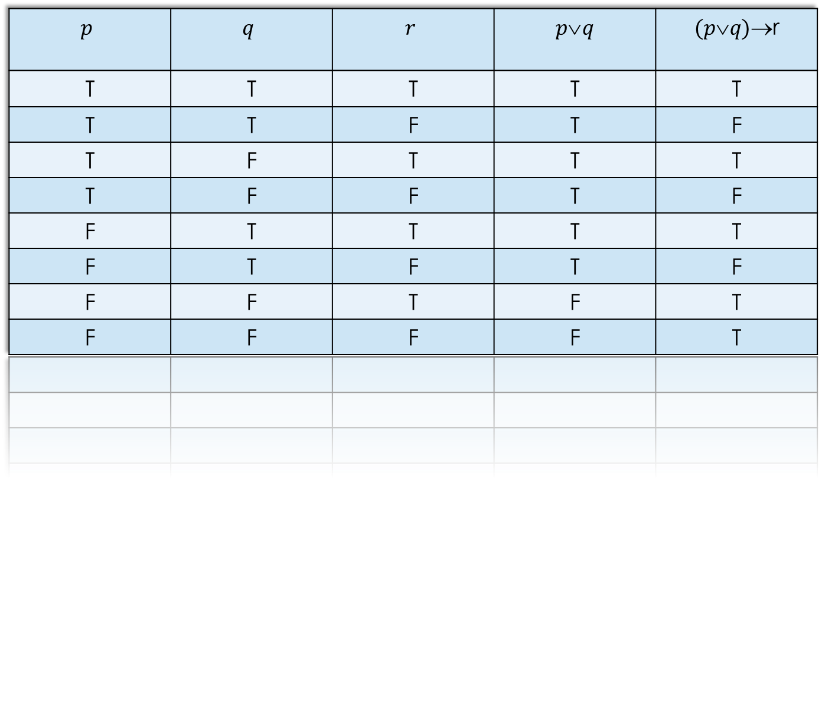
A truth table for compound proposition
$$p$$ | $$q$$ | $$r$$ | $$p\text{∨}q$$ | $$(p\text{∨}q)\text{→}\text{r}$$
T | T | T | T | T
T | T | F | T | F
T | F | T | T | T
T | F | F | T | F
F | T | T | T | T
F | T | F | T | F
F | F | T | F | T
F | F | F | F | T

Slide 4
Tautology
A compound proposition that is always True .

Slide 5
Tautology by truth table
p | q | ¬p | p ∨q | ¬p ∧(p ∨q ) | [¬p ∧(p ∨q )]→q
T | T | F | T | F | T
T | F | F | T | F | T
F | T | T | T | T | T
F | F | T | F | F | T

Slide 6
Contradiction
A contradiction is a compound proposition that is always False

Slide 7
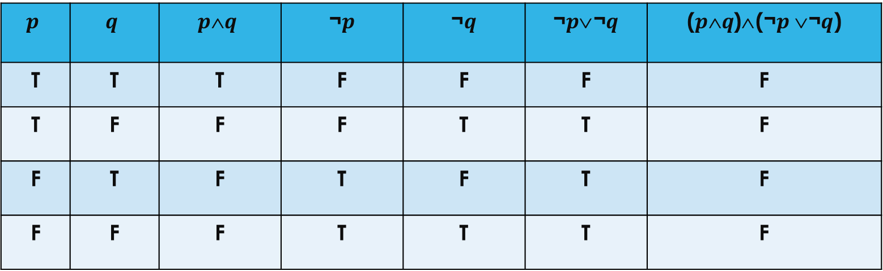
Contradiction by truth table
$$p$$ | $$q$$ | $$p\text{∧}q$$ | ¬$p$ | ¬$q$ | ¬$p$∨¬$q$ | ($p\text{∧}q$)∧(¬$p$∨¬$q$)
T | T | T | F | F | F | F
T | F | F | F | T | T | F
F | T | F | T | F | T | F
F | F | F | T | T | T | F

Slide 8
Contingency
A compound proposition which is sometimes true and sometime false

Slide 9
Contingency by truth table
p | q | p ∧ q | ¬q | (p ∧ q) ∨ ¬q
T | T | T | F | T
T | F | F | T | T
F | T | F | F | F
F | F | F | T | T

Slide 10
Thanks Everyone

