Slide 1
ANIK SARKAR
ID: 251311013

Slide 2
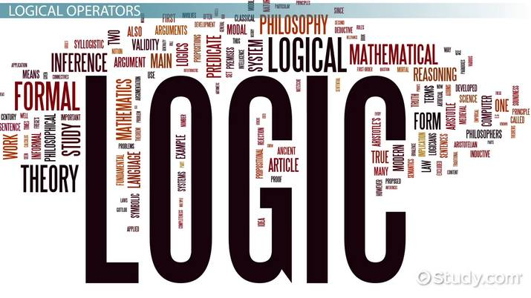
Converosin between English Sentense and logical Expressions
Understanding Propositional Logic in Daily Life

Slide 3
Introduction
Logic helps us represent ideas precisely.
English sentences can often be
unclear
Logical expressions remove unclarity and help in reasoning.

Slide 4
Propositions
A proposition is a statement that is either true or false.
Example:
English : “It’s raining” Logic: p

Slide 5
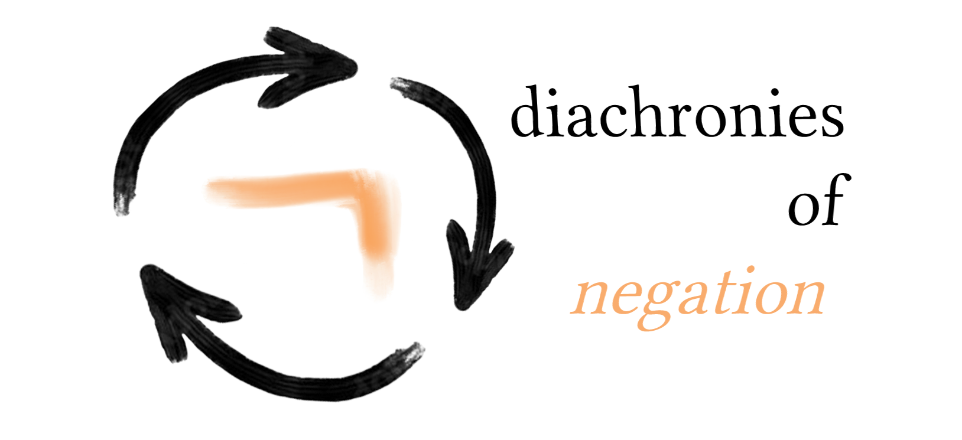
Negation ( )
Negation expresses the opposite meaning.
Example:
English : “It’s not raining” Logic: p

Slide 6
Conjunction( )
Conjunction means AND.
Example:
English : “It’s raining and it’s cold” Logic: p q

Slide 7
Disjunction( V )
Disjunction means OR.
Example:
English : “It’s raining or it’s snowing” Logic: p V q

Slide 8
Implication( )
Implication represent IF… THEN…
Example:
English : “If it rains, then the will be wet.” Logic: p s

Slide 9

Biconditional( )
Biconditional represent IF AND ONLY IF.
Example:
English : “The light is on if and only if the switch is down.” Logic: t u

Slide 10
Conversion practice
Convert to Logic:
English : “If you study, you will pass the exam.” Logic: x y
Convert to English:
Logic: m V n English : “If is morning or it is night.”

Slide 11

Conclusion
01.
Logical expression help us
think clearly.
02.
Conversion between English and Logic makes Logic easy.
03.
Useful in mathematics, computerscience, and philosophy.

Slide 12
Thank you

