Slide 1

Predicates And Quantifiers
Definition and example
MST.SOHELY
ID:251311021
36TH BATCH
SECTION:A

Slide 2

INTRODUCTION
In logic and mathematics, predicates and quantifiers are used to form precise statements.
They help us express properties and relationships clearly.

Slide 3
A predicate is a statement containing variables.
It becomes true or false when we assign values.
.
PREDICATE
Example
P(x):x>5
If x=7 → True
If x=3 → False

Slide 4

Types of Predicates
1. One place predicate
***Property of one variable
Example : p(x):x is prime
2. Two place predicate
***Relation between two variable
Example : Q(x , y): x<y

Slide 5
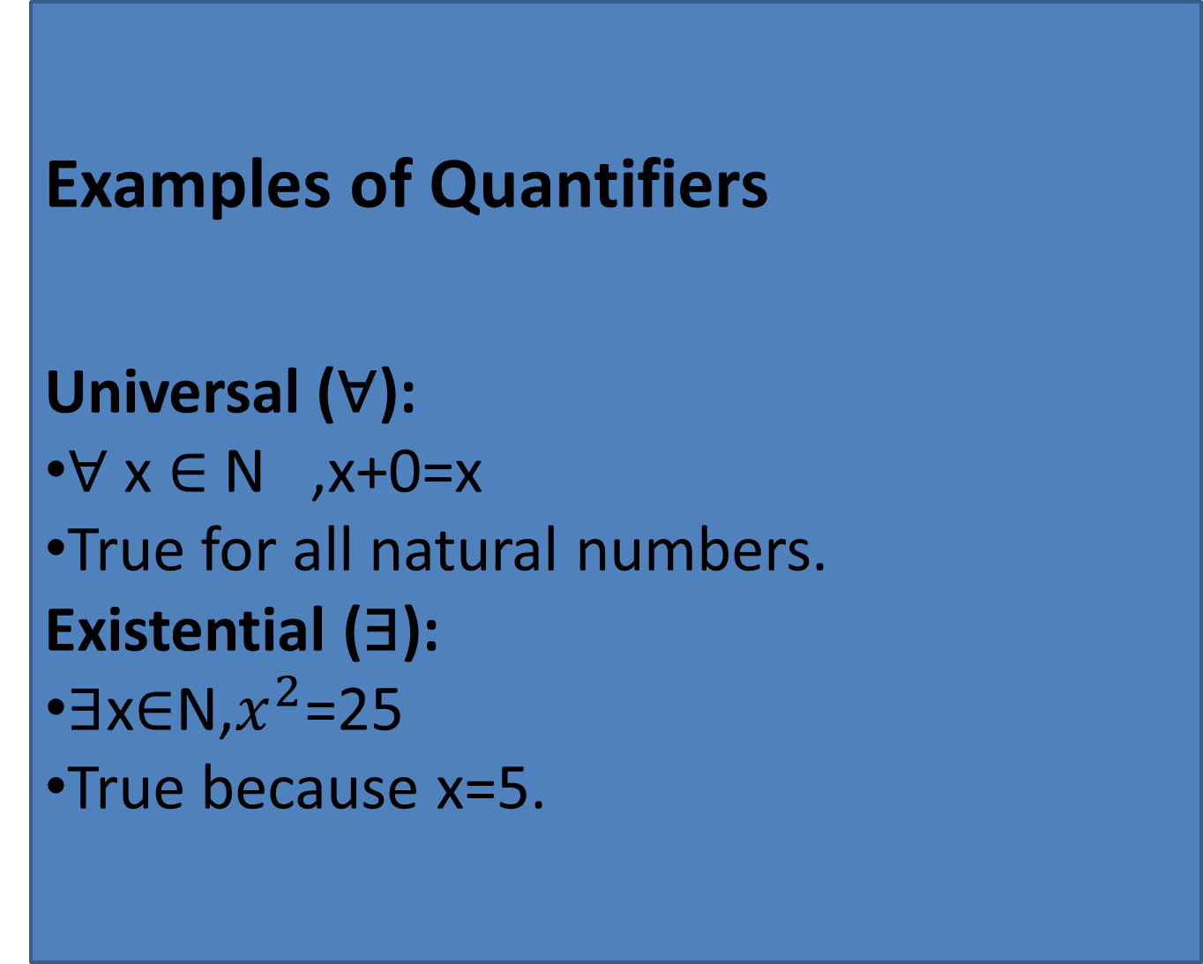
Quantifier
Quantifiers tell us how many objects satisfy a predicate.
Two main types:
  Universal Quantifier (∀) – “for all”
  Existential Quantifier (∃) – “there exists”
Examples of Quantifiers
Universal (∀):
∀ x ∈ N ,x+0=x
True for all natural numbers.
Existential (∃):
∃x∈N,$x^{2}$=25
True because x=5.
Question 2: Write the question you want to ask your students and allot space for the answers.

Slide 6

Predicate → Statement with variables.
Quantifiers → Define scope of the predicate.
  ∀ → True for all values.
  ∃ → True for at least one value.
Summary

Slide 7


THANK YOU!

