Slide 1
TRUTH TABLE
Tautology,Contradiction & Contingency proof using Truth table
Name: Maruf Ahmed
ID: 251311025
Sec: A

Slide 2
What is Truth table?
A truth table shows all possible truth values of statements.
It helps us analyze whether a compound statement is always true, always false, or sometimes true/false.

Slide 3
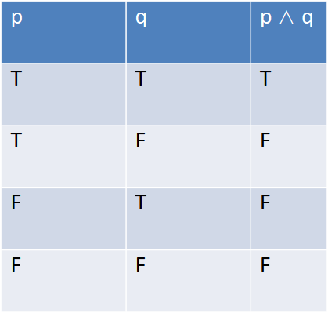
Compound Truth table

Slide 4
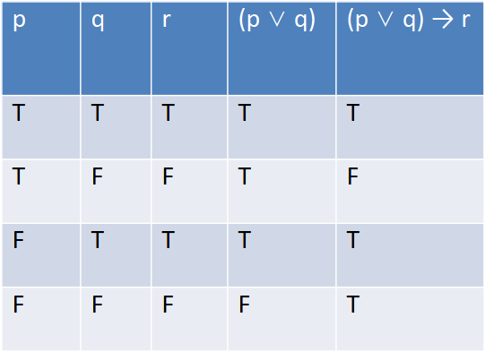
Compound Truth table
Complex truth table

Slide 5
Tautology
A statement that is always true in its truth table.
p | ¬p | p ∨ ¬p
T | F | T
F | T | T

Slide 6
Contradiction
A statement that is always false in its truth table.
p | ¬p | p ∧ ¬p
T | F | F
F | T | F

Slide 7
Contingency
A statement that is sometimes true, sometimes false.

Slide 8

THANK YOU

