Slide 1

Predicate and Quantifier
Presented By
Presented To
Sanjoy Kumar Chakravarty
A. N. M. Mahiuddin Bin Jalil
251311041
Associate Professor
2nd Semester
Dept. of CSE
Dept. of CSE

Slide 2
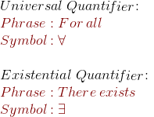
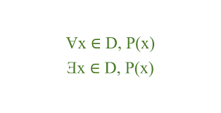
Introduction:
Quantifier:
Logic is the foundation of mathematics and computer science
What is Predicate?
Predicate:
Predicate is a sentence containing one or more variables that becomes a true or false statement when specific values are substituted for those variables
what is quantifier?
Quantifier specifies the quantity or extent to which a predicate (a statement with a variable) is true for a given set of elements

Slide 3
Predicate:
A predicate is a statement involving variables.
It becomes true or false when the variable is replaced with a specific value.
Example:
P(x):x>5
If x=7, then P(7) = True.
If x=3, then P(3) = False.

Slide 4
Quantifiers
Quantifiers specify the scope of a predicate.
Two main types:
Universal Quantifier ( ∀ ) → “For all”
Existential Quantifier ( ∃ ) → “There exists”

Slide 5
Universal Quantifier ( ∀ )
Symbol: ∀
Meaning: Statement is true for every value in the domain.
Example:
∀x∈N,x+0=x

Slide 6

Symbol: ∃
Meaning: Statement is true for at least one value.
Symbol: ∃
Meaning: Statement is true for at least one value.
Existential Quantifier ( ∃ )
Symbol: ∃
Meaning: Statement is true for at least one value.
Example:
∃x∈N, $x^{2}$=9

Slide 7



7
Example in
Real-Life
Predicate: P(x): “x is a student in this class.”
Quantifiers:
Universal: ∀x, P(x) → “Every person is a student in this class.”
Existential: ∃x, P(x) → “There is at least one student in this class.”

Slide 8
Conclusion
Turning Information
Predicate →
Logical statement with variables.
Quantifiers → Define scope:
∀ (all values)
∃ (some values)
Together, they form the basis of mathematical reasoning and logic.

Slide 9

CSE
THANK
YOU
EVERYONE

