Slide 1
WELCOME
Under the guidance of:
Dr. Akshita Chaudhary,
Assistance professor
Presented By: Md Enamullah
Reg no.: ra2332241030042

Slide 2

Presentation on E-Commerce (online shopping system)

Slide 3
Table of Contents
Introduction
Features
Languages & Tools used
Project Design
Design Plan
Process Model
Use Case
Activity Chart
Advantages
Disadvantages
Implementation Design (GUI)

Slide 4
Introduction
E-commerce definition
About our system

Slide 5
What is E-Commerce
Commonly known as Electronic Marketing.
“It consist of buying and selling goods and services over an electronic systems Such as the internet and other computer networks.”

Slide 6
Our System
Our System is an e-commerce website from where people can buy products online. In this system, you will see the mostly wearable product such as headphones, Bluetooth speakers and smart watches.
Admin monitors the activity of the users and checks the transactions.

Slide 7
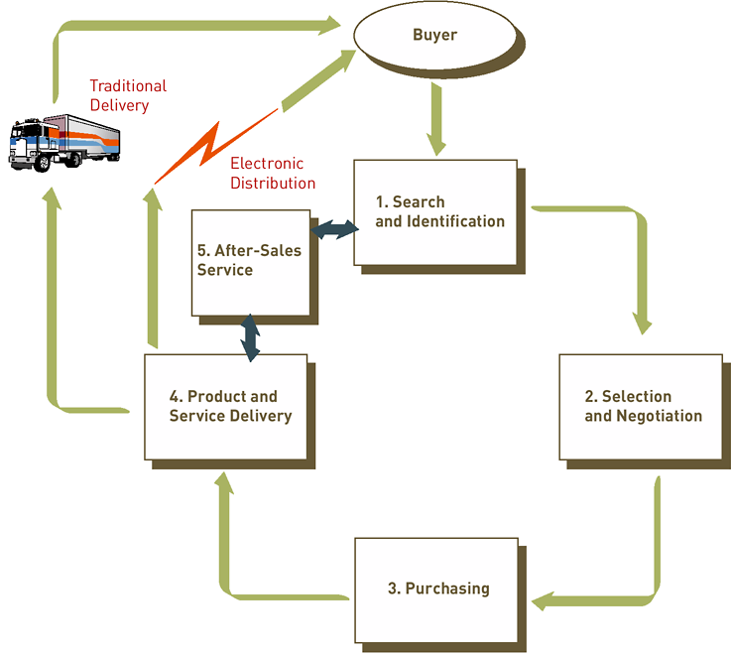
THE PROCESS OF E-COMMERCE
Notes:
The process of e-commerce involves several stages such as business planning, Marketing and sales, order management, payment processing, and customer support.

Slide 8
Features of our system
Menu
Catalog Browsing
Category List
Product List
Catalog Management
Single Product
Product Browsing
Related Products
Shopping Cart
Checkout
Auto generated bill
Payment Gateway

Slide 9
Languages:
HTML 5
CSS 3
Bootstrap
JavaScript
Tools:
Adobe Photoshop
Sublime text
Smart Draw
Stripe Payment Gateway

Slide 10
Project Design

Slide 11
Design plan
We are thinking of some modifications and adding some advanced new features in our system. Some of them are –
# GUI modification (more user friendly)
# Users can buy the products
# Users can view product, search product, select product, Add to cart product, checkout products and payment.
Notes:
Designing an e-commerce website requires careful planning to ensure it is user-friendly, visually appealing, and optimized for conversions.

Slide 12
Business process model
Start
Customer
Product List
Buy Product
Payment Type
End
Admin
Check Transaction
Notes:
Business Process Modeling is a critical part of Business Process Management (BPM), which involves the identification, documentation, analysis, and optimization of business processes.

Slide 13
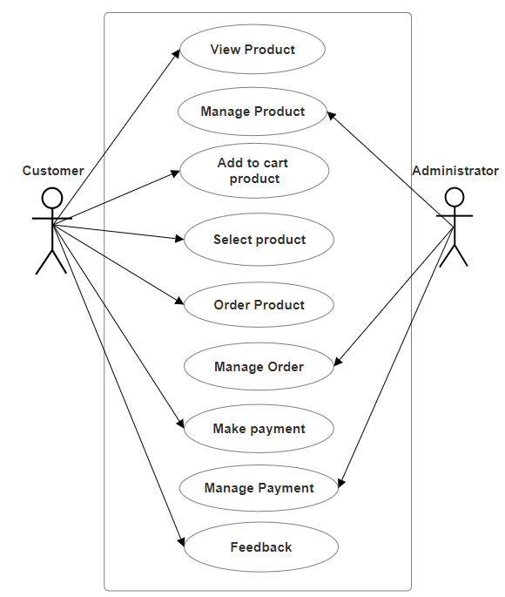
Use-Case (online shopping system)

Slide 14
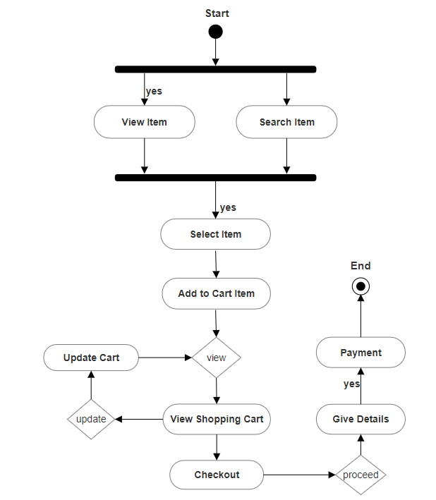
Activity Chart (online shopping system)

Slide 15
ADVANTAGES OF E-COMMERCE
Faster buying/selling procedure, as well as easy to find products.
Buying/selling 24/7.
More reach to customers, there is no theoretical geographic limitations.
Low operational costs and better quality of services.
No need of physical company set-ups.
Easy to start and manage a business.

Slide 16
DISADVANTAGES OF E-COMMERCE
Unable to examine products personally
Not everyone is connected to the Internet
There is the possibility of credit card number theft
Mechanical failures can cause unpredictable effects on the total processes.

Slide 17
GUI(Graphical User Interface)

Slide 18
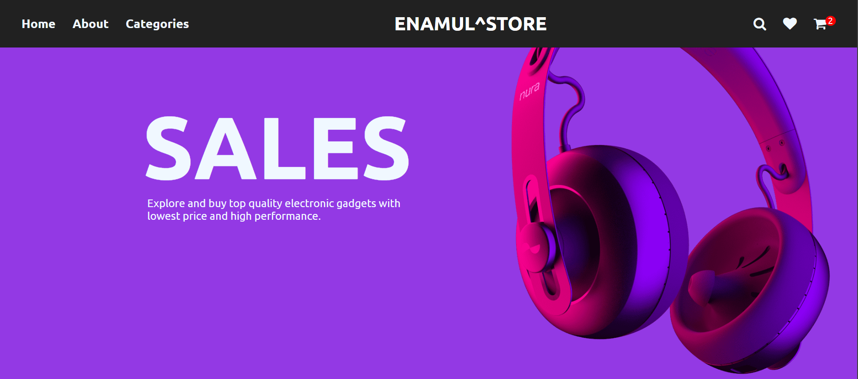
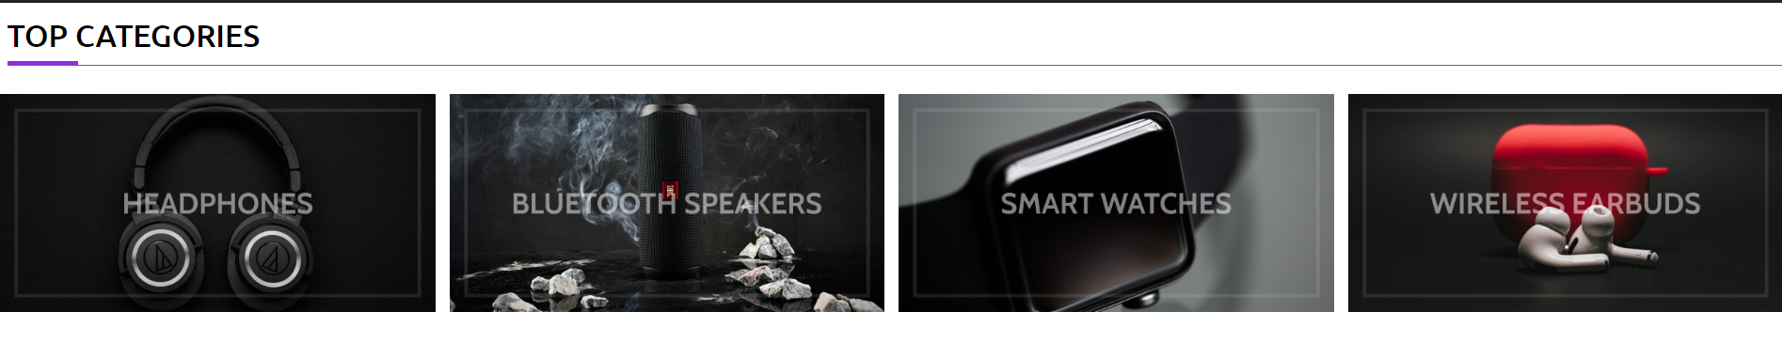
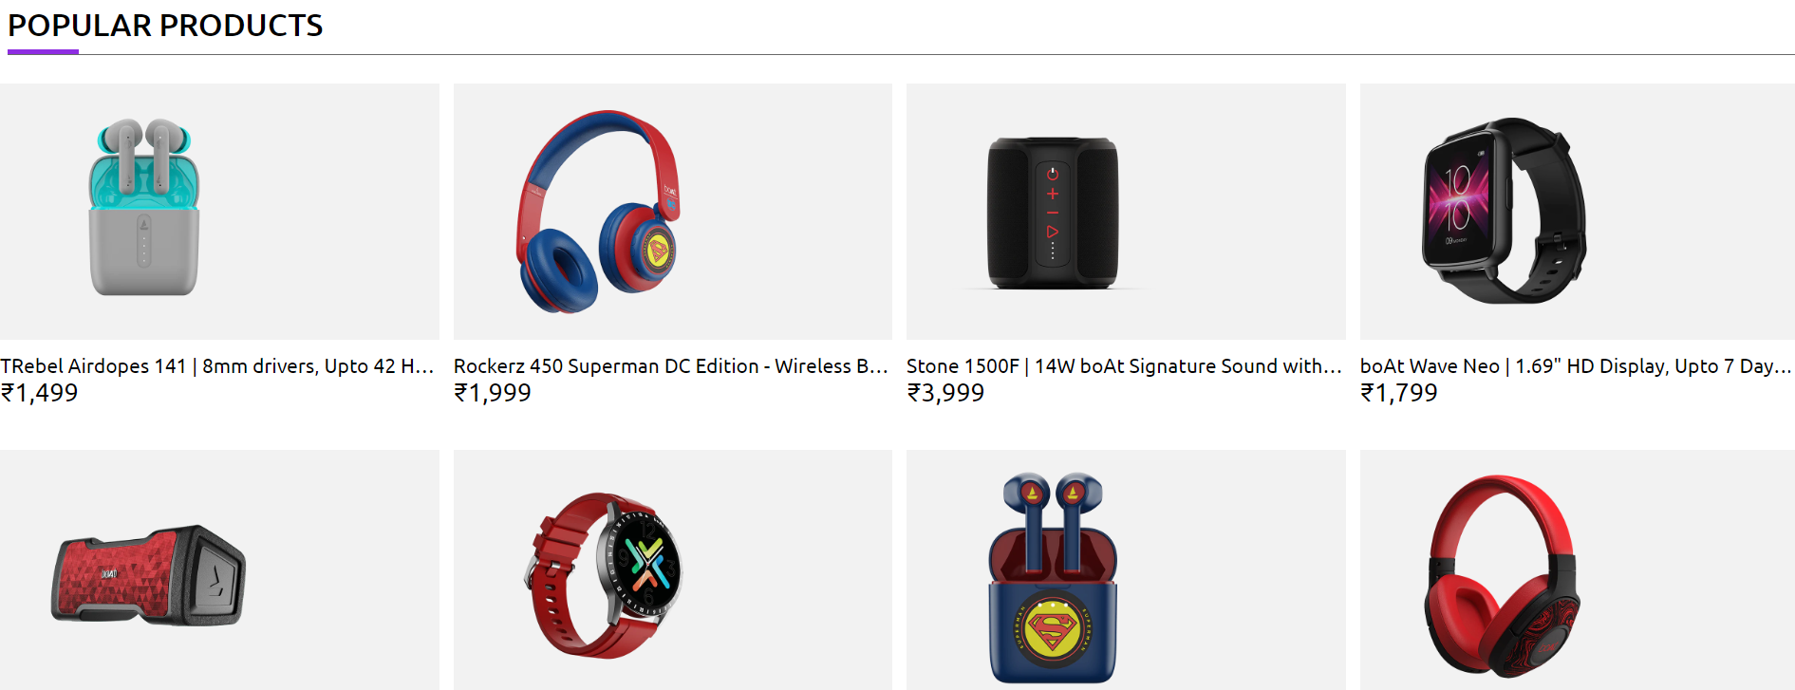
Homepage

Slide 19
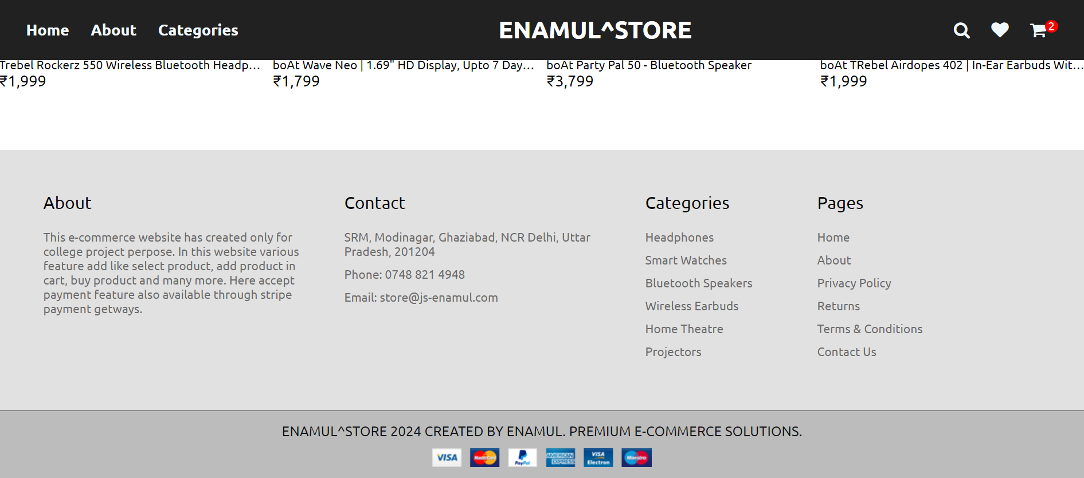
Footer Section

Slide 20
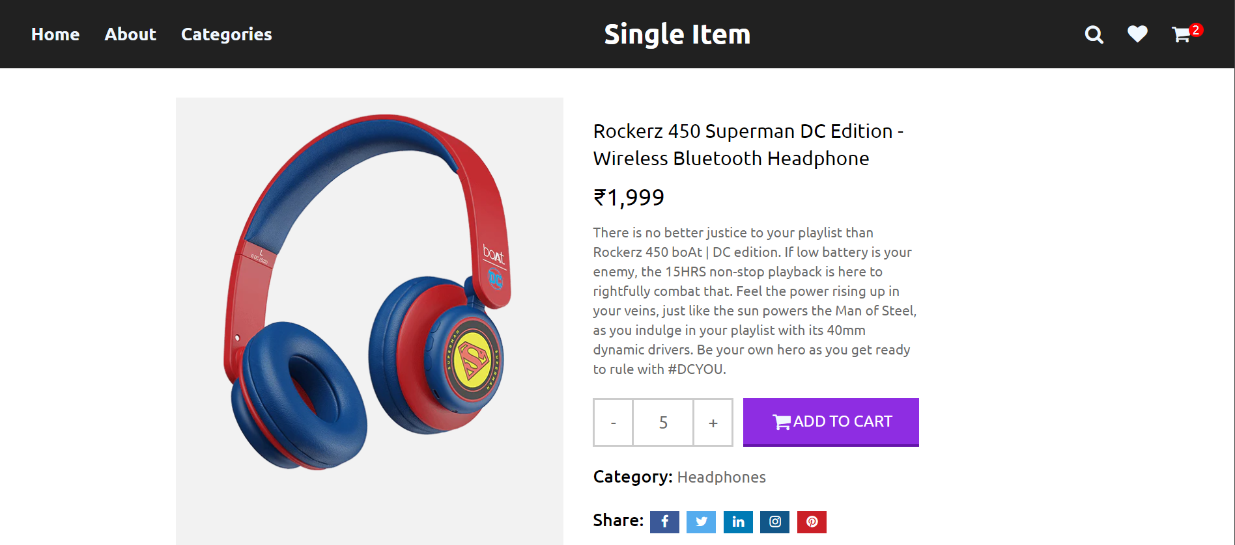
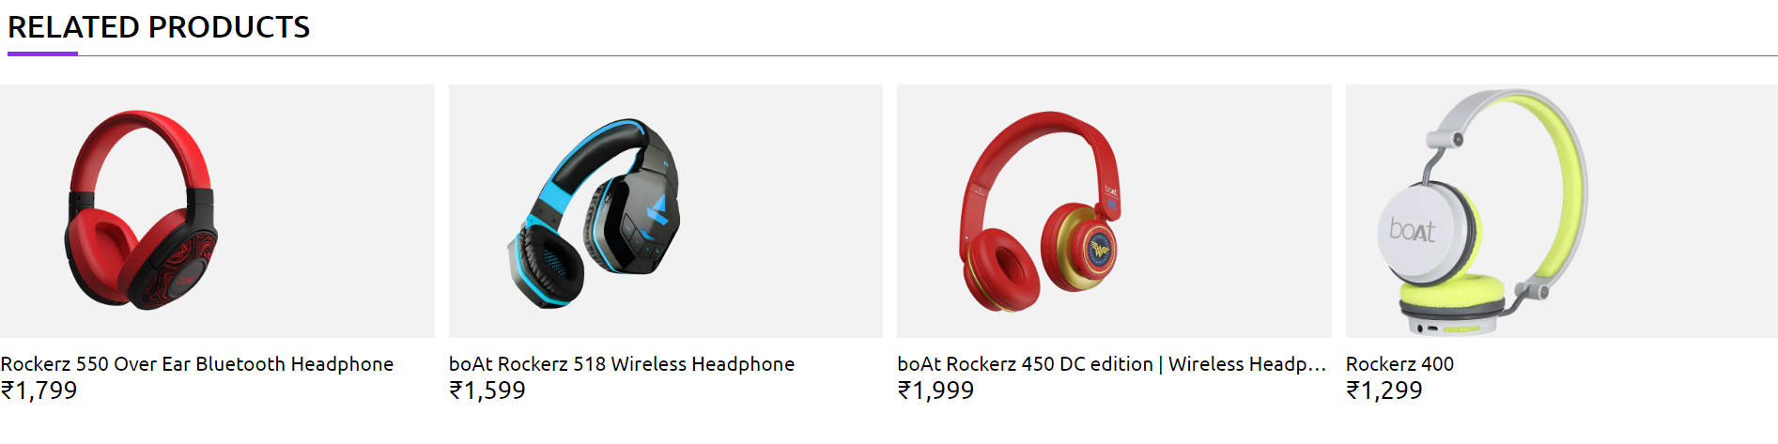
Single Product page

Slide 21
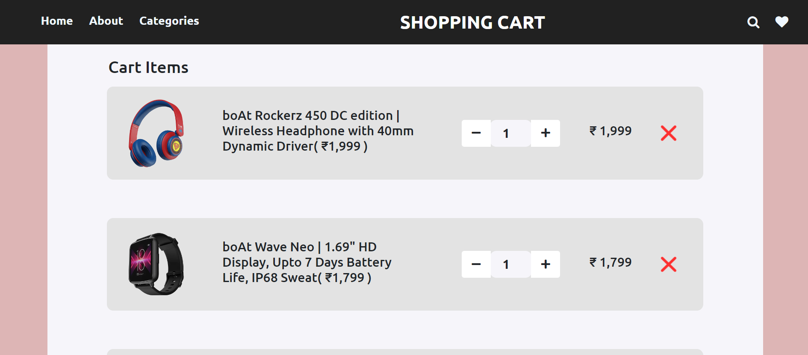
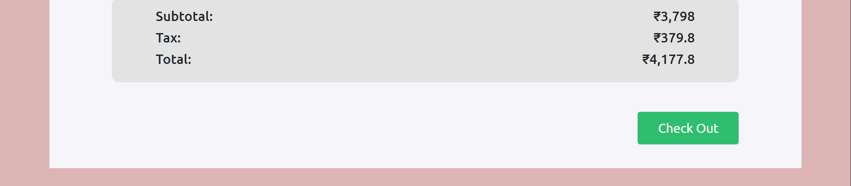
Shopping Cart page

Slide 22
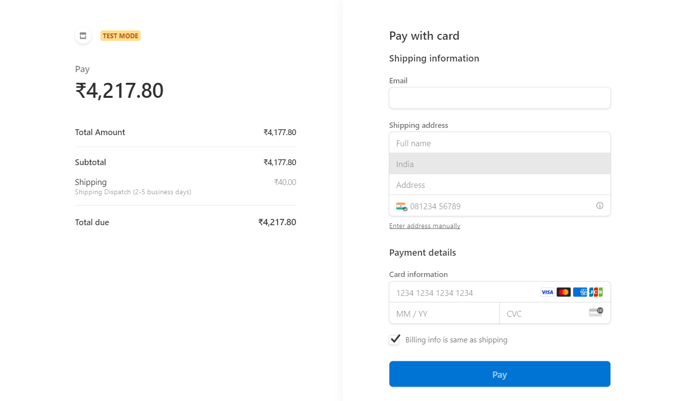
Checkout Page

Slide 23
Any Question ?

Slide 24
Thank you!

