Slide 1
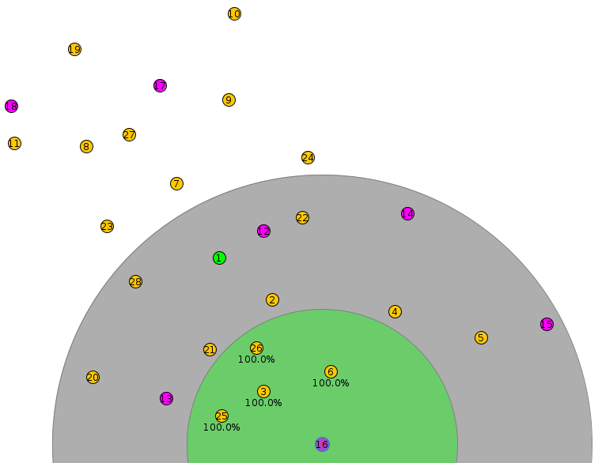
WSN SETUP
20 senders
6 dummy receivers
1 sink
1 root

