Slide 2
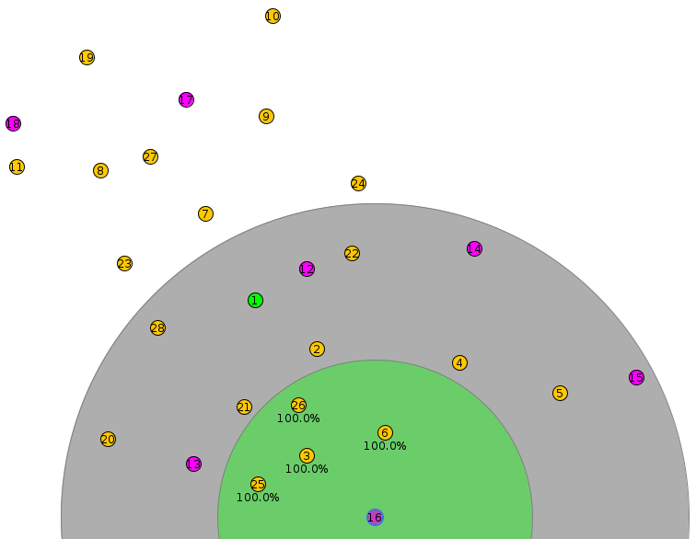
WSN SETUP
Multi-tier star, acting as a Mesh WSN
20 senders
6 dummy receivers
1 sink
1 root

Slide 3
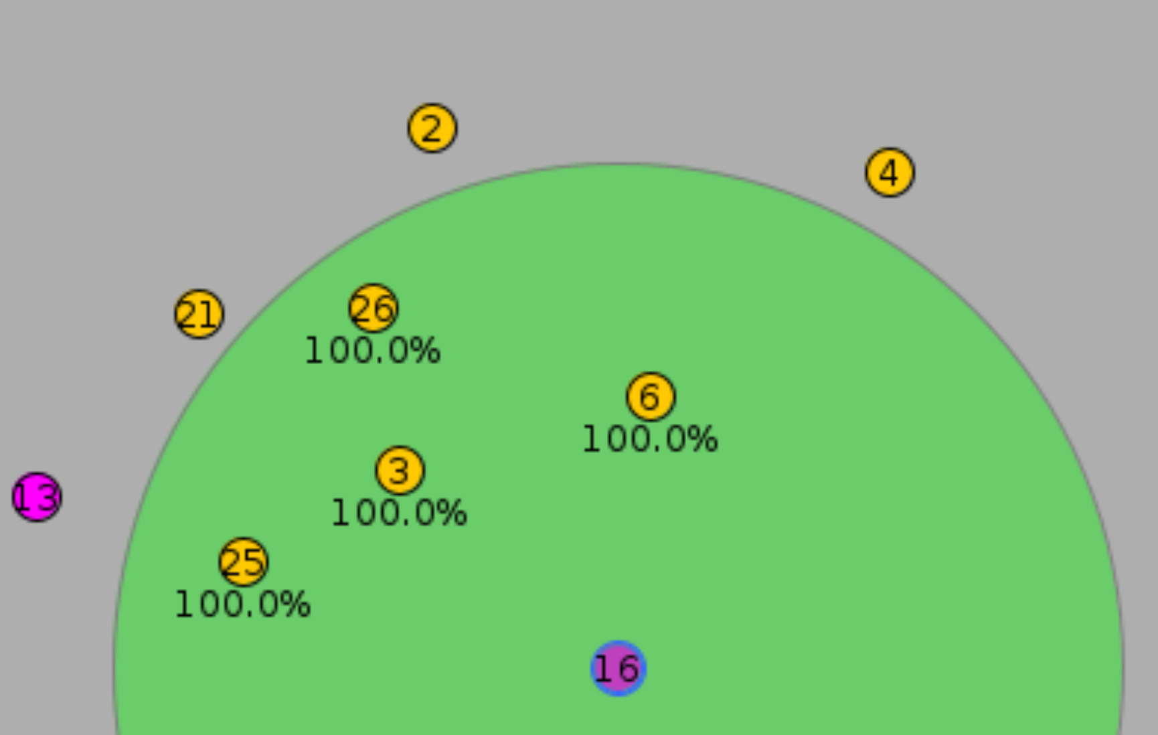
Crusial role of Relay nodes
Relay Nodes 3, 6, 25 and 26
1 sink node 16

Slide 4
Measurement requirements
100% correct measurements
Netto vs bruto msg. receiving
Random and evenly sendings
Full process, including steady state

Slide 5
Automated testing process
INPUT
TSCH or CSMA, sendingrates ex. 1,2,5,10, Testbins ex. 1-30, project-conf and Makefile, gui or not, logs save or not
QUEUEBUF CONF NUM = 64
MAX PACKETS PER NEIGHBOR = 16
SETUP TESTBIN
Sender-node.c (sending rate)
Coojalogger.js (simulation time)
ANALYSE TESTLOG
Extract PDR, latency, Throughput, etc...
SAVE RESULTS
Analyses to CSV line(a), logfiles
RUN TESTBIN cooja.testlog logging
Repeat sendingrate/testbin
END

Slide 6
Live Dashboard

Slide 7
Results and Discoveries
Critical Breaking Point @ 80%
  CSMA 65 msgs/min per senders node
  TSCH 7 msgs/min per sender node
Max PDR
  CSMA +99%
  TSCH 81,3%

