Slide 1
PRUDENT
TELECOM CHURN PREDICTION
MOHAMMED ESA BURHAN
01

Slide 2
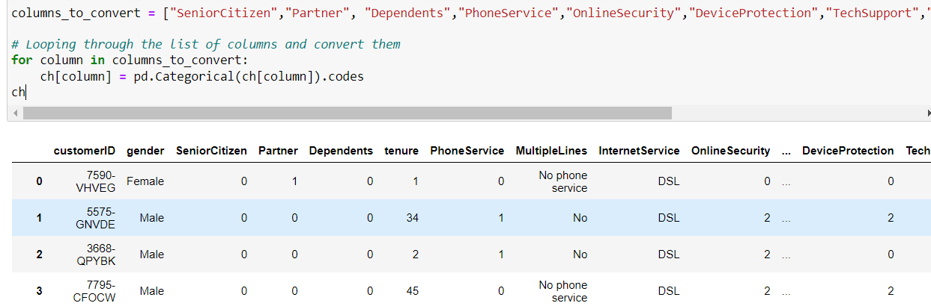
DATA PREPROCESSING
Categorical values were transformed into numerical format using one-hot encoding.
This step ensured that the data was in a suitable format for model training.
Libraries used: numpy, pandas

Slide 3
DATA ANALYSIS
Exploratory data analysis techniques were employed to identify features significantly affecting the churn rate.
Visualizations such as plots and graphs were utilized to gain insights into the dataset.
Libraries used: matplotlib, seaborn

Slide 4
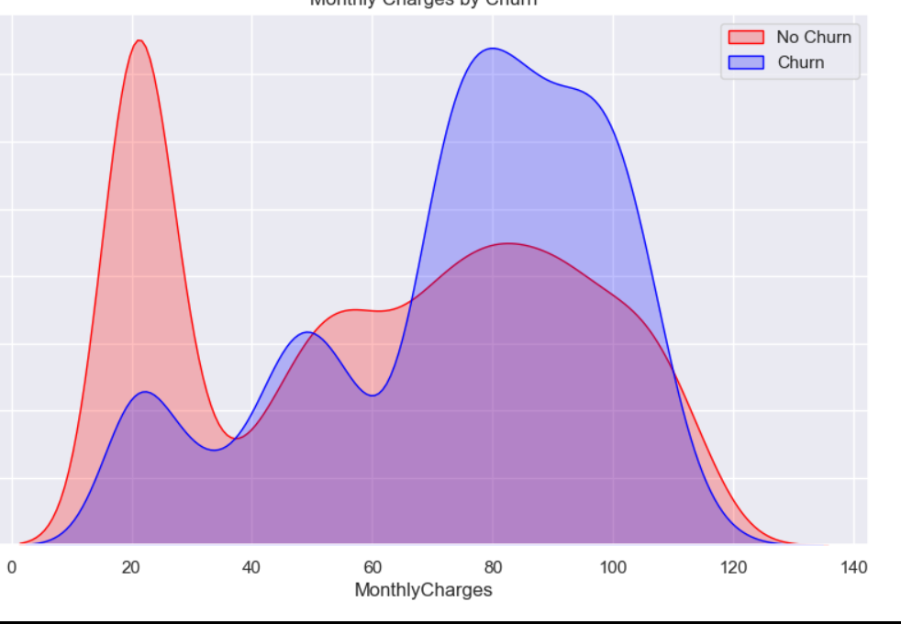
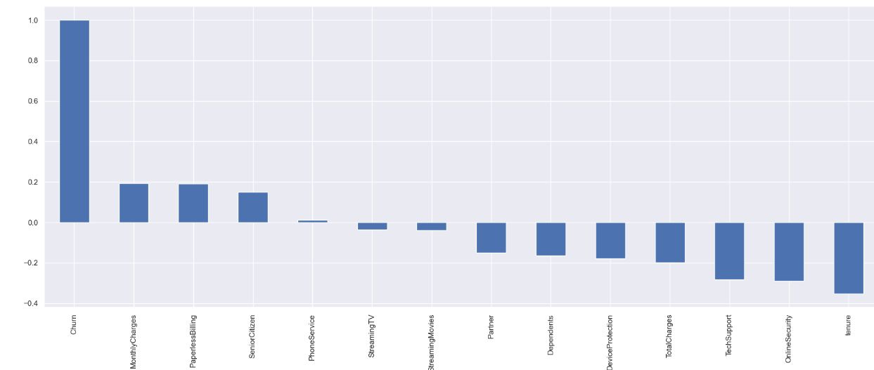
01

Slide 5
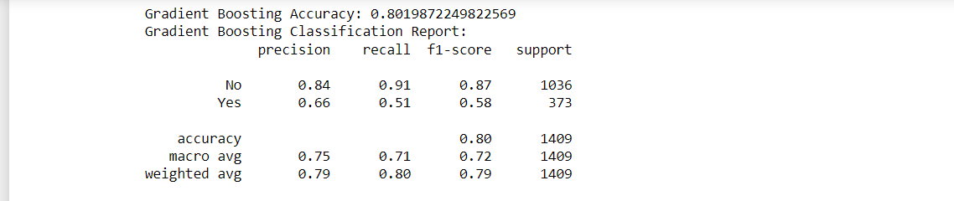
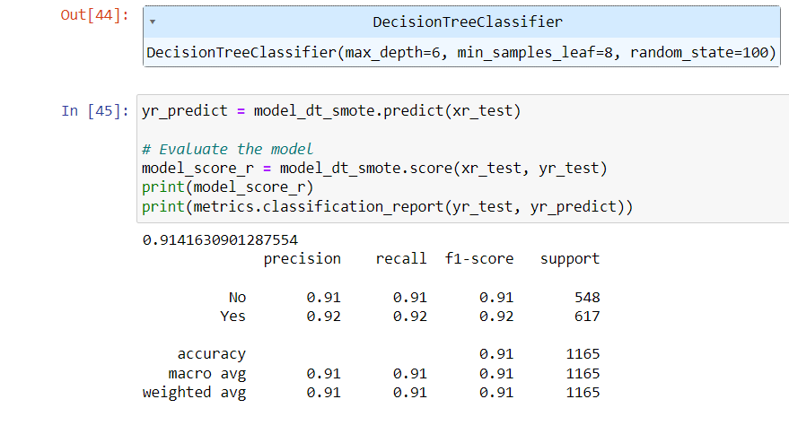
MODEL BUILDING
Various machine learning algorithms, including linear regression, random forest, and gradient boosting classifier, were tested to determine the most effective model.
Decision tree classifier emerged as the best-performing model based on accuracy metrics.
Libraries used: sklearn

Slide 6
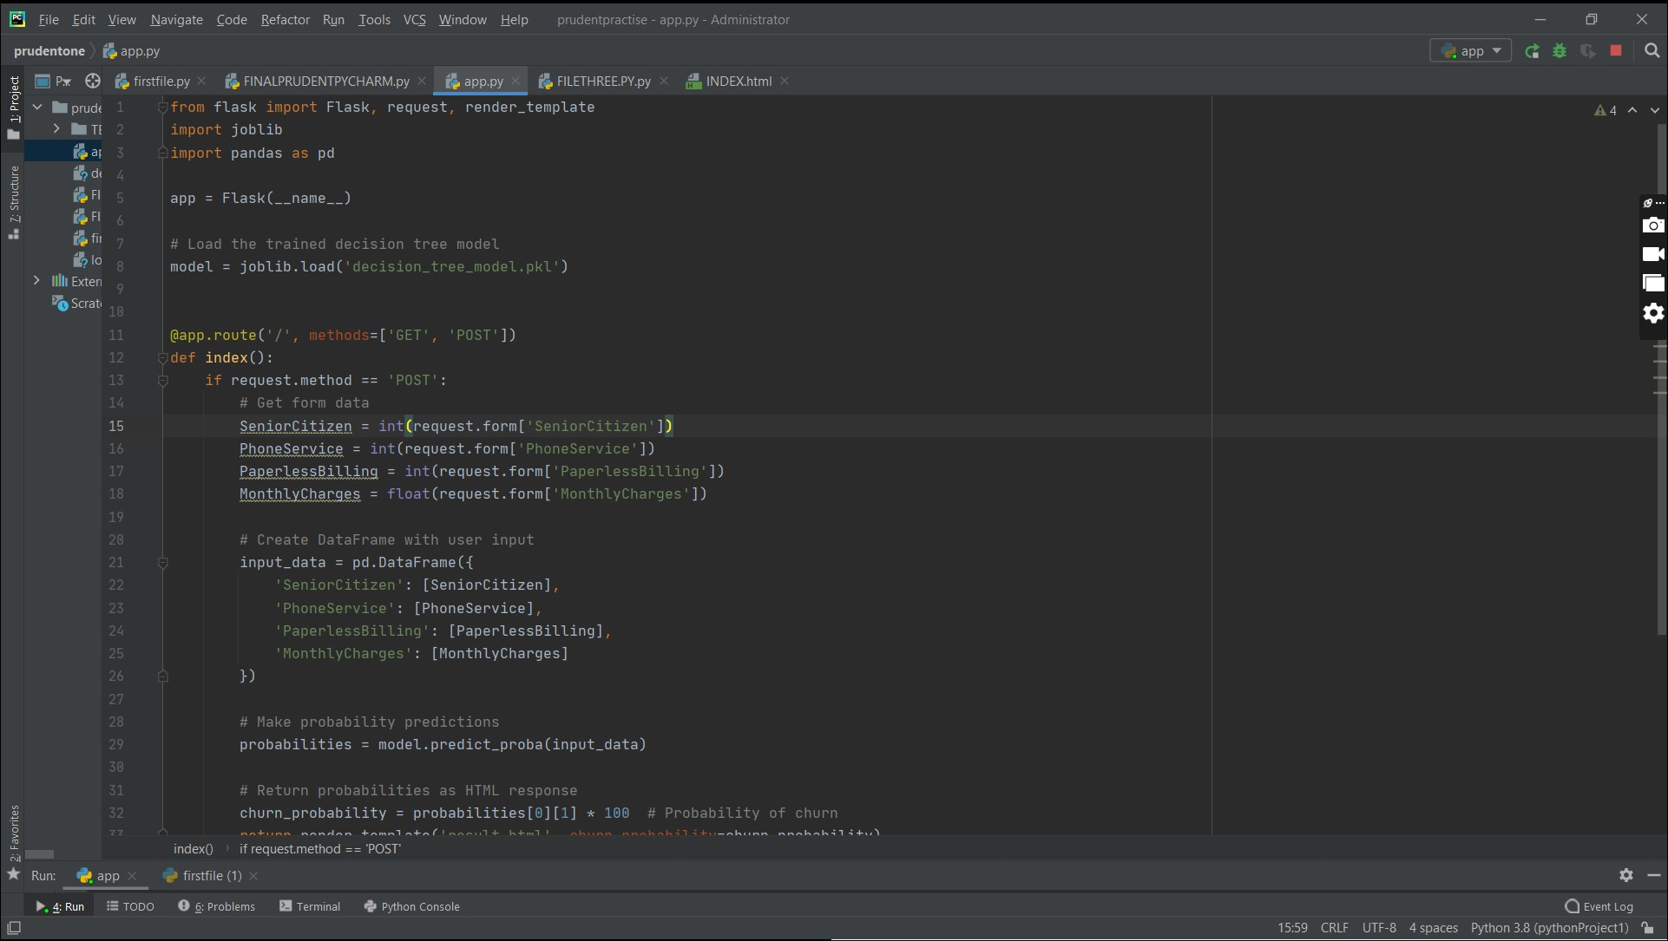
DEPLOYEMENT
The trained decision tree model was deployed on a web server using Flask, a lightweight Python web framework.
This facilitated easy access to the predictive model through a web interface.

Slide 7
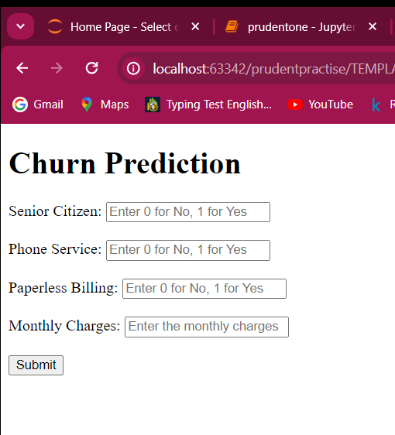
USER INTERFACE
An HTML form was created to enable users to input relevant data for churn prediction.
The form included fields for essential features such as senior citizenship, partner status, tenure, monthly charges, etc.
Users could submit their data through the form, triggering the model to make predictions on churn probability

Slide 8
By following this structured workflow, the project was successfully developed as a predictive model for customer churn and made it accessible through a user-friendly web interface. This documentation provides a gist of the project's methodology and outcomes. For a more detailed analysis and insights, please refer to the complete project.

Slide 9
THANKS
FOR THE OPPORTUNITY
01

