Slide 1
Content Based Image Retrieval System using multi-sequential search
GROUP CODE: CB-17
GROUP MEMBERS:
  14102B0015- Sanchit Shinde
  14102B0025- Mrudula Desai
  14102B0031- Mihika Gupte
UNDER THE GUIDANCE OF
- PROF. DIVYA RACHA

Slide 2
What is CBIR?
Content-based image retrieval systems aim to retrieve significant images from massive databases similar to the input query image based on the similarity between image features.
The indexing of the image and the representation is done using visual contents of an image like color, shape and texture layout.
Depending on the method incorporated to generate the similarity measure for the comparisons of different features and the vectors, the accuracy and response of the system would vary.
The traditional approach of annotating images by entering keyword data in a large database is time consuming and we may not get the desired image output.

Slide 3
What are its applications?
Medical Applications
From the teaching perspective, searching tools can be used to find important cases to present to students. Research also can be enhanced by using services combining image content information with different kinds of data.
Clinicians usually use similar cases for case-based reasoning in their clinical decision-making process.
Biodiversity Information Systems
Biologists gather many kinds of data for biodiversity studies, including spatial data, and images of living beings. Ideally, Biodiversity Information Systems (BIS) should help researchers to enhance or complete their knowledge and understanding about species and their habitats by combining textual, image content-based, and geographical queries.
3/5/18

Slide 4
What are its applications?
Digital Libraries
There are several digital libraries that support services based on image content. One example is the digital museum of butterflies, aimed at building a digital collection of Taiwanese butterflies. This digital library includes a module responsible for content-based image retrieval based on color, texture, and patterns.
In a different image context, present a content-based image retrieval digital library that supports geographical image retrieval. The system manages air photos which can be retrieved through texture descriptors. Place names associated with retrieved images can be displayed by cross-referencing with a Geographical Name Information System (GNIS) gazetteer.
3/5/18

Slide 5
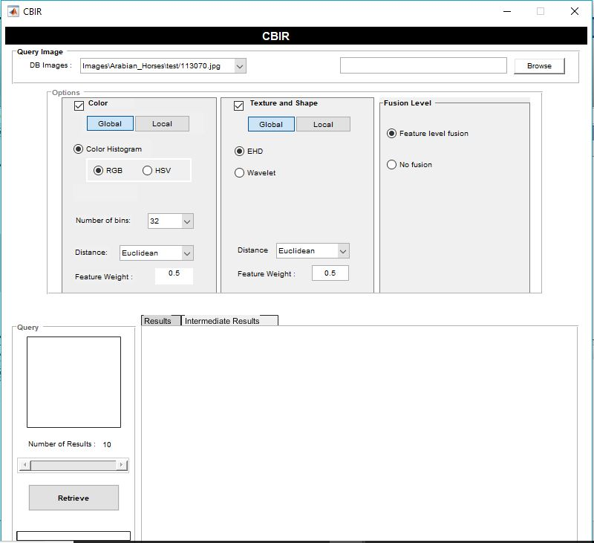
VIEW OF THE SYSTEM
3/5/18

Slide 6
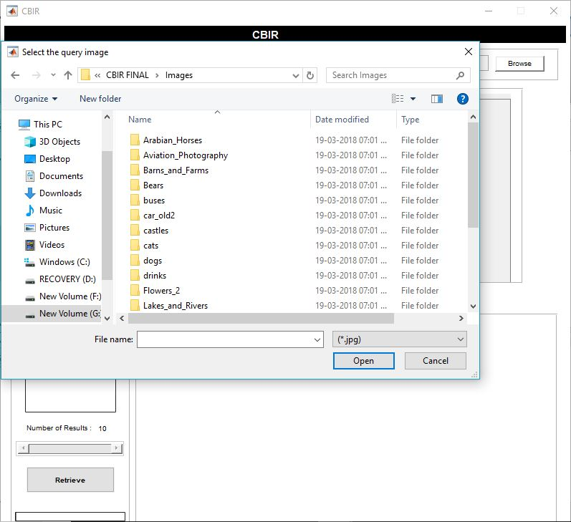
3/5/18

Slide 7
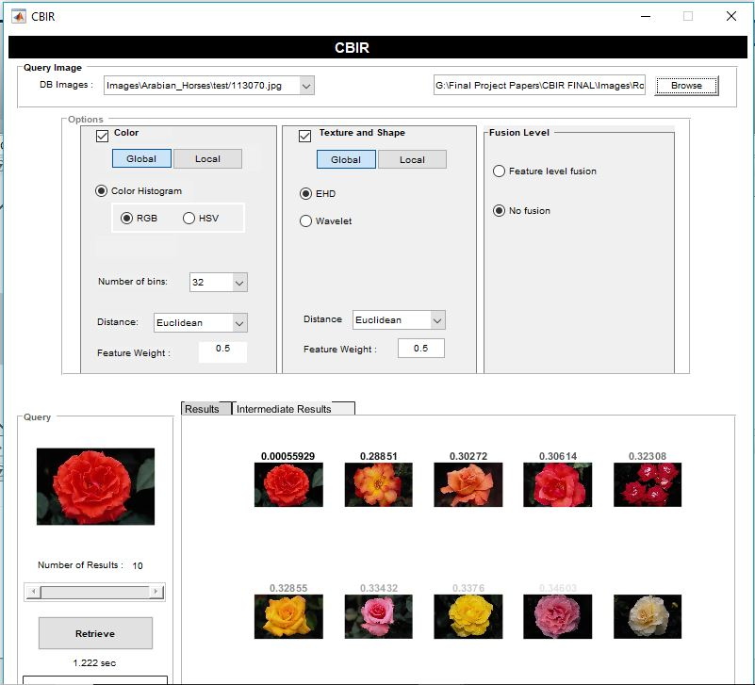
3/5/18

Slide 8
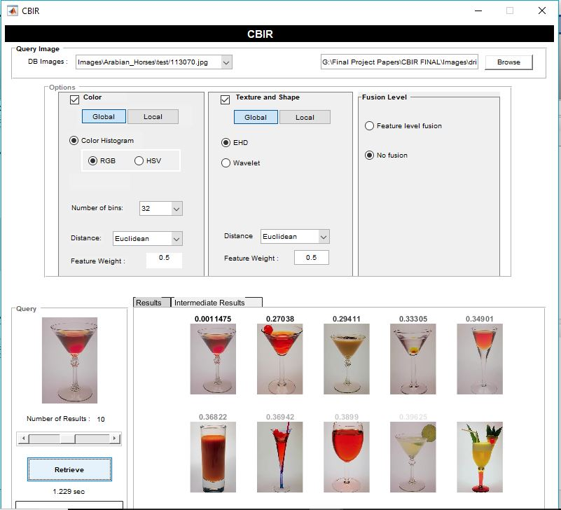
3/5/18

Slide 9
PROPOSED SYSTEM
It is a newer Approach for existing concept.
The proposed system is exclusive as it takes into consideration one particular feature at one step and uses the result of the above prior step as the input for the next step instead of fusing all the features at one step and thus providing an edge over the earlier used methods and also showing improvement in the retrieval quality.
A single-level sequential search fuses all the three feature vectors together for one step extraction. Though commonly used, the combined feature method may not give an accurate result. There is a possibility of one feature dominating the retrieval performance. The feature vectors need to be weakly correlate with each other for an improved result

Slide 10
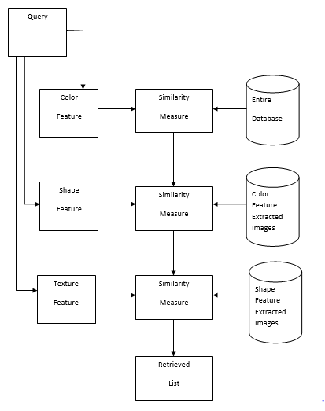
The working of the proposed system is as follows:
User submits a query image from their machine to the system.
The color feature of the input is extracted first and compared with the color feature database. The first top N₁ images found using the similarity matrix and color feature database are fed to the second stage for the texture computation.
Then, texture feature is extracted using texture feature database. The first top N₂ images are selected from the list N₁ as the output of this stage. These results are given to the third stage as the input.
Top N₃ are selected using the shape feature database and displayed.
Flow of the proposed system
3/5/18

Slide 11
PROJECT OBJECTIVE
To develop a novel simple CBIR system based on multi-level sequential searching in order to achieve adequate precision in image retrieval using the global representation.
This proposed system is unique as it considers one feature at each step and uses the results of the prior step as the input for the next step whereas in past methods all the features are fused at once for the single-level search.
Getting accurate and appropriate images from vast image database.

Slide 12
Resources Needed:
Various datasets
MATLAB/ SCILAB
Resources Availability:
MATLAB (available in the college)/SCILAB
Laptops/PC
Datasets
Working Internet Connection

Slide 13
PROJECT METHODOLOGY
Process Model to be used: Prototype Model will be used since we will develop modules in iterative manner based on content properties (e.g., shape, color, texture)
Three individual feature vectors are used to represent each image for colour, texture, and shape separately. The feature vectors are normalized to reduce the effect of bias in large values.
Descriptors that can be used:
  Color feature: Color Histogram, Color Coherence Vector, Color correlogram.
  Texture feature: Gabor Wavelet, Wavelet Transforms. Co-occurrence matrix is adopted to extract texture features. The texture values are compared by Euclidean distance, the closer the distance the higher the similarity
  Shape feature: Generic Fourier Descriptor, Edge Histogram Descriptor.

Slide 14
COLOR DESCRIPTOR …

Slide 15
COLOR FEATURE
Among the visual features, colors is the most vital, reliable and widely used feature in content analysis and retrieval.
The various methods, namely Global Color Histogram, Histogram Intersection, Local Color Histogram, Color Correlogram etc are employed to extract the color feature.
Color Histogram is a widely used extraction technique. The reason for this is that it is very easy to compute and is insensitive to small variations in the image.
Histogram, basically, gives the frequency distribution of the color bins in the image. Itcaptures only the color distribution in an image and does not include any spatial correlation information.

Slide 16
No | Feature | Approach | Limitations
1 | Color | Histogram and color moments | Query image is an unknown image, then the retrieval performance is poor
2 | Color | Region Histogram | Outcomes within the mismatch of the retrieval method when the image orientation, and position or scales are Altered
3 | Color | Color Histogram | Similarity measure is elevated to retrieve the texture areas from a database of common pictures.
4 | Color | Color Moment | Semantically relevant images will be retrieved with amount of time

Slide 17
COLOR HISTOGRAM:
Histogram, basically, gives the frequency distribution of the color bins in the image. It captures only the color distribution in an image and does not include any spatial correlation information.
An image histogram refers to the probability mass function of the image intensities.
This is extended for color images to capture the joint probabilities of the intensities of the three color channels.
More formally, the color histogram is defined by, hA,B,C (a,b,c) - N.Prob(A=a, B=b, C-c)where A , B and C represent the three color channels (R,G,B or H,S,V) and N is the number of pixels in the image.
Notes:
Each image added to the collection is analyzed to compute a color histogram, which shows the proportion of pixels of each color within the image. The color histogram for each image is then stored in the database. At search time, the user submit an example image from which a color histogram is calculated. the matching process then retrieves those images whose color histograms match those of the query most closely. The matching technique most commonly used, histogram intersection, was first developed . Variants of this technique are now used in a high proportion of current CBIR systems.
An image histogram refers to the probability mass function of the image intensities. This is extended for color images to capture the joint probabilities of the intensities of the three color channels. More formally, the color histogram is defined by,
h_{A,B,C} (a,b,c) - N.Prob(A=a, B=b, C-c)
where A , B and C represent the three color channels (R,G,B or H,S,V) and N is the number of pixels in the image. Computationally, the color histogram is formed by discretizing the colors within an image and counting the number of pixels of each color.

Slide 18
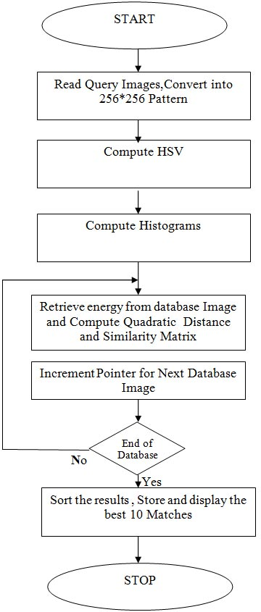
Colour extraction algorithm:
The images added in the collection are initially analyzed to compute individual histograms that indicate the frequency of different color pixels present in the image.
These histograms are then stored in the database.
The user submits his search argument in the form of an image to the system.
Color histogram of the input image is then calculated and compared with the ones that are present in the system database.
Similarity measure with respect to the perception of color content is computed using the two color distance formulas, namely, Euclidean distance and Intersection distance.
3/5/18

Slide 19
TEXTURE DESCRIPTOR …

Slide 20
TEXTURE FEATURE
It is a property that represents the picture surface and constitution.
It will also be defined as a typical repetition of sample and aspect on a surface.
Picture textures are complex visual patterns composed of regions or entities with sub-patterns with traits of brightness, color, form, measurement…and so on.
The generally known texture descriptors are Wavelet Transform, Gabor-filter, and Edge histogram

Slide 21
No. | Features | Approaches | Limitations
1 | Texture | Wavelet Transform | All the classes are assigned to one of the two possible groups of classes
2 | Texture | Edge Statistics | Due to the complex distribution of the image data, the k-means clustering often cannot separate images
3 | Texture | Gabor Filters | The machine learning predicts the category of the query image
4 | Texture | Statistical | The query image belongs to the class for which the membership is very large

Slide 22

SIMILARITY MEASURES
The Euclidean distance or Sum-of-Squared-Dierences (SSD) and the Sum-of-Absolute Dierences (SAD) functions have been found to be the most useful
The following equations define the SSD and SAD similarity measurements, respectively
Here fq = fq[0]; fq[1]; :::; fq [n] represents the query feature vector, ft = ft[0]; ft[1]; :::; ft[n] denotes the target feature vector, and n is number of features in each feature vector.

Slide 23
WHY GABOR WAVELET TRANSFORM?
It is a popular and powerful tool to decompose all the images of training set at different levels of scaling and dilation.
The major causative of the Gabor wavelet transform is not only applicable for spatial frequency domain but also applicable for spatial relevant of the given input image.

Slide 24
SHAPE DESCRIPTOR...
3/5/18

Slide 25
SHAPE TEXTURE
Shape is important in representing significant regions in images and can be sufficient to recognize objects without other visual cues.
There are generally two types of shape representations, i.e., contour-based and region-based.
The generally known shape descriptors are Edge Histogram Descriptor, Generic Fourier Transform and curvature scale space (CSS) descriptors.

Slide 26
EDGE HISTOGRAM DESCRIPTOR(EHD)
Edge Histogram Descriptor describes five edge types in the image, namely horizontal, vertical, two diagonal, and non-directional edge types.
It basically shows the relative frequency of occurrence of 5 types of edges in each local area called a sub-image or image block.
For extracting an edge histogram in the sub-image we can apply digital filters in the spatial domain.

Slide 27
PROJECT COST
RESOURCES AVAILABILITY
All the software resources are open source and college is providing the hardware resources or we have our own laptops for project development.
No cost
FUNDING AGENCY
Self-Financed

Slide 28
LITERATURE SURVEY
We studied some IEEE papers for our project
• Chathurani N. W. U. D., Geva S., Chandran V., “ An Effective Content Based Image Retrieval System Based on Global Representation and Multi-Level Searching” IEEE 10th International Conference on Industrial and Information Systems, ICIIS 2015
W. Rasheed, Y. An, S. Pan, I. Jeong, J. Park, and J.Kang, “Image Retrieval Using Maximum Frequency of Local Histogram Based Color Correlogram”, in International Conference on Multimedia and Ubiquitous Engineering, 2008, pp. 62–66.
Divya Srivastava, Rajesh Wadhvani, “Color Feature Extraction Methods for Content Based Image Retrieval” in International Journal of Computational Engineering and Management, 2015.
Anusha Yalavarthi, K. Veeraswany, “Content Based Image Retreival Using Enhanced Gabor Wavelet Transform”, International Conference on Computer, Communications and Electronics,2017.

Slide 29
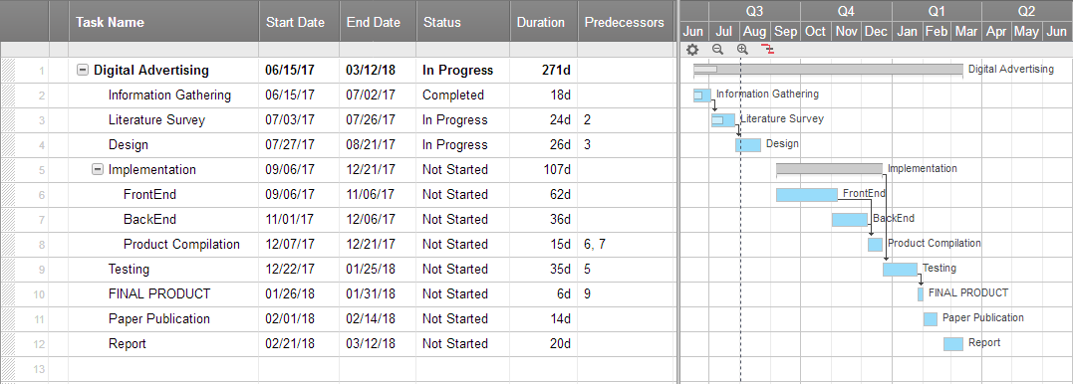
PROJECT PLANNING

Slide 30
THANK YOU!!!

