Slide 1
MCPD Use of Force Data Analysis
A capstone project by Michael Desir
Primary Dataset
Core Question
MCPD Use of Force - Details, filtered to 2022–2026,
pulled from openMontgomery APIs
What's actually in this data, and what does it say about how force is distributed across the county?
Notes:
• Hi everyone, I'm Michael Desir, and this semester, I had the opportunity to work with Montgomery County on an interesting project. They gave me a pretty open mandate: use of force, look into it, figure out what's going on. So I've been analyzing Montgomery County Police Department use of force incidents from 2022 through 2026, and I'm here to share my results.
• The data comes from the county's open data portal, so it's publicly available information
• This project pulls together data engineering, analysis, and visualization to tell a story about policing in this beautiful county.

Slide 2
DATA OVERVIEW
Unique Incidents Since 2022
6,900
91%
Unique Incidents
Officer Force Rows
Recorded since 2022 across Montgomery County
At least one officer force column flagged true
9%
Subject-on-Officer
Incidents with no officer force used
Notes:
• We've recorded 6,900 unique incidents across Montgomery County since 2022
• 91% of these incidents involved officer force — at least one officer force column was flagged as true
• The remaining 9% were subject-on-officer incidents where no officer force was used
• For each incident, we captured detailed data per subject-officer interaction including:
Subject demographics
Types of force used
District information
Case identifiers

Slide 3
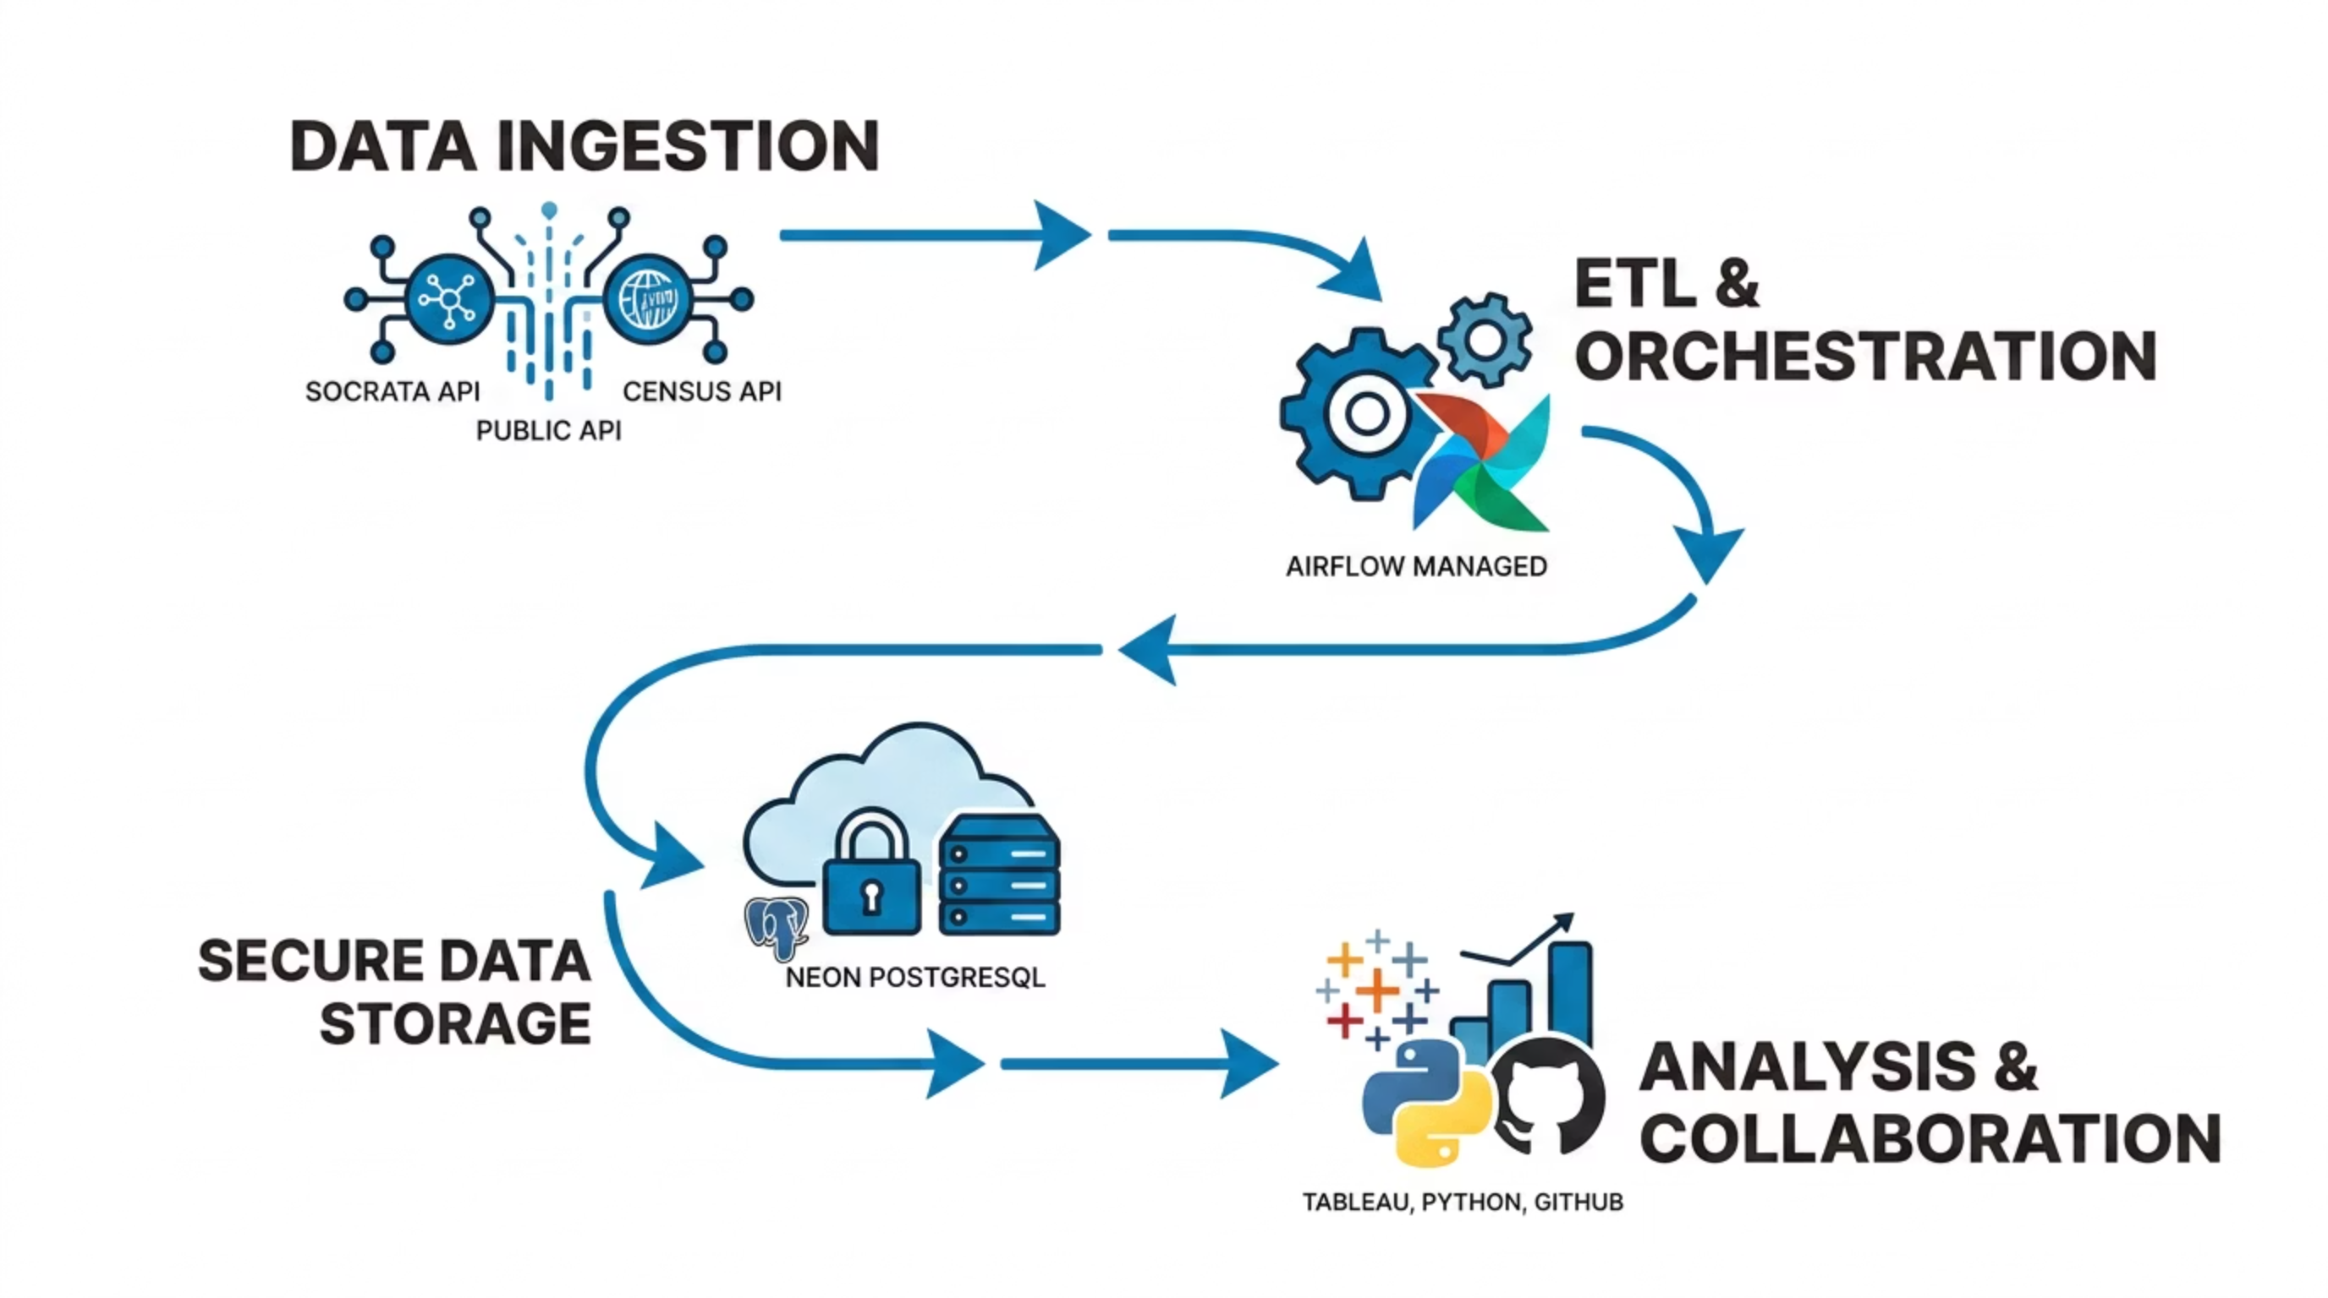

Data Pipelines
Notes:
• Early on in the project, I realized that downloading a spreadsheet wouldn't cut it. I was dealing with multiple gigabytes of data that I wanted to refresh daily, and there were layers of classification and editing that I couldn't do in Tableau. So I took a different approach, and orchestrated a full data workflow.
• It starts by ingesting data from the Montgomery County Open Data Portal's Socrata OData API, which provides the use-of-force incidents, and the UCSB ACS Census API to pull in demographic data for context we'll get to later.
• Apache Airflow acts as the orchestrator, managing and automating the entire ETL process – that's Extraction, Transformation, and Loading – ensuring data is fresh and reliable.
• All this processed data resides in a Neon PostgreSQL database.
• Finally, the insights are extracted and presented through various tools: Tableau for interactive dashboards, Python for deeper statistical analysis, and GitHub for version control and collaborative development of our code base.
• This setup not only provides a central location for all data processing, but also allows later analysis to be built off highly customizable SQL queries.

Slide 4
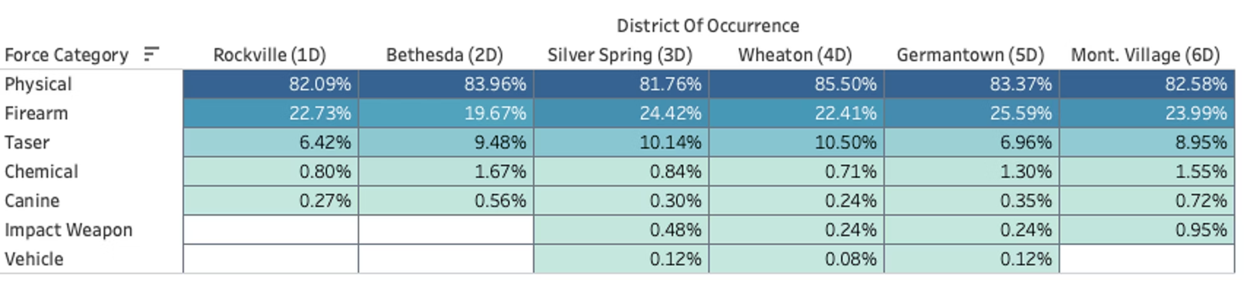
FINDINGS
Physical Force Dominates All Six Districts
What the numbers show
Physical force accounts for 82–86% of all force type instances across every district.
Firearms pointed but not discharged are represented in 20-26% of instances.
CEW (a.k.a. Taser) use, chemical agents, and canine deployments are each below 10% individually.
Notes:
• Ok, let's talk about force categories.
• The first thing you might notice when you look at this chart is that the columns sum to well above 100%. That's because real life policing is dynamic, and in many cases, multiple types of force are used in a single incident. So what we're looking at here is the percentage of incidents that a particular force category shows up in.
Physical force—hands, fists, bodies—is by far the dominant method, accounting for 82 to 86% of all force incidents
• This means roughly 4 out of 5 uses of force involve direct physical contact
• Firearms pointed but not fired show up in about 20 to 26% of cases—important to note these are situations where weapons were drawn but not discharged. There have only been 9 officer shooting incidents since 2022.
• All other force types combined—tasers, pepper spray, K-9 units—each represent less than 10% individually.

Slide 5
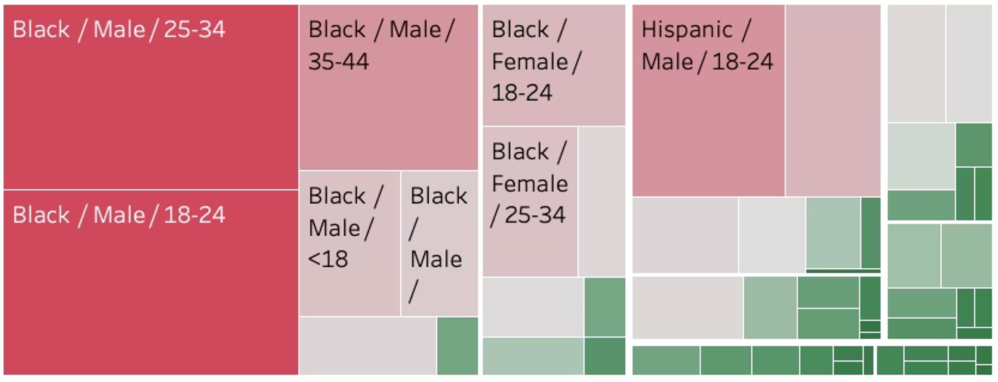
FINDINGS
Demographic Representation
Gender & Age
Most Over-Represented Group
Benchmarked Against
74.4% of subjects are male. The peak age group is 25–34, followed by 18–24.
Black males aged 25–34 account for
13% of all incidents
ACS 2023 5-year estimates via Census API (tables B01001B, B01001D, B01001H, B01001I)
Notes:
• Start by emphasizing that this data breaks down who is involved in use-of-force incidents by race, gender, and age
• Gender and age patterns:
Nearly 3 out of 4 subjects (74.4%) are male
Youngest adults are most affected—peak is 25-34 age group, with 18-24 as second highest
This shows use-of-force incidents concentrate in young adult male population
• Key disparity to highlight:
Black males aged 25-34 represent the single most over-represented demographic group
This group alone accounts for 13% of all incidents
This is a significant concentration worth examining
• Methodology note:
These racial percentages are benchmarked against actual Census data (2023 ACS estimates)
This allows us to compare incident rates against the actual population composition
Ensures our analysis is grounded in accurate demographic baselines

Slide 6



FINDINGS
Racial Over-Representation County-Wide
Black Subject Over-Representation
Hispanic Slight Over-Representation
White Under-Representation
55.7% of incidents vs. 19.6% of county population — a ratio of approximately 2.8x
24.1% of incidents vs. 21.7% of population — marginally above parity
15.9% of incidents vs. 42.6% of population — significantly below population share
Notes:
• This is a critical finding we need to highlight — racial disparities are evident across our county's incidents
• Three key takeaways from the data:
Black residents: Dramatically over-represented — they make up just under 20% of the county population but account for over 55% of incidents. That's nearly a 3-to-1 ratio. This is the most significant disparity.
Hispanic residents: Slightly over-represented — 24% of incidents versus 22% of population. This is much closer to proportional representation.
White residents: Under-represented — only 16% of incidents despite making up 43% of the county population. This is a substantial gap in the opposite direction.
• The pattern is clear: Black residents are significantly over-represented in incidents county-wide, while White residents are under-represented. I do understand that the data these conclusions are based on do not account for county residents versuss people passing through, and I do wish we had an algorithm to account for that. However, I believe the information we do have and the conclusions we can draw from it are enough to inspire further investigation into the root causes of these disparities, whether or not our officers can do anything about it.

Slide 7
Dashboard
Notes:
Now, I don't like slides much more than you do, so without further ado, let's go into this dashboard.

Slide 8
REFLECTION
What Worked, What Didn't, What's Next
Hardest Part
Getting the metrics right. The crime link rate went through three wrong versions. At one point, I had it at 78.4%, and Darren sent me back to the drawing table. Also, I now have a renewed appreciation for the complexities of policing and police structure, as I spent a lot of time distinguishing reports from incidents and sectors from beats from PRAs.
Next Steps
Zero in on the crime/force conversion rate, identify possible factors that could contribute to use of force
Extend sector map to show demographic breakdowns per sector, not just incident counts
Most Satisfying Part
Stories. The more familiar I got with the Use of Force - Details dataset, the more fun I had cobbling stories together from various columns.
Notes:
Hardest Part
Getting the metrics right was a real challenge—the crime link rate went through three iterations before we got it right
Darren had to send me back to recalibrate when I had it at 78.4%
Learned a lot about police terminology and structure—distinguishing between reports vs. incidents, sectors vs. beats vs. PRAs took significant time
Most Satisfying Part
Working with the Use of Force dataset became increasingly enjoyable as I got more familiar with it
The real payoff was finding and telling stories buried in the data—pulling together narratives from different columns
Next Steps
Dig deeper into the crime-to-force conversion rate and identify what factors might drive use of force incidents
Expand the sector map beyond just counting incidents—add demographic breakdowns by sector to show the full picture

Slide 9
Acknowledgements
This project would not have been possible without the support of the following individuals and organizations.
MCPD + MCG TEBS Data Innovation
Darren Dobkin, Kathy Luh, Lauren Der, and Victoria Liu
Montgomery College
Professor Mais Alraee for her guidance and aid in processing logic
Professors Saidi and Perine for placing me in this project
Classmates
Feedback throughout the course of this project
MCPD Use of Force Data Analysis · Montgomery College Data Science · Michael Desir
Notes:
• Before we go to questions, I'd like to thank the key contributors who made this project possible
• MCPD + MCG TEBS Data Innovation team
First, to Darren for his unending knowledge of the data I was working with and all those at MCPD who signed off on getting me the context I needed to understand this data
And to Kathy, Lauren, and Victoria for the questions you asked to point me in the right direction and the time you took to pull resources and fix my problems
• Montgomery College faculty — Professor Mais Alraee was instrumental in helping me work through the logic and methodology for geolocation; Professors Saidi and Perine connected me with this opportunity in the first place
• And to my classmates, whose constructive feedback throughout the project helped refine the analysis and presentation of my work
• This collaborative effort was crucial to completing this research

Slide 10

Trust the Numbers.

