Slide 1
Semantic Web
author: Michał Dettlaff
Notes:
Semantic = dotyczący języka, znaczenia, semantyki. If we want to talk about Semantic Web, we have to begin with...

Slide 2
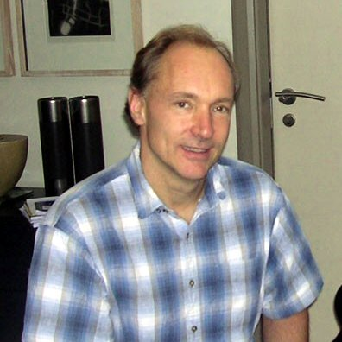
Tim Berners-Lee
Tim Berners-Lee
director of W3C
created the World Wide Web in 1990
proposed the idea of Semantic Web
Notes:
...this guy.

Slide 3
Tim Berners-Lee, "The Semantic Web"
Scientific American, May 2001
"Most of the Web's content today is designed for humans to read, not for computer programs to manipulate meaningfully. Computers can adeptly parse Web pages for layout and routine processing - here a header, there a link to another page - but in general, computers have no reliable way to process the semantics."

Slide 4
Tim Berners-Lee, "Weaving the Web", 1999
"I have a dream for the Web [in which computers] become capable of analyzing all the data on the Web – the content, links, and transactions between people and computers. A ‘Semantic Web’, which should make this possible, has yet to emerge, but when it does, the day-to-day mechanisms of trade, bureaucracy and our daily lives will be handled by machines talking to machines. The ‘intelligent agents’ people have touted for ages will finally materialize."
Notes:
For example, intelligent agent program can book you a plane, buy a book, make a doctor’s appointment.

Slide 5
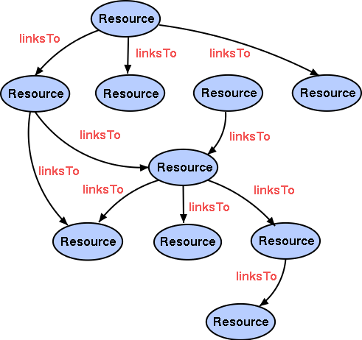
Current Web
It’s like a huge collection of documents.

Slide 6
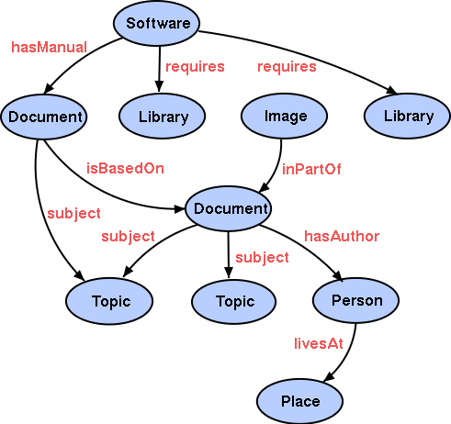
Semantic Web
described using meta-language
Web content becomes data, not just formatted documents.

Slide 7
What are the advantages?
Semantic data can be:
easily exchanged between websites and applications
easily accessed with meaningful queries, not just simple text search
processed by applications (reasoners, intelligent agents)

Slide 8
Web 1.0 technologies
HTML, XHTML
script languages (PHP, CGI)
Designed only to display web content

Slide 9
Web 2.0 technologies
AJAX (Javascript, XML)
CSS
Flash
wiki and forum software
Folksonomies (tag systems)
Designed for interaction between websites and users. Users create their own web content.
Notes:
XML and Folksonomies are in bold font, because they have to do with Semantic Web.

Slide 10
Examples of Web 2.0
del.icio.us, Digg
Myspace, Facebook
YouTube
Wikipedia
Flickr

Slide 11
Web 3.0 – Semantic Web
XML (eXtensible Markup Language)
RDF
OWL
SPARQL (Protocol And RDF Query Language)
Designed to describe web content using
meta-language
Notes:
Semantic Web requires new technologies

Slide 12
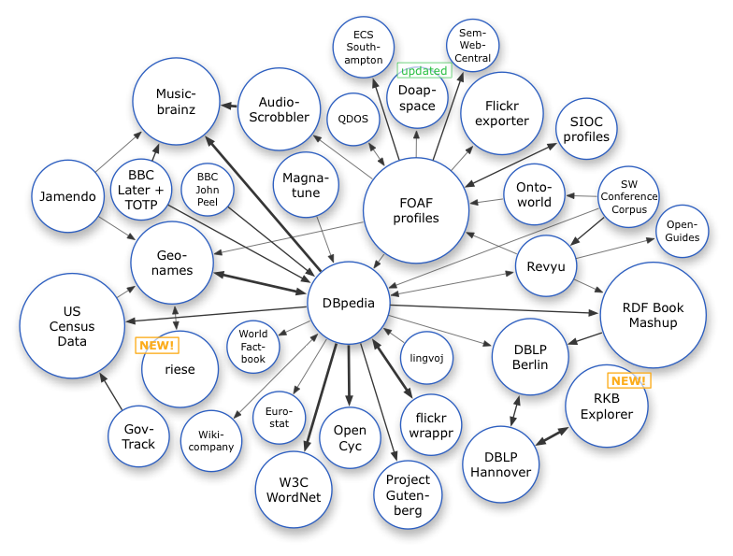
Semantic Web in 2008
Notes:
Jamendo is a place where you cand listen to, discover and share free music. It uses data from MusicBrainz and GeoNames.

Slide 13
How does it work?

Slide 14

RDF
Resource Description Framework
An extension of XML
Meta-language that expresses relationships between resources using triples
URI URI URI / literal
Notes:
All RDF documents are XML documents.

Slide 15
URI and URL
URL – Uniform Resource Locator
points to a location on the Web
URI – Uniform Resource Identifier
can point to anything
URL is a subclass of URI

Slide 16
Example: describing a book
title
URI for book "Thinking in Java"
author
URI for book URI for B. Eckel
located in
URI for book URI for New York
name
URI for B. Eckel "Bruce Eckel"
located in
URI for B. Eckel URI for New York

Slide 17
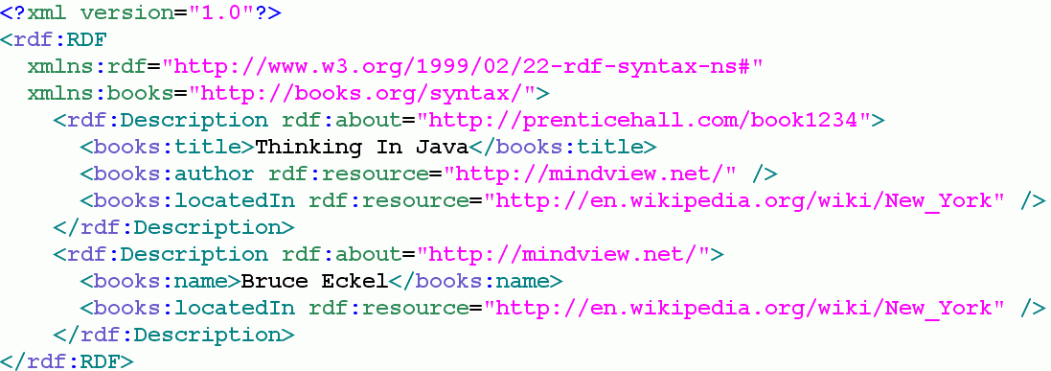
RDF source

Slide 18
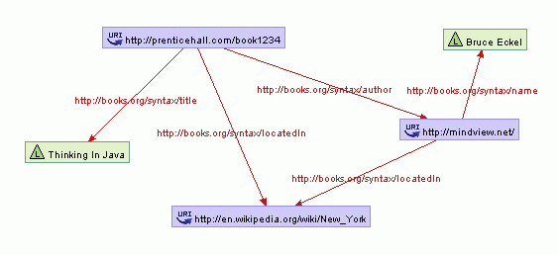
semantic data is represented by a graph
Graph created using RDF-Gravity

Slide 19
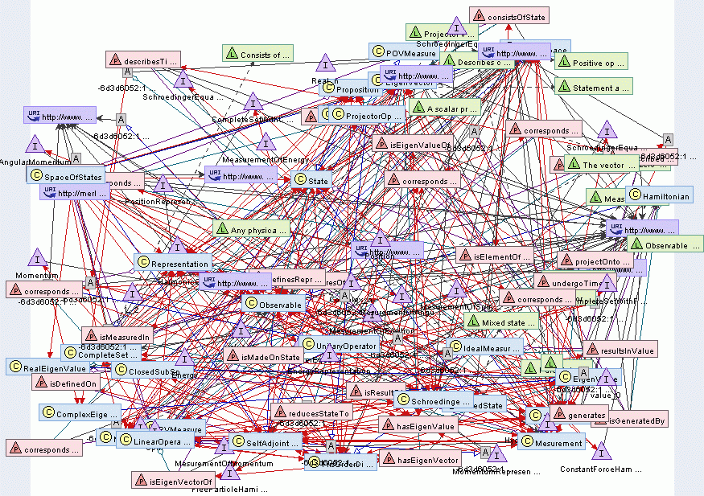
SW is like a Giant Global Graph

Slide 20
RDF Schema
Basic predicates (relationships) are defined in RDFS (RDF Schema). They include:
Class
subClassOf
domain – declares an instance of a class
Example:
subClassOf
apes primates

Slide 21
OWL
Web Ontology Language
ontology is a collection of relationships and definitions from some domain
OWL is an extension of XML and RDF
Much more powerful than RDF/RDFS:
- properties can be transitive, symmetrical
- you can define inverseOf, disjointWith...
- you can define cardinality
Notes:
OWL documents are also XML and RDF documents

Slide 22
OWL
Programs called reasoners can perform logical reasoning based on OWL ontologies
Example:
instanceOf
Flipper dolphin
subClassOf
dolphin mammal
subClassOf is transitive, so a reasoner deduces:
instanceOf
Flipper mammal

Slide 23
OWL
Another example:
disjointWith
white wines red wines
instanceOf
Sole D'italia white wines
instanceOf
Sole D'italia red wines
A reasoner can deduce that there is a contradiction

Slide 24
Examples of ontologies
Cyc – large ontology of common sense knowledge, for AI machines
Generations – family relationships
Gene Ontology
quONTOm – Quantum Mechanics ontology
LKIF Core – legal concepts

Slide 25
RDF and OWL tools
SemanticWorks
SMORE
Protege-OWL
...and many more
You don’t have to be a rocket scientist to create Semantic Web

Slide 26
Going from Web 2.0 to Web 3.0
Wikipedia and DBpedia

Slide 27
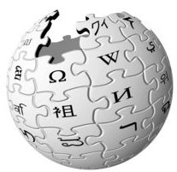
Wikipedia
Online encyclopedia that anyone can edit
Over 2,000,000 articles
Only standard text search

Slide 28

A project to extract structured data from Wikipedia and convert it to RDF
91 million triples
Sophisticated queries instead of simple text search
Online demonstration
Notes:
An effort of computer scientists from Leipzig

Slide 29
Frasier
All in the Family
Roseanne
Friends
Cheers
Becker
Full House
Will and Grace
Located At
Lived In
Situated
Took Place At
Set In
Staged
Found At
Placed In
NYC
New York
Soho
Bronx
Park Avenue
Manhattan
New York City
Queens

Slide 30
DBpedia Relationship Finder
Finds chains of connections between resources using DBpedia database
Online demonstration
Notes:
Leipzig – Innsbruck; Al Pacino – Taxi Driver

Slide 31
Semantic Search
Standard search engines (including Google) are based on text search
Results are often irrelevant
Semantic search engines analyze the syntax and context of your query to produce more relevant results

Slide 32
Semantic Search
Powerset
Hakia
[true knowledge] (online demonstration)
Notes:
Edsger Dijkstra – when did he die? How old was he when he died? Is Barack Obama older than Hillary Clinton?
Hakia - sitcoms set in new york

Slide 33
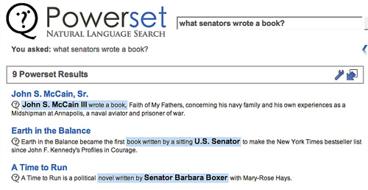

Slide 34
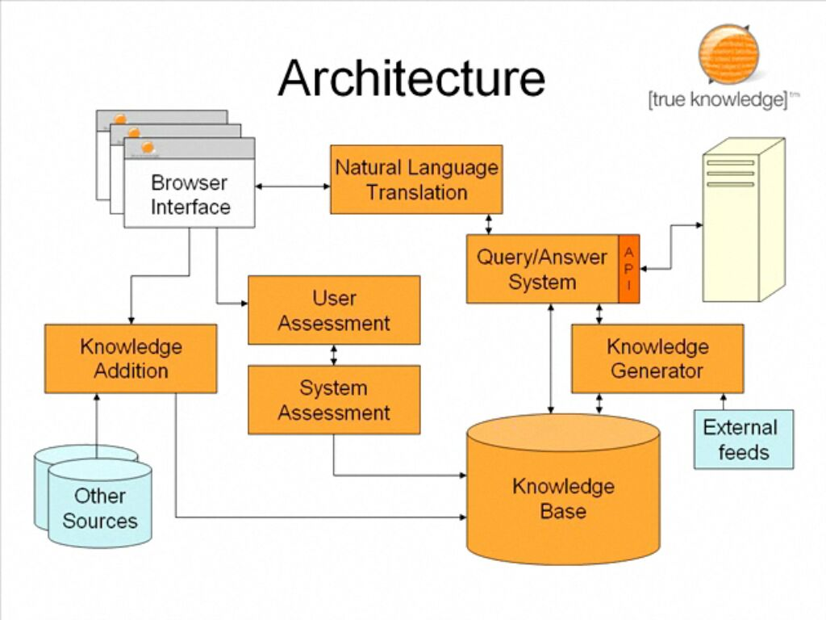

Slide 35
Going from Web 2.0 to Web 3.0
del.icio.us and Twine

Slide 36

del.icio.us
a social bookmarking website, enables you to:
access your links anywhere
share them with others
organize them using tags (folksonomy)
Online demonstration
Notes:
A especially neat feature is that you can see who likes the same pages that you do, and then explore their links.
http://del.icio.us/wbzyl

Slide 37

Twine
Tie it all together
service that helps you organize, share and discover information about your interests
Online demonstration

Slide 38
Going from Web 2.0 to Web 3.0
MySpace and FOAF

Slide 39

Friend Of A Friend
Your personal profile in RDF format
Online demonstration

Slide 40
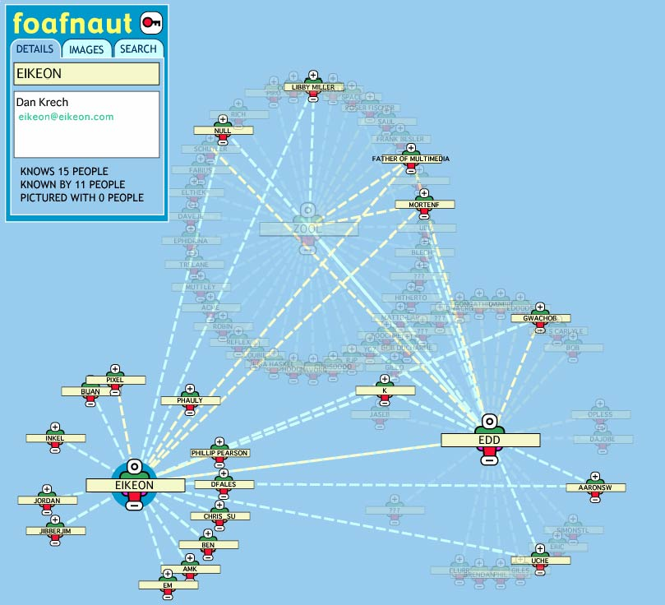
foafnaut

Slide 41
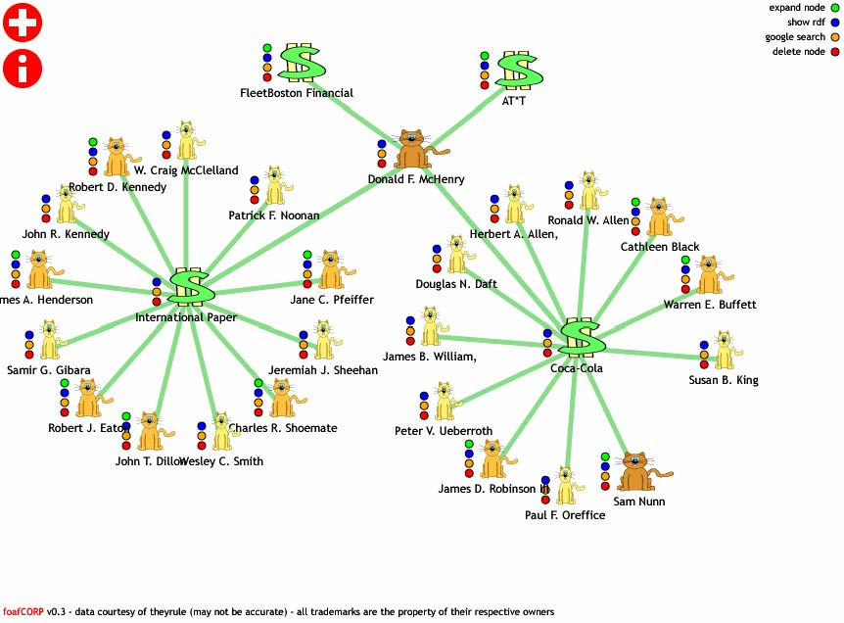
foafCORP

Slide 42
Semantic Web and science
Medical researchers from Cincinnati Children’s Hospital used SW tools to integrate databases about genes and diseases; it enabled them to discover genetic cause of a heart disease
Semantic Web technologies are also used for:
discovering new medications
early detection of epidemies
Notes:
New medications – Eli Lilly
Epidemies – Health Science Center from University of Texas

Slide 43
Has Berners-Lee’s vision of the Semantic Web been fulfilled? Not yet.
However...
SW already exists and is growing rapidly
RDF and OWL are recommended by W3C
Big players are coming in (Yahoo, Adobe, Oracle)
Will SW replace the old Web?
No. They can coexist.
Notes:
Yahoo – Yahoo Search, Yahoo Food

Slide 44
This presentation is available at:
http://manta.univ.gda.pl/~mdettla/Semantic_Web.ppt
If you want to learn more, see my links at:
http://del.icio.us/wundzun/semantic
Thank you for attention!
Questions?

