Slide 1
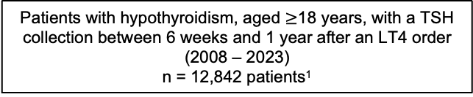
Patients with hypothyroidism, aged $≥$18 years, with a TSH collection between 6 weeks and 1 year after an LT4 order
(2008 – 2023)
n = 12,842 patients¹
Exclude patients with a history of hyperthyroidism or hypopituitarism (n = 763)
Analytical cohort
n = 12,045
Additional exclusion of co-medications related to hyperthyroidism
(e.g., MMI and PTU) (n = 34)
Eligible for high-feature dataset
n = 3986 (33.1%)
Complete vitals and labs
Excluded labs and/or vitals after clinical review
(n = 9)
Low-feature dataset
n = 12,045 (100%)
High-feature
(main) dataset
n = 3977 (33.0%)
Notes:
FIGURE 01
1. Excluded patients with a history of thyroid cancer and a history on non-LT4 thyroid hormone use

Slide 2
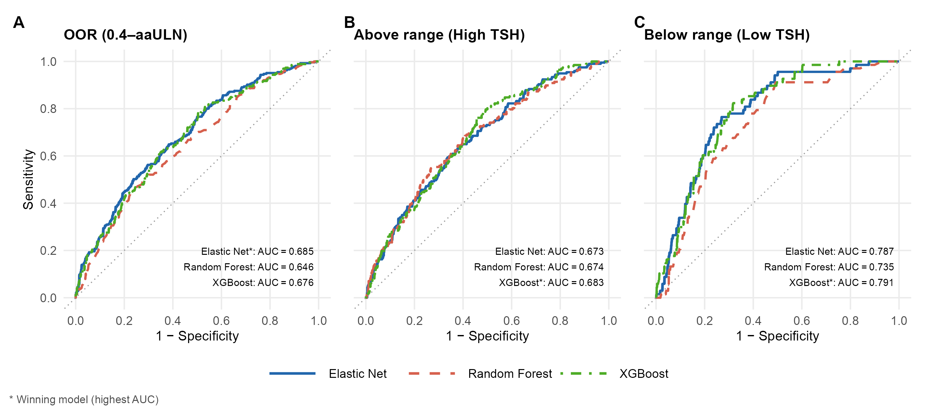
Notes:
FIGURE 02

Slide 3
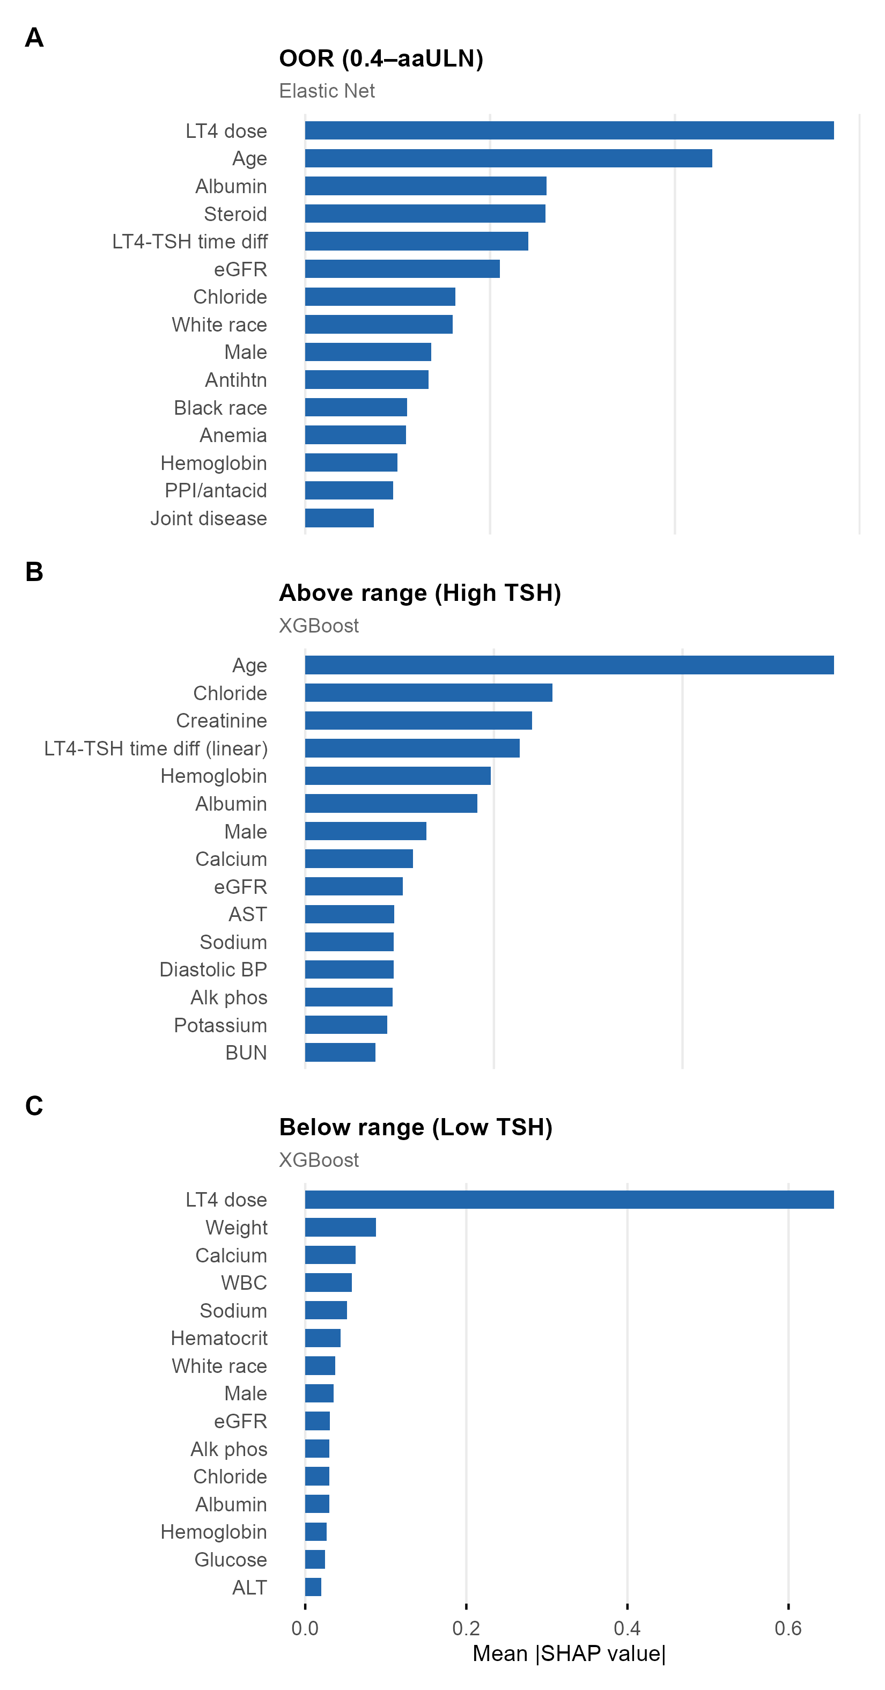
Notes:
FIGURE 03

Slide 4
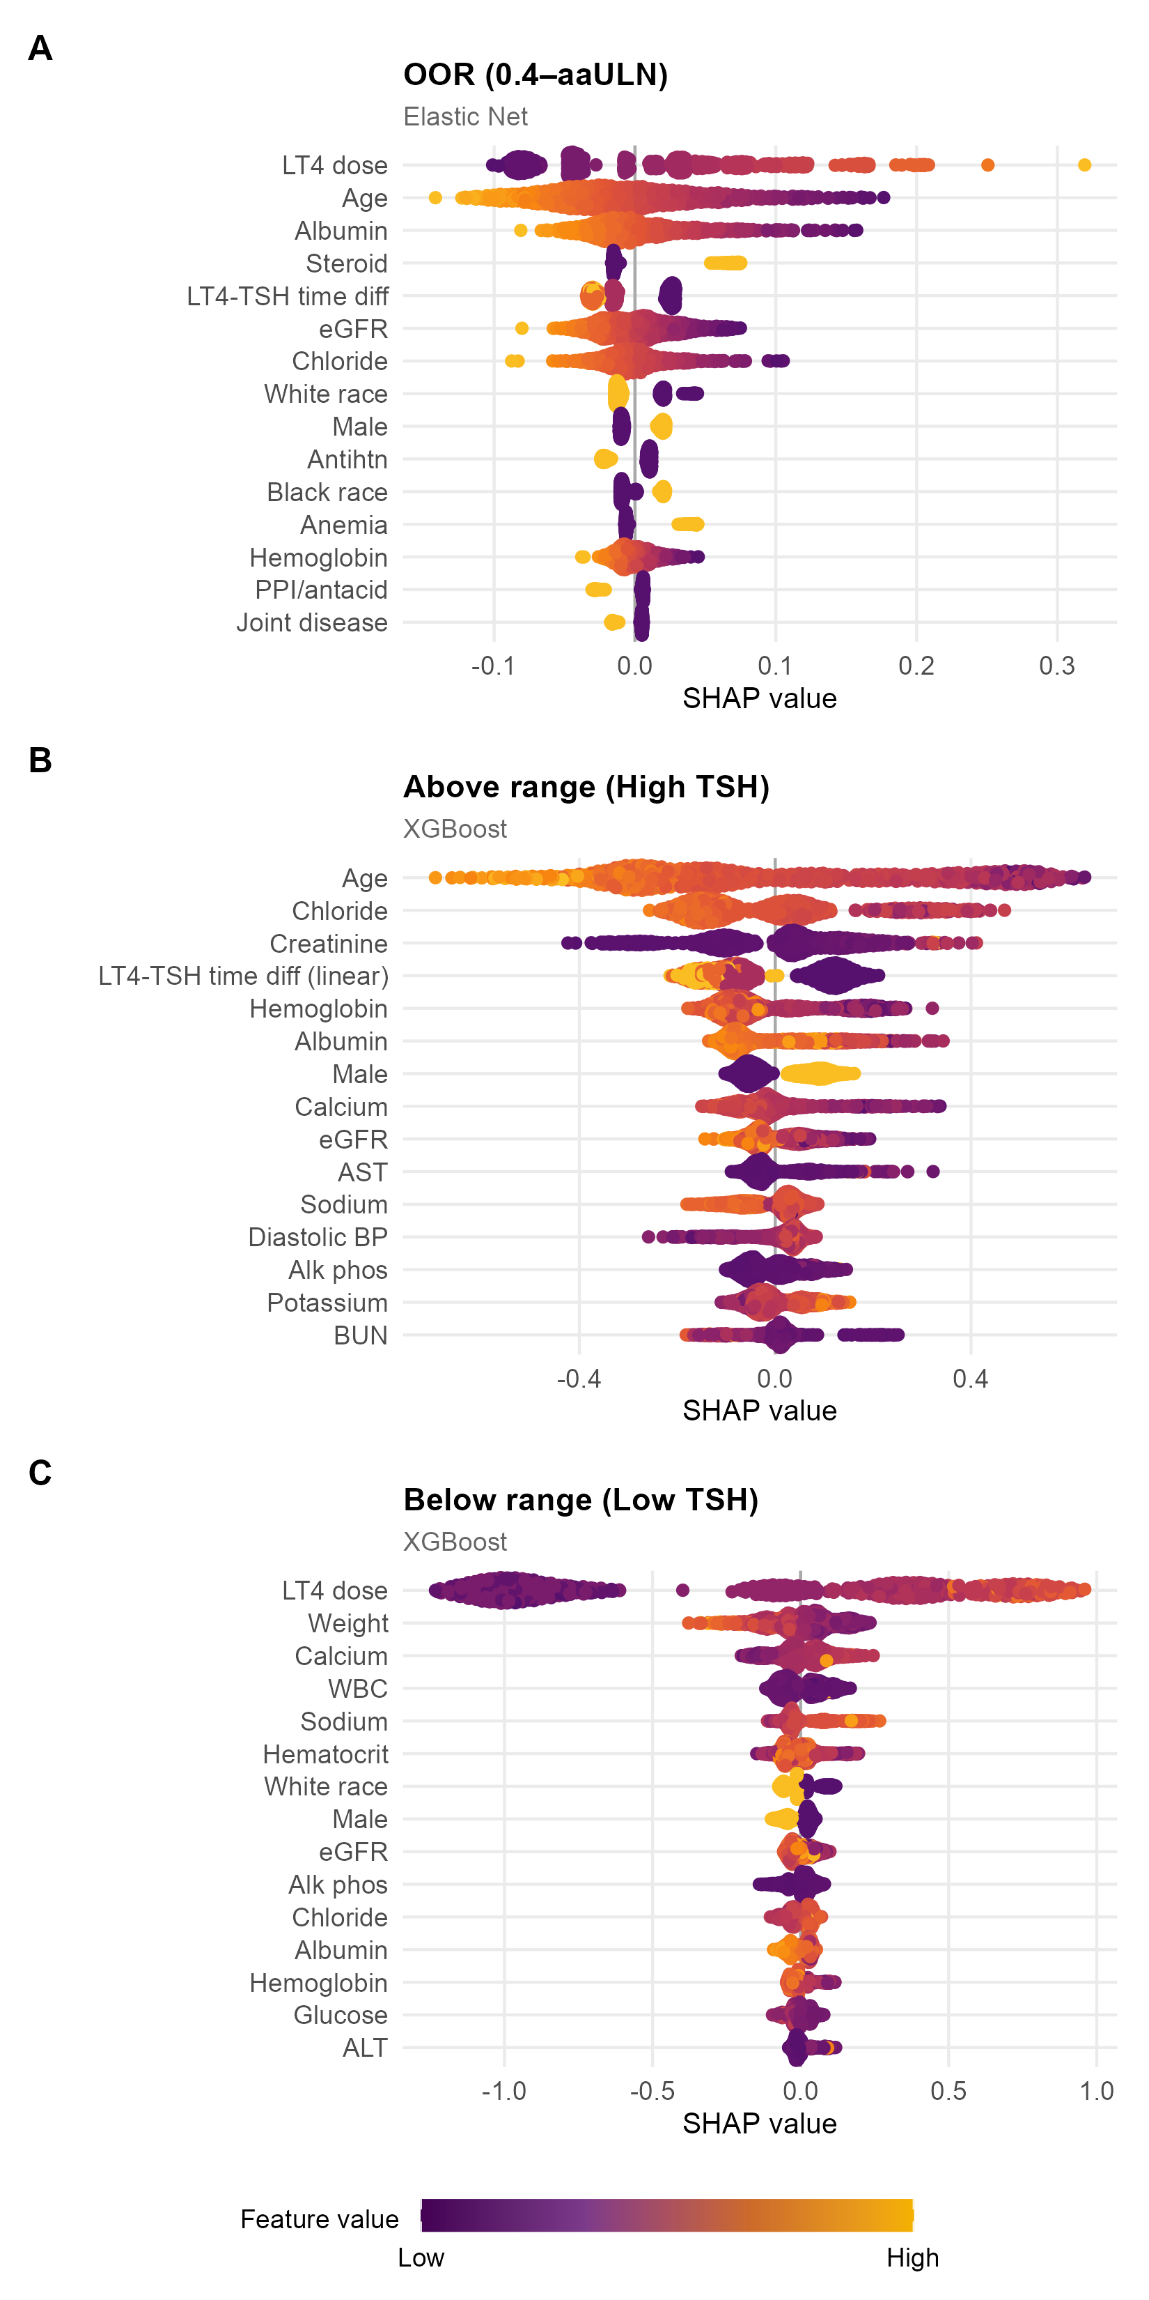
Notes:
FIGURE 04

Slide 5
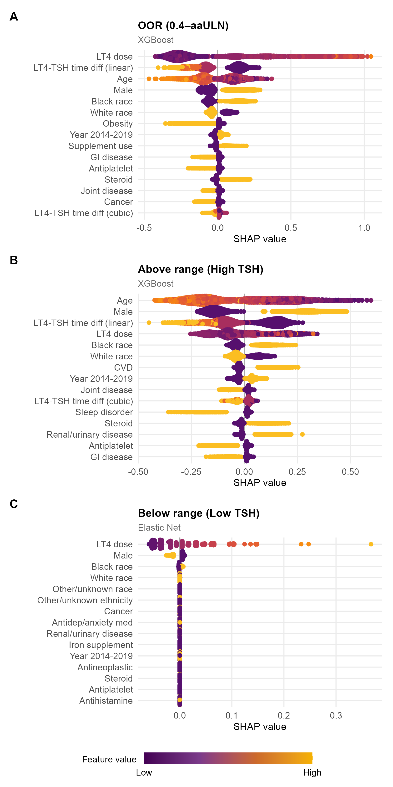
Notes:
Supplemental Figure 01

Slide 6
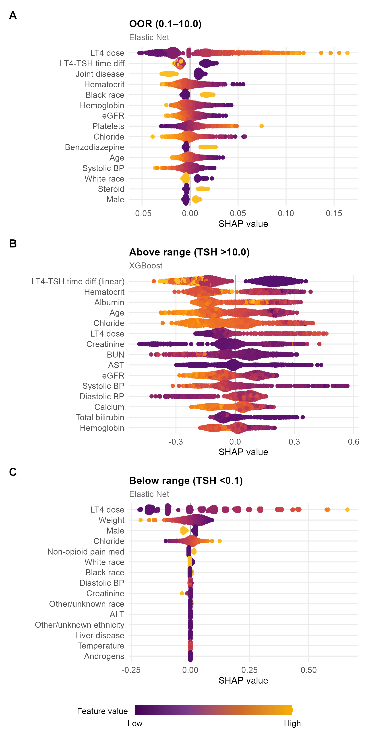
Notes:
Supplemental Figure 2

Slide 7
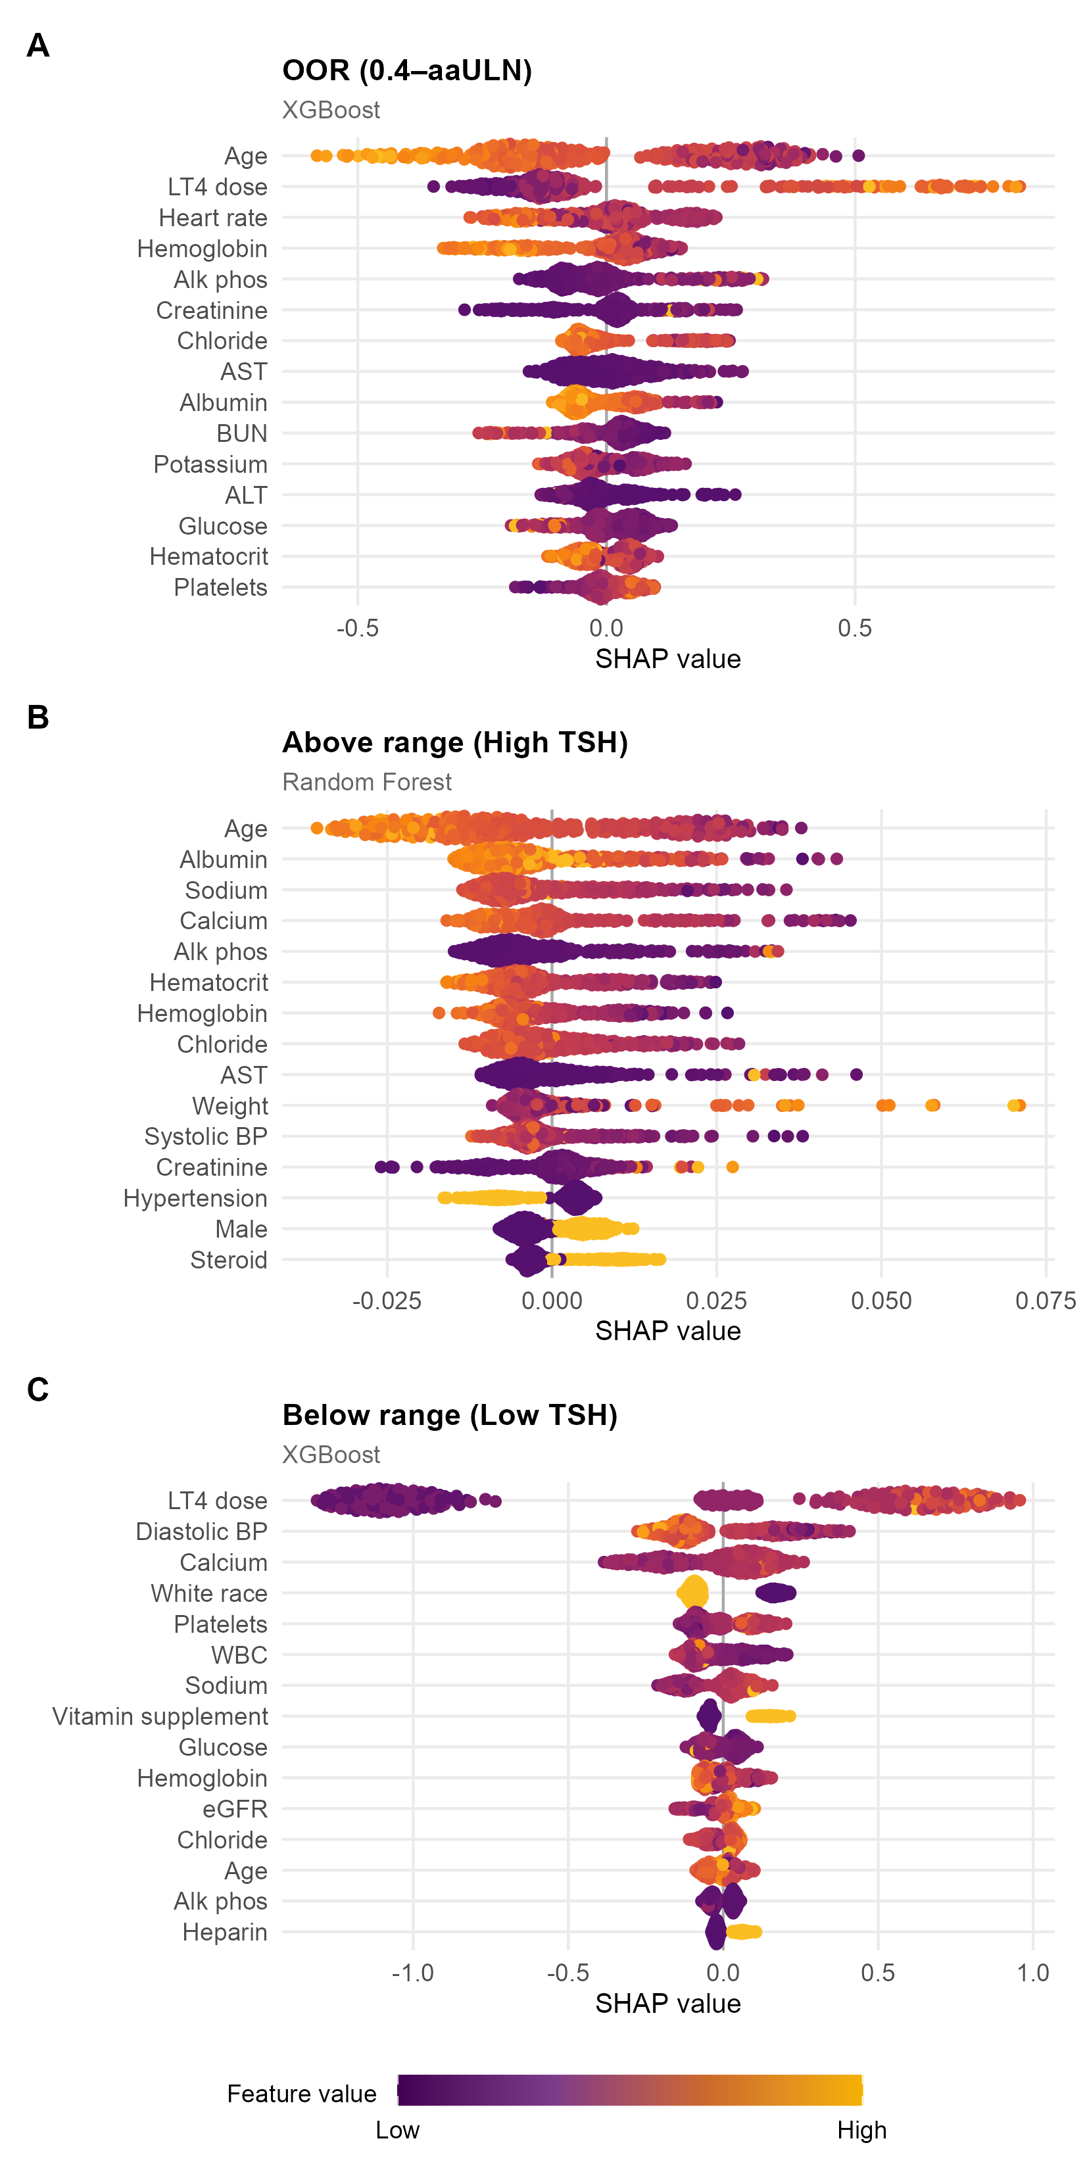
Notes:
Supplemental Figure 3

Slide 8
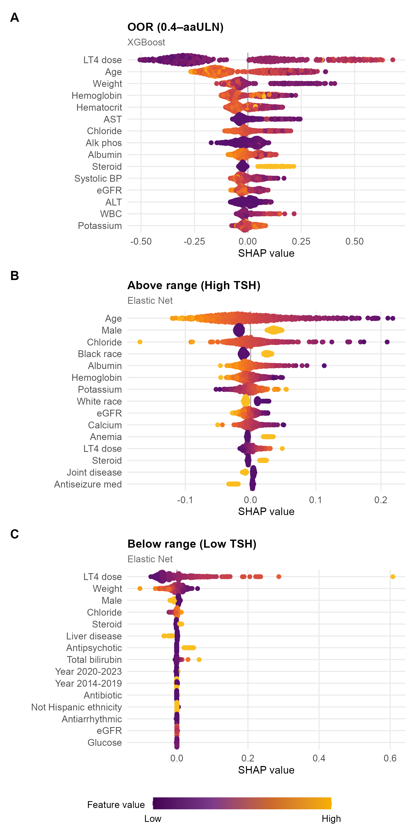
Notes:
Supplemental Figure 4

