Slide 1

Project Overview
EKS Ingress Security Automation
Mahesh Devendran, Cloud Architect
https://www.linkedin.com/in/mahesh-devendran-83a3b214/

Slide 2
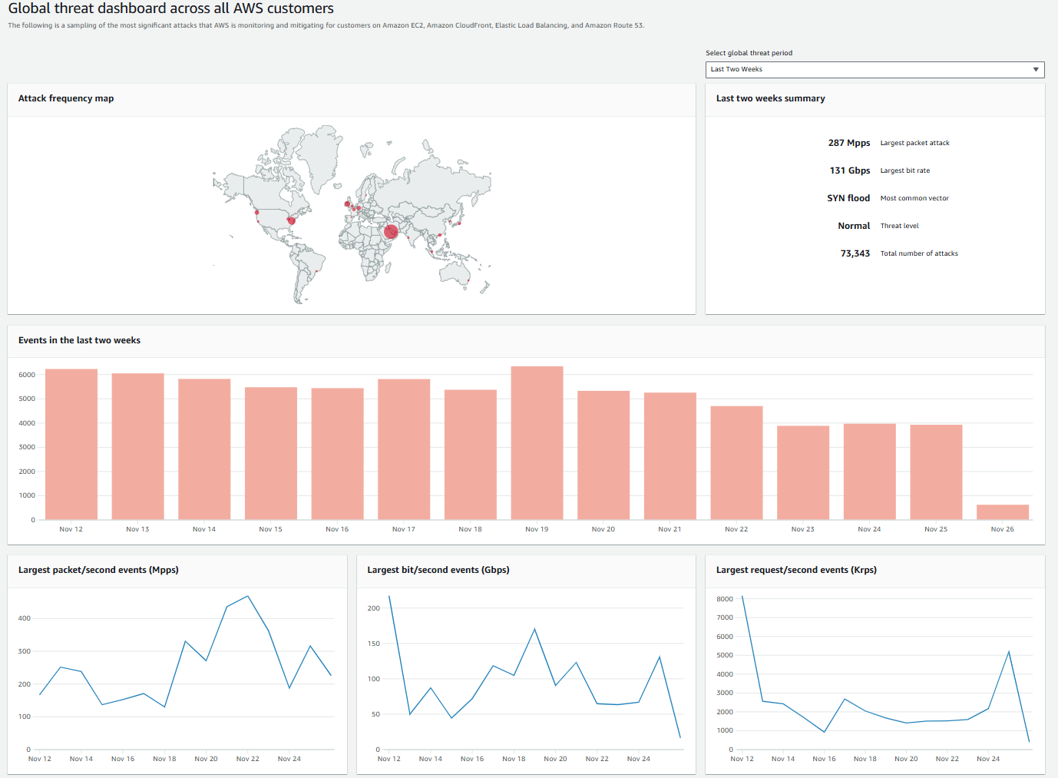

Slide 3
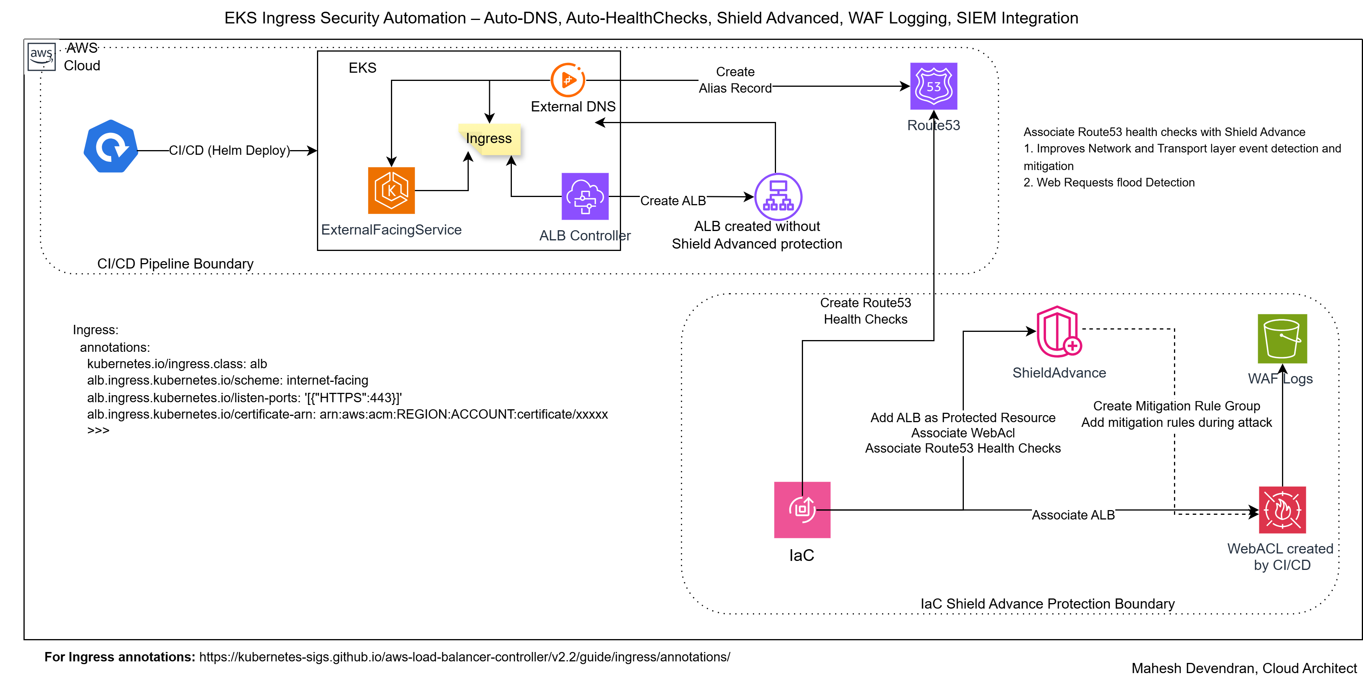
Solution Before
Background
Kubernetes Ingress deployment for external facing services, monitored by ALB controller and External DNS.
creates ALB
exposes by adding route53 alias record
Correct by design and specification but ALB is not protected to external threats.
Existing Solution
Every ingress deployment required a follow-on manual pipeline to - Attach ALB to WAF WebACL, Configure health checks and enable Shield Advance protection. No SRT engagement or monitoring or alerting in place. WAF logs stayed in S3 locally.

Slide 4
The Problem - Unprotected ALBs
PROBLEM with the solution:
Gap in protecting the ALBs leaving it vulnerable for attacks.
Additional pipeline with governance requiring 2+ hours per deployment per application team per customer.
Security gaps:
No Shield Response Team (SRT) or proactive AWS DDoS engagement
No centralized logging, Sentinel integration → Security Operation Center (SOC) had zero visibility
Compliance risk:
No automated guardrails - required security controls automatically and consistently across all workloads.
Costing:
Repeated IaC operation over 10+ spoke accounts (Customer) consuming manpower and pipeline resources.
Assuming : 3 Deployments per Application team, 2 Application teams per Customer.
Total Cost = (Manpower + Pipeline Run) X 3 X 2 X 10
= 60 X IaC Cost

Slide 5
Responsibilities
Owned the end-to-end architecture and design, including EDA flow, security boundaries, and multi-account integration patterns.
Designed a non-intrusive, attach-only protection model to ensure zero disruption to existing ALB traffic paths.
Led technical reviews with Application Security, Landing Zone, SOC, and Azure teams to align on design, governance, and operational readiness.
Developed the full automation stack using Terraform and Python (Lambda), including unit tests with Moto for safe validation.
Worked directly with application teams to test ALB onboarding flows, validate behaviors, and generate staging/production evidence.
Produced CAB-level artefacts including runbooks, rollback plans, testing evidence, and risk controls required for production release.

Slide 6
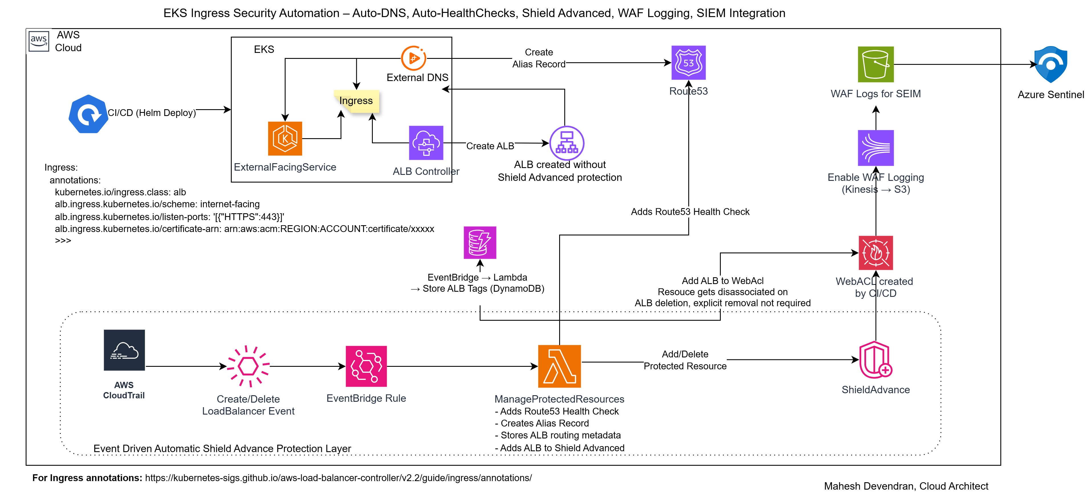
The Solution – Automated ALB Protection
Event-driven solution listens for ALB create/delete events and automatically enables the Shield Advance protection layer for the respective ALB. No additional pipeline runs required.

Slide 7
Architectural and Design Considerations
Integrating the protection workflow into CI/CD pipelines
ALB ARN is not available during pipeline execution; the ALB is created asynchronously by the AWS Load Balancer Controller, and creation latency varied.
Technically unreliable to attach WAF and Shield Advanced within the same pipeline run.
Additionally, embedding this into CI/CD would couple application deployment with security infrastructure updates, forcing a full application redeploy for security-only changes, which is technically inefficient and increases blast radius.
Centralized IaC deployment from a shared “platform” account
A centralized deployment model was considered, but it conflicted with account-level ownership.
Spoke teams manage their own Terraform stacks, state, and change windows.
Using Step Functions for orchestration Step Functions was evaluated but not chosen because the workflow was linear, short-lived, and required no branching or wait states. A single Lambda was simpler, faster, and easier to maintain.

Slide 8
Security Considerations
IAM Roles & Access Boundaries
IaC Deployment Role – provisions EventBridge rules, deploys the EDA Lambda, creates the Kinesis Firehose stream, and configures WAF logging (Kinesis→S3). .
EDA Lambda Execution Role – least-privilege permissions for Shield Advanced (attach/delete), WAF WebACL association, Route53 health checks, DynamoDB metadata operations, and CloudWatch logging.
EventBridge → Lambda Invoke Role – minimal lambda:InvokeFunction access.
Firehose Delivery Role – cross-account, write-only role enabling Kinesis Firehose to deliver WAF logs into the central S3 logging bucket, with the bucket policy updated to allow only the required S3 permissions (PutObject, multipart upload).
Security Controls & Protections
Shield Advanced auto-baselining with WAF in count mode for ~2 weeks before enabling blocking.
Route53 health checks configured for SRT Proactive Engagement readiness.
WAF logging flows through Kinesis → S3 → Sentinel, with bucket-level encryption and restrictive bucket policies.
Rate-limit and WAF rule drift
Traffic patterns evolve over time and WAF/rate-limit baselines can drift, requiring periodic re-baselining. This drift detection automation and alerting is outside the scope of this automation but highlighted as a future enhancement.

Slide 9
Shield Advance Protection
The EDA listens for ALB create/delete events and automatically:
Create Route53 health check
Associates the ALB with WAF WebACL.
Attaches ALB/Route53 healthcheck/WebAcl to Shield Advanced
Enable automatic mitigation
Enable SRT proactive engagement
Enables centralized WAF logging S3 (integrated with Sentinel for SIEM/SOAR.)
Clean-up orphaned health checks and WAF WebAcls on ALB deletion
Business Impact
Significant operational efficiency and cost savings.
Consistent, compliant, and automated security controls across all EKS workloads.
Faster onboarding for new application teams and lower risk through automated protections.
Zero production downtime

Slide 10
Success Measure
 | Measure/Metric | CICD/IaC approach | EDA Solution
Security | Protection | ALB unprotected between pipeline runs (2+ hours) | Immediate protection (10 seconds)
 | SRT proactive engagement | No | Yes
 | SOC engagement and alerting | No | Yes
 | Security posture and compliance | Partial, Human error risk, Audit gap | Full
Deployment Efficiency | Time | 2+ hours | 10 seconds
 | Team approvals | Every workload | Once per EDA deployment
 | Cleanup on ALB deletion | Required – manual scripting | Automatic
Process/Operational Efficiency | Workload onboarding | 2+ hours per workload per spoke (manual runs) | 2 hours per spoke account
 | Terraform module reuse | Limited to spoke | 100% across spoke accounts with centralized
 | Operational overhead | High recurring | Zero touch ongoing
Costing | Shield Advance/WAF | X | No additional fee for SRT engagement – same cost
 | Waf Logging | Waf->S3 (No Log Ingestion cost) | Waf->Kinesis->S3 (Log Ingestion cost)
 | Total Pipeline + Governance cost (TC) | IaC Cost – repeated for every deployment | Only Once per EDA deployment
 | EDA Infra (DynamoDB, Lambda, Event Rule) | None | ~ < $50 (triggered only on create/delete event)

Slide 11
Key Technical Decisions & Integrations
Enabled SRT + Proactive Engagement
Sentinel Integration
SOC Engagement
Centralised WAF logging using Kinesis → S3 (Logging)
Selected Kinesis instead of direct S3 delivery to absorb traffic bursts
Centralized IaC approach for event driven shield advance protection

Slide 12

Challenges
Engaging AWS Support, Landing Zone, Azure, SOC and spoke teams
Sentinel integration – centralized vs spoke
Automation consistency Complex cross‑team dependencies slowed onboarding
Couple of spoke accounts not enabled Shield Advance

Slide 13
Compromises
DDoS simulation testing could not be executed because production testing is not permitted and non-production environments do not reflect real-world traffic characteristics. A formal waiver was granted, supported by compensating controls such as rate-limiting, AWS Shield Advanced automatic mitigation, SRT proactive engagement, WAF threat protection, and 24×7 monitoring.

Slide 14
Process to live
Process to Live – EDA Automation Deployment
Staging Verification
All EDA automation workflows (ALB event detection, Shield Advanced onboarding, WAF attachment, log-pipeline creation, cleanup flows) were executed in the staging environment.
Full test evidence was captured to demonstrate functional correctness, security alignment, and audit traceability.
Production Deployment Under Change Control
Promoted to production via formal CAB process, following approved implementation and rollback plans.
The deployment was performed with zero production impact and required no downtime, as the automation uses an attach only model and does not modify. The EDA is driven by create/delete ALB event only.
Existing Shield Advanced protected ALBs required Proactive Engagement to be enabled separately as part of this production change.
Validated the EDA on production by deploying a CAB-approved test Ingress/ALB to trigger the workflow. We confirmed Shield Advanced onboarding, WAF association, Route53 health checks and automation logs. We did not intentionally generate traffic against production for WAF log validation, as this is not permitted. WAF logging configuration was validated, and actual log flow is confirmed once real production traffic begins. Entire validation was non-intrusive and performed with zero downtime.
Log Flow Validation (Sentinel)
The centralized S3 → Sentinel logging pipeline already existed, so no logging components were modified as part of this deployment.
The Azure team verified and evidenced that all EDA-generated logs (Shield Advanced events, WAF onboarding logs, automation traces) were successfully ingested by Sentinel as part of production readiness checks.
SOC Sign-Off
The SOC team reviewed the security posture, validated rule behavior and detection signals, and confirmed 24×7 monitoring readiness before final approval.

Slide 15
Questions ?

