Slide 1
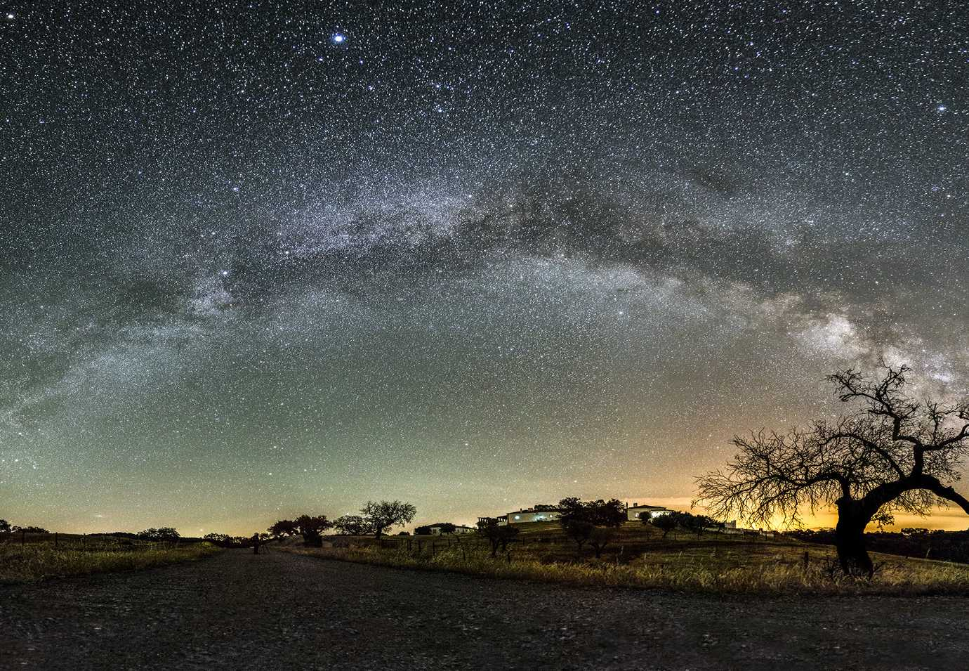

First Light: Shedding light on Missing Baryons
Mitchell de Zylva, Supervised by Dr Christian Reichardt

Slide 2
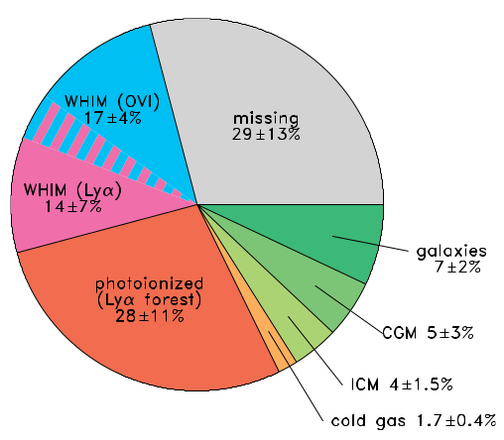
Baryon Phase Component at redshift z<2
Baryon Fraction
Source | Baryon Fraction
CMB | (0.0224 ± 0.0001) h⁻²
Lyman α Forest | > (0.0172) h⁻²
Light Element Ratios and Big Bang Nucleosynthesis | (0.019 ± 0.0001) h⁻²
Source: Shull et al. 2012

Slide 3
Large-Scale Structure
Credit: dragons Simulations/The University of Melbourne

Slide 4
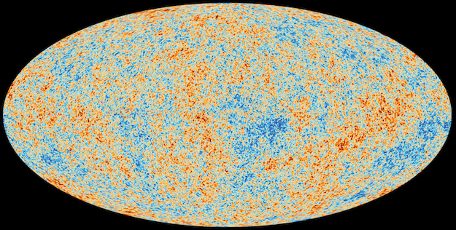
Cosmic Microwave Background
Credit: Planck Collaboration/European Space Agency

Slide 5
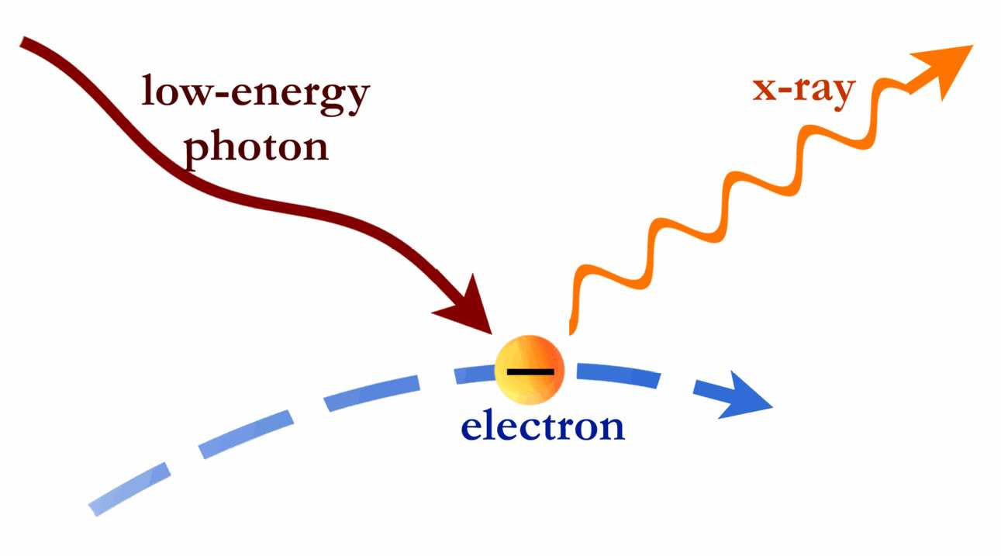
Inverse Compton Scattering
Credit: Chandra Observatory/Harvard University

Slide 6
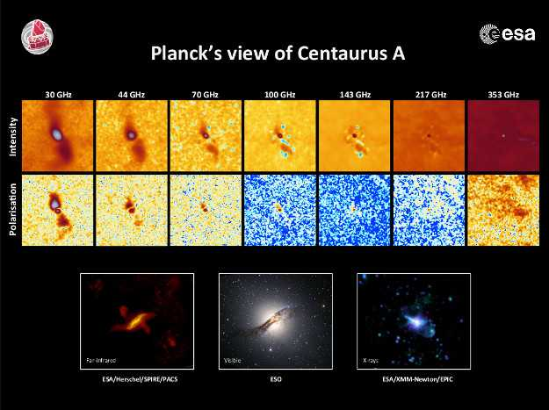
Credit: Planck Collaboration/European Space Agency

Slide 7
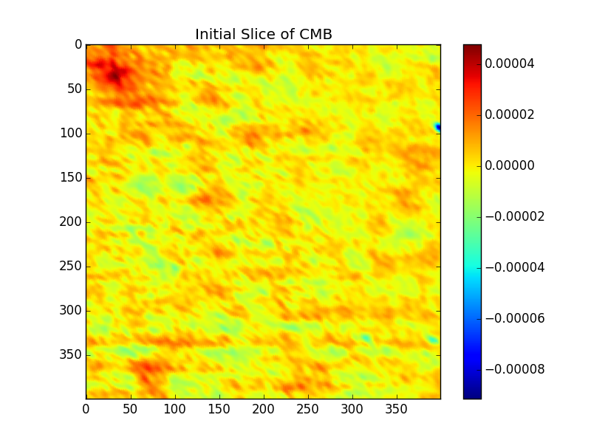

Slide 8
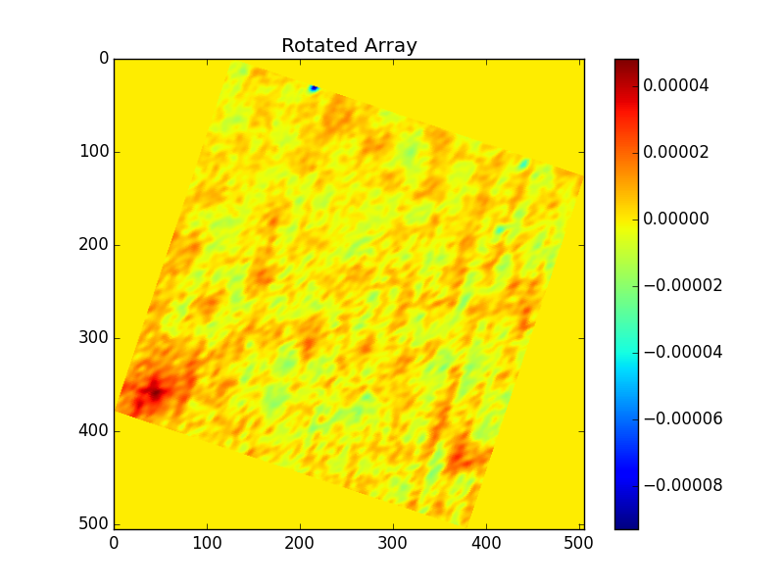

Slide 9
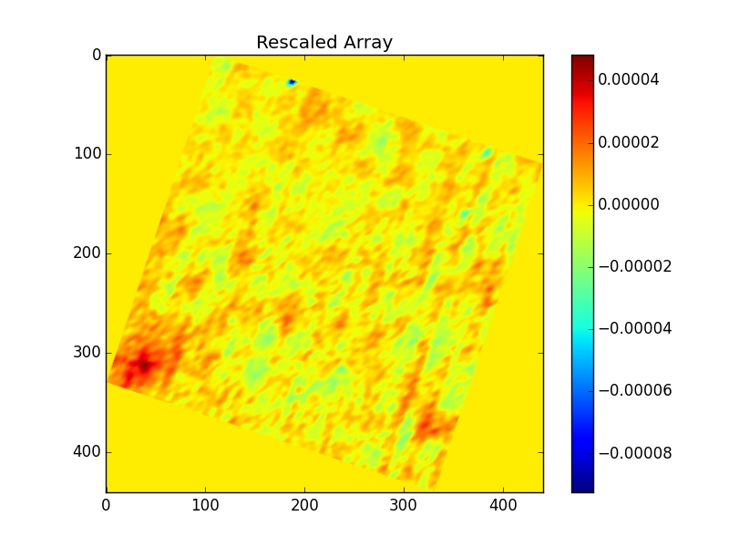

Slide 10
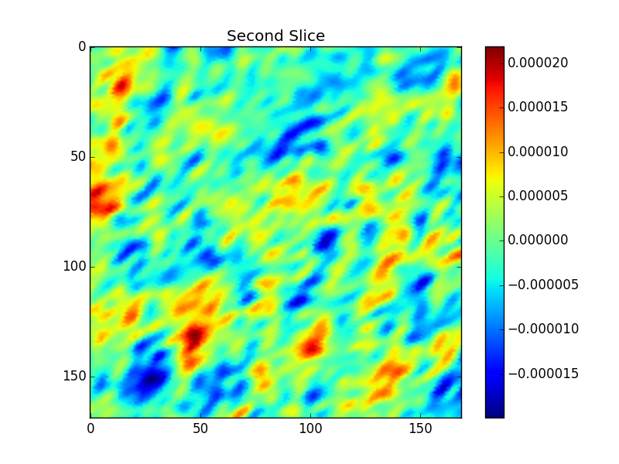

Slide 11
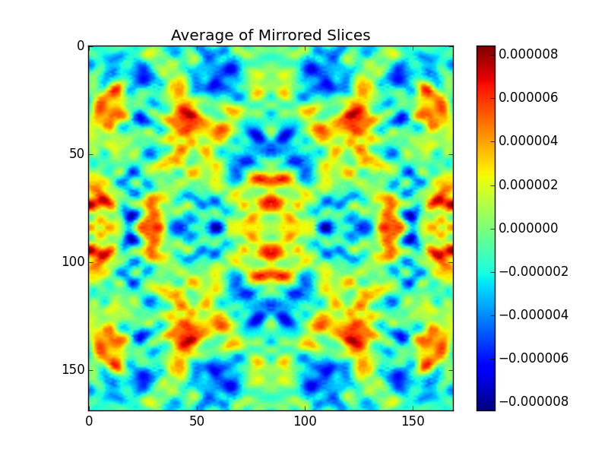

Slide 12
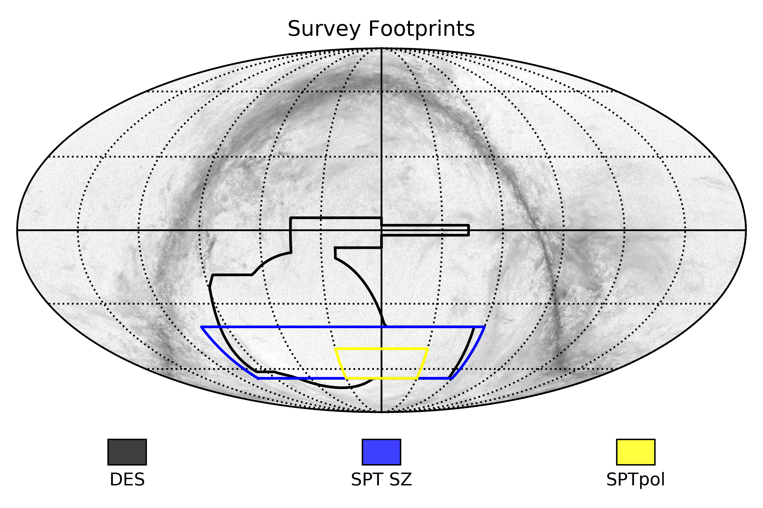

Slide 14
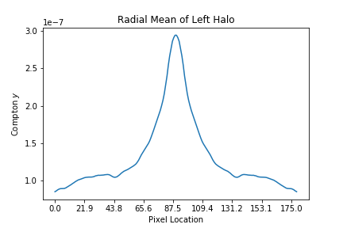

Slide 15
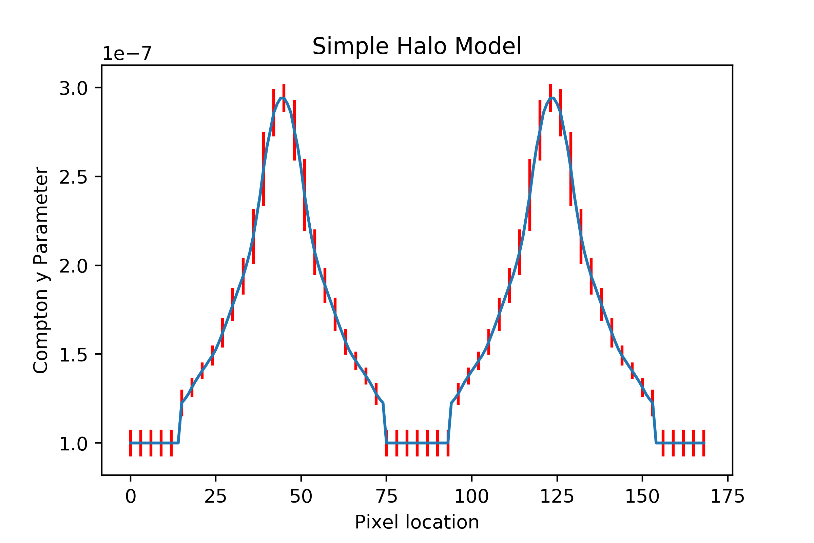

Slide 16
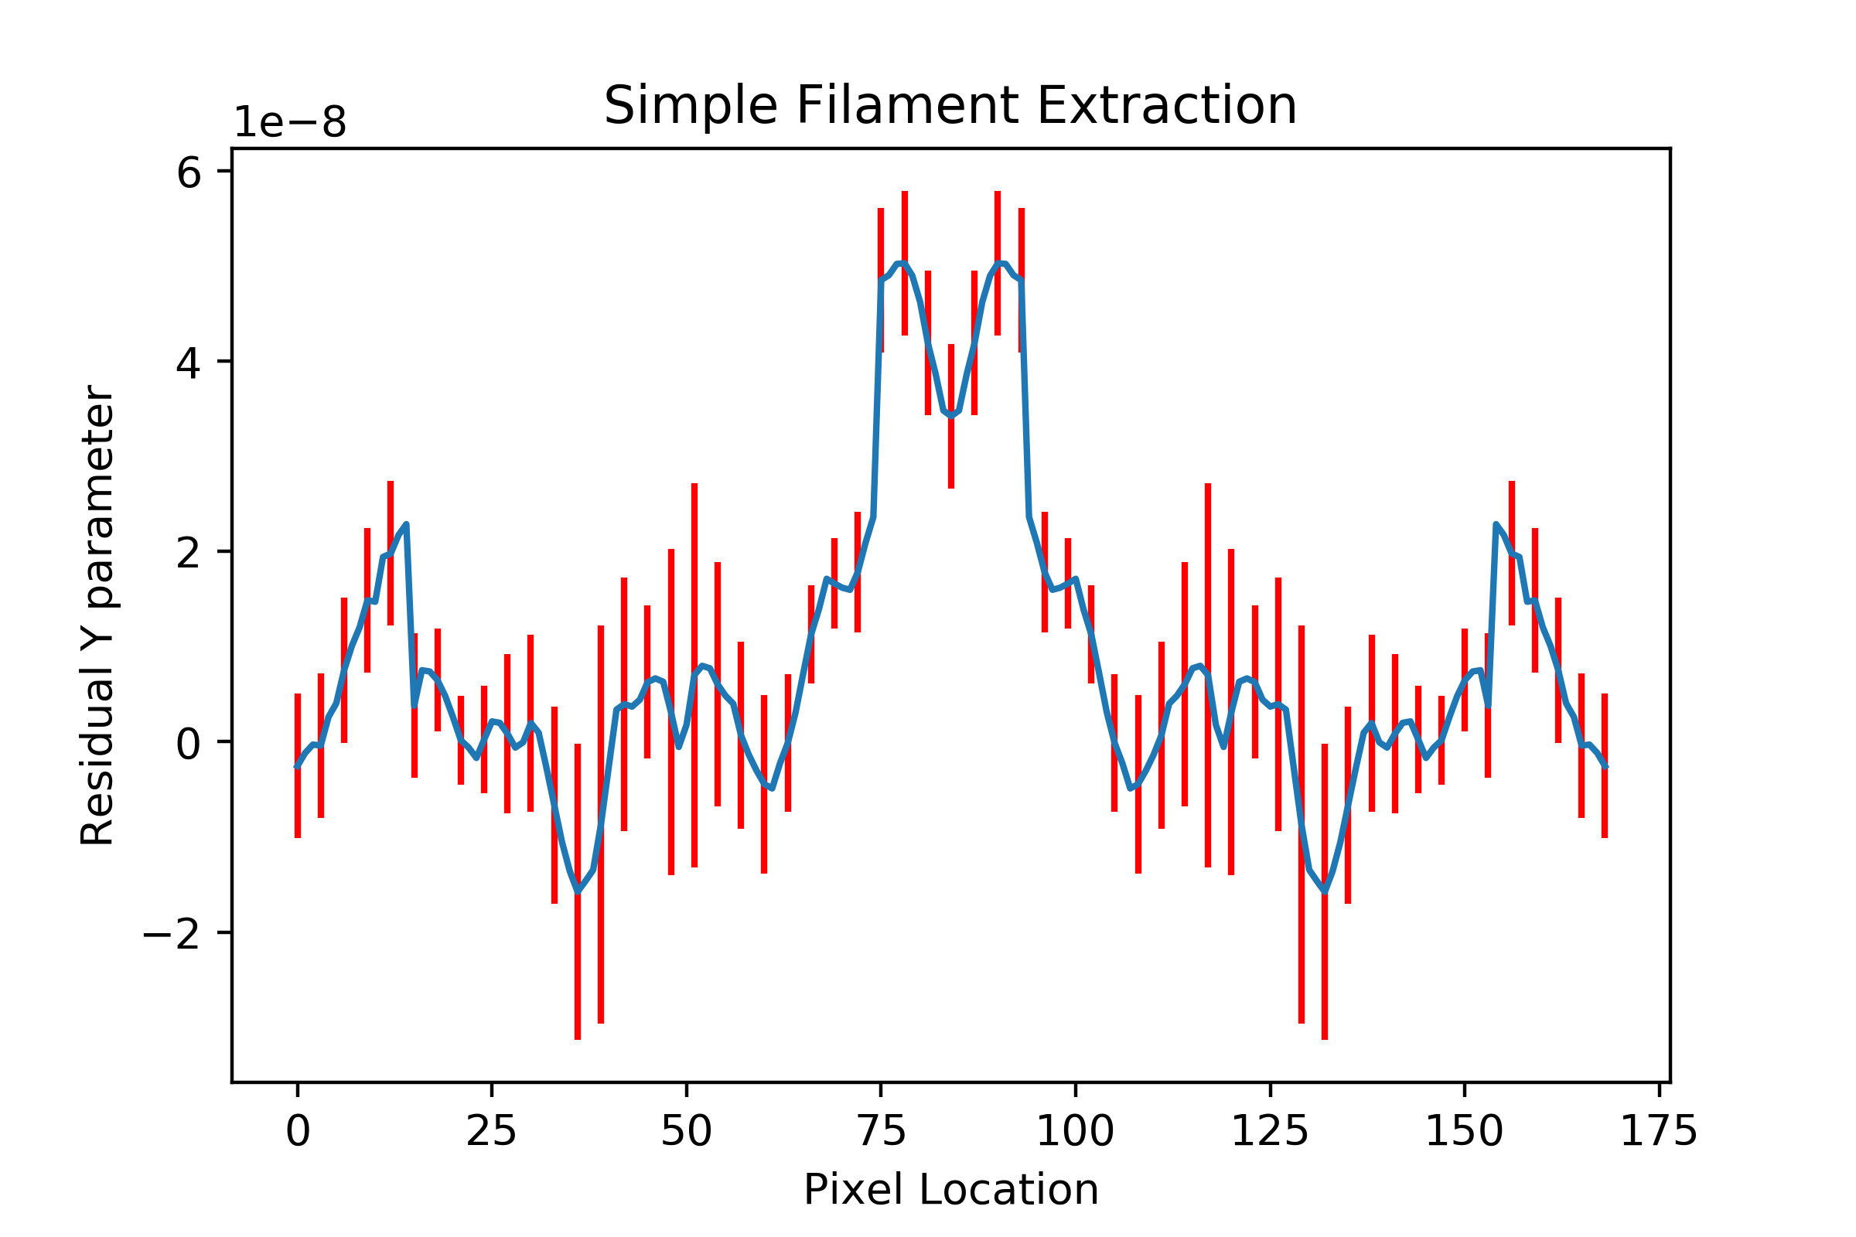

Slide 17
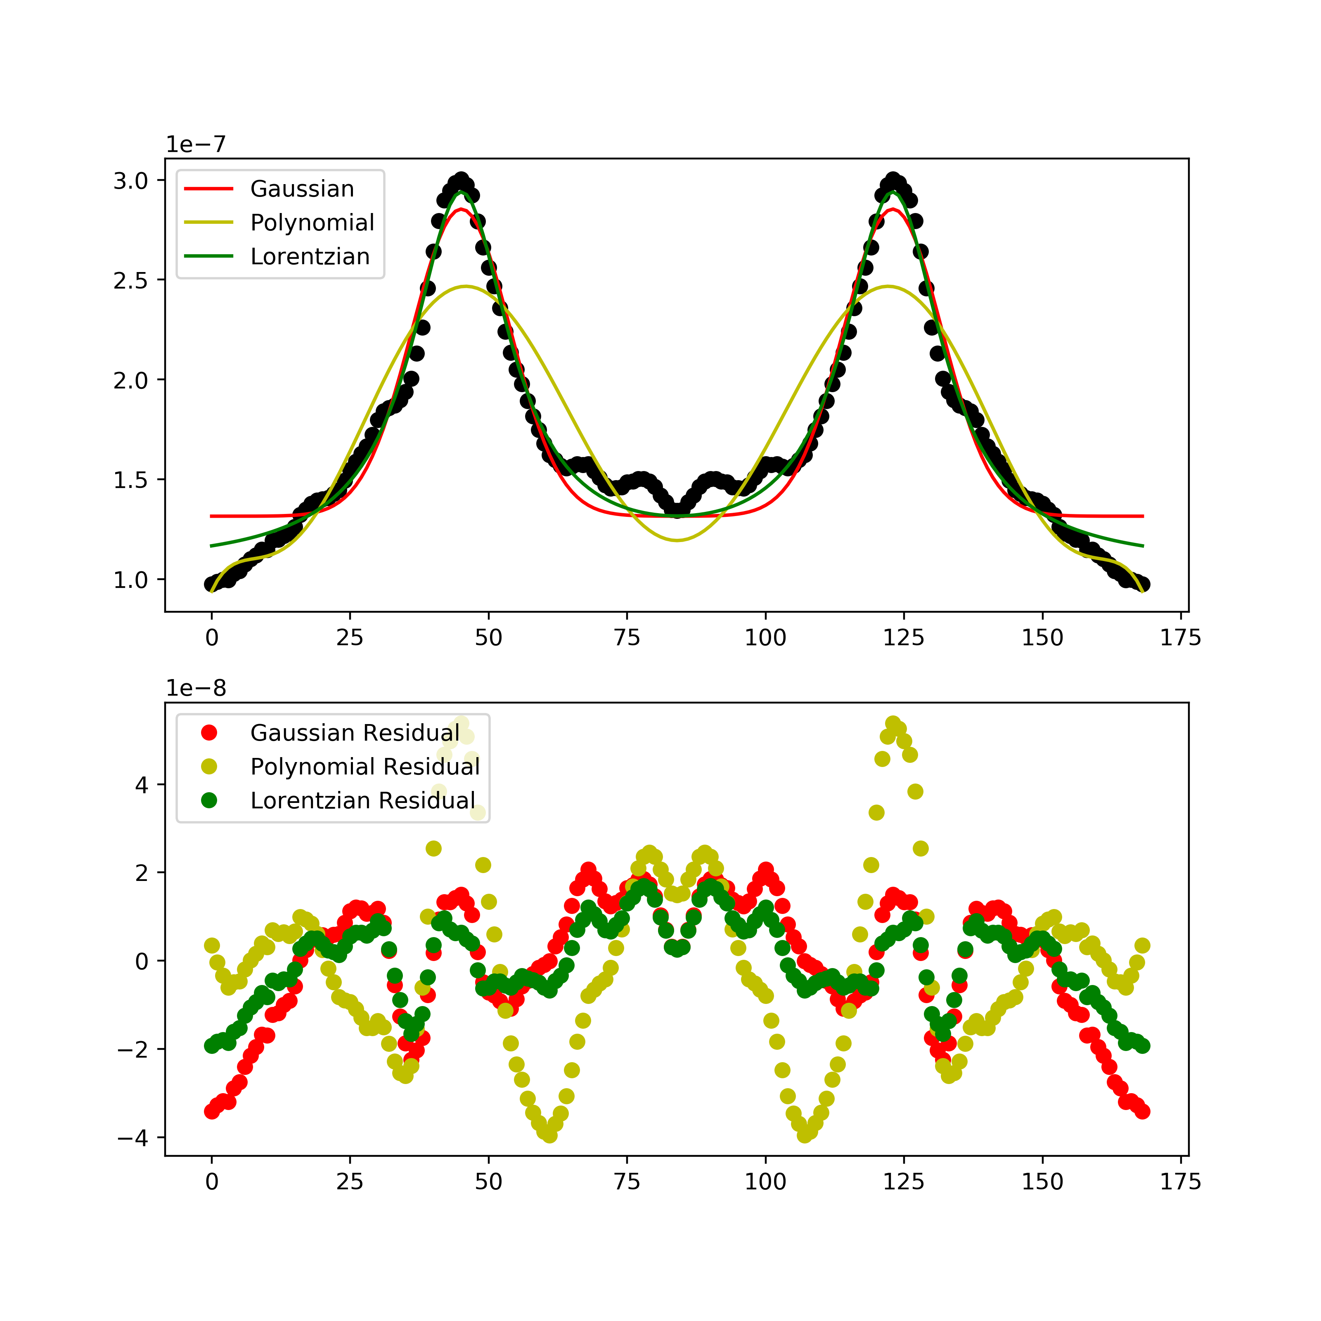

Slide 19
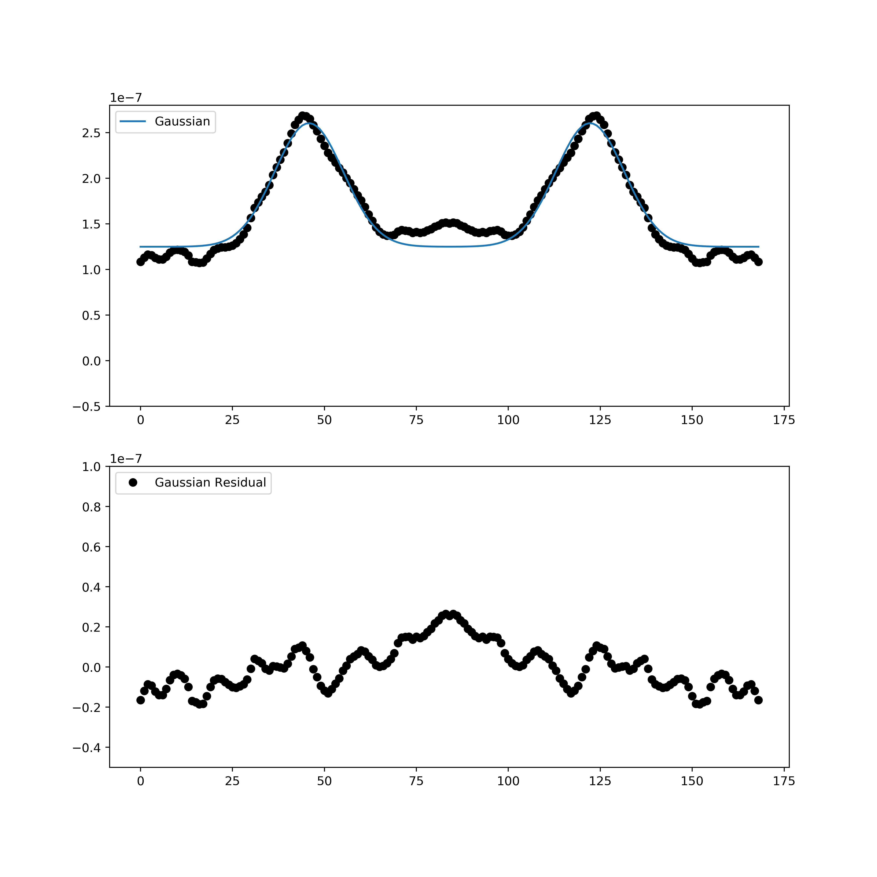

Slide 20
Source | Mean Residual Filament Compton y Signal | Precision
This Work | 1.29 * 10⁻⁸ | 2.05
Tanimura et al. (2017) | 1 * 10⁻⁸ | 5.3
de Graaf et al. (2017) | 0.6 * 10⁻⁸ | 5.1

Slide 21
Future Work
This algorithm can be applied to other tracers of large scale structure, such as Kinetic Sunyaev Zeldovich Effect (kSZ), and Gravitational Weak Lensing Convergence (κ)
Cross-correlations give a better measure of the agreement between these, but are much harder to model, and require more detailed models to constrain
Can also be correlated with other astrophysical sources, such as Fast Radio Bursts (FRBs), or 21cm Absorption.

Slide 22

Conclusions
Detection of missing baryons, with mean filamentary Compton y measure of 1.29 * 10⁻⁸
Comparable, but lower than previous work, due to differences in errors assosciated with the datasets, or issues with modelling
Algorithm can reasonbly be applied to multiple independent datasets, which would also improve the confidence of detection, as well as opening the door for cross-correlations

