Slide 1

A Presentation on
FIRE ALARM SYSTEM

Slide 2

Presented By
ID
Ashfaq Hossan Anik 20245103044
Mijanur Rahman 20245103053
Pulok Das 20245103062
Shantay Chandra Paul 20245103067
Gobinda Hazra 20234103203
ID
ID
ID
ID
Presented To
Sabbir Hasan Sohag
Assistant Professor
Department of EEE

Slide 3

Introduction
A fire alarm system is an electronic setup designed to detect potential fire hazards by sensing temperature, smoke, or flames. Upon detection, it emits a loud sound to alert individuals of the danger, enabling them to take timely action and minimize risk to life and property. These systems are widely used in homes, offices, and industrial facilities to ensure safety and prevent catastrophic losses.
To create a low-cost, reliable, and easy-to-assemble fire alarm system using basic electronic components, making it accessible for small-scale and rural applications.

Slide 4




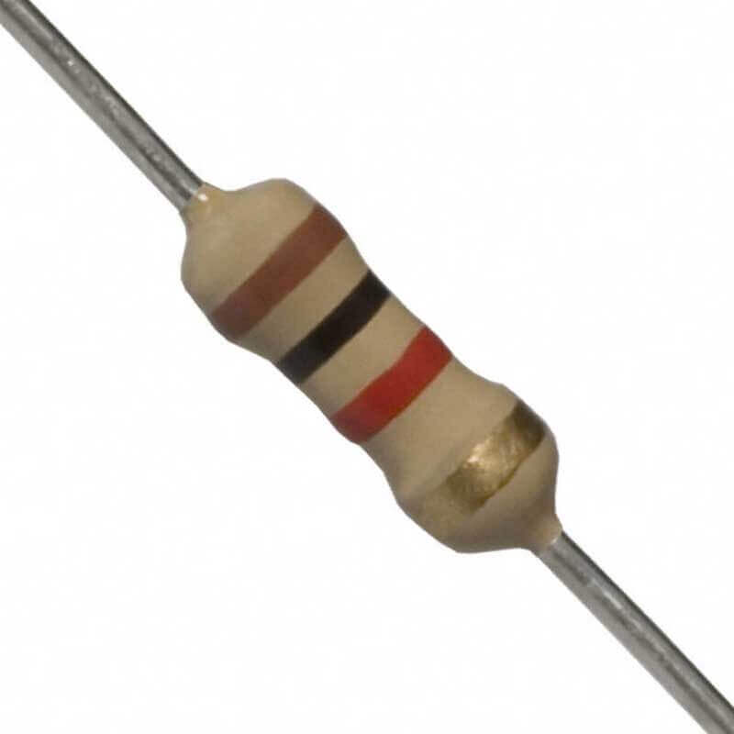
Components
9V Battery
10k NTC Thermistor
BC 547 Transistor
Buzzer
1k Resistor

Slide 5


Diagram

Slide 6

Working Principle
1
The NTC thermistor reduces its resistance as the temperature rises.
2
This change triggers the BC 547 transistor, allowing current to flow.
3
The buzzer sounds when the circuit is activated.

Slide 7

Assembly Process
1.
Connect the components as per the circuit diagram.
2.
Ensure the thermistor is positioned where it can sense heat.
3.
Test the circuit for functionality.

Slide 8

Applications
Homes and offices
Potential Uses
Low-cost fire detection systems in rural areas
Small-scale industries

Slide 9

Advantages
Low Cost
Affordable components.
Compact and Portable
Easy to transport and install.
Reliable
Effectively detects temperature changes.

Slide 10

Limitations
1. Limited sensitivity based on the NTC thermistor's range.
2. Cannot differentiate between harmless heat sources and actual fires.
3. Requires manual reset after activation.

Slide 11

Conclusion
This project serves as a proof-of-concept for a simple fire alarm system that is both affordable and effective for basic fire detection. It highlights the potential to create life-saving systems using minimal resources, making it an excellent starting point for further innovation and development in fire safety technology.

Slide 12

Thank You
Everyone

