Slide 1

Mini Project
on
Display Examination Result
Project By :
Shoeb Ahmad Fareed - 160311733034
Nadeem Ansari - 160311733029
Mohammed Ashfaq Ahmed - 160311733027

Slide 2
Index
Abstract
Literature Survey
Design
Coding & Testing
Deployment
Sources

Slide 3
Abstract
Introduction
The aim of Display Examination Result is to automate student academic performance, by maintaining their sessional marks in detail, security from unauthorized access, functionalities to admin such as insert, delete, update, etc and most important is to generate results of specific student when required. This system will help in displaying student examination result according to their classes and sections. This project mainly deals with JAVA language and Microsoft Excel for painless understanding and maintaining results.
Existing System:
Existing platform basically works on web based system with designing & programming done in web languages such as HTML, CSS, JS and PHP. This facilitates people to access the result from all over the world.
This system gives result once the person log on to the website and enter his or her roll no and the result is generated.

Slide 4
Abstract
Disadvantages in existing system:
No security to an individual's result. An unknown person having a desired rollno can see students result.
Database is maintained which is difficult for a layman to manage details.
Always need a web programmer to add or modify data.
Fails to load fast if huge traffic is on the website. This is due to lack of sufficient web hosting bandwidth.
Proposed System:
This system works on desktop based platform where designing & programming is done using software and languages such as MS Excel, JAVA, JSP, etc. This system generated results only to the person giving proper identity verification.

Slide 5
Abstract
Features As An Advantage:
Our proposed system gives high security to an individual's result. A person must give correct roll no, his/her full name, father's full name, and date of birth in order to get his/her result. Hence avoid unauthorised access to one's personal details.
No database via sql or pl/sql need to be mantained.
Students marks will be stored in an easily understandable Microsoft Excel sheet, so that even a beginner can add, modify and update details easily and quickly without any training.
Conclusion:
Usually programs designed for displaying examination results contains backend as a database (SQL or MySQL) due to which only technical person can handle it for maintenance while our designed program contains backend as

Slide 6
Abstract
a MS Excel Work Sheet to store data which allows anybody to add and modify data and also a person cannot see the result of another without proper verification of identification.

Slide 7
Literature Survey
Ancient:
In the distance past, ancient China first started their exams and result system in 605 A.D. The declaration of examination results used to be a traumatic experience - both for the students and for the teachers. The teachers used to spend sleepless nights in manually compiling marks of each paper for every single student, aggregating them and then deciding if one has passed or not.
In ancient times exams where taken by rich people who could afford the education at schools. In China many dynasties had similar pattern of examinations where students had to write the exam for 3 days and 2 nights. Each student taking the exam had to arrive at the examination compound with only a few amenities: a water bottle, a chamber pot, bedding, food, an ink stone, ink and brushes. Guards would verify the student's identity and search them for hidden written materials. The exam was conducted in a tiny room with a rough and ready bed, desk and bench.

Slide 8

Literature Survey
There were no interruptions in those three days, nor were candidates allowed to have any communication. After writing exam their papers were then copied by skilled copyists so that the student's handwriting wasn't recognized by the paper correction authority. However, when results were declared which would take about 2 to 3 months from the date of examination, they were announced publicly and the students would then know if they had passed or not thereby leading to public appreciation or even humiliation.
(In Ancient Times)

Slide 9
Literature Survey
Medieval:
From 1920s printing or publishing of examination results by way of newspapers was started and carried till 1970s. This aid candidates to avoid going to the college for checking the results which was a disturbing act in ancient times. In this time, only the travelling problem was solved, but the trouble of knowing secured marks in each paper and total aggregate marks was not cracked as the results published in newspapers were also by way of displaying roll numbers indicating only the passed or successful candidates. Later, in 1970s an update was made by way of posting a sheet on college or university notice board of typewritten roll numbers and secured marks indicating both succeeded and un-succeeded candidates. Hence giving information about the marks secured in each paper and even the aggregate marks. The formal marksheet (commonly known as MEMO) would be available only after a lapse of several weeks - sometimes, after months.

Slide 10

Literature Survey
(In Medieval Times)

Slide 11
Literature Survey
Present:
In 2004, results were made available on the Internet for the first time, which was commonly known as online examination results has drastically made a revolution into virtual world. Thus allowing students who for instance, had moved school or left school to get their results without having to return to their old school for checking the results. In the present system, we have made an endeavour to present the result digitally with detailed marks for each of the subjects that the student secured, his position/ranking and all the other relevant data. This result would be available to the students at the comfort of his home soon after the formal declaration of results is made. The simplification and the convenience would be very helpful to all those who are directly or indirectly involved in the process of examination.

Slide 12
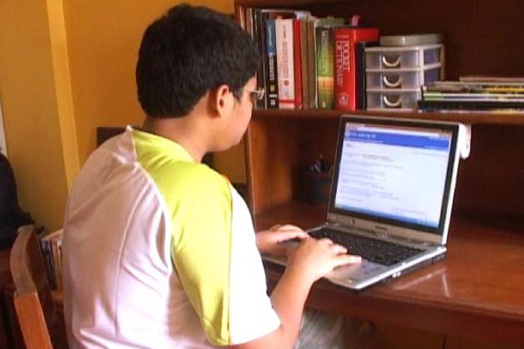
Literature Survey
(In Present Times)

Slide 13
Literature Survey
Future:
On 5th March, 2013 the Higher Secondary Education Board (HSEB) has decided to implement modern technology from this year to reform the examination system. The Board is using advanced technology for the first time in Nepal to reform the examination system and to change the examination security strategy and technology drastically.
The Board will use the technology as a pilot project in one million examinees of Class 11 and 12 from April this year by installing machine and software at a cost of Rs. 2 million to 2. 5 million. The Board will use the bar code in answer sheets and Optical Mark Reader (OMR) machine, which can bring out results quickly, said Council Member Secretary Bhimlal Gurung. This will make the examination systematic, safe and less labour consuming, precise and maintain secrecy of results from employees, he claimed.

Slide 14
Literature Survey
This will help in keeping secrecy as it can be done by one person in less time after its implementation as the previous system took much manpower and long time, said Gurung. Examination Controller of the Board, Durga Prasad Aryal said one cannot identify from the new technology whose answer sheet it is and there will be impartiality. In this system, fake students cannot give examination and there will be no fake mark sheet and fake certificate.

Slide 15
Design
Design section defines our application flow with UML diagrams

Slide 16
SESSIONAL MARKS RESULTS
LOGIN
ROLL NO
FULL NAME
FATHER’S NAME
DATE OF BIRTH
(dd/mm/yyyy)
NO
SUBMIT
YES

Slide 17
NO
YES
Enter correct details:
Roll no
Full name
Father’s full name
Date of birth
DISPLAYING RESULT.....
START OVER

Slide 18
If Student Details are Correct then result will be displayed below
Personal Details
Hall Ticket No. | 160311733001 | Gender | MALE
Name | Atif Aslam | Father’s Name | Sabeel Aslam
Course | BE | Medium | ENGLISH
Marks Details
Subjects | Marks | Result
DATA COMMUNICATION | 45 | PASS
OOP using JAVA | 34 | PASS
MATHEMATICS IV | 43 | PASS
ENVIRONMENTAL STUDIES | 32 | PASS
MPI | 45 | PASS
ECM | 36 | PASS
Result
Year | Semester | Result
2 | 1 | PASSED

Slide 19
Coding & Testing
Coding & testing section shows application code tested on various cases

Slide 20
Deployment
The purpose of this document is to identify the key factors that influence the performance, reliability and functionality of the Display Result application. This deployment guideline will help to ensure the highest possible level of reliability, sustainability, performance, predictability and end-user usability.
System Requirements:
Make sure that your system environment meets the following requirements:
Software Requirements:
Java JDK 1.6 & Above
Java JRE 6 Or Above
Minimum Hardware Requirements:
Processor speed 1 GHz
Operating System Compatibility
Hard Disk Space 200 MB
RAM 512 MB
Our Application Kit
Microsoft Windows XP
Microsoft Windows VISTA
Microsoft Windows 7
Microsoft Windows 8

Slide 21
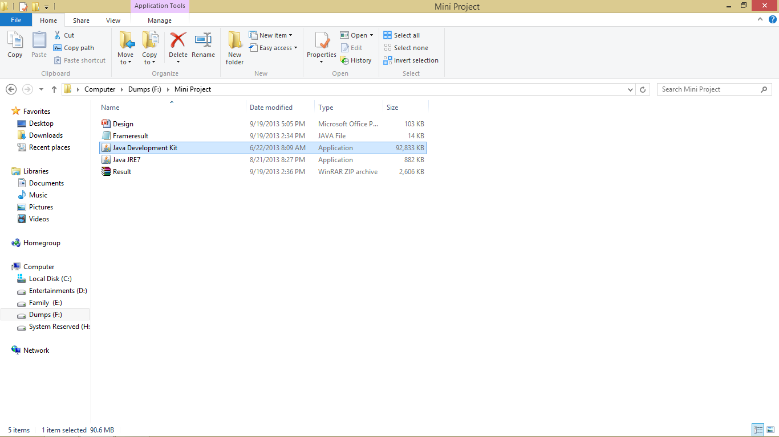

Installing Both JDK & Jre7
Double-click on Java Development Kit and follow the instructions.

Slide 22
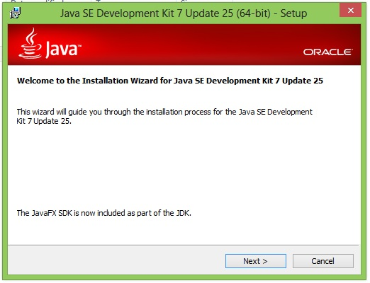
Click on the Next button.

Slide 23
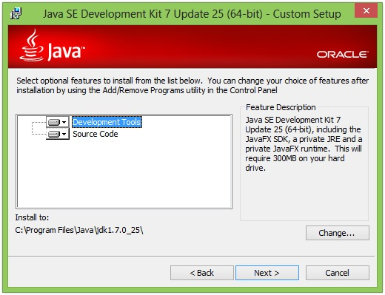
Click on the Next button.

Slide 24
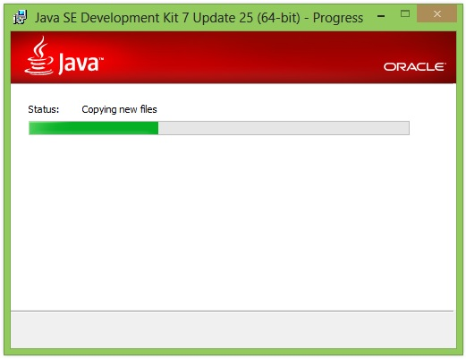
Installing is in progress. . . .

Slide 25
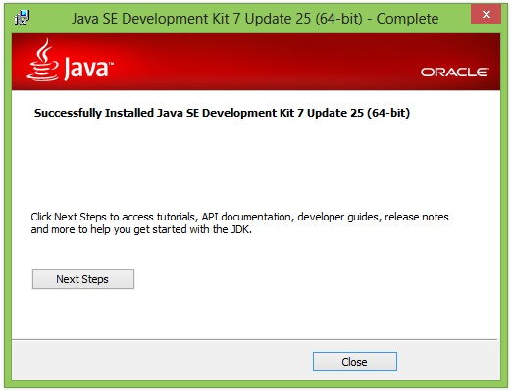
Java SE Development kit is successfully installed on your pc.

Slide 26
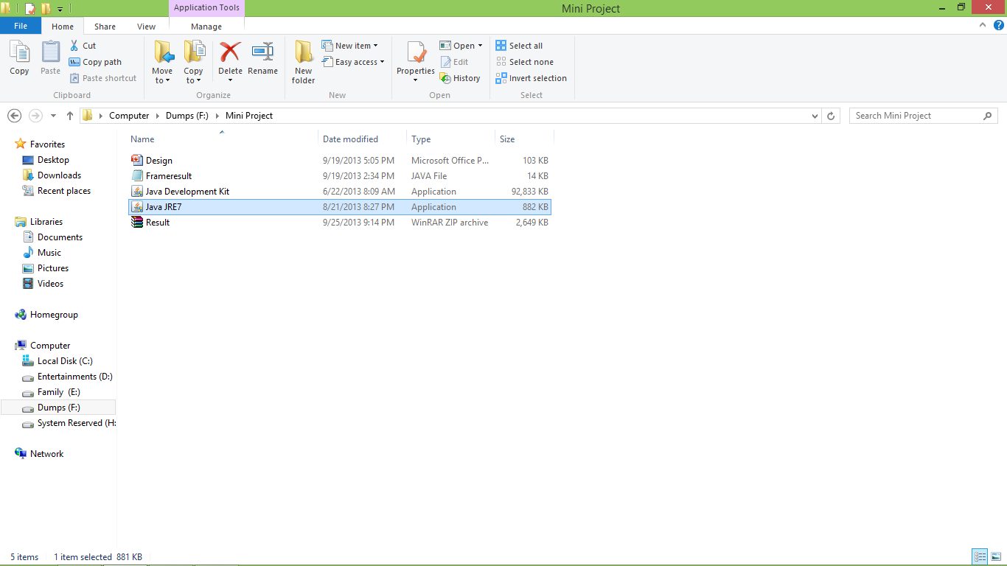

Installing Java JRE7
Double-click on the Java JRE7 and follow the instructions.

Slide 27
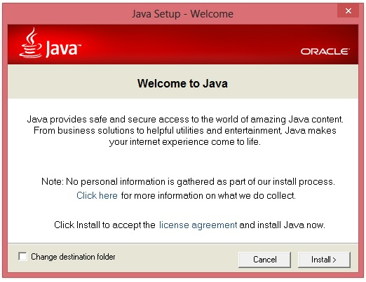
Click on the Install button.

Slide 28
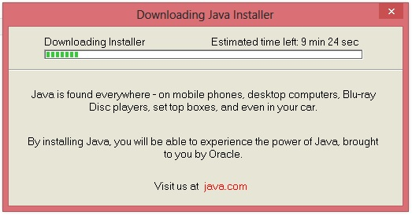
Downloading is in progress. . . .

Slide 29
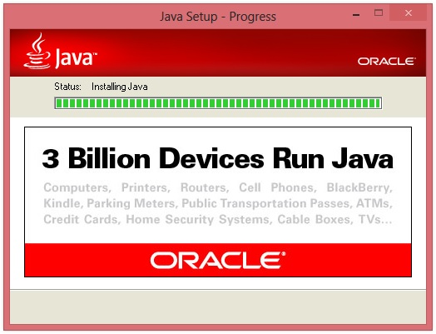
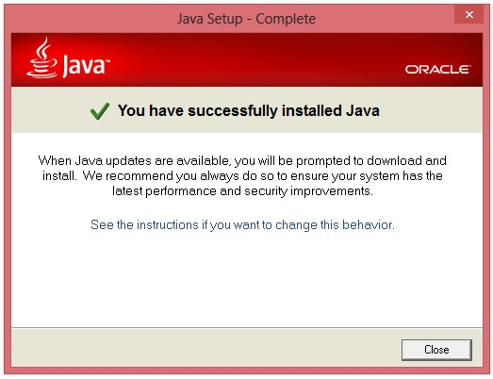
Installing is in progress. . . .

Slide 30
Java is now successfully installed on your pc.

Slide 31

How To Execute Our Application

Slide 32
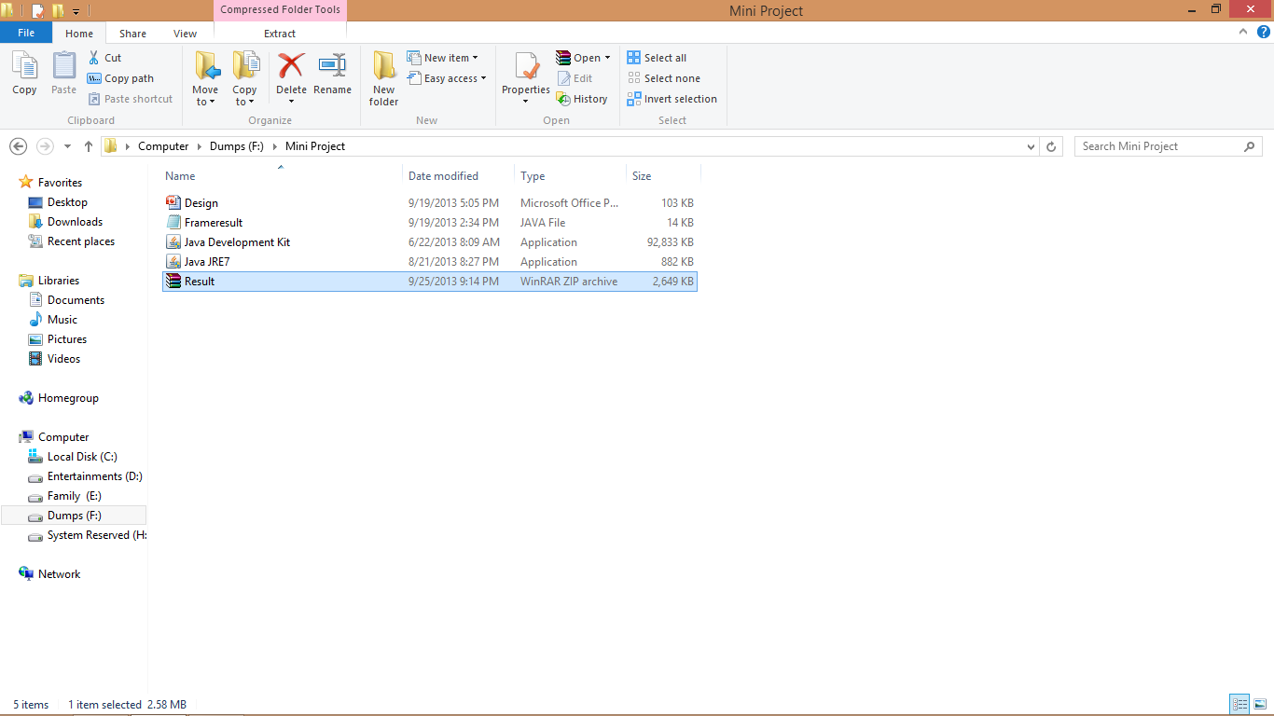
Double-click on the Java JRE7 and follow the instructions.

