Slide 1

ShopBusters: Best Online Bookstore
CIS-475 Software Engineering
Professor:
Dr. Zahid Anwar
Group Members:
Mir hussain ali
Mohammed ashfaq ahmed
Humaira fatima

Slide 2




Business model
Customer: Users / Readers
Business Model: An online representation of the Books that are sold in the physical store. There are different categories and products for each category, which online shoppers can browse. Details are provided for each product (i.e., name, image, description, price).
Benefits:
Faster buying procedure
Easy to find products
More reach to customers, there is no theoretical geographic limitations.
Low operational costs and better quality of services.

Slide 3



High-Level Design Flow : Admin Portal
Admin Login
Index Page
Book Info
Admin
Add a new book
New Book
****
View book list
Sign in
Add book
Edit
View books
Edit Book details
Update Book
Edit
Delete

Slide 4
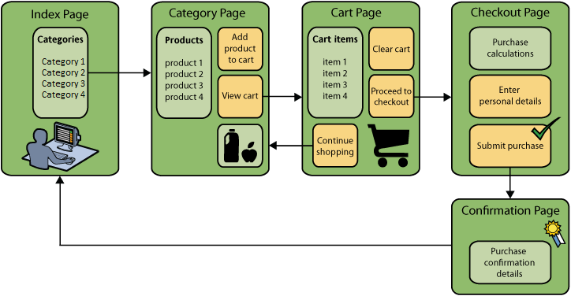
High-Level Design Flow : User Portal

Slide 5
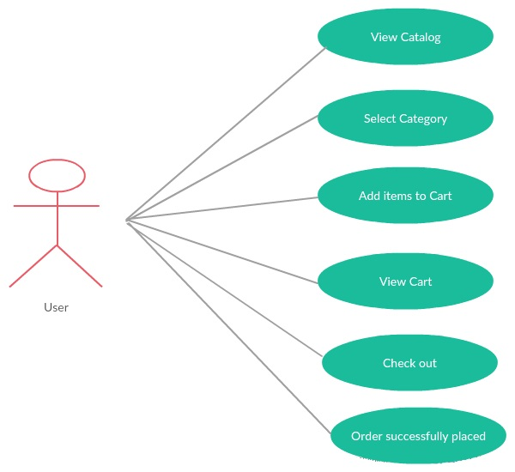
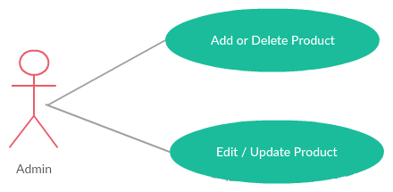
User Requirements

Slide 6
Delete Book Use Case
Use Case Title: Delete a Book.
Primary Actor: Admin , Level: Actor goal
Precondition: The Book must be viewed in “View Book List”.
Success Guarantees: Book is deleted. It can no longer be viewed in the Booklist
Main Success Scenario
1. Admin: selects the View Booklist option
2. System: displays all the books
3. Admin: selects the book to be deleted
4. System: Displays the Message to Confirm the operation.
5. Admin: Selects the Confirm button
6. System: Deletes the selected Book and displays the remaining list of Books
Delete Book
Book1
Delete

Slide 7
ER Diagram

Slide 8
Design and Architecture
Controller
Service
Persistence
HomeController
BookService
BookServiceImpl
ShoppingCartController
UserService
CartItemServiceImpl
CheckOutController
CartItemService
UserServiceImpl
1
Configuration
Model
*
BookStore
Books
1
*
SecurityConfig
UserSecurityService
User
Role

Slide 9

This Live Demo will constitute the following
Adding Book as an Admin
Editing / Updating Book as an Admin
Deleting Book as an Admin
Browsing Books as a User
Login as User and adding a book to the shopping cart.
Placing the Order
Order Confirmation page/Email
User Logout

Slide 10
Challenges Faced
Setting up a Spring Starter project in Eclipse.
Performing CRUD operations .
Experimented with Spring Framework and Hibernate.
Experimented with Spring web Security.
Committing files to github after editing.
Did not had sufficient time to complete full functionality which we had planned.

Slide 11
Known Issues
There is no Favorite feature available as of now for books to mark as favorites
Auto Update on Price when user is changing the quantity of the product.
No option to search Orders by date in User’s Account.
when you click on privacy policy or license agreement you get redirected to same FAQ’s page need to update it.

Slide 12
Future Work
Add Search by Price, List , category
Compare Two products from different Authors.
Add User Management to Admin portal.
Add Seller Feature to the website where people can upload their Products and sell it on our website.
Adding Introduction videos about each Book.
Adding AutoComplete Suggestion to search box
Github link for source code:
https://github.com/mhali2090/SWEPROJECT.git

Slide 13
Thank you
Questions?

