Slide 1

WAREHOUSE MANAGEMENT SYSTEM
A Project Report Submitted in Partial Fulfillment of the Requirements for the Award of the Degree
of Bachelor of Technology (B.Tech.) in Computer Science & Engineering
Submitted by:
IMRAN AHMAD – Roll No: 0116CS221028
MD KAIF – Roll No: 0116CS221040
Under the Guidance of:
Mr. Nishant Singh, Assistant Professor, CSE Department
Head of Department:
Mr. Vipin Verma
All Saints’ College of Technology, Bhopal
Affiliated to Rajiv Gandhi Proudyogiki Vishwavidyalaya (RGPV)
Academic Year: 2025–2026

Slide 2
CERTIFICATE
This is to certify that the project entitled 'Warehouse Management System' submitted by Imran Ahmad and Md Kaif is a bonafide record of work done under the supervision of Mr. Nishant Singh, Assistant Professor, CSE Department.
Guide:
Mr. Nishant Singh
HOD (CSE):
Mr. Vipin Verma
Principal:
All Saints' College of Technology, Bhopal

Slide 3
APPROVAL CERTIFICATE
The project titled 'Warehouse Management System' submitted by Imran Ahmad and Md Kaif is hereby approved for partial fulfillment of the B.Tech. degree requirements.
Internal Examiner: ______________________
External Examiner: ______________________
HOD (CSE): Mr. Vipin Verma
Principal: All Saints' College of Technology, Bhopal

Slide 4
DECLARATION
We hereby declare that this project titled 'Warehouse Management System' is an original work carried out by us under the guidance of Mr. Nishant Singh, Assistant Professor, CSE Department. This work has not been submitted elsewhere.
IMRAN AHMAD
MD KAIF

Slide 5
ACKNOWLEDGEMENT
We sincerely thank our guide, Mr. Nishant Singh, for his guidance and motivation.
We also thank Mr. Vipin Verma (HOD, CSE) for providing departmental support.
We thank faculty members, friends, and families for their constant support.

Slide 6
TABLE OF CONTENTS
1. Abstract
2. Introduction
3. Problem Definition
4. Objectives
5. Scope
6. Methodology
7. Requirement Analysis
8. Functional Requirements
9. Non-Functional Requirements
10. Hardware Requirements
11. Software Requirements
12. System Architecture
13. Use Case Diagram
14. ER Diagram
15. Module Descriptions
16. Implementation
17. Testing
18. Output Screens
19. Conclusion
20. Future Scope

Slide 7
Abstract
The Warehouse Management System (WMS) automates warehouse processes such as UOM, User, Item, GRN, Shipping, and Inventory to improve efficiency and accuracy.

Slide 8
Introduction
A Warehouse Management System is used to manage goods, stock operations, tracking, and logistics. It improves accuracy and reduces manual work.

Slide 9
Problem Definition
Manual warehouse systems suffer from errors, delays, difficulty in tracking goods, and no real-time monitoring.

Slide 10
Objectives
• Automate warehouse tasks
• Improve accuracy
• Reduce errors
• Make warehouse processes digital

Slide 11
Scope
Includes UOM, WH User, Items, Orders, GRN, Shipping, and Inventory modules.

Slide 12
Methodology
Requirement analysis → System design → Development → Testing → Deployment

Slide 13
Requirement Analysis
Analysis of user needs, data flow, functional and non-functional requirements.

Slide 14
Functional Requirements
UOM management, User registration, Item creation, GRN creation, Shipping entry, Inventory updates.

Slide 15
Non-Functional Requirements
High performance, security, usability, reliability, scalability.

Slide 16
Hardware Requirements
Processor i3 or above, RAM 4GB+, HDD 500MB, Windows/Linux OS.

Slide 17
Software Requirements
Java, JSP/Servlet, MySQL, Tomcat, HTML/CSS/JS, JDBC, Eclipse IDE.

Slide 18
System Architecture
Follows a 3-tier architecture: Presentation Layer, Business Logic Layer, Data Layer.

Slide 19
Use Case Diagram
Depicts interactions between Admin/Users and system operations such as Add UOM, Add User, GRN, Shipping.

Slide 20
ER Diagram
Represents the relationships among UOM, Users, Items, GRN, Shipping, Inventory tables.

Slide 21
Module Descriptions
• UOM Module
• WH User Module
• Item Module
• GRN Module
• Shipping Module
• Inventory Module

Slide 22
Implementation
Implemented using JSP/Servlet backend, MySQL database, HTML/CSS frontend, MVC pattern.

Slide 23
Testing
• Unit Testing
• Integration Testing
• System Testing
• Validation Testing
• User Acceptance Testing

Slide 24
Output Screens
This section contains screenshots of all modules: UOM, WH User, GRN, Shipping, Inventory.

Slide 25
Conclusion
The WMS improves warehouse efficiency, accuracy, and digital workflow.

Slide 26
Future Scope
• Barcode integration
• Mobile app
• Real-time alerts
• AI-based forecasting
• Cloud deployment

Slide 27
Inventory Management
The system updates inventory automatically whenever GRN or shipping operations occur.
It maintains accurate stock levels and prevents mismatch between physical and recorded inventory.

Slide 28
Data Flow Diagram
The DFD illustrates movement of data between modules such as UOM, User, Item, GRN, Shipping, and Inventory.
It helps understand how information flows through the WMS system.

Slide 29
System Workflow
1. Admin registers UOM, Users, Items.
2. Purchase order is created.
3. GRN updates warehouse stock.
4. Sale order dispatch updates stock again.
5. System generates reports for management.

Slide 30
Database Details
The database uses normalized tables: UOM, USER, ITEM, PO, GRN, SHIPPING, INVENTORY.
Primary and foreign keys maintain relationships ensuring integrity.

Slide 31
Key Features Summary
• Automated GRN + Shipping workflow
• Accurate real-time inventory
• Secure authentication
• Structured modular system
• Clean interface with export options
• Reliable data management

Slide 32
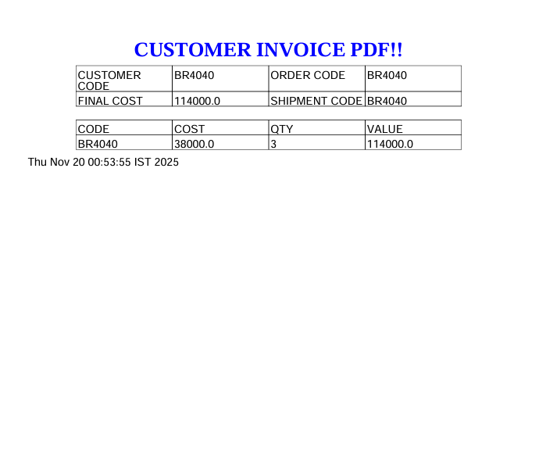
Project Screenshot 1

Slide 33
Project Screenshot 2

Slide 34
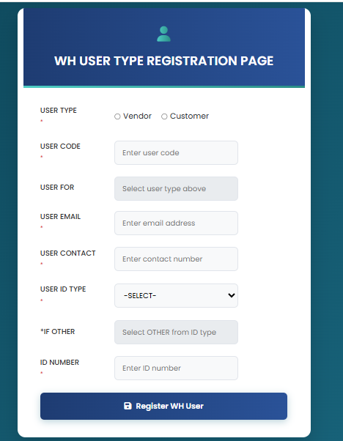
Project Screenshot 3

Slide 35
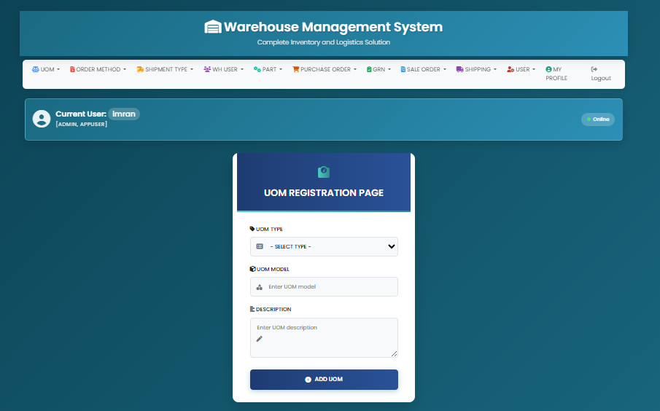
Project Screenshot 4

Slide 36
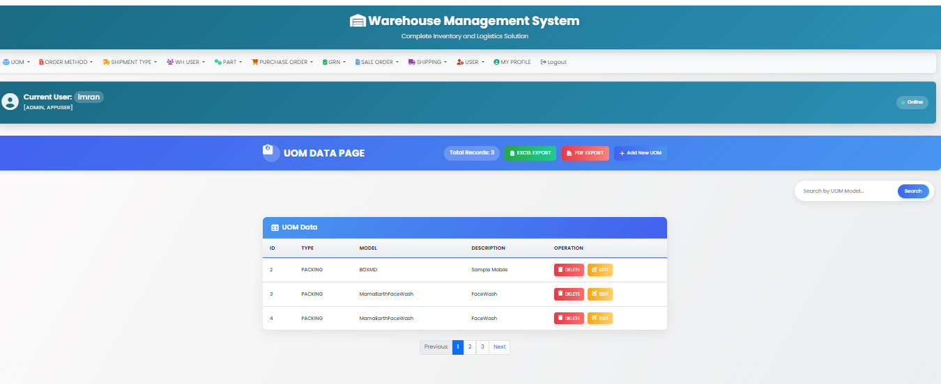
Project Screenshot 5

Slide 37
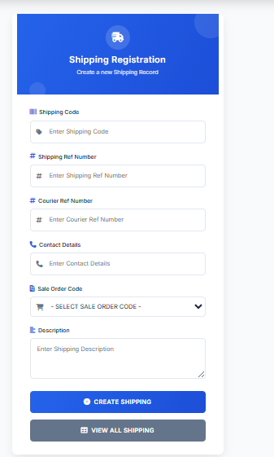
Project Screenshot 6

Slide 38
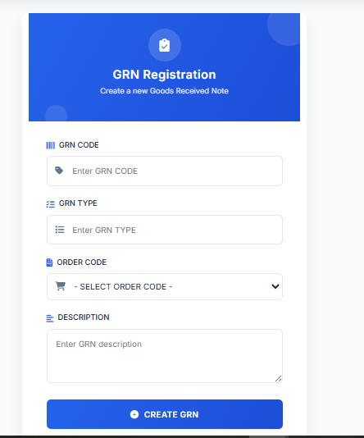
Project Screenshot 7

Slide 39
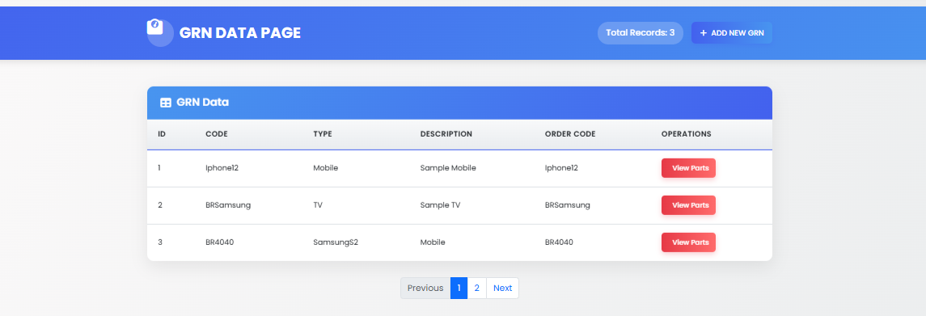
Project Screenshot 8

Slide 40
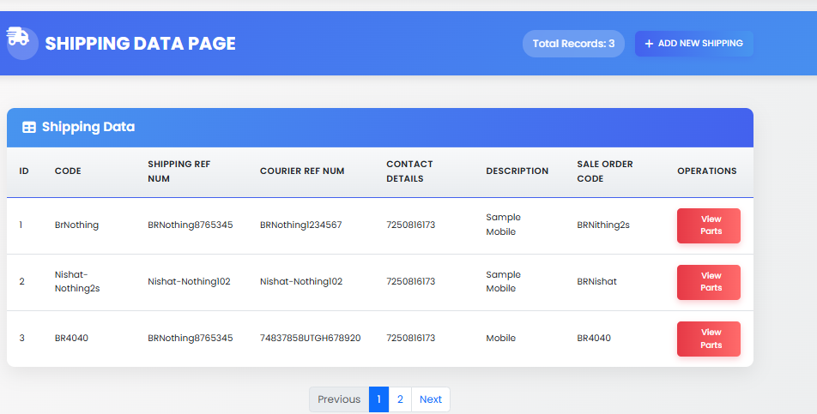
Project Screenshot 9

Slide 41
Inventory Management
The system automatically updates inventory whenever GRN is created or shipping is executed.
It ensures stock accuracy and prevents mismatch between physical and digital records.

Slide 42
Data Flow Diagram
DFD illustrates how data flows between modules like UOM, User, GRN, Shipping, and Inventory.
It helps visualize how information moves inside the WMS application.

Slide 43
System Workflow
1. Admin registers UOM, users, and items.
2. Purchase order is generated.
3. GRN updates stock.
4. Sale order dispatch updates inventory again.
5. Reports provide insights into warehouse performance.

Slide 44
Database Details
The database consists of normalized tables such as UOM, USERS, ITEM, GRN, SHIPPING, and INVENTORY.
Primary and foreign keys maintain relational integrity within tables.

Slide 45
Key Features Summary
• Automated GRN & Shipping
• Real-time inventory
• Secure authentication
• Structured modules
• User-friendly interface
• Accurate reporting

Slide 46
Additional Explanation 6 – GRN Importance
Goods Received Note (GRN) is a critical warehouse document verifying receipt of items.
It ensures that supplier-delivered products match purchase order details and supports inventory accuracy.

Slide 47
Additional Explanation 7 – Shipping Workflow
Shipping module handles sales order dispatch.
It updates inventory, generates packing slips, and records outgoing goods for traceability.

Slide 48
Additional Explanation 8 – User Management Role
Warehouse user module stores vendor and customer details.
It plays an essential role in linking purchase and sales documents with actual business partners.

Slide 49
Additional Explanation 9 – Report Generation
WMS generates structured reports such as user lists, inventory status, GRN reports, and shipping logs.
Reports help in decision-making and performance monitoring.

Slide 50
Additional Explanation 10 – System Security
The system uses role-based access and secure database connections.
Only authorized users can access or modify core warehouse data.

