Slide 1
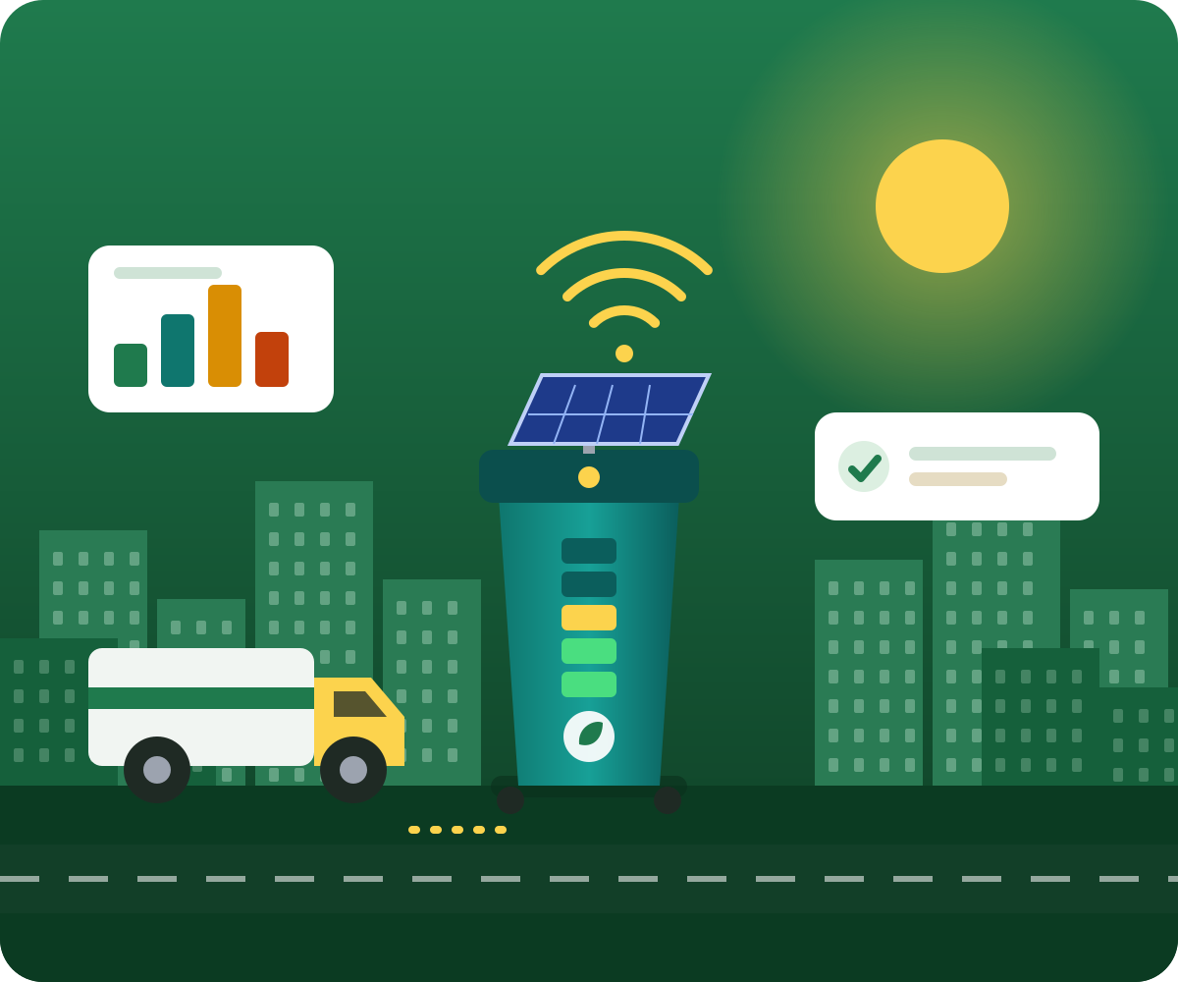














CODE FOR A BILLION · WASTE MANAGEMENT TRACK
EcoBin
Send trucks only where they are needed, and turn every kilogram of waste into a resource.
Solar smart bins sense, AI predicts overflow 24 hours ahead, routes are optimised to save diesel, and recyclables, food waste, e-waste and reusable goods flow back into use.
Map, routes, forecast, driver, technician and citizen apps: all running.
Solar IoT edge node
XGBoost · 98.1% R²
Google OR-Tools
Scan to open the live platform
YOLOv8 vision
4 role-based apps
ecobin-one.vercel.app
Hyderabad simulation
MEASURED IMPACT PER COLLECTION CYCLE · 403-BIN, 5-TRUCK HYDERABAD SIMULATION
₹1,120
11.3 L
3,420 kWh
4,200 L
60%
30.3 kg
saved per cycle
diesel conserved
clean biogas energy
water conserved per run
fewer overflows
CO₂ avoided per cycle
Team Coding Ninja · Waste Management track · Deployed live · 100% open source
GitHub Code ↗
Demo Video ↗
1 / 20
Notes:
Imagine a city where garbage trucks only visit bins that truly need emptying. EcoBin measures every bin, predicts overflow, optimises routes and recovers every material. Scan the QR to open the live platform.

Slide 2









INSIDE THIS DECK
Your roadmap through EcoBin
Eight sections, from the real-world problem to a live, verifiable platform
SLIDES
SLIDES
SLIDES
SLIDES
3 – 4
5 – 7
8 – 10, 12
11
Problem
Approach & solution
Hardware & AI
Routing
Blind trucks, silent overflows and the scale of India’s waste crisis
Measure, automate, optimise; then sense, predict, route and recover
₹2,400 solar node, XGBoost forecast, YOLOv8 vision and three roles of AI
Google OR-Tools beats three other algorithms on the same 403 bins
SLIDES
SLIDES
SLIDES
SLIDES
13, 15
14
16 – 18
19 – 20
People & apps
Circular economy
Impact & results
Scale & live proof
Driver, technician, citizen and city command centre, all in one platform
Recycling, biogas power, e-waste pickup and reuse marketplace
Environmental impact, traditional versus EcoBin charts and the scorecard
Business model, payback and the live demo, video and source code
Goal: measure every bin, predict every overflow, optimise every route and recover every material.
EcoBin · AI Smart Waste & Circular Economy
GitHub Code ↗
Demo Video ↗
Live: ecobin-one.vercel.app
2 / 20
Notes:
Roadmap of the deck: problem, approach, technology, people, circular economy, impact, business and live proof.

Slide 3









THE REAL-WORLD PROBLEM
Cities collect waste blind, and everyone pays
Fixed truck schedules, silent overflows and a landfill-first system waste fuel, health and valuable materials at the same time
1
Trucks follow fixed schedules. A bin that is 15% full gets the same visit as one at 98%, so diesel, driver hours and engine wear are spent for almost nothing. Fleets end up burning far more fuel than the job needs.
30-40%
Half-empty bins get emptied
of collection diesel wasted on blind routes
Real-world: A truck empties a quarter-full bin in one street while an overflowing bin two streets away waits.
2
Nobody predicts rapid fill. Spilled garbage attracts flies and rats, blocks drains, leaches into groundwater and rots into methane, a gas about 21 times stronger than CO₂ over 100 years.
15+
Full bins overflow
overflows per city, per day (baseline)
Real-world: A weekend market plus monsoon rain fills a street bin overnight and the city learns only from complaints.
3
Over 75% of city waste is dumped mixed. PET, aluminium, copper, paper, food waste and e-waste are buried or burned, so recoverable money and clean energy are lost for ever.
75%+
Waste ends up in landfill
of municipal waste landfilled unsegregated
Real-world: A dead phone battery thrown in with food scraps leaks lead and cadmium into the soil.
Root cause: no measurement. Cities cannot manage what they cannot see. EcoBin puts a sensor, a forecast and an optimised route behind every bin.
EcoBin · AI Smart Waste & Circular Economy
GitHub Code ↗
Demo Video ↗
Live: ecobin-one.vercel.app
3 / 20
Notes:
A resident walks past an overflowing bin on Monday while, two streets away, a truck empties a bin that is barely a quarter full. Nobody is at fault; the city simply has no live data.

Slide 4









THE SCALE OF THE CRISIS
India’s numbers show how much is at stake
Four national figures, and what EcoBin does about each of them
62 Mt
22%
3.2 Mt
68.8 Mt
of municipal waste a year
Only 22% of homes sort waste
of e-waste, 3% recycled
of food wasted
India generates about 62 million tonnes of municipal solid waste annually, and most of it is landfilled unsorted. Every wasted collection trip adds fuel cost and Scope-1 carbon on top.
Mixed waste cannot be recycled or composted efficiently. People do not sort because they get no guidance, no feedback and no reward for doing it right.
India is the world’s third-largest e-waste producer. The rest is burned or acid-bathed informally, leaching lead, cadmium and chromium into water tables.
Each landfilled tonne of food waste leaks about 250 m³ of methane. The same organics in a digester produce clean electricity and bio-fertiliser instead.
29.6%
86.5%
+30 pts
3,420 kWh
shorter routes with optimised dispatch
recyclable diversion (from 22.4% baseline)
EcoPoints for each doorstep e-waste pickup
clean power per 100-tonne organic cycle
Real-world: Trucks visit only bins forecast to need service.
Real-world: A camera scan tells a student which bin a battery belongs in.
Real-world: An old laptop is collected from home by a certified recycler.
Real-world: Hotel and canteen surplus goes to a digester, not a dump.
Why it matters: every litre of diesel, tonne of methane and kilogram of metal lost today is avoidable with live data and smart routing.
EcoBin · AI Smart Waste & Circular Economy
GitHub Code ↗
Demo Video ↗
Live: ecobin-one.vercel.app
4 / 20
Notes:
Figures come from the EcoBin research base; see the project README.

Slide 5








THE APPROACH
From a blind waste system to measured, automated, optimised
A deployed, open-source answer to India’s waste crisis: segregation, collection routing, recycling markets and landfill tracking in one platform
Measure
1
Automate
2
Optimise
3
Solar IoT nodes report fill level, heat, battery and signal from every bin. Cameras classify waste at the source. Timestamped data replaces guesswork, so every saving can be proven.
Forecast-triggered dispatch, touchless lids, QR-verified pickups and auto-created repair tickets run without phone calls or paperwork. A fire alert raises its own priority work order.
Google OR-Tools plans the shortest multi-truck routes for only the bins that need service, and the recycling exchange sends each bale to the best-paying buyer.
403 bins
< 2.4 h
29.6%
monitored live across 8 Indian cities
average repair time, 99.4% node uptime
fewer kilometres, 11.3 L diesel saved per cycle
HARDWARE
SOFTWARE
AI
IoT
Solar ESP32 node, ultrasonic + heat + gas sensors, ₹2,400 per kit
FastAPI with 40+ endpoints, React + TypeScript, 4 role-based apps
XGBoost forecast, YOLOv8 vision, OR-Tools route solver
LoRa, MQTT and WebSocket telemetry for 100,000+ nodes
Judging lens: size of problem (62 Mt a year), severity (overflows, methane, e-waste), quality (98.1% R², OR-Tools) and proven impact (live data, slide 18).
EcoBin · AI Smart Waste & Circular Economy
GitHub Code ↗
Demo Video ↗
Live: ecobin-one.vercel.app
5 / 20
Notes:
Built for the Code for a Billion Waste Management track. We frame it by the four judging criteria: size of the problem, severity, quality of solution and proven impact. EcoBin measures, automates and optimises the whole waste chain, and the results are live and open source.

Slide 6



THE SOLUTION
Sense, predict, route, recover
Think of it as ride-hailing for garbage trucks: dispatch only where there is demand
SENSE
1
PREDICT
2
A solar smart bin measures how full it is, how hot it is (fire risk), its battery and its signal, then reports online. Retrofits onto existing bins.
XGBoost forecasts every bin 24 hours ahead using 31 signals. The city acts before overflow, not after the complaint.
139 days
Real-world: A night-time fire inside a bin is caught by a heat spike.
98.1% R²
Real-world: Saturday market bins are scheduled first, before noon.
dark autonomy on one battery
forecast accuracy, 1.72% average error
ROUTE
3
RECOVER
4
A route optimiser sends trucks only to bins that need service, in the shortest order, with turn-by-turn directions on real roads.
Sorted waste flows to recycling, biogas power, e-waste pickup and reuse. Nothing of value is buried.
39.4 km
Real-world: Two trucks, one EV and one CNG, get routes instantly.
3,420 kWh
Real-world: 1.4 tonnes of PET and cardboard reach a recycler.
saved every cycle, 11.3 L diesel
clean energy from food waste
Simple analogy: a city that only dispatches trucks where there is demand saves fuel, money, time and the environment on every single run.
EcoBin · AI Smart Waste & Circular Economy
GitHub Code ↗
Demo Video ↗
Live: ecobin-one.vercel.app
6 / 20
Notes:
EcoBin is a complete loop with a simple app for each person: admin, driver, technician and citizen.

Slide 7




REAL-WORLD SCENARIO · ONE MORNING IN HYDERABAD
A day in the life of EcoBin
From prediction to recycling in three hours, with no calls and no paperwork
08:00
08:15
09:30
10:15
11:00
Predict
Route
Collect
Repair
Recover
AI flags 14 market-area bins in Banjara Hills that will pass 92% full by 11:30 because of weekend footfall.
The optimiser clusters them into 2 truck routes (one EV, one CNG) and pushes them to the drivers’ phones.
The driver scans the bin’s QR code at a mall. Time and GPS are logged and fill resets to 0% on every screen.
A bin with erratic sensor readings is auto-detected and removed from routes. A technician gets a ticket.
Dry recyclables reach the recovery facility and the batch is logged with its CO₂ offset.
14 bins
2 trucks
0%
30 min
1.4 t
flagged 3.5 h before overflow
instead of a full fixed round
fill reset instantly, pickup proven
fault to fix (10:15 to 10:45)
PET and cardboard, 2.6 t CO₂ displaced
Real-world: Nobody had to phone in a complaint.
Real-world: Bins that are fine are left alone.
Real-world: No ghost or skipped collections.
Real-world: Bin turns green on the map again.
Real-world: Sold at live commodity prices.
Result: only the trucks and drivers that are truly needed go out, fuel is saved, nothing overflows and materials are recovered.
EcoBin · AI Smart Waste & Circular Economy
GitHub Code ↗
Demo Video ↗
Live: ecobin-one.vercel.app
7 / 20
Notes:
Prediction, dispatch, verified pickup, repair and recycling all happen inside one system. Bins that are fine are simply left alone.

Slide 8

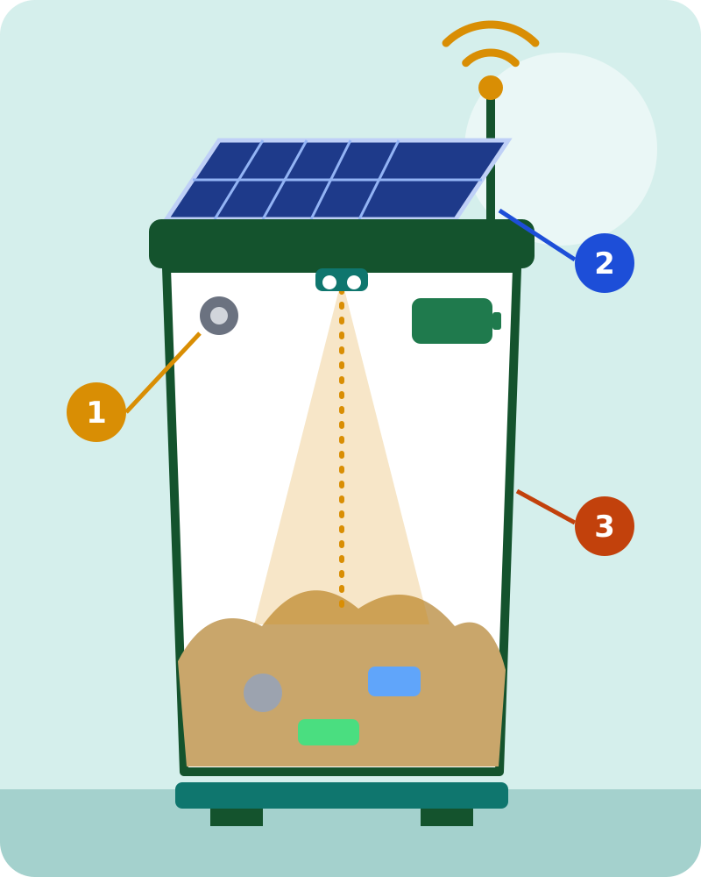



TECHNOLOGY 1 · SMART BIN HARDWARE
A solar smart bin kit for under ₹2,400
Off-the-shelf parts (about $29) that retrofit onto any existing bin, designed and tested in a virtual bench and a physical prototype
What it senses
4 signals fill · heat · gas · weight, plus battery and signal
1
A waterproof ultrasonic sensor measures fill level from 20 to 450 cm. A DHT22 watches temperature, an MQ-135 smells methane and ammonia, and an HX711 load cell weighs the waste in kilograms.
Real-world: Smouldering waste is flagged before it becomes a street fire.
How it stays alive
139.4 days of autonomy with zero sunlight
2
A 5 W solar panel with a TP4056 charger feeds a 2600 mAh battery. The node sleeps at 15 µA and wakes for a 140 mA burst of 1.2 s, so one charge lasts weeks.
Real-world: Survives a full monsoon week of cloud cover.
Built for streets
IP67 weatherproof, touchless, offline-safe
3
IP67 waterproof sensor, touchless PIR servo lid for hygiene, long-range LoRa uplink (20 km+), Kalman noise filtering and a flash queue so readings are not lost when the network drops.
Real-world: A bin in a dead-zone lane still reports once signal returns.
BILL OF MATERIALS (₹) Total ₹2,400, against $2,000+ for commercial smart-bin units.
ESP32
Ultrasonic
Load cell
Gas sensor
DHT22
Solar + charger
Battery
PIR servo lid
LoRa
Enclosure
280
180
290
120
80
150
320
380
420
180
EcoBin · AI Smart Waste & Circular Economy
GitHub Code ↗
Demo Video ↗
Live: ecobin-one.vercel.app
8 / 20
Notes:
Every part is off the shelf. The IoT Bench tab simulates the firmware so judges can push a real LoRa packet live.

Slide 9


TECHNOLOGY 2 · AI PREDICTION
AI that knows a bin will overflow before it does
XGBoost forecasts every bin 24 hours ahead, so dispatch happens before the overflow, not after
R² by model (24 h fill forecast)
What it looks at
1
31 signals: hour, weekday, rainfall, temperature, area type (market, home, office, industrial), ward, 7-day lag fills and rolling averages, including monsoon and holiday effects. Trained on 403 bins in 8 cities.
Real-world: Before a Saturday market, shop-front bins are already ranked first.
How accurate
2
R² of 0.981 with a mean error of just 1.72 percentage points. It clearly beats Random Forest (R² 0.924, MAE 3.18%) and Linear Regression (R² 0.631, MAE 8.74%) on the same data.
Real-world: An error under 2% means a forecast of 88% really is about 88%.
31
98.1%
6 h
What it outputs
features: spatial, temporal, weather and lag inputs
R² · MAE 1.72% · RMSE 2.14% · MAPE 2.8%
early warning before a bin passes 90% full
3
A Gaussian-CDF overflow probability for each bin at 6, 12 and 24 hours. Bins at 70% risk or higher are promoted to priority, and the list feeds the route solver directly.
Real-world: Top-5 at-risk bins appear on the dashboard with overflow odds.
Impact: overflows fall from 15 to 6 or fewer per day (60% fewer) because trucks arrive before the bin is full.
EcoBin · AI Smart Waste & Circular Economy
GitHub Code ↗
Demo Video ↗
Live: ecobin-one.vercel.app
9 / 20
Notes:
Weekend markets fill bins faster and rain changes waste weight. The model learns these patterns.

Slide 10




TECHNOLOGY 3 · AI WASTE VISION
Point a camera at an item, get the right bin
YOLOv8 follows India’s CPCB 2016 segregation rules and shows the carbon saved by sorting correctly
BLUE
GREEN
RED
Dry recyclable
Wet compostable
Hazardous
Bottles, cans, paper, cardboard, cable and metal. These go to the recovery facility and are baled and sold at live commodity prices, so sorting correctly pays.
Food scraps and organic waste. Collected separately so it is not mixed with dry waste, then sent to anaerobic digesters for biogas or to compost for fertiliser.
Batteries, medicines, e-waste and other domestic hazardous items that must never enter normal waste. EcoBin shows the safe hand-in route or books a doorstep pickup.
₹40 / kg
3,420 kWh
94.2%
PET price index · aluminium ₹140 · copper ₹520
electricity per 100-tonne food-waste cycle
classification accuracy, 6 waste classes
Real-world: A plastic bottle is scanned, sorted Blue and its resale value is shown.
Real-world: Canteen leftovers become power instead of landfill methane.
Real-world: A used battery is flagged Red so it never leaks into soil.
Behaviour change: each correct scan earns 20 EcoPoints, shows kg of CO₂ offset and adds a voice and confetti reward, which turns sorting into a habit.
EcoBin · AI Smart Waste & Circular Economy
GitHub Code ↗
Demo Video ↗
Live: ecobin-one.vercel.app
10 / 20
Notes:
Also estimates weight and CO2 avoided. Example: a student photographs a used battery; EcoBin says Red, hazardous.

Slide 11



TECHNOLOGY 4 · ROUTE OPTIMISATION
Google OR-Tools beats traditional routing
Four algorithms tested on the same 403 bins and 5 trucks. Shorter distance means less diesel and less CO₂
Route distance per cycle (km), lower is better
Algorithm | Distance | Fuel | Solve | Rank
OR-Tools (GLS) | 93.8 km | 28.1 L | 1.42 s | #1
Genetic (500 gen) | 108.4 km | 32.5 L | 4.85 s | #2
Sim. Annealing | 114.2 km | 34.2 L | 3.10 s | #3
Greedy nearest | 133.2 km | 39.4 L | 0.08 s | #4
39.4 km
11.3 L
30.3 kg
saved per cycle
diesel, ≈ ₹1,120
CO₂ avoided
4 routing modes
Real roads
Time saved too
Solves in seconds
Eco-Save (minimum fuel), Priority (bins at 80%+ first), Shortest and Traffic-adaptive.
OSRM snaps every route to real streets with turn-by-turn navigation for the driver.
Driver shift falls from 4.8 h to 3.4 h and truck load use rises from 52% to 78.5%.
1.42 s for 403 bins and 5 trucks, so routes can be re-planned live during the day.
EcoBin · AI Smart Waste & Circular Economy
GitHub Code ↗
Demo Video ↗
Live: ecobin-one.vercel.app
11 / 20
Notes:
OR-Tools with Guided Local Search wins: 93.8 km versus 133.2 km for the traditional nearest-stop approach.

Slide 12


AI FOR WASTE MANAGEMENT
Three roles of AI: monitoring, prediction and optimisation
AI moves a waste system from watching, to forecasting, to acting automatically
AI for Monitoring
AI for Prediction
AI for Optimisation
Ultrasonic readings are filtered for noise and temperature drift. Heat and gas trends catch smouldering fires. Edge vision audits waste at the point of disposal and estimates mass. Plausibility checks catch a stuck sensor that reads 0% on a full bin.
24-hour fill curves for every bin, a probability that each bin crosses 90% in 6, 12 or 24 hours, and battery-health prognostics from voltage trends that flag failures weeks in advance.
Capacitated vehicle routing over real roads, truck load allocation to cut empty runs, and matching each recycled commodity to certified buyers by price and distance.
99.4%
6 h
78.5%
sensor-node uptime across the grid
warning before overflow, 98.1% R²
truck load use, up from 52.0%
Real-world: A failing sensor is found and ticketed within minutes.
Real-world: A battery sliding toward 3.2 V is replaced before the bin goes dark.
Real-world: One fuller truck replaces two half-empty ones.
Outcome: less fuel burned, fewer overflows, fewer breakdowns and more material recovered, all measured and logged automatically.
EcoBin · AI Smart Waste & Circular Economy
GitHub Code ↗
Demo Video ↗
Live: ecobin-one.vercel.app
12 / 20
Notes:
Monitoring, prediction and optimisation each feed the next stage.

Slide 13


PEOPLE 1 & 2 · THE DRIVER AND THE TECHNICIAN
Proof of every pickup, and a self-healing sensor grid
Two mobile web apps (PWA) keep the field crews accountable, fast and connected
Route 7 · 12 stops
Driver: follow the route
Driver: scan to prove
Stops appear in optimised order over street geometry with voice turn-by-turn and a live 5,000 L truck-load gauge, so trucks never run overloaded or empty.
The driver scans the bin’s time-limited QR code. Timestamp and GPS are logged, the bin resets to 0% and the code expires, so screenshots cannot be replayed.
1.4 h
Real-world: Blocked by parked cars? File an exception and a priority ticket is created.
0 ghost
Real-world: Skipped or faked collections are stopped.
Turn right in 200 m
saved per driver shift (4.8 h to 3.4 h)
pickups: every collection is auditable
Next: Bin #214 · 92% full
Works offline
Technician: fix before dark
Payload 3,650 / 5,000 L
Narrow lanes lose signal. Actions are saved on the phone and sync automatically on reconnect. The app runs in English, Hindi and Telugu.
Sensor timeout, battery under 3.2 V or temperature above 50 °C opens a ticket with GPS and error code. A checklist guides the repair and a QR scan closes it out.
Scan bin QR to confirm
3 languages
Real-world: No data lost in low-signal wards.
< 2.4 h
Real-world: BIN-042 faults at 10:15 and is back on the map by 10:45.
English · Hindi · Telugu, offline-first
average repair time, Open → In progress → Resolved
Why it matters: a smart bin that silently dies is worse than a dumb one. These apps keep data trustworthy and every trip verified.
EcoBin · AI Smart Waste & Circular Economy
GitHub Code ↗
Demo Video ↗
Live: ecobin-one.vercel.app
13 / 20
Notes:
The QR nonce rotates, so a screenshot cannot fake a pickup. A broken bin is a blind spot, so it is removed from routes automatically.

Slide 14




CIRCULAR ECONOMY · RECYCLE, POWER, REUSE
Closing the loop: waste becomes value
Reuse first, then recycle, then recover energy: the waste hierarchy, working in one platform
₹2,14,400
Recycling and material recovery
Baled PET, copper wire, aluminium and cardboard are logged with live prices, a certified buyer list and a QR manifest per batch, giving full chain of custody from bin to recycler.
Real-world: Recycling was 90% informal with no price data.
material revenue per year (Hyderabad)
3,420 kWh
Food waste to power
Organic waste from hotels, wedding halls and canteens goes to anaerobic digesters. Biogas is metered into electricity and bio-CNG, and the digestate becomes bio-fertiliser.
Real-world: Landfilled food waste leaks methane; this captures it.
clean power · 4,200 L water conserved per run
+30 pts
E-waste pickup
Doorstep collection of laptops, phones, CRT monitors and lithium cells with an AI pre-check and GPS booking. Certified recyclers recover gold, copper and cobalt and keep lead and cadmium out of water.
Real-world: Only 3% of e-waste is recycled formally today.
EcoPoints per verified pickup
+25 pts
Reuse and repair
A peer-to-peer marketplace for working appliances, furniture and clothes, with repair guides and Right-to-Repair built in. Reuse diverts goods before they become waste.
Real-world: A working fan goes to a neighbour, not a landfill.
EcoPoints per item claimed, CO₂ saved shown
Result: recyclable diversion rises from 22.4% to 86.5%, and what cannot be reused or recycled is turned into energy.
EcoBin · AI Smart Waste & Circular Economy
GitHub Code ↗
Demo Video ↗
Live: ecobin-one.vercel.app
14 / 20
Notes:
Waste avoided is better than waste recycled: reuse keeps items in use, recycling recovers materials, biogas recovers energy.

Slide 15










PEOPLE 3 & 4 · THE CITIZEN AND THE CITY
Residents become partners, and the city sees everything
Rewards and easy reporting change habits, and one command centre turns live data into decisions
Report black spots
+50 pts EcoPoints per verified report
Admin command centre · live
Snap a photo of illegal dumping. Auto-GPS and severity tag it, officials dispatch a crew in one tap, and the status moves Reported → Dispatched → Resolved.
Active bins
Critical bins ≥80%
AI accuracy
Fuel saved / week
Real-world: A roadside dump is cleared and the resident earns a bill discount.
Earn EcoPoints
₹250-300 utility-bill rebates, e.g. BESCOM, TSSPDCL, BSES
CO₂ offset
Overflows prevented
Collection efficiency
City status
Points for depositing recyclables (10 per kg), correct AI sorting, e-waste bookings and reuse claims. Redeem for metro passes, electricity-bill rebates and free bio-compost in 5 cities.
Admin command centre
Real-world: Sorting at home becomes a lower electricity bill.
A live map of 403 bins across 8 cities, 8 KPI cards, route generation, driver assignment, tickets, alerts, carbon and ROI audit, and a 4-algorithm benchmark across 16 modules.
Learn as you sort
48.5 kg diverted, 89.2 kg CO₂ avoided (demo profile)
The vision scanner shows the right bin, the estimated weight and the CO₂ you saved. A profile tracks kilograms diverted, badges and a city leaderboard.
8 cities
Real-world: A commissioner opens one screen and sees every red bin.
Hyderabad live; Bengaluru, Mumbai, Delhi and more ready
Real-world: Zero Waste Hero and Rapid Reporter badges keep people engaged.
Try it live: open ecobin-one.vercel.app (or scan any QR code in this deck) and click through the map, routes, forecast and impact tabs.
EcoBin · AI Smart Waste & Circular Economy
GitHub Code ↗
Demo Video ↗
Live: ecobin-one.vercel.app
15 / 20
Notes:
Technology alone cannot change habits. Rewards and easy reporting bring citizens into the loop.

Slide 16







ENVIRONMENTAL IMPACT
How EcoBin saves fuel, cuts carbon and keeps materials in use
Every figure below is produced by the platform’s own simulation and model outputs, compared with a traditional fixed-route baseline
Saves fuel and money
Cuts carbon and methane
Protects land and water
Keeps materials in use
11.3 L
30.3 kg
4,200 L
86.5%
diesel saved per cycle, ₹1,120 per run
CO₂ avoided per cycle, about 11 t a year
water conserved per run
recyclable diversion, up from 22.4%
Trucks drive only where needed, by the shortest route. Fewer kilometres and shorter shifts mean less diesel, less engine wear and lower overtime for every collection cycle.
Less diesel means less Scope-1 CO₂. Fewer overflows and food waste sent to digesters instead of dumps cuts methane, which is about 21 times stronger than CO₂.
E-waste and hazardous items are diverted from landfill, so lead, cadmium and mercury do not reach soil or groundwater. Less leachate and less truck washing conserve water.
Recyclables are sorted at source, baled and sold. Reuse and repair keep appliances working, and food waste becomes power and fertiliser. Less virgin material is extracted.
Real-world: Cost per run falls from ₹3,840 to ₹2,720.
Real-world: Overflows fall 60%, from 15 to 6 or fewer per day.
Real-world: A battery sorted Red never leaks into a drain.
Real-world: 6,240 kg diverted from landfill in the model year.
ANNUALISED FOR HYDERABAD
402
700
844 km
3,420 kWh
trees of CO₂ absorption
car-off-road days avoided
unnecessary truck travel removed
of clean power
EcoBin · AI Smart Waste & Circular Economy
GitHub Code ↗
Demo Video ↗
Live: ecobin-one.vercel.app
16 / 20
Notes:
The goal is not just awareness, it is physical, verified reduction.

Slide 17
IMPACT AT A GLANCE
Traditional versus EcoBin, in one view
Same 403-bin, 5-truck Hyderabad scenario; lower is better for distance, diesel and CO₂
29.6%
60%
₹1,120
1.8 yrs
shorter truck routes
fewer overflows
saved per cycle
payback, Hyderabad deployment
Per collection cycle
Utilisation and recovery (%)
Method: figures are the simulation and model outputs shown in the full scorecard on the next slide.
EcoBin · AI Smart Waste & Circular Economy
GitHub Code ↗
Demo Video ↗
Live: ecobin-one.vercel.app
17 / 20
Notes:
Charts use the same figures as the scorecard on the next slide.

Slide 18










RESULTS · MEASURED
Before versus after: the EcoBin scorecard
Same 403-bin, 5-truck Hyderabad scenario, traditional fixed schedule versus EcoBin AI
 | Metric | Traditional | EcoBin | Benefit
 | Cost per run (₹) | ₹3,840 | ₹2,720 | ₹1,120 saved per cycle
 | Route distance | 133.2 km | 93.8 km | 39.4 km saved (29.6% shorter)
 | Diesel fuel | 39.4 L | 28.1 L | 11.3 L saved (28.7%)
 | CO₂ emitted (Scope 1) | 105.6 kg | 75.3 kg | 30.3 kg avoided, about 11 t a year
 | Overflow-risk bins | 15 per day | 6 or fewer | 60% fewer overflows
 | Truck load used | 52.0% | 78.5% | +26.5 points, fewer empty runs
 | Driver shift | 4.8 h | 3.4 h | 1.4 h saved per route
 | Recyclable diversion | 22.4% | 86.5% | +64.1 points recovered
 | Clean energy | 0 kWh | 3,420 kWh | Biogas from food waste
 | Water | Baseline | 4,200 L conserved | Less truck wash and leachate
Method: baseline is greedy nearest-neighbour fixed routing. Results come from the simulation and model outputs; real cities will vary with layout and fleet.
EcoBin · AI Smart Waste & Circular Economy
GitHub Code ↗
Demo Video ↗
Live: ecobin-one.vercel.app
18 / 20
Notes:
Every row is a measured or simulated output from the platform. Headline: 29.6% fewer kilometres, 60% fewer overflows and ₹1,120 saved on every truck run.

Slide 19





BUSINESS AND SCALE
Built to scale and to pay for itself
Low-cost hardware, four revenue streams and a cloud-native stack that replicates city by city
₹9.67 L
₹5.33 L
1.8 yrs
8 cities
capex for 403 bins (₹2,400 each)
yearly benefit: fuel + materials + energy
payback on Hyderabad deployment
pre-configured, 4,041 towns addressable
Affordable
Four revenue streams
A ₹2,400 retrofit kit from off-the-shelf parts versus $2,000+ for commercial smart-bin units. Open hardware means cities are not locked in to one vendor. Real-world: A ward of 50 bins starts for about ₹1.2 lakh.
Stream | Unit economics | Per year
City SaaS licence | ₹15,000 / city / month | ₹1,80,000
Material commission | 5% of commodity sales | ₹10,720
Bio-energy agreement | ₹8 / kWh × 3,420 kWh | ₹27,360
Carbon credits | $3 / tonne × 7.05 t | ₹1,763
EcoPoints sponsors | Metro / utility brands | ₹60,000
TOTAL ANNUAL REVENUE |  | ₹2,79,843
Production-grade stack
Async FastAPI (40+ endpoints, 10,000+ concurrent events), React + TypeScript, Docker, PostgreSQL per-city isolation, deployed live. MQTT and WebSockets target 100,000+ nodes. Real-world: One Docker image deploys to any new city.
Ready for many cities
Multi-city data for Hyderabad, Bengaluru, Mumbai, Delhi, Chennai, Kolkata, Pune and Ahmedabad. Built in CPCB compliance and English, Hindi and Telugu interfaces. 4,041 towns nationally. Real-world: A municipality starts with one ward and expands without new software.
Real-world: yearly benefit is fuel ₹2.91 L + materials ₹2.14 L + power ₹27,360.
SDG ALIGNMENT
SDG 11 Sustainable Cities
SDG 12 Responsible Consumption
SDG 13 Climate Action
SDG 17 Partnerships
EcoBin · AI Smart Waste & Circular Economy
GitHub Code ↗
Demo Video ↗
Live: ecobin-one.vercel.app
19 / 20
Notes:
Payback is 1.8 years on the Hyderabad 403-bin deployment: about 9.67 lakh of capex against about 5.33 lakh of annual benefit.

Slide 20






PROVEN IMPACT · VERIFY IT
See it, run it, watch it
Deployed, open source and reproducible: every claim can be checked. Scan with your phone camera.
Live platform
Demo video
Source code
Map, routes, forecast, driver, technician and citizen apps
A 5-minute walkthrough of all eight circular-economy modules
Full stack, ML models, solver, firmware and README
ecobin-one.vercel.app
youtu.be/VfSfVugS8gM
github.com/mdfaizaanalam/EcoBin-AI-Smart-Waste-Management-System
₹1,120
11.3 L
30.3 kg
3,420 kWh
60%
86.5%
saved per cycle
diesel saved
CO₂ avoided
clean energy
fewer overflows
recyclables recovered
EcoBin: from blind trucks to a smart, zero-waste Bharat. Team Coding Ninja
EcoBin · AI Smart Waste & Circular Economy
GitHub Code ↗
Demo Video ↗
Live: ecobin-one.vercel.app
20 / 20
Notes:
Please open the live website, watch the demo video and browse the code. Thank you.

