Slide 1

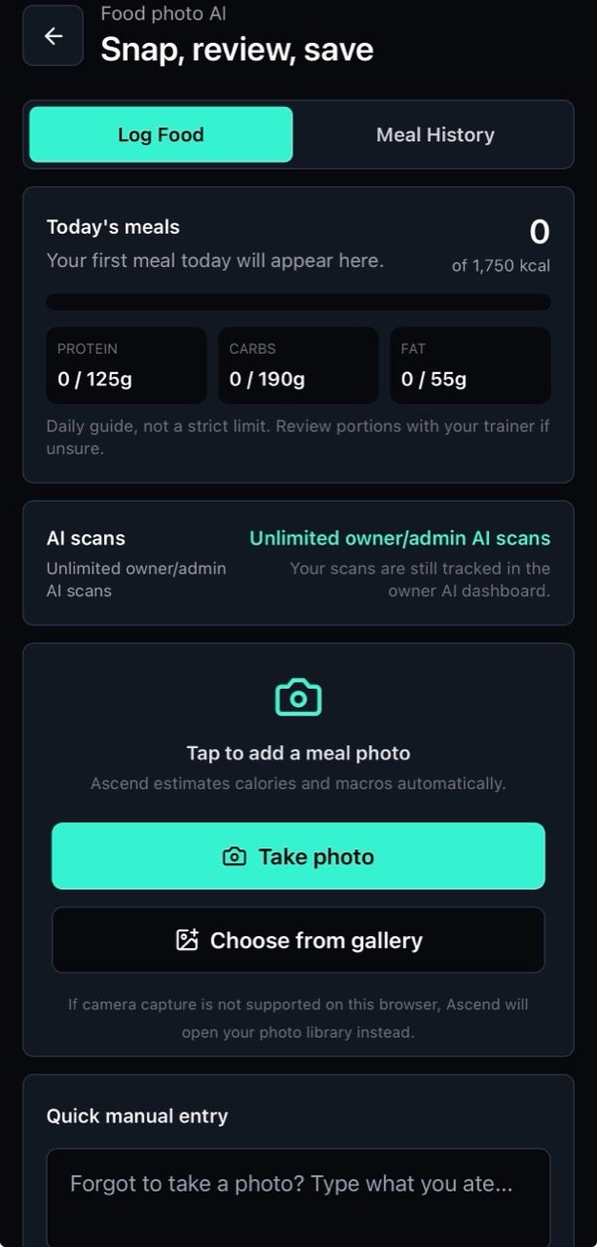
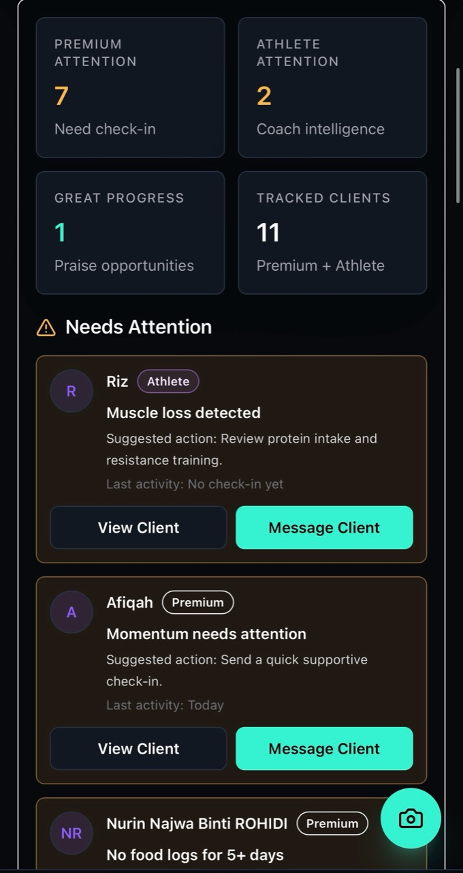
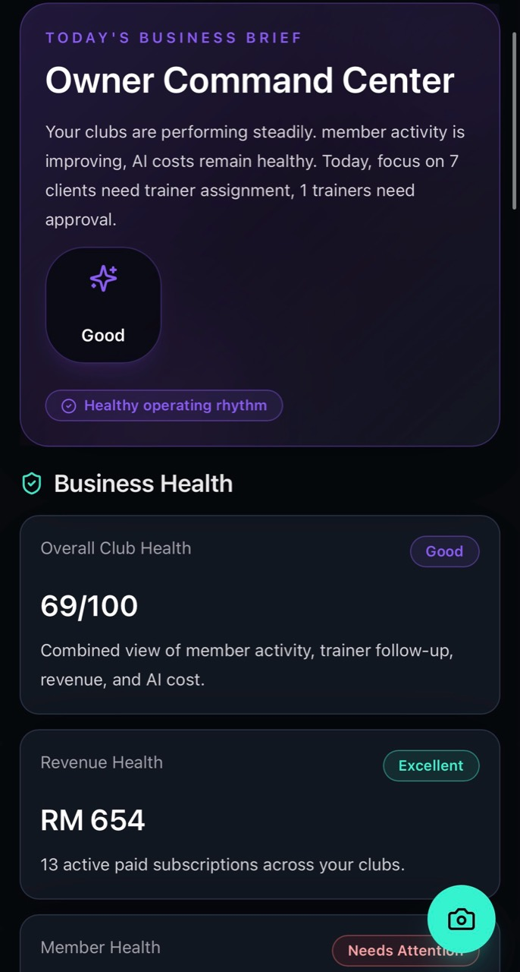
ASCEND
Your trainers coach members for one hour each week.
Ascend coaches them during the other 166 hours.
The operating system for fitness accountability

Slide 2
The week breaks after the session.
Results are built during the other 166 hours of the week.
Members drift
Habits happen away from the club.
Trainers guess
THE 166-HOUR GAP
Signals arrive too late.
Owners react
Retention risk stays hidden.

Slide 3
How Ascend closes the 166-hour gap.
Traditional coaching
Ascend coaching
PT Session
PT Session
Coach Zoe
↓
Food Logging
Workout Guidance
7 days with little visibility
Hydration
Progress Tracking
↓
Trainer Visibility
Next PT Session
Next PT Session
The coach finds out after the week has already happened.
Every action between sessions becomes visible to the trainer.

Slide 4
Why AI?
Without Ascend
With Ascend
Trainer manages 40 clients
AI observes
Meals
Workouts
Hydration
Habits
Progress
Motivation
↓
AI summarizes
↓
Important signals are missed.
Trainer coaches
AI replaces admin. Not coaching.

Slide 5
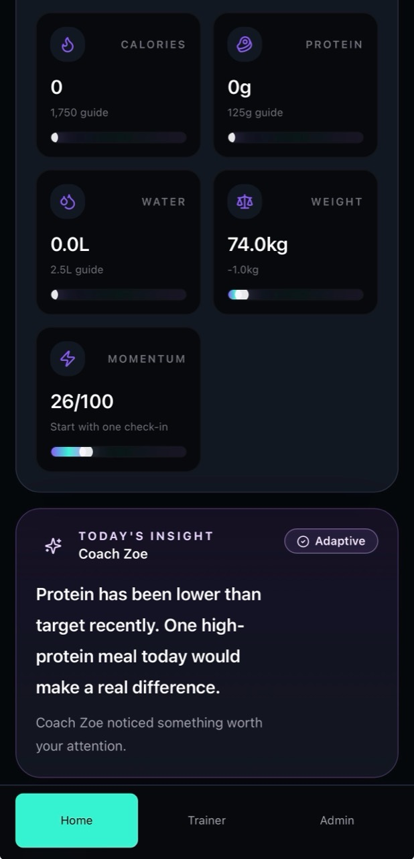
Ascend connects the three stakeholders that drive results.
Client action creates trainer visibility. Trainer visibility creates owner confidence.
CLIENT
TRAINER
OWNER

Slide 6
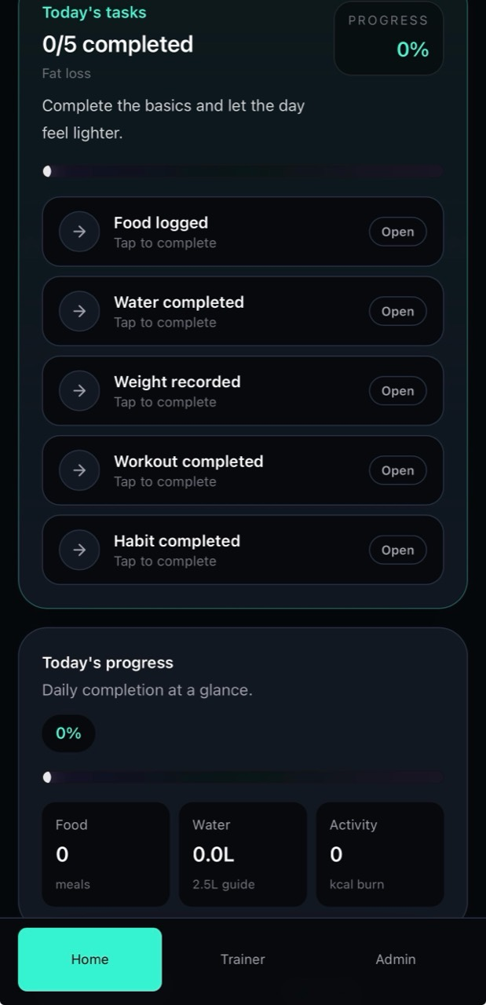
Members know what to do today before they scroll.
What this solves
Less overwhelm
The member sees today's task before the full feature set.
More consistency
Simple progress cards reinforce small daily actions.
Coach Zoe feels present
One timely insight, not a wall of AI text.

Slide 7
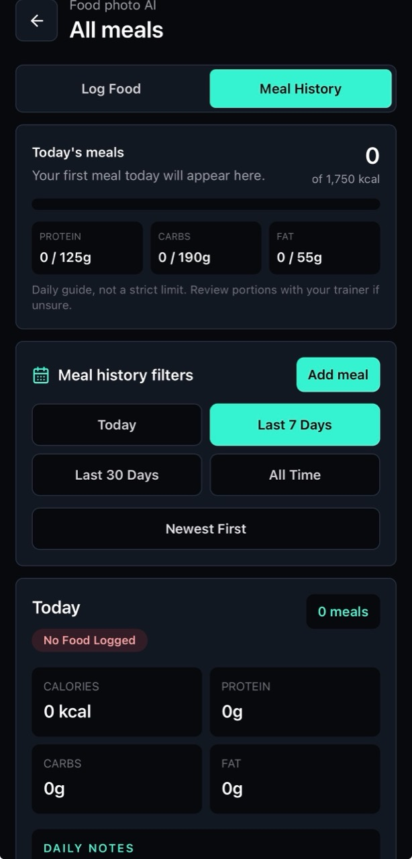
Food logging that works in real life.
No perfect photos. No calorie database. Just describe the meal.
Take Photo
OR
Type what you ate
Chicken rice • Nasi lemak
Protein shake • McChicken meal
2 eggs and toast
↓
AI analyses the meal
↓
Calories • Protein • Carbs • Fat
Save

Slide 8
Coach Zoe keeps the member moving between sessions.
So what?
Momentum is protected
One useful nudge at the right time.
Workouts become easier to start
The member gets a plan when motivation is low.
The app remembers
Recent activity shapes the next recommendation.

Slide 9
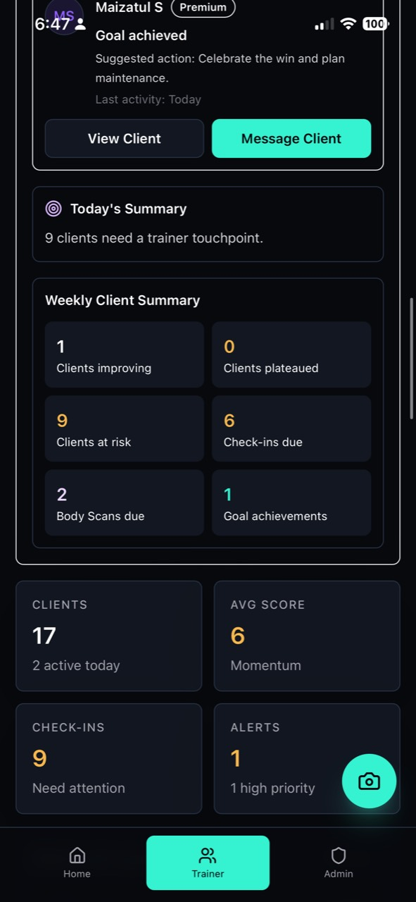
Trainers begin each day with a coaching plan.
Why trainers care
Faster triage
Premium and Athlete clients surface in one priority list.
Clear next action
Each card suggests what the coach should do next.
Weekly summary
Trainers can see improving, plateaued and at-risk clients.

Slide 10
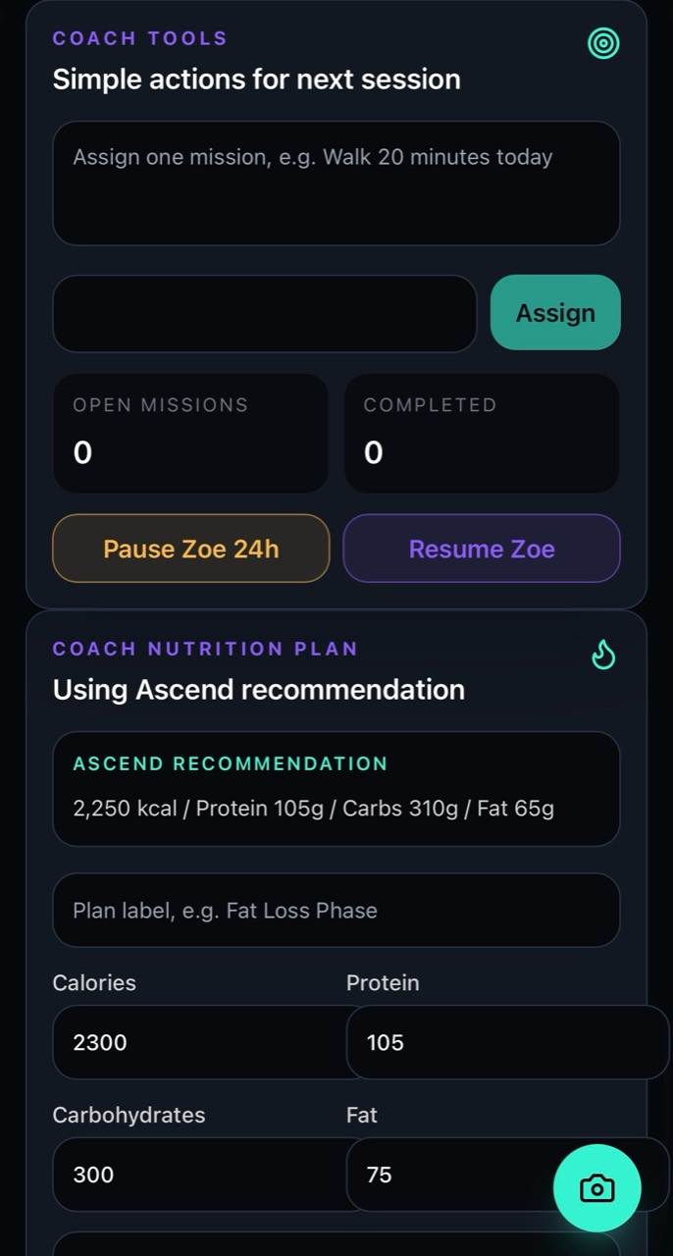
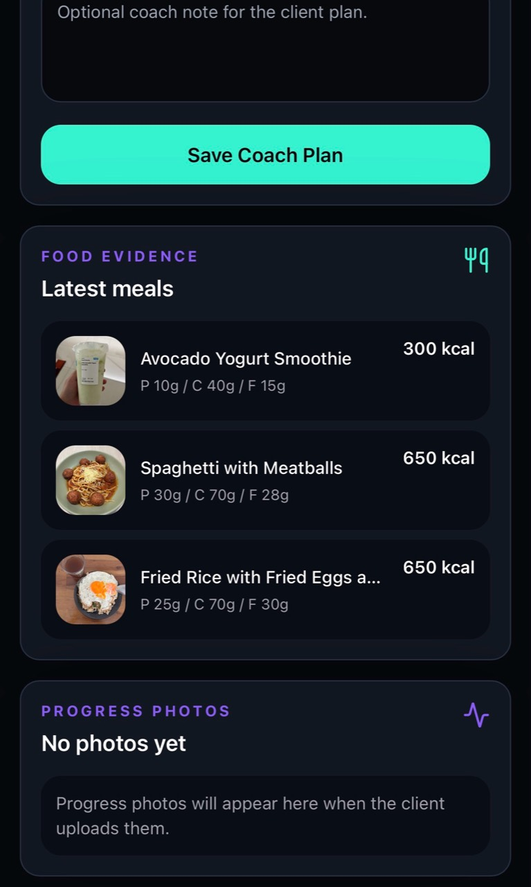
Every client check-in starts with evidence, not guesswork.
MEAL EVIDENCE
Latest
Food logs are visible where the coach reviews the client.
MISSIONS
NUTRITION PLAN
Assign
Adjust
Simple actions keep the client accountable between sessions.
Trainer can set context without replacing Ascend's recommendation.

Slide 11
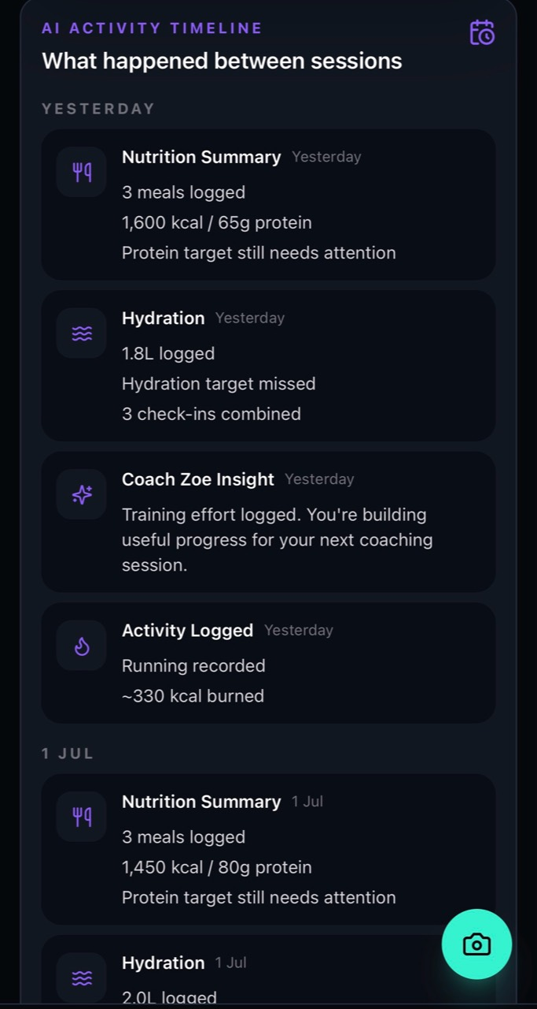
Every week begins with a coaching summary instead of guesswork.
A coaching briefing, not an activity dump
Nutrition summary
Meals, calories and protein are grouped by day.
Hydration summary
Water logs become one coaching signal.
Coach Zoe interventions
The trainer sees when Zoe supported the client.

Slide 12
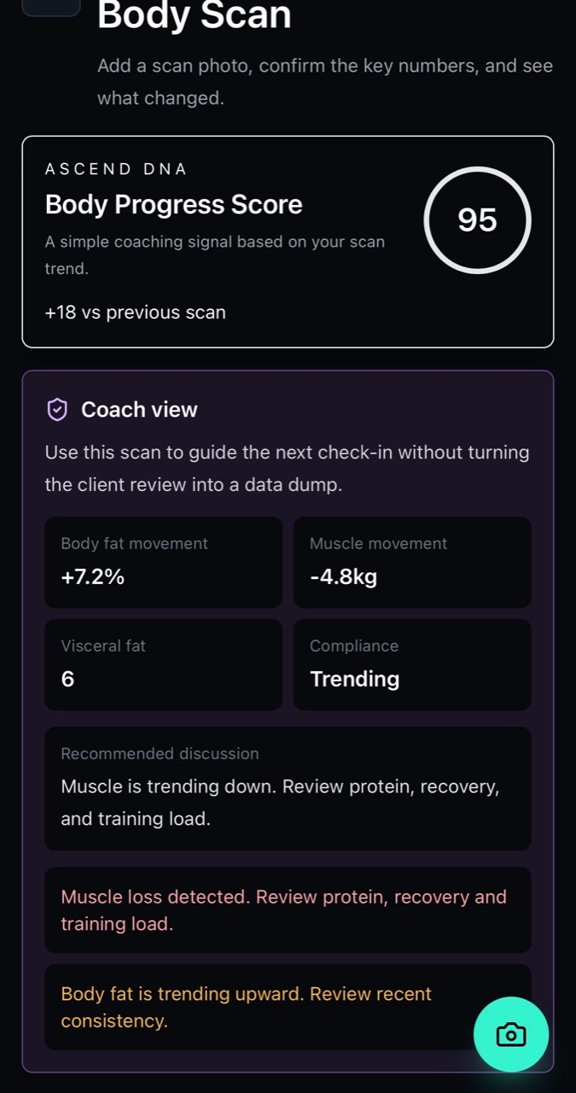
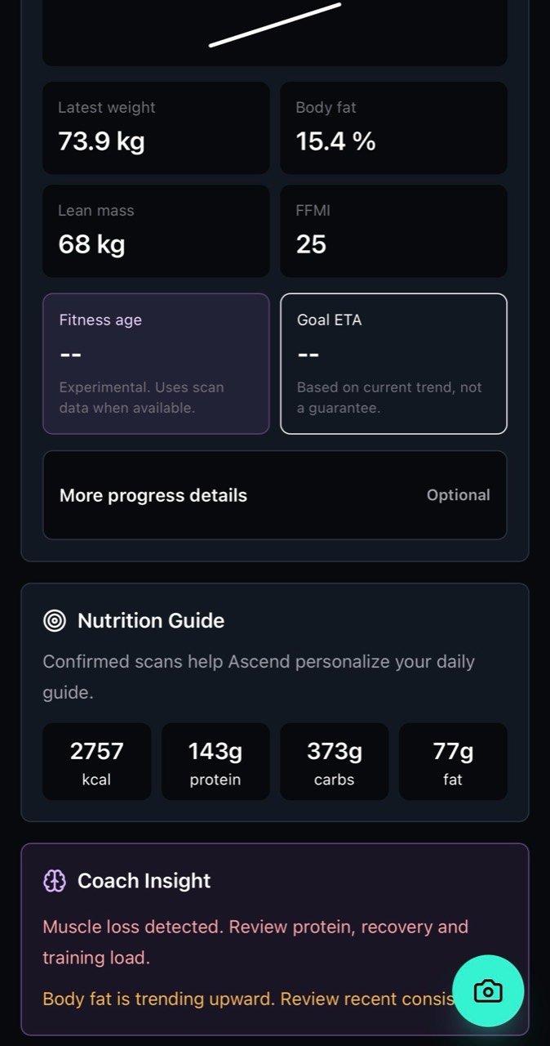
Premium members receive a coaching experience worth paying for.
Why this matters commercially
Higher perceived value
Body scans turn Athlete Mode into a premium coaching product.
Better reviews
Trainer can discuss body fat, muscle and nutrition without a data dump.
More retention hooks
Progress beyond the scale gives clients a reason to continue.

Slide 13
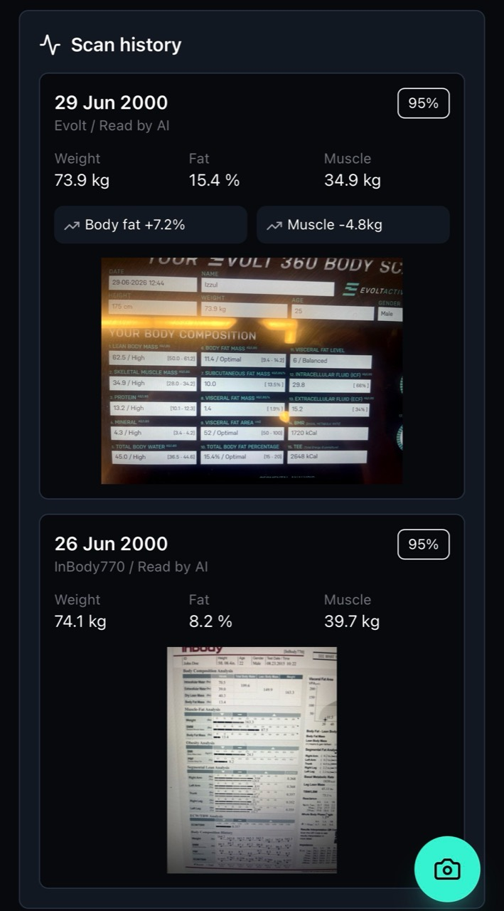
Progress beyond the scale gives clients a reason to stay.
What the coach can review
Current vs previous
Weight, body fat, muscle and score changes are easy to compare.
Source evidence
The scan photo stays attached so reviews feel credible.
Nutrition update
Athlete targets can use confirmed scan data without changing normal members.

Slide 14
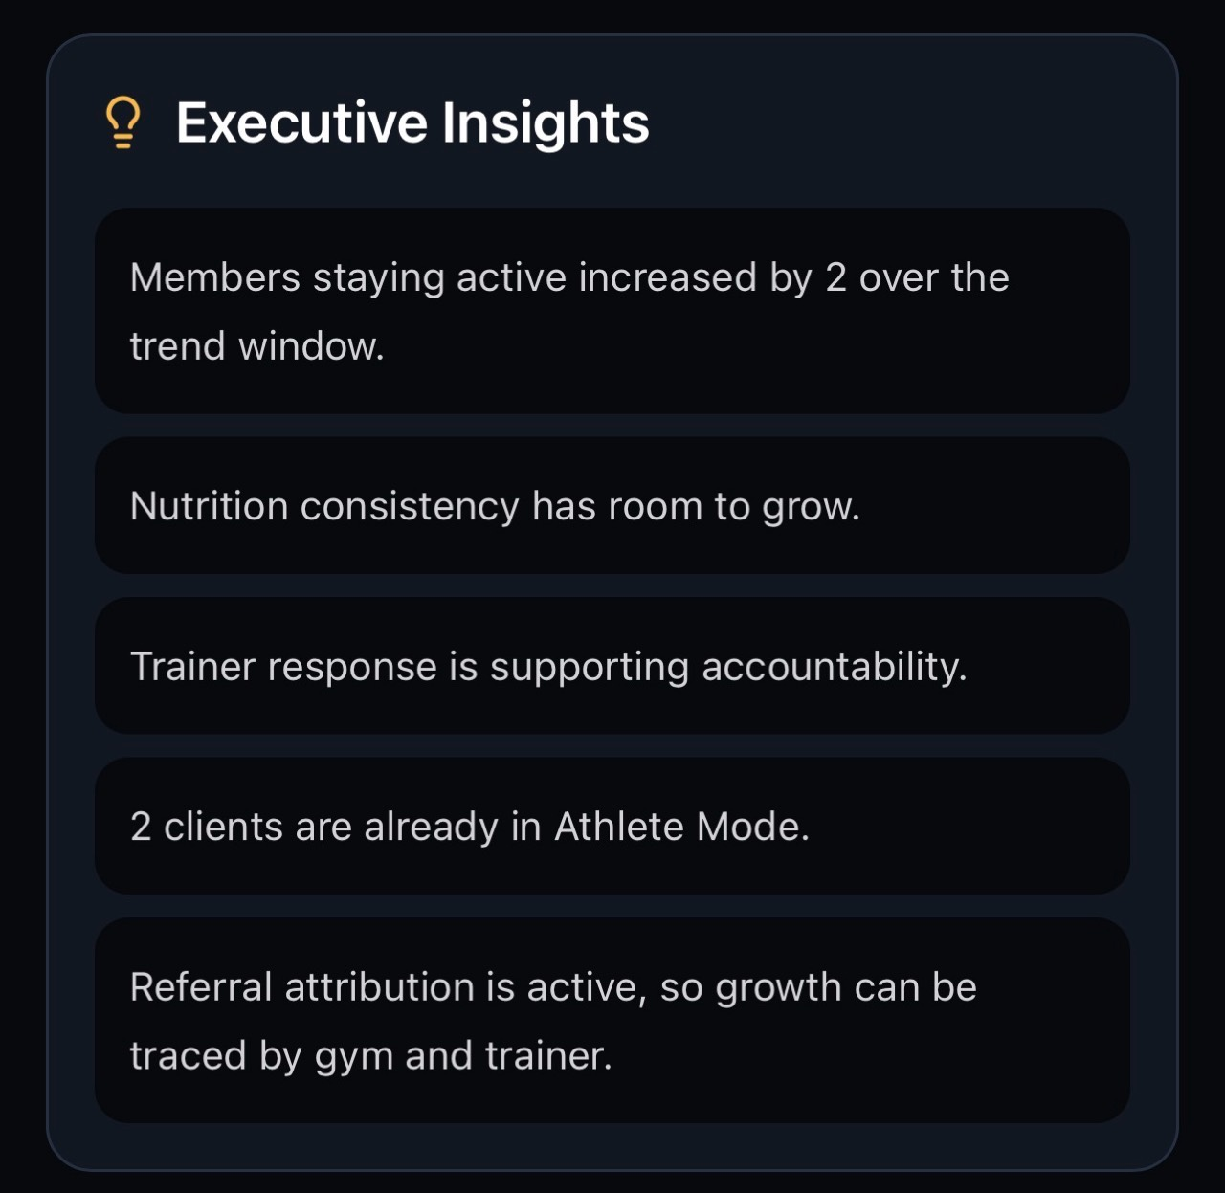
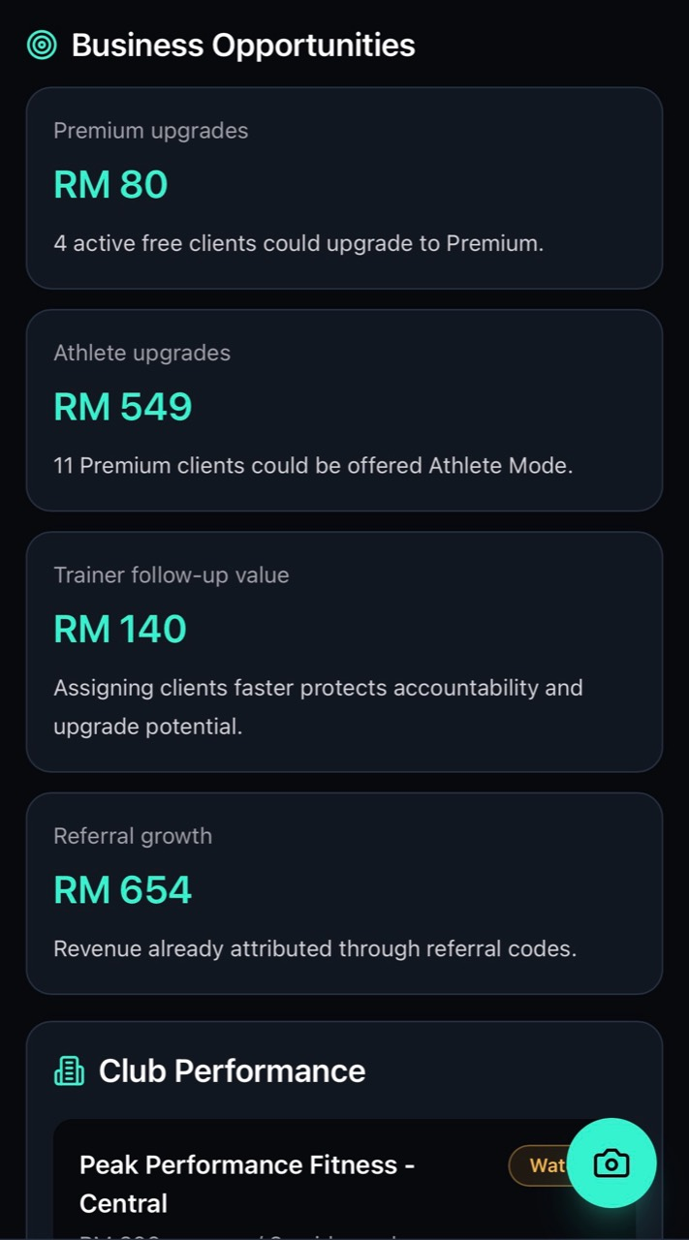
Owners see the business levers that deserve attention.
CEO view
Revenue opportunities. Retention watchlist. Trainer performance. Members needing attention. Growth opportunities.

Slide 15
The owner dashboard should drive action, not report trivia.
Trainer Engagement
CLIENTS CONTACTED
WEEKLY REVIEWS
FOLLOW-UPS
24
9
7
This week
Completed
Outstanding
Owners care about whether trainers are creating accountability, not internal system metrics.

Slide 16
A pilot should prove usage, not promise miracles.
1
2
3
4
1-2 clubs
Selected trainers
Selected members
60-90 days
Controlled
Coaching buy-in
Real usage
Enough signal
Measure usage. Trainer action. Member feedback.

Slide 17
Ascend doesn't replace coaching. It extends coaching.
Trainer
Ascend
1
166
hour
hours
per week
per week
Members stay accountable. Trainers stay informed. Owners stay in control.
The gym session starts results. Consistency finishes them.

Slide 18
ASCEND
Let's show the live product.
A short walkthrough can show how Ascend supports members, trainers and club operations without replacing the coaching model already inside the gym.
www.getascend.fit
Fariz Anwar
Founder / Ascend

