Slide 1
Course Enrollment System
Project Title 09
A complete solution for Student and Admin

Slide 2
EduPlatform Summary
I will be designing an interactive interface that allows students to browse through a list of available courses, view important details such as course name and description, and then select and enroll in the courses of their choice. The system will make the enrollment process simple and user-friendly, ensuring that students can easily register for multiple courses online.

Slide 3
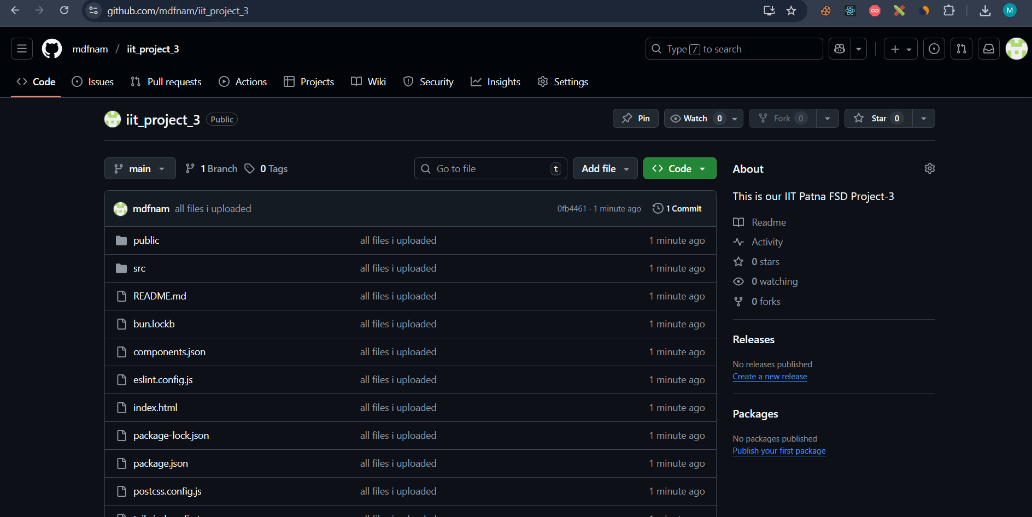

Project Github Link:
https://github.com/mdfnam/iit_project_3

Slide 4
Follow the steps:
# Step 1: Clone the repository using the project's Git URL.
git clone https://github.com/mdfnam/iit_project_3 .
# Step 2: Install the necessary dependencies.
npm install
# Step 3: Start the development server with auto-reloading and an instant preview.
npm run dev

Slide 5
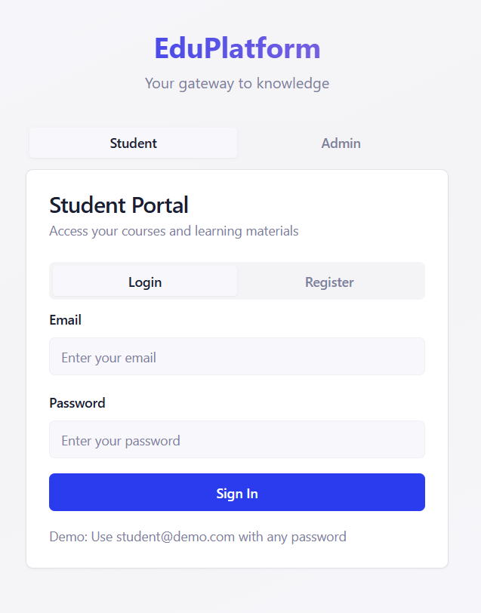
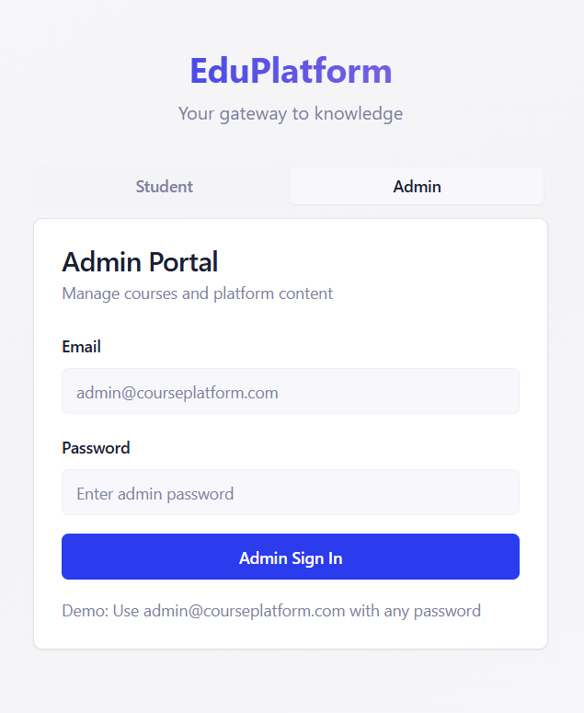
Login/Signup for Student & Admin (teachers)
1

Slide 6
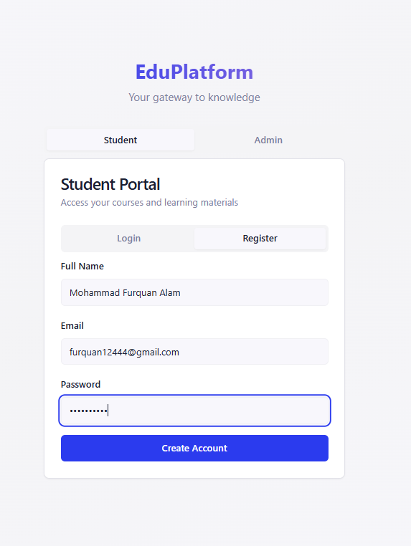
Login/Signup for Student & Admin (teachers)

Slide 7
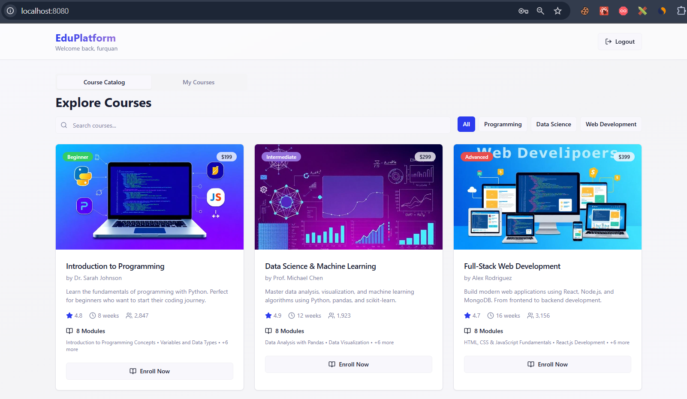
Procedure - Frontend (React)
2

Slide 8
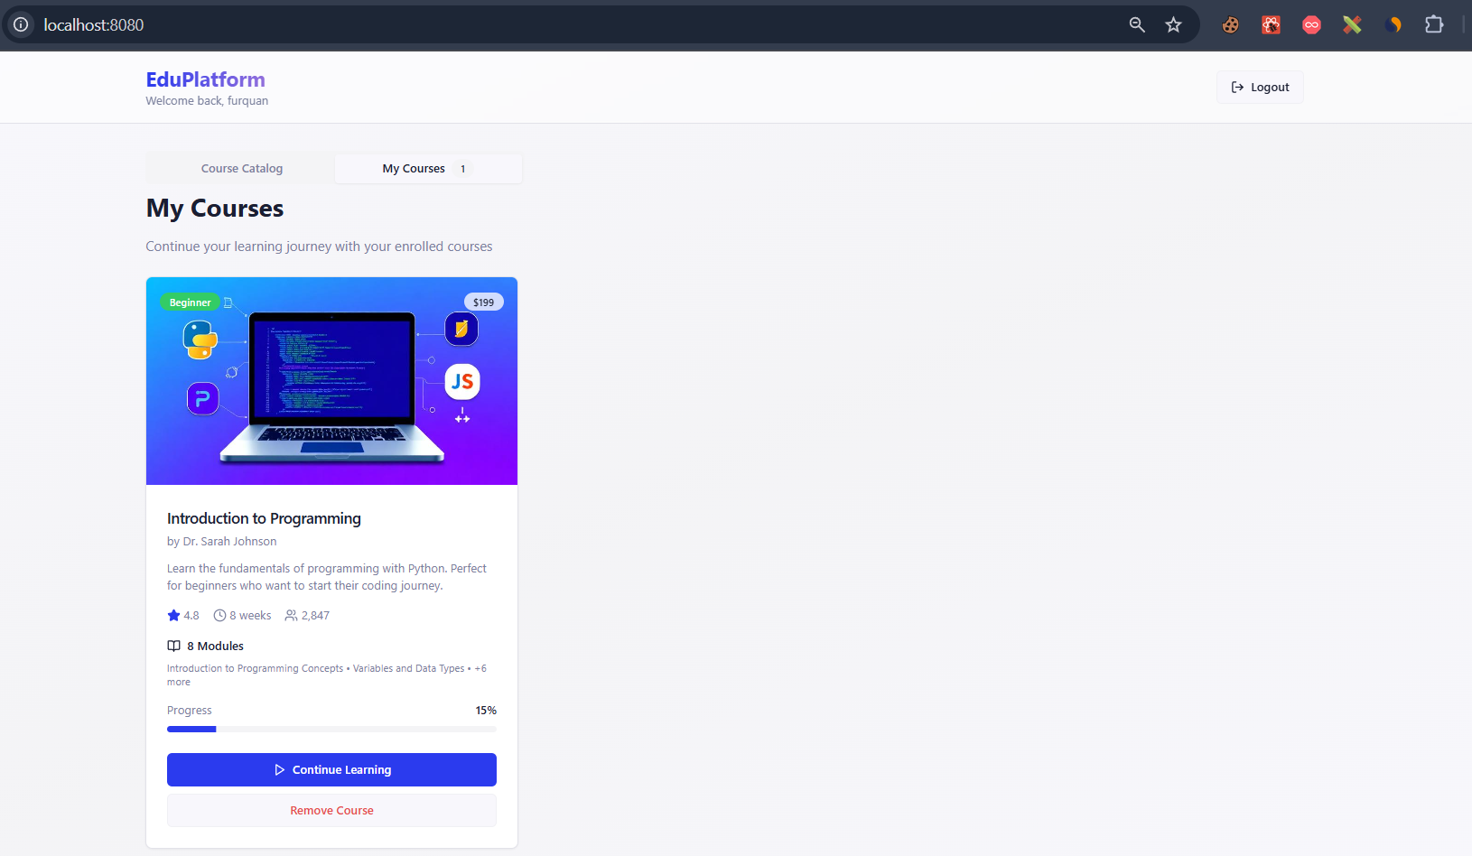
Procedure - Frontend (React)
3

Slide 9
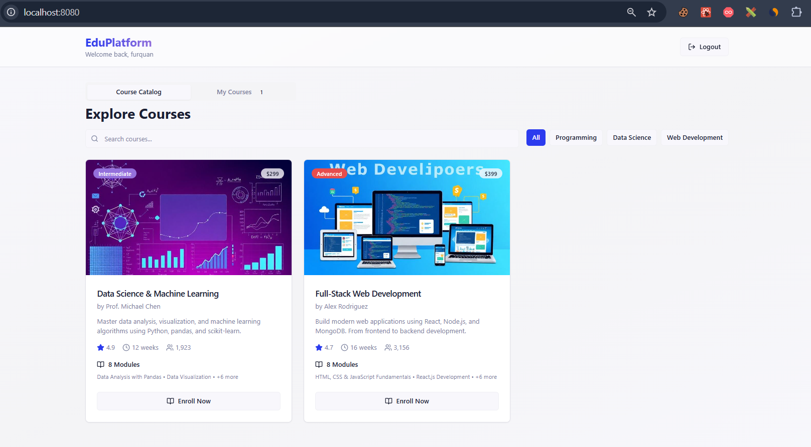
Procedure - Frontend (React)

Slide 10
Procedure - Storage
• Store the course details, like the progress, ratings, students enrolled.
• Stores different modules, chaptes and files related to the course.
• stores the thumbnail of the course.

Slide 11
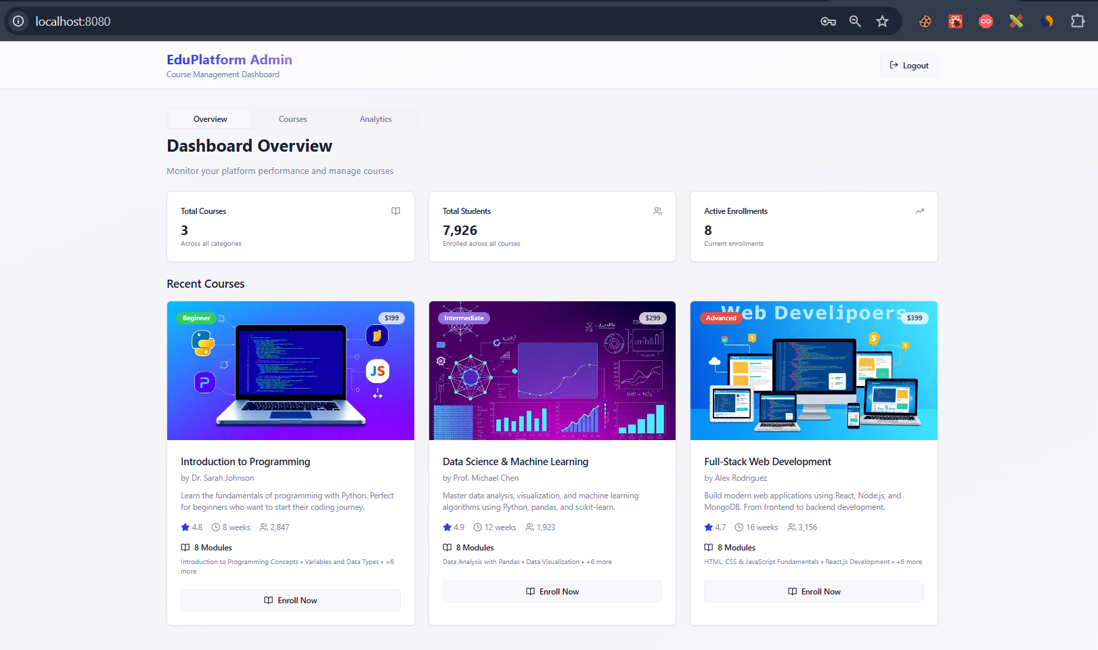
Procedure - Admin Features

Slide 12
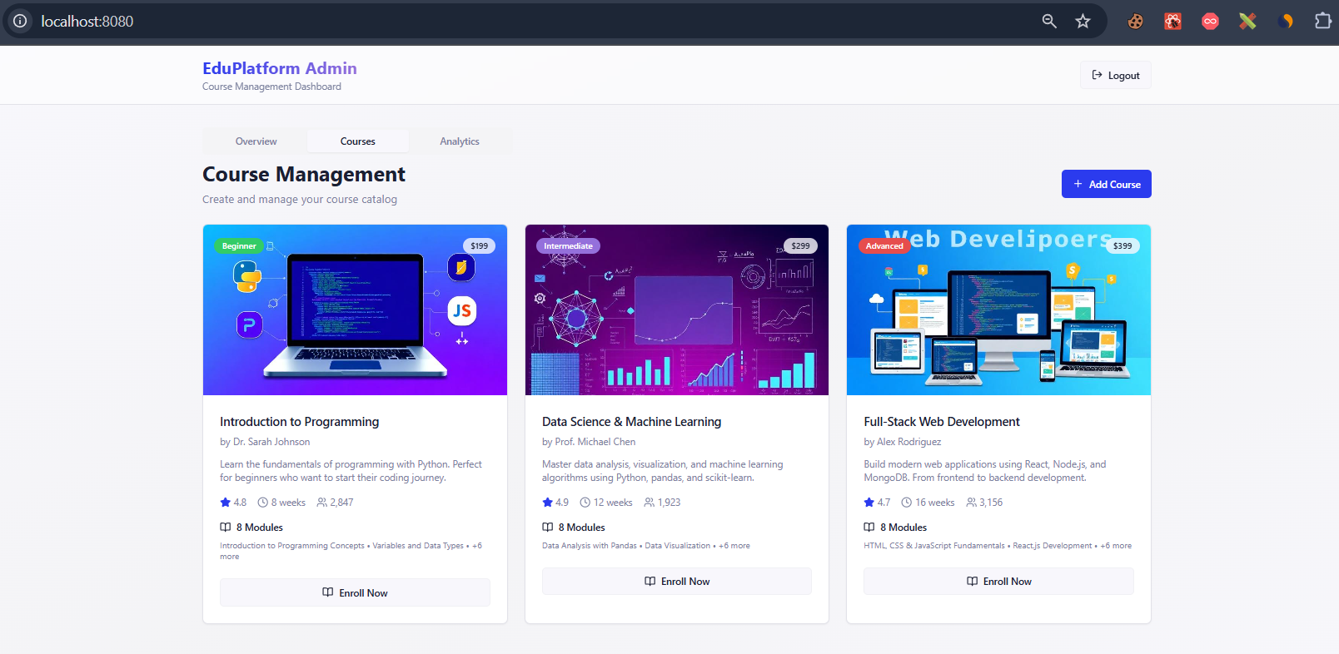
Procedure - Admin Features

Slide 13
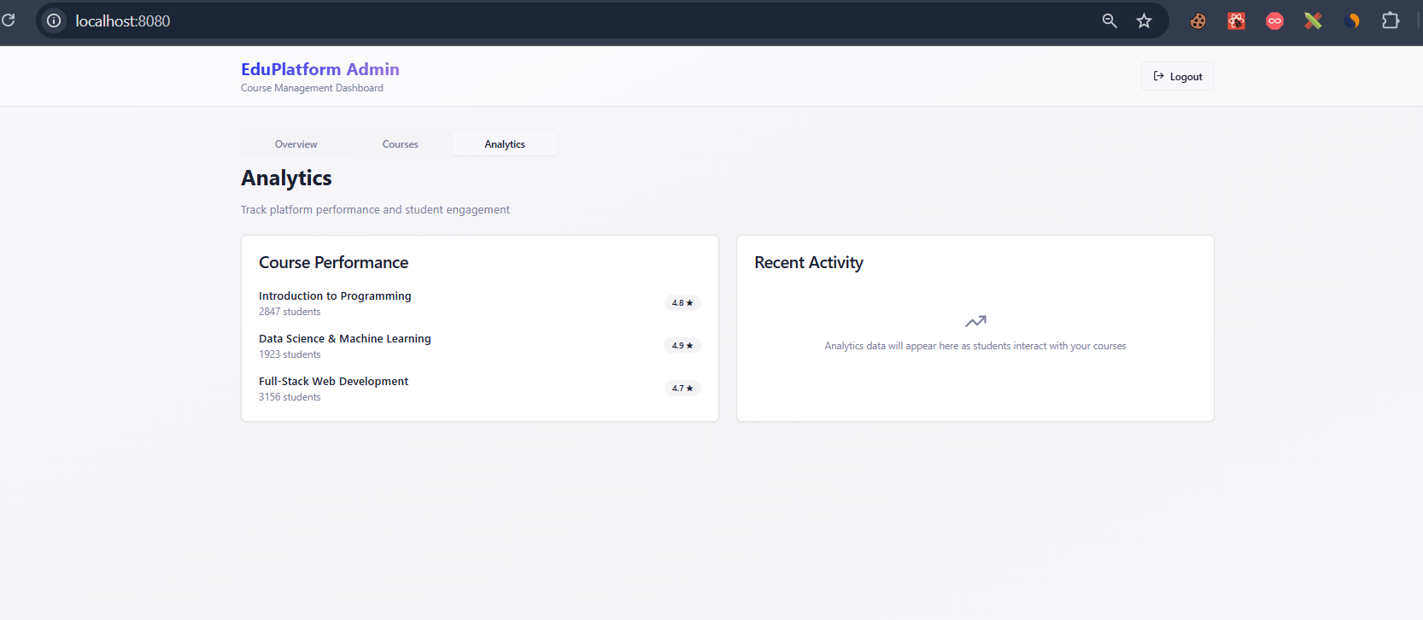
Procedure - Admin Features

Slide 14
THANK YOU!!!

