Slide 1
Simple Calculator with Logs
A responsive calculator project with history and dark mode

Slide 2
Project Overview
This project is a basic calculator built using HTML, CSS, and JavaScript.
It features real-time calculations, a persistent history log, a dark mode toggle,
Backspace key, and an added square root function.

Slide 3
Features
Basic arithmetic operations
Dark/light mode toggle
Backspace button
Calculation history log
Square root function
Responsive layout

Slide 4
Technologies Used
HTML5 for structure
CSS3 for styling
JavaScript for logic
LocalStorage for history persistence

Slide 5
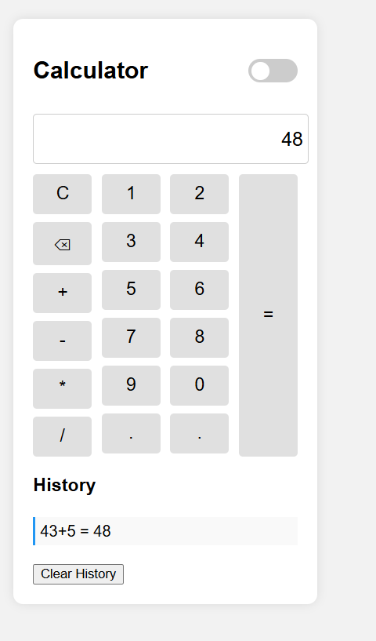
User Interface
Dark Mode Toggle Button
Result of Calculation
Buttons
History
Clear History Button

Slide 6
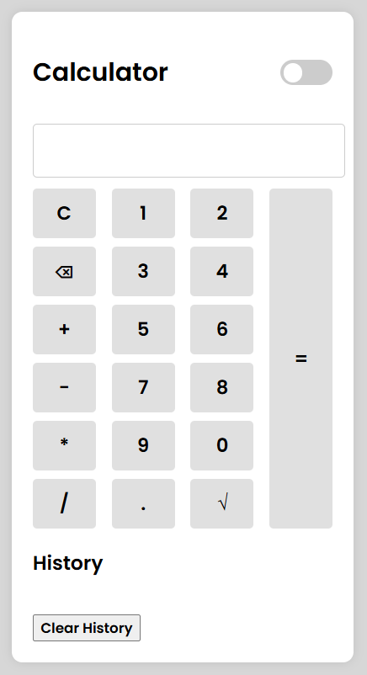
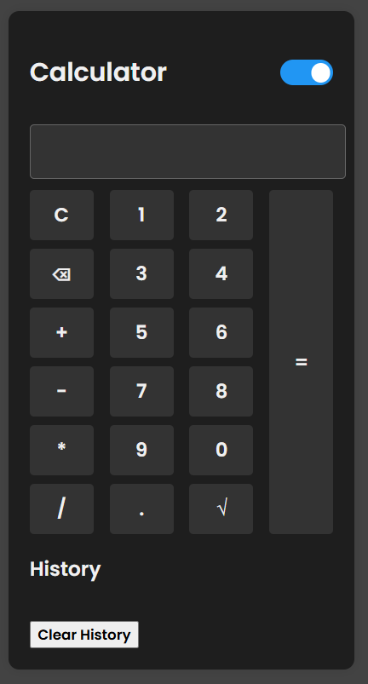
Dark Mode

Slide 7
How It Works
1. User inputs via calculator buttons.
2. Expressions are evaluated in real time.
3. Results are shown in the display.
4. Each expression/result is saved in localStorage.
5. Dark mode toggle switches UI theme.
6. Square root function uses JavaScript's Math.sqrt().

Slide 8
Thank You!

