Slide 1
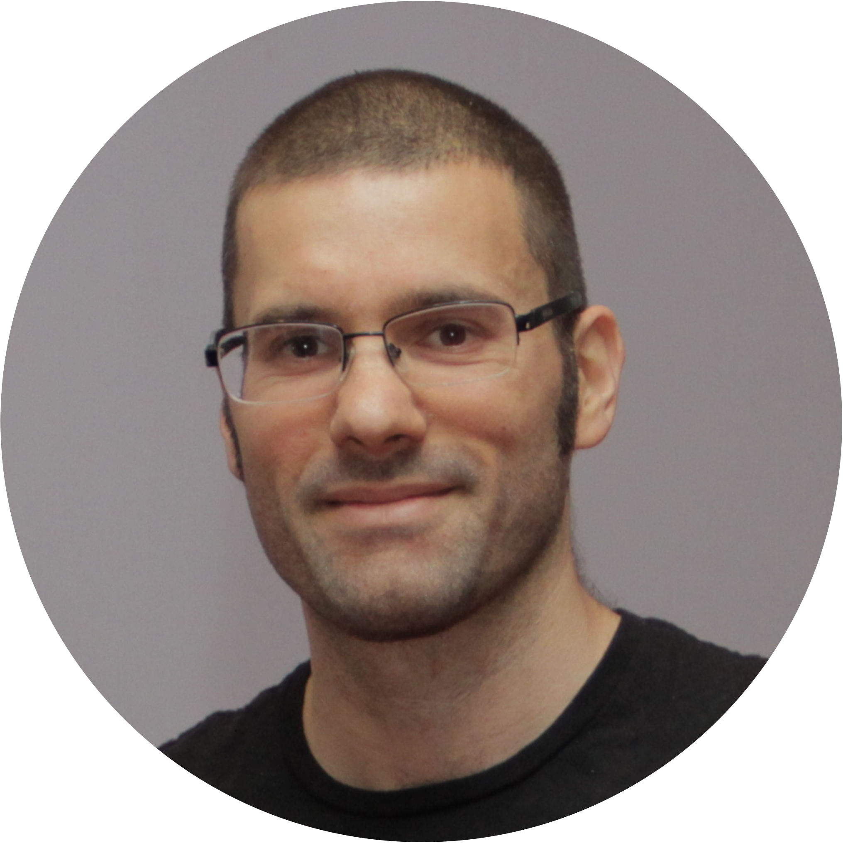
2018-10-17
Why I am the best Candidate for ThermoConc@QUB
Mariano Forti

Slide 2
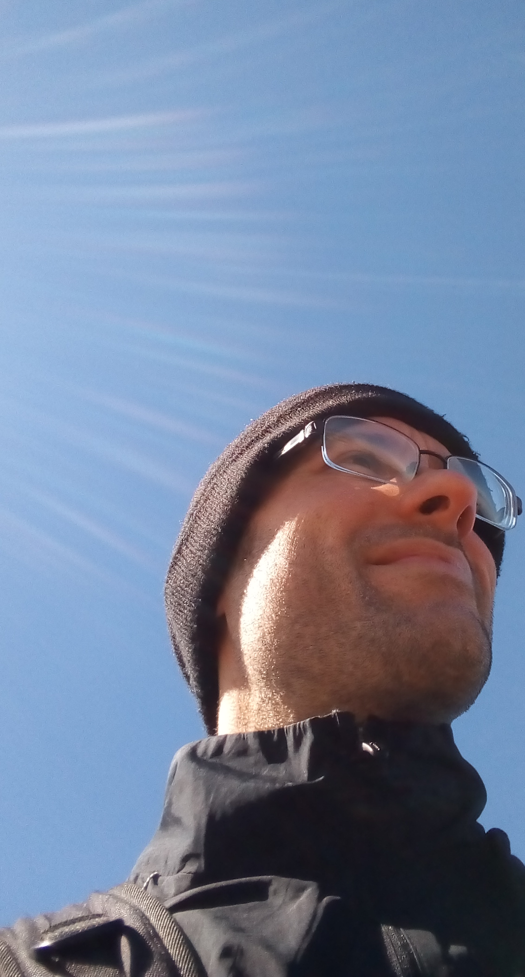








Who Am I
UTC-3

Slide 3
Experience
DFT of Metal / Oxide Interfaces
FDT of Point Defects in ZrO₂
TA , FEM implemtation
Programming/Scripting

Slide 4
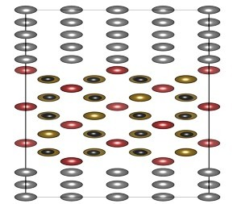
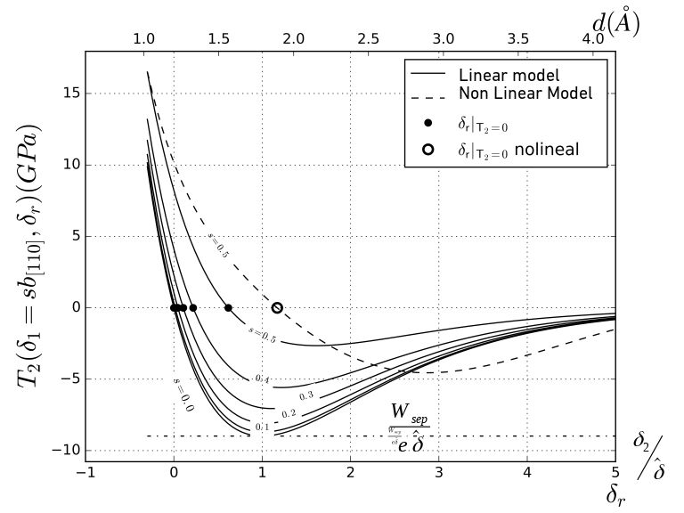
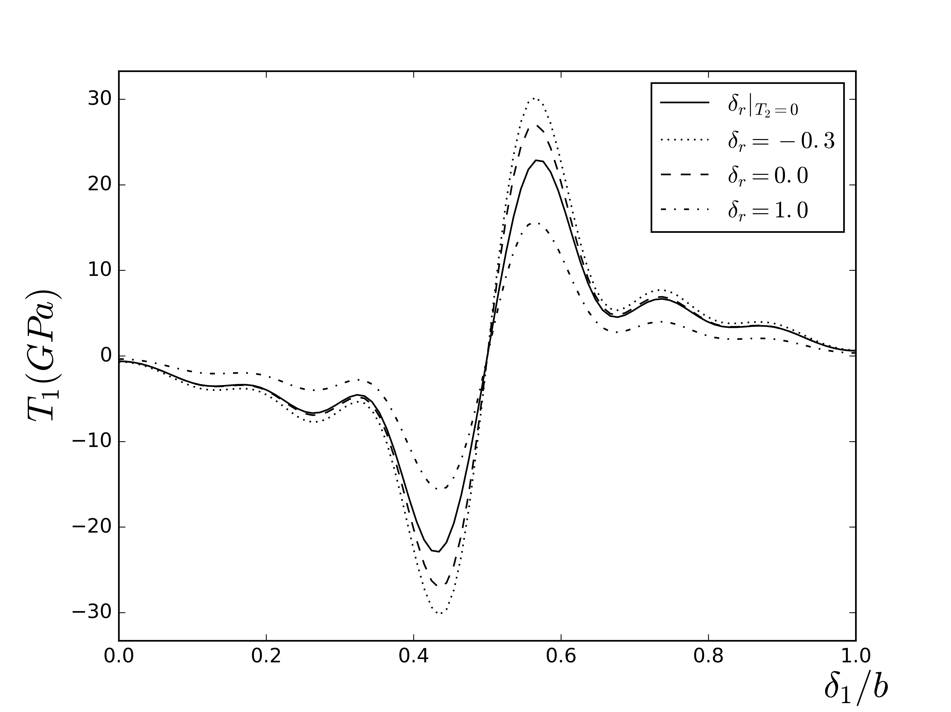
Experience 1: DFT Calculations
Why MF@ThermoConc
Experience
Metal / Oxide Interfaces
Plasticity
E
E∞
δ2
δ1
δ₂
δ₁

Slide 5
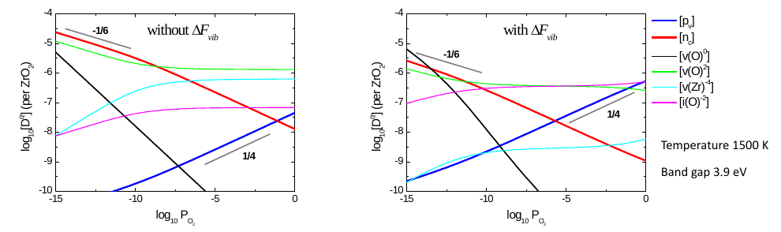
Experience 1: DFT Calculations
Why MF@ThermoConc
Experience
Point Defects in ZrO₂

Slide 6
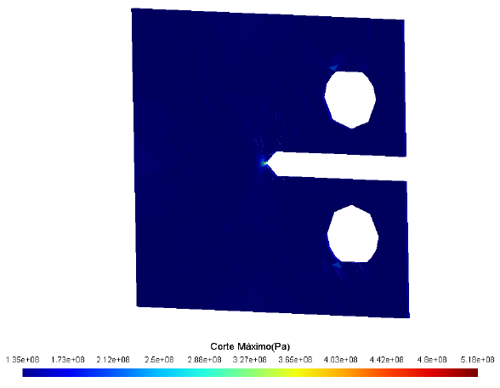
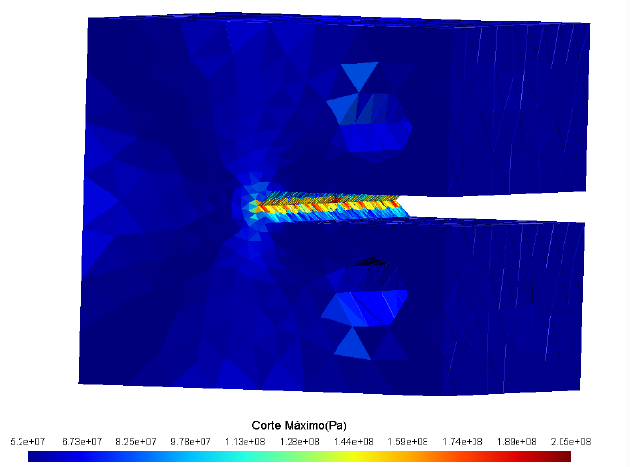
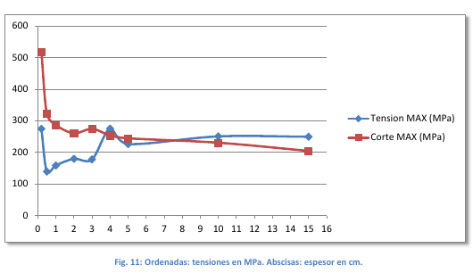
Experience 2: FEM basics
Why MF@ThermoConc
Experience
TA , FEM implemtation

Slide 7
Task 1.1 in ThermoConc
DFT Calculations
Interfacial Electronic structure
Large Scale Simulations
Point Defects in Oxides
Electronic Structures, bands and DOS

Slide 8
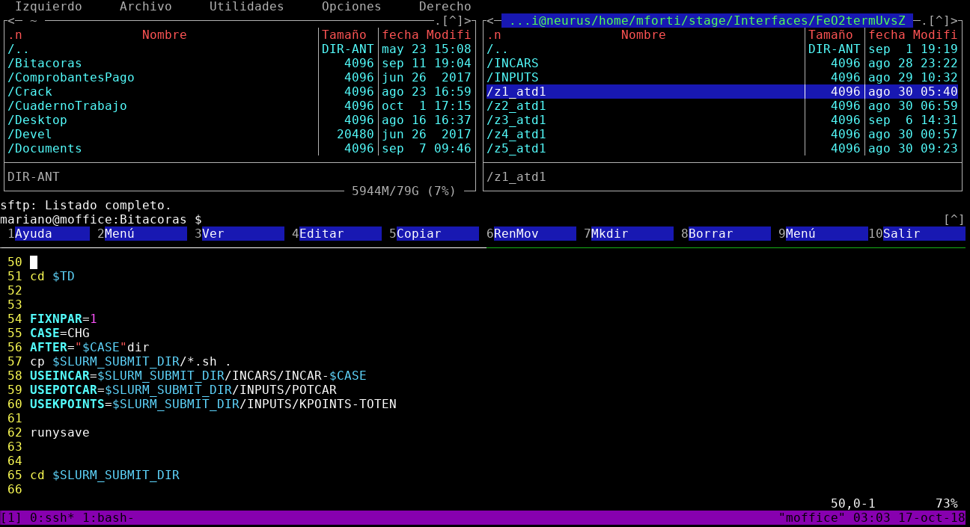
Programming
Why MF@ThermoConc
Experience
Bash, vim, python, fortran, matlab
disclaimer: Image is only an ilustration, does not represent my real workflow

Slide 9

Conclusion
Such experience, much promise

Slide 10
Any Questions?
42

Slide 11
Concerns
Thermal Properties from Ab Initio
Portland Cement
Relocation
Out of confort zone.

