Slide 1


PREPARED FOR
Logical Systems Inc.
Facility Services Proposal · April Bocox, Health and Safety Coordinator · May 28, 2026

Slide 2

WHY MAD DOG FACILITY PARTNERS
2
You can choose any janitorial company.
Here is why our clients stay for an average of 6 years.
92%+
<24hr
CEO
avg. inspection score
avg. resolution time
is your primary contact
Real-Time Quality Assurance
Documented Service Resolution
Direct Executive Access
Every service tracked through a third-party inspection platform — GPS-logged, photo-documented, time-stamped. Scores shared with you after every visit. You never have to wonder if the work was done or how well.
Every flagged issue becomes a service ticket with photos, notes, and an assigned owner. Tracked from open to close. Nothing falls through — every response documented and time-stamped.
Hereford Johnson, US Air Force veteran and company founder, picks up the phone. No account managers, no call routing, no corporate layers between you and the person accountable for every service.
"We surveyed our clients on what we should do more of. The #1 answer was communication and integrity. We believe this is why our average client has been with us for 6 years."

Slide 3
YOUR FACILITY
3
We built this for Logical Systems.
INDUSTRY TYPE
Manufacturing / Automation Controls
LSI operates manufacturing and industrial facilities where precision, compliance, and uptime are non-negotiable. Your environment demands cleaning that works around production schedules, protects sensitive controls equipment, and meets the documentation standards your own clients hold you to.
FACILITY PROFILE
MDF delivers compliance-ready facility services designed for automation and controls environments. We coordinate around your production calendar, document every service, and treat your facility with the same operational discipline your team applies to every project. When we say nothing gets missed, we have the inspection scores and service tickets to back it up.
Controls Integrator Since 1985
"Your core values — service, integrity, and excellence — are the same values we build our teams around. That alignment isn't coincidental. It's why this partnership works."
COMPLIANCE CONTEXT
OSHA / Production-Grade
— Hereford Johnson, CEO, Mad Dog Facility Partners

Slide 4
SCOPE OF WORK
4
Your Facility. Your Scope.
Weekly service · Start July 1, 2026 · Month-to-Month · 30-Day Notice
WEEKLY
Restrooms (3): sanitize & disinfect all fixtures
Weekly
Break room countertops, tables & chairs
Weekly
Restrooms: mop & disinfect floors, clean mirrors
Weekly
Microwave — inside & outside
Weekly
Office mopping, sweeping & vacuuming
Weekly
Refrigerator & water machine exterior
Weekly
General dusting — all areas
Weekly
Kitchen area full wipe-down
Weekly
Front glass cleaning
Weekly
Warehouse dust mopping throughout
Weekly
MONTHLY
Refrigerator interior deep clean
Monthly
QUARTERLY
Baseboard cleaning — all areas
Quarterly
Desk dusting — all offices
Quarterly
All frequencies confirmed at onboarding walkthrough with CEO and QA Manager.

Slide 5


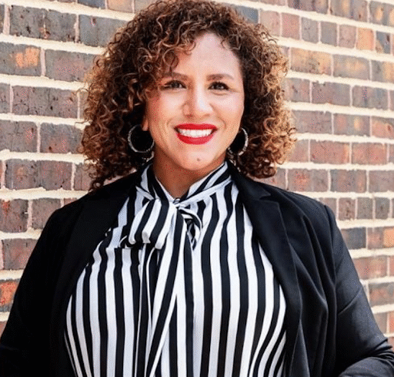
YOUR TEAM
5
Your Team. Not a Call Center.
Three people accountable to your facility — by name, by role, by phone.
Hereford Johnson
Victoriana Johnson
Johanna Hernandez
US Air Force Veteran · SDVOSB · ISSA Member
Certified QA Inspector · OrangeQC Platform
Talent Acquisition · Training & Certification
CEO & Owner
QA Manager
Area Talent Manager
Your primary point of contact. Picks up the phone personally — no account managers, no call routing, no corporate layers between you and the person accountable for every service.
Conducts weekly on-site inspections and logs every score. Personally owns resolution follow-through on every open service ticket. If a score drops, she is first to know and first to respond.
Handles recruiting, vetting, background checks, and ongoing training for all custodial staff. Every person assigned to your facility is screened, trained to your environment, and held to documented standards.
"I've held the mop. I've been the crew. That's why we're built around accountability, not excuses." — Hereford Johnson, CEO

Slide 6
QUALITY ASSURANCE
6
You Get Full Visibility Into Every Clean.
Inspection Scoring
TARGET INSPECTION SCORE
Every zone graded at each visit. Scores trend over time — you see at a glance whether standards are holding or slipping, week over week.
90%+
Tracked and reported every week
Service Ticket System
AVERAGE RESPONSE TIME
Any flagged issue auto-creates a ticket, assigned to a team member and time-stamped. Resolution tracked from open to close. Nothing disappears.
<2hr
From ticket open to acknowledgment
Full Audit Trail
AVERAGE RESOLUTION TIME
Every service, every score, every resolved ticket lives in your dashboard. Useful for compliance reviews, facility audits, and accountability records.
<24hr
From issue flagged to issue closed
Included with every MDF contract — at no additional charge.

Slide 7
RAMP-UP PLAN
7
Your Ramp-Up. Before Day One.
ACTIVITY
Wk -2
Wk -1
Week 1
Week 2
Mo. 2
Mo. 3
CEO + QA Manager Site Walk
Key Handoff & Supply Staging
Team Assignment & Orientation
Service Launch
Daily Supervisor Check-Ins
OrangeQC Baseline Report
30-Day Review Call
90-Day QBR & Scope Review
Pre-Start
Active Service
Milestone Review

Slide 8



CLIENT RESULTS
8
What Our Clients Say.
Facilities that can't afford to get it wrong — and don't.
"What impressed us most was their understanding of our compliance requirements. They didn't just clean — they followed our protocols, documented everything, and worked around our production schedule without missing a beat."
— Manufacturing Plant Operations Manager
Certified Past Performance
"The team at MDF understands that in our environment, cleaning is part of our safety program — not just an afterthought."
"We've worked with several cleaning companies over the years, but Mad Dog is different. When there's an issue, they fix it immediately."
Past Performance
— Sheriff's Office Facility Manager
— Government Administrator
"The background checks and professionalism of their crew gave us confidence from day one. In a government facility, security and accountability aren't negotiable. Mad Dog gets that."
— Municipal Building Supervisor
Industry Member

Slide 9
YOUR INVESTMENT & NEXT STEPS
9
YOUR INVESTMENT
READY TO MOVE FORWARD?
$1,000
What happens when
you say yes:
per month · $12,000 annually · Month-to-Month · 30-Day Notice
1
Agreement signed & start date confirmed
OrangeQC Inspection Reporting
Included
2
CEO + QA Manager schedule facility site walk
Dedicated QA Manager
Included
Ownership Direct Line
Included
3
Team assigned, keys exchanged, supplies staged
W-2 Employed Staff
Included
Supply & Equipment Management
Included
4
Inspection dashboard created — you get login access
Monthly Total
$1,000
5
First service delivered on your start date, July 1, 2026
Hereford Johnson
623-321-2542 · office@maddogcleaning.com

