Slide 1
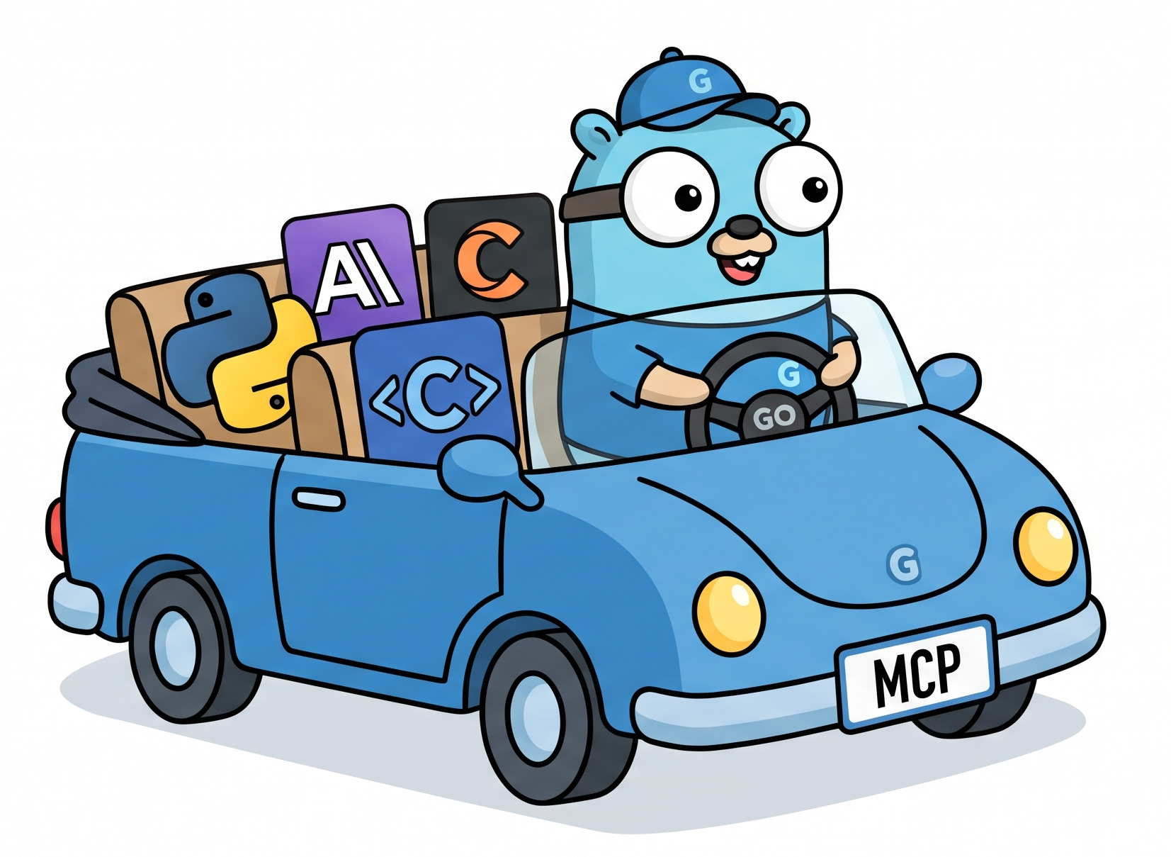


Go-ing Fast with MCP
Rapid Development of Custom MCP Servers
for Security Agents
Matt Franz, Pydantic
DC State of the Stack 2026

Slide 2
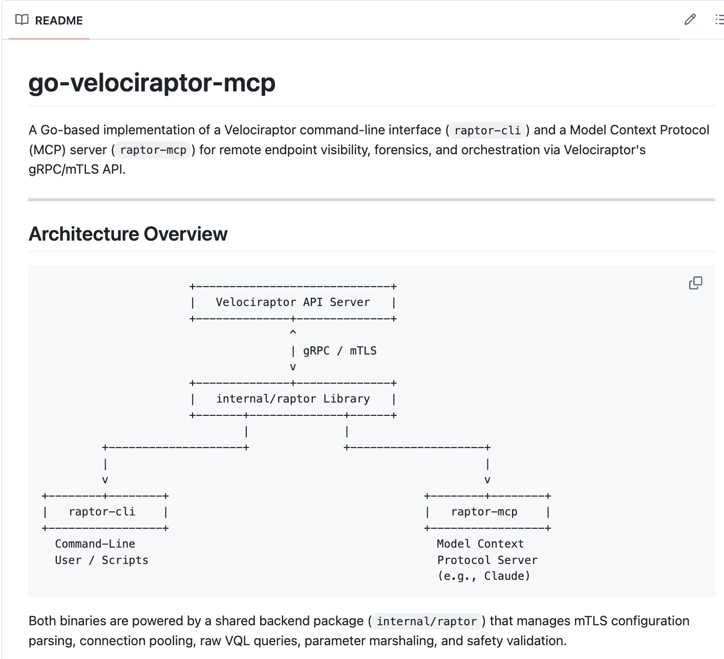
During the next five minutes you will learn…
Why you should consider writing a custom MCP server for data-intensive platforms (SIEM, EDR, observability)
How to iteratively build, test, and run STDIO MCP servers (and CLIs) for Python agents or Claude, Codex, OpenCode, and more…
2

Slide 3

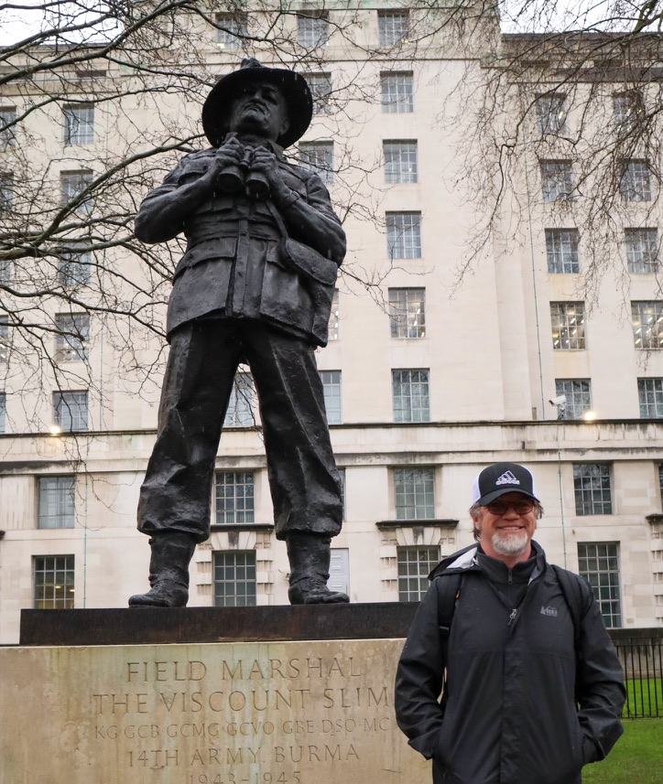
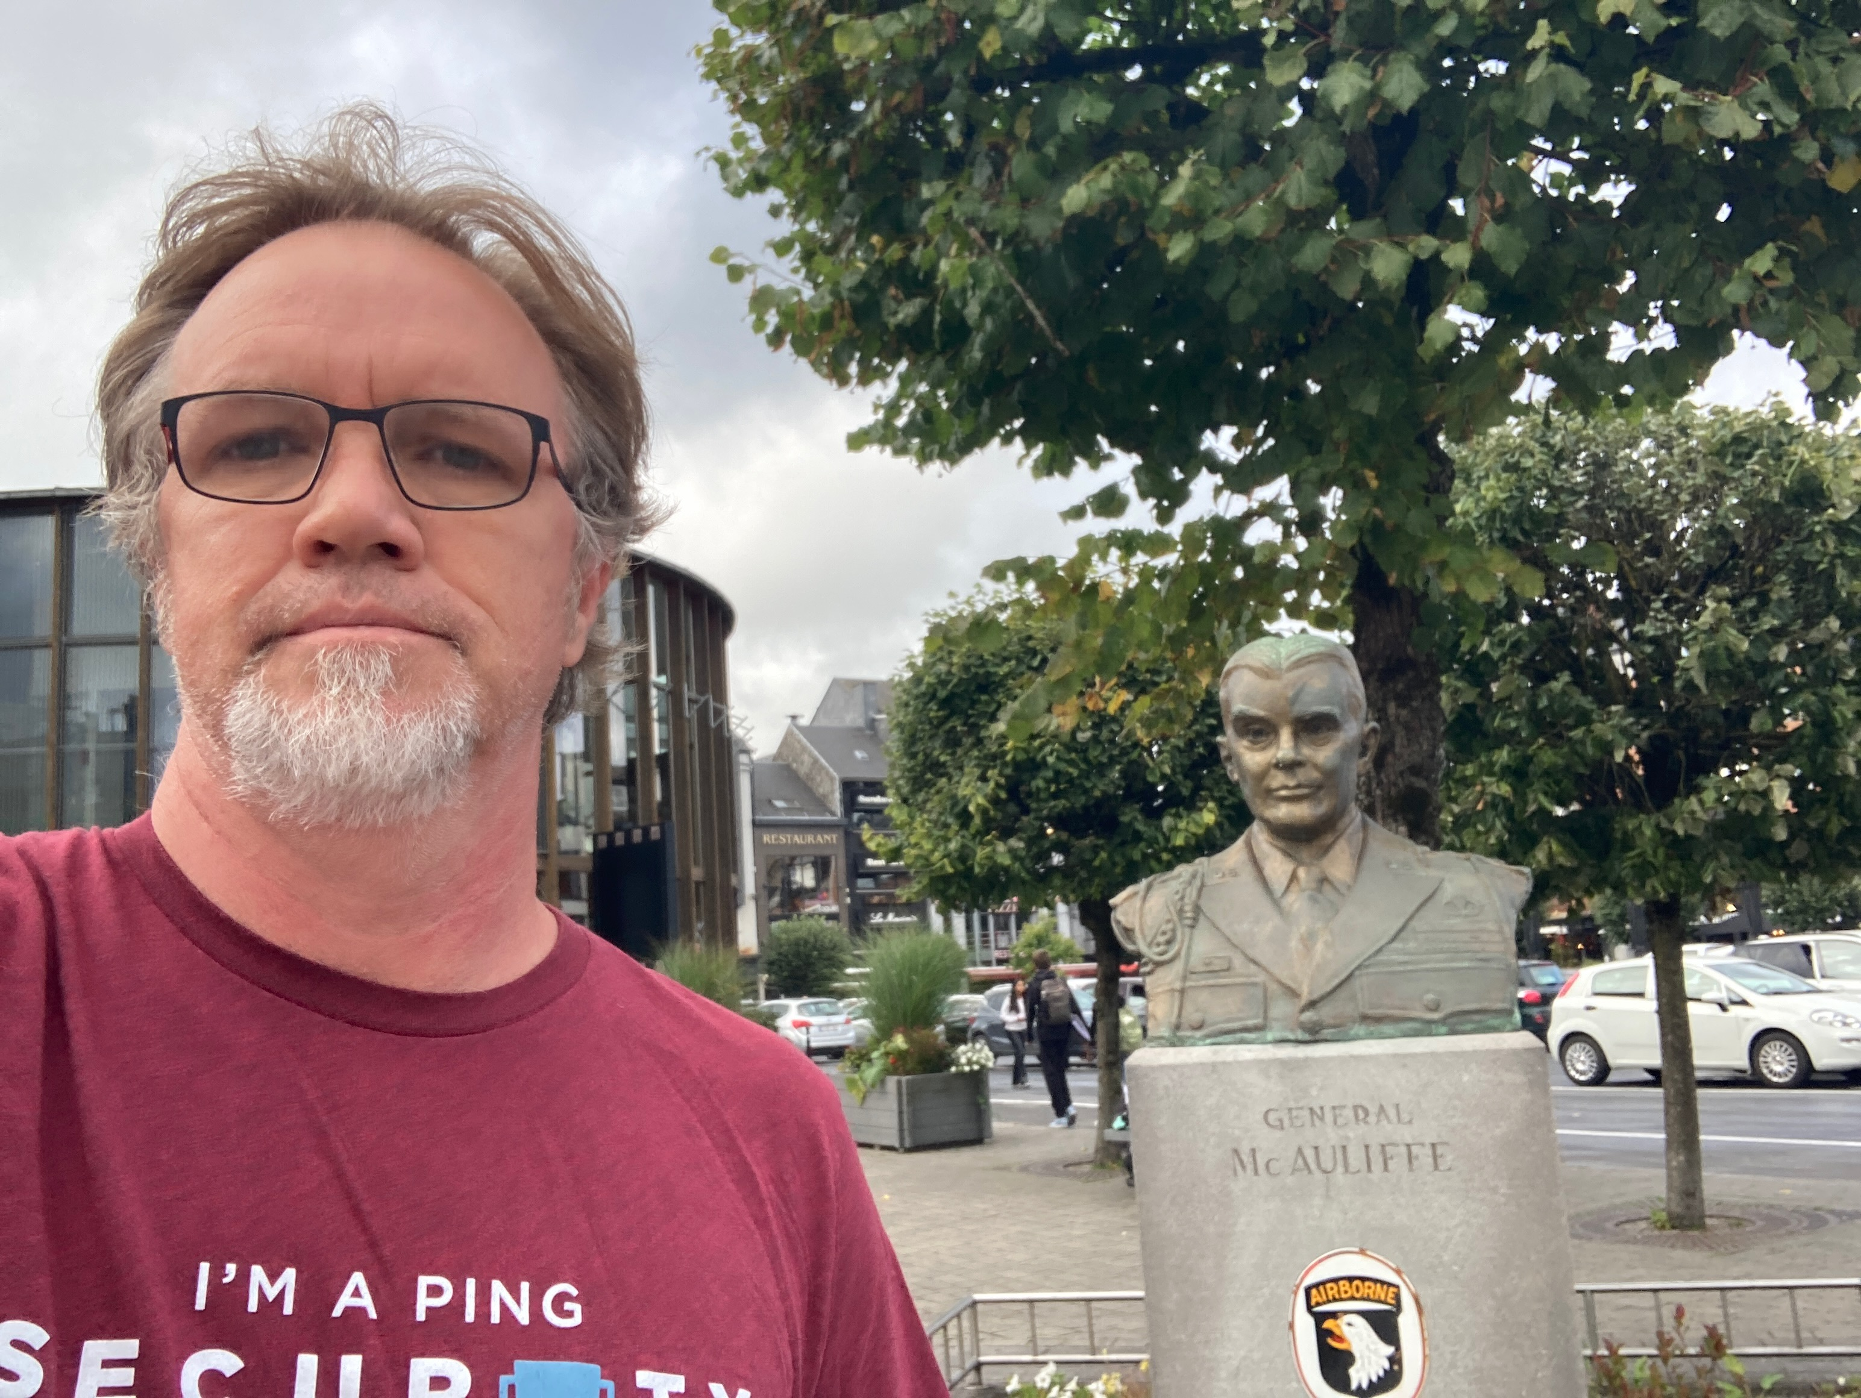
Who am I?
25+ years in Security and Infrastructure roles (IC to Director-level)
Currently Security & Compliance Lead at Pydantic
For the last 2.5 years, I’ve been building blue-team security agents
In 2026, I’ve built over a dozen MCP servers in Go, Python, and Rust
Love European/Canadian travel and read way too much military history (was SIGINT Analyst)
3

Slide 4

MCP and its Discontents
Token burn — large JSON payloads overwhelming agent context window
Agent thrashing — hallucinated queries and API calls leading to agent delays
Security — inherent vulnerabilities, RBAC challenges, and more
Alternative approaches:
CLIs called by coding agents
Python code generation – processing and REST APIs
Where I find MCP still adds value:
Optimized tool calls (and descriptions) and input/output query guardrails to monitor and proxy agent interactions
4

Slide 5
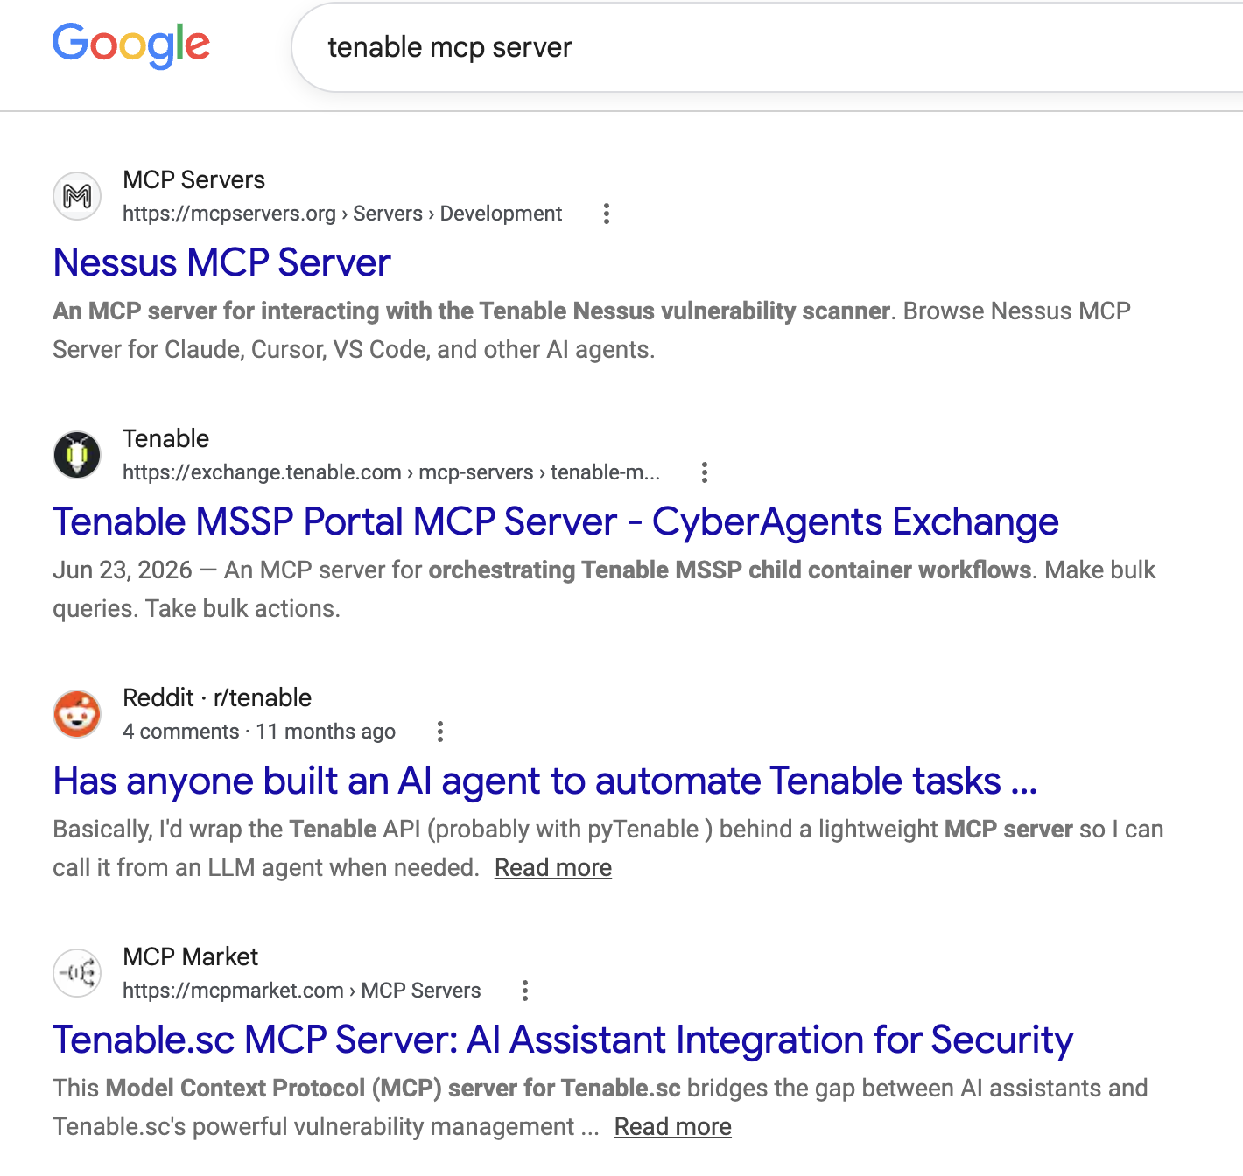
Why build custom MCP servers?
Issues using off the shelf MCP Servers
Minimal logging or caching — often black boxes.
Generic tool calls — tuned for everyone, not your telemetry or workflows
Sketchy MCP marketplaces — do you really trust them with your SIEM API keys?
You probably need to learn the APIs (and data) to effectively create prompts, anyway…
5

Slide 6

Why Go?
Increased supply-chain risks
Bloated Python/JS dependencies have slower startup-time
Go compiles to as a single cross-platform executable – choose features you bundle and how many tools.
Faster iteration and simplicity than Rust—especially for Python developers.
Mature, cross-platform libraries with lots of options
6

Slide 7



A Go template
Library Selection
Official Go SDK (https://github.com/modelcontextprotocol/go-sdk)
Use SPF13 (Cobra/Viper/pflag) for command-line handling
Code Structure
See GO-MCP-GUIDE.md
9

Slide 8
Lessons — start with the CLI
Build the CLI first — reuse a client library, or generate from Swagger/OpenAPI (worst case: HTML/PDF)
Explore the data — list / get / describe
Start with 3–5 tools — enough to learn the shape and the use cases
7

Slide 9
Lessons — instrument and iterate
Instrument from day one — logging, observability, test coverage
Add an LLM harness — Pydantic AI against common queries
Explore, then specialize — let telemetry tell you the next tool to build
8

Slide 10
Testing layers
Unit tests — Both for CLI and MCP server
Direct JSON-RPC smoke test — no LLM required
Pydantic AI harness — real tools with a range of models.
Exploratory with Claude, Codex, OpenCode, etc.
10

Slide 11
The tool ladder
Intent | Tool | Why
See the surface | list_tables | Cheapest inventory
Find relevant data | search_tables | Names + columns
Inspect one schema | describe_table | No row payloads
Learn shape + values | preview_table | Schema + sample
Query one table | query_table | Validated, bounded
Join or advanced SQL | run_query | Flexible, riskiest
Prefer the narrowest tool that answers the question.
12

Slide 12
Tool typing — args
type SearchProcessesArgs struct {
Executable string `jsonschema:"Exact path match. No wildcards."`
CommandLine string `jsonschema:"Token search (OR), not substring."`
HashSHA256 string `jsonschema:"SHA256 for malware detection."`
// + ProcessName, Host, Start/End
}
13

Slide 13

Guard Out — bound the query
Start read-only and restrict index and scope to prevent expensive, unbounded scans
Use aggregation queries with sane defaults to get the shape of the data
Require filters — and always bound the time range (and mind storage tiers)
Per-tool timeouts — surface partial results, relative to data you need
Implement disk/memory caching in the MCP server
15

Slide 14
Guard In — bound the response
Cap rows and payloads returned to the LLM
Provide helpful error message to inform agent retry
Export separately — paginate to files, never bulk JSON into context, MCP supports async and progress
16

Slide 15
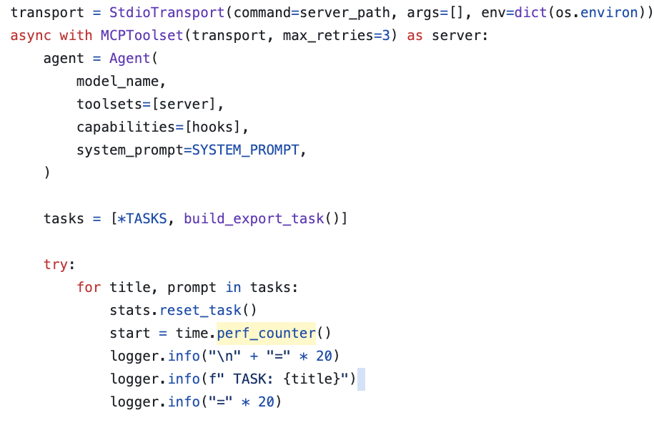
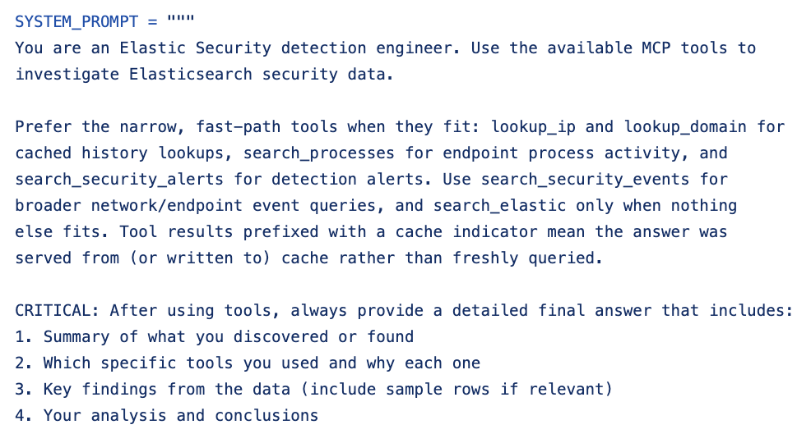
E2E testing with Pydantic AI
Test across multiple Providers and Models
Normalize model queries and catch hallucinations
Test tool descriptions
Easy integration with Logfire for token, turn, and exception monitoring
17

Slide 16
Implement observability early
Logs — one agent (Claude) builds, another (Codex) observes and gives feedback
Traces — exceptions and spans
Metrics — query latency
18

Slide 17
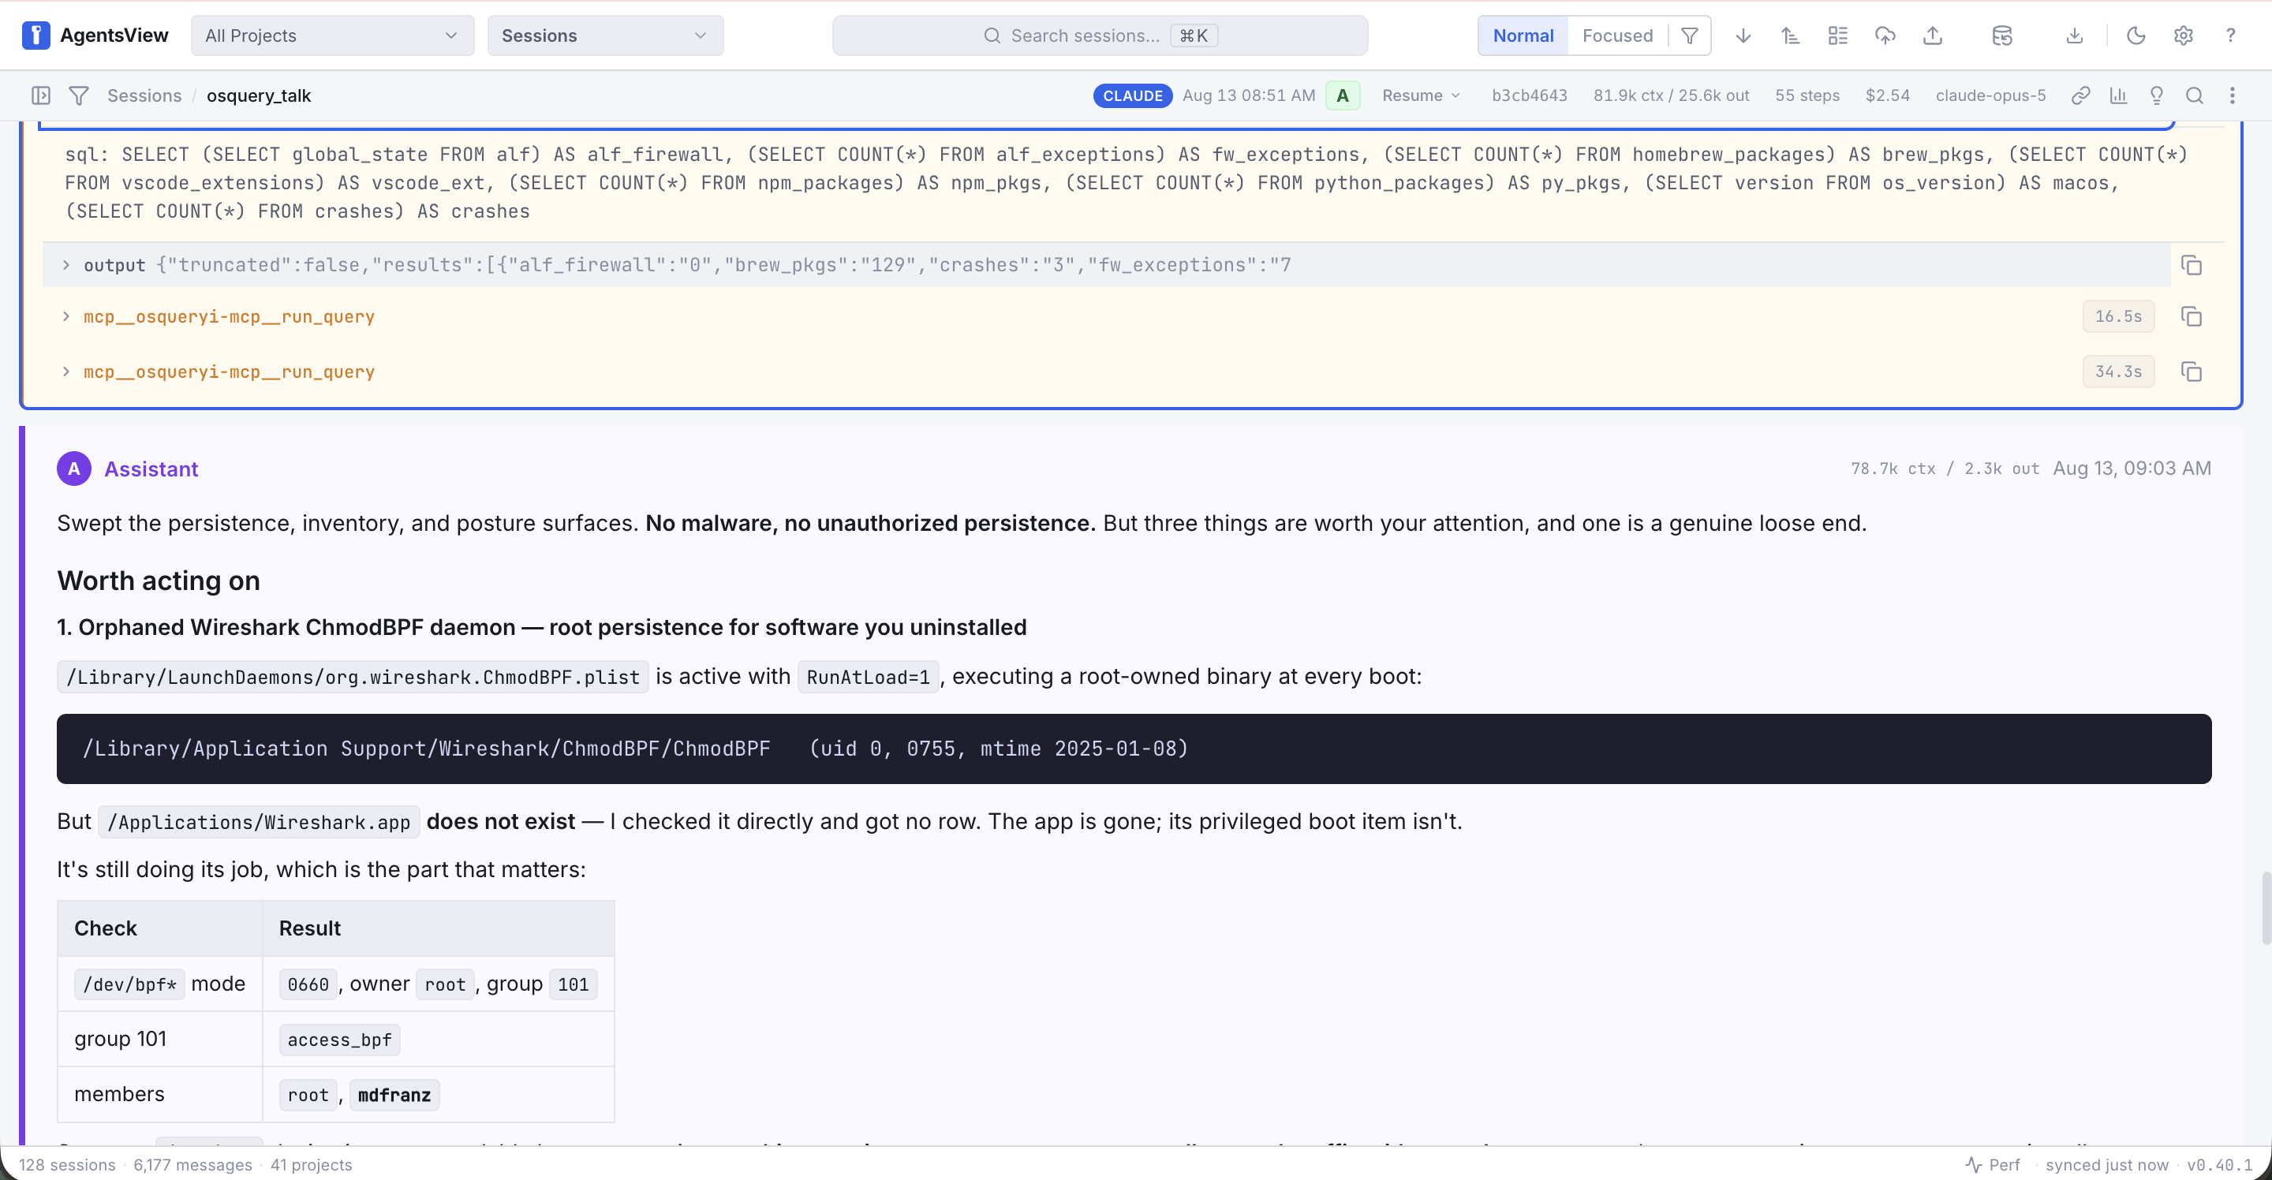
Agentsview for On Box Analysis of Coding Agents
Local agentic analytics for Claude, Codex, and OpenCode sessions
Tool sequence, arguments, and outcomes per task
Export sessions along your .git history to track improvent!
https://github.com/kenn-io/agentsview or https://agenstview.io
19

Slide 18
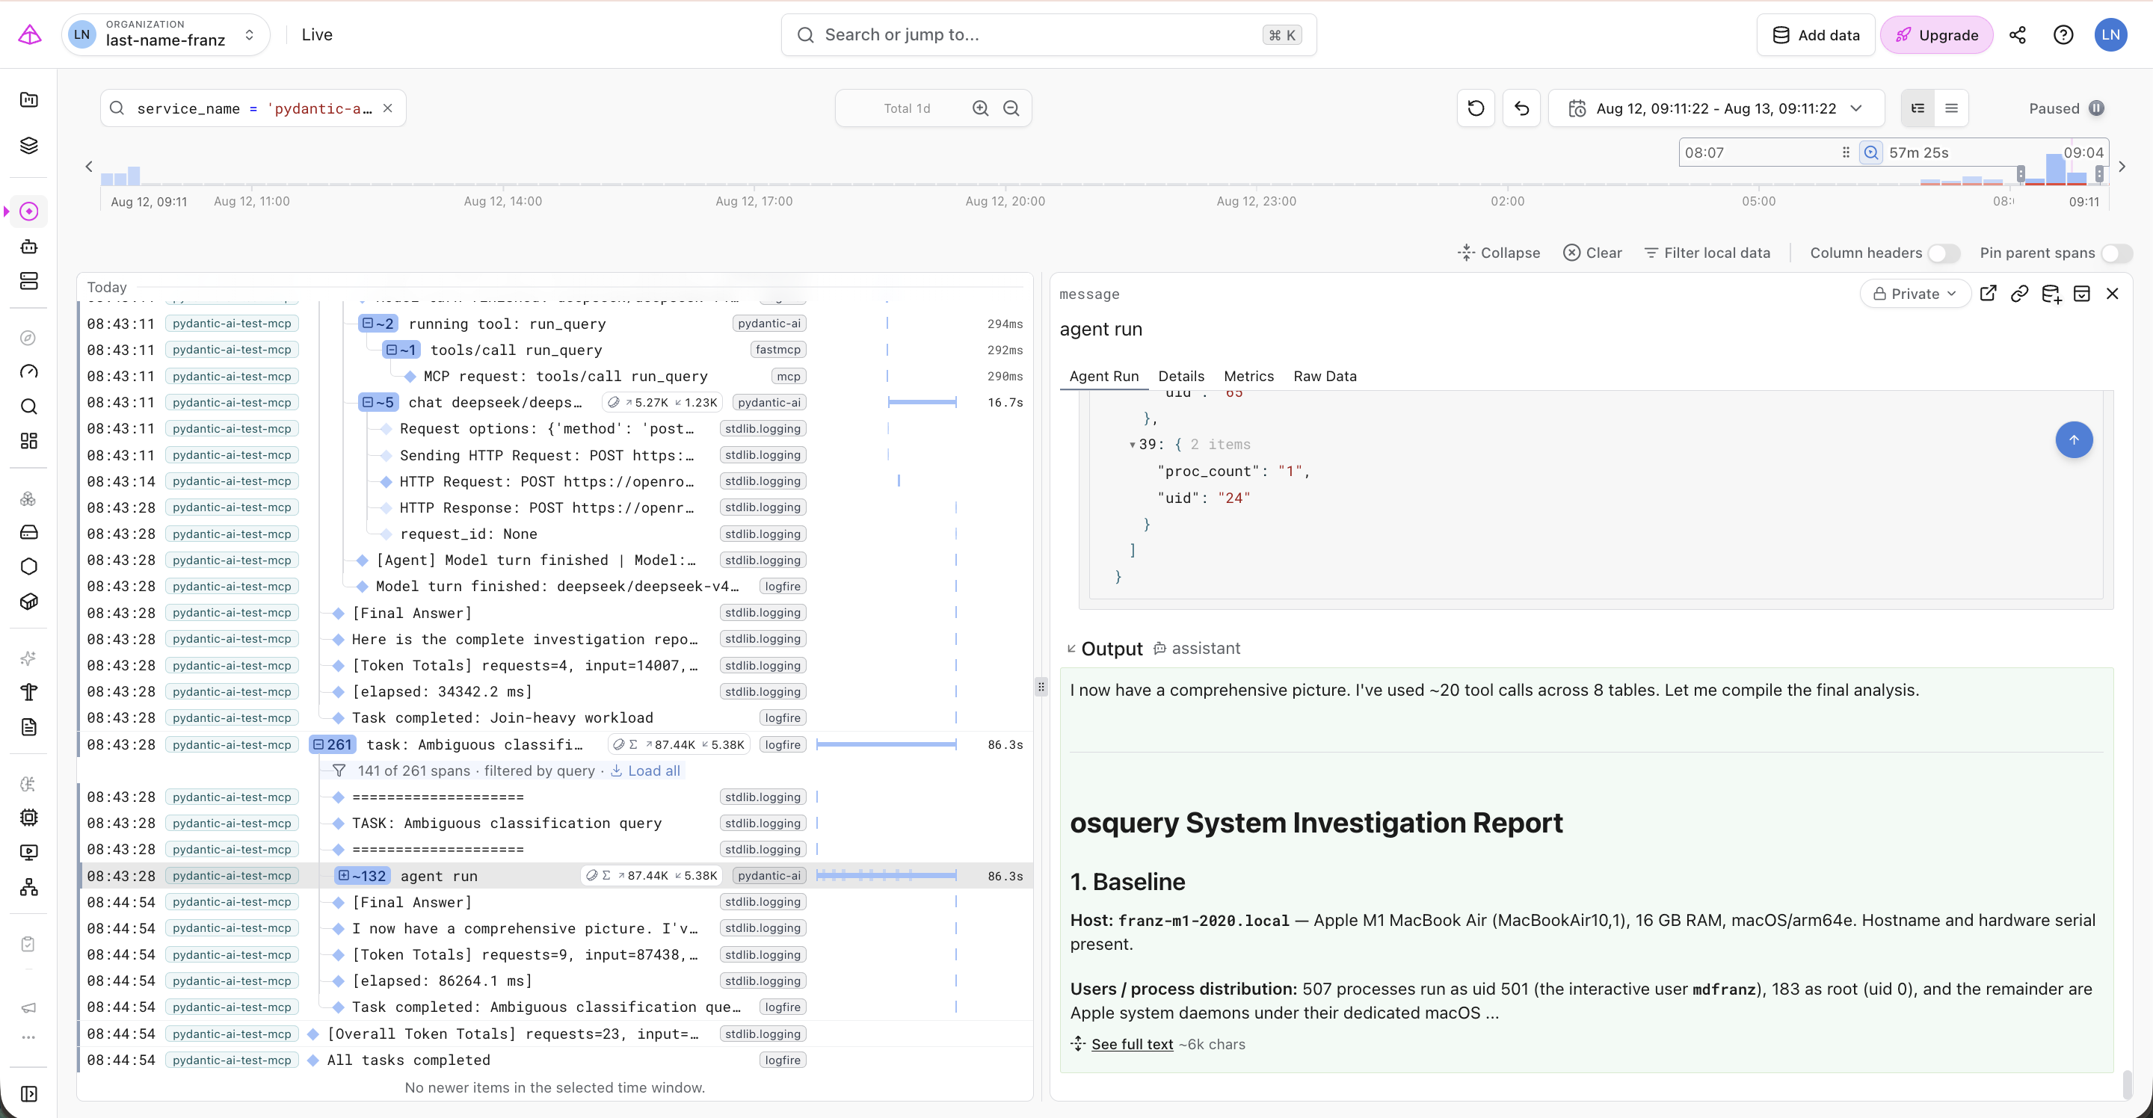
Logfire for Agent and MCP Observability!
OpenTelemetry traces across model calls, tool calls, and spans
Drop in librarires for most frameworks—and infra too!
Queryable after the fact, with a built-in MCP server
https://pydantic.dev/logfire
20

Slide 19
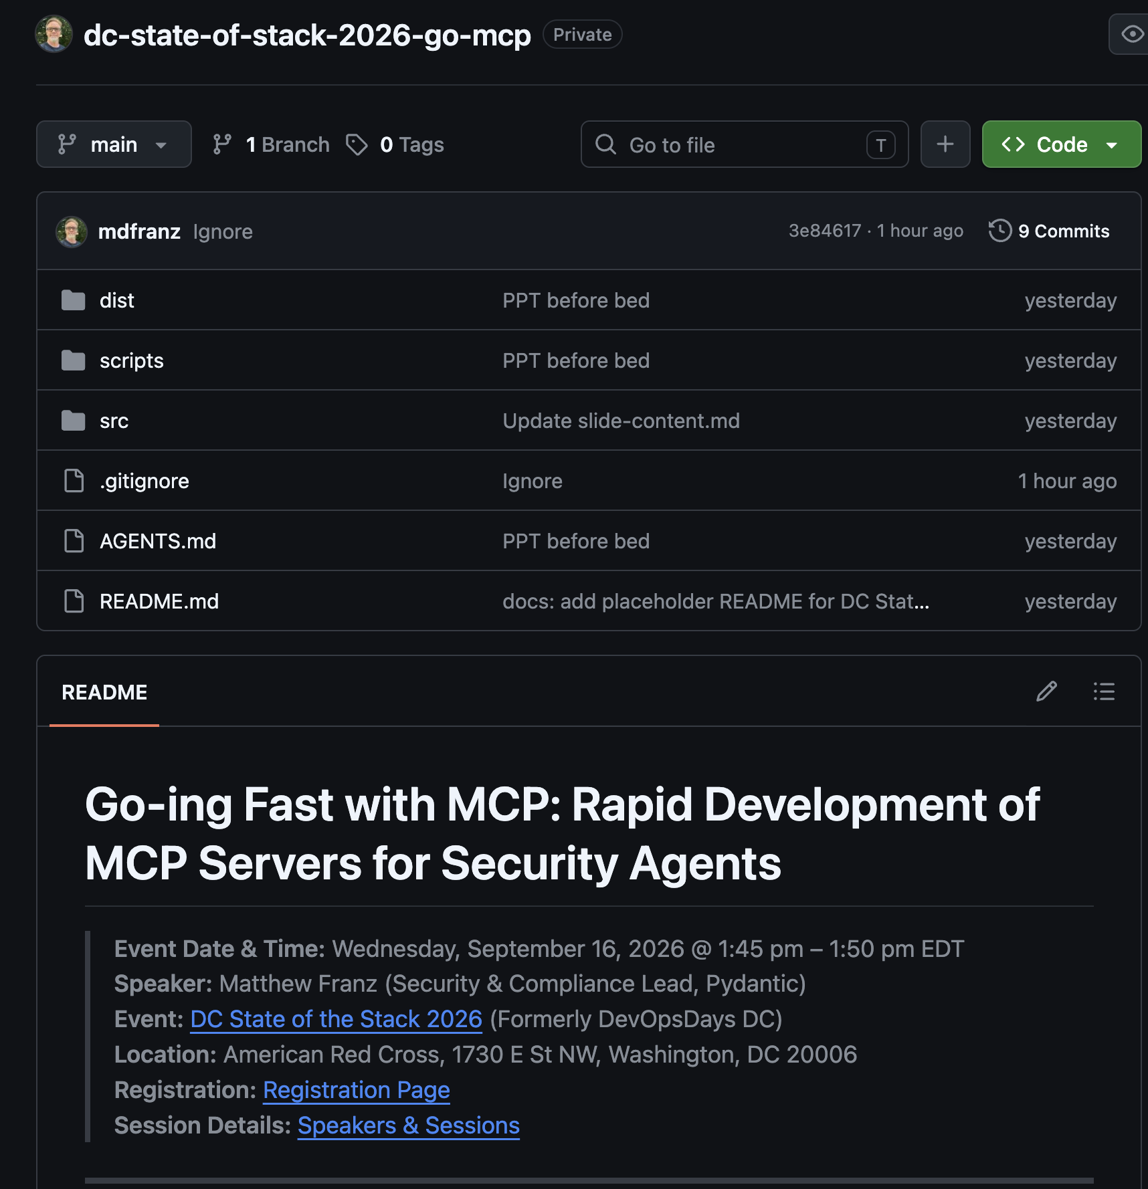
For more info
osqueryi-mcp — starter server, smoke harnesses, framework examples
elastic-security-mcp — structured tools, raw DSL fallback, caching, export
mcp-threat-hunt-aug-2026 — the long-form companion talk
https://github.com/mdfranz/dc-state-of-stack-2026-go-mcp
21

Slide 20
Takeaways and Thank You!
21

