Slide 1
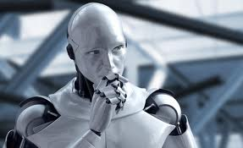
oops!
Time’s over !

Slide 2

Fruits Finding
Game !

Slide 3

Congratulations !
Congratulations !

Slide 4

Congratulations !
you’re
Fruits Finding
Master.

Slide 5
Screen clear !
Points :
Life Bonus :
Time Bonus :
Total Score :

