Slide 1




Travis Cook
Matthew Groh
Marshal Rittenger

Slide 2


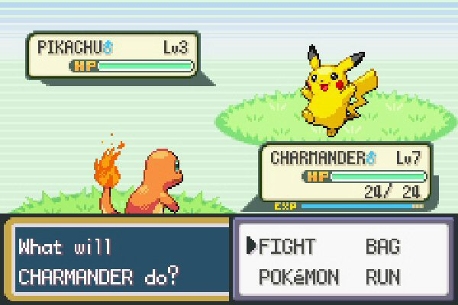
POKÉMON
Video Game
Handheld video game
Head-to-head battle
Each Pokémon has unique stats and abilities.

Slide 3

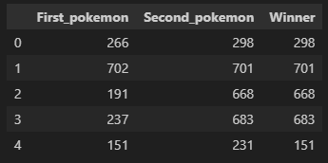

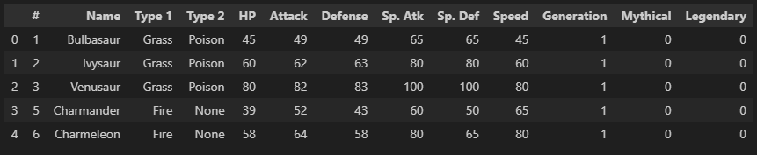
POKÉMON DATA SET
Battles
Pokémon Stats

Slide 4

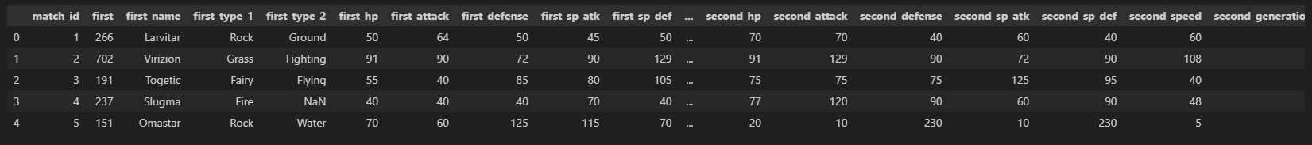
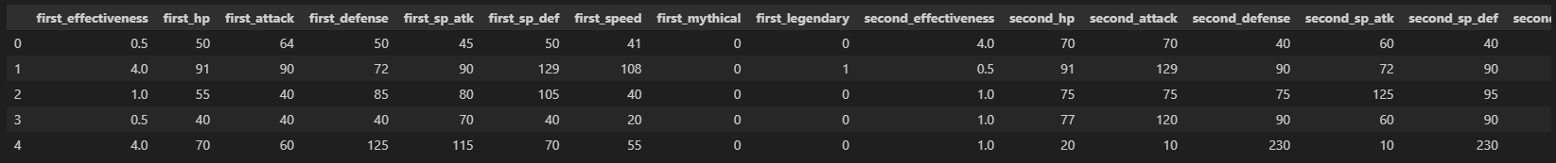
ETL
Data Prep
Combined Battle Data
Finalized Battle Data

Slide 5

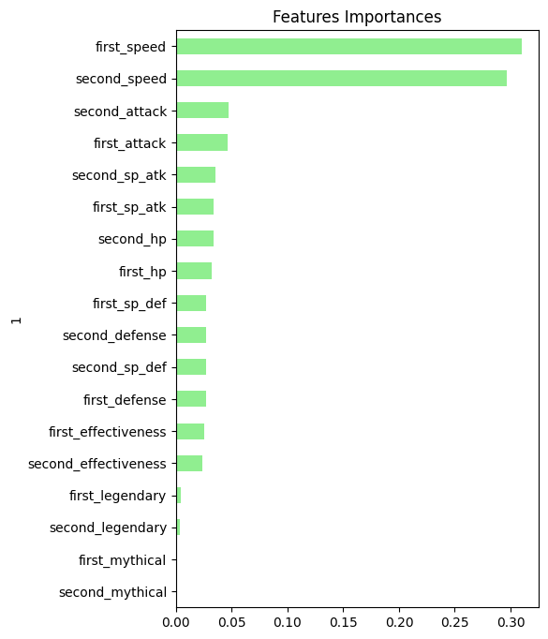
RANDOM FOREST
Features (independent variables) most important to the Random Forest model.
Features reduced to improve accuracy.

Slide 6

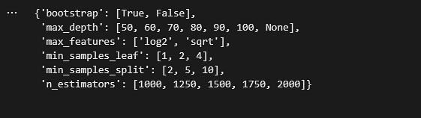

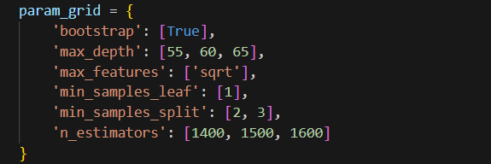

RANDOM FOREST
Randomized Search
Grid Search

Slide 7
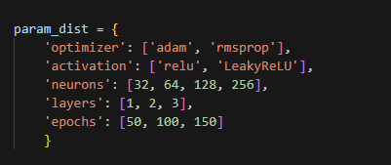
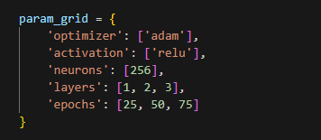

NEURAL NETWORK
Randomized Search
Grid Search

Slide 8

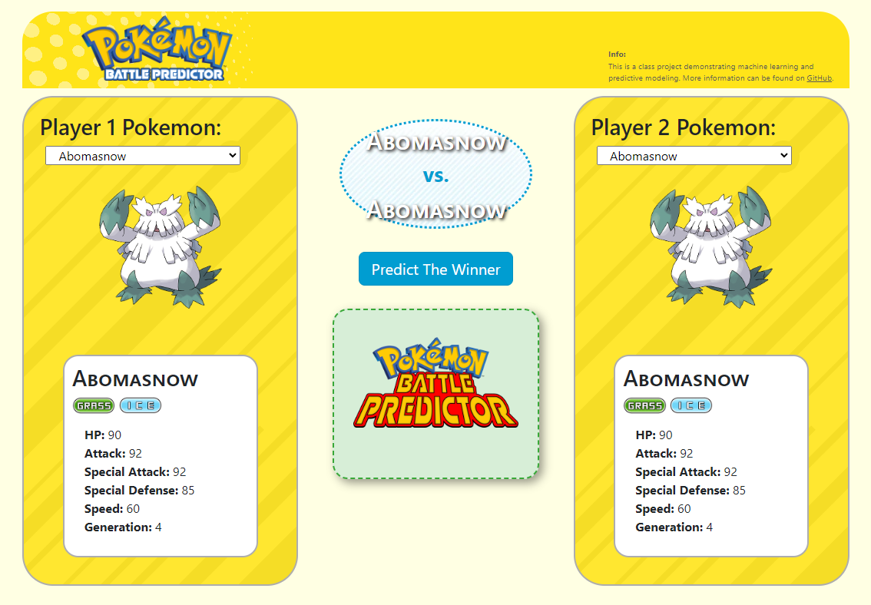
DEMO

Slide 9



POTENTIAL
ENHANCEMENTS
Updated Pokémon generations
Pokémon move data
Search for different models
Explore other optimization methods

