Slide 1
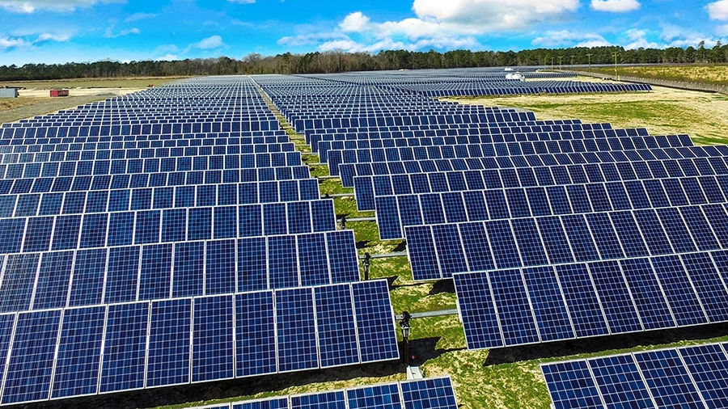
MPPT algorithm for calculating the maximum power of a photovoltaic system
Renewable Energy Smart Management

Slide 2

Problem description
This presentation focuses on solving an optimization problem related to a parallel-series configuration of photovoltaic (PV) panels to maximize power generation. The objective is to identify the optimal voltage value that achieves maximum power output. Throughout the presentation, the techniques employed and the results obtained will be analyzed, highlighting the advantages of this solution and potential applications in the field of solar energy. The focus will be on the approach used to optimize the performance of photovoltaic systems and the potential benefits that arise from it.

Slide 3
Problem outline
Measure the I-V curve for each panel
Make a I-V curve for a string of panel
Perform an optimization for the parallel of N strings
Plot the results starting from the single I-V curve to the optimized power result.

Slide 4
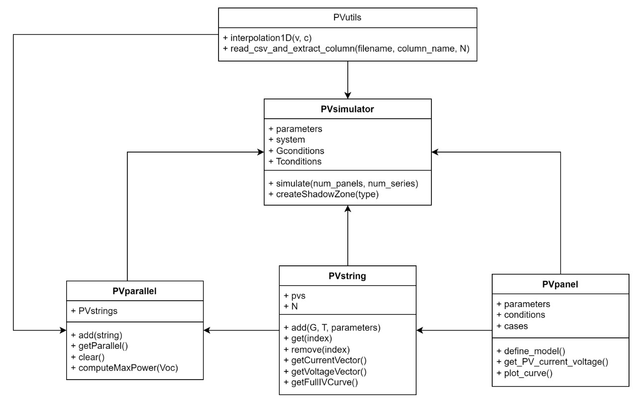
Code structure
For the implementation of the system and optimization modules, 4 classes and a utility library were required:
PVpanel
PVstring
PVparallel
PVsimulator
PVutils

Slide 5
PVpanel class
A set of parameters and a pair of operating conditions (G, T)
The single I-V curve of the photovoltaic panel is produced by measuring the current at the terminals as the voltage varies.
Input
Output

Slide 6
PVstring class
The PVpanel class is utilized to construct a new class for defining a series string of photovoltaic panels. In particular, thanks to the ability to create a list of objects. (MODIFICARE)
A list of PVpanel objects and a total I-V curve of all the panels in series.
Input
Output

Slide 7
PVparallel class
Having a class for strings available, we can connect these PV strings in parallel to increase the total power output.
In particular, a method is constructed to optimize the selection of voltage in order to maximize the power output of the system.
Input
Output

Slide 8
PVutils class
There are problems in both the string and parallel configurations:
In the PVString class, there is a need to interpolate the total curve as it is initially composed of a series of points.
In the PVparallel class, on the other hand, it is necessary to extract data from precise reports in CSV format.
The result is the development of two methods that address these two encountered problems.
Problem
Solution

Slide 9
PVsimulator class
In conclusion, a General and Modular Simulation class is created to generate a series of data on the power generated by the photovoltaic system.
In particular, the result will be plots generated by the various classes mentioned earlier and invoked during the simulation.
Input
Output

Slide 10
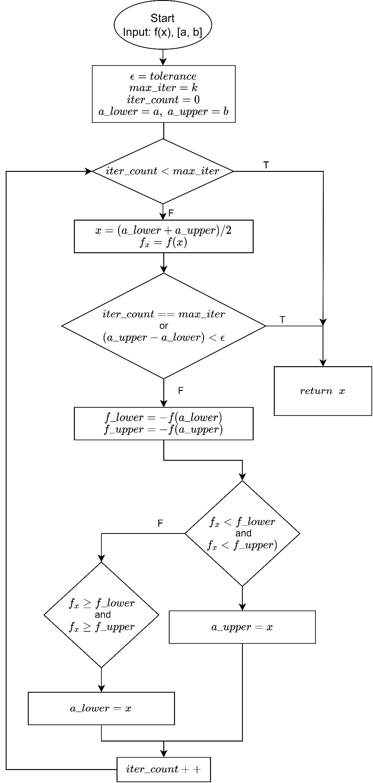
Ottimizzazione della scelta della V
Define a convergence tolerance ε and the maximum number of iterations max_iter.
Initialize the iteration counter iter_count to 0.
Initialize the bounds of the search interval as a_lower = a and a_upper = b.
Repeat until iter_count < max_iter:
Calculate the midpoint of the search interval: x = (a_lower + a_upper) / 2
Calculate the value of the objective function at point x: f_x = f(x).
If the width of the search interval is less than ε or the maximum number of iterations has been reached:
Return the point x as the optimal solution.
Terminate the algorithm.
d. Calculate the negative value of the objective function at points a_lower and a_upper:
f_lower = -f(a_lower), f_upper = -f(a_upper).
e. If f_x < f_lower and f_x < f_upper, then the point x is closer to the minimum of the interval:
Update a_upper = x.
f. Otherwise, if f_x ≥ f_lower and f_x ≥ f_upper, then the point x is closer to the maximum of the interval:
Update a_lower = x.
g. Increment the iteration counter iter_count by 1.
Return the last approximation of the minimum point found.

Slide 11
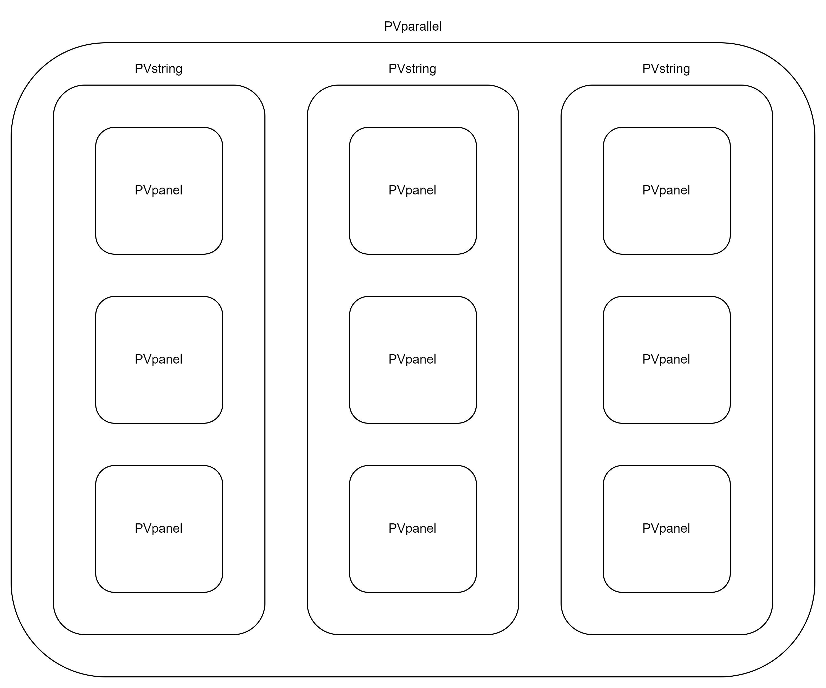
Considered structure of PV panels

Slide 12
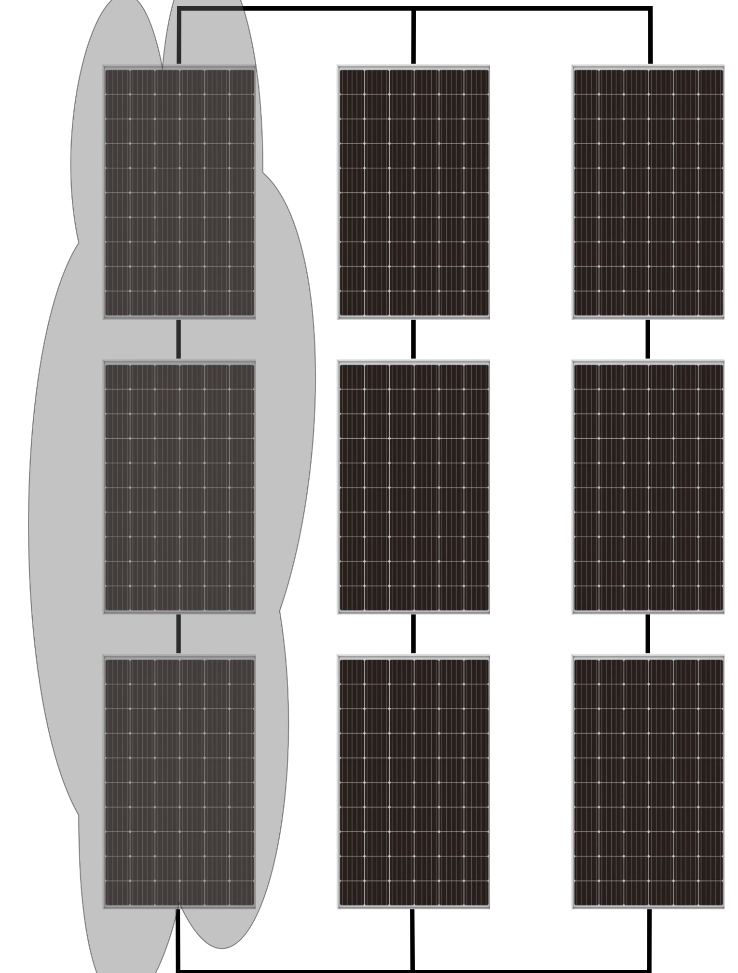
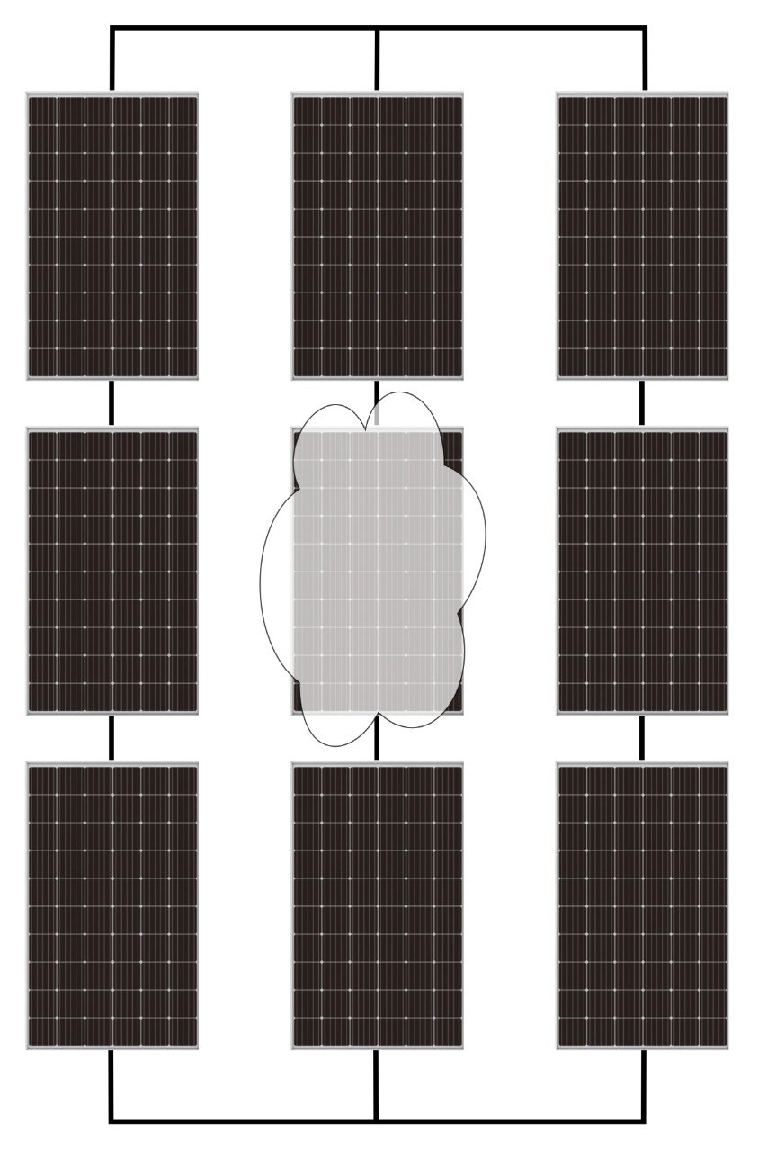
Shadow zone creator - 1
To generate more realistic simulations and evaluate the increase or decrease in system performance caused by various environmental and weather conditions. Hence, we have used a mismatch generator between the different panels within a string or across the entire parallel configuration, as shown in the figures.

Slide 13
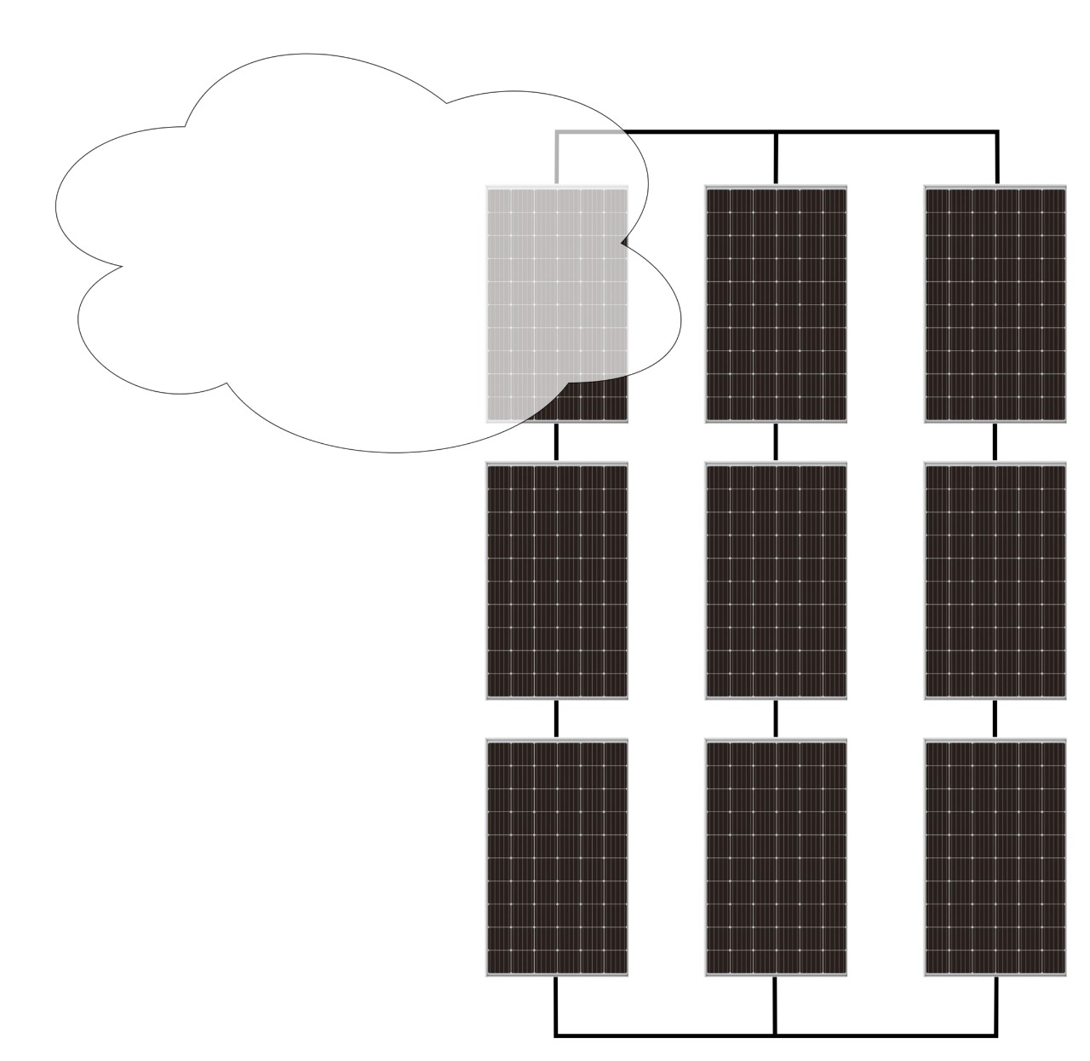
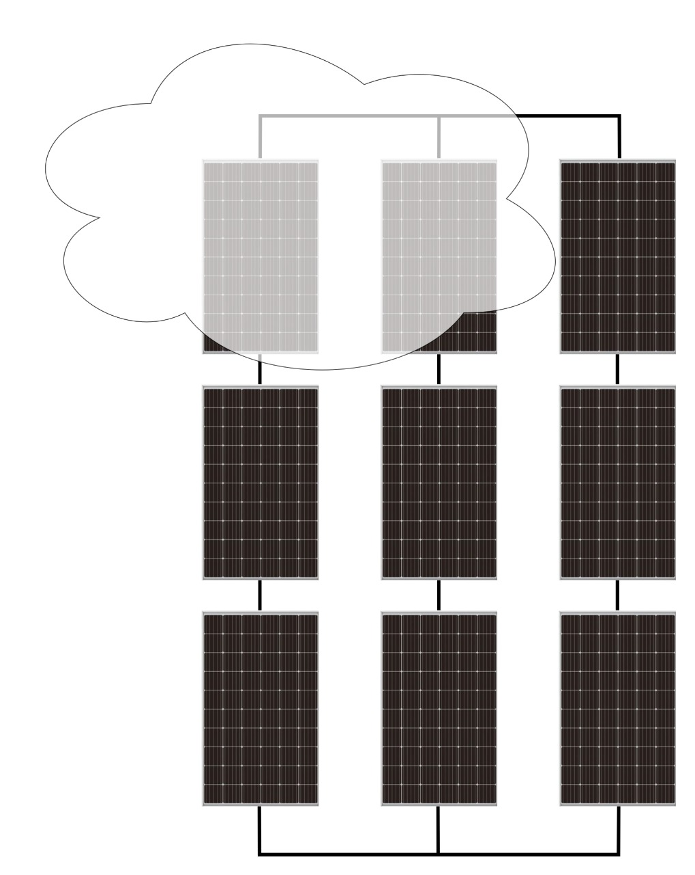
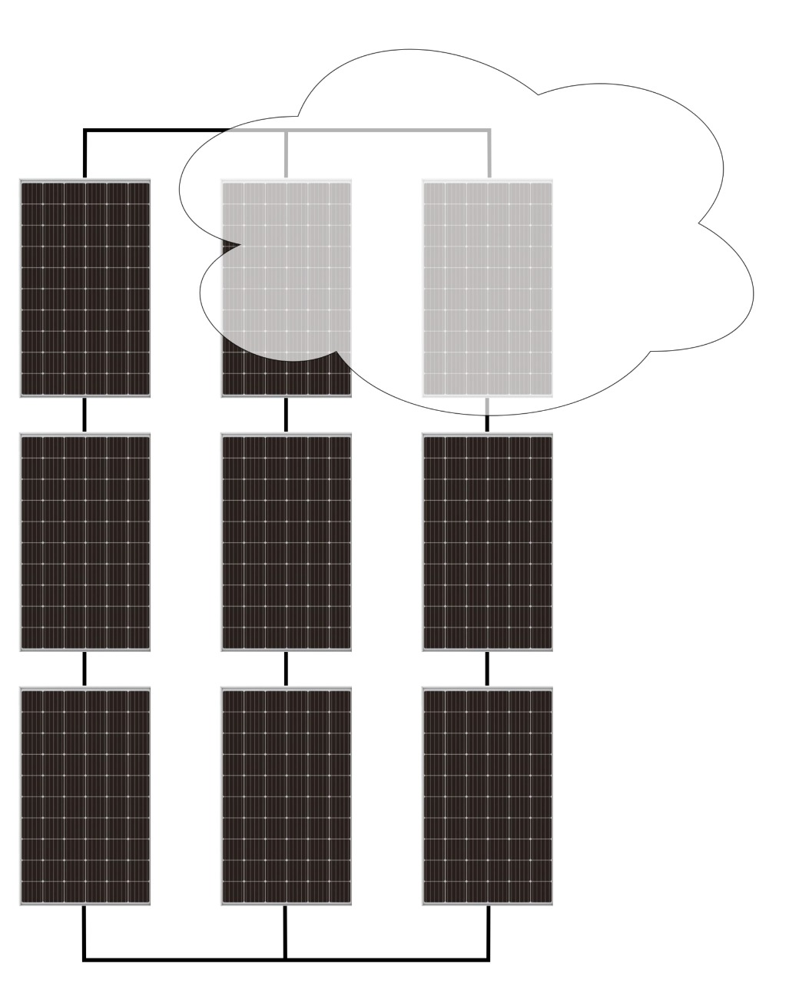
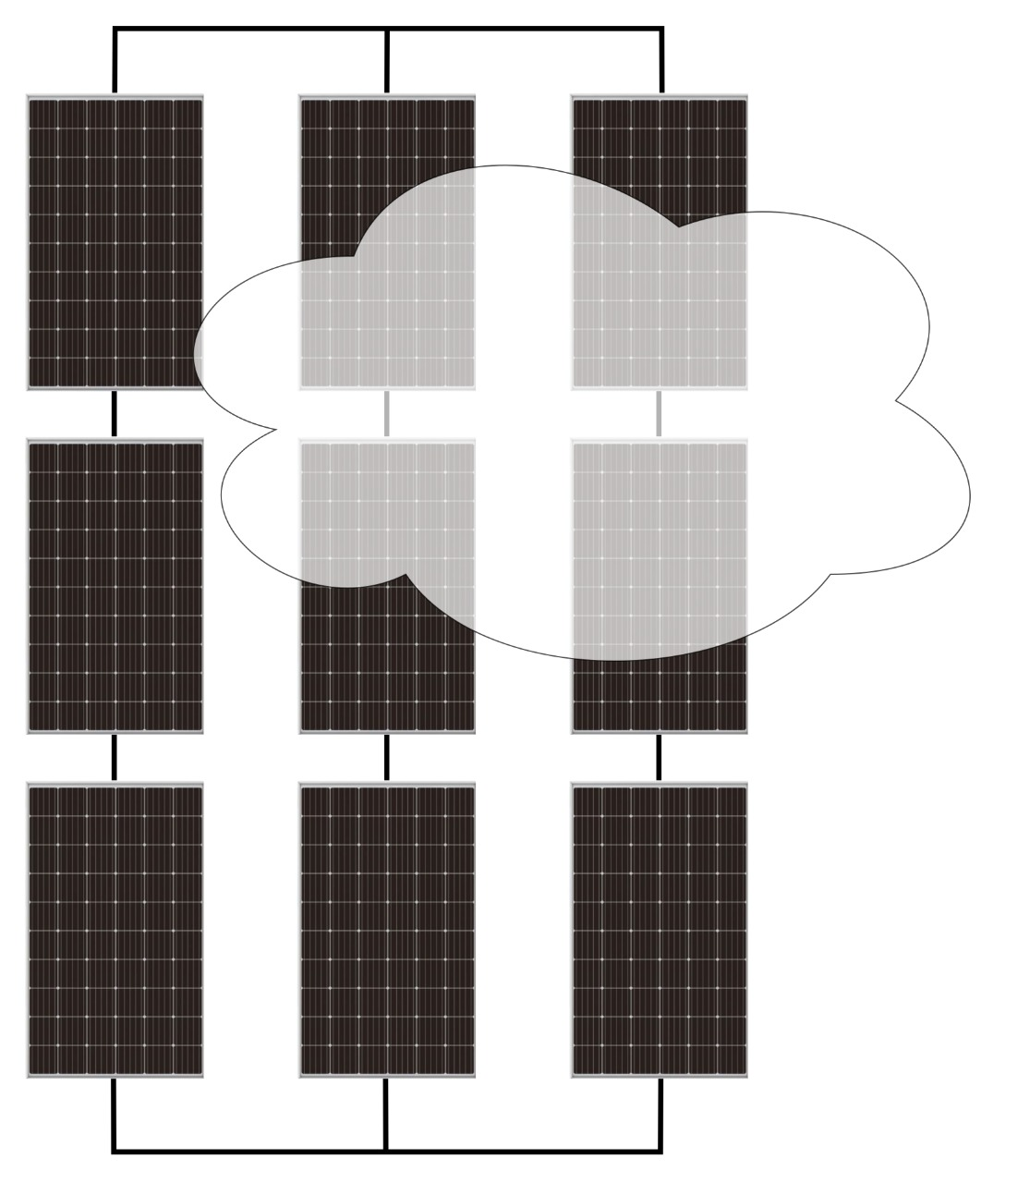
Shadow zone creator - 2
By implementing a time-varying simulation of the cloud positions that create shading on the panels, it will be possible to observe significant changes in power production compared to the previous static variations.

Slide 14
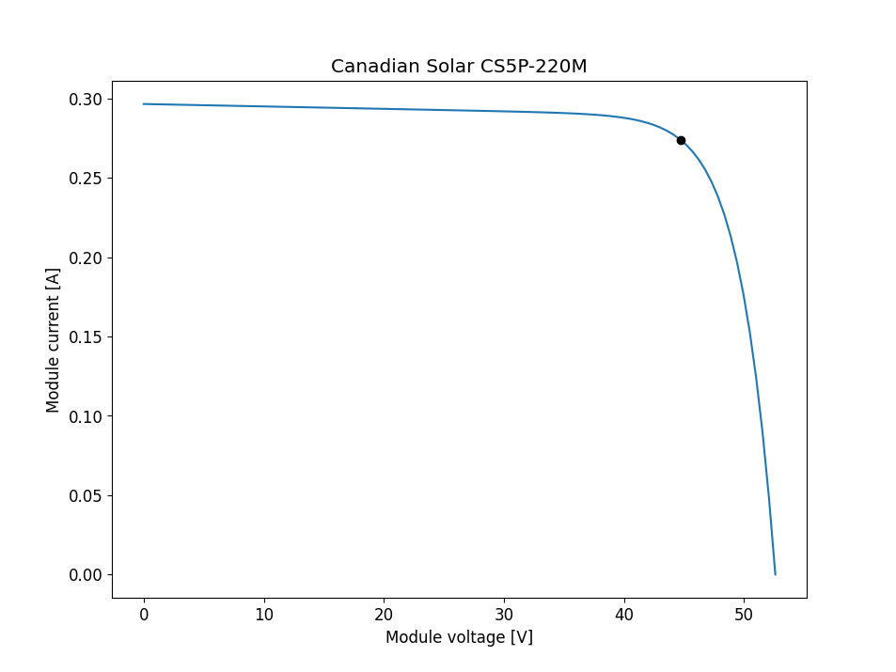
I-V Curve for the PV
Results without Shadow - 1
The I-V (current-voltage) curve is a graphical representation that shows the relationship between the current and voltage outputs of a solar panel or any electronic device. It provides valuable information about the panel's performance, efficiency, and power generation capabilities.

Slide 15
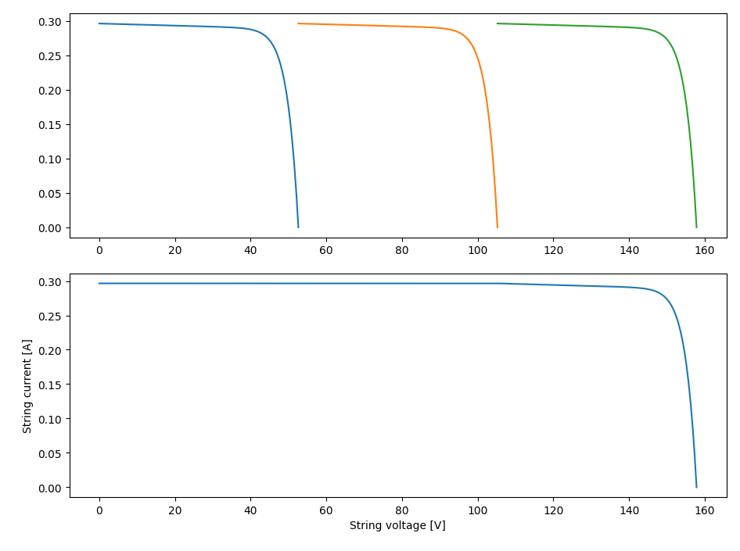
The Series I-V Curve
Results without Shadow - 2
The I-V (current-voltage) curve for a series of PV (photovoltaic) panels represents the relationship between the current and voltage outputs when multiple panels are connected in a series configuration. It helps assess the combined performance and power generation of the interconnected panels.

Slide 16
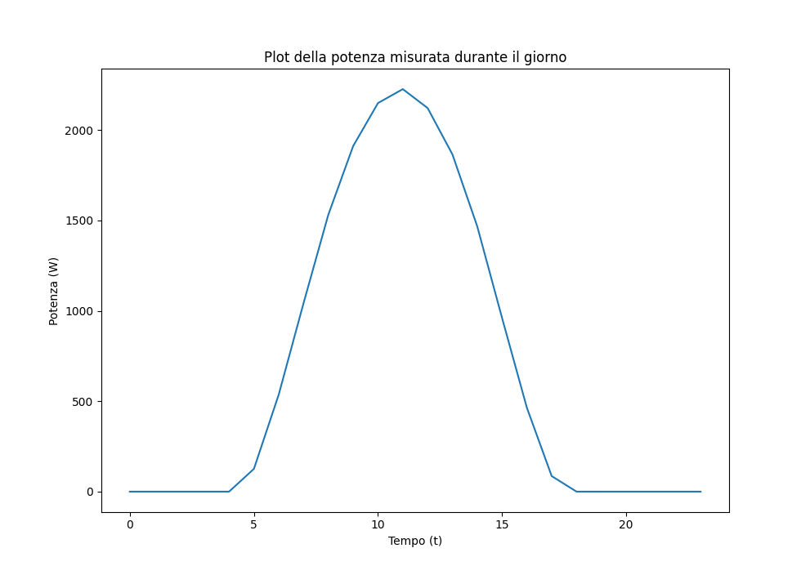
The Parallel Power curve
Results without Shadow - 3
A parallel configuration of PV (photovoltaic) panels involves connecting multiple panels side by side, with their positive terminals connected together and negative terminals connected together. This setup increases the overall current output while maintaining the same voltage level, resulting in higher power generation capacity.

Slide 17
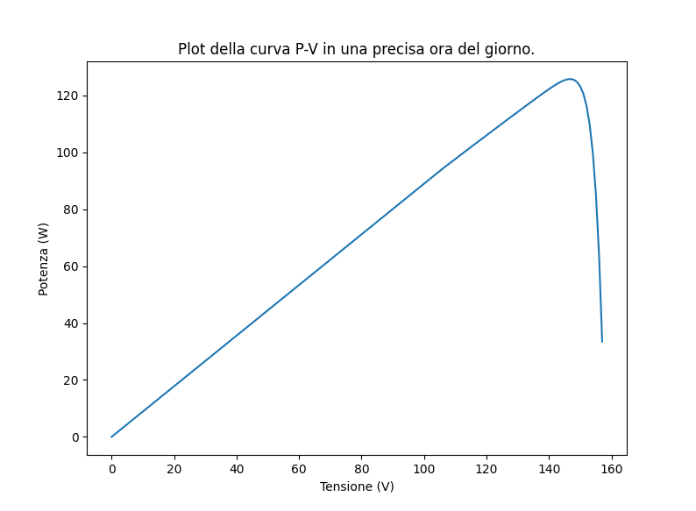
The P-V curve for the critical points
Results without Shadow - 4
At every hour, optimization is calculated, and therefore we can also construct the individual P-V curve for each optimization to display the chosen peak.

Slide 18
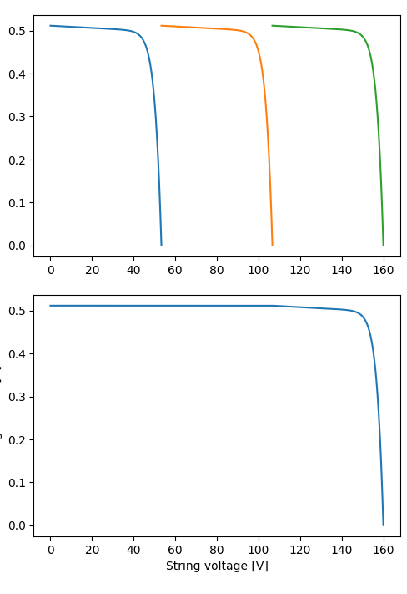
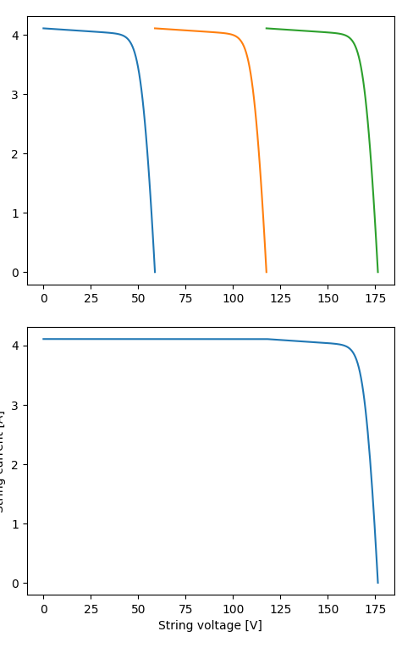
Results with Shadow on a single String - 1
String Ampere [A]
String Ampere [A]
String Ampere [A]

Slide 19
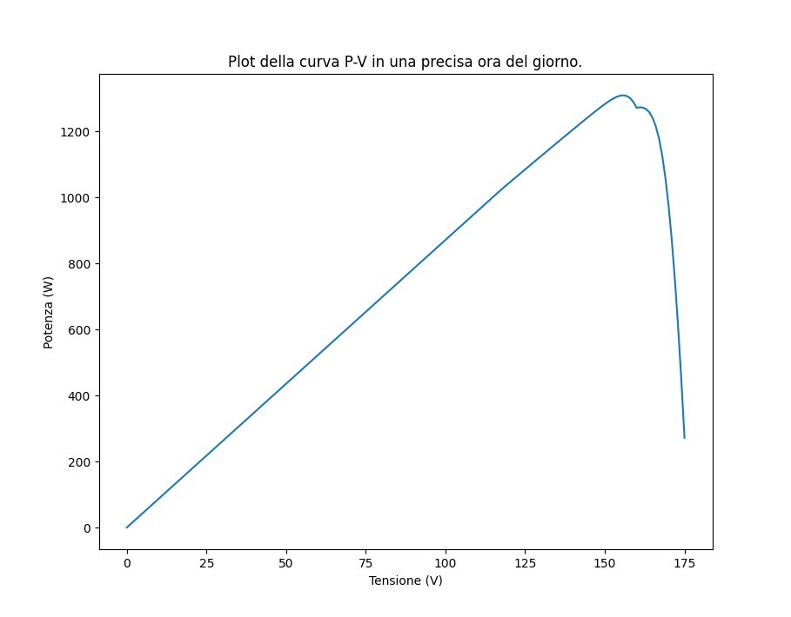
Results with Shadow on a single String - 2
It is noticeable that, unlike case 1, the presence of a second peak of lesser magnitude indicates a difference in power generated at different voltage values, which could represent a possible maximum of optimization, albeit local.

Slide 20
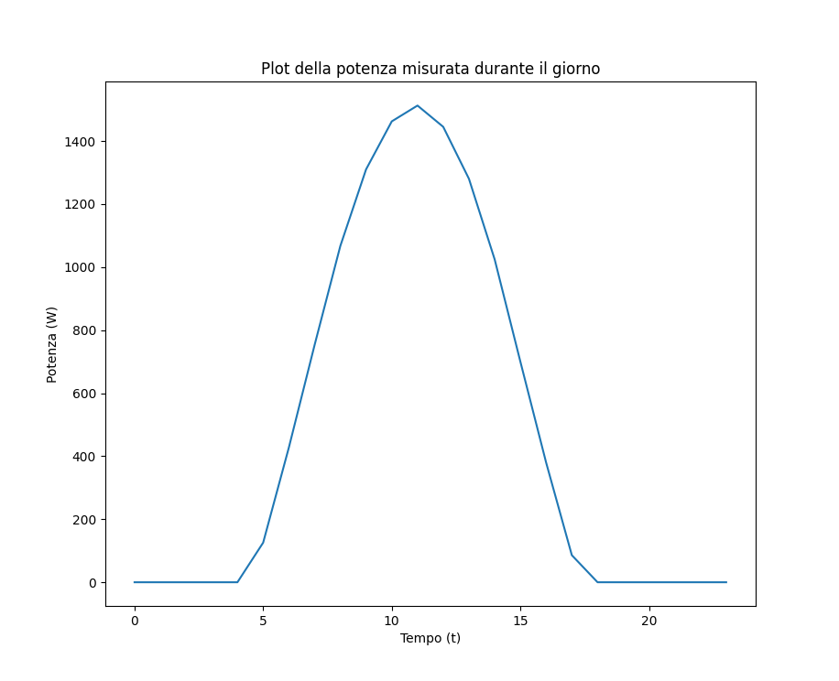
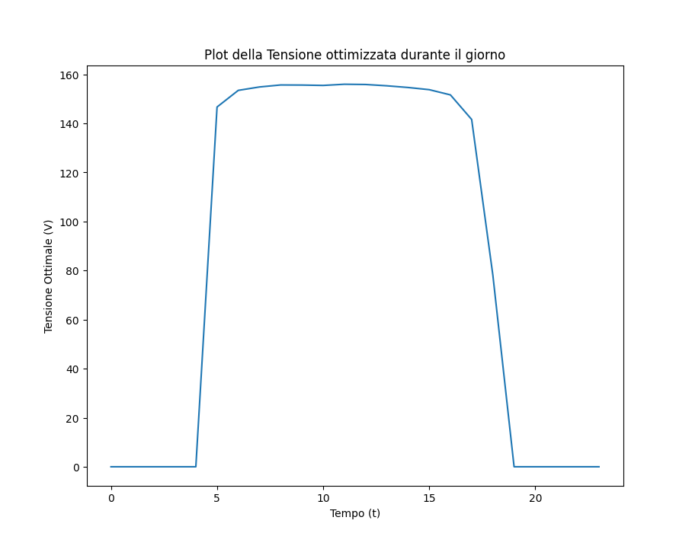
Results with Shadow on a single String - 3
The optimized voltage remains the same as in the shade-free case, as it is easily understood that in a parallel configuration, the voltage is shared among all components. Therefore, even if one of the three strings is turned off, the voltage remains unchanged. What varies, of course, is the amount of power produced during the day.

Slide 21
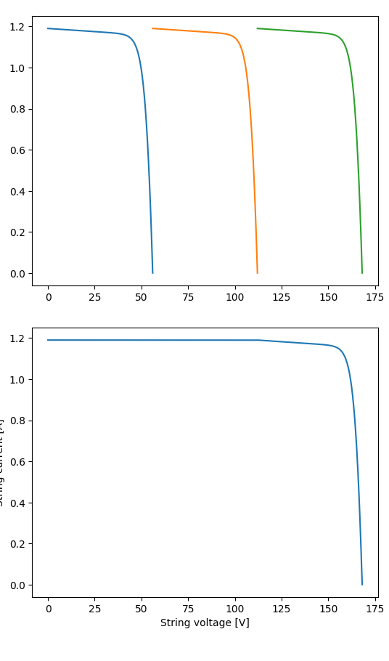
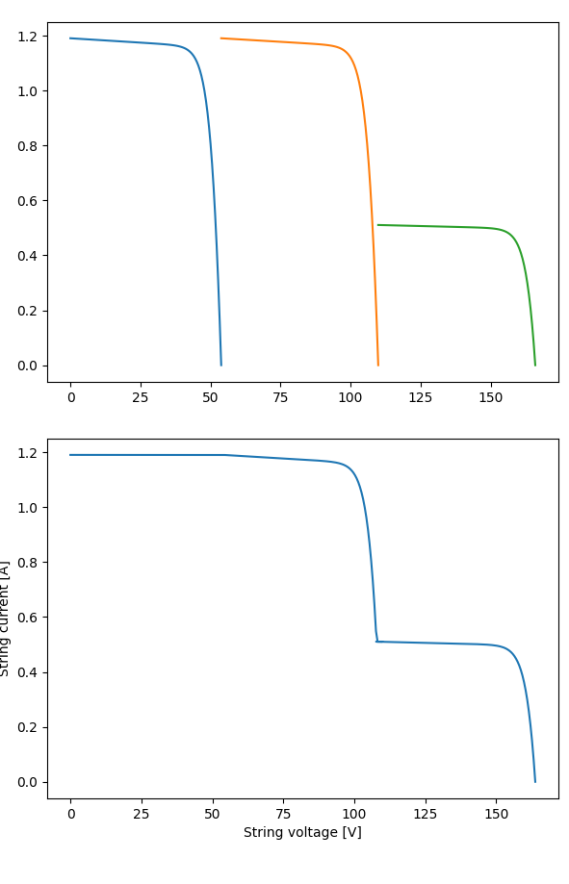
Results with Shadow on a single - 1

Slide 22
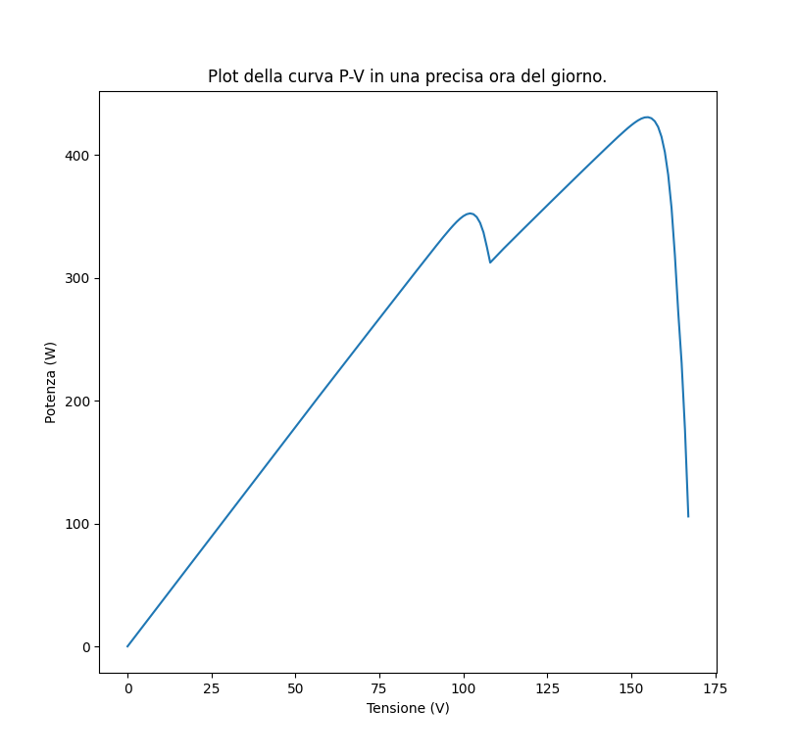
Results with Shadow on a single - 2
In this case, unlike case 1, the presence of a second peak of lesser magnitude indicates a difference in power generated at different voltage values, which could represent a possible maximum of optimization, albeit local.

Slide 23
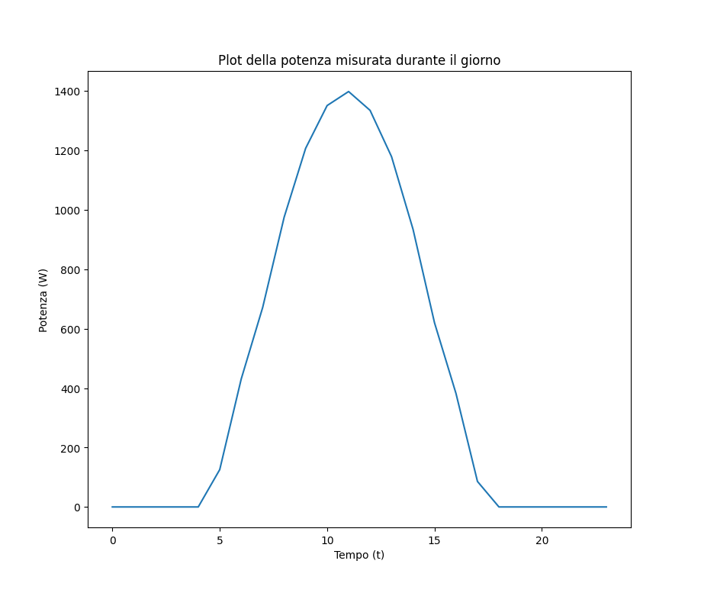
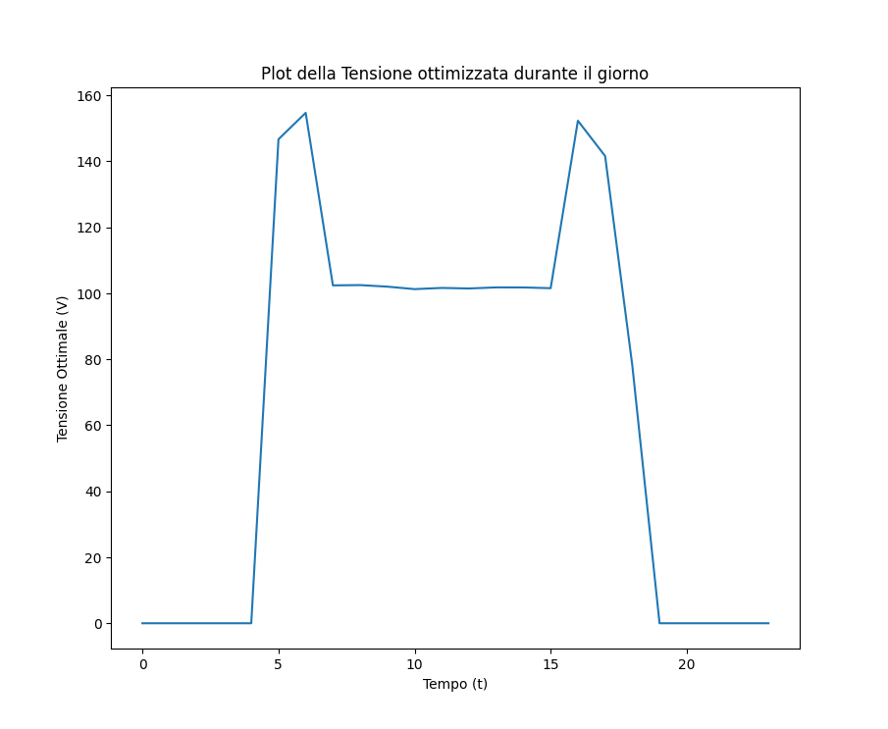
Results with Shadow on a single - 3
It can be observed that the power chosen by the optimizer is precisely the higher one among the two peaks in the previously shown P-V plot, which displayed two maximum power points.

Slide 24
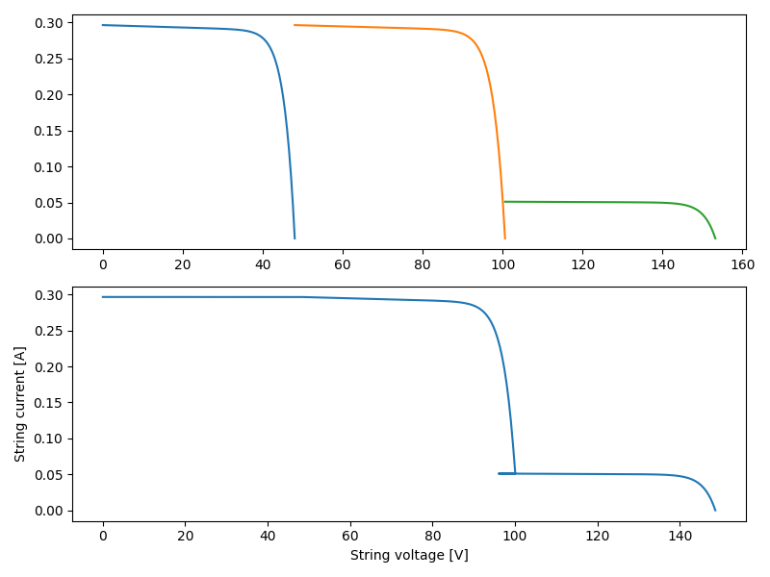
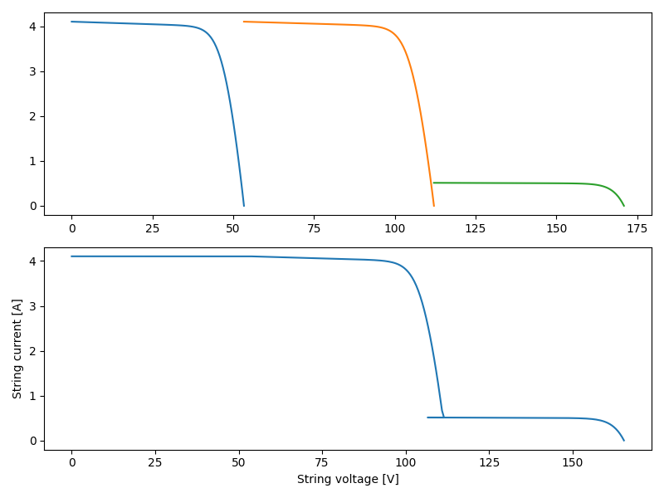
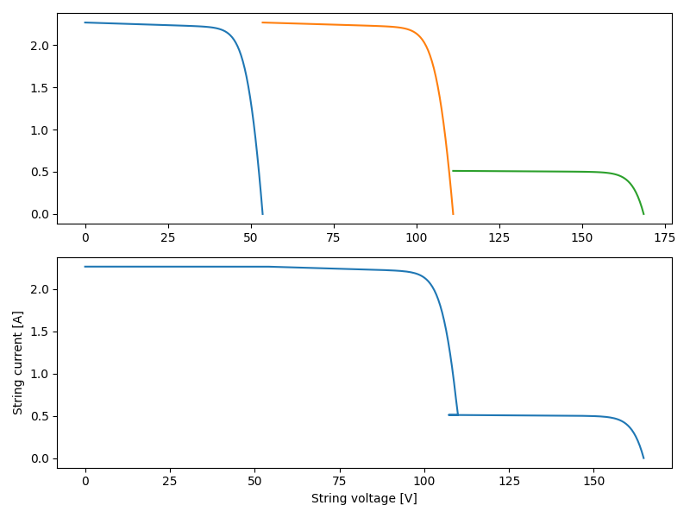
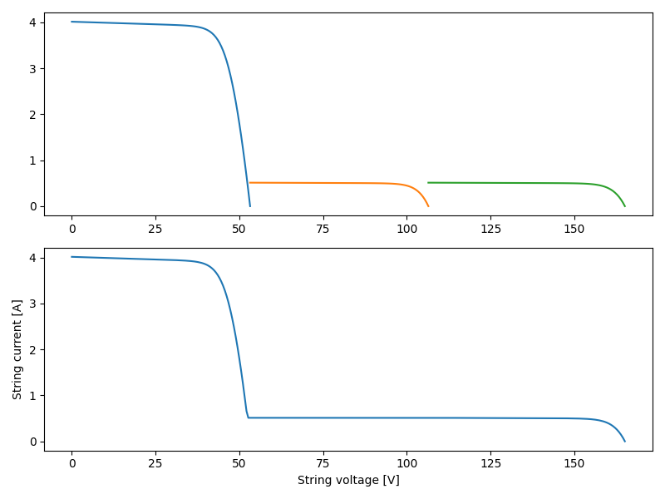
Results with Dynamic Shadow - 1
String 2 – Panel 1 shaded
String 3 – Panel 1 shaded
String 1 – Panel 1 shaded
By following the arrows, you can observe the changing conditions of the various panels in the strings.
String 1 – Panel 1 shaded
String 2 – Panel 1 shaded
String 2 – Panel 1,2 shaded
String 3 – Panel 1,2 shaded

Slide 25
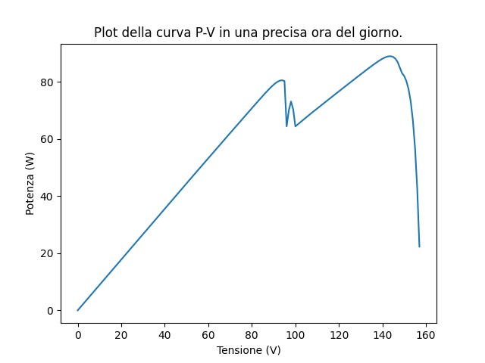
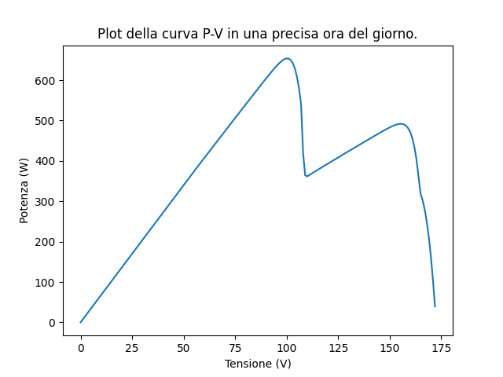
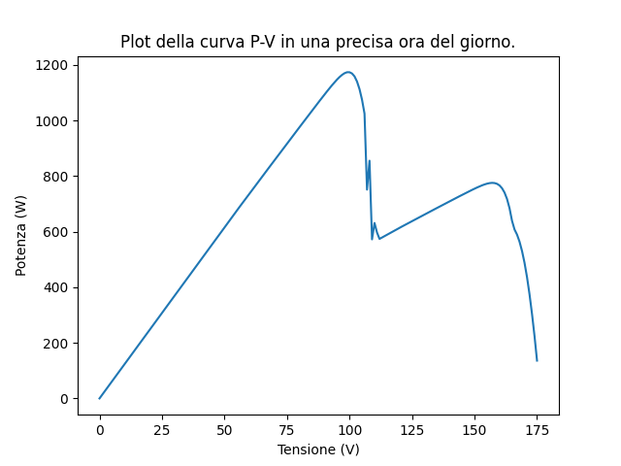
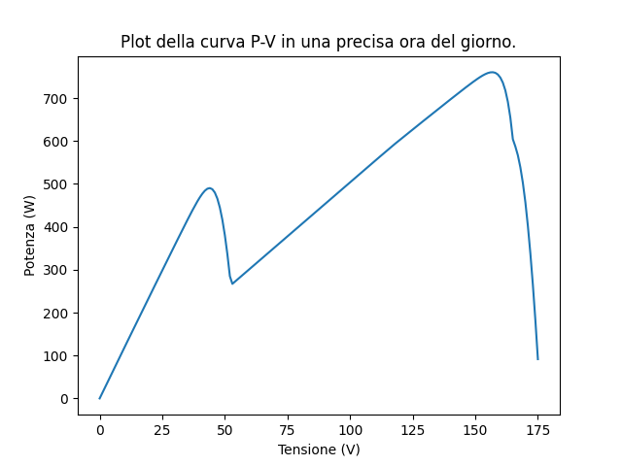
Results with Dynamic Shadow - 2
String 2 – Panel 1 shaded
String 3 – Panel 1 shaded
String 1 – Panel 1 shaded
As it was easy to deduce from the previous graphs, multiple peaks can be observed, which are obviously due to the presence of mismatch conditions among the various panels.
String 1 – Panel 1 shaded
String 2 – Panel 1 shaded
String 2 – Panel 1,2 shaded
String 3 – Panel 1,2 shaded

Slide 26
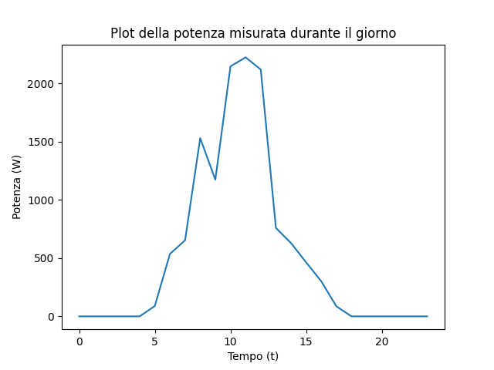
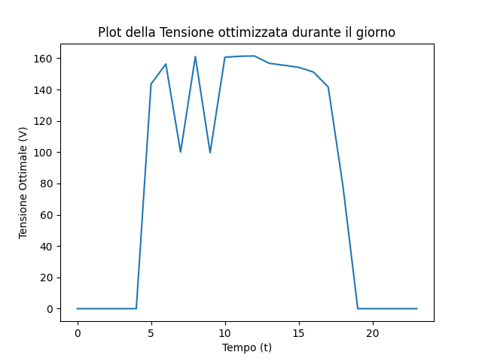
Results with Dynamic Shadow - 3

Slide 27
Time-Execution considerations
Necessary time for the optimization is: 0.07278084754943848
Necessary time for the optimization is: 0.08374691009521484
Necessary time for the optimization is: 0.08379578590393066
Necessary time for the optimization is: 0.08479881286621094
Necessary time for the optimization is: 0.5177104473114014
Necessary time for the optimization is: 0.5123865604400635
Necessary time for the optimization is: 0.507803201675415
Necessary time for the optimization is: 0.5382218360900879
Necessary time for the optimization is: 0.08324074745178223
Necessary time for the optimization is: 0.08420610427856445
Necessary time for the optimization is: 0.08022427558898926
Necessary time for the optimization is: 0.09141087532043457
Necessary time for the optimization is: 0.08193039894104004
The execution time on a high-quality laptop workstation is relatively low, with a maximum calculation time of 0.53 seconds for the 14-hour schedule. However, if the program were to be run on a microcontroller, it could take significantly longer. Considering the performance differences between the PC and the STM32 Nucleo F401RE microcontroller, we can estimate that the execution time on the microcontroller will be approximately 10 times longer.

Slide 28
Conclusions
In conclusion, this project has successfully addressed the optimization problem associated with a parallel-series configuration of photovoltaic (PV) panels in order to maximize power generation. By identifying the optimal voltage value that achieves maximum power output, the project has demonstrated an effective approach to optimizing the performance of photovoltaic systems.
Additionally, the project considered the impact of mismatch conditions among the panels within the parallel strings. By evaluating the system's behavior under varying mismatch conditions, valuable insights were gained into the robustness and adaptability of the proposed solution. This analysis contributes to a better understanding of real-world scenarios and the potential challenges that may arise in practical PV installations.
Overall, this project offers a comprehensive exploration of optimizing PV panel configurations and their performance under different conditions. The findings provide valuable insights for researchers, engineers, and industry professionals, fostering advancements in solar energy technologies and facilitating the widespread adoption of efficient and reliable photovoltaic systems.

Slide 29
Bibliography
https://pvlib-python.readthedocs.io/en/stable/
Photovoltaic Sources Modeling [Wiley]

