Slide 1
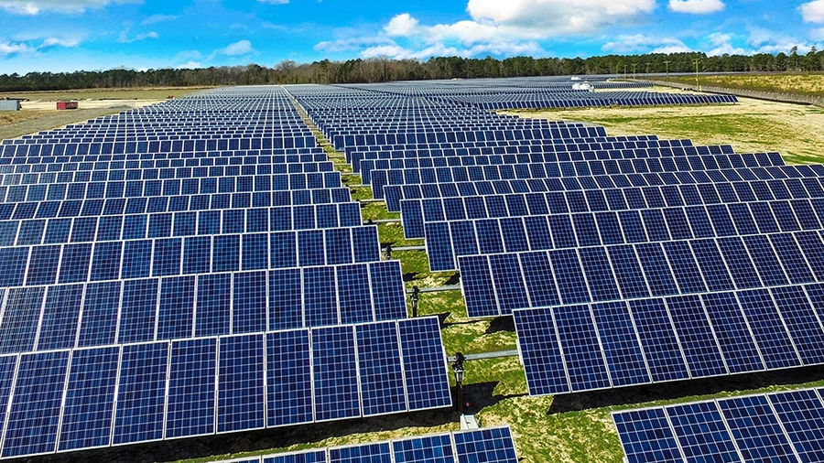
MPPT algorithm for calculating the maximum power of a photovoltaic system
Renewable Energy Smart Management

Slide 2

Problem description
This presentation focuses on solving an optimization problem related to a parallel-series configuration of photovoltaic (PV) panels to maximize power generation. The objective is to identify the optimal voltage value that achieves maximum power output. Throughout the presentation, the techniques employed and the results obtained will be analyzed, highlighting the advantages of this solution and potential applications in the field of solar energy. The focus will be on the approach used to optimize the performance of photovoltaic systems and the potential benefits that arise from it.

Slide 3
Problem outline
Mesure the I-V curve for each panel
Make a I-V curve for a string of panel
Make an optimization for the parallel of N strings
Plot the results starting from the single I-V curve to the optimized power result.

Slide 4
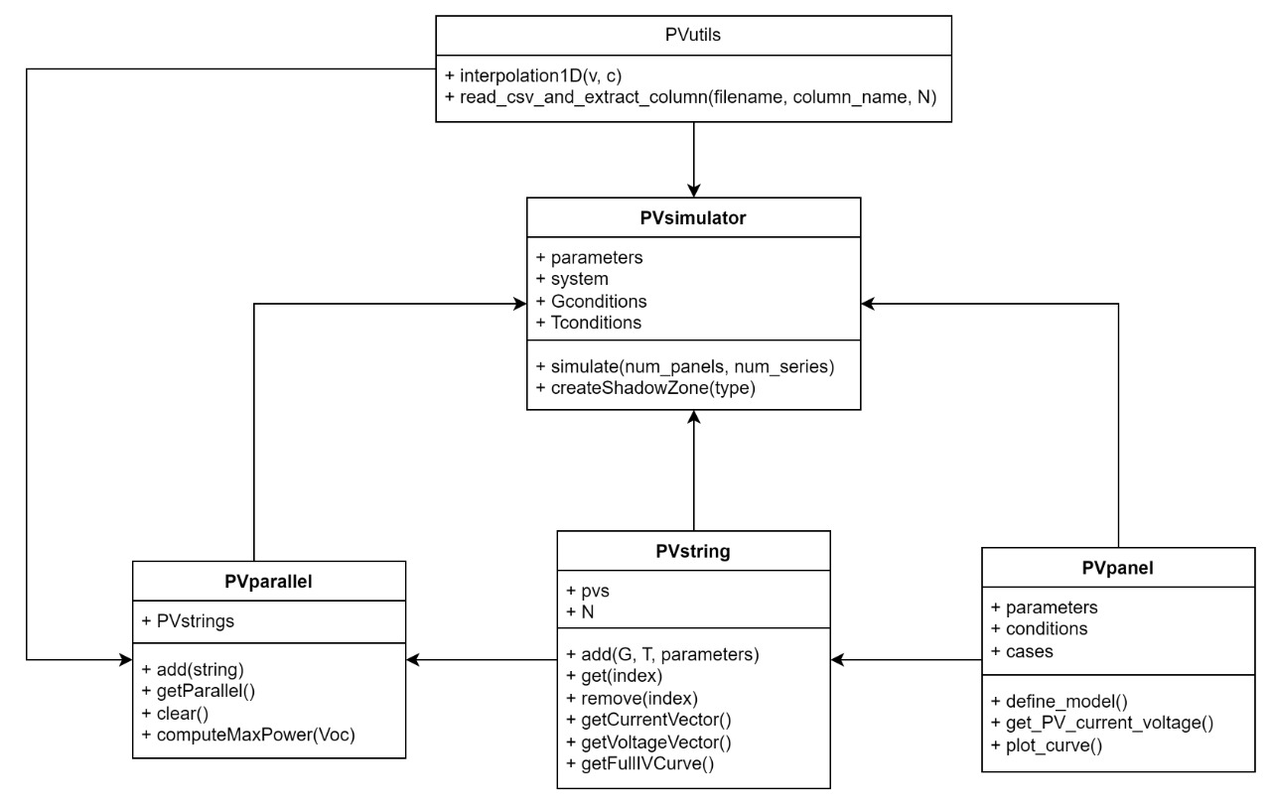
Code structure
For the implementation of the system and optimization modules, 4 classes and a utility library were required:
PVpanel
PVstring
PVparallel
PVsimulator
PVutils

Slide 5
PVpanel class
Starting from a set of parameters and a pair of operating conditions (G, T)
The single I-V curve of the photovoltaic panel is produced by measuring the current at the terminals as the voltage varies.
Input
Output

Slide 6
PVstring class
The PVpanel class is utilized to construct a new class for defining a series string of photovoltaic panels. In particular, thanks to the ability to create a list of objects.
An output is generated consisting of a list of PVpanel objects and a total I-V curve of all the panels in series.
Input
Output

Slide 7
PVparallel class
Having a class for strings available, we can connect these PV strings in parallel to increase the total power output.
In particular, a method is constructed to optimize the selection of voltage in order to maximize the power output of the system.
Input
Output

Slide 8
PVutils class
There are problems in both the string and parallel configurations:
In the PVString class, there is a need to interpolate the total curve as it is initially composed of a series of points.
In the PVparallel class, on the other hand, it is necessary to extract data from precise reports in CSV format.
The result is the development of two methods that address these two encountered problems.
Input
Output

Slide 9
PVsimulator class
In conclusion, a General and Modular Simulation class is created to generate a series of data on the power generated by the photovoltaic system.
In particular, the result will be plots generated by the various classes mentioned earlier and invoked during the simulation.
Input
Output

Slide 10
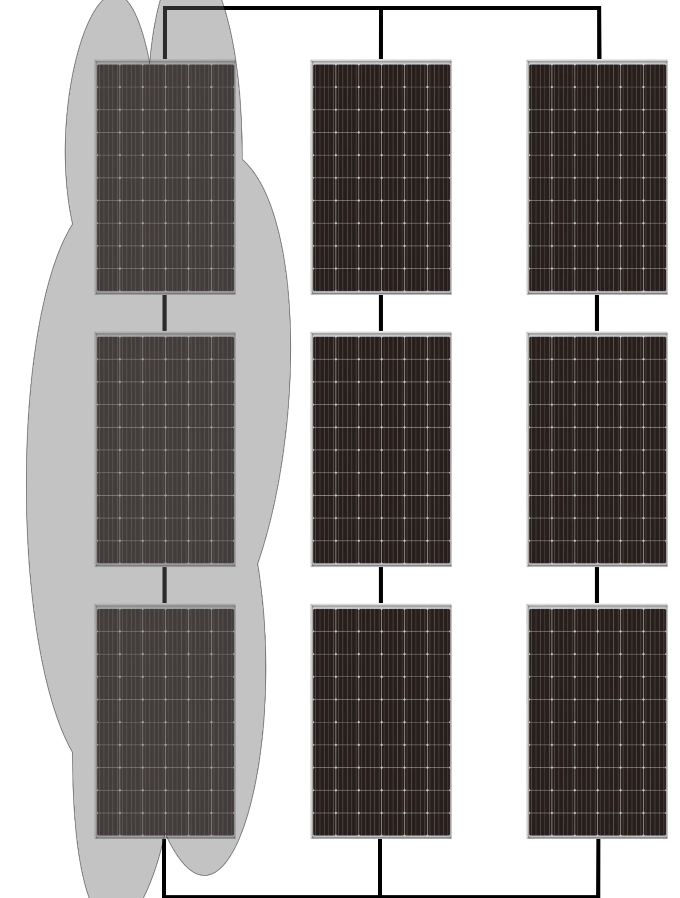
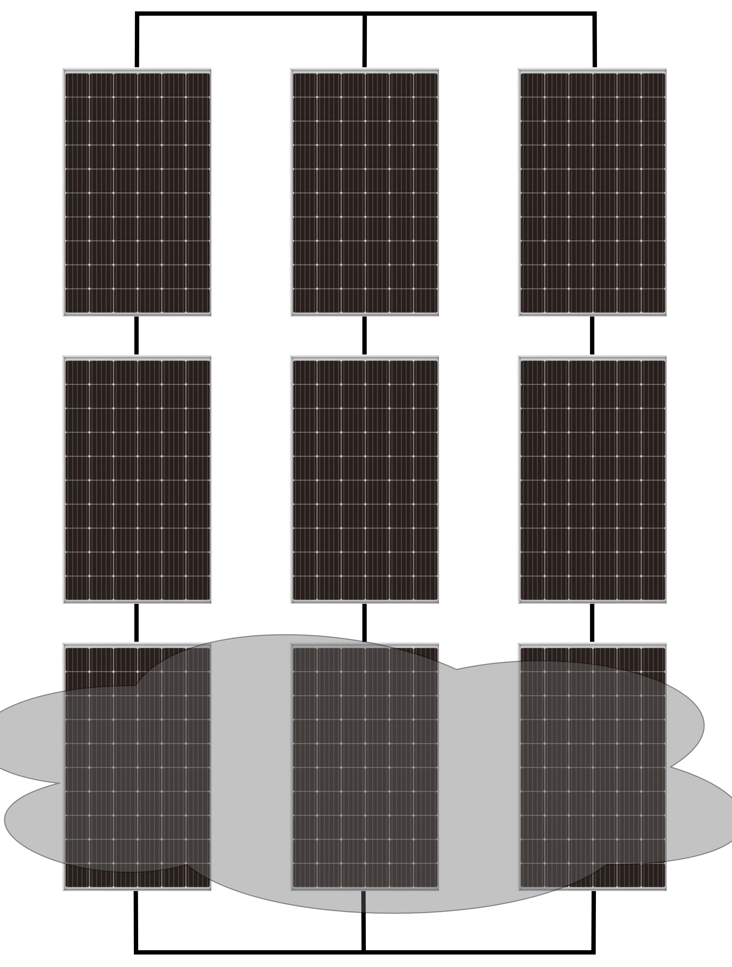
Shadow zone creator
To generate more realistic simulations and evaluate the increase or decrease in system performance caused by various environmental and weather conditions, a kind of mismatch generator is also used between the different panels within a string or across the entire parallel configuration, as shown in the figures.

Slide 11
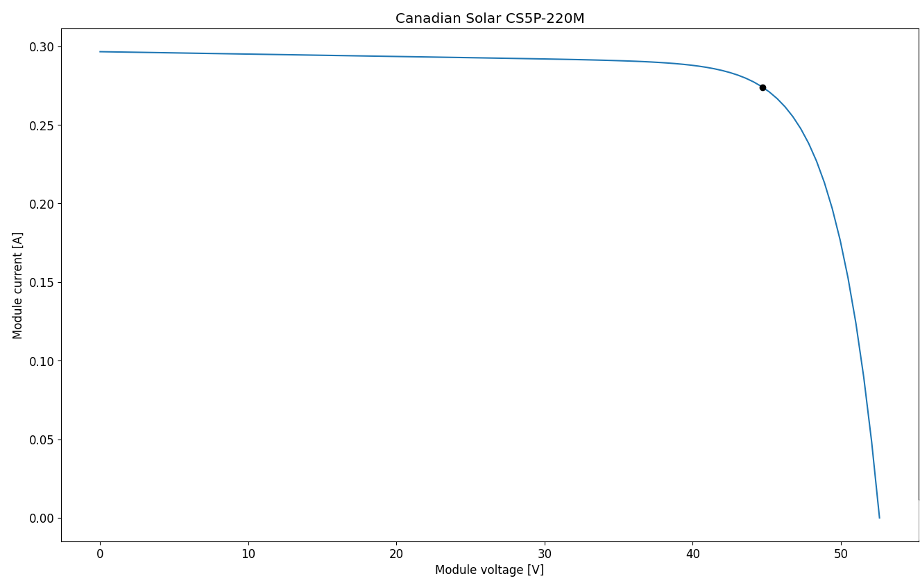
I-V Curve for the PV
Results without Shadow
The I-V (current-voltage) curve is a graphical representation that shows the relationship between the current and voltage outputs of a solar panel or any electronic device. It provides valuable information about the panel's performance, efficiency, and power generation capabilities.

Slide 12
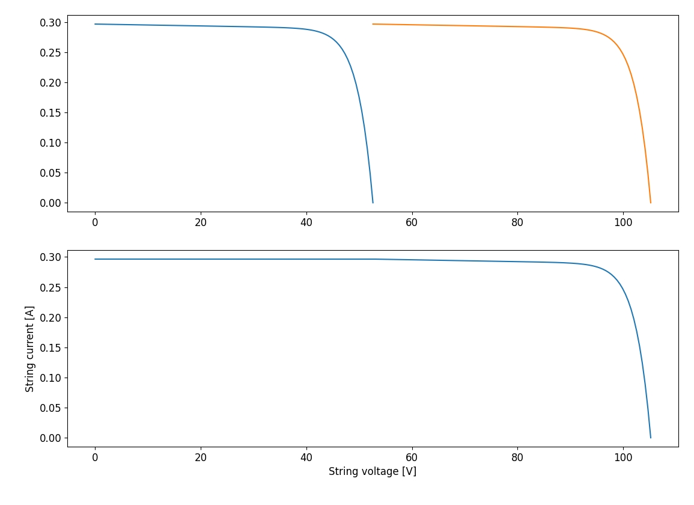
The Series I-V Curve
Results without Shadow
The I-V (current-voltage) curve for a series of PV (photovoltaic) panels represents the relationship between the current and voltage outputs when multiple panels are connected in a series configuration. It helps assess the combined performance and power generation of the interconnected panels.

Slide 13
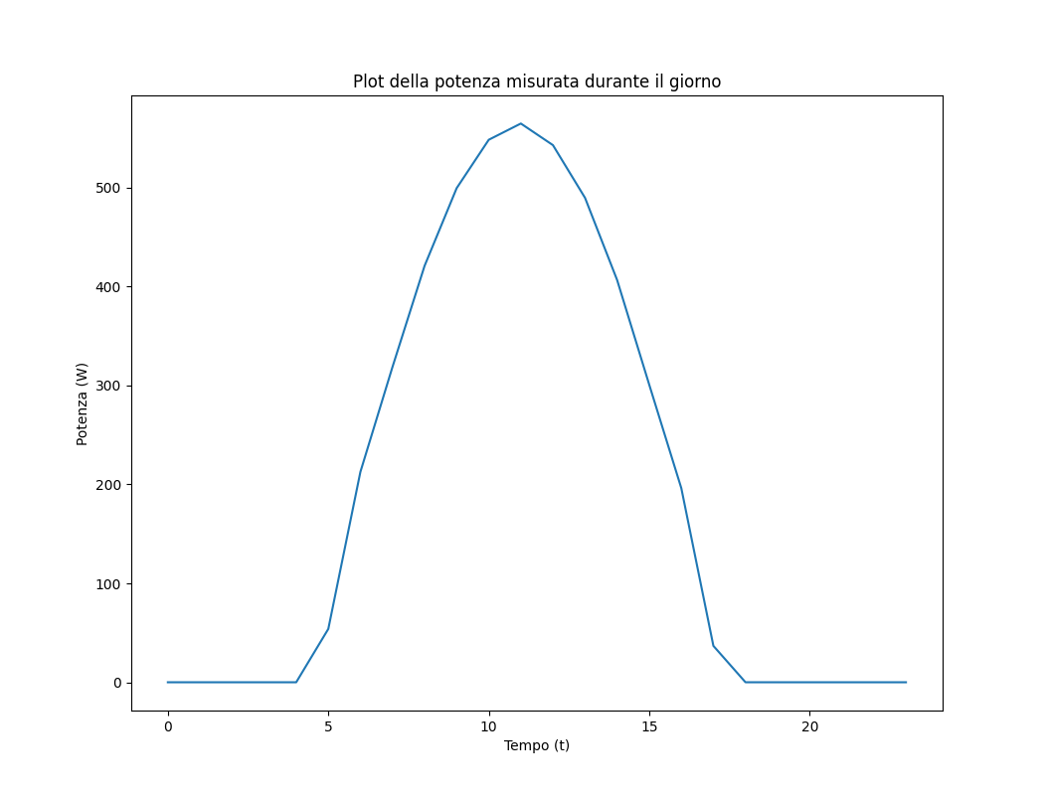
The Parallel Power curve
Results without Shadow
A parallel configuration of PV (photovoltaic) panels involves connecting multiple panels side by side, with their positive terminals connected together and negative terminals connected together. This setup increases the overall current output while maintaining the same voltage level, resulting in higher power generation capacity.

Slide 14
I-V Curve for the PV
Results with Shadow on a single String
The I-V (current-voltage) curve is a graphical representation that shows the relationship between the current and voltage outputs of a solar panel or any electronic device. It provides valuable information about the panel's performance, efficiency, and power generation capabilities.

Slide 15
The Series I-V Curve
Results with Shadow on a single String
The I-V (current-voltage) curve for a series of PV (photovoltaic) panels represents the relationship between the current and voltage outputs when multiple panels are connected in a series configuration. It helps assess the combined performance and power generation of the interconnected panels.

Slide 16
The Parallel Power curve
Results with Shadow on a single String
A parallel configuration of PV (photovoltaic) panels involves connecting multiple panels side by side, with their positive terminals connected together and negative terminals connected together. This setup increases the overall current output while maintaining the same voltage level, resulting in higher power generation capacity.

Slide 17
I-V Curve for the PV
Results with Shadow on a single panel but entire parallel
The I-V (current-voltage) curve is a graphical representation that shows the relationship between the current and voltage outputs of a solar panel or any electronic device. It provides valuable information about the panel's performance, efficiency, and power generation capabilities.

Slide 18
The Series I-V Curve
Results with Shadow on a single panel but entire parallel
The I-V (current-voltage) curve for a series of PV (photovoltaic) panels represents the relationship between the current and voltage outputs when multiple panels are connected in a series configuration. It helps assess the combined performance and power generation of the interconnected panels.

Slide 19
The Parallel Power curve
Results with Shadow on a single panel but entire parallel
A parallel configuration of PV (photovoltaic) panels involves connecting multiple panels side by side, with their positive terminals connected together and negative terminals connected together. This setup increases the overall current output while maintaining the same voltage level, resulting in higher power generation capacity.

Slide 20
Conclusions

Slide 21
Bibliography

