Slide 1
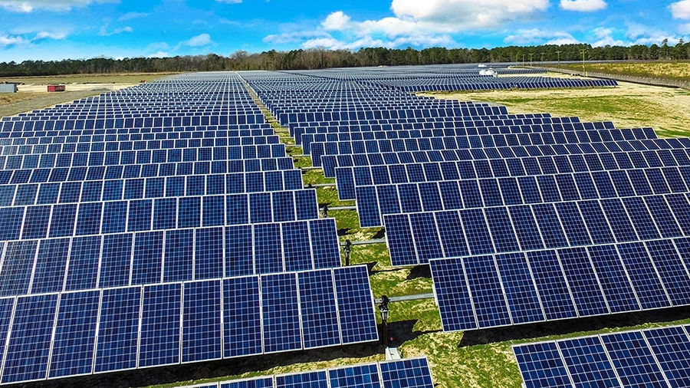
MPPT algorithm for calculating the maximum power of a photovoltaic system
Renewable Energy Smart Management

Slide 2
Theoretical outlines
Accenni sui pannelli
Come funziona MPPT in generale

Slide 3
Problem description

Slide 4
Problem resolution

Slide 5
Conclusions

Slide 6
Bibliography

