Slide 1
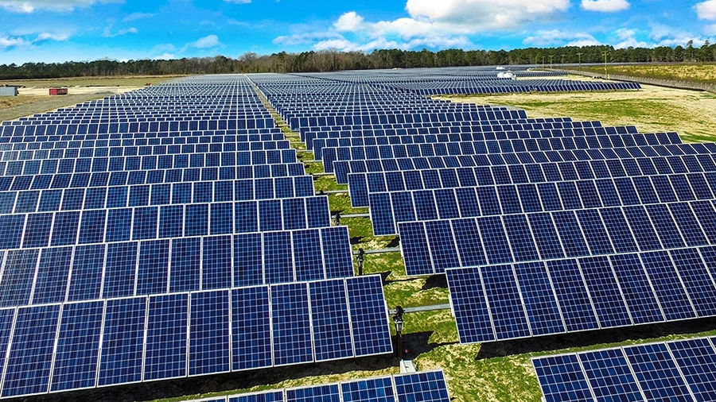
MPPT algorithm for calculating the maximum power of a photovoltaic system
Renewable Energy Smart Management

Slide 2

Problem description
This presentation focuses on solving an optimization problem related to a parallel-series configuration of photovoltaic (PV) panels to maximize power generation. The objective is to identify the optimal voltage value that achieves maximum power output. Throughout the presentation, the techniques employed and the results obtained will be analyzed, highlighting the advantages of this solution and potential applications in the field of solar energy. The focus will be on the approach used to optimize the performance of photovoltaic systems and the potential benefits that arise from it.

Slide 3
Problem outline
Mesure the I-V curve for each panel
Make a I-V curve for a string of panel
Make an optimization for the parallel of N strings
Plot the results starting from the single I-V curve to the optimized power result.

Slide 4
Theoretical outlines
Accenni sui pannelli
Come funziona MPPT in generale

Slide 5
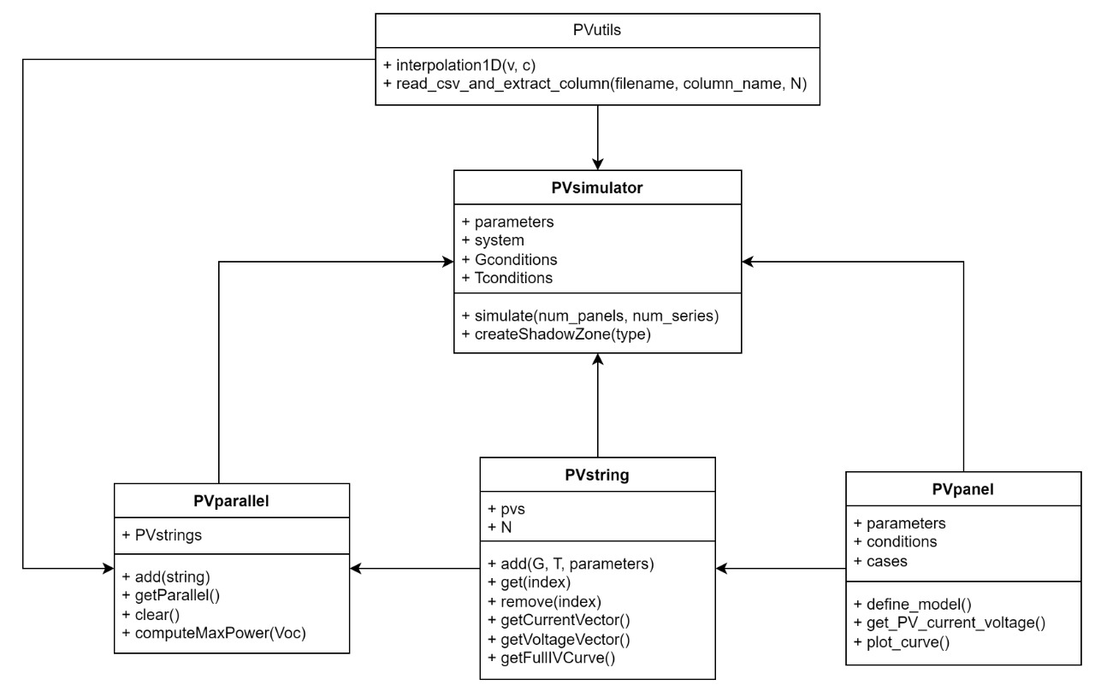
Code structure
Per l’implementazione del sistema e dei moduli di ottimizzazione sono state necessarie 4 classi e una libreria di utilità:
PVpanel
PVstring
PVparallel
PVsimulator
PVutils

Slide 6
PVpanel class
Input
Output

Slide 7
PVstring class
Input
Output

Slide 8
PVutils class
Input
Output

Slide 9
PVparallel class
Input
Output

Slide 10
PVsimulator class
Input
Output

Slide 11
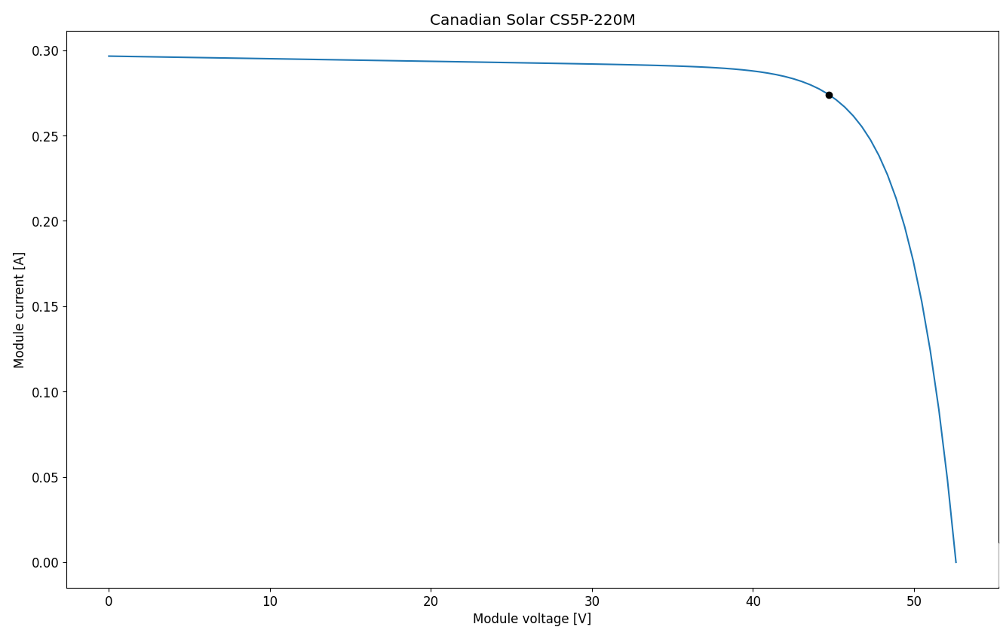
I-V Curve for the PV
Results without Shadow
The I-V (current-voltage) curve is a graphical representation that shows the relationship between the current and voltage outputs of a solar panel or any electronic device. It provides valuable information about the panel's performance, efficiency, and power generation capabilities.

Slide 12
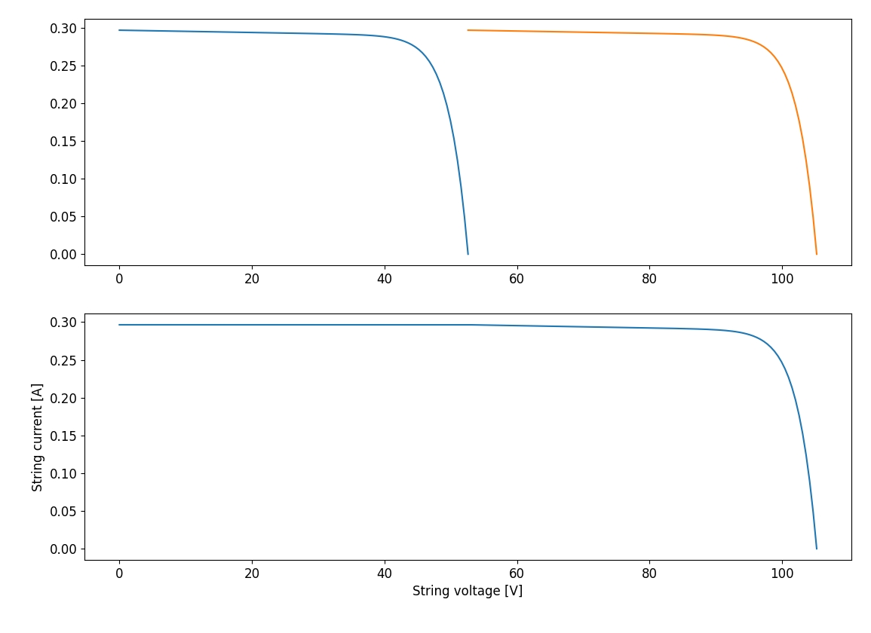
The Series I-V Curve
Results without Shadow
The I-V (current-voltage) curve for a series of PV (photovoltaic) panels represents the relationship between the current and voltage outputs when multiple panels are connected in a series configuration. It helps assess the combined performance and power generation of the interconnected panels.

Slide 13
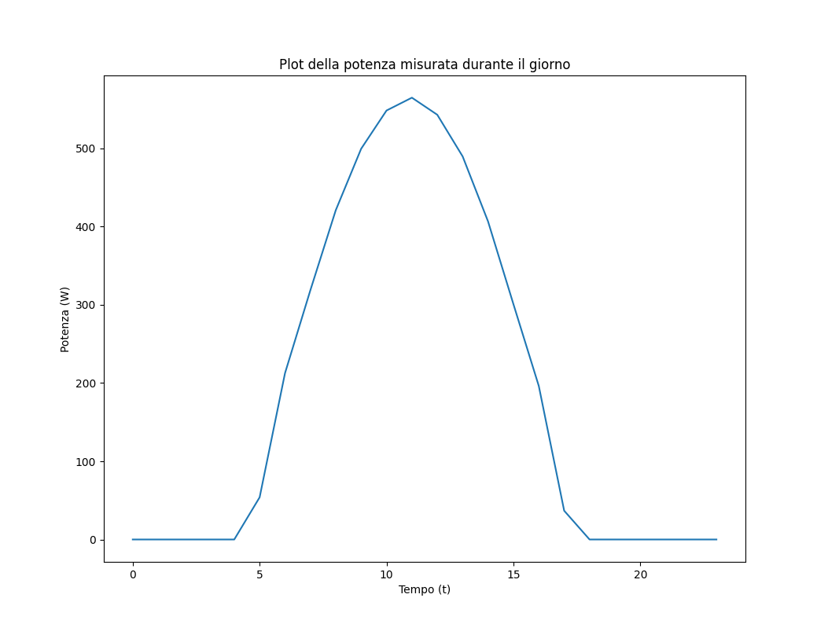
The Parallel Power curve
Results without Shadow
A parallel configuration of PV (photovoltaic) panels involves connecting multiple panels side by side, with their positive terminals connected together and negative terminals connected together. This setup increases the overall current output while maintaining the same voltage level, resulting in higher power generation capacity.

Slide 14
I-V Curve for the PV
Results with Shadow on a single String
The I-V (current-voltage) curve is a graphical representation that shows the relationship between the current and voltage outputs of a solar panel or any electronic device. It provides valuable information about the panel's performance, efficiency, and power generation capabilities.

Slide 15
The Series I-V Curve
Results with Shadow on a single String
The I-V (current-voltage) curve for a series of PV (photovoltaic) panels represents the relationship between the current and voltage outputs when multiple panels are connected in a series configuration. It helps assess the combined performance and power generation of the interconnected panels.

Slide 16
The Parallel Power curve
Results with Shadow on a single String
A parallel configuration of PV (photovoltaic) panels involves connecting multiple panels side by side, with their positive terminals connected together and negative terminals connected together. This setup increases the overall current output while maintaining the same voltage level, resulting in higher power generation capacity.

Slide 17
I-V Curve for the PV
Results with Shadow on a single panel but entire parallel
The I-V (current-voltage) curve is a graphical representation that shows the relationship between the current and voltage outputs of a solar panel or any electronic device. It provides valuable information about the panel's performance, efficiency, and power generation capabilities.

Slide 18
The Series I-V Curve
Results with Shadow on a single panel but entire parallel
The I-V (current-voltage) curve for a series of PV (photovoltaic) panels represents the relationship between the current and voltage outputs when multiple panels are connected in a series configuration. It helps assess the combined performance and power generation of the interconnected panels.

Slide 19
The Parallel Power curve
Results with Shadow on a single panel but entire parallel
A parallel configuration of PV (photovoltaic) panels involves connecting multiple panels side by side, with their positive terminals connected together and negative terminals connected together. This setup increases the overall current output while maintaining the same voltage level, resulting in higher power generation capacity.

Slide 20
Conclusions

Slide 21
Bibliography

