Slide 1
Overview of Python Setup and Tools

Slide 2

Anaconda for Python
Why use anaconda prompt vs command prompt?
Handles background PATH information
Allows us to use the conda and python commands immediately
Ease of accessing, changing, and updating conda environments
Uses same commands as command prompt
https://www.thomas-krenn.com/en/wiki/Cmd_commands_under_Windows
Notes:
You can set the paths/environmental variables in the regular command prompt to operate the same way as anaconda, but the anaconda prompt does it for you

Slide 3
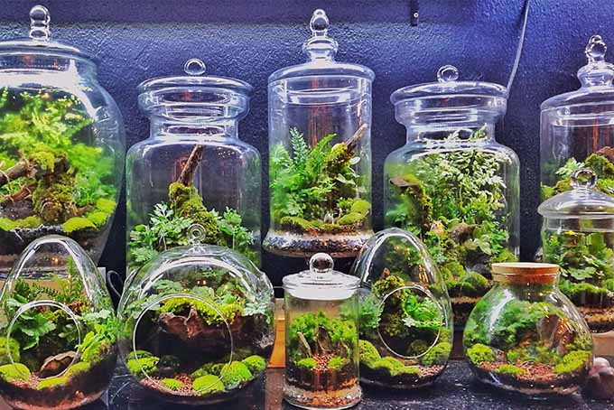
Anaconda Environments
Important for organization, management, and replicability
Contain specific modules, packages, and dependencies
Allows for more efficient collaboration
Keeps projects independent of each other
MUST BE MAINTAINED

Slide 4




VS Code
Programming IDE (integrated development environment) that works for many programming languages
Python, R, JavaScript, Java, C++, Node.js, etc.
Ranked as the most popular developer environment tool by the Stack Overflow 2023 Developer Survey
Great place to build, test/debug, and troubleshoot code
Can utilize Git
Notes:
**Open VS Code**

Slide 5
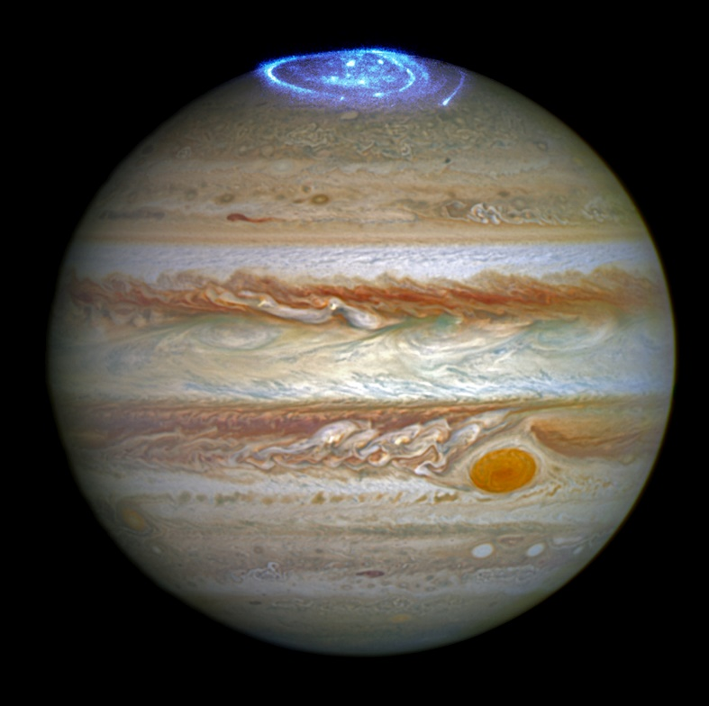

Jupyter Notebooks
“Notebooks” contain both rich text and code
Rich text can include figures, links, and equations and is written using Markdown syntax
“Jupyter” originally targeted the use of Julia, Python, and R
Really good for class homeworks and projects
Not as good for efficient programming

Slide 6
Python Data Structures

Slide 7
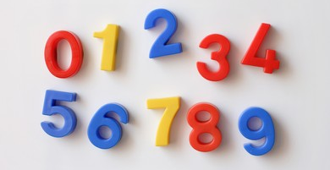
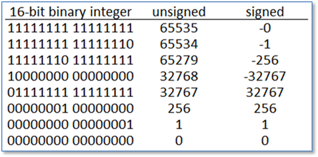
Primitive Data Structures
Integer
Numeric data
Whole numbers
Positive and negative
Float
String
Boolean

Slide 8
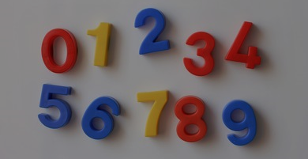
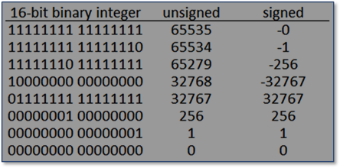
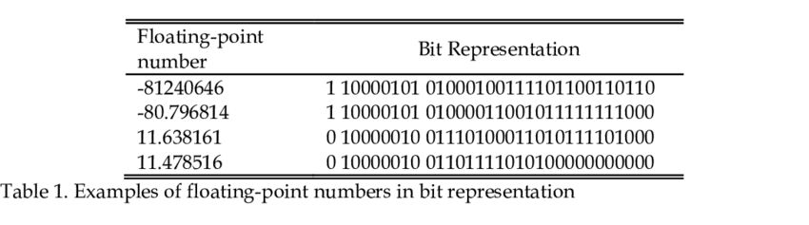
Primitive Data Structures
Integer
Float
“Floating point numbers”
Numeric data
Real numbers*
Positive and negative
Contains a decimal
String
Boolean
Notes:
*floats can also represent real numbers as an approximation, but they cannot accurately and precisely represent all real numbers (ex. Sqrt(2) or Pi)

Slide 9
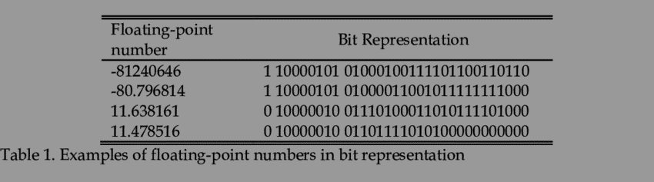
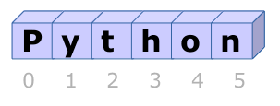
Primitive Data Structures
Integer
Float
String
Sequence of characters
Denoted using ‘…’ or “…”
Indexable
Specific string operations
Boolean

Slide 10
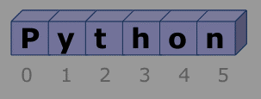
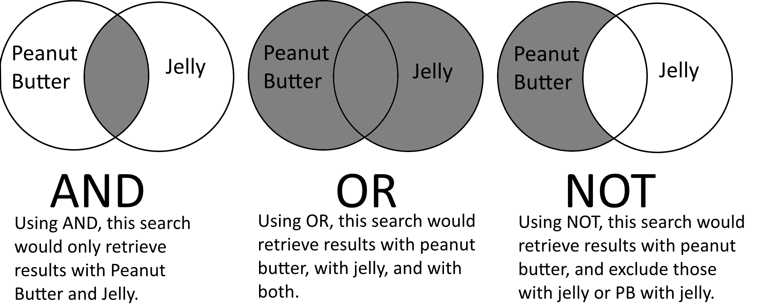
Primitive Data Structures
Integer
Float
String
Boolean
Only values:
True or False
Logical operations:
or and not
Comparison operations:
== != >= <= > <

Slide 11
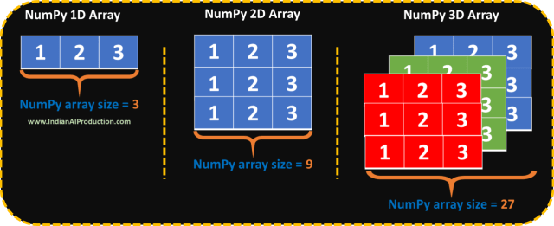
Non-primitive Data Structures
Array
Stores a collection of items
Ordered, mutable, can store duplicates
Must import a module or package
Important with the numpy package
More efficient than lists for storing large amounts of data
Good for numerical operations
List
Tuple
Set
Dictionary

Slide 12
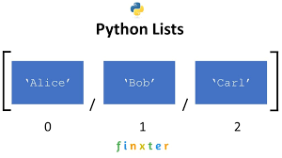
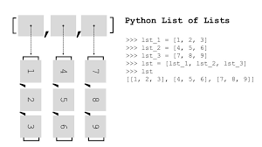
Non-primitive Data Structures
Array
List
Stores a collection of items
Ordered, mutable, can store duplicates
Built-in data structure
Denoted by […] and elements separated by commas
Tuple
Set
Dictionary

Slide 13
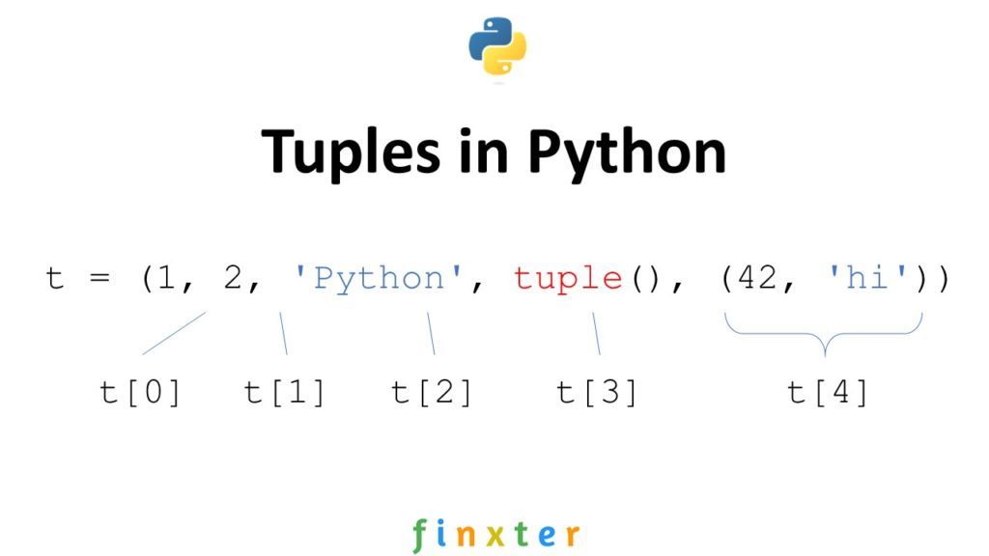
Non-primitive Data Structures
Array
List
Tuple
Stores a collection of items
Ordered, immutable, can store duplicates
Built-in data structure
Denoted by (…) and elements separated by commas*
Set
Dictionary
Notes:
*if creating a tuple with one element, must have a trailing comma (ex: t = (17,)) otherwise python reads it as a parenthesized numerical expression
Ref: “Data Structures & Algorithms in Python” by Goodrich et al

Slide 14

Non-primitive Data Structures
Array
List
Tuple
Set
Stores a collection of items
Unordered, immutable, can not store duplicates
Built-in data structure
Denoted by {…} and elements separated by commas
Dictionary

Slide 15
Non-primitive Data Structures
Array
List
Tuple
Set
Dictionary
Stores a collection of key : value pairs
Ordered*, mutable, can not store duplicate keys, can store duplicate values
Built-in data structure
Denoted by {…} and key : value elements separated by commas

Slide 16
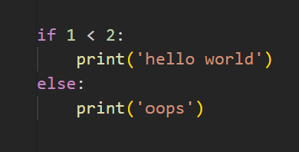
Conditional Statements
IF / ELSE statements use Booleans to execute different sections of code
IF the Boolean result of a logical or comparison operator is True…
Notes:
IF the Boolean result of a logical or comparison operator is True, then the code directly beneath the IF statement will be executed
ELSE (if the Boolean result is False), the code directly beneath the IF statement is skipped, and the code below the ELSE statement is executed

Slide 17
Conditional Statements
IF / ELSE statements use Booleans to execute different sections of code
IF the Boolean result of a logical or comparison operator is True, then the code directly beneath the IF statement will be executed
Notes:
IF the Boolean result of a logical or comparison operator is True, then the code directly beneath the IF statement will be executed
ELSE (if the Boolean result is False), the code directly beneath the IF statement is skipped, and the code below the ELSE statement is executed

Slide 18
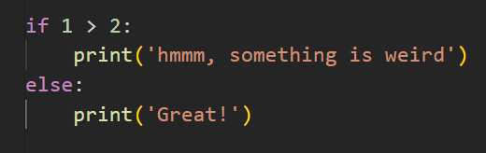
Conditional Statements
IF / ELSE statements use Booleans to execute different sections of code
ELSE (if the Boolean result is False)…
Notes:
ELSE (if the Boolean result is False), the code directly beneath the IF statement is skipped, and the code below the ELSE statement is executed

Slide 19
Conditional Statements
IF / ELSE statements use Booleans to execute different sections of code
ELSE (if the Boolean result is False), the code directly beneath the IF statement is skipped, and the code below the ELSE statement is executed
Notes:
ELSE (if the Boolean result is False), the code directly beneath the IF statement is skipped, and the code below the ELSE statement is executed

Slide 20
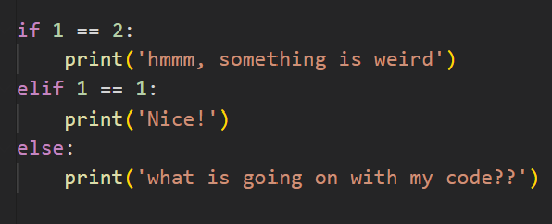
Conditional Statements: ELIF
The ELIF statement must follow an IF statement
It reads as “ELSE IF”, aka…
Notes:
**NOT THE SAME AS IF IF **
An IF statement following an IF statement will be tested regardless of the order
An ELIF will only be executed if the preceding IF statement was False

Slide 21
Conditional Statements: ELIF
The ELIF statement must follow an IF statement
It reads as “ELSE IF”, aka, the IF statement was False therefore, we will try another IF statement
Notes:
**NOT THE SAME AS IF IF **
An IF statement following an IF statement will be tested regardless of the order
An ELIF will only be executed if the preceding IF statement was False

Slide 22
Conditional Statements: ELIF
The ELIF statement must follow an IF statement
It reads as “ELSE IF”, aka, the IF statement was False therefore, we will try another IF statement
If the ELIF statement is True, the code beneath it will be executed
Notes:
**NOT THE SAME AS IF IF **
An IF statement following an IF statement will be tested regardless of the order
An ELIF will only be executed if the preceding IF statement was False

Slide 23
Conditional Statements: ELIF
The ELIF statement must follow an IF statement
It reads as “ELSE IF”, aka, the IF statement was False therefore, we will try another IF statement
An ELIF will only be executed if the preceding IF statement was False
Notes:
**NOT THE SAME AS IF IF **
An IF statement following an IF statement will be tested regardless of the order
An ELIF will only be executed if the preceding IF statement was False

Slide 24
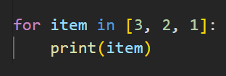
FOR and WHILE Loops
Loops are very useful structures that allow a section of code to be executed repeatedly
A FOR loop iterates over a sequence
Notes:
A WHILE loop iterates as long as a condition is TRUE
**NOTE: it is possible to create an infinite while loop – try to avoid this!

Slide 25

FOR and WHILE Loops
Loops are very useful structures that allow a section of code to be executed repeatedly
A FOR loop iterates over a sequence
Notes:
A WHILE loop iterates as long as a condition is TRUE
**NOTE: it is possible to create an infinite while loop – try to avoid this!

Slide 26
FOR and WHILE Loops
Loops are very useful structures that allow a section of code to be executed repeatedly
A FOR loop iterates over a sequence
Notes:
A WHILE loop iterates as long as a condition is TRUE
**NOTE: it is possible to create an infinite while loop – try to avoid this!

Slide 27
FOR and WHILE Loops
Loops are very useful structures that allow a section of code to be executed repeatedly
A FOR loop iterates over a sequence
Notes:
A WHILE loop iterates as long as a condition is TRUE
**NOTE: it is possible to create an infinite while loop – try to avoid this!

Slide 28
FOR and WHILE Loops
Loops are very useful structures that allow a section of code to be executed repeatedly
A FOR loop iterates over a sequence
Notes:
A WHILE loop iterates as long as a condition is TRUE
**NOTE: it is possible to create an infinite while loop – try to avoid this!

Slide 29
FOR and WHILE Loops
Loops are very useful structures that allow a section of code to be executed repeatedly
A FOR loop iterates over a sequence
Notes:
A WHILE loop iterates as long as a condition is TRUE
**NOTE: it is possible to create an infinite while loop – try to avoid this!

Slide 30
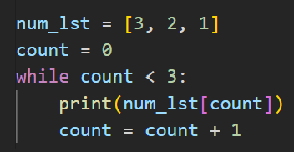
FOR and WHILE Loops
Loops are very useful structures that allow a section of code to be executed repeatedly
A FOR loop iterates over a sequence
A WHILE loop iterates as long as a condition is TRUE
count = 0
Notes:
A WHILE loop iterates as long as a condition is TRUE
**NOTE: it is possible to create an infinite while loop – try to avoid this!

Slide 31
FOR and WHILE Loops
Loops are very useful structures that allow a section of code to be executed repeatedly
A FOR loop iterates over a sequence
A WHILE loop iterates as long as a condition is TRUE
count = 0
Loops are very useful structures that allow a section of code to be executed repeatedly
A FOR loop iterates over a sequence
A WHILE loop iterates as long as a condition is TRUE
Notes:
A WHILE loop iterates as long as a condition is TRUE
**NOTE: it is possible to create an infinite while loop – try to avoid this!

Slide 32
FOR and WHILE Loops
Loops are very useful structures that allow a section of code to be executed repeatedly
A FOR loop iterates over a sequence
A WHILE loop iterates as long as a condition is TRUE
count = 1
Loops are very useful structures that allow a section of code to be executed repeatedly
A FOR loop iterates over a sequence
A WHILE loop iterates as long as a condition is TRUE
Notes:
A WHILE loop iterates as long as a condition is TRUE
**NOTE: it is possible to create an infinite while loop – try to avoid this!

Slide 33
FOR and WHILE Loops
Loops are very useful structures that allow a section of code to be executed repeatedly
A FOR loop iterates over a sequence
A WHILE loop iterates as long as a condition is TRUE
count = 1
Notes:
A WHILE loop iterates as long as a condition is TRUE
**NOTE: it is possible to create an infinite while loop – try to avoid this!

Slide 34
FOR and WHILE Loops
Loops are very useful structures that allow a section of code to be executed repeatedly
A FOR loop iterates over a sequence
A WHILE loop iterates as long as a condition is TRUE
count = 1
Loops are very useful structures that allow a section of code to be executed repeatedly
A FOR loop iterates over a sequence
A WHILE loop iterates as long as a condition is TRUE
Notes:
A WHILE loop iterates as long as a condition is TRUE
**NOTE: it is possible to create an infinite while loop – try to avoid this!

Slide 35
FOR and WHILE Loops
Loops are very useful structures that allow a section of code to be executed repeatedly
A FOR loop iterates over a sequence
A WHILE loop iterates as long as a condition is TRUE
count = 2
Loops are very useful structures that allow a section of code to be executed repeatedly
A FOR loop iterates over a sequence
A WHILE loop iterates as long as a condition is TRUE
Notes:
A WHILE loop iterates as long as a condition is TRUE
**NOTE: it is possible to create an infinite while loop – try to avoid this!

Slide 36
FOR and WHILE Loops
Loops are very useful structures that allow a section of code to be executed repeatedly
A FOR loop iterates over a sequence
A WHILE loop iterates as long as a condition is TRUE
count = 2
Notes:
A WHILE loop iterates as long as a condition is TRUE
**NOTE: it is possible to create an infinite while loop – try to avoid this!

Slide 37
FOR and WHILE Loops
Loops are very useful structures that allow a section of code to be executed repeatedly
A FOR loop iterates over a sequence
A WHILE loop iterates as long as a condition is TRUE
count = 2
Loops are very useful structures that allow a section of code to be executed repeatedly
A FOR loop iterates over a sequence
A WHILE loop iterates as long as a condition is TRUE
Notes:
A WHILE loop iterates as long as a condition is TRUE
**NOTE: it is possible to create an infinite while loop – try to avoid this!

Slide 38
FOR and WHILE Loops
Loops are very useful structures that allow a section of code to be executed repeatedly
A FOR loop iterates over a sequence
A WHILE loop iterates as long as a condition is TRUE
count = 3
Loops are very useful structures that allow a section of code to be executed repeatedly
A FOR loop iterates over a sequence
A WHILE loop iterates as long as a condition is TRUE
Notes:
A WHILE loop iterates as long as a condition is TRUE
**NOTE: it is possible to create an infinite while loop – try to avoid this!

Slide 39
FOR and WHILE Loops
Loops are very useful structures that allow a section of code to be executed repeatedly
A FOR loop iterates over a sequence
A WHILE loop iterates as long as a condition is TRUE
count = 3
Loops are very useful structures that allow a section of code to be executed repeatedly
A FOR loop iterates over a sequence
A WHILE loop iterates as long as a condition is TRUE
Notes:
A WHILE loop iterates as long as a condition is TRUE
**NOTE: it is possible to create an infinite while loop – try to avoid this!

Slide 40
Functions

