Slide 1
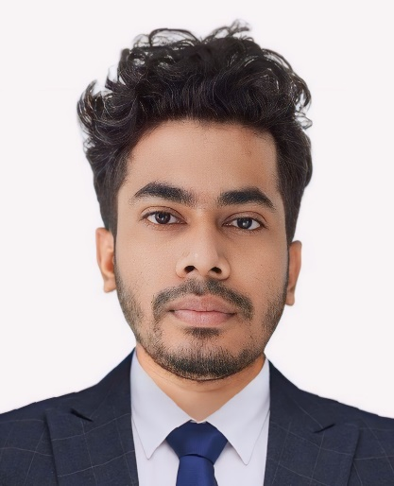


MD HABIBUR RAHMAN Faculty Of Law and Land Administration
mdhabibpstu026@gmail.com
md-habibur-rahman-b330731b0

Slide 2
Introduction
I am a dedicated and enthusiastic law student currently pursuing my degree in law with a specialization in Cyber Law. My academic journey has equipped me with a solid foundation in legal principles and an in-depth understanding of the complexities surrounding cyber-related legal issues.

Slide 3

EDUCATIONAL QUALIFICATION
Name of Examination | Year | Board/University | GPA/CGPA
LL.M | 2025 | PSTU | 3.40
LL.B | 2024 | PSTU | 3.50
HSC | 2019 | DHAKA | 4.75
SSC | 2017 | DHAKA | 5.00

Slide 4
Work Experience:
Legal Intern, A.S. Associate, 2024
Conducted legal research, drafted legal documents, and assisted in case preparations.
Volunteer Legal Advisor, Bangladesh Legal Aid and Services Trust (BLAST),2024
Provided legal advice and assistance to individuals in need, conducted legal awareness programs, and participated in legal aid initiatives

Slide 5
RESEARCH & COCURRICULAR ACTIVITIES DURING MY STUDY:
Proficient in legal research and analysis.
Strong understanding of Bangladeshi legal system and laws.
Excellent written and verbal communication skills in Bengali and English.
Ability to work under pressure and meet deadlines.
Familiarity with legal software and research tools.

Slide 6
RESEARCH DURING MY STUDY:
1. A Comparative Study on Rape Culture In Bangladesh.

Slide 7
Cont..
2. Cyber Security Act and the fear of history repeating itself.
Privacy
Data
Password

Slide 8
SKILS
Leadership
Management
Operating System : Windows, Android
Application Package : Microsoft Packages
Database : MS Access

Slide 9
Thanks

