Slide 1
CLOUD COMPUTING MODULAR ASSIGNMENT 8
Newvale Smart City
Infrastructure
AWS telemetry, traffic forecasting and adaptive lighting
Notes:
This capstone combines a deployed AWS ingestion lab with local traffic forecasting and street lighting simulation. All sensor readings are synthetic.

Slide 2
NEWVALE SMART CITY
Project scope and stakeholders
Transport authority
Energy provider
Use hourly traffic forecasts to explore congestion and threshold alerts.
Compare fixed lighting with a dimming strategy that uses predicted traffic.
City council and IT
Healthcare and waste
Assess access controls, monitoring and the cost of processing sensor messages.
Plan separate telemetry and governance for future services.
Two synthetic datasets with 5,760 hourly records each across four zones
MODULAR ASSIGNMENT 8
02
Notes:
The assignment covers transportation, energy, healthcare and waste. The implemented lab demonstrates the first two. Healthcare and waste are future extensions. Two historical datasets, traffic and lighting energy, each contain 5,760 hourly records across four zones.

Slide 3
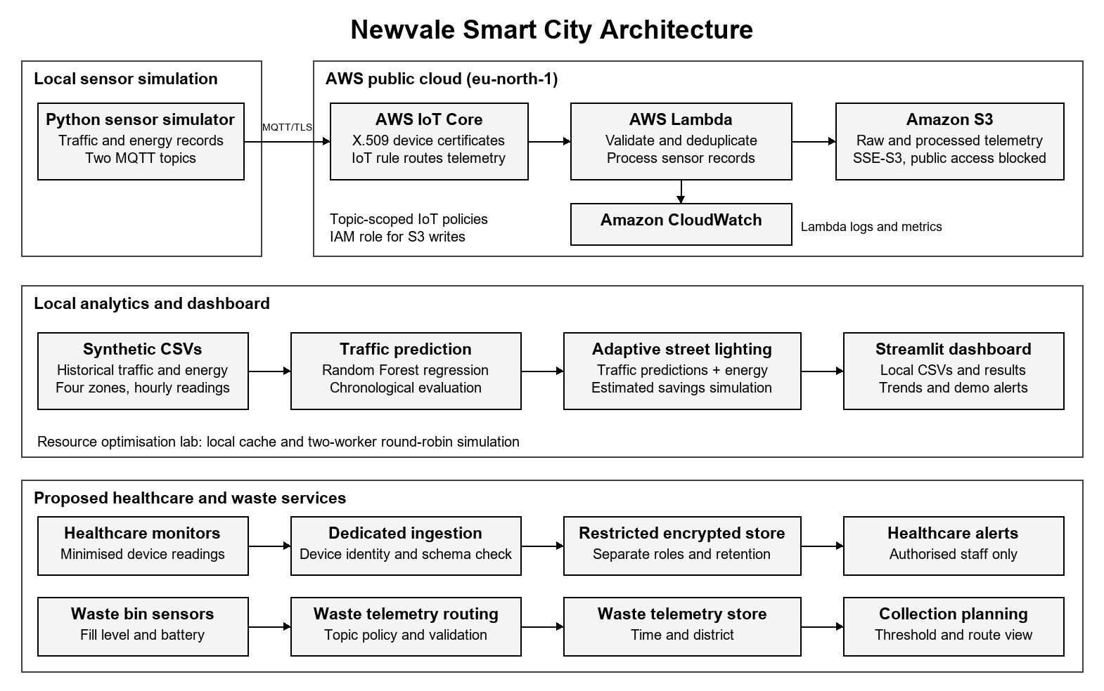
NEWVALE SMART CITY
Newvale Smart City Architecture
The repository includes the editable draw.io PNG.
MODULAR ASSIGNMENT 8
03
Notes:
AWS Europe (Stockholm), eu-north-1, hosts the ingestion lab. Simulated devices connect over MQTT/TLS. IoT Core routes traffic and energy telemetry to Lambda, which writes to S3. CloudWatch collects runtime logs and metrics. The dashboard and analytics read local files. The lower section shows proposed healthcare and waste telemetry flows. The NIST public-cloud rationale is in the report. Reference: https://csrc.nist.gov/pubs/sp/800/145/final

Slide 4
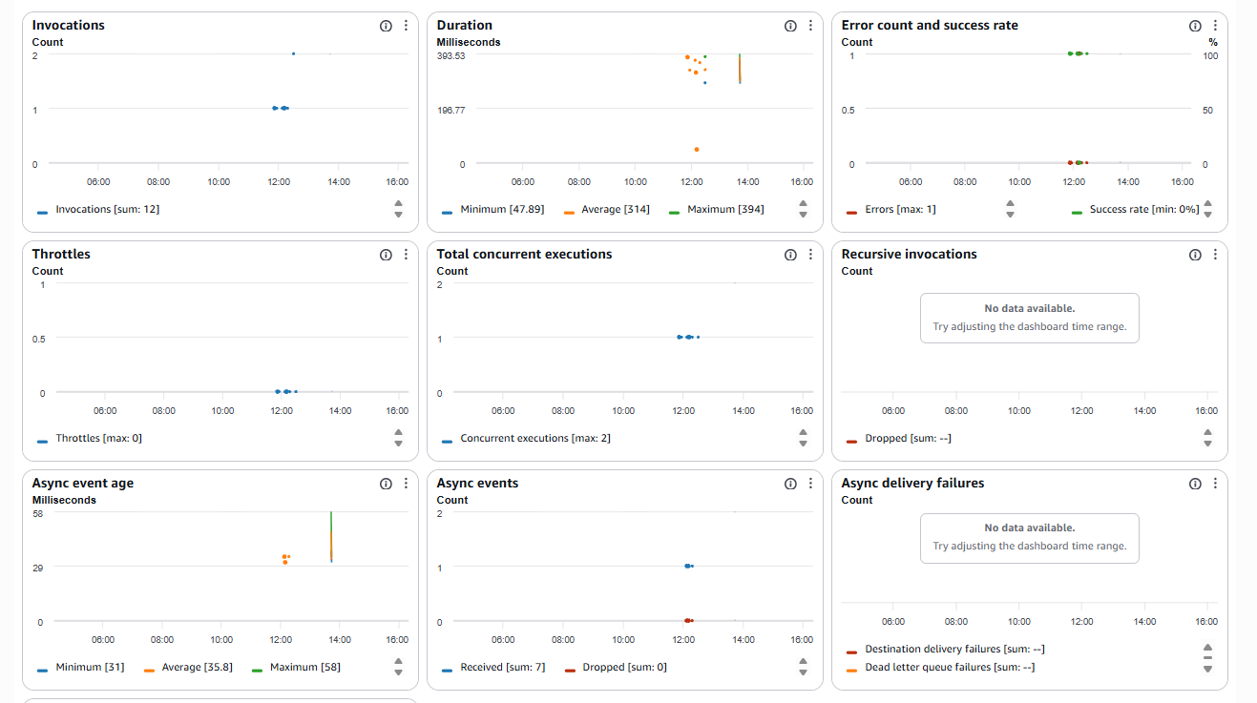
NEWVALE SMART CITY
AWS deployment and verification
Validated storage
Lambda checks incoming values and writes raw and processed JSON to S3.
Duplicate handling
Identical payloads share a SHA-256 identifier. Conditional S3 writes preserve existing objects.
Observed workload
12 invocations, peak concurrency of two and zero throttles in the CloudWatch capture.
M8-07 Lambda performance metrics
Deployed IoT rule SELECT * FROM 'newvale/+/telemetry'
MODULAR ASSIGNMENT 8
04
Notes:
M8-02 documents active device certificates. M8-03 shows a successful storage log. M8-08 shows validation failure and later successful storage. M8-07 is a bounded monitoring capture. A read-only AWS console check on 10 November 2026 confirmed the rule NewvaleSmartCitySensorIngestion was active in eu-north-1, used SQL version 2016-03-23 and had one action targeting Newvale-SmartCity-IoT-Processor.

Slide 5
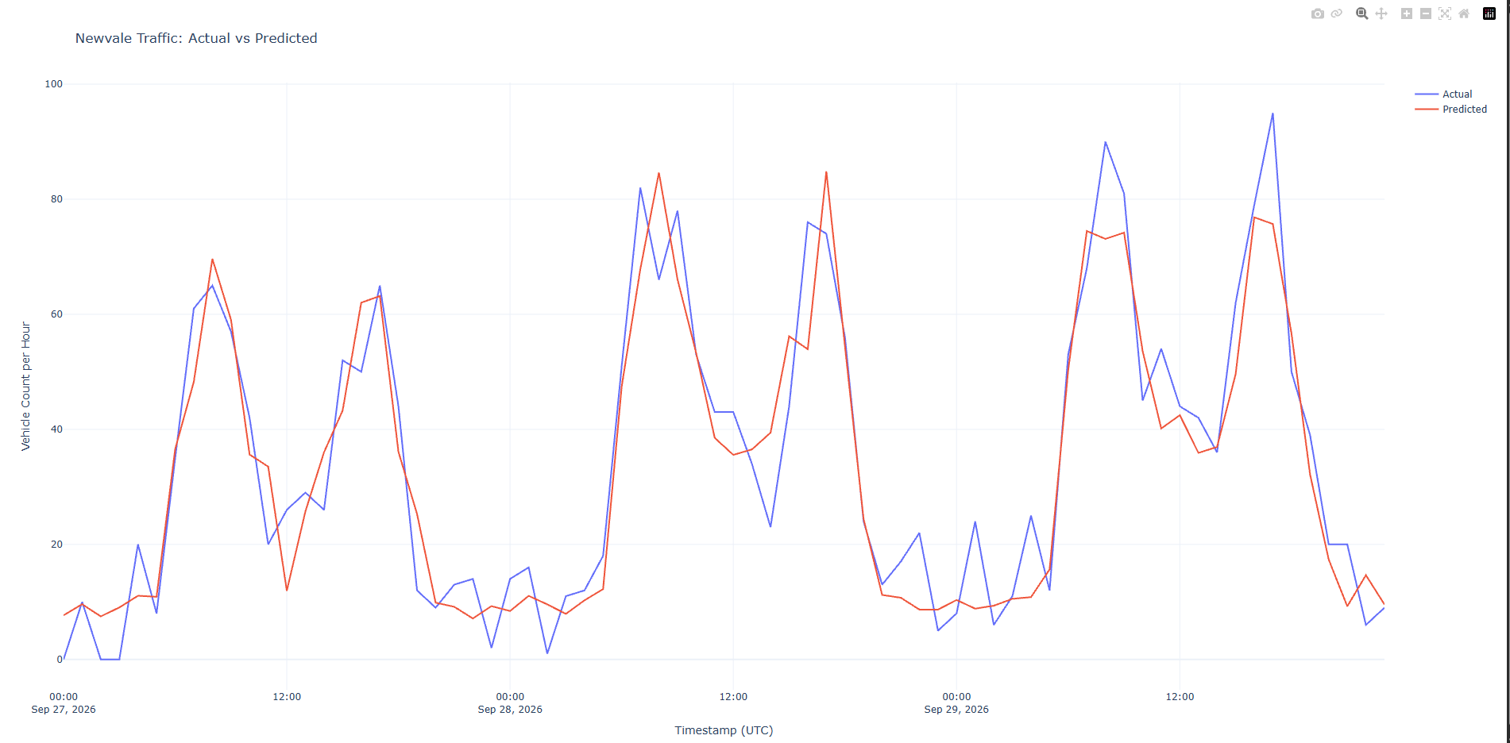
NEWVALE SMART CITY
Traffic forecasting results
21.9%
Lower mean absolute error
10.80 vehicles per hour
Random Forest
13.82 vehicles per hour
Same hour the previous day
M8-04 Final 72 hours of the holdout in zone Z01
1,136 held-out synthetic observations
MODULAR ASSIGNMENT 8
05
Notes:
The Random Forest uses zone, hour, weekday and observed 1-hour and 24-hour traffic lags. The chronological holdout has 1,136 rows, with 4,528 training rows. Actual lag observations were available during evaluation, so this is a one-hour-ahead test. Results are synthetic. Sources are results/traffic_metrics.json and M8-04.

Slide 6
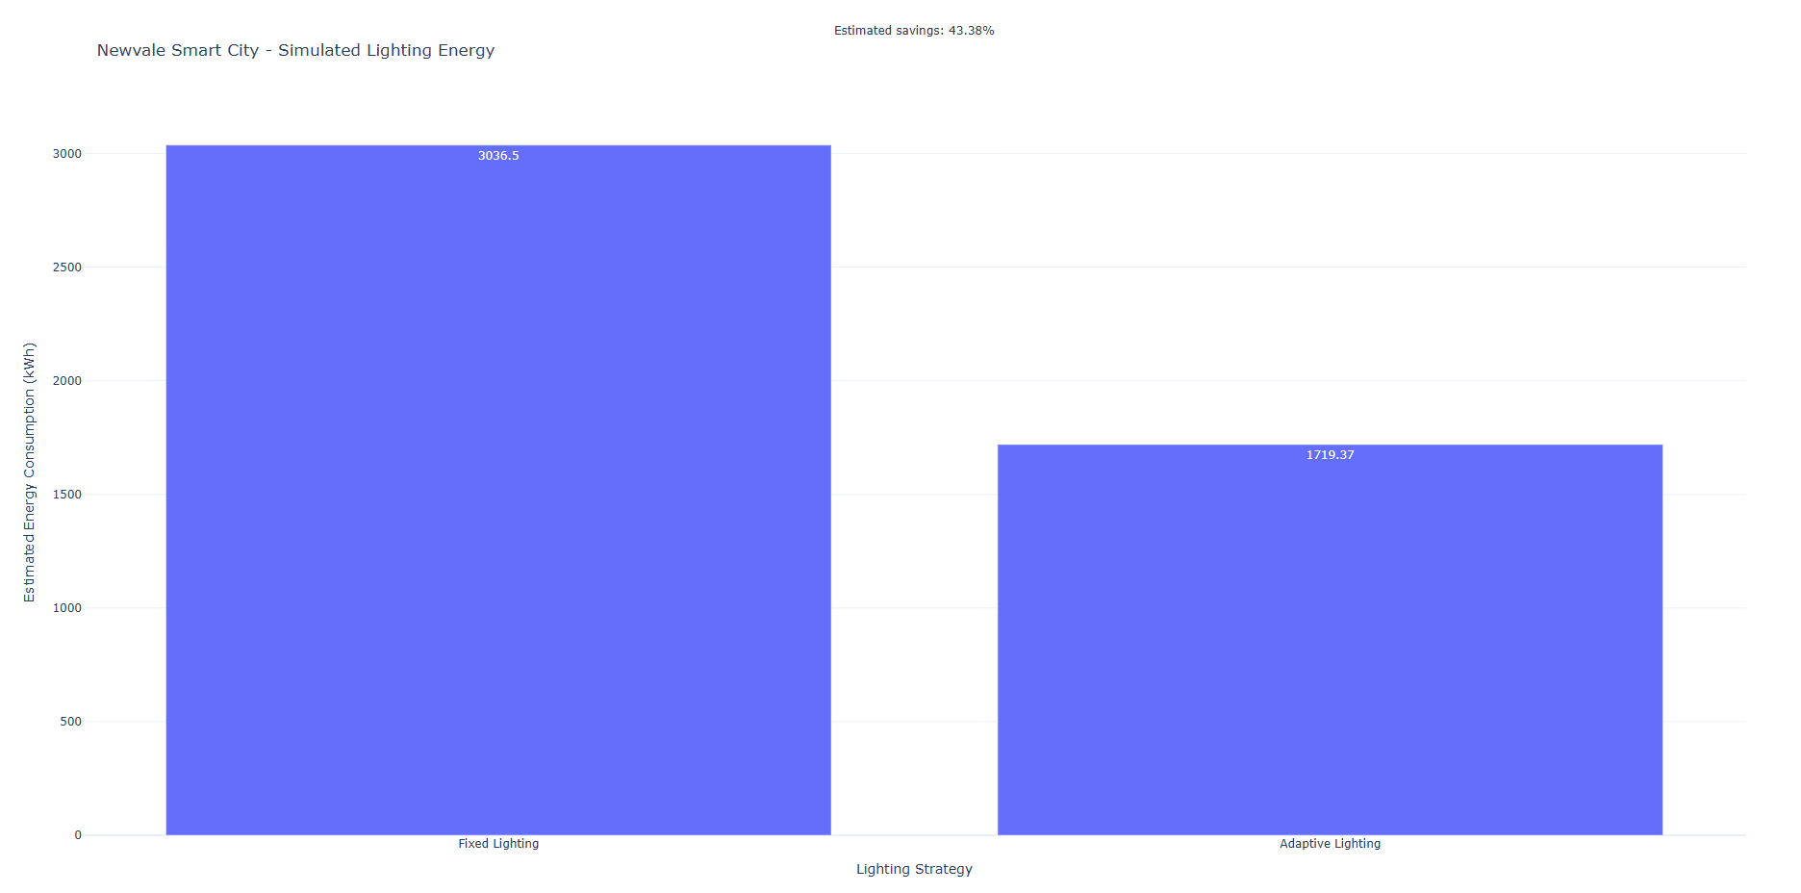
NEWVALE SMART CITY
Adaptive street lighting
43.38%
Estimated energy reduction
3,036.504 kWh with fixed lighting
1,719.370 kWh with adaptive lighting
The comparison covers 1,136 matched zone hours in the simulation.
M8-05 Fixed and adaptive lighting energy
MODULAR ASSIGNMENT 8
06
Notes:
The simulation applies 40%, 70% or full brightness during lighting hours, depending on whether predicted traffic is below 20, below 60 or at least 60 vehicles per hour. It assumes linear dimming energy use. Source results/adaptive_lighting_summary.json and M8-05.

Slide 7
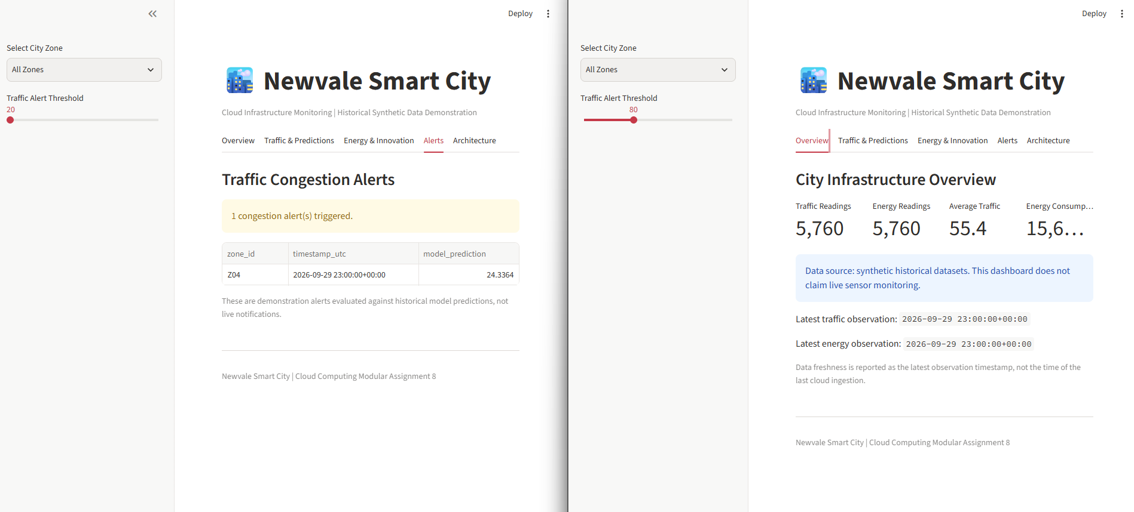
NEWVALE SMART CITY
Dashboard and resource optimisation
Streamlit dashboard
Historical traffic and energy, traffic forecasts, lighting estimates and demonstration alerts.
Cache simulation
196 hits in 200 requests.
Round-robin simulation
100 requests assigned to each of two workers.
M8-06 Dashboard overview and alert
MODULAR ASSIGNMENT 8
07
Notes:
The dashboard reads local historical files and demonstrates a traffic alert based on the selected forecast threshold. The cache and load distribution exercise ran locally. Sources are M8-06 and results/resource_optimisation_summary.json.

Slide 8
NEWVALE SMART CITY
Simulated burst scaling and recovery
41 to 2 ticks
Recovery after a partial write
The offline Lambda test saved the raw object, then simulated a failed processed write. An identical retry completed the pair. A further replay returned a duplicate.
95th-percentile completion time
Peak backlog fell from 40 to 5 jobs. Both policies completed all 60 jobs. The elastic run peaked at six workers.
Capacity trade-off
The elastic run used 98 available worker slots. The fixed run used 60.
Simulated ticks and in-memory storage. The original CloudWatch capture is reported separately.
MODULAR ASSIGNMENT 8
08
Notes:
The 60-job burst uses identical arrivals under both policies. The deterministic model assigns one job per worker per tick and starts workers immediately. Elastic capacity returned to one worker after the queue stayed empty. This is separate from the captured AWS workload. The recovery test uses the actual handler and an in-memory S3 substitute. Sources: results/scaling_recovery_summary.json and results/scaling_recovery_trace.csv.

Slide 9
NEWVALE SMART CITY
Proposed services and reliability targets
Healthcare monitoring
Ingestion targets
Dedicated ingestion, approved fields, encrypted storage and alerts restricted to healthcare staff.
95th-percentile latency at or below 5 seconds and 99.9% monthly ingestion success.
Waste collection
Recovery targets
Bin fill and battery readings feed district-level thresholds and collection planning.
Resume worker processing within 5 minutes. Test regional recovery against a 60-minute recovery time and 15-minute data-loss window.
Proposed pilot targets. The report describes how each target would be tested.
MODULAR ASSIGNMENT 8
09
Notes:
These design targets are proposed acceptance criteria. They were not measured against a production deployment. Healthcare would require a governance review covering data minimisation, retention and audit. A regional recovery test would need approval for where data is stored.

Slide 10
NEWVALE SMART CITY
Security and operating cost
Security controls
USD 11.62
Device certificates and MQTT over TLS. Topic-scoped permissions, a Lambda IAM role and S3 Block Public Access.
Estimated 30-day Stockholm cost
100 sensors at five-minute intervals
864,000 messages and 1.728 million S3 writes
S3 writes are the largest modelled charge
Observed lab cost
About USD 0.00 after rounding for IoT, Lambda, S3 and CloudWatch in the 1–8 November Cost Explorer capture.
AWS Stockholm rates checked 10 November 2026. The Cost Explorer capture is account-wide.
MODULAR ASSIGNMENT 8
10
Notes:
The project evidence documents blocked public access and active certificates. The estimate uses AWS Stockholm on-demand rates checked on 10 November 2026 and excludes credits, retries, retention, reads, egress and taxes. Sources: M8-01, M8-02 and M8-09. The repository includes the catalogue links and versioned rates in results/stockholm_cost_model.json. AWS Price List documentation: https://docs.aws.amazon.com/awsaccountbilling/latest/aboutv2/using-the-aws-price-list-bulk-api.html

