Slide 1
TECHNICAL UNIVERSITY OF CHEMNITZ
CODE GUARDIAN
Privacy-Preserving Source Code
Vulnerability Detection & Repair
Retrieval-Augmented LLMs for Visual Studio Code
PRESENTED BY
SUPERVISOR
EXAMINER
Md Hafizur Rahman
Abubaker Gaber (Internal)
Dr.-Ing. Sebastian Heil
Mat. No. 810641 · M.Sc. Web Engineering
DATE
June 16, 2026
Notes:
Slide 1 — Title · [60 s]
VOICE
"Good afternoon. You have just finished writing code for a bank — or a hospital. You need the answer to one simple question: is it secure? Getting that answer today means making a trade-off. And by the end of this talk, I want to convince you it is a trade-off no developer should have to make.
The thesis is titled Privacy-Preserving Source Code Vulnerability Detection and Repair using Retrieval-Augmented Local LLMs for Visual Studio Code. The system is called Code Guardian. Three parts: why the tool is needed, what it does, and what the evaluation shows. About thirty minutes."
(Pause. Look at the panel. Move to next slide.)
TRANSITION — "I'll start with the problem the tool solves."

Slide 2




TECHNICAL UNIVERSITY OF CHEMNITZ
CODE GUARDIAN
The Developer's Dilemma
Can't use the cloud
Scanners miss bugs
Sensitive code can't be pasted into a cloud model without breaking compliance.
The local scanner keeps missing real vulnerabilities, so the bug reaches production.
Warnings, no fixes
What's the alternative?
When a scanner flags an issue it only warns. Writing the repair is still your job.
No tool today combines privacy, full coverage, and one-click repair. Closing that gap is what this thesis sets out to do.
Md Hafizur Rahman
2 / 25
Notes:
Slide 2 — The Developer's Dilemma · [40 s]
VOICE
"Three problems arrive at once. First: sensitive code can't be pasted into a cloud model without breaking compliance. Second: the local scanner on your machine keeps missing real bugs — so the vulnerability reaches production. Third: when a scanner does flag something, it warns you, but it never fixes anything. The repair is still entirely your job.
No tool today solves all three. So the real question is the one in the corner — what is the alternative? That is what the rest of this talk answers."
(Four bubbles on screen: three problems plus one question — the green 'What's the alternative?'. Let the image breathe; gesture, don't enumerate them.)
TRANSITION — "Let me make the cost concrete."

Slide 3
TECHNICAL UNIVERSITY OF CHEMNITZ
CODE GUARDIAN
Today You Pick: Send Code Away, or Get No Help
Cloud LLM (Copilot, ChatGPT, Cursor)
Local SAST (Semgrep, CodeQL, ESLint)
Source code crosses the network on every request.
Blocked outright in finance, healthcare, defence,
and air-gapped environments.
Strong reasoning · zero privacy guarantees.
Stays local. Cannot reason across files or generate fixes.
Semgrep canonical recall on our JS/TS corpus: 12.68 %
Strong privacy · poor coverage · no repair.
Either choice forces a trade-off: privacy or capability, never both.
Md Hafizur Rahman
3 / 25
Notes:
Slide 3 — Today You Pick: Send Code Away — or Get No Help · [80 s]
VOICE
"Today, in practice, there are only two options. On one side, the cloud assistants — Copilot, ChatGPT, Cursor. The reasoning is excellent. But every request leaves your machine, and in finance, healthcare, defence, or any air-gapped setting, that door is simply closed.
On the other side, the local scanners — Semgrep, CodeQL, ESLint. They stay on your machine, so privacy is complete. But they miss most of the bugs. On the JavaScript and TypeScript in this thesis, Semgrep's canonical recall is 12.68 percent. And they only warn — they never fix.
So here is the trade you're offered: send your code away, or work almost unprotected. That's the whole menu. And neither side is good enough."
TRANSITION — "So this thesis asks one question: why should that be the trade at all?"

Slide 4



TECHNICAL UNIVERSITY OF CHEMNITZ
CODE GUARDIAN
No Tool Combines All Three
Local Inference
Retrieval-Augmented
Developer-Controlled Repair
Code never leaves the
developer's machine.
Verifiable network boundary.
Grounded in CWE / OWASP
knowledge.
Not just pattern matching.
Structured fix returned.
Developer applies via Quick Fix.
No silent rewrites.
This thesis builds and evaluates a tool that delivers all three.
Md Hafizur Rahman
4 / 25
Notes:
Slide 4 — No Tool Combines All Three · [60 s]
VOICE
"Removing that trade requires three things to be true at the same time. The tool must be local, so your code never leaves the machine and you can prove it. It must be grounded, reasoning with real CWE and OWASP knowledge rather than fixed patterns. And it must stay in your hands, offering a fix that you choose to apply, with nothing rewritten behind your back.
No existing tool delivers all three together, and that is the gap this thesis sets out to close."
PRE-EMPT (fold into the flow — answers a question before it's asked) — "And the scope is JavaScript and TypeScript on purpose: it's the most-used stack on GitHub, and it's where local static analysis is weakest — so it's where a privacy-preserving tool helps most." → defuses "why JS/TS?" (QA_PREP A.4)
LIT-ANCHOR (reserve — drop only if the IDE-integration gap is doubted in Q&A) — "A 2025 survey of 58 LLM vulnerability studies found not one was wired into a developer's workflow — every one was evaluated offline. That's the gap this slide names." (Zhou et al., TOSEM 2025) → backs "in your hands"; QA_PREP J.1
TRANSITION — "Before the system, here are the research questions and the five requirements I commit to."

Slide 5
TECHNICAL UNIVERSITY OF CHEMNITZ
CODE GUARDIAN
Research Questions and Requirements
RESEARCH QUESTIONS
FIVE REQUIREMENTS
RQ1
Can a local LLM on consumer hardware reach acceptable detection quality under a strict privacy envelope?
R1
Accuracy
R2
Consistency
precision, recall, F1
JSON parse, inter-run
RQ2
Does grounding the LLM in retrieved CWE / OWASP knowledge (RAG) improve detection?
R3
Repair Quality
R4
Usability
manual + auto-applicable
latency, IDE integration
RQ3
Is in-IDE latency acceptable for developer workflows?
R5
Privacy
zero exfiltration, signed corpus
R1–R5 map to fixed threshold scales, set before evaluation, with no post-hoc bands.
RAG = look up known CWE / OWASP weakness patterns before answering · CWE = standard catalogue of software-weakness types
F1 = balance of catching real bugs vs. false alarms (higher = better) · FPR = share of safe code wrongly flagged (lower = better)
Md Hafizur Rahman
5 / 25
Notes:
Slide 5 — Research Questions and Requirements · [90 s]
VOICE
"Three research questions frame the work. RQ1 asks whether a local model, on a normal laptop, can detect vulnerabilities well enough under a strict privacy envelope. RQ2 asks whether grounding that model in retrieved CWE and OWASP knowledge actually helps. And RQ3 asks whether it is fast enough inside the editor for real work.
Before measuring anything, I fixed five requirements. R1 is accuracy — precision, recall, and F1. R2 is consistency — valid, stable output. R3 is repair quality. R4 is usability — latency and IDE fit. And R5 is privacy — nothing leaves the machine.
Each requirement has a fixed grading scale, written into the requirements chapter before any model ran. R1 and R2 use four levels, and R3 and R4 use three. This matters because the bar was set before I saw a single result, so it is the same bar before and after evaluation."
PRE-EMPT (this line is itself the pre-empt — say it slowly, look at the panel) — fixing the grading scales before evaluation is exactly what disarms "how did you choose the thresholds?" → defuses QA_PREP G.3
TRANSITION — "Where do existing systems sit against R1 to R5?"

Slide 6
TECHNICAL UNIVERSITY OF CHEMNITZ
CODE GUARDIAN
Three Existing Approaches
CLOUD LLM ASSISTANTS
LOCAL SAST
ACADEMIC LLM-FOR-SEC
GitHub Copilot
Semgrep
IRIS + GPT-4
Microsoft · 2021
Rule-based · OSS
Li et al. · ICLR 2025
ChatGPT / GPT-4
CodeQL
SecRepair
OpenAI · 2022
GitHub · taint analysis
Islam et al. · NDSS 2024
Cursor
ESLint security plugins
LLMSecGuard
Anysphere · 2023
Lint-level
Kavian et al. · EASE 2024
Claude Code
Bandit / SpotBugs
RESCUE
Anthropic · 2024
Other languages
Shi & Zhang · 2025
Md Hafizur Rahman
6 / 25
Notes:
Slide 6 — Three Existing Approaches · [60 s]
VOICE
"The related work falls into three camps. The cloud assistants — Copilot, ChatGPT, Cursor, Claude Code — are strong on accuracy, repair, and usability, but they fail privacy by design, because every request leaves the machine. Local static analysis — Semgrep, CodeQL, ESLint — is strong on consistency and privacy, but weak on accuracy and repair, because it matches patterns rather than reasoning and it only warns. And the academic LLM-for-security work — IRIS, SecRepair, LLMSecGuard, RESCUE — is promising, but each system drops at least one of privacy, repair, or IDE speed. None brings them all together."
TRANSITION — "Put them in a matrix against R1 to R5, and the gap is clear."

Slide 7



TECHNICAL UNIVERSITY OF CHEMNITZ
CODE GUARDIAN
No Tool Satisfies R3 + R4 + R5 Together
Solution / Approach
R1
ACCURACY
R2
CONSISTENCY
R3
REPAIR
R4
USABILITY
R5
PRIVACY
LEGEND
High / Satisfied
GitHub Copilot
Partial
Not satisfied
Semgrep
CodeQL
THE GAP
No existing tool delivers
repair + IDE-grade latency
+ privacy together.
IRIS (GPT-4)
SecRepair
Levels apply the fixed R1–R5 scales, set before evaluation: accuracy / repair thresholds [Johnson 2013; Monperrus 2014], latency [Card 1983; Nielsen 1994], privacy = checklist. Full scale + sources in Appendix A8.
Md Hafizur Rahman
7 / 25
Notes:
Slide 7 — No Tool Satisfies R3 + R4 + R5 Together · [75 s]
VOICE
"Read across each row. Copilot meets accuracy, consistency, and repair, is only partial on usability, and fails privacy. Semgrep and CodeQL meet privacy but fail accuracy and repair. IRIS, even with GPT-4 behind it, fails repair, usability, and privacy, because it is a whole-repo batch tool. And SecRepair fine-tunes a model rather than prompting one, runs in batch, and targets mostly C and C++.
The bottom row is Code Guardian, and it is the claim this talk defends: no existing tool delivers privacy, repair, and IDE-grade speed at the same time."
LIT-ANCHOR (reserve — drop only if the bottom row is challenged in Q&A) — "LLMSecGuard's own authors call IDE integration 'essential' — then leave it as future work. Code Guardian ships it." (Kavian et al., EASE 2024) → sharpens the matrix; QA_PREP H.1
SOURCE NOTE (point to the footnote only if asked where the levels come from — don't read it) — the small line under the matrix says the High / Partial / Not-satisfied levels apply the fixed R1–R5 scales, with accuracy/repair thresholds from IR/SE work, latency from HCI response-time limits, and privacy as a checklist. The full scale-and-source table is Appendix slide A8 — put it up if the panel pushes on "how did you choose the thresholds?" → backs QA_PREP G.3
TRANSITION — "Now the system itself."

Slide 8




TECHNICAL UNIVERSITY OF CHEMNITZ
CODE GUARDIAN
Proposed Workflow
Real-time Diagnostics
On-demand File Scan
Interactive Q&A
Workspace Audit
Inline squiggles per function as you save.
Right-click → scan the current file.
Ask about a finding in a side panel.
Batch scan the whole project.
ALL FOUR WORKFLOWS HIT THE SAME PIPELINE
INPUT
→
STAGE 1
Detection (LLM + RAG)
→
Consensus
filter
→
STAGE 2
Repair (LLM)
→
QUICK
FIX
Md Hafizur Rahman
8 / 25
Notes:
Slide 8 — Proposed Workflow · [60 s]
VOICE
"The extension offers four ways to work: inline diagnostics that appear as you save, a file scan on right-click, a side panel for asking about any finding, and a workspace audit that covers the whole project at once.
Why four? Because the question 'is this secure?' arises at different moments — as you save, on a single file, on one finding, or across the whole project — and each workflow meets it where it happens. One pipeline sits behind all four: detect, then repair. And everything inside the dashed line runs on your machine."
TRANSITION — "Here are the two stages in detail."

Slide 9

TECHNICAL UNIVERSITY OF CHEMNITZ
CODE GUARDIAN
Two-Stage Local Pipeline
→
Stage 1 · Detection
Stage 2 · Repair
• JSON-mode LLM call · schema-pinned output
• Optional RAG context · top-k CWE / OWASP snippets
• Two consensus passes · distinct seeds (42, 137)
• Finding kept only when both passes agree
• Returns: category, severity, line range, evidence
• Separate structured call · invoked only when detected
• Returns { code, language } · no-fix return allowed (18 / 297)
• Validator parses output with @babel/parser · rejects prose
• Surfaced as a VS Code Quick Fix
• Developer applies the patch · no silent rewrites
Privacy by construction · Ollama bound to loopback · Embeddings local · No telemetry
Md Hafizur Rahman
9 / 25
Notes:
Slide 9 — Two-Stage Local Pipeline · [90 s]
VOICE
"Two stages. The first finds the problem. The second repairs it.
Stage one is detection. The code goes to the local model as a single JSON-mode call, and the model fills a fixed schema — so what comes back is structured data, not an essay. When RAG is on, the most relevant CWE and OWASP snippets go into the prompt first. And to filter out one-off noise, detection runs twice — each pass from a different random starting point, what's called a seed. A finding survives only when both passes agree. That's the consensus check.
Stage two is repair. It runs only when stage one has actually found something. It's a separate call that returns just the fixed code and its language. That output goes through the Babel parser — so if the model returns prose instead of code, it's thrown away before you ever see it. What survives appears as an ordinary one-click Quick Fix. And you are the one who applies it. Nothing is rewritten behind your back.
Now notice what didn't happen anywhere in that flow: nothing left the machine. Ollama runs on loopback, the embeddings are local, and there's no telemetry."
PRE-EMPT (fold into the flow — answers a question before it's asked) — "In the shipping extension those two passes use different seeds — a real consensus step in the product. In the evaluation the seed is pinned for reproducibility, so the repeated runs come out identical — which is why the R2 consistency result is reported as a property of deterministic decoding, not a robustness claim. Measuring the filter's gain under seed rotation is future work." → defuses "your consensus is just identical runs" (QA_PREP G.2)
TRANSITION — "What does this look like when it runs?"

Slide 10
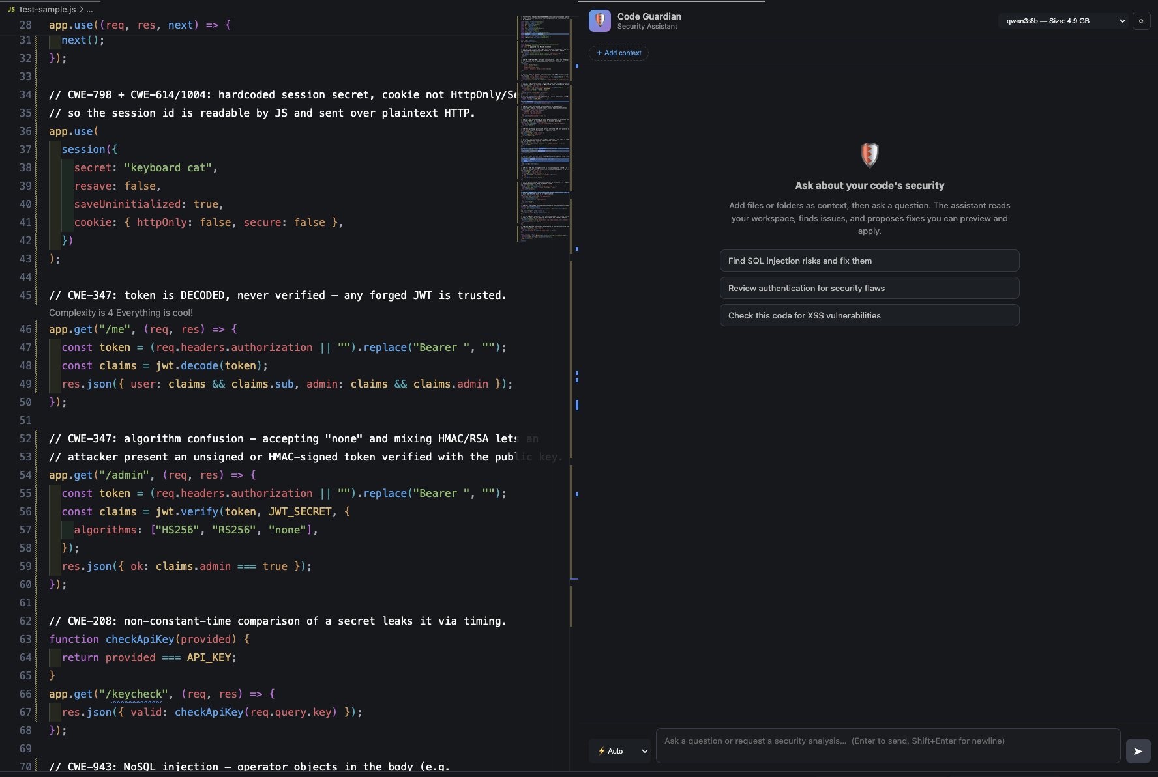

TECHNICAL UNIVERSITY OF CHEMNITZ
CODE GUARDIAN
Live in VS Code
SCAN · Install from VS Code Marketplace
Md Hafizur Rahman
10 / 25
Notes:
Slide 10 — Live in VS Code · [75 s]
VOICE (pointing at the screenshot)
"This is the extension running on a file full of vulnerable endpoints — SQL injection, reflected XSS, code injection, command injection, and path traversal. On the right is the Code Guardian panel, currently examining the reflected-XSS endpoint. It explains why the user input is unsafe, and it proposes a fix.
Notice that the panel marks this one 'not auto-applicable.' That is the system being deliberately honest: it shows you the fix but asks you to review it first. There are no silent rewrites, and nothing here leaves the laptop.
The QR code installs the extension from the VS Code Marketplace."
TRANSITION — "Behind that UI sits the architecture."

Slide 11
TECHNICAL UNIVERSITY OF CHEMNITZ
CODE GUARDIAN
System Architecture
outside the privacy boundary
Public Security Feeds
NVD · OWASP · CWE · GitHub
CODE GUARDIAN
runs entirely on your laptop
Analyzer (two-stage)
Client UI
VS Code · 4 workflows
analyze
Extension Core
orchestration
on miss
prompt (JSON)
Ollama
local · codellama / qwen3
Stage 1 · Detect
consensus · JSON
Stage 2 · Repair
Babel-validated
check
hit
store on miss
optional fetch
RAG enrich
off by default
Analysis Cache
LRU · 100 · 30 min
RAG Manager
context retrieval
Egress Gate
loopback-only · off by default
Privacy by construction
top-k 3
egress req
✓ all local execution
✓ no code leaves machine
✓ no telemetry
✓ egress off by default
✓ signed corpus
Knowledge Base
HNSWlib · Ed25519-signed
sync
Vulnerability Data
24 h cache · 7 sources
Local data flow
Optional outbound: public metadata, off by default
Md Hafizur Rahman
11 / 25
Notes:
Slide 11 — System Architecture · [75 s]
VOICE (walk the diagram)
"Everything inside the dashed rectangle runs on your laptop. The VS Code extension host drives the four workflows, and it talks to Ollama on loopback only. That line is the privacy boundary. Ollama runs an 8B-class quantised model — qwen3:8b is the one I evaluate and recommend, but any Ollama model works, because the extension isn't tied to one. The RAG store is HNSWlib, on disk, local.
Now follow a request through. It hits the local cache first. On a hit, the answer comes straight back — no model call at all. On a miss, it runs the two-stage analyzer — detect, then repair — and stores the result, so the next identical check is instant.
When RAG is on, the RAG Manager pulls the top three snippets from that local, signed knowledge base — and it picks them by meaning, not by keyword. A small model, also on the laptop, turns the code and the prompt into a string of numbers that captures what they're about. That fingerprint pulls the three closest entries out of the store. So it still finds the right CWE or OWASP guidance even when the code never says the word 'injection' or a CWE number. Those public feeds are what sync into the corpus in the first place.
Now look at the boundary itself. By default, nothing crosses it. The vulnerability data ships pre-bundled, so the tool runs fully offline out of the box. There's exactly one outbound call you can opt into — a refresh of public NVD, OWASP, and CWE metadata, on a 24-hour cache — and it's off by default. Even switched on, it carries look-ups, never your code.
So privacy here isn't a feature you switch on. It's decided by where the boundary sits."
PRE-EMPT (fold into the flow — answers a question before it's asked) — "The 8B model is a deliberate ceiling, not a compromise: it's the largest that fits a 16 GB laptop alongside VS Code. A 70B model needs 40-plus gigabytes — that turns 'developer laptop' into 'workstation' and shrinks who can run it." → defuses "why not a bigger model?" (QA_PREP B.4)
TRANSITION — "Four ways the privacy claim is enforced."

Slide 12



TECHNICAL UNIVERSITY OF CHEMNITZ
CODE GUARDIAN
Privacy by Construction
Loopback-only Ollama
Signed RAG Corpus
Bound to 127.0.0.1. Network isolation arm of the threat model, enforced by network policy.
Ed25519 manifest verified at load. Provenance arm of the threat model. The corpus cannot be silently rewritten.
Prompt-Injection Harness
Pinned Container
12 cases of crafted prompts attempting exfiltration. leakFreeRate = 100 %.
Node 20.19.0-alpine · npm ci · seed = 42 · byte-identical runs.
Md Hafizur Rahman
12 / 25
Notes:
Slide 12 — Privacy by Construction · [75 s]
VOICE
"Privacy here is not a single feature; it is four separate arms. Three of them shut down a specific attack, and the fourth lets you verify the other three — and each one can be checked on its own.
The network arm stops your code leaving the machine. Ollama is bound to loopback — 127.0.0.1 and nothing else — so nothing it sends can leave your laptop.
The provenance arm stops a poisoned knowledge base, where someone swaps in malicious guidance that the model would then trust. The RAG corpus is Ed25519-signed and checked on every load, and if it has been tampered with, the extension refuses to load it.
The injection arm stops prompt injection — instructions hidden in the code that try to hijack the model. Twelve crafted attacks were run, and all twelve came back clean.
The reproducibility arm is not about an attacker but about trust. The whole pipeline rebuilds from a pinned container at seed 42, so anyone can re-run it and obtain the exact same result, rather than taking my word for the other three.
Because each arm stands on its own, no single failure can quietly break the whole promise."
LIT-ANCHOR (reserve — network arm, if "why local" is pushed in Q&A) — "An industry study on ChatGPT for secure coding lands on the same rule this arm enforces: run local LLMs, kept off the network, so proprietary code never leaves the building." (Espinha Gasiba et al., 2024) → backs the network arm; QA_PREP F.5
LIT-ANCHOR (reserve — provenance/injection arms, if corpus-signing is questioned) — "Why sign the corpus? A 2024 RAG-security survey shows poisoning just 0.04 percent of a corpus can hijack retrieval 98 percent of the time. The signature is the lock on that door." (Zhou et al., RAG-Trust survey 2024) → backs the provenance + injection arms; QA_PREP F.4
TRANSITION — "Now the evaluation."

Slide 13


TECHNICAL UNIVERSITY OF CHEMNITZ
CODE GUARDIAN
Evaluation Setup
Corpus
Configurations
Statistical Discipline
Curated JS / TS · 101 cases
(71 vulnerable + 30 secure)
20 CWE categories
External: 15 cases from NodeGoat,
Juice Shop, 3 named CVEs
Whole-project scan: OWASP NodeGoat
5 Ollama models × {LLM-only, LLM+RAG}
= 10 configurations
+ 3 SAST baselines
(Semgrep, CodeQL, ESLint)
3 runs per sample · deterministic
→ 303 invocations per config
Held-out 71 / 30 test split
(threshold tuning off the test set)
McNemar with Bonferroni
across paired model comparisons
Exact-binomial CIs for small-n rates
Md Hafizur Rahman
13 / 25
Notes:
Slide 13 — Evaluation Setup · [85 s]
VOICE
"Three things were locked down before any number went on screen.
First, the corpus. A curated JavaScript and TypeScript set — 101 cases, 71 vulnerable, 30 secure, across 20 CWE categories, every label verified by hand. And every case is traceable to a source. Some are real bugs from popular npm packages and named CVEs. The rest are written in JavaScript to match standard weakness patterns from suites like Juliet and the OWASP Benchmark — which only ship in C and Java. Alongside it sits an external set of 15 cases — OWASP NodeGoat, Juice Shop, three named CVEs — plus a whole-project NodeGoat scan, run end to end. Why verify the labels by hand, and not with a scanner? Because CWEval found that fewer than a third of one popular benchmark's flagged samples could even be reproduced by its own analyzer. A scanner's labels are not ground truth.
Second, the configurations. Five Ollama models, each run two ways — with RAG and without. That's ten. Plus three SAST baselines: Semgrep, CodeQL, and ESLint. Each sample runs three times, deterministically — 303 invocations per configuration.
Third, the statistical discipline. The cases are split in two — I tune on one half and freeze the other, so tuning never touches the headline numbers. McNemar with Bonferroni across the paired comparisons. And exact-binomial intervals for the small-sample rates.
Rules set first, measurements taken second. That discipline stands behind every number that follows."
PRE-EMPT (two short ones — fold into the flow, answer before asked) — First: "101 curated cases is a deliberate choice, not a shortcut — the peer benchmark CWEval uses 119, the big auto-mined sets are mostly broken, and there's no existing JS/TS corpus that fits, since Juliet and OWASP Benchmark are C, C++, and Java." Second: "There's no cloud-LLM baseline by design — a cloud model would break the privacy threat model the thesis is built on, so the three SAST tools set the local floor instead." → defuses "101 is too small / why not Juliet?" (QA_PREP A.1, A.3) and "why no GPT-4 baseline?" (QA_PREP B.2)
TRANSITION — "Four headline numbers, one per requirement."

Slide 14
TECHNICAL UNIVERSITY OF CHEMNITZ
CODE GUARDIAN
Results
MEDIUM
HIGH
R1 · DETECTION
R3 · REPAIR
71.43 %
90.32 %
F1 · qwen3:8b + RAG · P 72.46 % · R 70.42 %
On unseen code: held-out 61.11 % · external 63.64 %
Auto-applicable: parses & applies (n = 279)
Semantic-correct ≈ 68 % combined · 42 % run as-is (n = 25)
HIGH
MET
R4 · LATENCY
R5 · PRIVACY
2.2 s
100 %
Median stage-1 · p95 = 4.3 s
Comfortably inside on-demand band (≤ 5 s)
leakFreeRate · 12-case prompt-injection harness
schemaValidRate 83 % (10/12) · loopback-only by policy
R2 · HIGH
Consistency: 100 % JSON-parse success, 3,030 invocations (inter-run agreement is deterministic by seed). Colour = requirement band (A8). R1 / R3 / R4 / R5 detailed next.
Md Hafizur Rahman
14 / 25
Notes:
Slide 14 — Results · [70 s]
VOICE (land each number briefly; save the detail for the next four slides)
"Four numbers. One per requirement.
Detection: an F1 of 71.43 percent — the balance between precision and recall — from qwen3:8b with RAG. And it travels — 61.11 on code I held back during tuning, 63.64 on outside projects I had no hand in.
Repair: 90.32 percent auto-applicable — the fix parses and applies cleanly — with combined semantic correctness around 68 percent.
Latency: a median of 2.2 seconds, well inside the on-demand band.
Privacy: leak-free across all 12 injection attempts.
And along the bottom, R2 — consistency. 100 percent valid JSON across all 3,030 invocations. But the runs share a seed, so that agreement reflects determinism, not robustness. I say so plainly rather than dress it up.
Each of these four gets its own slide next. R2 stays in the appendix."
COLOUR NOTE (optional — only if you want to point at the card colours) — each card is tinted by its requirement band from the A8 scale: repair, latency, and privacy land green (High / met), and detection is amber (Medium). Don't over-explain it — but the single amber card quietly pre-figures the slide-21 admission that accuracy is the one area marked partial, not class-leading. The confidence-gate number (74.07) is no longer on this card; it lives on appendix A9.
TRANSITION — "Start with R1, detection accuracy."

Slide 15
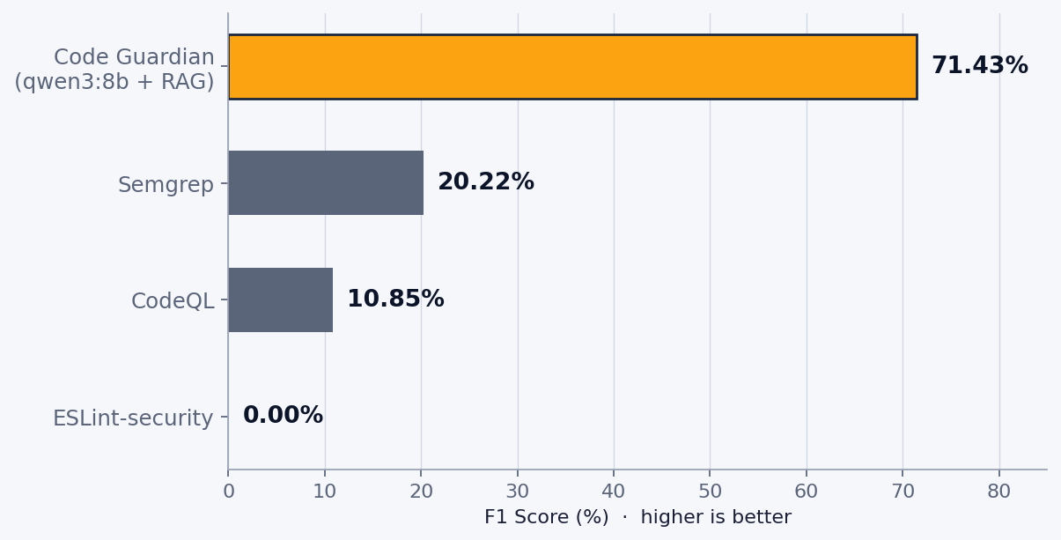

TECHNICAL UNIVERSITY OF CHEMNITZ
R1
R1 · Detection Accuracy
qwen3:8b + RAG · canonical taxonomy · full 101-case run
71.43 %
72.46 %
70.42 %
10.0 %
F1
Precision
Recall
FPR
On unseen code
Held-out split: F1 61.11 %
External corpus: F1 63.64 %
→ recall gives ground, precision holds
FAIRNESS
FPR 10 % · 95 % CI [2.1–26.5 %]
SAST shown at function scope,
understating full-project recall (A7)
Optional ≥ 0.67 rescore gate → A9
Md Hafizur Rahman
15 / 25
Notes:
Slide 15 — R1 Detection Accuracy · [95 s]
VOICE
"This is the main result. qwen3:8b with retrieval — the setup I recommend — run across all 101 cases.
The headline is an F1 of 71.43. In plain terms, that's two things at once. When it flags code, it's right about seven times in ten. And of all the real vulnerabilities in the set, it catches about seven in ten. The false-positive rate is ten percent — so roughly one safe snippet in ten gets a warning it doesn't need. In short: it finds most of the real bugs, and most of what it shows you is real.
Does that hold on code it hasn't seen? I checked two ways. On the cases I held back while tuning, it drops to 61. On a separate external set — real projects I had no hand in — it's about 64. So on unfamiliar code it sits in the low sixties, where recall gives ground but precision holds. That dip isn't a weakness. It's the reason you hold cases back in the first place — and the gap between curated and real-world code is a well-known pattern.
Now set that against what's already on a developer's machine. On the chart it scores 71. Semgrep, about 20. CodeQL, 11. ESLint, essentially zero. Even Semgrep, the strongest of the three, catches only about one in eight of these bugs. One point on fairness: I ran those tools one function at a time — the same narrow window the model gets — which understates their full-project recall. The details are in appendix A7."
RESERVE — confidence gate (eval-only; raise only if pressed on precision — it now lives on appendix A9, not the main slide) — "There's an optional rescore filter at 0.67: precision rises from 72 to 78 and F1 to 74, with recall unchanged. It drops the findings the model couldn't map to a category — six false positives here. It's eval-only, off in the shipped extension, and because the runs are seed-pinned it's a category filter, not run consensus. The full before-and-after is appendix A9." → backs QA_PREP D.3 / G.1
PRE-EMPT (the fairness note in the VOICE is the pre-empt — don't skip it) — saying the SAST tools ran at the model's function-level scope, which understates their full-project recall, disarms the "your baselines are strawmen" attack before it's raised. → defuses "ESLint scores 0 %, strawman" (QA_PREP B.5)
LIT-ANCHOR (reserve — drop only if the held-out drop is called a weakness) — "A review of over 300 works reports the same shape: detection looks strong on curated data and drops on real-world code. So 71 down to the low sixties isn't a crack — it's the field's normal." (Zhang et al., SLR 2024) → frames the generalization gap; QA_PREP B.7
TRANSITION — "The second research question — does retrieval actually help — turned out more interesting than I expected."

Slide 16
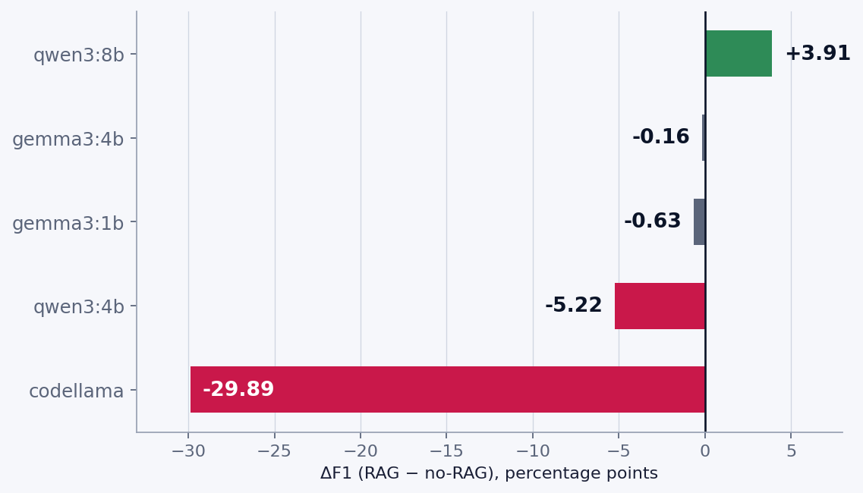
TECHNICAL UNIVERSITY OF CHEMNITZ
R1 · RQ2
RAG Is Not a Uniform Win
TAKEAWAY
RAG can help, harm,
or do nothing,
depending on the model.
Only codellama's −29.89 F1 survives Bonferroni at α = 0.01
(McNemar p = 0.0013).
Design implication: treat RAG as a per-model configuration choice, not a default.
Md Hafizur Rahman
16 / 25
Notes:
Slide 16 — RAG Is Not a Uniform Win · [90 s]
VOICE
"This is the second research question — whether retrieval actually helps — and the answer was more interesting than I expected.
The plan was simple: switch RAG on and get better detection across the board. Five models, two modes each, in a paired comparison measuring the change in F1 when RAG is enabled.
The results did not cooperate. qwen3:8b improved by 3.91. The gemma models were essentially flat. qwen3:4b fell by 5.22. And codellama fell by 29.89 — the single largest effect in the whole study, and it pointed the wrong way.
So the question is whether that is real. Only codellama's drop survives Bonferroni at alpha 0.01, with McNemar p equal to 0.0013. It is a genuine effect, not noise.
The error profile explains why it broke that way. With retrieval on, qwen3 treats the retrieved examples as a reference page, and its false alarms fall from one in two down to one in ten. The very same text does the opposite to codellama: handed a prompt full of vulnerability descriptions, the weaker model starts to see vulnerabilities everywhere — it flags almost everything and catches fewer real bugs than before. The same corpus produces opposite results, and the difference is whether the model can treat that extra context as a reference or simply drowns in it. A stronger model checks against it; a weaker one loses the actual code in the noise.
That changes the lesson. Retrieval is not a free upgrade; it is a per-model choice. And the field agrees. RESCUE, in 2025, found that naive RAG did not significantly help secure generation, blaming noise in the raw retrieved text that drowned the signal, and two 2025 systematic reviews report the same pattern — retrieved context helps some setups and hurts others, depending on the model."
PRE-EMPT (this whole slide is a pre-empt — lean into it) — volunteering that retrieval can hurt, and that only the codellama drop survives a strict Bonferroni correction, shows the finding is disciplined rather than cherry-picked. Stating it yourself is far stronger than conceding it under questioning. → defuses "your RAG hurts / is this significant?" (QA_PREP C.1, G.1)
TRANSITION — "Next, R3, repair quality."

Slide 17


TECHNICAL UNIVERSITY OF CHEMNITZ
R3
R3 · Repair Quality
AUTO-APPLICABLE
MANUAL REVIEW · n = 25
Validator parses with @babel/parser · fully automated
Rubric-based review on a sampled subset
On issued fixes (252 / 279)
Fix provided
90.32 %
76 %
Semantically correct
89.5 %
Across all stage-2 calls
Strategy-aligned
84.85 %
94.7 %
Executable code
42.1 %
TWO-TIER METRIC
Auto-applicable = deployment reading. Manual = decision-support reading. Combined = 76 % fix-rate × 89.5 % semantic ≈ 68 %. Stage 2 returns { code, language }; 18 of 297 calls returned no fix.
Md Hafizur Rahman
17 / 25
Notes:
Slide 17 — R3 Repair Quality · [95 s]
VOICE
"Repair quality is measured two ways — one automatic, one by hand. The slide is split to match.
The left half is the automatic measure, and it's the main number. Every fix the model writes goes through the Babel parser before you see it. The parser confirms the fix is valid code the editor can insert as a one-click Quick Fix. Out of 279 fixes, 252 passed — 90.32 percent. There were 18 more calls where the model returned no fix at all; count those against the total of 297 and the rate is 84.85 percent.
Why is this the main number? Two reasons. It's objective — the parser decides, not a person. And it covers every fix, not a sample.
The right half is a manual review. I read 25 repairs by hand and scored them against a rubric. A fix was offered in 76 percent of cases. Of the fixes offered, 89.5 percent correctly address the vulnerability, and 94.7 percent use the right approach. Taken together, about 68 percent of cases got a fix that was both offered and correct.
One score on the right looks low — only 42 percent run exactly as they are. That doesn't contradict the 90 percent, because the two measure different things. 'Applies' means the fix is valid code the editor can insert. 'Runs as is' means the fix is a complete program on its own. Most fixes are a small patch meant to sit inside your function, not a whole file — so they apply cleanly even though they wouldn't run by themselves. Take a SQL-injection fix: the model swaps a string-built query for a parameterized one — two lines that slot straight into your function. The editor inserts them cleanly, so they count toward the 90. But lift those same two lines out and run them on their own, and they fail — they reference a database handle and an id that only exist in the surrounding function. A correct fix, just not a standalone program.
So there are two levels, and the thesis reports both. The automatic number shows whether a fix can be applied. The manual review shows whether a developer can rely on it. That review is one reviewer on 25 cases — so it supports the result rather than leading it."
PRE-EMPT (fold into the flow) — "One thing to state plainly: auto-applicable means the fix parses and applies, not that it is proven secure. That is why both bars are on the slide — the automatic one for whether a fix applies, the manual one for whether it is correct." → defuses "single reviewer n = 25 / repair rate too high" (QA_PREP D.1, D.3)
TRANSITION — "R4, usability — which latency band does this actually fall in?"

Slide 18
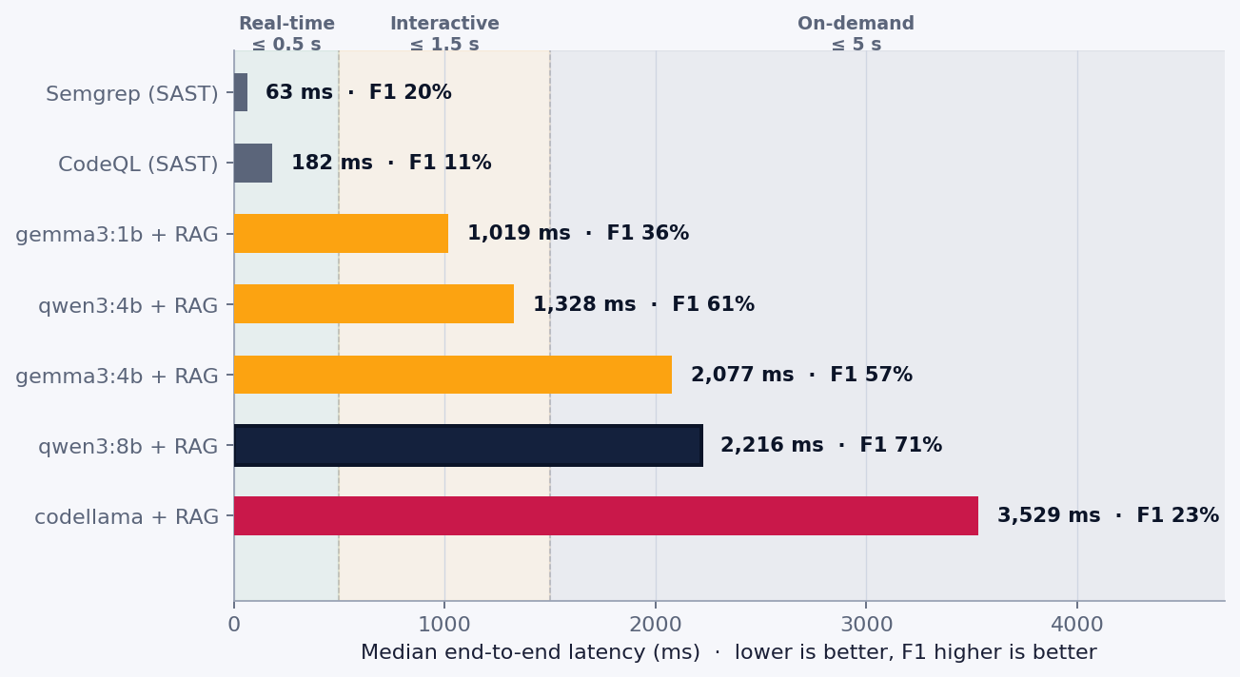


TECHNICAL UNIVERSITY OF CHEMNITZ
R4
R4 · Usability: Latency Bands
Real-time ≤ 500 ms
SAST baselines only
Interactive ≤ 1.5 s
gemma3:1b + RAG (1,019 ms)
qwen3:4b (1,328 ms)
On-demand ≤ 5 s
qwen3:8b + RAG (2,216 ms) ← headline
p95 = 4,327 ms
Md Hafizur Rahman
18 / 25
Notes:
Slide 18 — R4 Usability: Latency Bands · [80 s]
VOICE
"Three latency bands, fixed before evaluation. Real-time — under 500 milliseconds — is the SAST band, not the model's. Interactive — under 1.5 seconds — is met by gemma3:1b with RAG at 1,019 milliseconds, and qwen3:4b with RAG at 1,328. And on-demand — under 5 seconds — is where the headline qwen3:8b with RAG lands: 2,216 milliseconds, with the 95th percentile at 4,327. Comfortably inside.
A real product picks the band per workflow. Inline-diagnostic mode runs a 4B model. On-demand and audit modes run the 8B."
PRE-EMPT (fold into the flow — answers a question before it's asked) — "Real-time under 500 milliseconds is deliberately out of scope for the LLM — that band belongs to SAST. Framing it that way up front makes 2.2 seconds read as on-target, not slow." → defuses "2.2 s is too slow" (QA_PREP E.1)
TRANSITION — "R5, privacy."

Slide 19
TECHNICAL UNIVERSITY OF CHEMNITZ
R5
R5 · Privacy: Empirically Verified
Network Isolation
Prompt-Injection Harness
Loopback-only by network policy. Source-leak
scan: 0 non-loopback refs in 9,488 code windows.
12 crafted exfiltration attempts: no code
echoed · schemaValidRate 83 % (10/12).
100 % satisfied
100 % leakFreeRate
Ed25519-Signed Corpus
Reproducible Build
RAG corpus provenance verified at
load (manifest signature checked).
Node 20.19.0-alpine · npm ci · seed = 42
byte-identical runs.
Verified ✓
Reproducible ✓
Resource footprint: harness 3 ms median CPU, under 100 MB RSS · Ollama 6–8 GB RAM for 8B-q4.
Md Hafizur Rahman
19 / 25
Notes:
Slide 19 — R5 Privacy: Empirically Verified · [70 s]
VOICE
"Same four arms from the architecture — but now each one carries a measurement, not just a claim.
The network arm. The policy allows loopback only, so a non-loopback connection can't even open. A source-leak scan corroborates it: it breaks the corpus into more than nine thousand small text fingerprints, then watches for any of those byte-sequences trying to leave the machine. It found none.
The injection arm. Twelve crafted attempts to make the model leak. All twelve, leak-free. The slide also carries a stricter number, answering a different question — did the model return a clean, well-formed reply? There the result is 83 percent, ten of twelve. The other two didn't leak; they just went silent, returning an empty response instead of a proper refusal. So the worst case was the model saying nothing — not the model leaking.
The provenance arm. The corpus's Ed25519 signature is verified on every load. Tampering makes it fail closed.
The reproducibility arm. The pinned container gives byte-identical runs — Node 20.19-alpine, npm ci, seed 42.
And the cost is modest. The harness stays under a hundred megabytes of RAM. Ollama is the heavy part — 6 to 8 gigabytes for an 8B model."
TRANSITION — "What does all of this add up to?"

Slide 20

TECHNICAL UNIVERSITY OF CHEMNITZ
CODE GUARDIAN
What the Evaluation Showed
A local 8B model is enough · RQ1
RAG is model-dependent · RQ2
qwen3:8b + RAG reaches ~71 % F1 on JS/TS, well inside the on-demand latency band on a developer laptop. The privacy envelope holds without paying for it in quality.
The largest paired effect in the dataset is a RAG-induced degradation (codellama −29.89 F1). Treat retrieval as a per-model design choice, not a default.
Repair is the real product gap
Privacy as a verifiable boundary
90 % auto-applicable means the developer can act, not just be warned. This is where SAST falls flat: they detect, they don't fix.
Loopback + signed corpus + container pin makes privacy testable, not aspirational. leakFreeRate = 100 % isn't a slogan; it's a measurement.
RQ1 Yes: 71.43 % F1 under the privacy envelope · RQ2 Yes, but per-model: RAG is not a default · RQ3 Yes: 2.2 s median, inside the on-demand band
Md Hafizur Rahman
20 / 25
Notes:
Slide 20 — What the Evaluation Showed · [90 s]
VOICE
"So what did all that measurement actually show? Four things.
First — a local 8B model is enough. qwen3:8b with RAG reaches about 71 percent F1 on JavaScript and TypeScript, inside the on-demand band, on a laptop. You don't pay for privacy with quality.
Second — retrieval depends on the model. It's not a universal win. The largest single effect in the whole study is RAG making things worse — codellama, at minus 29.89. That one result is enough to rewrite the rule.
Third — repair is the real gap. Ninety percent auto-applicable means you can act, not just be warned. That's the one thing the local scanners cannot do.
Fourth — privacy is something you can test. Loopback, a signed corpus, a pinned container — they make 'leak-free' a measurement, not a slogan.
And the three questions from the start are answered. RQ1: yes — 71.43 F1 under the privacy envelope. RQ2: yes, but per-model. RQ3: yes — 2.2 seconds, on-demand."
TRANSITION — "So where does that leave Code Guardian against the gap I opened with?"

Slide 21
TECHNICAL UNIVERSITY OF CHEMNITZ
CODE GUARDIAN
Code Guardian Closes the Gap
Solution / Approach
R1
ACCURACY
R2
CONSISTENCY
R3
REPAIR
R4
USABILITY
R5
PRIVACY
LEGEND
High / Satisfied
GitHub Copilot
Partial
Semgrep
Not satisfied
CodeQL
GAP CLOSED
IRIS (GPT-4)
The only approach to bring privacy + repair + IDE-grade latency together in one local tool, with competitive detection accuracy.
SecRepair
Code Guardian
Green check = meets the pre-registered threshold; amber = Medium. R1 is amber: F1 71 % lands in the Medium band, competitive but not High.
Md Hafizur Rahman
21 / 25
Notes:
Slide 21 — Code Guardian Closes the Gap · [55 s]
VOICE
"Recall the trade I opened with — send your code away, or work almost unprotected. This is the same matrix from the start, now with one row added at the bottom.
Privacy is met. Repair is met — and that's the column every other local tool leaves empty. Usability sits inside the band. Consistency holds.
Accuracy I've marked partial, not top — and that's deliberate. 71 percent F1 is the Medium band: competitive under these constraints, but not class-leading. So the claim isn't that the tool is best at everything. It's something narrower, and more useful. This is the one approach that brings privacy, repair, and IDE-grade speed together. And in doing so, it refuses the trade no developer should have to make."
TRANSITION — "Now the limitations."

Slide 22









TECHNICAL UNIVERSITY OF CHEMNITZ
CODE GUARDIAN
Limitations & Future Work
Current Limitations
Future Work
Single-reviewer manual review (n = 25)
Seed rotation
Headline R3 is the objective auto-applicable rate; inter-rater κ is future work.
Genuine consensus signal beyond the deterministic-decoding floor.
Curated 101-case corpus
Inter-rater agreement
Offset by held-out 71 / 30 split, 15-case external set, whole-project NodeGoat run.
Second reviewer on the 25-sample subset for a κ statistic.
One real-world project end-to-end
Multi-project real-world validation
NodeGoat only · multi-project validation pending.
Measured recall beyond NodeGoat, across diverse production codebases.
Consensus filter inert under determinism
Streaming partial results
Three seed-42 runs are byte-identical; a real signal needs seed rotation.
Surface first-token findings to break into the real-time band.
No cloud-LLM baseline
Adaptive RAG gating
Excluded by the privacy threat model · 3 SAST tools set the floor.
Per-model RAG enable/disable driven by slide 16's finding.
Md Hafizur Rahman
22 / 25
Notes:
Slide 22 — Limitations & Future Work · [95 s]
VOICE
"Now the honest part — and it's on one slide, because every limitation points straight at a piece of future work. Limitations on the left. Where each one leads, on the right.
Five limitations, stated in the open. First — the manual repair review was one reviewer on 25 cases. A single informed judgment, not a consensus. Second — the corpus is 101 curated cases; I guard against that bias four ways: the held-out split, the external 15-case set, the NodeGoat whole-project run, and the signed-manifest provenance. Third — only one real-world project was run end to end, NodeGoat, and one project can't prove the system generalizes. Fourth — the consensus filter does nothing under deterministic decoding, since three runs at seed 42 are byte-identical. And fifth — there's no cloud-LLM baseline, ruled out by the privacy threat model, so the three SAST tools set the floor instead.
And each one has a next step. Rotating the seeds would let the consensus filter do real work. A second rater would strengthen the manual review. Validation across more projects would test generalization. Streaming partial results would reach the real-time band. And gating retrieval per model follows directly from slide 16. None of these are loose ends — they're the roadmap the evaluation wrote for itself."
TRANSITION — "Now the contributions."

Slide 23



TECHNICAL UNIVERSITY OF CHEMNITZ
CODE GUARDIAN
Contributions of This Thesis
Working VS Code extension
Local LLM + RAG + signed corpus + pinned container, published to the Marketplace.
Two-stage pipeline with structured contracts
Detection (JSON-mode) + Repair ({ code, language }), schema-pinned at every boundary.
Empirical study
5 models × 2 modes + 3 SAST baselines · 303 invocations per config · CWE-mapped JS/TS corpus.
Reproducibility infrastructure
Byte-identical runs, Ed25519-signed manifest, pinned Node 20.19.0-alpine container.
Statistical discipline
Bonferroni-corrected McNemar, exact-binomial CIs, held-out 71 / 30 split.
Md Hafizur Rahman
23 / 25
Notes:
Slide 23 — Contributions of This Thesis · [70 s]
VOICE
"Five contributions. The first is a working VS Code extension — local model, RAG, signed corpus, pinned container — published to the Marketplace, so any developer can install it today. The second is a two-stage pipeline with a structured JSON contract at every boundary, covering detection and repair. The third is an empirical study: five models, two modes, and three SAST baselines, at 303 invocations per configuration, on a CWE-mapped JavaScript and TypeScript corpus. The fourth is reproducibility infrastructure — byte-identical runs, a signed manifest, and a pinned Node container — so anyone can re-run the study and get the same numbers. And the fifth is statistical discipline: Bonferroni-corrected McNemar, exact-binomial intervals, and a held-out test split."
TRANSITION — "Those are the contributions; the key references are on the next slide."

Slide 24
TECHNICAL UNIVERSITY OF CHEMNITZ
CODE GUARDIAN
References
[1] Touvron, H., et al.: Llama 2: Open foundation and fine-tuned chat models. arXiv:2307.09288 (2023)
[7] Pearce, H., et al.: SecurityEval dataset: mining vulnerability examples. MSR4P&S (2022)
[2] Lewis, P., et al.: Retrieval-augmented generation for knowledge-intensive NLP tasks. NeurIPS (2020)
[8] MITRE: Common Weakness Enumeration (CWE) · https://cwe.mitre.org
[3] Li, Z., et al.: IRIS: Using LLMs for context-aware vulnerability detection. ICLR (2025)
[9] OWASP Foundation: OWASP Top 10 · https://owasp.org/Top10
[4] Islam, N., et al.: SecRepair: LLM-driven security vulnerability repair. NDSS (2024)
[10] Malfa, E.L., Petrov, A., et al.: A taxonomy of evaluation methods for LLMs. arXiv:2402.13887 (2024)
[5] Kavian, S., et al.: LLMSecGuard: Securing LLM-generated code. EASE (2024)
[11] Ollama: Local LLM serving · https://ollama.com
[6] Peng, B., et al.: CWEval: Outcome-driven evaluation of LLM code generation. ACL (2025)
[12] Microsoft: VS Code Extension API · https://code.visualstudio.com/api
Md Hafizur Rahman
24 / 25
Notes:
Slide 24 — References · [10 s]
VOICE
"These are the main sources — the foundation models and RAG, the academic LLM-for-security comparators, and the standards the corpus maps against. I'll leave this up for a moment."
(Don't read the list. Advance once the panel has had a moment.)
TRANSITION — "Thank you. I'd be glad to take questions."

Slide 25
TECHNICAL UNIVERSITY OF CHEMNITZ
Thank You
?
Questions & Discussion
HEADLINE
F1 71.43 % · Repair 90.32 % auto-applicable · Latency 2.2 s median · leakFreeRate 100 %
Md Hafizur Rahman
DEFENSE · 16.06.2026
M.Sc. Web Engineering · TU Chemnitz
Notes:
Slide 25 — Thank You · [Q&A — 20 min]
VOICE
"Recall the opening: you, the bank's code, and today's trade — send your code away, or work almost unprotected. Code Guardian refuses that trade. The code stays on your machine, you get the finding, and you get the fix.
Four numbers hold it together: F1 71.43, repair 90.32, latency 2.2 seconds, and leak-free on the harness. Thank you. I would be glad to take your questions."
(Stop talking. Look at the panel. Wait.)
During Q&A (you have a full 20 minutes — slow down, answer properly):
- Briefly restate the question in your reframe. It confirms you understood and buys thinking time.
- With 20 minutes you can give a full answer and then open the matching appendix slide — put A1–A7 on the projector when it helps.
- Use the QA_PREP structure: Frame → Anchor (one number) → Concede (the smallest honest limit). Aim for ~60–90 s per answer; you're not racing the clock.
- It's fine to pause and think. Silence reads as care, not weakness.
- Don't apologise. Don't say "good question." Just answer.

Slide 26
TECHNICAL UNIVERSITY OF CHEMNITZ
APPENDIX
A1 · Full Per-Model Results · Canonical Taxonomy
Configuration
F1
Prec
Recall
FPR
Latency p50
VRAM
qwen3:8b + RAG
71.43
72.46
70.42
10.00
2,216 ms
~6 GB
qwen3:8b (no RAG)
67.52
61.63
74.65
50.00
1,534 ms
~6 GB
qwen3:4b + RAG
60.92
51.46
74.65
100.00
1,328 ms
~4 GB
qwen3:4b (no RAG)
66.14
56.95
78.87
90.00
1,305 ms
~4 GB
gemma3:4b + RAG
57.14
46.85
73.24
100.00
2,077 ms
~4 GB
gemma3:4b (no RAG)
57.30
46.49
74.65
100.00
2,550 ms
~4 GB
gemma3:1b + RAG
36.02
32.22
40.85
23.33
1,019 ms
~2 GB
gemma3:1b (no RAG)
36.65
29.17
49.30
53.33
1,215 ms
~2 GB
codellama + RAG
23.17
14.79
53.52
100.00
3,529 ms
~6 GB
codellama (no RAG)
53.06
41.60
73.24
100.00
2,024 ms
~6 GB
Semgrep (SAST)
20.22
50.00
12.68
6.67
63 ms
n/a
CodeQL (SAST)
10.85
12.07
9.86
53.33
182 ms
n/a
ESLint-security
0.00
0.00
0.00
0.00
1 ms
n/a
qwen3:8b + RAG headline uses phase1-b3 canonical run; all others use canonical-taxonomy ablation. p95 latencies in source JSON.
Md Hafizur Rahman

Slide 27
TECHNICAL UNIVERSITY OF CHEMNITZ
APPENDIX
A2 · Confusion Matrices · qwen3:8b + RAG
Full corpus (n = 101) · case-level majority
Held-out test split (n = 30)
Predicted: Vuln
Predicted: Safe
Predicted: Vuln
Predicted: Safe
Actual
Vuln
50
21
Actual
Vuln
11
10
TP
FN
TP
FN
Actual
Safe
3
27
Actual
Safe
0
9
FP
TN
FP
TN
Sample-level via ≥2/3 majority over 3 deterministic runs (seed=42, T=0). Precision is finding-level/pooled, so 72.46 % ≠ TP/(TP+FP) here. Source: phase1-b3 canonical taxonomy.
Md Hafizur Rahman

Slide 28
TECHNICAL UNIVERSITY OF CHEMNITZ
APPENDIX
A3 · Why the Single-Reviewer Manual Review Is Bounded
Fix provided
Semantically correct
76 %
89.5 %
Of 25 reviewed samples, 19 included a repair suggestion.
Fix addresses the CWE (17 of 19 issued fixes).
Strategy-aligned
Executable code
94.7 %
42.1 %
Right repair pattern (parameterized query, escaping, etc.).
Patch runs without modification; the rest give prose guidance.
Inter-rater on the 25-sample subset = future work. Headline R3 is the fully objective auto-applicable rate (90.32 %, n = 279).
Md Hafizur Rahman

Slide 29
TECHNICAL UNIVERSITY OF CHEMNITZ
APPENDIX
A4 · Why a Curated Corpus, Not an Existing Benchmark
WHY EXISTING JS/TS BENCHMARKS DON'T FIT
SELECTION-BIAS MITIGATIONS IN THIS THESIS
Juliet (NIST)
Held-out 71 / 30 split
C / C++ / Java only. No first-party JS port.
Frozen TEST set keeps threshold tuning out of headline numbers.
OWASP Benchmark
Java only.
15-case external corpus
NodeGoat, Juice Shop, 3 named CVEs, independent of the curator.
SecurityEval (Pearce 2022)
Small, partially synthetic. CWE labelling inconsistent with OWASP Top 10.
Whole-project NodeGoat run
CyberSecEval
Project-level recall independent of sample selection.
29.3 % of vulnerable samples are reproducible (Peng et al. 2025).
CWEval (Peng 2025)
Provenance bound into manifest
119 curated tasks across 31 CWEs, 5 languages, peer-comparable to 101 cases.
Ed25519 signature; corpus cannot be silently rewritten.
Md Hafizur Rahman

Slide 30
TECHNICAL UNIVERSITY OF CHEMNITZ
APPENDIX
A5 · Why No Cloud-LLM Baseline
YOUR LAPTOP · privacy boundary
ARGUMENT
Code Guardian
local LLM + RAG
Cloud-LLM is the problem statement
✓
Including it as a baseline contradicts the threat model.
Local SAST baselines
Semgrep · CodeQL · ESLint
Floor provided by 3 SAST baselines
✓
Semgrep, CodeQL, ESLint · all local, all reproducible.
Your code & prompts
source · embeddings · context
requires
code egress
Cloud LLM
Copilot · GPT-4
Claude · Cursor
✓
✗
Frontier cloud will always win raw F1
The thesis competes on the constraint set: local, zero-egress, reproducible.
Only outbound: signed corpus updates
Post-defense addendum
A one-paragraph comparison to published GPT-4 numbers on similar JS corpora is straightforward.
Cloud baselines can't be run without breaking the threat model.
Md Hafizur Rahman

Slide 31
TECHNICAL UNIVERSITY OF CHEMNITZ
APPENDIX
A6 · Why R2 Reports 100 % Inter-Run Agreement
RUN 1
RUN 2
RUN 3
{
"findings": [
{
"category":
"sql-injection",
"severity":
"high",
"line": 42
}
]
}
{
"findings": [
{
"category":
"sql-injection",
"severity":
"high",
"line": 42
}
]
}
{
"findings": [
{
"category":
"sql-injection",
"severity":
"high",
"line": 42
}
]
}
WHY THEY'RE IDENTICAL
temperature = 0 · seed = 42 · format = JSON · fixed prompt. Byte-identical → consensus signal requires seed rotation (future work).
Md Hafizur Rahman

Slide 32
TECHNICAL UNIVERSITY OF CHEMNITZ
APPENDIX
A7 · SAST Baseline Configuration
Semgrep
20.22 %
Registry packs: p/security-audit · p/javascript ·
p/typescript · p/owasp-top-ten (--metrics=off)
CodeQL
10.85 %
Suite: javascript-security-and-quality.qls
JavaScript database, default queries
ESLint
0.00 %
eslint-plugin-security v4 · recommended config
(eslint ^9.21); no rule fired on the corpus
FAIRNESS CAVEAT
All three were run per-snippet, at the same function-level scope as the LLM, the only scope-parity setting. In full-project deployment they get cross-file data flow, so these recall figures understate their production performance. Read as “SAST under LLM-equivalent scope.”
Md Hafizur Rahman

Slide 33
TECHNICAL UNIVERSITY OF CHEMNITZ
APPENDIX
A8 · Requirement Scales: Metrics, Thresholds & Sources
Requirement
Metric(s)
Levels & thresholds
Source
R1 · Accuracy
F1, precision, recall, FPR
High: F1≥.75, P/R≥.70, FPR≤.20 · Medium: F1≥.60, FPR≤.40 · Low: F1≥.45 · Insufficient: F1<.45 or FPR>.70
Johnson 2013;
Ji 2023
R2 · Consistency
JSON parse rate, inter-run agreement
High: parse≥99%, agreement≥90% · Medium: 95–99% · Low: 85–95% · None: <85%
Harness
(raw agreement)
R3 · Repair
Auto-applicable parse rate + manual rubric
High ≥75% · Medium 50–75% · Low <50% (3 bands; repair quality is partly qualitative)
Monperrus 2014
R4 · Usability
End-to-end median latency
High: ≤5 s inline / ≤15 s full-file · Medium: 5–15 s · Low: >15 s
Card 1983;
Nielsen 1994
R5 · Privacy
5-item verification checklist
Binary: all five criteria pass, or the requirement fails (privacy is a design constraint, not a spectrum)
Design constraint
(Ch. 2)
WHY THESE THRESHOLDS
Fixed in Chapter 2 before any model ran, the same pre-registration discipline as the held-out split. Accuracy and repair bands follow IR/SE convention; latency bands follow HCI response-time limits; privacy is a binary design constraint.
Md Hafizur Rahman

Slide 34
TECHNICAL UNIVERSITY OF CHEMNITZ
APPENDIX
A9 · Confidence Gate: Eval-Only Rescore Filter
Metric
Ungated
Gate ≥ 0.67
F1
71.43 %
74.07 %
▲ precision-driven
Precision
72.46 %
78.13 %
▲ +5.67 pts
Recall
70.42 %
70.42 %
= unchanged
FPR
10.0 %
10.0 %
= unchanged
WHAT THE GATE ACTUALLY DOES
• Drops findings the model could not map to a specific canonical category (the low-signal 'other' bucket): 6 findings in this run, all false positives. Recall is untouched.
• NOT run consensus: the three evaluation runs share seed 42 and are byte-identical, so there is no run-to-run disagreement to gate on, so the gate reduces to a category filter.
• Off by default in the shipped extension (minConfidence). Both gated and ungated numbers are reported in the thesis, so the reader picks the bar.
Md Hafizur Rahman

