Slide 1
Angular 7 - Day 6
Materials, PWA and SASS

Slide 2
Vignesh Murali Natarajan (119780)
Veteran Trainer, Delivery Manager and Sr. Architect with more than a decade of technical training experience. He has 13 technical certifications on Java, Mobile, Web, Architecture, Design and Development under his belt
1.0, March 2019

Slide 3

Session Rules
Please keep your phone on mute during the session.
Use WebEx icons to indicate your statuses like – Stepping Out, Coffee, Applause etc.
Stay on mute in WebEx unless you need to speak
Raise your hand if you need to communicate
There is no set time to ask questions, feel free to interrupt, should you have questions
There will be a 10 minutes short break around the middle of the session
Utilize the time provided by the trainer, in analyzing
examples, trying out exercises and coming up
with questions

Slide 4

Objectives
After completing this session, you will be able to:
Explain the design and components of Angular Material
Define Progressive Web Application(PWA)
Describe the features of Sass

Slide 5
Materials

Slide 6
Material Design
Material Design (codenamed Quantum Paper) is a visual design language developed by Google.
It can be used to create digital experiences. It’s a set of principles and guidelines across platforms and devices for interactivity, motion and components that simplify the design workflow for teams designing their product.
Based on the Google Cards Design principles, Cards are surfaces that display content and actions on a single topic.
Angular Material brings the idea of Materials to Angular. It provides a library of pre-designed material tools with rich UI components

Slide 7
Material Design
Google Cards are surfaces that display content and actions on a single topic.
They are built with the following core principles:
Contained - A card is identifiable as a single, contained unit.
Independent - A card can stand alone, without relying on surrounding elements for context
Individual - A card cannot merge with another card, or divide into multiple cards.
Notes:
Contained - A card is identifiable as a single, contained unit.
Independent - A card can stand alone, without relying on surrounding elements for context
Individual - A card cannot merge with another card, or divide into multiple cards.

Slide 8
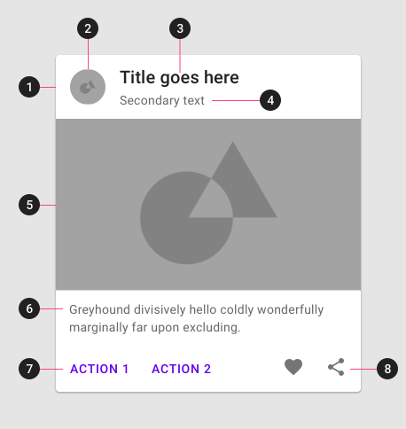
Card Anatomy
1. Container
Card containers hold all card elements, and their size is determined by the space those elements occupy. Card elevation is expressed by the container.
2. Thumbnail [optional]
Cards can include thumbnails to display an avatar, logo, or icon.
3. Header text [optional]
Header text can include things like the name of a photo album or article.
4. Subhead [optional]
Subhead text can include text elements such as an article byline or a tagged location.
5. Media [optional]
Cards can include a variety of media, including photos, and graphics, such as weather icons.
6. Supporting text [optional]
Supporting text include text like an article summary or a restaurant description.
7. Buttons [optional]
Cards can include buttons for actions.
8. Icons [optional]
Cards can include icons for actions.

Slide 9
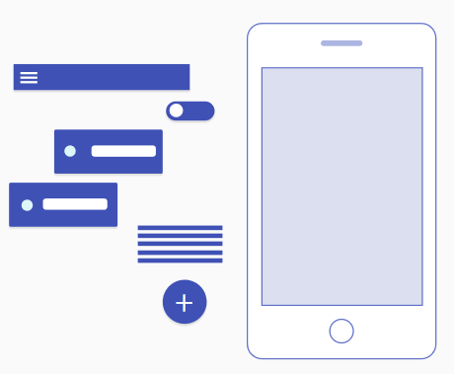
Angular Material
Angular Material is a UI component library for Angular developers. Angular Material components help in constructing attractive, consistent, and functional web pages and web applications, while adhering to modern web design principles like browser portability, device independence, and graceful degradation – principles adopted from Google Cards.
Following are the key features of Angular Material:
Comprehensive, modern UI components that work across the web, mobile and desktop
Themable, for when you need to stay on brand or just have a favorite color. Accessible and internationalized so that all users are welcome.
Built by the Angular team to integrate seamlessly with Angular

Slide 10
Material Components
Angular Material comprises a range of components which implement common interaction patterns according to the Material Design specification.
Form Controls
Controls that collect and validate User Input
Navigation
Menus, SideNavs and Toolbars that organize your content
Layout
Essential building blocks for presenting your content
Buttons & Indicators
Buttons, Toggles, status and progress indicators
Popups and Modals
Floating components that can be dynamically shown / hidden
Data Table
Tools for displaying and interacting with tabular data

Slide 11
Angular Material Support
Install Material Toolkit to the Application
Configure animations; Import BrowserAnimationModule
Import the component modules
npm install --save @angular/material @angular/cdk @angular/animations
import {BrowserAnimationsModule} from '@angular/platform-browser/animations';
@NgModule({
...
imports: [BrowserAnimationsModule],
...
})
export class PizzaPartyAppModule { }
import {MatButtonModule, MatCheckboxModule} from '@angular/material';
@NgModule({
...
imports: [MatButtonModule, MatCheckboxModule],
...
})
export class PizzaPartyAppModule { }

Slide 12
Angular Material Support (Contd.)
Include a theme in styles.css; required
Include HammerJS for Gesture support on mobile devices
Some components (mat-slide-toggle, mat-slider, matTooltip) rely on HammerJS
Add Material icons in index.html; optional
npm install --save @angular/material @angular/cdk @angular/animations
npm install --save hammerjs
<link href="https://fonts.googleapis.com/icon?family=Material+Icons" rel="stylesheet">

Slide 13

Learn How - Demonstration
Demo : Materials
Notes:
Instructions to Trainer:
Instructions to Facilitator:

Slide 14
Progressive Web Applications(PWA)

Slide 15
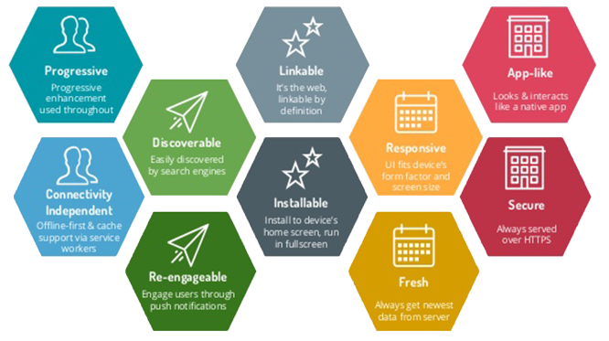
Introducing PWA
Progressive web applications (PWAs) are web applications that offer functionalities such as working offline, push notifications, and device hardware access traditionally available only to native applications. PWAs combine the flexibility of the web with the experience of a native application.

Slide 16
PWA Characteristics
Progressive
Responsive
Connectivity independent
App-like
Fresh
Work for every user, regardless of browser choice, because they are built with progressive enhancement as a core tenet.
Fit any form factor, desktop, mobile, tablet, or whatever is next.
Enhanced with service workers to work offline or on low-quality networks.
Use the app-shell model to provide app-style navigation and interactions.
Always up-to-date thanks to the service worker update process.
Safe
Discoverable
Re-engageable
Installable
Linkable
Served via HTTPS to prevent snooping and ensure content has not been tampered with.
Are identifiable as “applications” thanks to W3C manifests and service worker registration scope allowing search engines to find them.
Make re-engagement easy through features like push notifications.
Allow users to “keep” apps they find most useful on their home screen without the hassle of an app store.
Easily share via URL and not require complex installation.

Slide 17
PWA Enabling Technologies
Application Manifest:
The web app manifest is a W3C specification defining a JSON-based manifest to provide developers a centralized place to put metadata associated with a web application including:
The name of the web application
Links to the web app icons or image objects
The preferred URL to launch or open the web app
The web app configuration data for a number of characteristics
Declaration for default orientation of the web app
Enables to set the display mode e.g. full screen
This metadata is crucial for an app to be added to a home screen or otherwise listed alongside native apps.
WebWorkers:
Allow a web app to run multiple threads of (JavaScript) code simultaneously. Long activities can be moved off the user-interface thread, keeping responses snappy. They have a close relationship with Service Workers, but are more widely supported.
WebAssembly:
Allows precompiled code to run in a web browser, at near-native speed. Libraries written in languages such as C can be added to web apps. Due to the cost of passing data from JavaScript to WebAssembly, near-term uses will be mainly number-crunching (such as voice recognition and computer vision), rather than whole applications.

Slide 18
PWA Enabling Technologies (Contd.)
Indexed Database (IDB):
A NoSQL database built into modern browsers. Allows a PWA to immediately display content, regardless of connection status or speed
LocalStorage & SessionStorage:
Key-Value stores that largely make cookies obsolete
Application shell architecture:
Some progressive web apps use an architectural approach called the App Shell Model. For rapid loading, service workers store the Basic User Interface or "shell" of the responsive web design web application. This shell provides an initial static frame, a layout or architecture into which content can be loaded progressively as well as dynamically, allowing users to engage with the app despite varying degrees of web connectivity. The shell can be stored locally in the browser cache of the mobile device
Service workers:
Native mobile apps deliver rich experiences and high performance, purchased at the expense of storage space, lack of real-time updates, and low search engine visibility. Traditional web apps suffer from the inverse set of factors: lack of a native compiled executable, along with dependence on unreliable and potentially slow web connectivity. Service workers are used in an attempt to give progressive web apps the best of both these worlds.

Slide 19
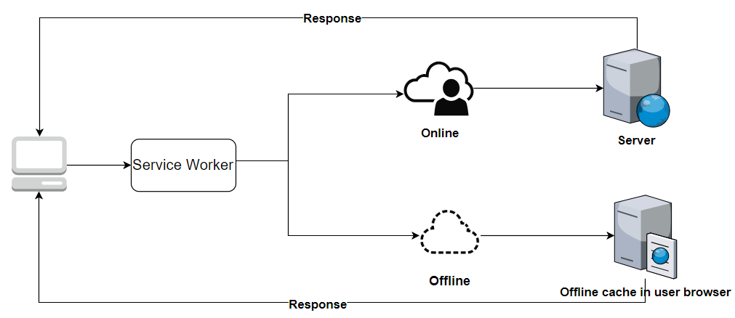
Service Workers Characteristics
Properties of service workers:
Following are the properties of service workers:
Trigger and keep alive by the relationship to the events, not by the documents.
Event-driven with time limit scripting contexts and running at the origin
State-driven with natural endpoints for a wide range of runtime services
Managed object with lifecycle events that contains registration
Benefits of service workers
Following are key benefits of service workers:
Capable of handling the push notification easily
Synchronize data in the background
Capable of responding to resource requests originating elsewhere
Receive centralized updates

Slide 20


Slide 21
Angular PWA Support
Create a new Angular Application
Add PWA Support
Explore these files
package.json, angular.json, ngsw-config.json
Launch the PWA Application
$ ng new angular-pwa-sample
$ Cd angular-pwa-example
ng add @angular/pwa
npm install –g http-server
ng build –prod
http-server –c-1 dist\angular-pwa-sample

Slide 22
Angular PWA Support
Create a manifest file – manifest.json in the src folder
Add the manifest.json file to the assets section of the angular.json file
Include the manfiest.json file in the index.html file
{
‘name’: ‘angular-pwa-sample’,
‘short_name’: ‘aps’,
‘theme_color’: ‘#ff0’,
‘background_color’: ‘#fafafa’,
‘display’: ‘standalone’,
‘scope’: ‘/’,
‘start_url’: ‘/’,
‘icons’: [
{
‘src’: ‘assets/icons/icon-72x72.png,
‘sizes’: ‘72x72’,
‘type’: ‘image/png’
}
]
}
...
‘assets’:[
‘src/favicon.ico’,
‘src/manifest.json’
]
...
<link rel=‘manifest’ href=‘manifest.json’>

Slide 23
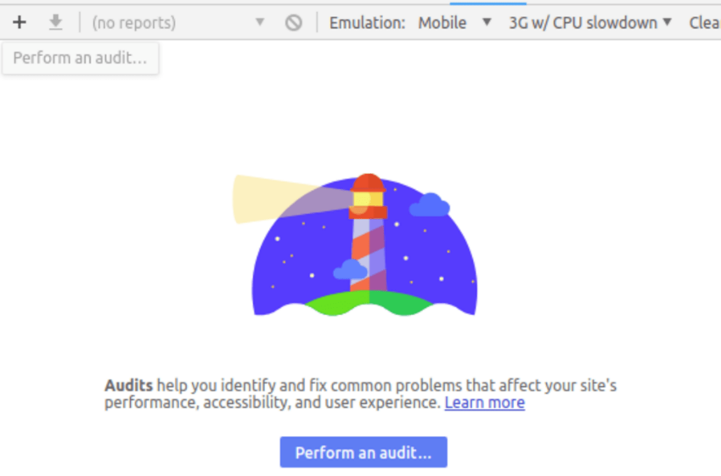
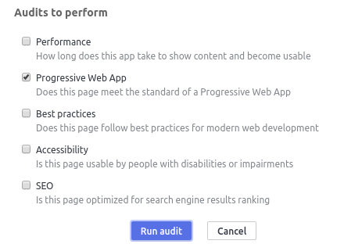
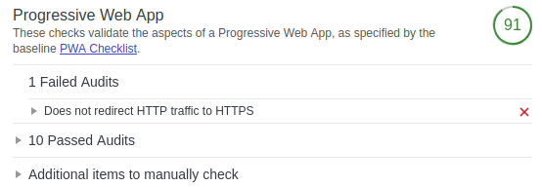
Lighthouse Plugin
Lighthouse is an open-source auditing tool created by Google which can be used to audit websites and applications for accessibility performance, SEO, best practices and PWA features.
Commonly Accessible as a Google Chrome Plugins are listed below:
Audit Selection
Plugin Page
Audit Results

Slide 24
Learn How - Demonstration
Demo : Pwa, PwaCam
Notes:
Instructions to Trainer:
Instructions to Facilitator:

Slide 25
Sass

Slide 26
CSS Preprocessors
CSS Preprocessors help in managing larger, complex and hard to maintain Stylesheets.
CSS Preprocessors introduce features that do not exist in primitive CSS, such as:
Variables, nesting, mixins, inheritance and the like
Preprocessors typically introduce an augmented version of a CSS like scripting language, that is dependent on the Preprocessor that is employed. This augmented script lets you use the aforementioned features inexistent in CSS. The augmented script is interpreted and compiled by the preprocessor to output a standard .css file.
Following are some of the common Preprocessors:
Sass / SCSS
Less
Notes:
Instructor note: We will focus on Sass with SCSS in this session.

Slide 27
Introducing Sass
Sass (Syntactically awesome style sheets) is a style sheet language that is interpreted or compiled into Cascading Style Sheets (CSS).
SassScript is the scripting language itself. Sass consists of two syntaxes:
The original syntax .SASS, called "the indented syntax", uses indentation to separate code blocks and newline characters to separate rules.
The newer syntax .SCSS (Sassy CSS), uses block formatting like that of CSS. It uses braces to denote code blocks and semicolons to separate lines within a block.
The term Sass usually refers to the pre-processor itself that supports both .sass and .scss files. The SCSS format is more popular and shall be the focus in this material.

Slide 28
Introducing Sass (Contd.)
CSS3 consists of a series of selectors and pseudo-selectors that group rules that apply to them. Sass extends CSS by providing several mechanisms available object-oriented languages, but absent in CSS3 itself.
When SassScript is interpreted, it creates blocks of CSS rules for various selectors as defined by the Sass file. The Sass interpreter translates SassScript into CSS.
Sass can also monitor the .sass or .scss file and translate it to an output .css file whenever the .sass or .scss file is saved.

Slide 29
Sass Features
Following are some of the key features of Sass:
Variables, Nesting, Partials, Import, Mixins, Inheritance, Operators
Variables help in reusing common values across styles and can inter-operate with functions. They can be of the following types
Numbers (including units)
Strings (with quotes or without)
Colors (name, or names)
Booleans
SCSS >>> CSS
$primary-color: #3bbfce;
$margin: 16px;
.content-navigation {
border-color: $primary-color;
color: darken($primary-color, 10%);
}
.border {
padding: $margin / 2;
margin: $margin / 2;
border-color: $primary-color;
}
.content-navigation {
border-color: #3bbfce;
color: #2b9eab;
}
.border {
padding: 8px;
margin: 8px;
border-color: #3bbfce;
}

Slide 30
Sass Features
Nesting styles logically to reduce style repetition.
SCSS >>> CSS
table.hl {
margin: 2em 0;
td.ln {
text-align: right;
}
}
li {
font: {
family: serif;
weight: bold;
size: 1.3em;
}
}
table.hl {
margin: 2em 0;
}
table.hl td.ln {
text-align: right;
}
li {
font-family: serif;
font-weight: bold;
font-size: 1.3em;
}
Mixins are logical groups(like classes) of styles that could be reused in multiple spots.
@mixin table-base($width) {
th {
text-align: center;
width: $width;
}
td, th {
padding: 2px;
}
}
#data {
@include table-base(600px);
}
#data th {
text-align: center;
width: 600px;
}
#data td, #data th {
padding: 2px;
}

Slide 31
Sass Features
Loops allow for iterating over variables using @for, @each and @while, which can be used to apply different styles to elements with similar classes or ids
SCSS >>> CSS
@each $animal in puma, sea-slug, egret, salamander {
.#{$animal}-icon {
background-image: url('/images/#{$animal}.png');
}
}
.puma-icon {
background-image: url('/images/puma.png'); }
.sea-slug-icon {
background-image: url('/images/sea-slug.png'); }
.egret-icon {
background-image: url('/images/egret.png'); }
.salamander-icon {
background-image: url('/images/salamander.png'); }
@for $i from 1 through 3 {
.item-#{$i} { width: 2em * $i; }
}
.item-1 {
width: 2em; }
.item-2 {
width: 4em; }
.item-3 {
width: 6em; }

Slide 32
Sass Features
Partials contain little snippets of CSS that you can include in other Sass files. This is a great way to modularize your CSS. Often used in tandem with Imports
Reusable SCSS Snippet Importing SCSS
// _reset.scss
html,
body,
ul,
ol {
margin: 0;
padding: 0;
}
// base.scss
@import 'reset';
body {
font: 100% Helvetica, sans-serif;
background-color: #efefef;
}
Extend/Inheritance enables sharing a set of CSS properties from one selector to another. It helps keep your Sass very DRY.
// This prints as it is extended
%message-shared {
border: 1px solid #ccc;
padding: 10px;
color: #333;
}
// This won't print as it is not extended
%equal-heights {
display: flex;
flex-wrap: wrap;
}
//Extensions
.message {
@extend %message-shared;
}
.success {
@extend %message-shared;
border-color: green;
}
.error {
@extend %message-shared;
border-color: red;
}

Slide 33
Sass Features
Parent Selector & is used to refer the parent selector that the current style is hosted in
SCSS CSS
#main {
color: black;
a {
font-weight: bold;
&:hover { color: red; }
}
}
#main {
color: black; }
#main a {
font-weight: bold; }
#main a:hover {
color: red; }
#main {
color: black;
&-sidebar { border: 1px solid; }
}
#main {
color: black; }
#main-sidebar {
border: 1px solid; }

Slide 34
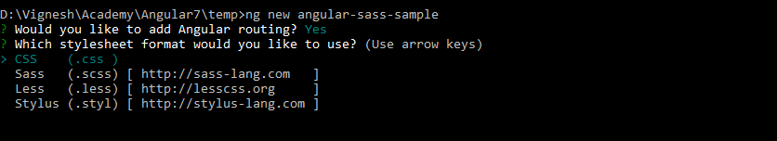
Angular Sass Support
While creating an Angular Application using Angular CLI, it prompts the user to pick from CSS Options – CSS, SCSS, Less or Stylus
Or set the --style flag with the new command while creating a new project
To convert an existing CSS project into SCSS, perform the following steps:
Run the following command in the project
Rename existing .css files to .scss (i.e. styles.css and app/app.component.css)
Point the angular.json file to find styles.scss
Point the components to find your new style files; wherever styleUrls attribute was used
ng new angular-sass-sample --style=scss
ng config defaults.styleExt=scss

Slide 35
Learn How - Demonstration
Demo : SASS
Notes:
Instructions to Trainer:
Instructions to Facilitator:

Slide 36
What Next?
Unit Testing
E2E Testing
Angular Style Guide
Best Practices
Coding Standards
Convention over Configuration
Angular Animations
Designing Multiple Modules
Advanced Techniques
Internationalization
Security
Server Side Rendering
?
.

Slide 37


Questions

Slide 38
Test Your Understanding
How to enable Material in an Angular application?
Is Material part of Angular?
What are some traits of a PWA Application?
How to test the PWA adherence of an application?
What are CSS Pre-processors?
What is the difference between SASS and SCSS?
Notes:
Instructions to Trainer:
Instructions to Facilitator:

Slide 39
Summary
Following are the key points of this session:
Material Design (codenamed Quantum Paper) is a visual design language developed by Google.
Based on the Google Cards Design principles, Cards are surfaces that display content and actions on a single topic.
Angular Material comprises a range of components which implement common interaction patterns according to the Material Design specification.
The term Sass usually refers to the pre-processor itself that supports both .sass and .scss files.
PWAs combine the flexibility of the web with the experience of a native application.

Slide 40
References
The author or the organization does not claim any intellectual rights on the content used in these materials. Some of the materials have been taken from the following(but not limited to the below) references. These materials belong to the respective authors. The content is used for learning purposes. Most of them with due permission from the original sources
https://angular.io/
https://genuitec.com
https://angularexamples.io
https://lishman.io
https://rangle.io
https://dzone.com/articles/developing-pwa-using-angular-7
https://sass-lang.com/
https://material.angular.io/
https://www.smashingmagazine.com/2018/09/pwa-angular-6/
https://www.sitepoint.com/angular-material-design-components/
https://www.freakyjolly.com/angular-7-implement-infinite-virtual-scroll-in-few-easy-steps-in-latest-angular-7-x/

Slide 41
You have successfully completed
Materials, PWA and Sass

