Slide 1

Amazon Book Review Analysis with NLP
Melanie Hanna
August 2017

Slide 2
Introduction
In this analysis, we set out to:
Analyze book review text from Amazon to understand how favorably readers find books on average from the star rating system and determine the most frequently used words and parts of speech in review text.
Create a Naive Bayes model to predict star rating of a review based on textual analysis.
Recommend books based on topics determined through latent Dirichlet allocation that are included in favorable reviews by the user.

Slide 3
Data Sets
Five-core data set compiled from Julian McAuley at UCSD containing:
More than 500,000 reviews from…
12,000 different books
214,000 unique reviewers
Data set included:
Book title
Reviewer ID
Reviewer name
Review text
Star rating

Slide 4
Data Exploration

Slide 5
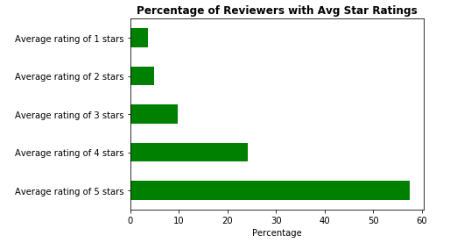
Initial analysis
78% of all reviews were rated as 4 stars or higher
Only 10% of reviews were rated at 2 stars or below
Most users (~60%) reliably rate at 5 stars
Indicates users only review for well-liked books or mainly buy books they enjoy

Slide 6
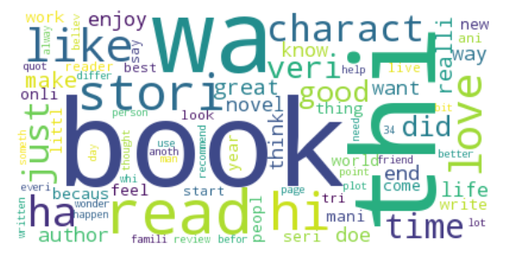
N-gram analysis
“Stemmed” tokens were counted to determine most frequent words:
Book
Read
Stori
Like
Charact
Reviews were sorted into bi-grams and frequencies again counted:
Thi book
Read book
Recommend thi
Main charact

Slide 7
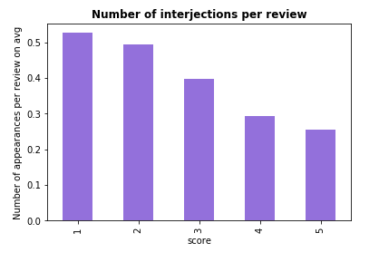
Parts of speech
No. of stars | 1 | 2 | 3 | 4 | 5
Adjective | 19.18 | 21.48 | 22.28 | 21.74 | 16.70
Adverb | 15.72 | 18.30 | 17.61 | 15.14 | 11.26
Interjection | 0.53 | 0.49 | 0.40 | 0.29 | 0.26
Noun | 35.45 | 38.57 | 39.51 | 38.88 | 30.10
Number | 2.00 | 1.99 | 1.95 | 1.84 | 1.50
Pronoun | 12.57 | 14.18 | 13.88 | 12.51 | 10.02
Verb | 36.66 | 40.03 | 39.57 | 36.93 | 28.61
Compiled average number of each part of speech in a review per star rating
Interjections (ex. “Wow!”) are used in 5-star reviews at twice the rate of 1-star reviews

Slide 8
Predictive Modeling

Slide 9
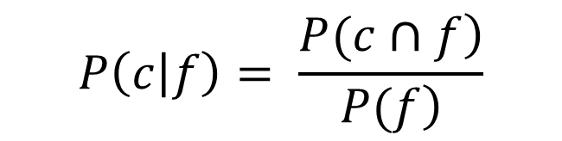
Naïve Bayes classifier
Goal: Find probability of each star rating given a bag-of-words representation of review text
Result: 60% accuracy on the test set
Performs well on 1-star and 5-star reviews but struggles with 3-star
$$P\left(c | f\right)= \frac{\left.P(c∩f\right)}{\left.P(f\right)}$$

Slide 10
Naïve Bayes classifier example
Example review: “This Harvard Law grad finally has a Yale man he can respect. I grew up without running water in Boone County, WV, and wound up with a degree from Harvard Law School. JD Vance's story brought me to tears and cheers, for he has told the story of my people.”
Model correctly predicted 5-stars with 90% certainty

Slide 11
Naïve Bayes classifier example
Example review: “Insulting Trash. Classicism to the tenth degree. No actual analytical thought in how circumstances out of the individuals control contributed to their plight. Also, don't degrade a whole society based on your own trashy family. Also, the author seems to think he's special. He's not, he had decent grandparents so he had some good influences that contributed to his success. He should focus more on that instead of his mommy daddy issues.”
Model correctly predicted 1-star with 50% certainty

Slide 12
Naïve Bayes classifier example
Example review: “Good, but no real surprises. I enjoyed reading this memoir because of the fact it was a memoir and, if well written, I am generally intrigued by the lives of others. However, one of the big hypes of the book was it supposedly contained the answers to why so many voted for Trump. I didn't find any fascinating revelations on that issue and am still stupefied by it. There were some interesting statistics though and, overall, it was a good read. I'm sure there will be good discussions at book group tonight!”
Model incorrectly predicted 3-stars with 72% certainty. Review is a 4-star.

Slide 13
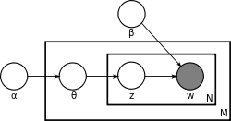
Topic modeling
Latent Dirichlet allocation (LDA) represents documents as a mixture of topics, which are in turn represented by a mixture of terms
Number of topics is pre-defined (50 used in this analysis)
Text pre-processing includes parsing, lemmatizing, finding bi-grams and omitting stop-words

Slide 14
Pre-processing example
Original:
“Flawless. Anything I've read by Gibran is, in my mind, flawless. This, the most famous of his works, is no exception. It is simple, yet deep; honest and profound; moving and inspirational. Gibran's work is one of a kind, and can be far more encouraging and moving than any self-help program or therapy or anything like that. The poetic style, the aphorisms, the parables, the almost biblical feel, are all just what over-worked, over-stressed, modern and spiritually starved worldly people need.”
Transformed:
“flawless read gibran mind flawless most_famous work no_exception simple deep honest profound inspirational gibran work kind far encouraging self help program therapy like poetic style aphorism parable biblical feel work stress modern spiritually starve worldly people ne”

Slide 15
Topics created
#27: “Humor”
“laugh”, “funny”, “hilarious”
#18: “Physical book”
“illustration”, “edition”, “art”
“General” topics have no apparent overarching theme
“Like”, “know”, “juliette”
Topic No. | Theme
0 | Rome
1 | sports, monsters
2 | Christianity
3 | general
4 | character
5 | sci-fi
6 | humankind
7 | contractions
8 | general
9 | general
10 | women
11 | good, great
12 | world, experience
13 | life, people
14 | general
15 | love, like
16 | family relationships
17 | story, family
18 | physical book
19 | plot
20 | male names
21 | angel
22 | general
23 | paranormal
24 | history
Topic No. | Theme
25 | story
26 | America
27 | humor
28 | fantasy
29 | general
30 | good, great
31 | Jewish history
32 | American military
33 | survival
34 | fairy tale
35 | like, love
36 | self-help
37 | story
38 | family
39 | cookbook
40 | general
41 | series
42 | murder mystery
43 | technical
44 | general
45 | novel
46 | Dallas
47 | children
48 | general
49 | female names

Slide 16
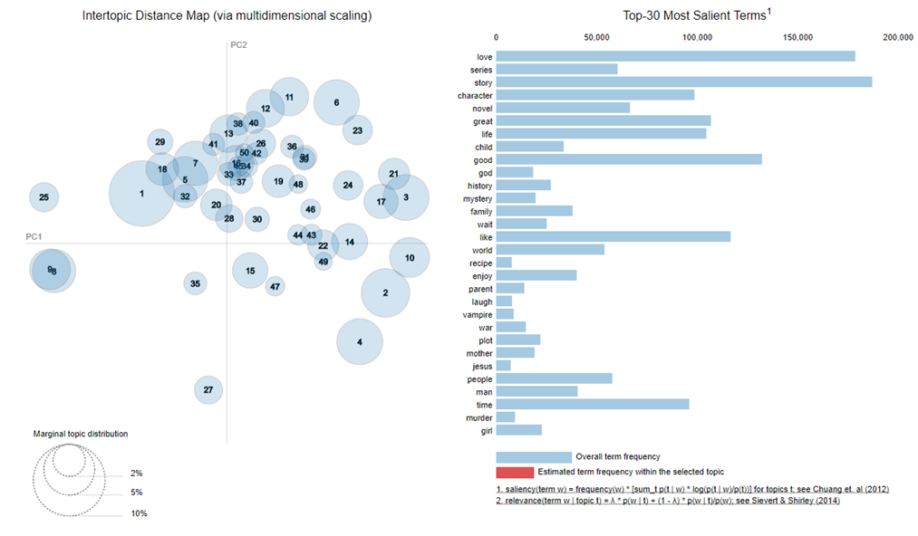
2-D visualization
Outliers to left (9, 8, 25, 1) are “like, love” topics
Near the bottom of the plot (27, 35, 4, 2, 15) are “cookbook”, “self-help” and “physical book” themes
Y-axis = abstraction
More concrete themes on bottom and more abstract themes (family, adventure) on top
X-axis = descriptiveness
Descriptions (“love”, “like”) on left and object-based (vampire, Jesus) on right

Slide 17
Topic model example
“Words to Live By and Learn From. A must in everyone's library for graceful poetry, inpirational reading and lessons to live by and to even to let go. A new printing would be a welcome as the "used" ones in good condition are quite expensive.”
“physical book” (0.493)
“life, people” (0.271)
“good, great” (0.184)

Slide 18
Recommender system overview
Extracts 3 most common topics from user’s favorable reviews
Searches through all 5-star reviews in database for titles with matching topics
Compiles list of recommended titles

Slide 19
Recommender system in action
Reviewer Aistis Zidanavicius gave 5 stars to:
The Monk Who Sold His Ferrari
The Zahir: A Novel of Obsession
Brave New World
The Alchemist
The Greatness Guide: 101 Lessons for Making What’s Good at Word and in Life Even Better
Start Where You Are: Life Lessons in Getting from Where You Are to Where You Want to Be
Recommender system identified as Aistis’ preferred dominant themes:
“life, people”
“like, love”
“self-help”

Slide 20
Recommender system in action
System returned 10,500 titles as recommendations for Aistis, some of which were:
Big Fish
Shadowmagic: Prince of Hazel and Oak
The Hair Color Mix Book
Matched fantasy/mysticism from Brave New World, The Alchemist and self-help on The Hair Color Mix Book

Slide 21
Recommendations and Future Work
Increase number of topics in the LDA model to create more specific themes
Weight similar topics (ex. “American military” & “survival”) more heavily
Incorporate user data (i.e. age, gender)
Recommendations:
After further refinement, implement recommender system
Identify new titles to stock that correspond to the terms the Naïve Bayes model finds most accurate in predicting favorability of a review

