Slide 1
NotesNPU
Private, offline AI lecture & meeting copilot - accelerated by the Snapdragon NPU on HP PCs
Qualcomm AI Hub Whisper on the Hexagon NPU + on-device LLM | 100% offline
Mohammed Haris Suhaib M | Snapdragon AI Lab Build & Present Challenge 2026
https://github.com/mdharishsuhaib/NotesNPU

Slide 2
THE PROBLEM
Taking notes while learning is broken
■ Indian students attend 25-30 hours of lectures a week, often in fast, code-mixed Hindi-English, and struggle to take notes and listen at the same time.
■ Cloud transcription tools (Otter, Fireflies, cloud Copilots) upload sensitive classroom and meeting audio to third-party servers.
■ They need reliable internet and paid subscriptions, which are hard to get in hostels, tier-2/3 colleges, trains and field work.
■ Running AI on the CPU drains the battery and heats the laptop, so it can't run through a whole day of classes.
25-30 h
lectures / week per student
0
bytes of audio should leave the laptop
1 day
battery needed for back-to-back classes
NotesNPU | 2

Slide 3
THE SOLUTION
NotesNPU: your private AI note-taker
■ Record or upload a lecture and get a timestamped transcript, fully on-device, even in airplane mode.
■ Qualcomm AI Hub Whisper runs on the Hexagon NPU via ONNX Runtime QNN EP, leaving the CPU free and saving battery.
■ A local LLM (Phi-3.5-mini INT4) generates a summary, structured notes, flashcards, a quiz and answers questions.
■ Auto-extracts action items and deadlines ('exam next Monday', 'read chapter 6').
■ Supports 10+ Indian languages, with Hindi lecture to English notes translation in the same pass.
Transcribe
Live mode
Upload or record; pause-aware 30 s chunking; timestamps
Mic streaming, text every ~8 s, on-device
Translate
Study notes
Hindi / Tamil / Telugu / Bengali... to English
Summary, key concepts, detailed notes, deadlines
Revise
Ask the lecture
Flashcards and 5-question MCQ quiz
Grounded Q&A chat on your transcript
Export
Benchmark
One-click Markdown notes
Built-in NPU vs CPU performance panel
NotesNPU | 3

Slide 4
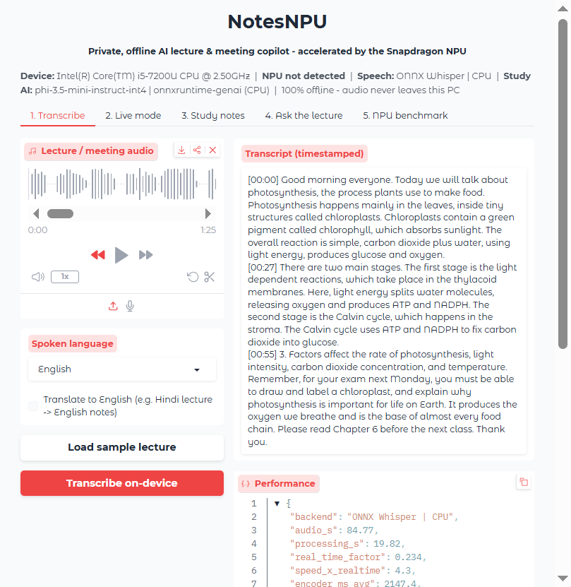
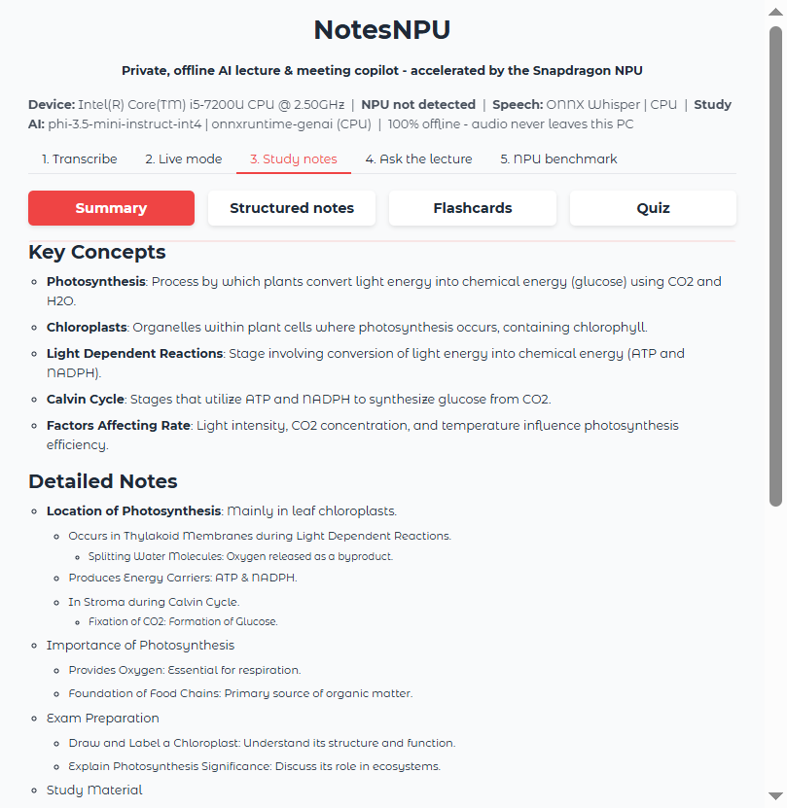
PRODUCT
Live demo: lecture in, study notes out
1. Load or record a lecture > 2. Transcribe on-device (NPU) > 3. Summary / notes / flashcards / quiz > 4. Ask & export
NotesNPU | 4

Slide 5
TECHNICAL IMPLEMENTATION
Architecture: everything runs on the PC
Audio
Chunker
Whisper encoder
Whisper decoder
Phi-3.5-mini
Study outputs
mic / file
16 kHz mono
pause-aware
<=30 s + silence gate
AI Hub QNN ONNX
Hexagon NPU
KV-cache, 200 slots
Hexagon NPU
INT4, onnxruntime-genai
summary, notes,
quiz, Q&A, export
■ ONNX Runtime QNN Execution Provider (plugin EP, HTP backend, burst perf mode) runs AI Hub precompiled context binaries, so there is no on-device compile.
■ Encoder emits cross-attention KV caches directly; the fixed-shape decoder loop feeds self-attention caches back, so every step stays on the NPU.
■ Robust by design: NPU to CPU to extractive fallback chain, repetition guard, silence gating, head+tail context fitting for long lectures.
NotesNPU | 5

Slide 6
AI MODELS & OPTIMISATION
Why the Snapdragon NPU
Task | Model | Source | Runtime / hardware
Speech-to-text (NPU) | Whisper-Base, precompiled QNN ONNX FP16 | Qualcomm AI Hub | ONNX Runtime + QNN EP (HTP) on the Hexagon NPU
Speech-to-text (fallback) | Whisper-Base ONNX (INT8 decoder) | Hugging Face onnx-community | ONNX Runtime CPU EP
Study assistant | Phi-3.5-mini-instruct INT4 AWQ | Microsoft (Hugging Face) | onnxruntime-genai
■ Whisper encoder = dense transformer over 1500 frames, a good fit for the Hexagon HTP's FP16 tensor engines (measured: 45.5 ms per 30 s of audio on X Elite).
■ AI Hub precompiled context binaries: no on-device compile, instant start-up.
■ Fixed-shape KV-cache decoder (200 slots) keeps every step on the NPU (3.8 ms/token).
■ NPU does the speech, so the Oryon CPU stays free for the LLM and UI and live mode never stutters.
■ Low-power NPU inference means a full day of lectures on battery, quiet and cool.
NotesNPU | 6

Slide 7
BENCHMARKS (WHISPER-BASE, 85 S LECTURE)
Performance: measured on a real Snapdragon NPU
Device / backend | Speed | Encoder per 30 s | Decoder per token
Intel i5-7200U laptop (dev machine), CPU | 5.7x real time (14.9 s) | 1312 ms | 44.8 ms
Snapdragon X Elite NPU (measured on Qualcomm AI Hub) | ~80x real time (~1.1 s) | 45.5 ms | 3.8 ms
NPU speed-up | ~14x end to end | 28.8x | 11.8x
■ Measured on a real Snapdragon X Elite (Qualcomm AI Hub hosted device): encoder 45.5 ms per 30 s of audio, decoder 3.8 ms per token.
■ 100% of ops on the NPU: 556 encoder ops + 975 decoder ops on the Hexagon HTP, none on the CPU; peak memory 34 MB / 60 MB.
■ Accuracy: NPU (FP16) encoder output matches the FP32 CPU reference with cosine similarity 0.999, and gives an identical, correct transcript of the sample lecture.
■ The 85 s sample lecture takes ~1.1 s on the NPU vs 14.9 s on a laptop CPU.
NotesNPU | 7

Slide 8
USE CASE & INNOVATION
Who it helps
Students
Focus on understanding, not scribbling; revise with auto flashcards and quizzes.
Accessibility
Live captions for deaf and hard-of-hearing learners; notes for students with dyslexia or ADHD.
Regional language learners
Hindi / regional lectures turned into English notes, bridging the medium-of-instruction gap.
Professionals
Confidential meetings summarised with action items, and nothing is uploaded.
Teachers
Publish lecture notes and question banks from their own recordings.
NotesNPU | 8

Slide 9
READY TO USE
Deployment & accessibility
■ One-click setup.bat / run.bat: detects Snapdragon, installs native ARM64 deps, downloads AI Hub models.
■ Runs as a local web app on 127.0.0.1, with offline mode enforced (HF_HUB_OFFLINE, no analytics).
■ Automatic fallback: NPU to CPU to extractive engine, so it works on every Windows PC.
■ Light install (-NoLLM, ~300 MB) for low-storage laptops.
■ Open source (MIT) on GitHub, with CLI tools for transcription and benchmarking.
> git clone <repo>
> cd notesnpu
> setup.bat
> run.bat
Opens http://127.0.0.1:7860
Works offline after setup
NotesNPU | 9

Slide 10
WHAT'S NEXT
Roadmap
■ LLM on the NPU: AI Hub Llama-3.2-3B / Phi-3.5 QNN binaries via Genie
■ Speaker diarisation for meetings (who said what)
■ Slide / whiteboard capture with on-device OCR, linked to the timeline
■ Semantic search across a semester of lectures (on-device embeddings)
■ MSIX installer on the Microsoft Store; HP AI Companion integration
NotesNPU | 10

Slide 11
Thank you
NotesNPU: learn more, write less, and keep it on your PC.
https://github.com/mdharishsuhaib/NotesNPU
Mohammed Haris Suhaib M

