Slide 1
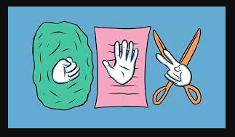
Rock Paper Scissors

Slide 2
This program or a mini-game is designed when you don’t have anyone to play or you are under lockdown alone. There are a number of functions that this program requires so let us have an overview of each.
  a random function: to generate rock, paper, or scissors.
  valid function: to check the validity of the move.
  result function: to declare the winner of the round.
  scorekeeper: to keep track of the score.
The program requires the user to make the first move before it makes one the move. Once the move is validated the input is evaluated, the input entered could be a string or an alphabet. After evaluating the input string a winner is decided by the result function and the score of the round is updated by the scorekeeper function.

Slide 3
""" Rock Paper Scissors
----------------------------------------
"""
import random
import os
import re
os.system('cls' if os.name=='nt' else 'clear')
while (1 < 2):
print "\n"
print "Rock, Paper, Scissors - Shoot!"
userChoice = raw_input("Choose your weapon [R]ock], [P]aper, or [S]cissors: ")
if not re.match("[SsRrPp]", userChoice):
print "Please choose a letter:"
print "[R]ock, [S]cissors or [P]aper."
continue
// Echo the user's choice

Slide 4
print "You chose: " + userChoice
choices = ['R', 'P', 'S']
opponenetChoice = random.choice(choices)
print "I chose: " + opponenetChoice
if opponenetChoice == str.upper(userChoice):
print "Tie! "
#if opponenetChoice == str("R") and str.upper(userChoice) == "P"
elif opponenetChoice == 'R' and userChoice.upper() == 'S':
print "Scissors beats rock, I win! "
continue
elif opponenetChoice == 'S' and userChoice.upper() == 'P':
print "Scissors beats paper! I win! "
continue
elif opponenetChoice == 'P' and userChoice.upper() == 'R':
print "Paper beat rock, I win! "
continue
else:
print "You win!"

Slide 5
Thank you

