Slide 1
Viral production R package
Development plan

Slide 2
Anatomy of an R package
Code + Documentation
Extra:
+ Data
+ Automated workflows

Slide 3
Anatomy of an R package
R/
man/
DESCRIPTION
NAMESPACE

Slide 4
Anatomy of an R package
R/
man/
tests/
vignettes/
.github/
DESCRIPTION
NAMESPACE
LICENSE

Slide 5
Anatomy of an R package
R/ scripts containing the functions of the package
man/ GENERATED AUTOMATICALLY, documentation of the functions
tests/ Automated tests that check if the functions work as expected
vignettes/ .Rmd files with usage documentation
.github/ Automated workflows: testing and package website
DESCRIPTION Info about the package
NAMESPACE GENERATED AUTOMATICALLY declares the functions of the pkg
LICENSE A software license, e.g. MIT
README.rmd How to install and basic usage documentation

Slide 6
Anatomy of an R package
Create with `usethis::create_package()`
usethis
devtools

Slide 7
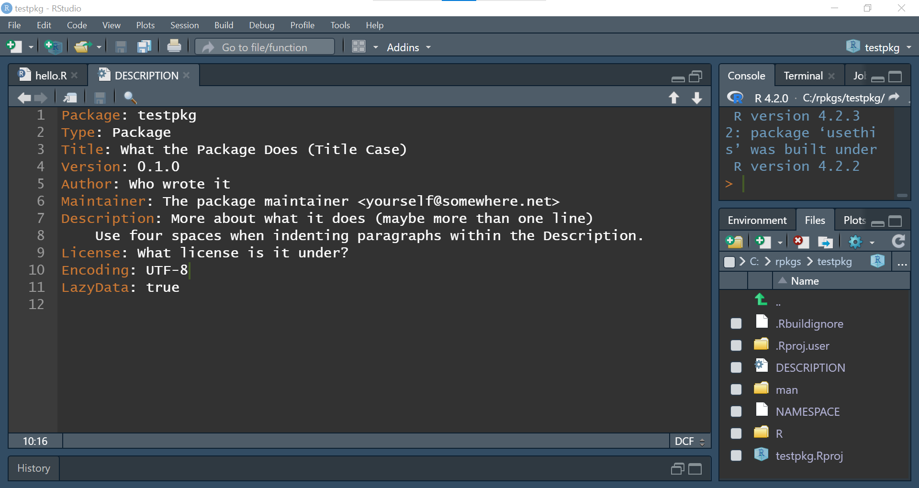

Slide 8
Package dependencies
ALWAYS call via pkgname::fun() and NEVER via library() or require()
Declare the dependency with `usethis::use_package()`:
Will include in write in DESCRIPTION
Include in NAMESPACE with `devtools::document()`
Strong dependency: `usethis::use_package(“pkgname”, “Imports”)`
Use within code
Your pkg won’t be installed if any dependency fails
Weaker dependency: `usethis::use_package(“pkgname”, “Suggests”)`
Use only in tests, vignettes or README
Your pkg can be installed even if these dependencies fail

Slide 9
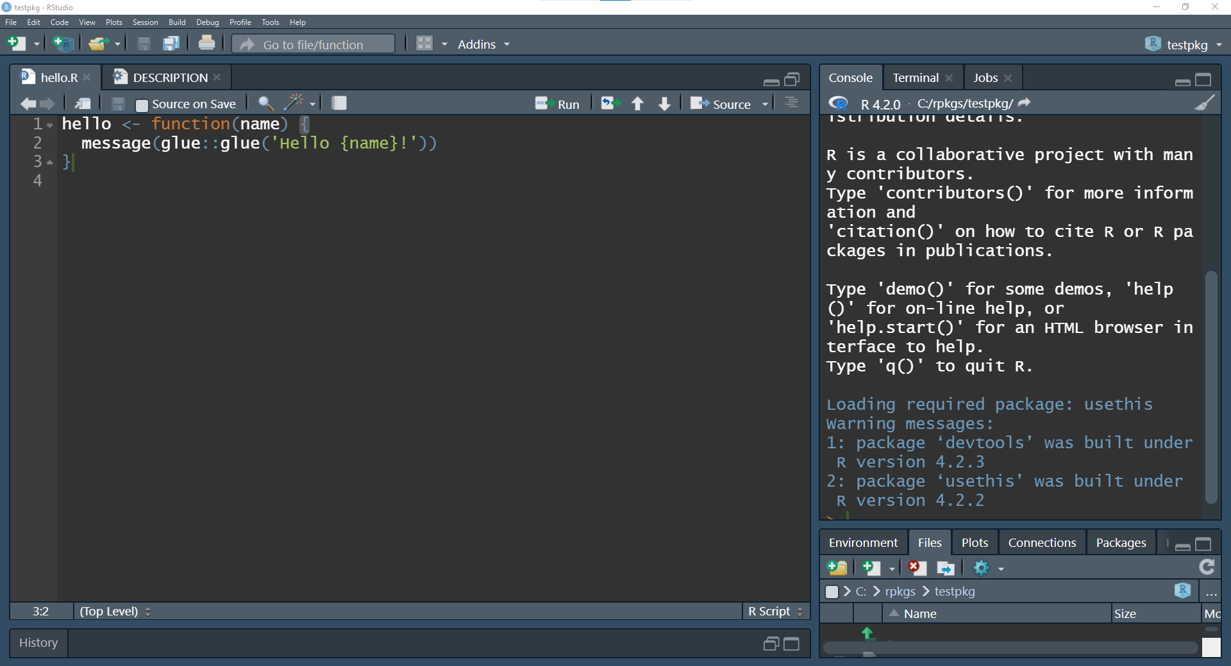

Slide 10
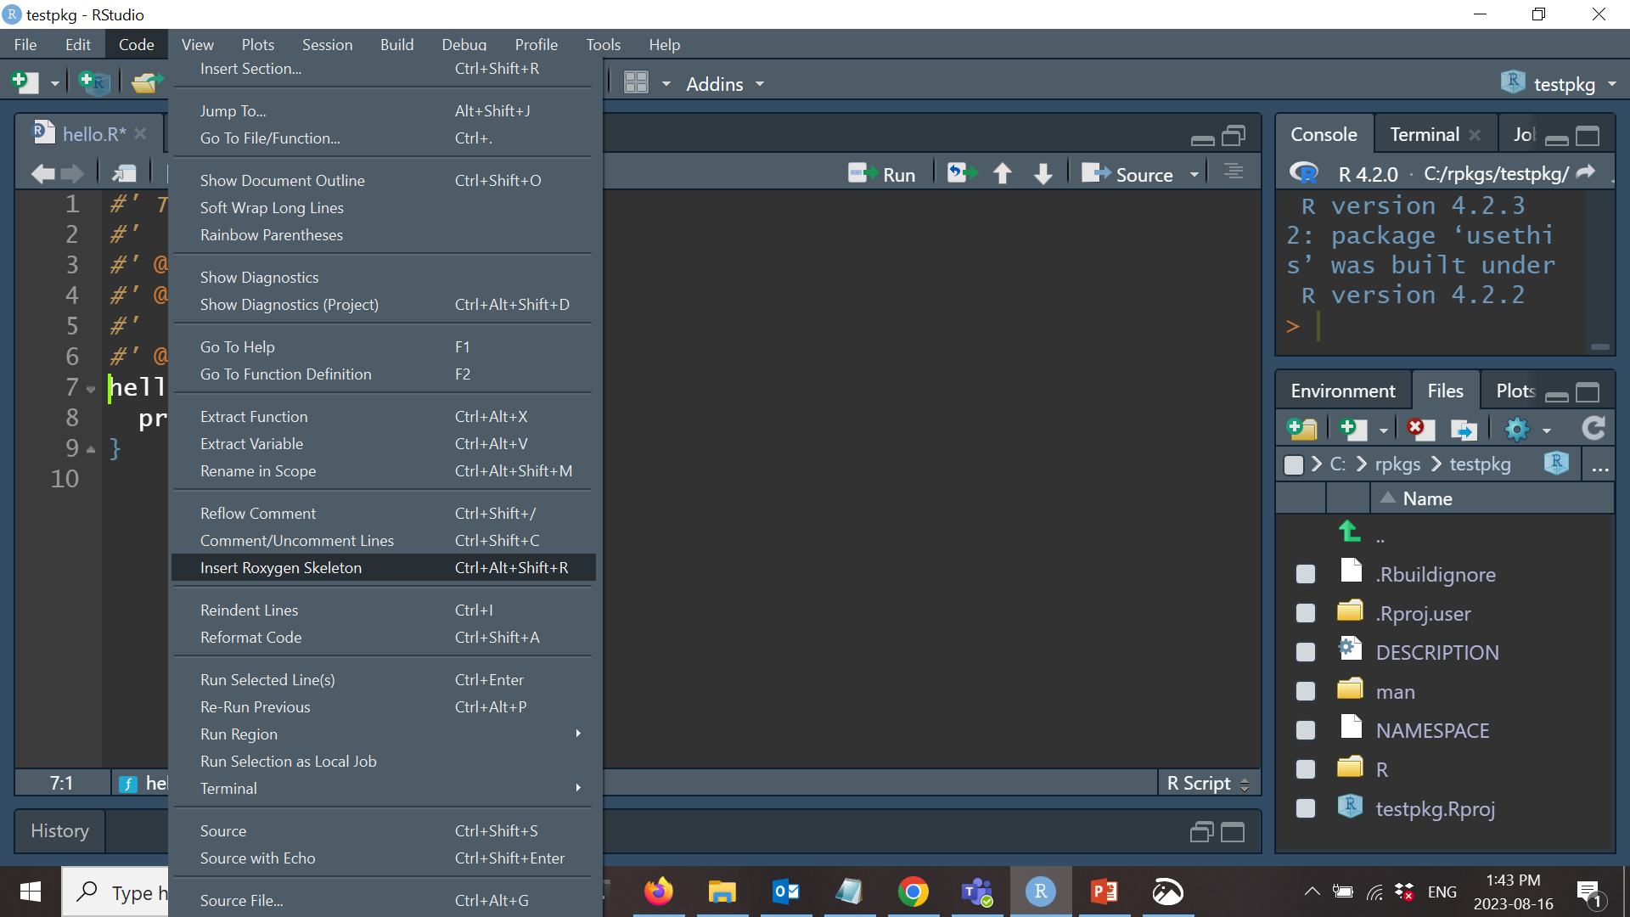
Document with Roxygen

Slide 11
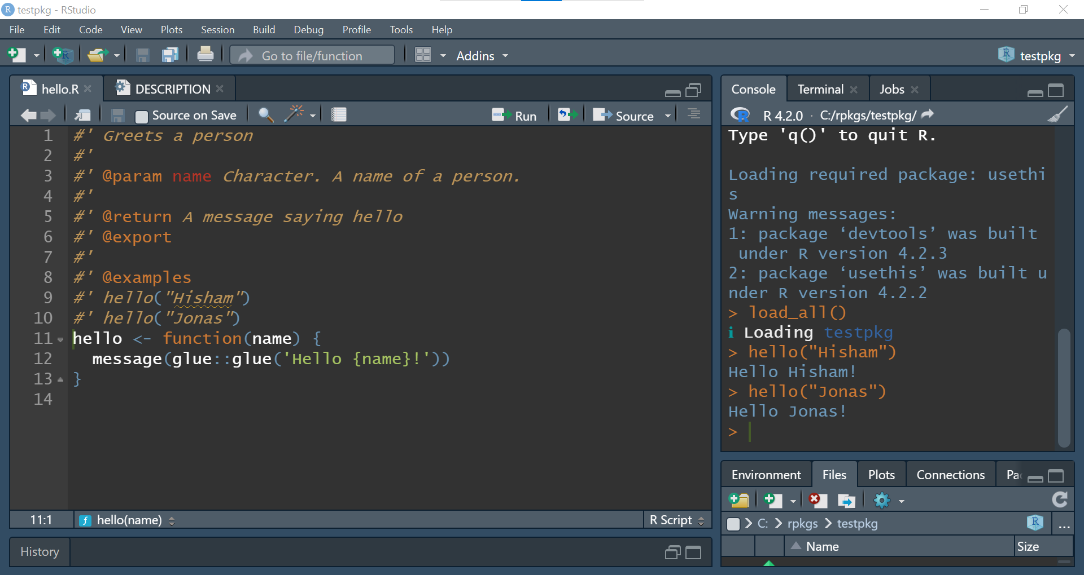

Slide 12
Document with ROxygen
devtools::document()
Turns the comments into pkg documentation that goes into man/

Slide 13
Licensing
No license = All rights reserved
a.k. everyone who wants to use your code must ask permission first
Best to add a license that requires acknowledging
MIT: usethis::use_mit_license()
All uses allowed, including comercial
GPL: usethis::use_agpl3_license()
Derivative work must also be open source

Slide 14
Vignettes
A paper-like documentation form
E.g. run vignette(“dplyr”)
This later turns into a page of the package website: https://dplyr.tidyverse.org/articles/dplyr.html
Create with: usethis::use_vignette()
If the vignette has the package name, this is a special type of vignette that will appear in the website as “Get Started”
Should be lightweight -> careful with plots
If you require more space -> create “articles” instead. These will be in the website but won’t go with the package to CRAN. usethis::use_article()

Slide 15
Include data in a package
You can add small data file in .rda format that will be packed together with the package
Document how you created the file with usethis::use_data_raw()
Include the data with usethis::use_data()

Slide 16
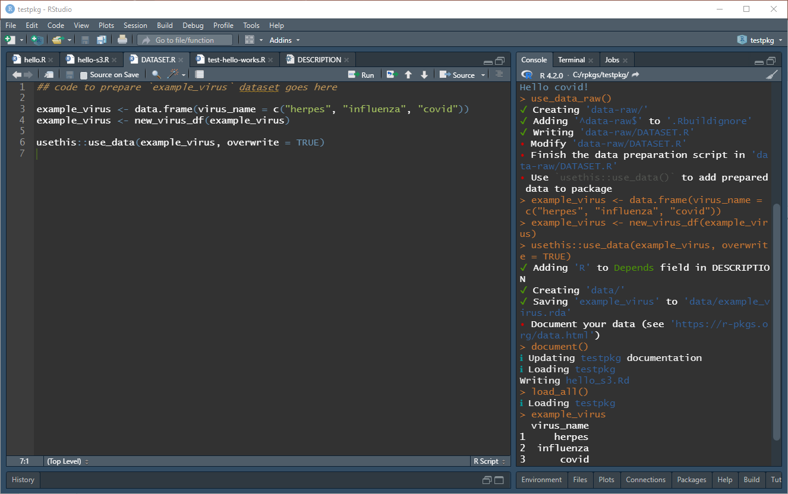

Slide 17
S3
Object-oriented
Your function will have methods. Each method is a function that works only on the class of the object you pass as first argument.
You can define your own classes within a package. E.g. a data frame that has a few restrictions such as column names and data types.

Slide 18
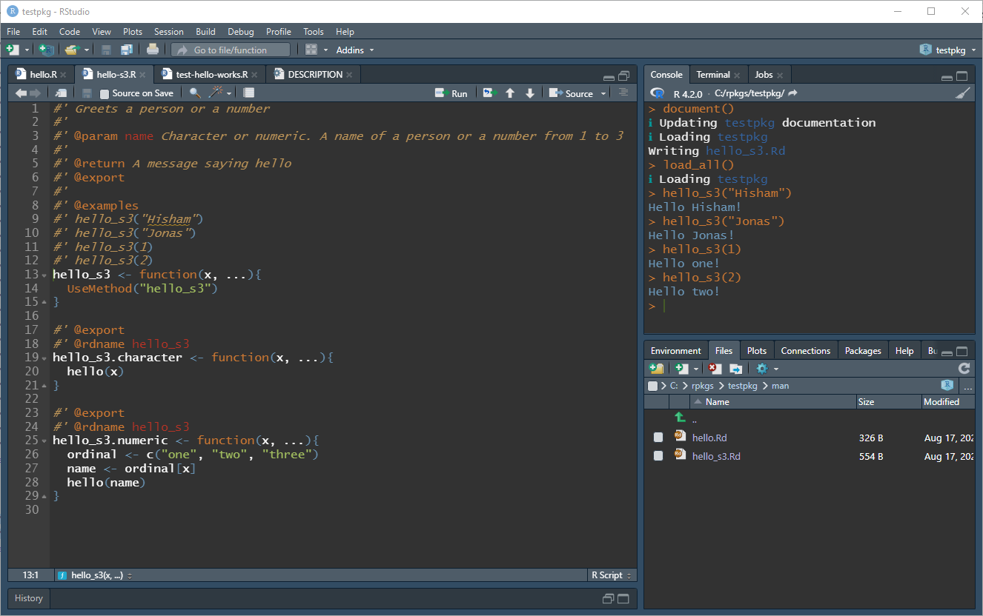

Slide 19
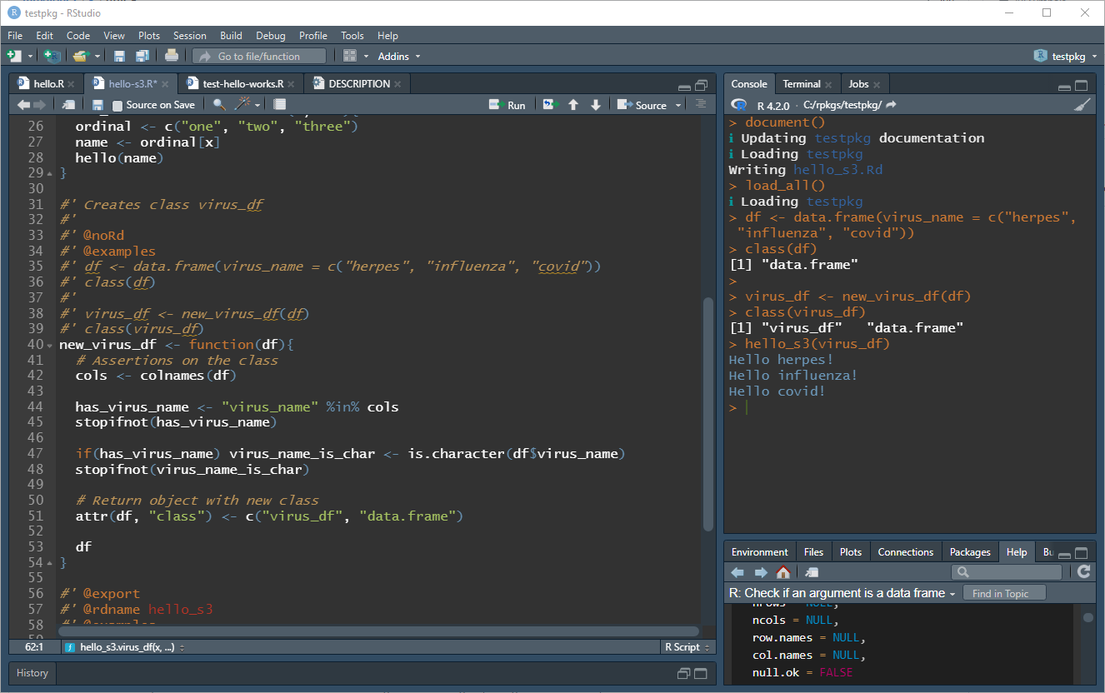

Slide 20
Testing units
Pieces of code that test that your functions do what they are supposed to do
https://testthat.r-lib.org/
Get started -> usethis::use_testthat()
Create a new test -> usethis::use_test()
Run tests from Rstudio or with devtools::test()

Slide 21
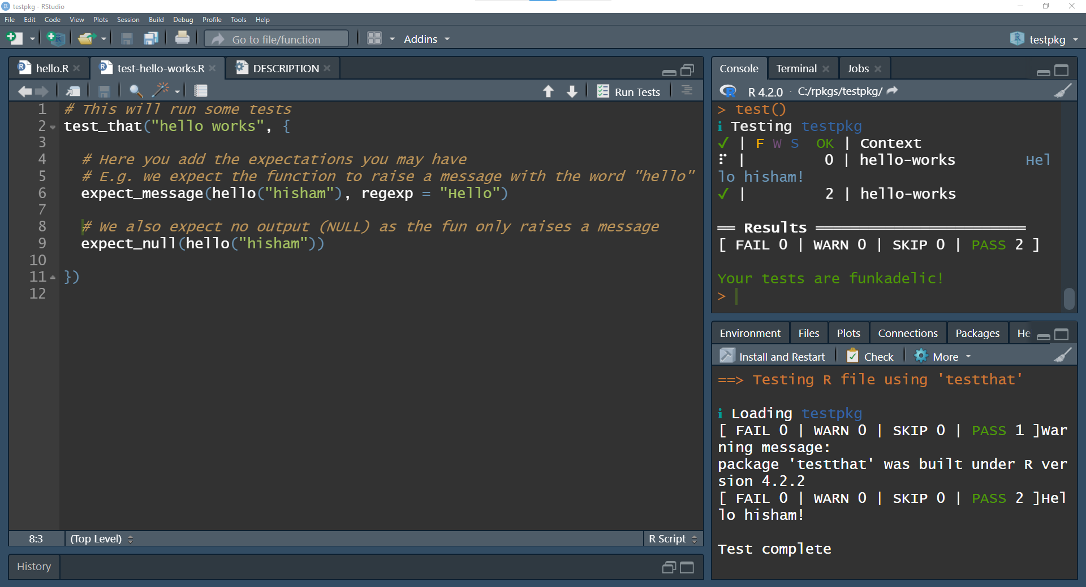

Slide 22
R CMD Check
Automatic checks that tells you if the package is suitable for CRAN
Run from Rstudio or devtools::check()
CRAN requires that you check your package in at least two OS. E.g. Linux and Windows
Best is to set up a Continuous Integration pipeline on github. This will run a check on your package with every commit or periodically
usethis::use_github_action_check_standard()

