Slide 1
Viral Reduction Assay

Slide 2
Week 1
01/08 – 09/08

Slide 3
Step 2: Viral Production Calculation – Main changes
When making this, I ran everything for NJ1.csv and NJ2020.csv since this last one has multiple stations

Slide 4
Source File for Step 2
Consist of general setup and all the functions needed to calculate viral production
vp_calc_functions.R + sourcesourcebaby.R => viral_production_step2_source.R
Beginning of script has some general information about current step and checks if all the necessary packages are installed

Slide 5
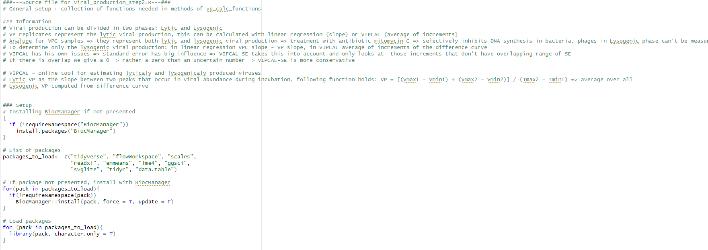

Slide 6
Main changes in functions
Determine timepoints: tp()
Linking of colnames to colvalues simplified with for loop
Main comment: a lot of functions had rm()-statement in the end of the function to delete variables. But since these are defined in the function and not in the global environment these won’t be returned => no need to delete them

Slide 7
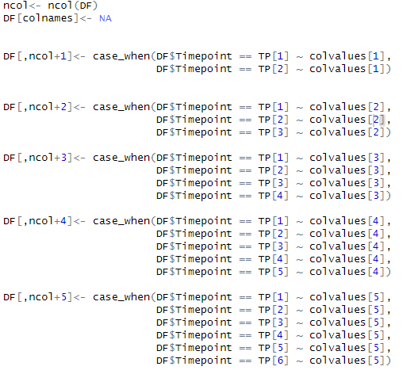
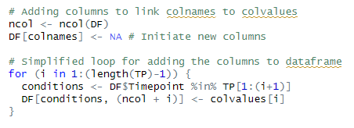
More general with for-loop => also if in the future more timepoints are available then this is automatically taken into acccount

Slide 8
2. Separate and Average dataframe functions: df_SR() and df_AVG()
Made one function that consists an option to add the timepoints (add_tp), for all the methods this was the case so default: add_tp = T => only for the bacterial_endpoint it was set to false
Tried to change gather to pivot_longer because I read that online that pivot_longer was more recent, but there were problems with the arrange line and the order of the output dataframe so I sticked with gather()
When trying with bigger dataset just find mistake of df_list that was not in my code
Gather() with index instead of names since select in previous step assures us the correct order of columns

Slide 9
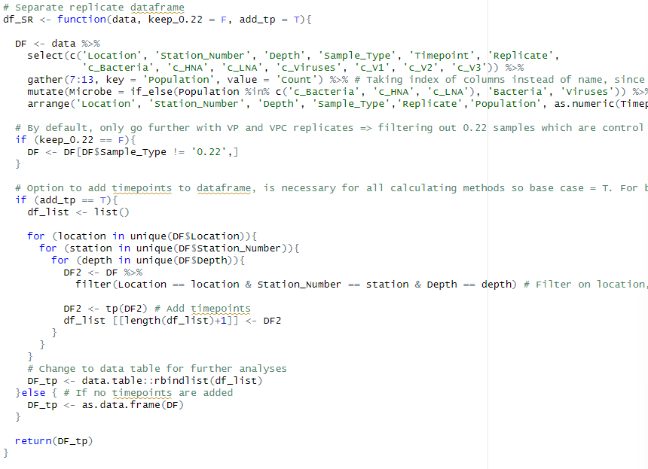

Slide 10
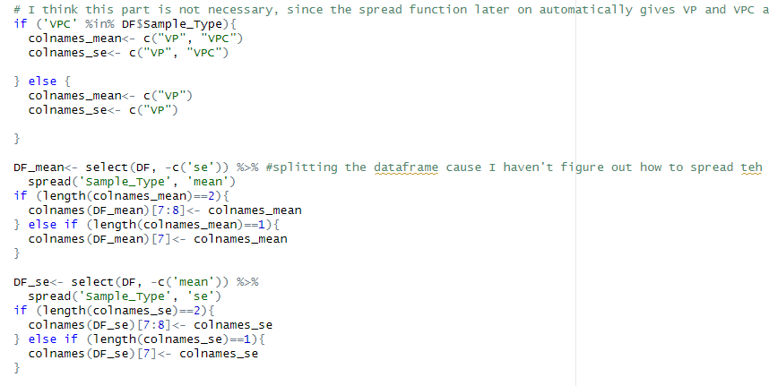
Spread() in df_AVG gives automatically VP and VPC as colnames for mean and SE resp.
This part of the code is not necessary. My function doesn’t have this part and all same results are obtained

Slide 11
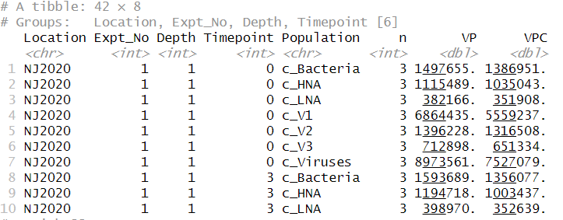
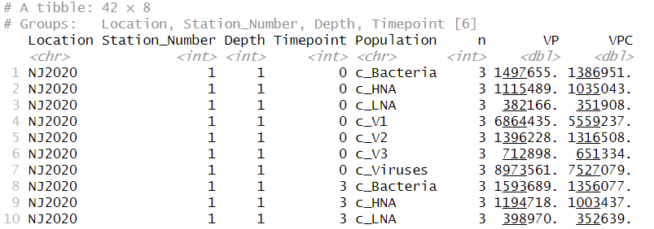

Slide 12
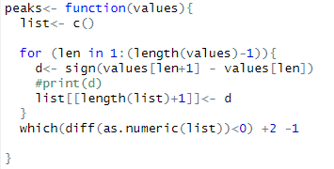
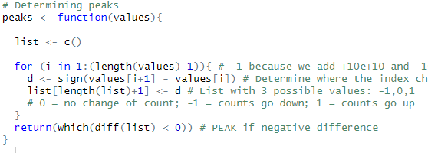
3. Peaks and valleys: peaks() and valleys()
Saving all the results in a nested list and then when looking at the difference as.numeric => just save values as a list of numerics
You do +2 -1 which is just +1 and then later on in the VIPCAL functions you determine peaks but subtract 1 so first you add 1 and then remove 1?

Slide 13
4. LMER model: LMER_model()
First tried to not include the change of replicates for VPC samples => all same results were obtained except the SE of the diff samples => but indeed to distinguish between samples for the model this is necessary
No main changes here, just gave the function a bit more structure

Slide 14
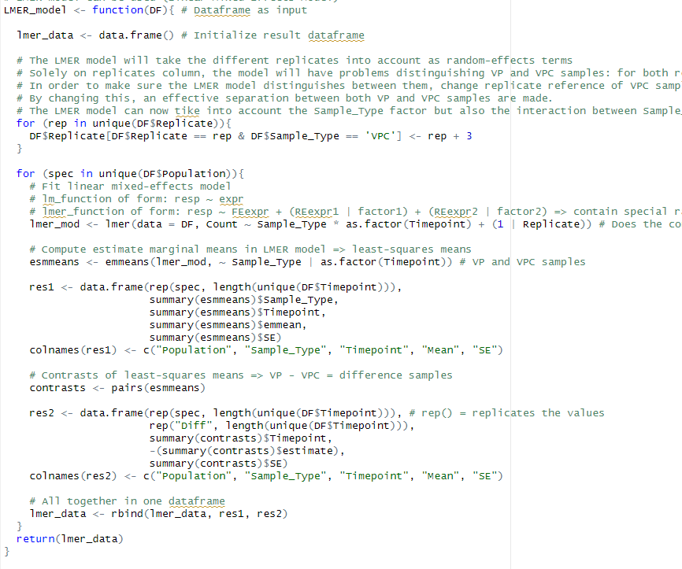

Slide 15
5. Slope functions Linear Regression: slope_LM_...()
Main small thing: initiate data.frame at beginning of function but later on data.frame(t(sapply(lm,c)) => first initiation is not necessary
No general changes in these 4 functions
In the one with LMER model: don’t think those try()statement and following if df4 exists is necessary => I got same results without these
There is probably a way to make one general slope_LM and one general VIPCAL function and again distinguish the different scenarios => Definitely, keep the 12 separate functions for each method!

Slide 16
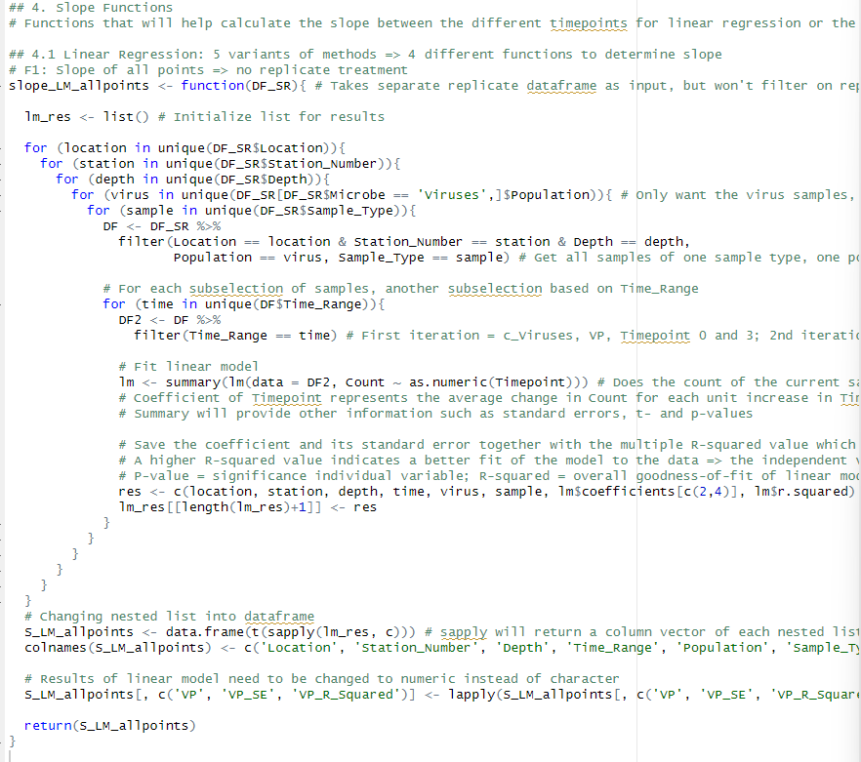
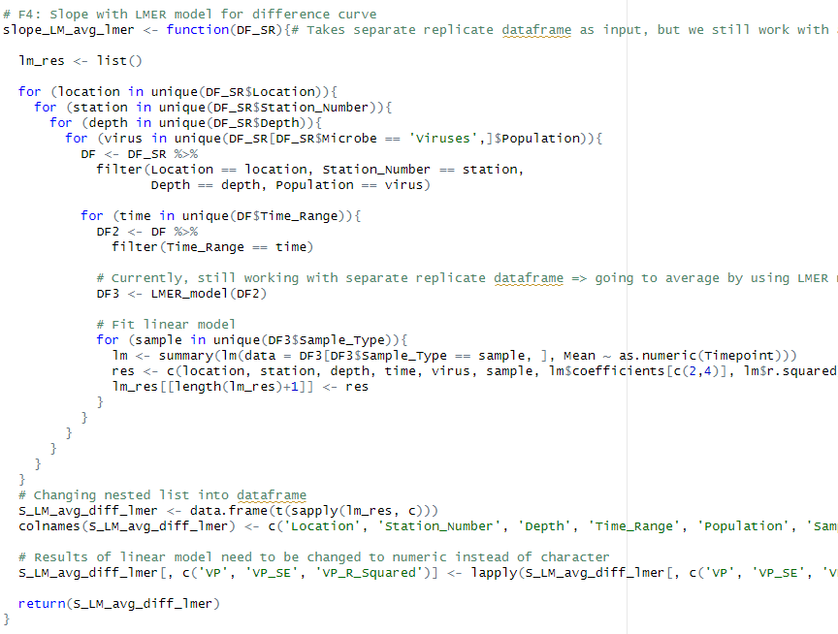

Slide 17
6. VIPCAL functions: VIPCAL_...()
Again, the same with the data.frame initialization and try statement=> is just a small thing
In the calculation of peaks and valleys -1 is not necessary if you change the peaks and valley’s function and don’t add one there
Calculation of viral production optimized with 1 if-else statement and for loop through different peaks instead of manually if-elseif and so go through different values of p. If somehow in future data more then 3 peaks are found then the for-loop takes care of those

Slide 18
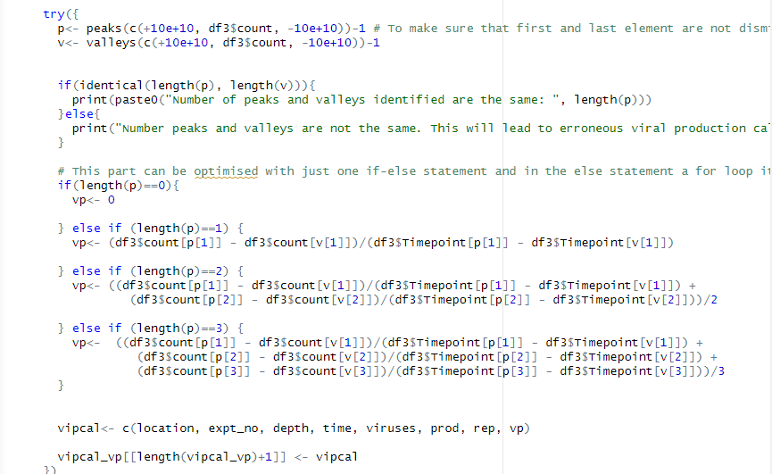
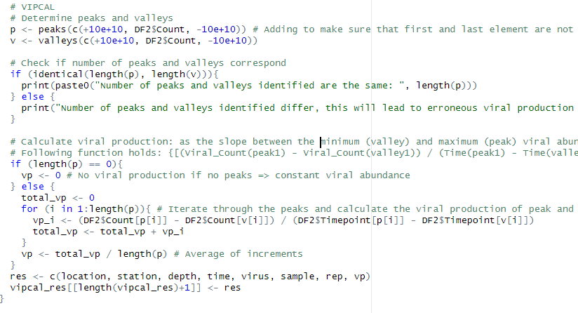

Slide 19
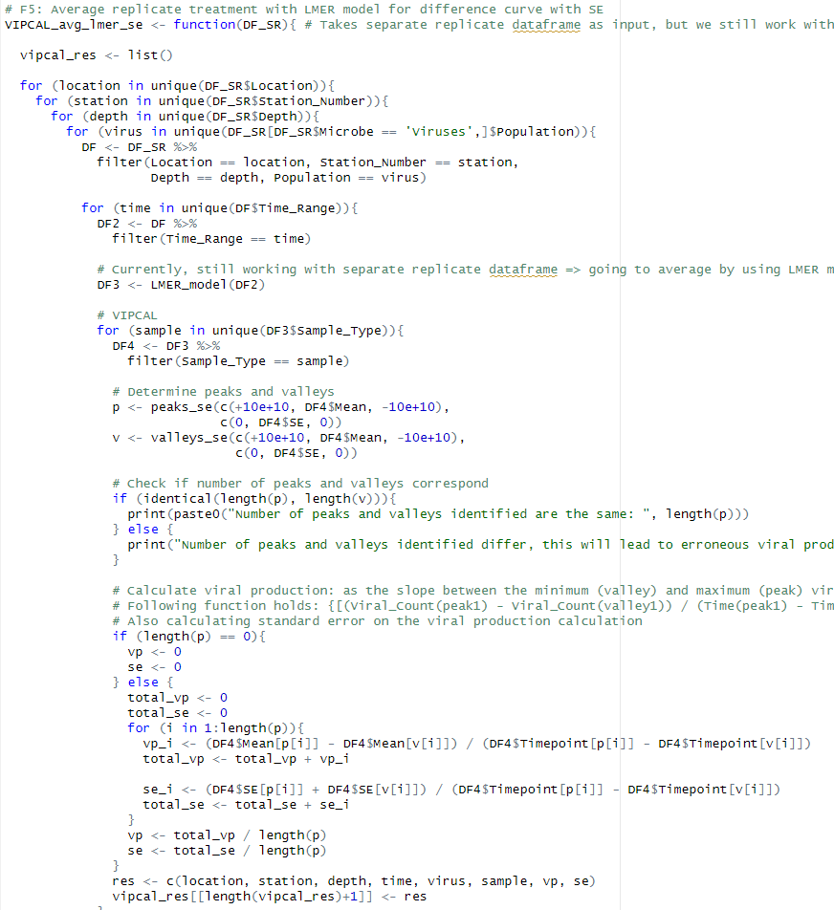
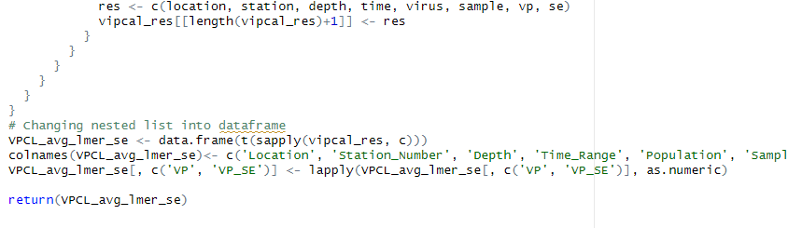

Slide 20
7. Calculate Lysogenic production: calc_DIFF()
First thing I saw, is that the current four functions are all in general doing the same => made 1 functions that holds all cases instead of 4 separate functions
Also, in one of the vipcal methods there was a mistake that SE wasn’t taken into account => is fixed now
Making of dataframe on the basis of dplyr: group_by and summarize instead of as.data.frame(cbind())

Slide 21
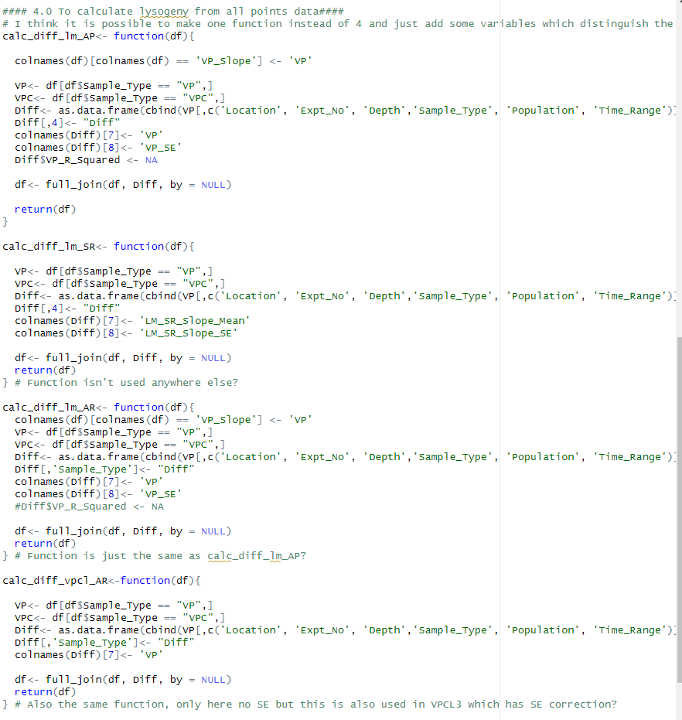
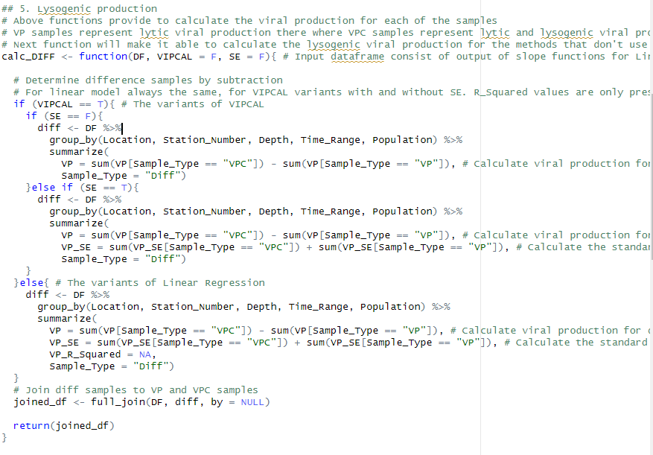

Slide 22
8. Different methods_general functions: LM_x() & VPCL_x()
These functions just refer to all the functions described before, made sure that general structure of each of the methods is the same
Added a group_by and arrange statement so that output_df always have the same structure => had some problems with the Time_Range of my diff samples => for some reason it was T17, T20, T24, T3 & T6 => fixed now
For LM-2 and VPCL-1, which have separate replicate treatment => 1 function instead of two, with variable avg = T by default. In main combine function this is set to False if you want the results for separate replicate treatment

Slide 23
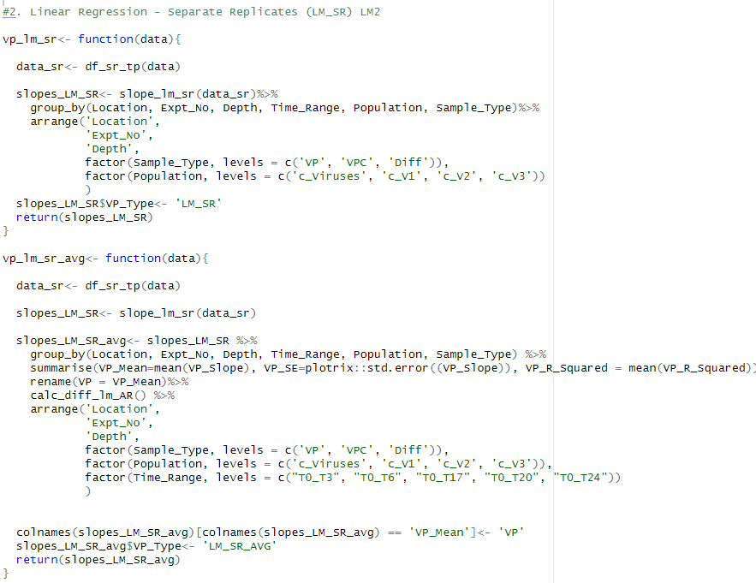
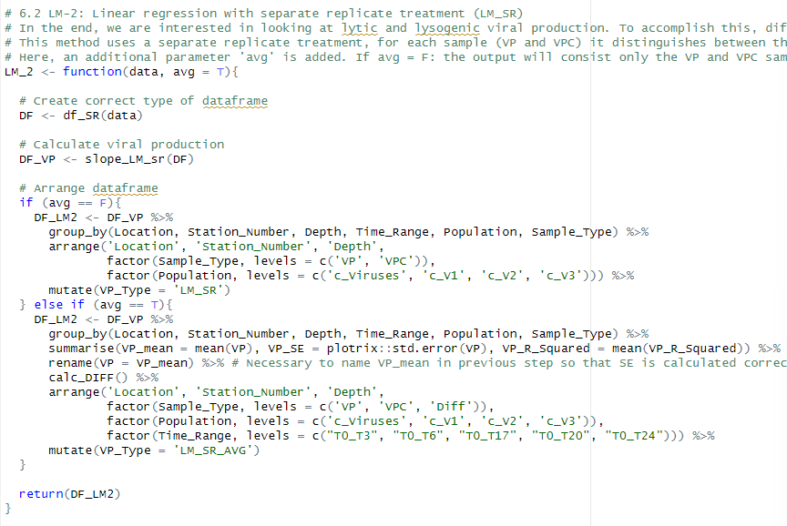

Slide 24
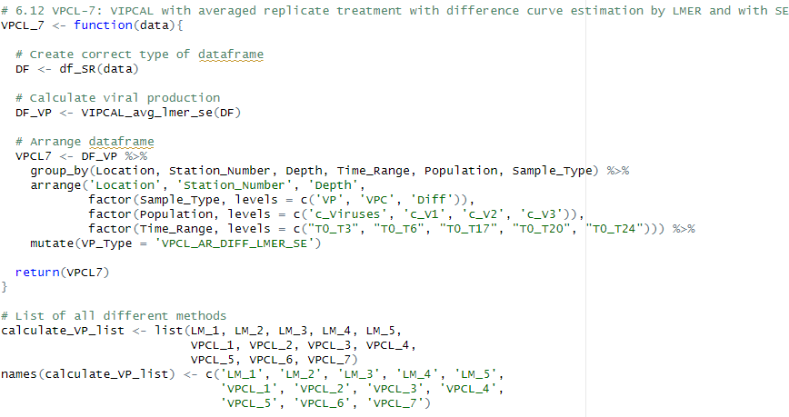
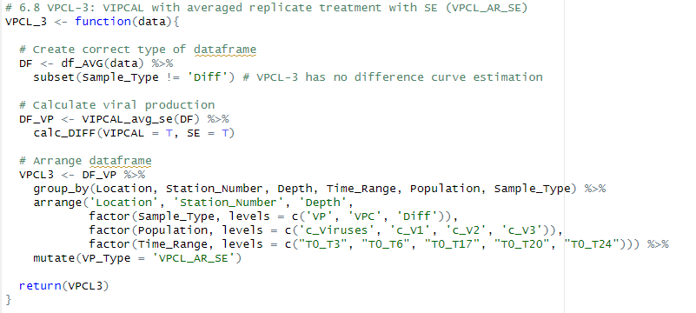
List of all different methods. Only have one list since the separate replicate treatment is incorporated in the function (no individual function). Also changed the names of the list, in combine function the name of the Method will be printed out instead of the index number

Slide 25
9. Bacterial endpoint: bacterial_endpoint()
The storing of the generation times is different => I used the same method as we did in the slope functions => store everything in a nested list and then make a data frame from it
Pivot_wider to have a more structured dataframe
Left a print statement in it so that when running this, you can see the generation times

Slide 26
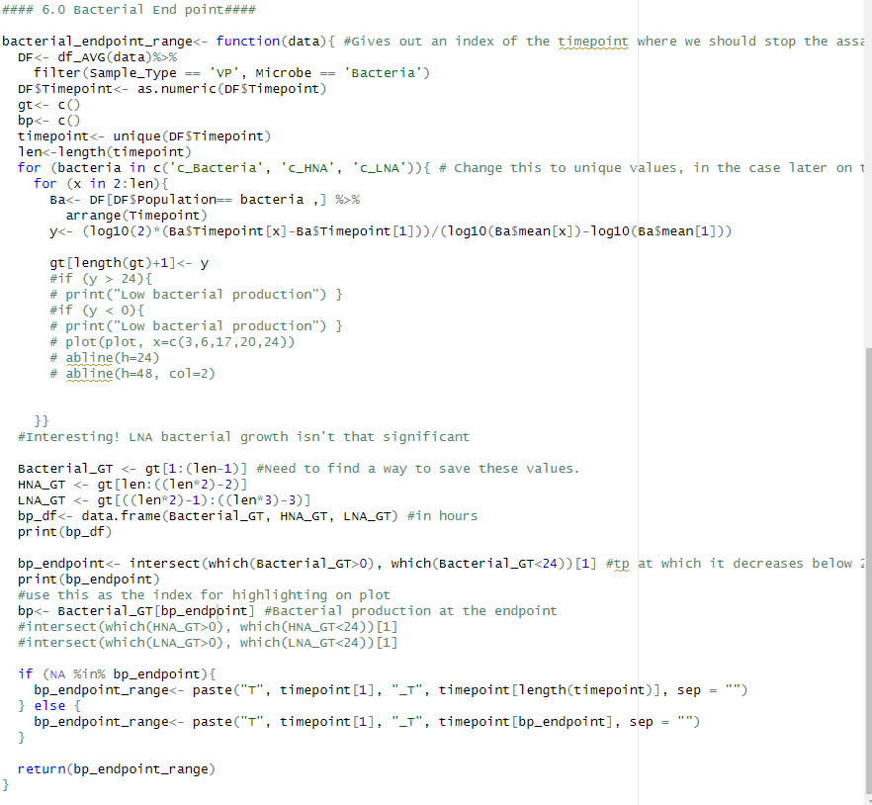
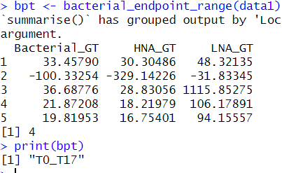

Slide 27
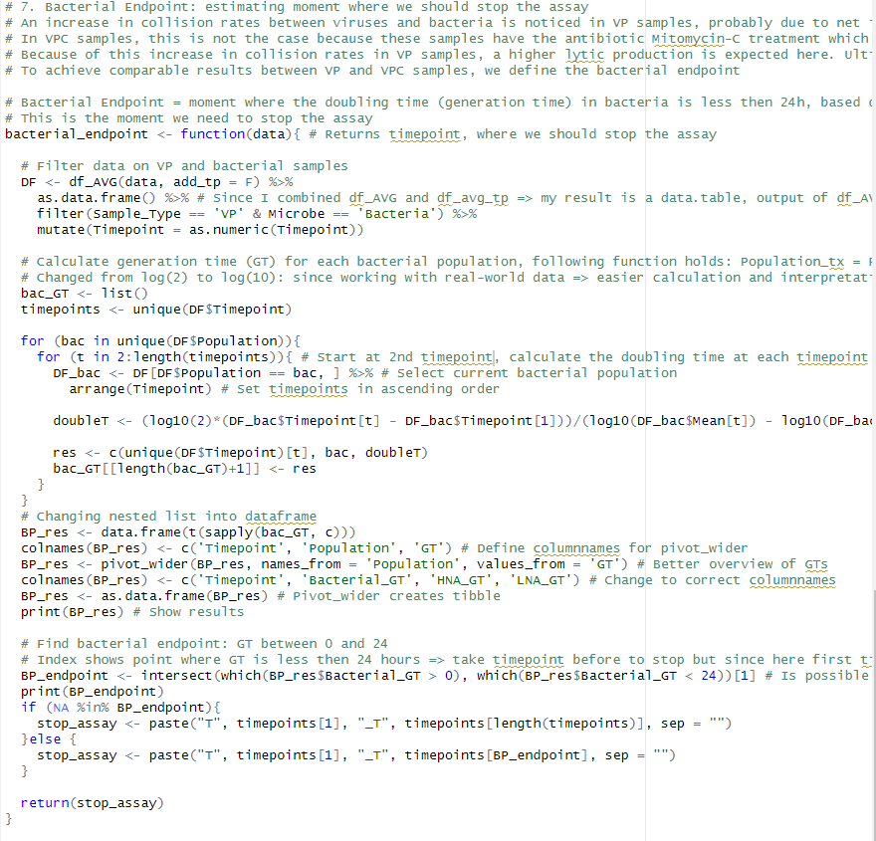
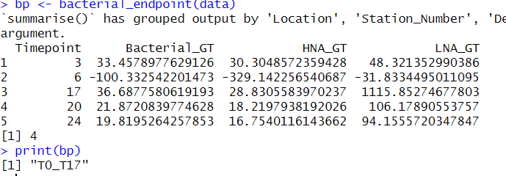

Slide 28
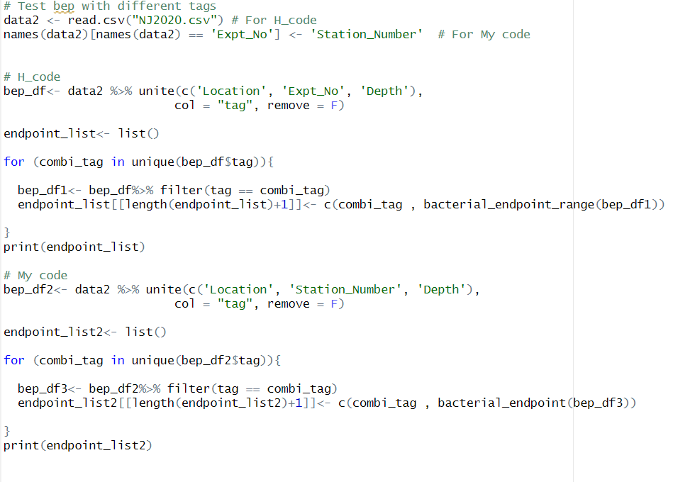


With this function I still have some issues when running the NJ2020.csv data. It is really strange since I have the same dataframes and I calculate the generation time correctly, but for some reason the wrong index is returned in some cases?
For following code:

Slide 29
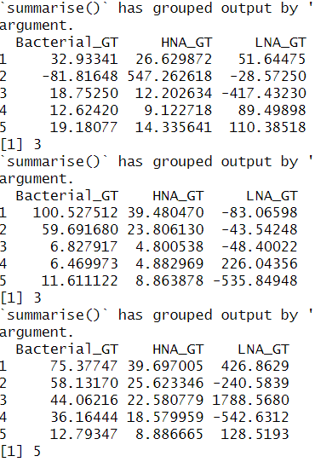
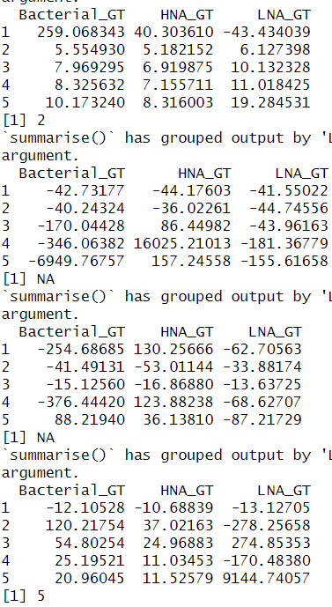
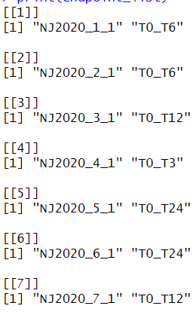









Desired result (code Hisham)

Slide 30
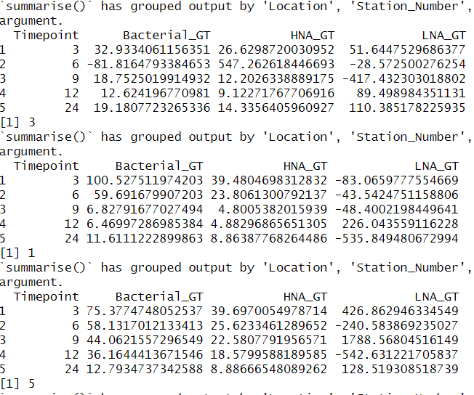
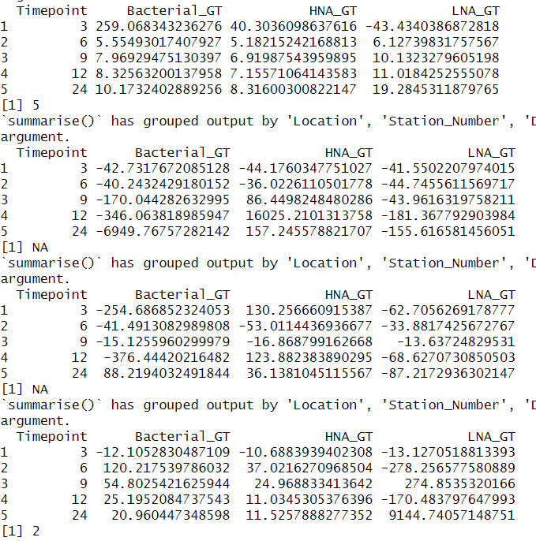
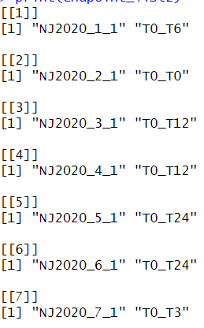









My output

Slide 31
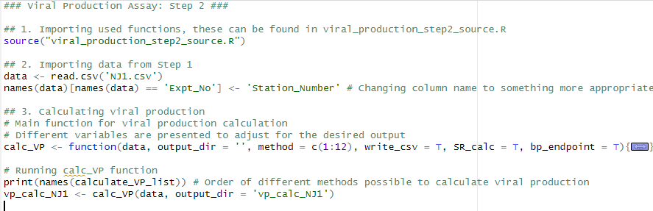
Actual File for Step 2 [viral_production_step2.R]
Consist of importing all the functions [viral_production_step2_source.R] and the data of step 1 [NJ1.csv]
The main function for calculating viral production: calc_VP()
Creating the output dataframe is done a little bit smoother by directly assigning the class type to the columns
For separate replicate treatment, I needed to define the two functions that are eligible and change the argument avg to F
General structure for handling errors and warnings is the same

Slide 32
Week 2
10/08 – 17/08

Slide 33
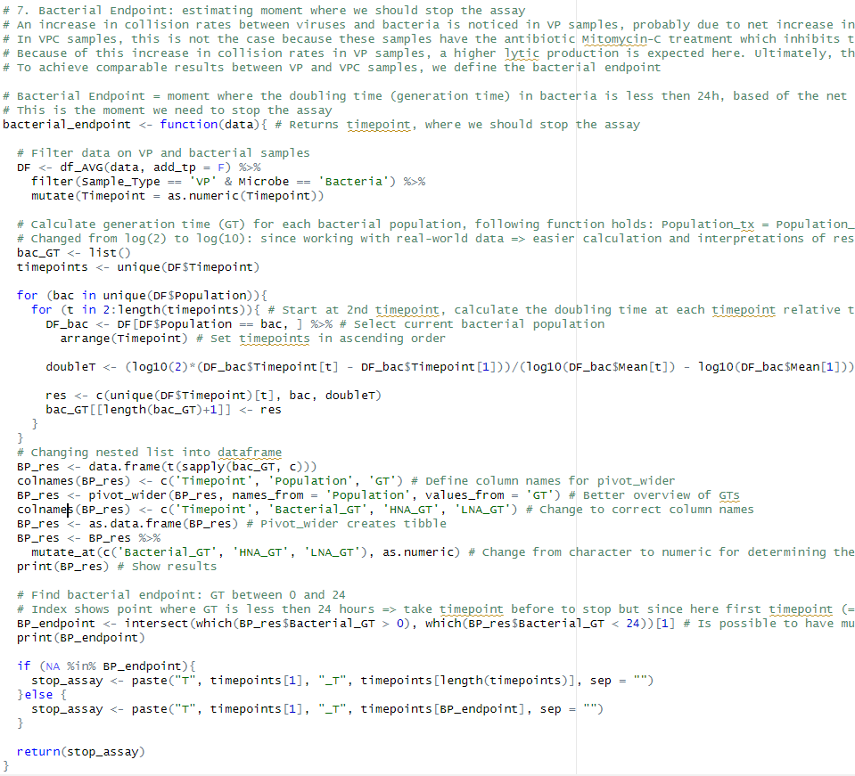
1. Fixing bacterial endpoint for NJ2020 dataset
Found the bug: when making the overview dataframe with the GTs for each bacterial population at each timepoint, it saved these values as a character and not as numeric value => because of that the intersect gave back the wrong index on some occasions

Slide 34
Successfully ran step 2 for both datasets: NJ1 and NJ2020
Results dataframes are in vp_calc_NJ1 & vp_calc_NJ2020

Slide 35
2. Visualization
Looked at two visualizations that are already there:
Overview of the input data of step2: FCM counts vs Sampling Timepoints for each population
Visual of the difference in collision rates between both samples at the different timepoints + showing the bacterial endpoint

