Slide 1
Outline:
Viral Production Assay:
Set Up
Assumptions
Data Analyses Methods: LM vs VIPCAL
Literature survey LM vs VIPCAL
All possible ways to analyze VP assay
12 methods – description
12 methods – comparison
Linear Method selection – LM_AP. Why? (using time range data)
VIPCAL Selection – VPCL_Diff_No_SE (VIPCAL) and VPCL_Diff_LMER_SE (VIPCAL_Modified) (using time range data)
Linear Method – Supervised – Only to be used in later discussion.
Comparison between three selected methods
With time ranges on Jetty data.
Simulation with 1000 dataset for VP, VPC and Diff.
Bacterial Endpoint
Motive.
Comparison with T24 between methods

Slide 2
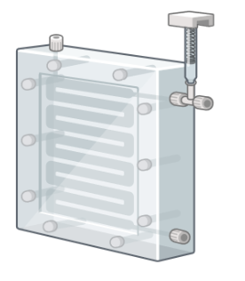
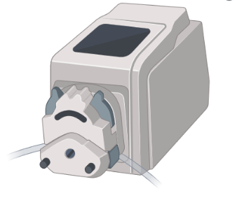

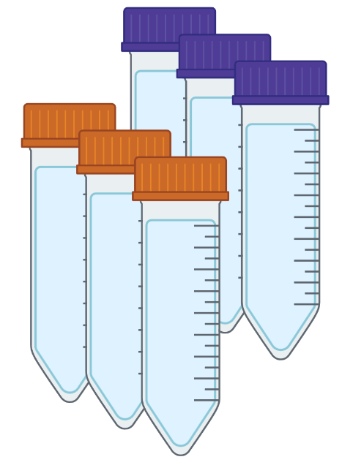
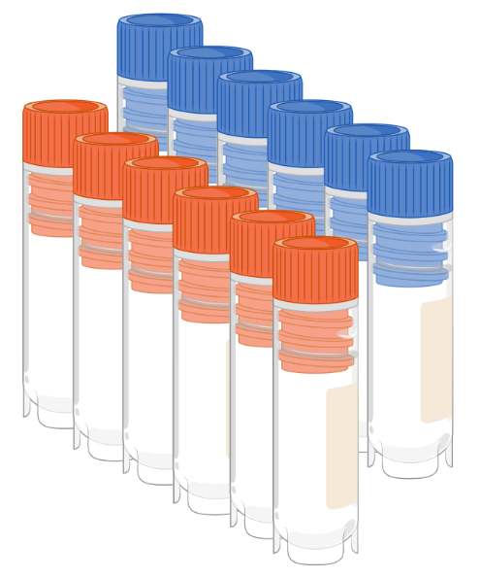



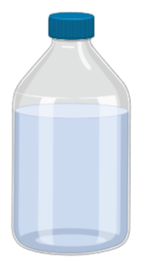



Viral Production/Reduction Assay: Set Up & Assumptions
Mitomycin – C doesn’t affect lytic viral production directly.
24-h Incubations
in dark
Virus-free water
VPC
Tangential flow filtration (10 KDa)
With
Mitomycin - C
Seawater
VP
Subsampling:
T0, T3, T6, T9, T12, T24
There is no reinfection over the assay. Only previously infected bacteria release viruses upon lysis.
Virus-reduction
Tangential flow filtration (0.22 µm)
Loss of bacteria is not biased.

Slide 3
To do list:
Comparison of 12 methods using only Jetty data.
Calculate LM-S with endpoint þ
Separate endpoint and T24 plots
Collision rate calculation over time in the assay.
Plots to make everyone understand the difference between the 12 methods. þ

Slide 4
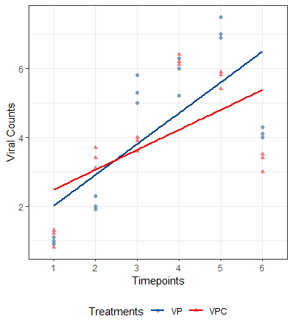
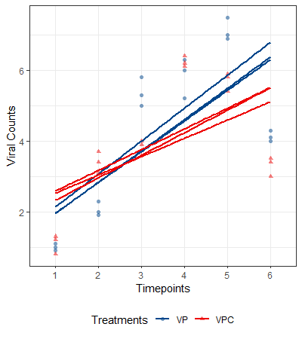
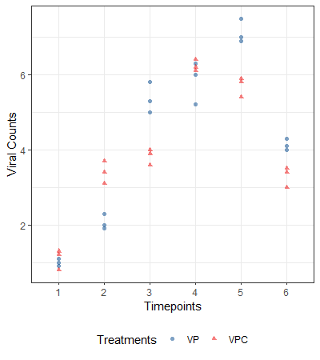

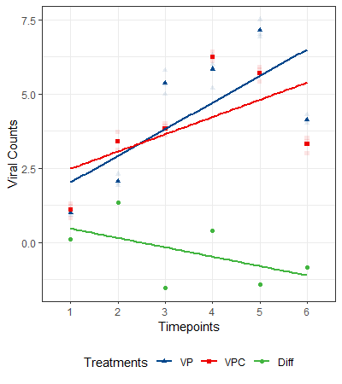
LM_AP
LM_SR
LM_AR
LM_Diff

Slide 5
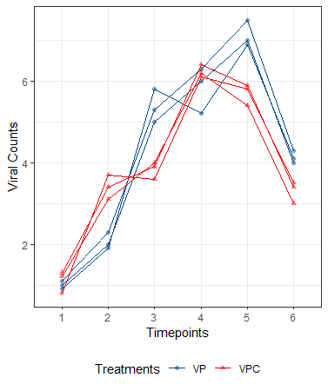
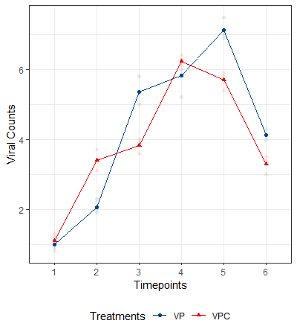
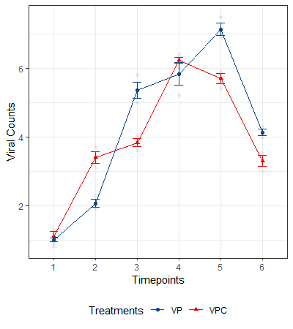
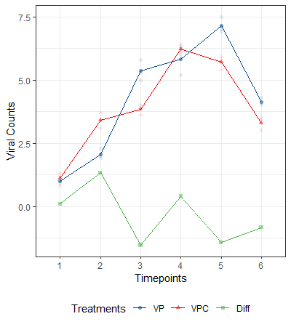
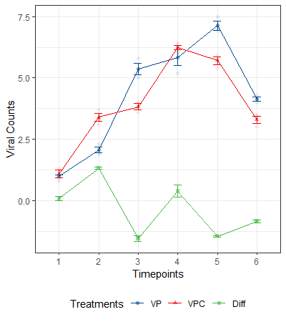
VPCL_SR
VPCL_AR_No_SE
VPCL_AR_SE
VPCL_AR_Diff_No_SE
VPCL_AR_dIFF_LMER_SE

Slide 6
No. | Name | Type |  | Replicates |  |  | SE |  | Diff Curve
 |  | Linear | VIPCAL | No | Yes |  | No | Yes | No | Yes
 |  |  |  |  | Separate | Averaged |  |  |  | Subtraction | LMER
1 | LM_AP | x |  | x |  |  | x |  | x
2 | LM_SR_AVG | x |  |  | x |  | x |  | x
3 | LM_AR | x |  |  |  | x | x |  | x
4 | LM_AR_Diff | x |  |  |  | x |  |  |  | x
5 | LM_AR_Diff_LMER | x |  |  |  | x | x |  |  |  | x
6 | VPCL_SR_AVG |  | x |  | x |  | x |  | x
7 | VPCL_AR_No_SE |  | x |  |  | x | x |  | x
8 | VPCL_AR_SE |  | x |  |  | x |  | x | x
9 | VPCL_AR_Diff_No_SE |  | x |  |  | x | x |  |  | x
10 | VPCL_AR_Diff_SE |  | x |  |  | x |  | x |  | x
11 | VPCL_AR_Diff_LMER_No_SE |  | x |  |  | x | x |  |  |  | x
12 | VPCL_AR_Diff_LMER_SE |  | x |  |  | x |  | x |  |  | x

Slide 7
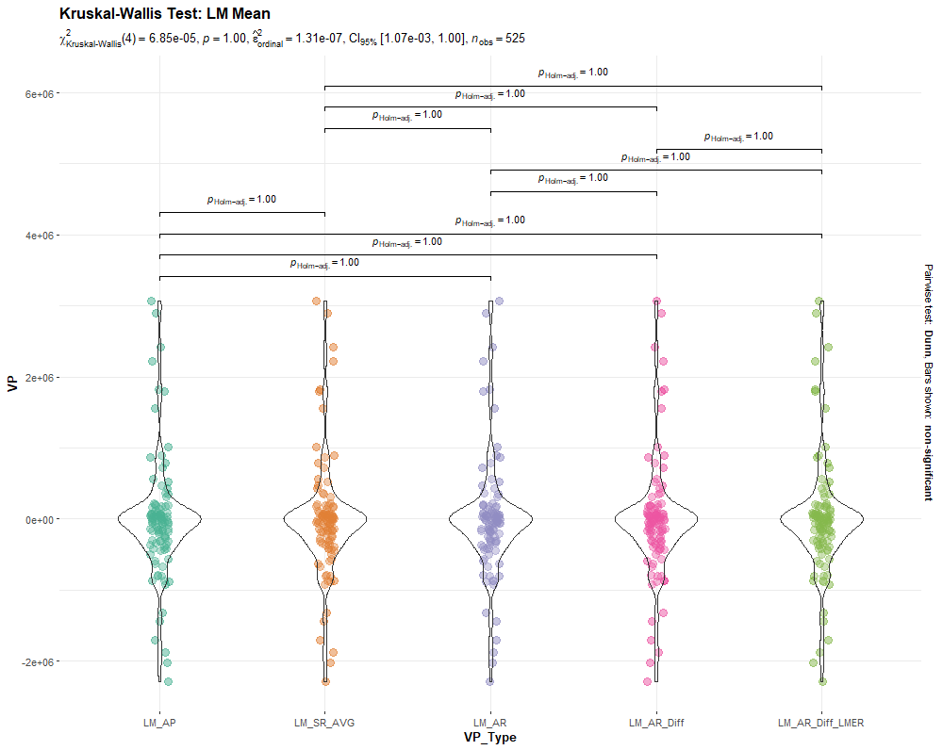
LM – Comparison - Mean
Data:
VP, VPC, Diff
All time ranges
No differences between the means

Slide 8
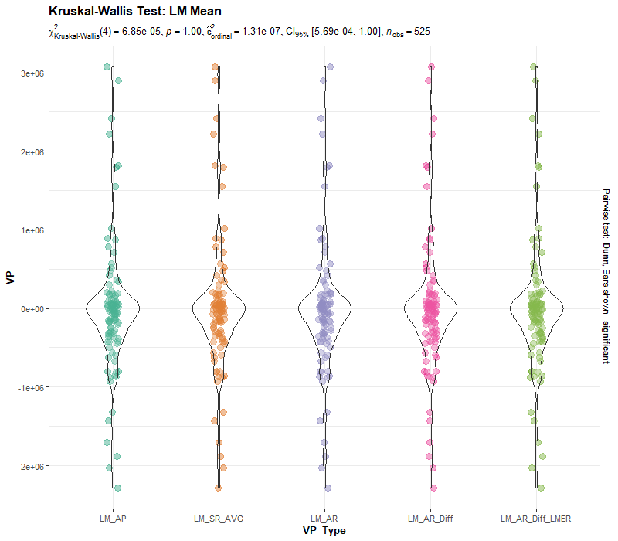
LM – Comparison - Mean
Data:
VP, VPC, Diff
All time ranges
No differences between the means

Slide 9
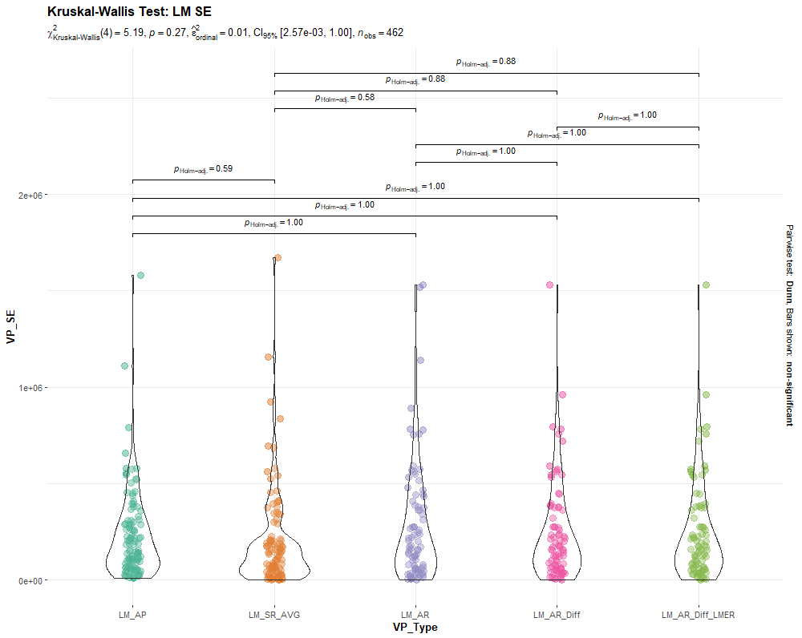
LM – Comparison - SE
No differences between the means

Slide 10
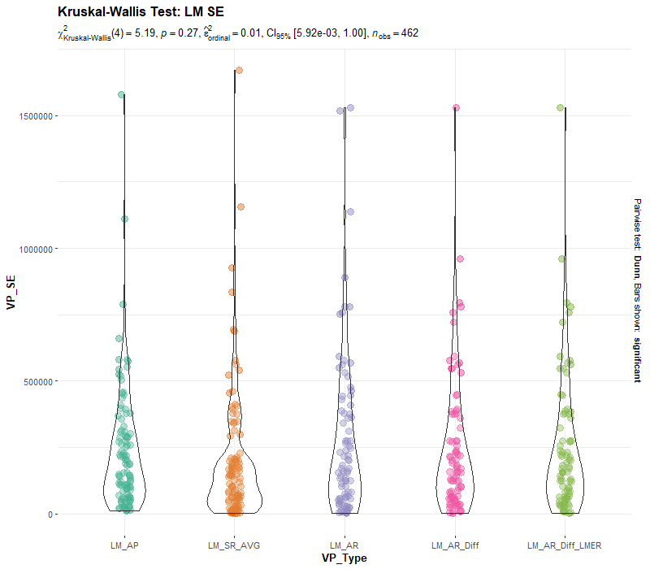
LM – Comparison - SE
No differences between the means

Slide 11
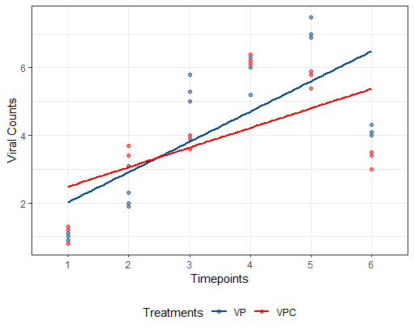
LM – Comparison - SE
Three types of error:
Averaging replicates
Linear Regression SE
Diff Curve SE
VPC – VP subtraction error

Slide 12
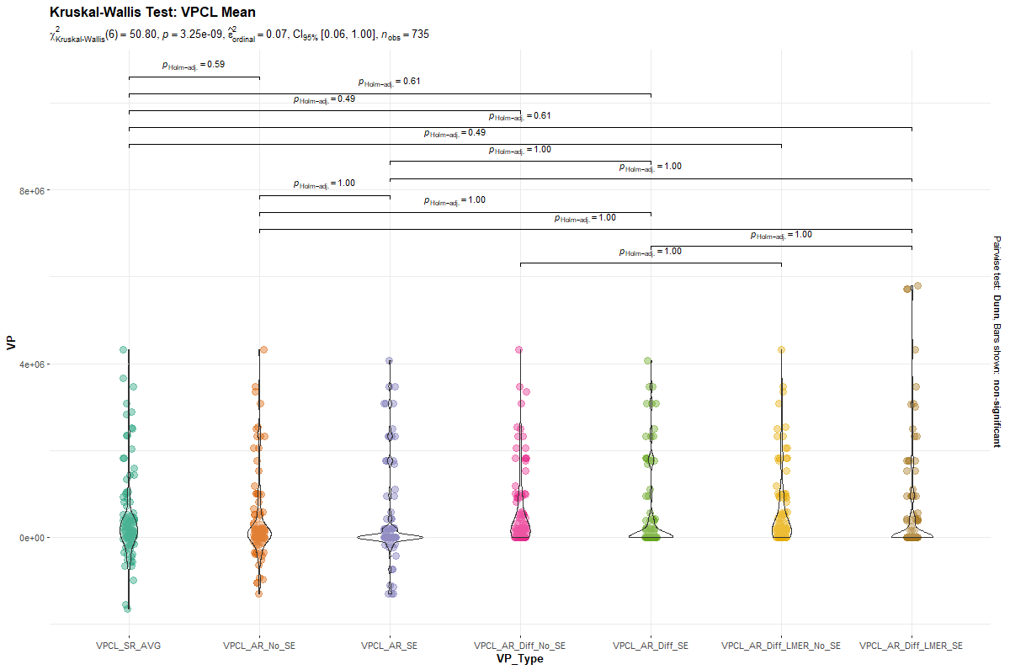

Slide 13
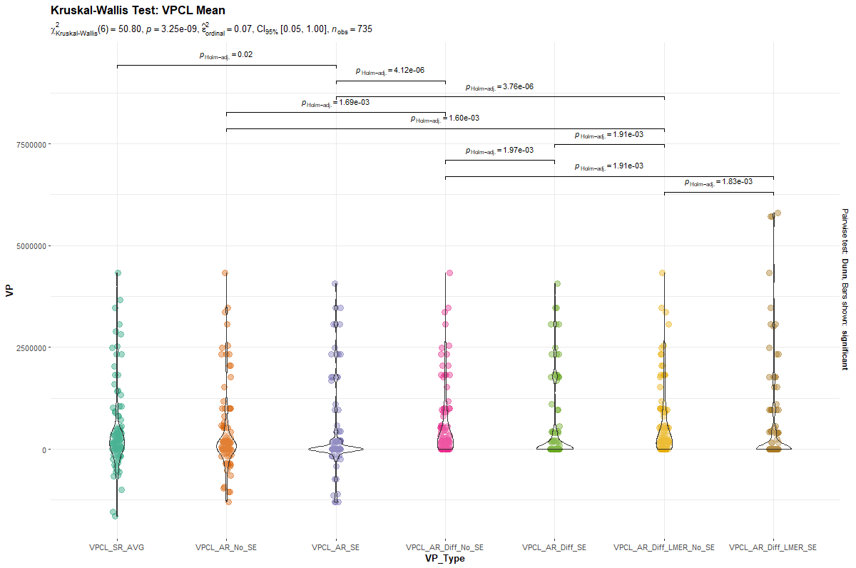

Slide 14
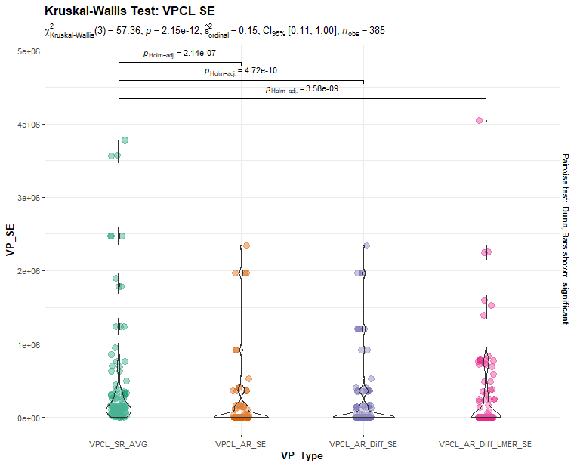

Slide 15
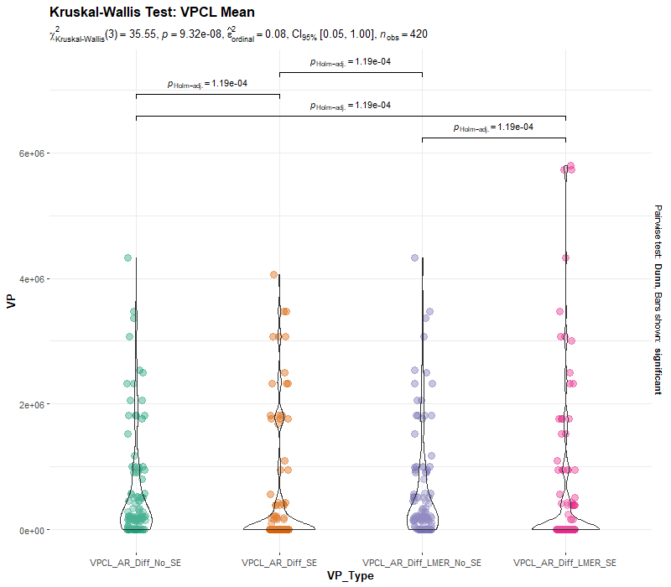

Slide 16
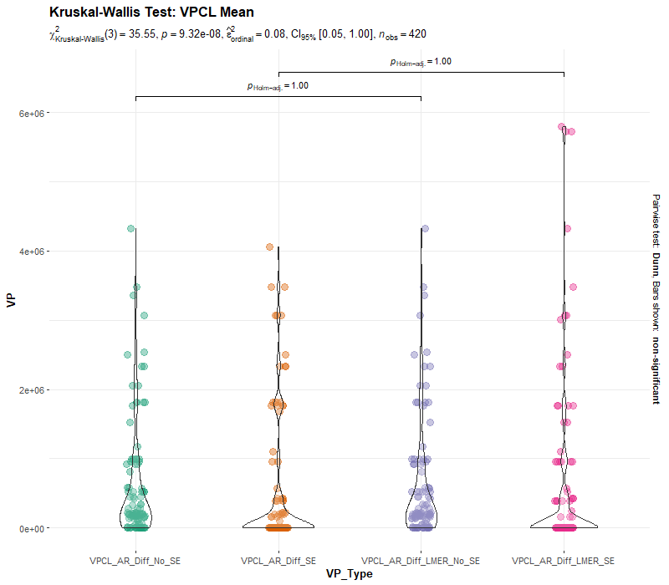

Slide 17
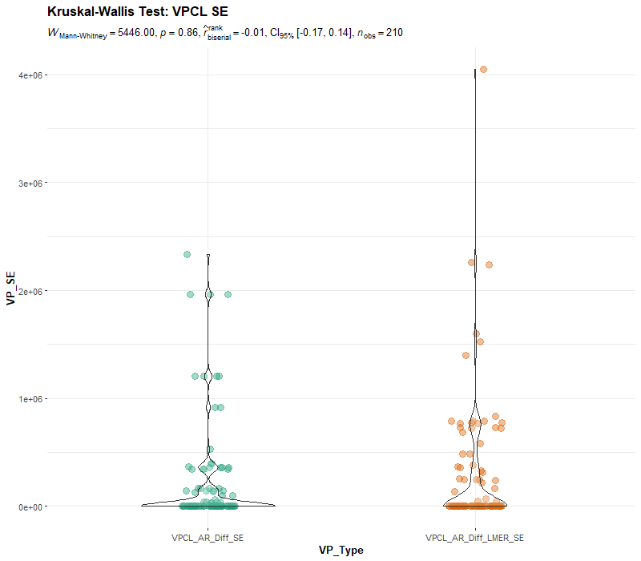

Slide 18
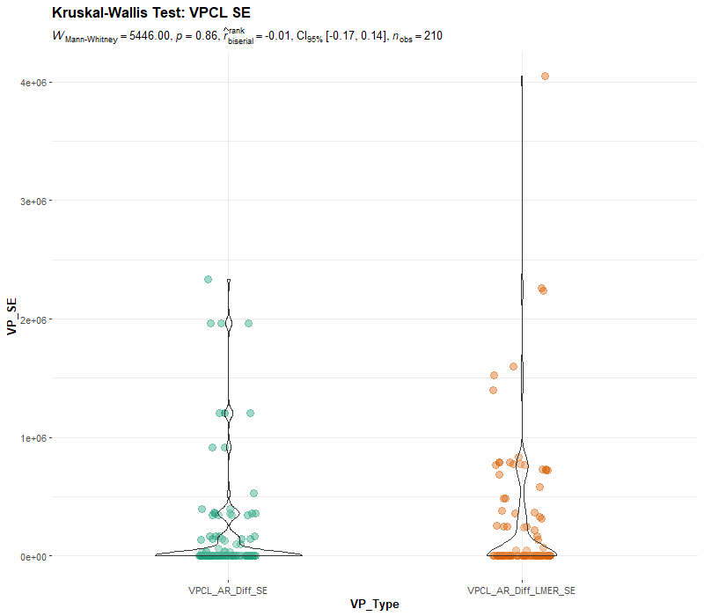

Slide 19
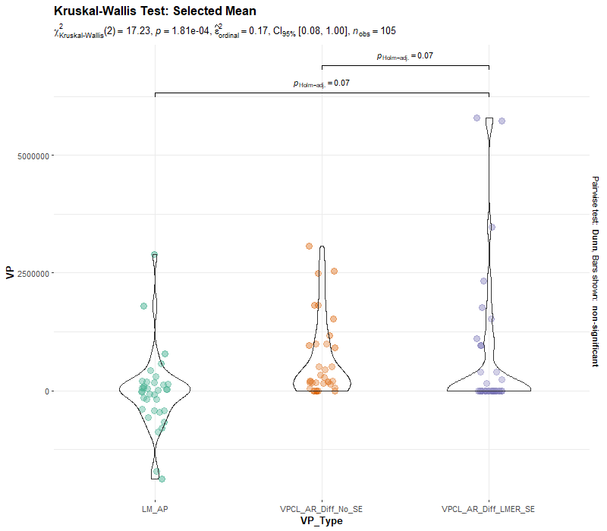

Slide 20
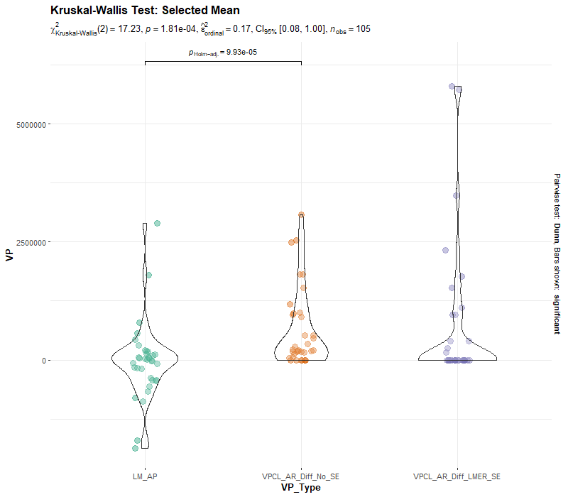

Slide 21
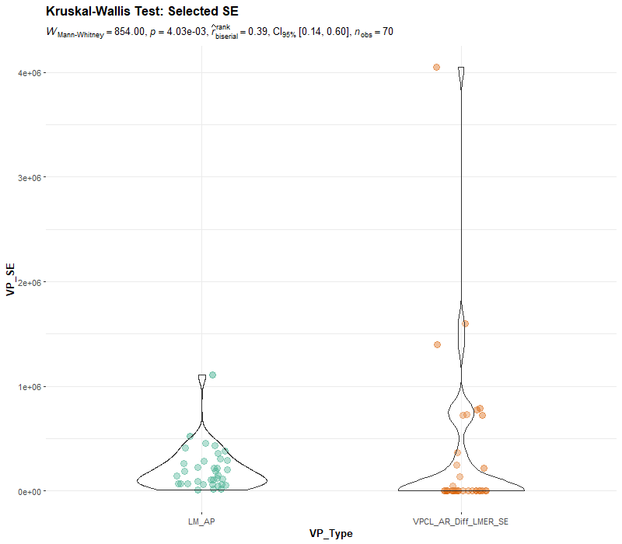

Slide 22
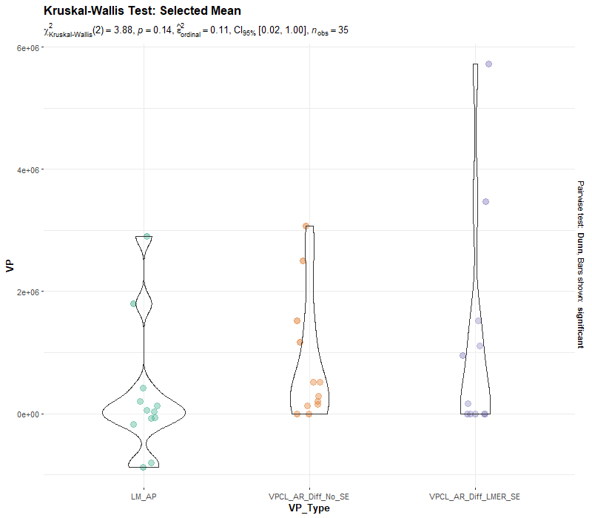
Vpcl_ VP Select

Slide 23
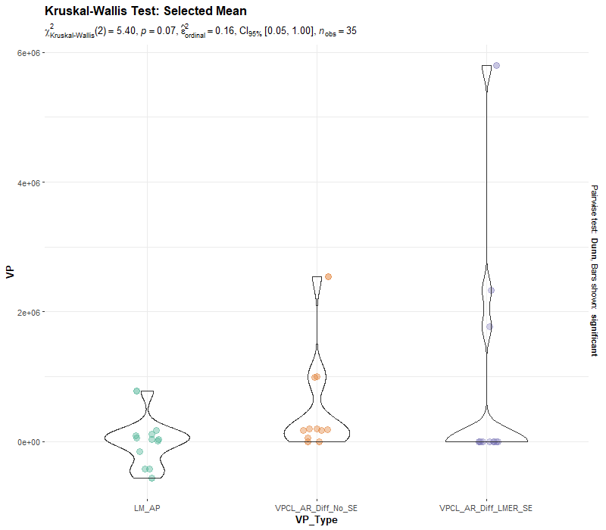

Slide 24
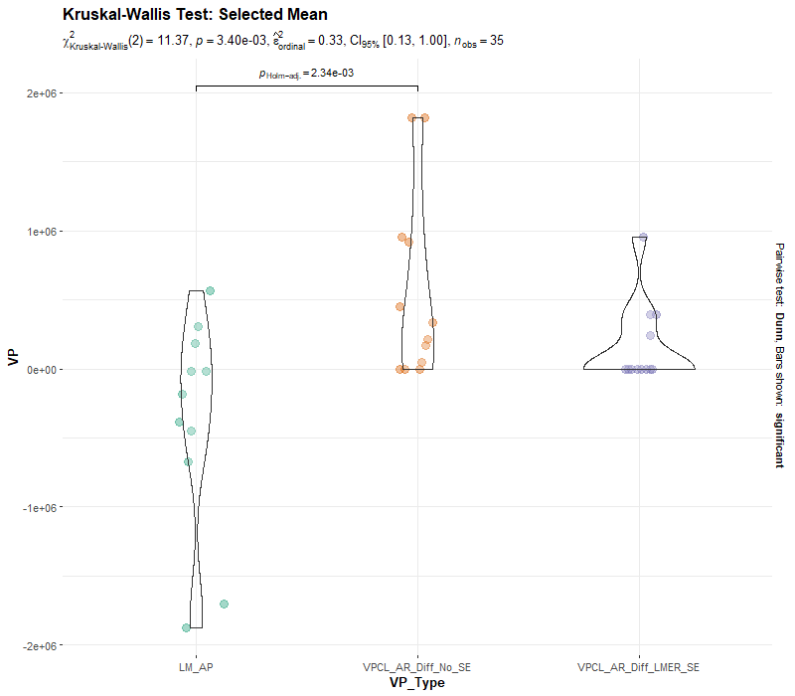

Slide 25
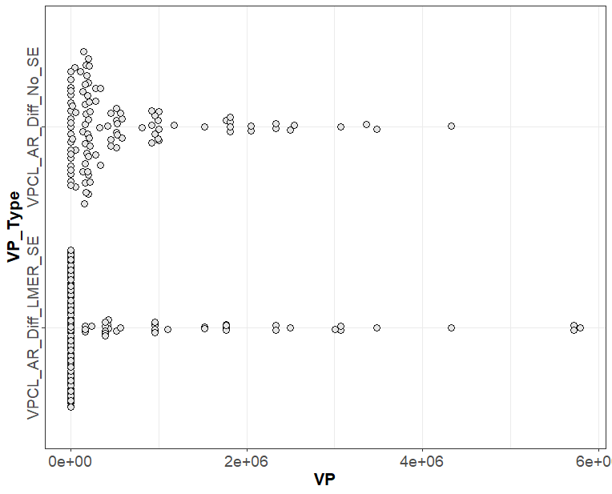
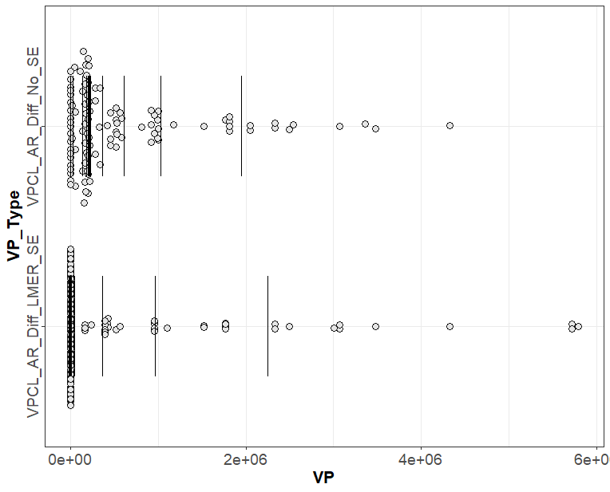

Slide 26
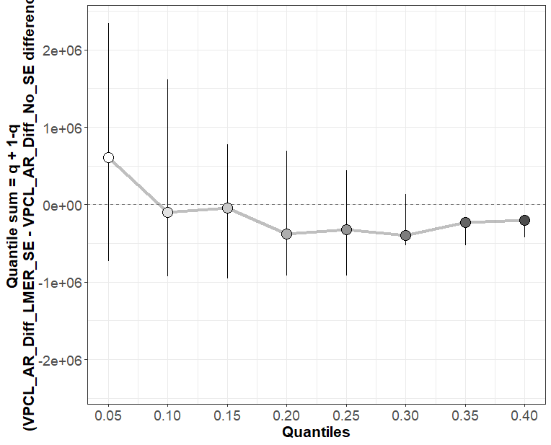
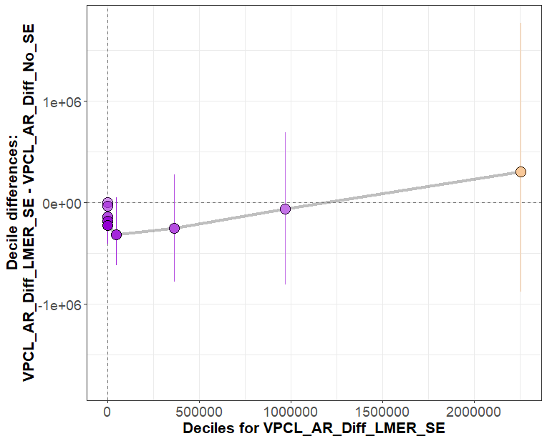

Slide 27
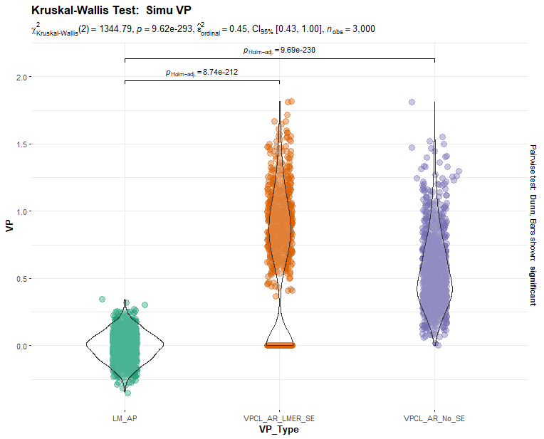

Slide 28
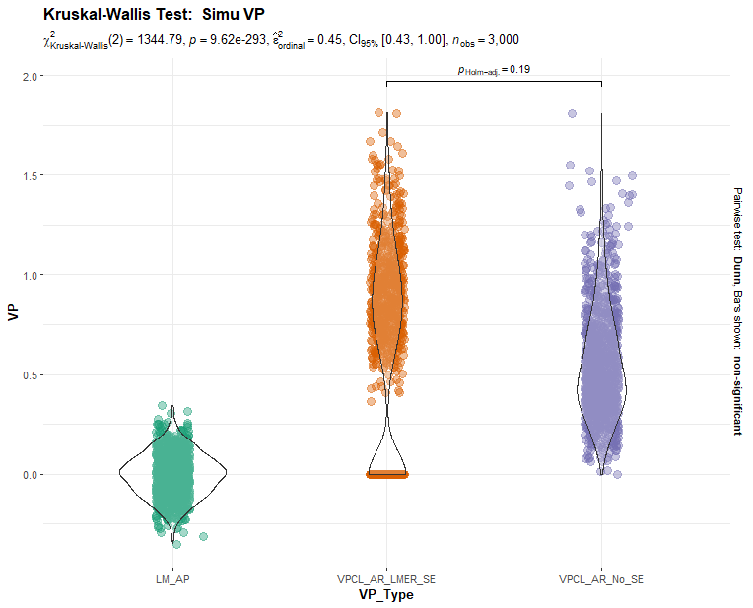

Slide 29
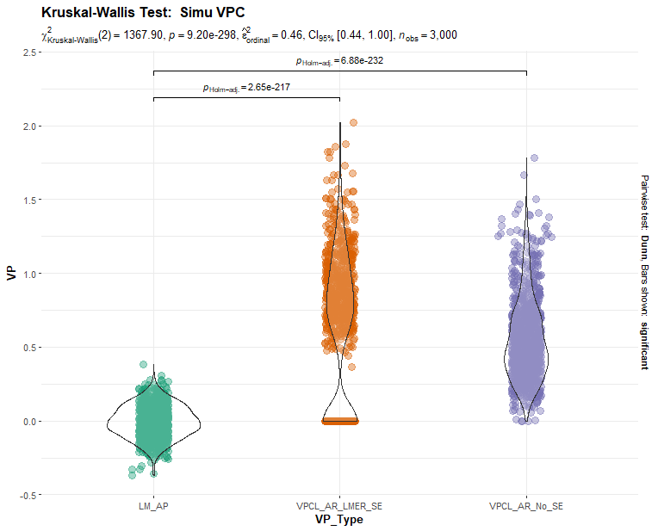

Slide 30
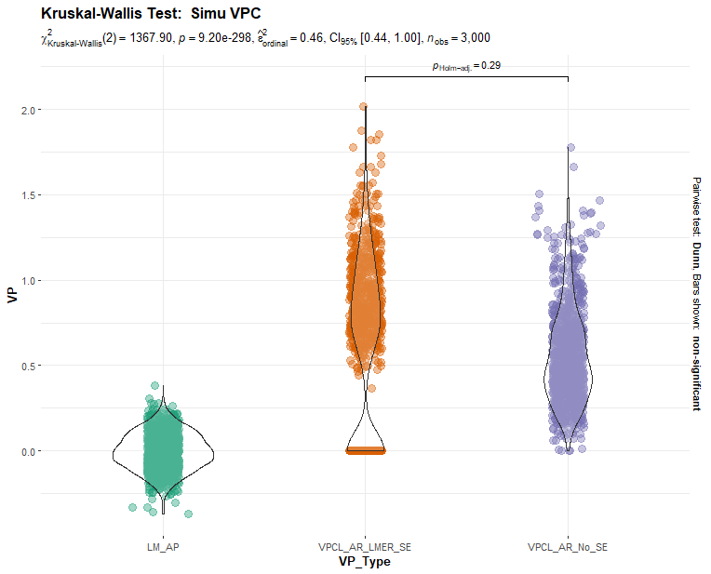

Slide 31
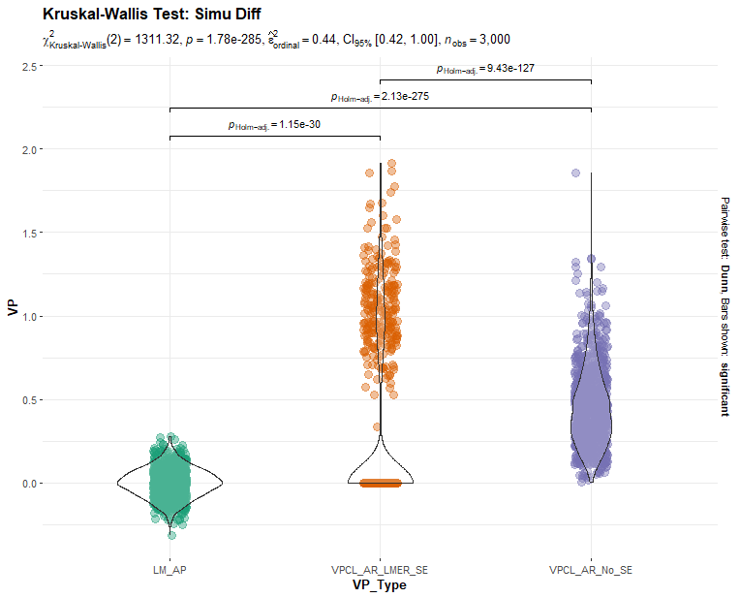

Slide 32
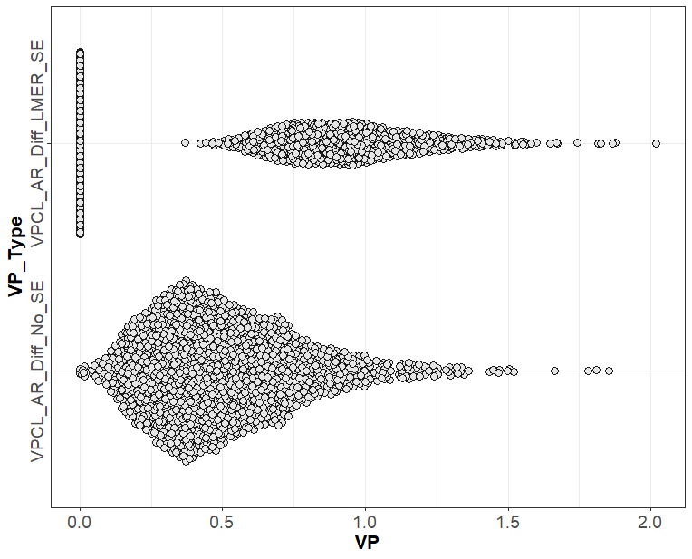


Slide 33
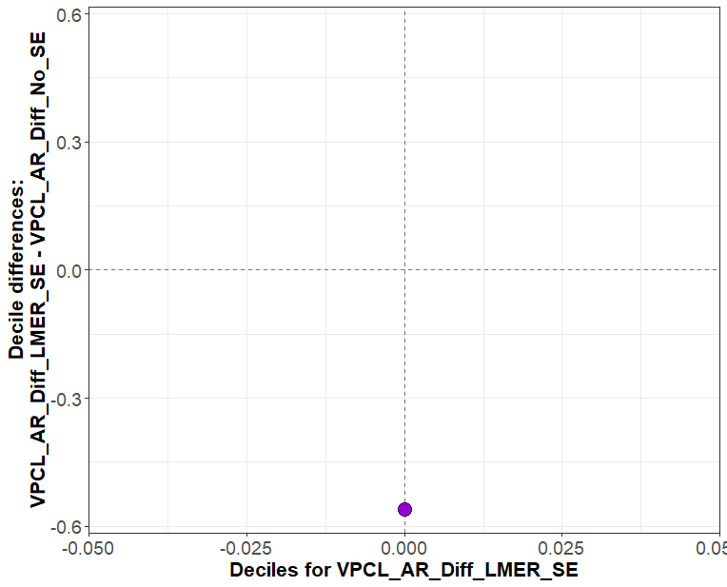
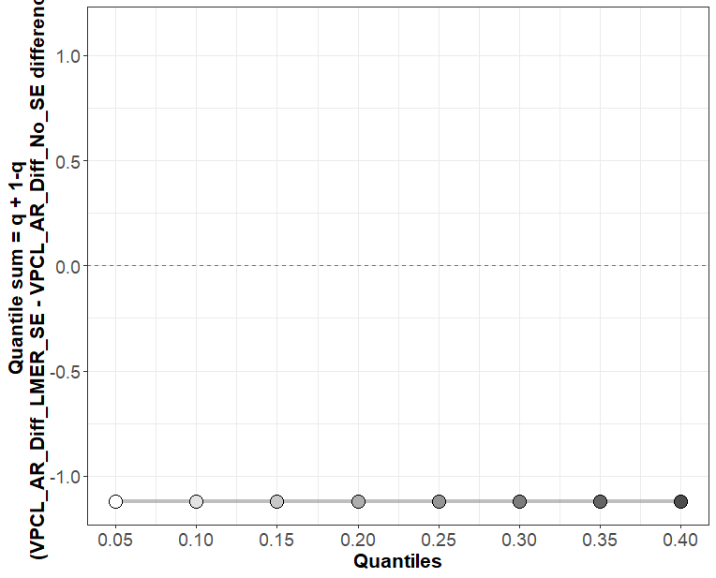

Slide 34
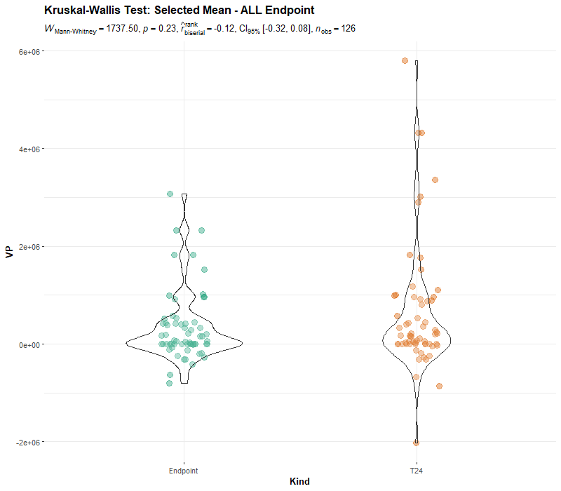

Slide 35
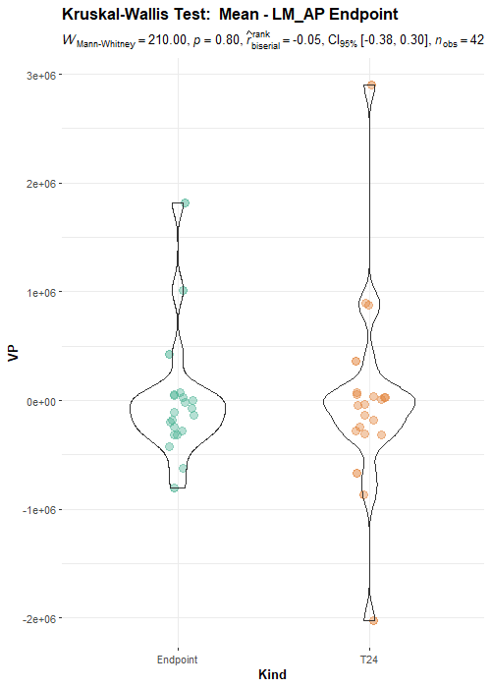
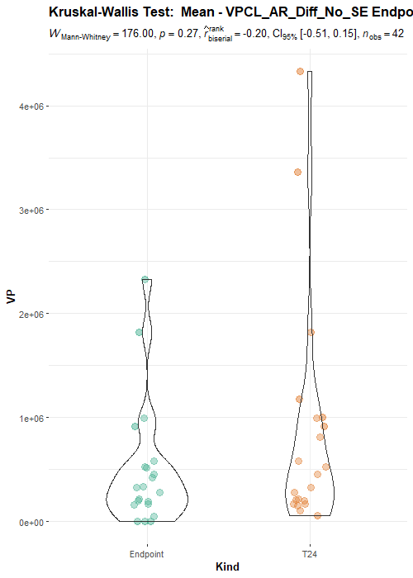
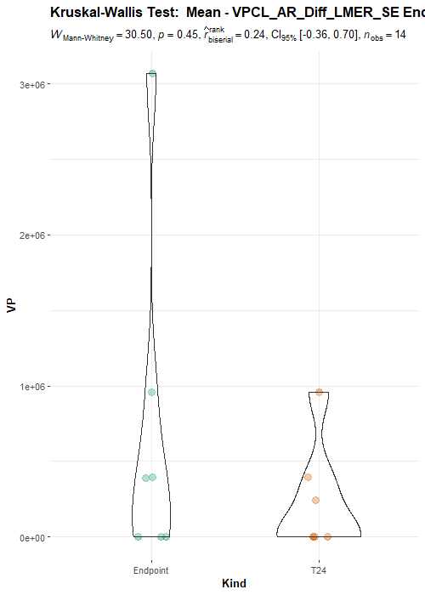

Slide 36
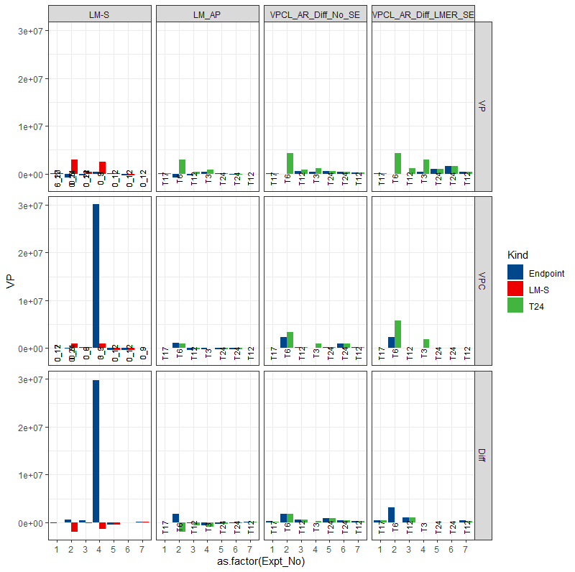
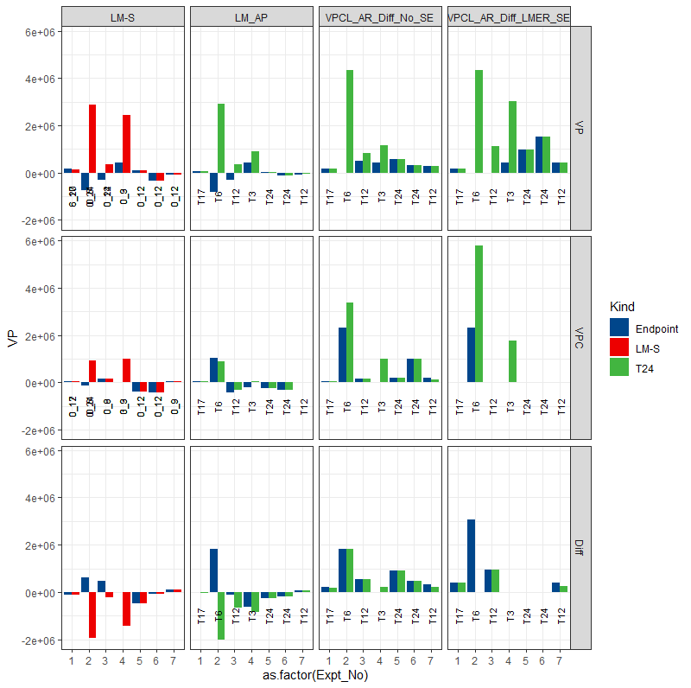

Slide 37



Slide 38


Slide 39

Endpoint Time
T24

