Slide 1
STUDENT ACADEMIC ANALYSIS
Classification & Linear Regression analysis
Submitted to:
Submitted by:
Prof. Savita Seharawat
Medha Trivedi(W0827295)
Simranjit (W0813397)
Ruby (W0784452)
Course:
Machine Learning I(DAB200)

Slide 2
Introduction
Purpose: Predict student’s dropout reasons and academic success
Dataset contains data from a higher education institution on various variables related to undergraduate students, including demographics, social-economic factors, and academic performance, to investigate the impact of these factors on student dropout and academic success.

Slide 3
Import panadas as pd :The import pandas portion of the code tells Python to bring the pandas data analysis library into your current environment. The as pd portion of the code then tells Python to give pandas the alias of pd.
Using this command will import StudentAcademic dataset in python

Slide 4
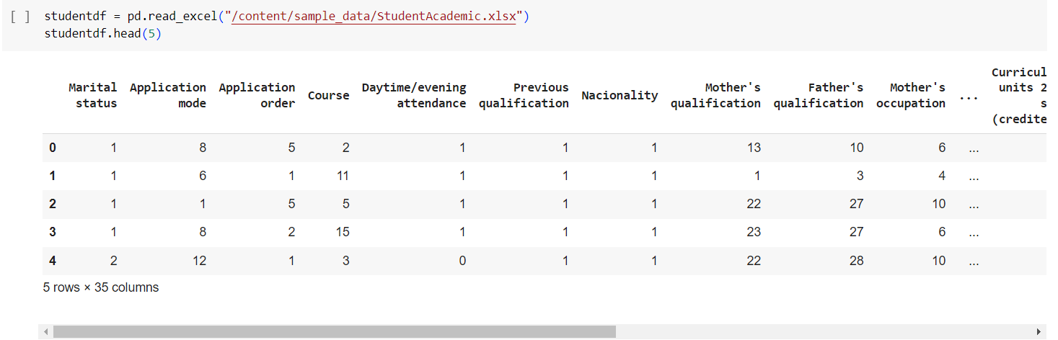
pd.read_excel() is an in-built function that imports dataset of type .xls or .xlsx mentioned in the url into python head() method returns a specified number of rows, string from the top. The head() method returns the first 5 rows if a number is not specified.

Slide 5

matplotlib.pyplot is a collection of command style functions that make matplotlib work like MATLAB. Each pyplot function makes some change to a figure: e.g., creates a figure, creates a plotting area in a figure, plots some lines in a plotting area, decorates the plot with labels, etc.

Slide 6
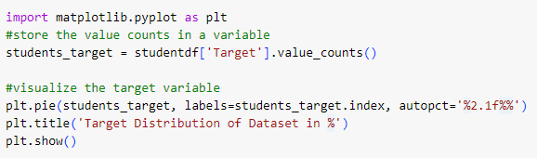
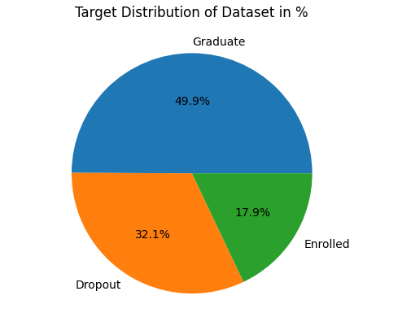
EXPLORATORY DATA ANALYSIS: Analysis student academic records and finds trends for future forecasting. This plot explains us what percentage of students are currently enrolled, graduated or dropout.

Slide 7
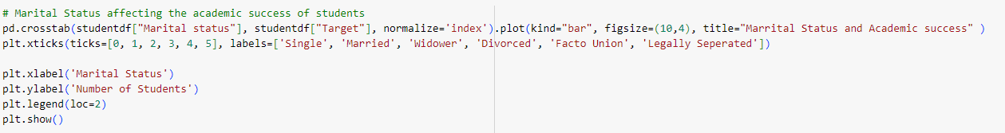
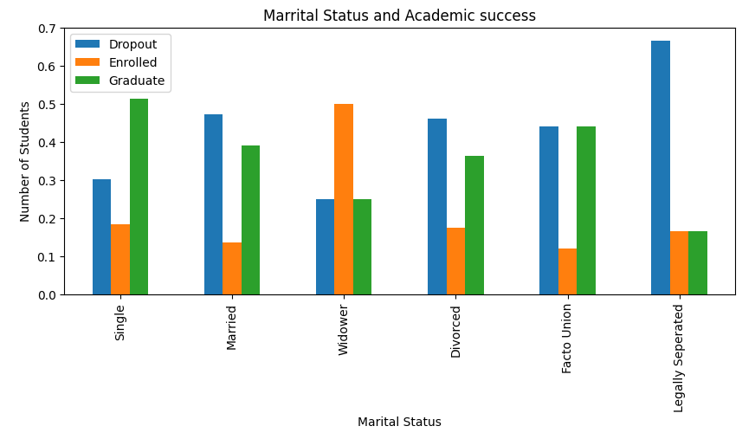
EXPLORATORY DATA ANALYSIS: This plot illustrates how many students were enrolled, graduated, dropout as per marital status. It helps us to understand the trend whether the marital status hinders student’s academic progress.

Slide 8
Usage of plt.pie( ), plt.title() , plt.show()
plt.pie(): Matplotlib API has a pie() function that generates a pie diagram representing data in an array. The fractional area of each wedge is given by x/sum(x). If sum(x)< 1, then the values of x give the fractional area directly and the array will not be normalized
plt.title(): The Matplotlib title() function is used to specify titles to the 2D graphs plotted using matplotlib. pyplot. The title() function can also be used to change the color, size, font, alignment, etc., of the title.
plt.show(): The show() function in pyplot module of matplotlib library is used to display all figures.

Slide 9
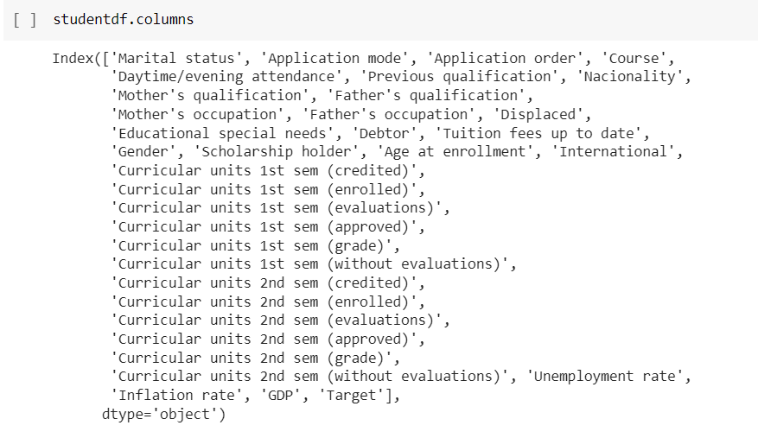
.columns() – it’s an in-built function which lists all the attribute names of the dataset

Slide 10
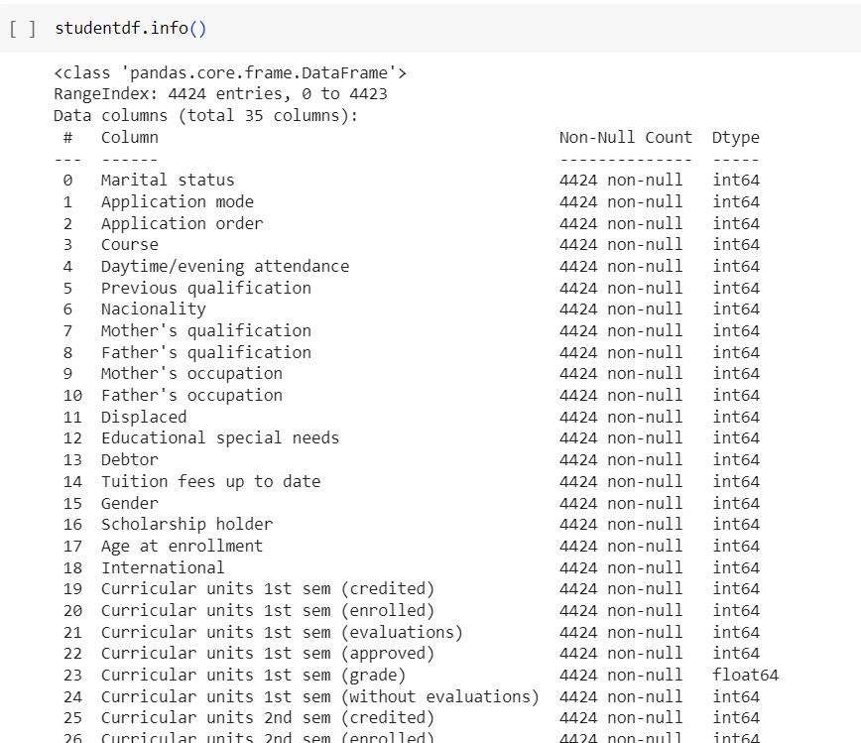
Info( ): The info() method prints information about the DataFrame. The information contains the number of columns, column labels, column data types, memory usage, range index, and the number of cells in each column (non-null values).

Slide 11
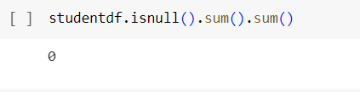
The function dataframe.isnull().sum().sum() returns the total number of missing values in the dataset.
The output clearly explains that our dataset do not have any missing values.

Slide 12
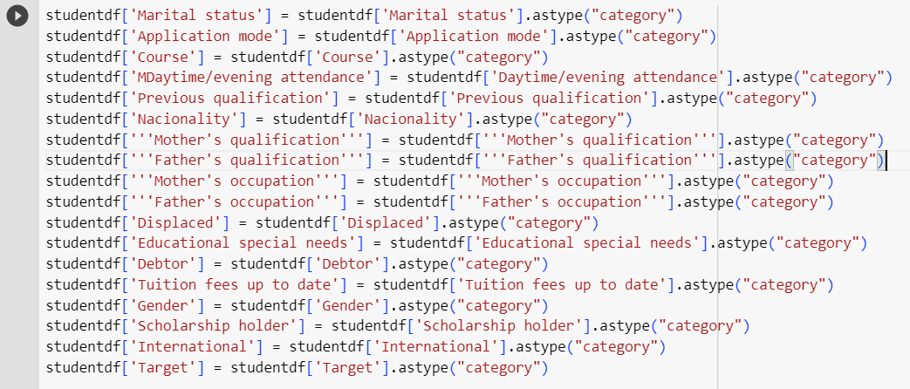
The .astype() function is used to cast a pandas object to a specified data type. Use a numpy. In student academic dataset there are various attributes whose actual datatypes are categorical and has to be converted to the same in python.

Slide 13
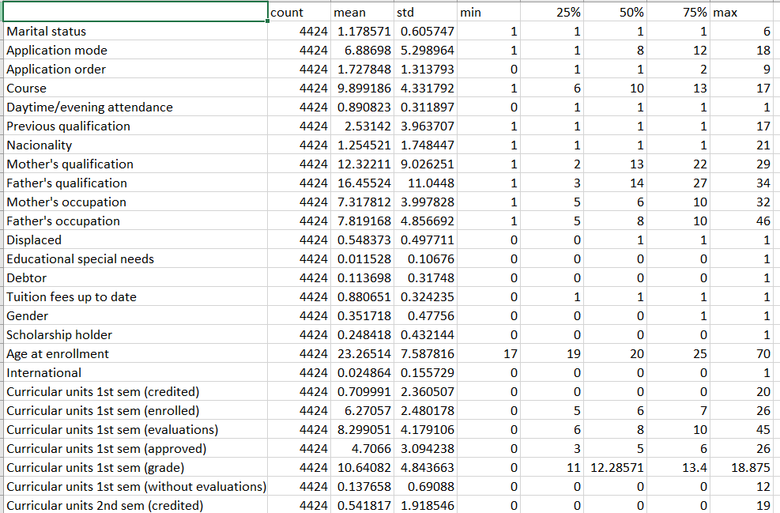
The .describe() method returns description of the data in the DataFrame. If the DataFrame contains numerical data, the description contains these information for each column: count, mean, standard deviation, min, max, percentile

Slide 14
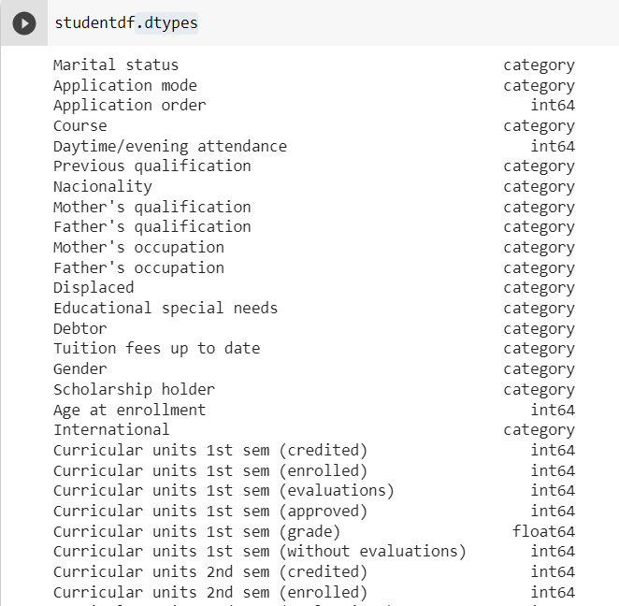
.dtypes: Data type object informs about the type of the data (integer, float, Python object, category)

Slide 15

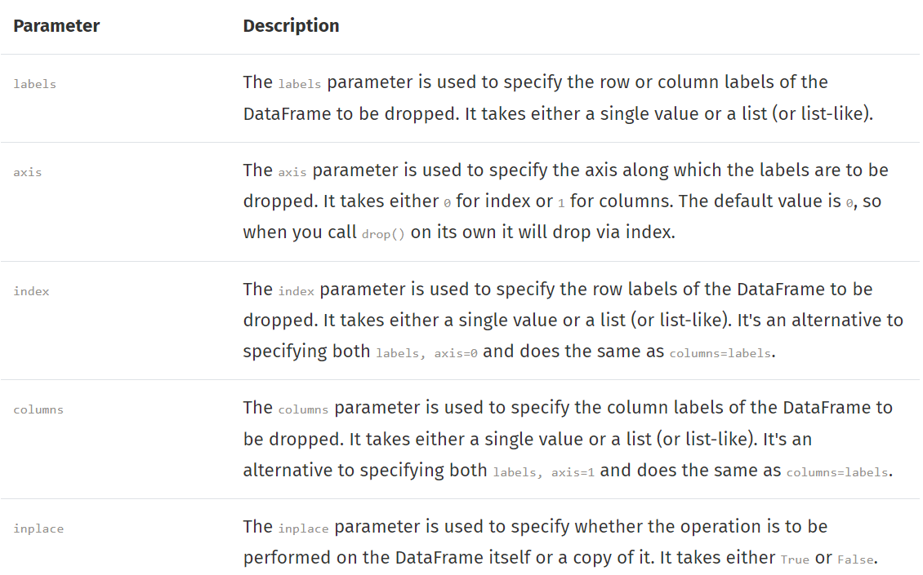
drop(): The Pandas drop() method is used by appending the method to the name of a dataframe, i.e. df.drop() and can be used to delete or remove rows, columns or series from the original dataframe. In our case we are dropping Target attribute as it is our output attribute.

Slide 16
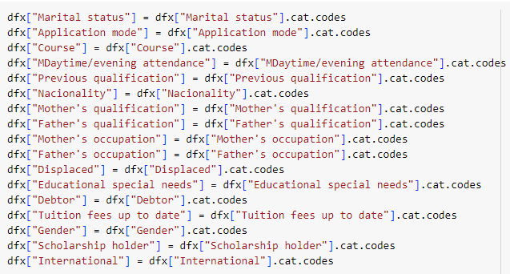
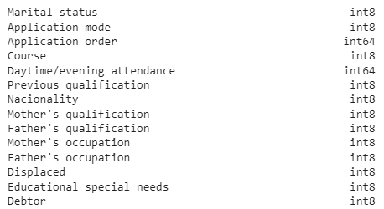
Label Encoding - converts categorical values into numerical format, assigning a unique integer to each category. ML typically works with numerical data and not categorical. Hence, it is important to convert all attributes to numerical by using cat.codes which typically assigns integer to each category.

Slide 17
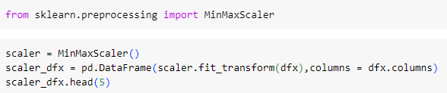
The sklearn.preprocessing() package provides several common utility functions and transformer classes to change raw feature vectors into a representation that is more suitable for the downstream estimators. In general, learning algorithms benefit from standardization of the data set.

Slide 18
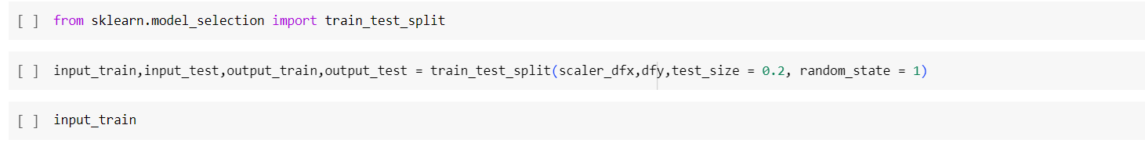
Sklearn.model_selection() is used to split our data into train and test sets where feature variables are given as input in the method.
Scaler_dfx – input dataset(without “Target”)
Dfy – output dataset (with “Target”)
Test_size - the portion of the data which will go into test sets
Random_state - used for data reproducibility

Slide 19
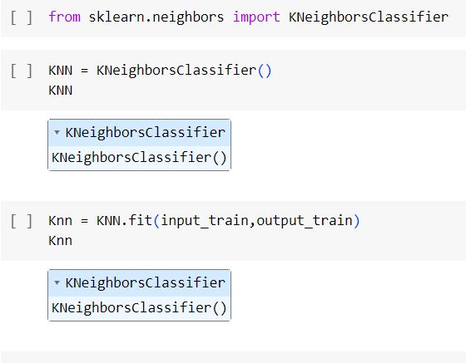
Sklearn.neighbors - provides functionality for unsupervised and supervised neighbors-based learning methods KNeighborsClassifier - looks for the 5 nearest neighbors by default

Slide 20
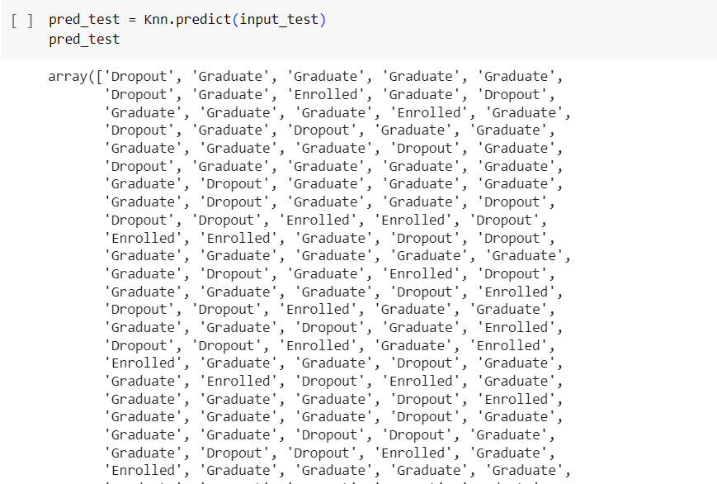
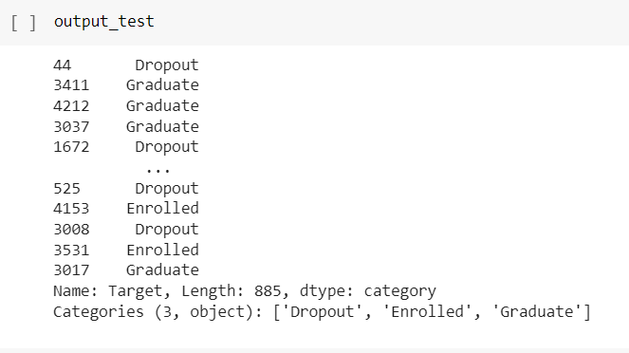
Predict() - Predictions are calculated for each test case by aggregating the responses of the k-nearest neighbors among the training cases.
This gives us predicted target values as per the input dataset

Slide 21
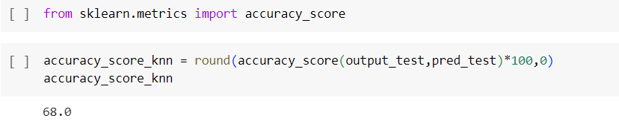
The accuracy_score() method of sklearn. metrics, accept the true labels of the sample and the labels predicted by the model as its parameters and computes the accuracy score as a float value, which can likewise be used to obtain the accuracy score in Python.
The accuracy score in our case is 68%

Slide 22
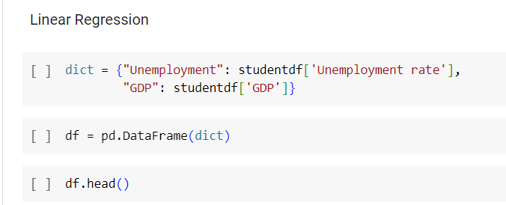
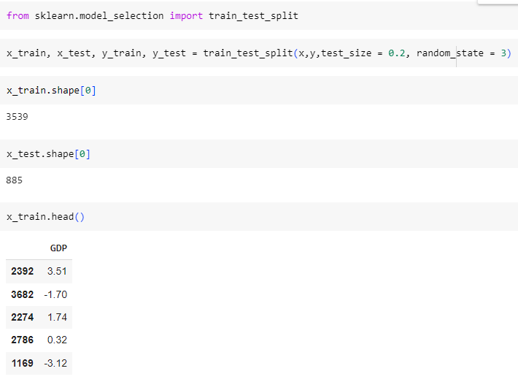
Linear regression is an approach for modeling the relationship between two (simple linear regression) or more variables (multiple linear regression). In simple linear regression, one variable is considered the predictor or independent variable, while the other variable is viewed as the outcome or dependent variable.

Slide 23
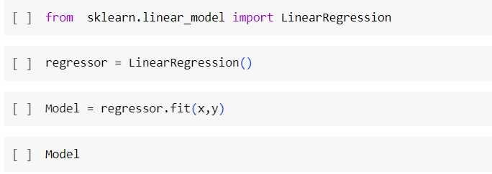
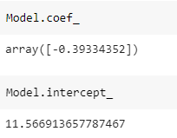
Linear regression uses the relationship between the data-points to draw a straight line through all them. This line can be used to predict future values. In Machine Learning, predicting the future is very important.
Model.coef_, Model.intercept : gives an array of weights estimated by linear regression.

Slide 24
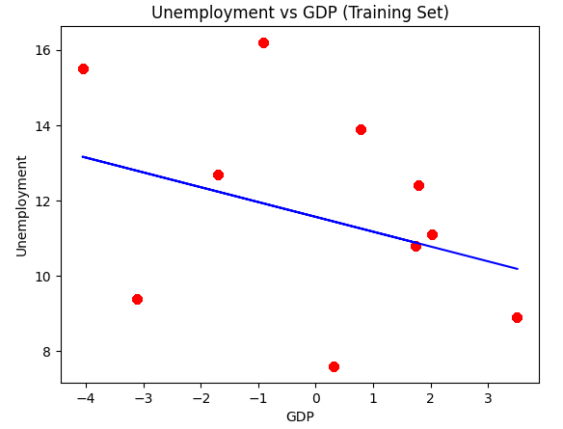
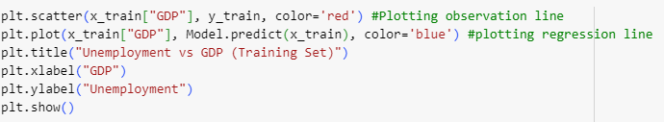
Linear regression: Unemployment & GDP

Slide 25
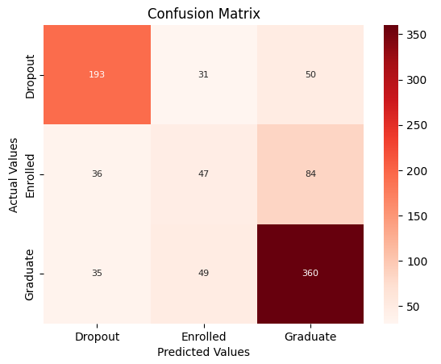
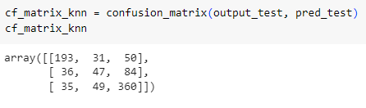
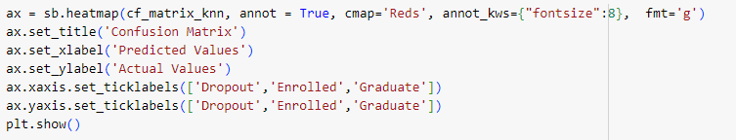
Confusion Matrix, HeatMap: Represent counts from predicted and actual values.

Slide 26
Analysis
As per pie chart, it is clear that graduates are maximum.
Bar chart indicates that single students are more likely to graduate. Moreover, widower are more interested in further education therefore high enrollment is seen. Legally separated students are highly likely to dropout.
As per linear regression, there is positive correlation between unemployment and GDP. When unemployment is at hike, GDP declines drastically.
As per confusion matrix, it is obvious that actual and predicted graduates are highest. However, dropout counts cannot be neglected as they are still at high risk to get escalated.

Slide 27
Conclusion
According to our conclusion, it would be better to tailor made the course, structure and fees as per marital status or consider enrollment accordingly to ensure maximum students graduate and avoid dropouts.
Moreover, it would be wise to encourage students to finish their academic.
Unemployment and GDP can also be contributing factors for student dropouts. Hence, these factors should be kept in mind while developing program plan.
As per confusion matrix, dropouts are predicted positive and hence it is vital to take it seriously for student’s academic progress while strategizing the program plan accordingly.

Slide 28
Reference
Dataset: https://www.kaggle.com/datasets/thedevastator/higher-education-predictors-of-student-retention

Slide 29


