Slide 1
STUDENT ACADEMIC ANALYSIS
Classification & Linear Regression analysis
Submitted to:
Submitted by:
Prof. Savita Seharawat
Medha Trivedi(W0827295)
Simranjit (W0813397)
Ruby (W0784452)
Course:
Machine Learning I(DAB200)

Slide 2
Introduction
Purpose: Predict student’s dropout reasons and academic success
Dataset contains data from a higher education institution on various variables related to undergraduate students, including demographics, social-economic factors, and academic performance, to investigate the impact of these factors on student dropout and academic success.

Slide 3
Machine learning steps
Import dataset
Exploratory data analysis on percent of students enrolled, graduated and dropout
Exploratory Data Analysis on Marital status and Academic progress of students
Check existence of nulls in dataset
Defined “Target” Attribute as our target variable
Created two separate input and output datasets
Using Label Encoding, converted categorical attributes to numerical
Normalized dataset
Applied K-Nearest Neighbor as a classification Model while checking accuracy score.
Linear Regression for investigating linear correlation of Unemployment and GDP
Confusion matrix for predicting future trend of student especially in case of graduation and dropouts.

Slide 4
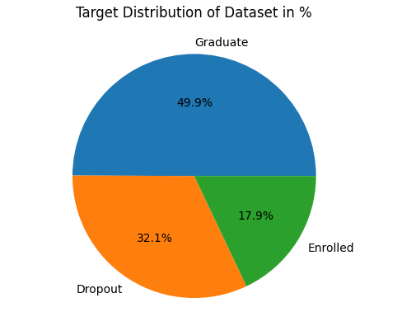
EXPLORATORY DATA ANALYSIS: Analysis student academic records and finds trends for future forecasting. This plot explains us what percentage of students are currently enrolled, graduated or dropout.
The proportion of students who successfully graduate is at its highest level. However, there is a notably substantial rate of students who discontinue their studies before completion.

Slide 5
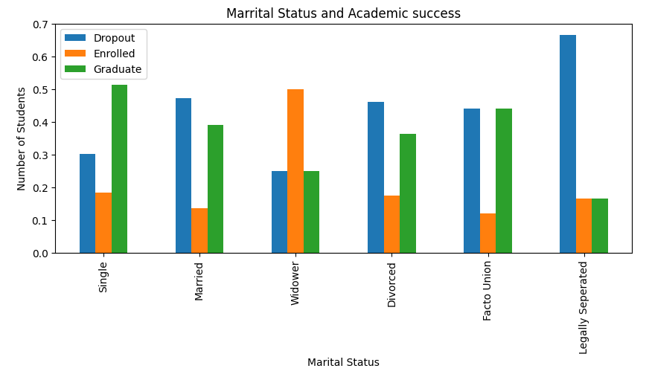
EXPLORATORY DATA ANALYSIS: This plot illustrates how many students were enrolled, graduated, dropout as per marital status. It helps us to understand the trend whether the marital status hinders student’s academic progress.
The largest group consists of individuals who have attained a bachelor's degree as their highest level of education. On the contrary, those who have undergone legal separation display a lower inclination towards completing their education. Interestingly, widowed individuals exhibit a heightened interest in pursuing advanced studies. However, the category of legally separated students encounters challenges in successfully completing their educational pursuits, resulting in a comparatively higher dropout rate.

Slide 6
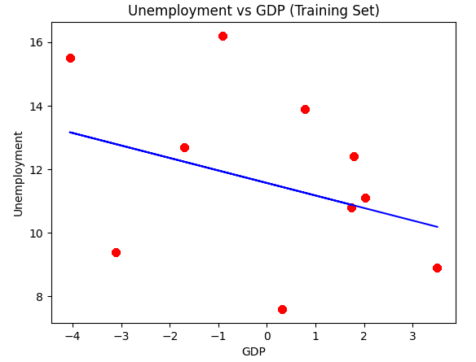
Linear regression: Unemployment & GDP
Our goal is to investigate whether unemployment and GDP have an impact on the occurrence of student dropouts. Linear regression operates under the assumption that a linear relationship exists between the independent variables (input factors) and the dependent variable (outcome). This suggests that changes in the independent variables are directly proportional to changes in the dependent variable.

Slide 7
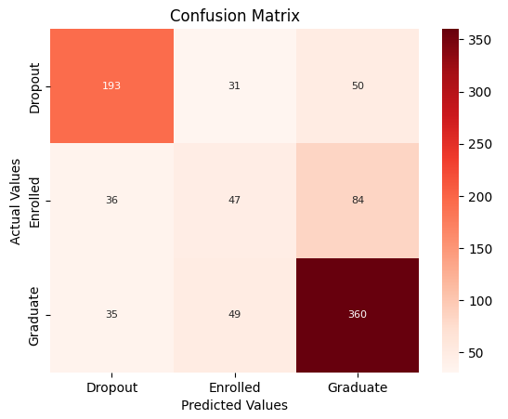
Confusion Matrix, HeatMap
The confusion matrix provides an in-depth and thorough summary of a classifier's predictions, comparing them against the true labels in the dataset. We create this matrix to understand various scenarios related to student outcomes, like graduation and dropout cases. This strategy offers a clear representation of potential future forecasts. This knowledge is crucial for making informed choices that have a positive influence on students' academic paths, nurturing their dedication to accomplishing their educational goals.

Slide 8
Analysis
As per pie chart, it is clear that graduates are maximum.
Bar chart indicates that single students are more likely to graduate. Moreover, widower are more interested in further education therefore high enrollment is seen. Legally separated students are highly likely to dropout.
As per linear regression, there is positive correlation between unemployment and GDP. When unemployment is at hike, GDP declines drastically.
As per confusion matrix, it is obvious that actual and predicted graduates are highest. However, dropout counts cannot be neglected as they are still at high risk to get escalated.

Slide 9
Conclusion
According to our conclusion, it would be better to tailor made the course, structure and fees as per marital status or consider enrollment accordingly to ensure maximum students graduate and avoid dropouts.
Moreover, it would be wise to encourage students to finish their academic.
Unemployment and GDP can also be contributing factors for student dropouts. Hence, these factors should be kept in mind while developing program plan.
As per confusion matrix, dropouts are predicted positive and hence it is vital to take it seriously for student’s academic progress while strategizing the program plan accordingly.

Slide 10
Reference
Dataset: https://www.kaggle.com/datasets/thedevastator/higher-education-predictors-of-student-retention

Slide 11


