Slide 1
Introduction to deep learning
for crystal language models
PSDI & Royce Materials Data Summit
Notes:
Slide 1 - Introduction to Deep Learning for Crystal Language Models
**Approx. timing: 45 seconds**
"Hi everyone. In this first part I am going to give the introduction to deep learning that we need for the rest of the workshop.
In this section we’ll cover: what we mean by representations, embeddings, neural network layers, losses, gradients, sequence models, and autoregressive generation.
These concepts will be important because the rest of the workshop is about CrystaLLM: treating crystal structures, written as CIFs, as a kind of language. Joley will take over after me and go into attention, transformers, and the pretrained CrystaLLM model. Then Cyprien will cover conditioning, finetuning, and CrystaLLM-pi.
So for this workshop, we will hopefully take you all the way from ordinary feature vectors to generated crystal structures conditioned on functional properties of interest"
**Transition:**
"Let me start by showing the whole workshop arc, so this first talk has a place in the larger story."

Slide 2
WHAT THIS WORKSHOP COVERS
1. Learn representations
2. Generate CIF text
3. Steer generation
MLP basics
Embeddings
Training by gradients
Why fixed vectors are limiting
Attention
Transformers
Autoregressive decoding
CrystaLLM generation
Conditioning
Finetuning
Property injection
CrystaLLM-pi
~40 mins
Speaker: Bradley
Break
~35 mins
Speaker: Joley
Break
~20 mins
Speaker: Cyprien
Break
Practical notebooks: load_and generate.ipynb and Z_finetune_and conditioning.ipynb
Notes:
Slide 2 - What This Workshop Covers
**Approx. timing: 1 minute**
"The workshop has three connected pieces.
The first piece, which is this section, is about learning representations. We will start with classical machine learning intuition, then move to multilayer perceptrons, embeddings, and training by gradients. We will also talk about why fixed-length vector inputs are limiting once our data are sequences.
The second piece is about generating CIF text. That is where attention and transformers come in. Joley will explain how attention lets a model use context more flexibly than a recurrent model, and then connect that to large language models and CrystaLLM generation.
The third piece is about steering generation. Cyprien will cover conditioning mechanisms, finetuning, property injection, and CrystaLLM-pi.
The hands-on notebooks follow the same structure. The point is that the concepts and the code should reinforce each other."
**Optional add if useful:**
"So if one idea feels abstract in the slides, keep it in mind, because it will usually reappear in a notebook a little later."
**Transition:**
"For this first section, these are the specific things I want people to leave with."
[Sources]
- CaMML School training material: https://workshop.camml.ac.uk/
- Antunes, Butler, and Grau-Crespo, Crystal structure generation with autoregressive large language modeling, Nature Communications 15, 10570, 2024.

Slide 3
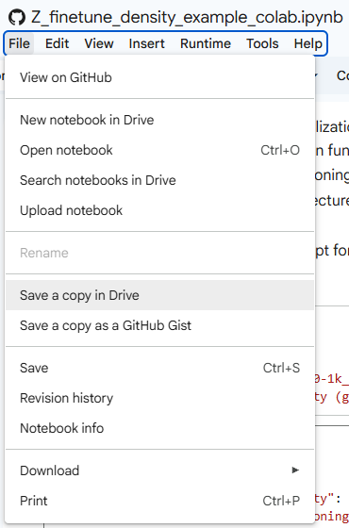
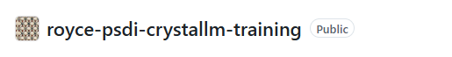
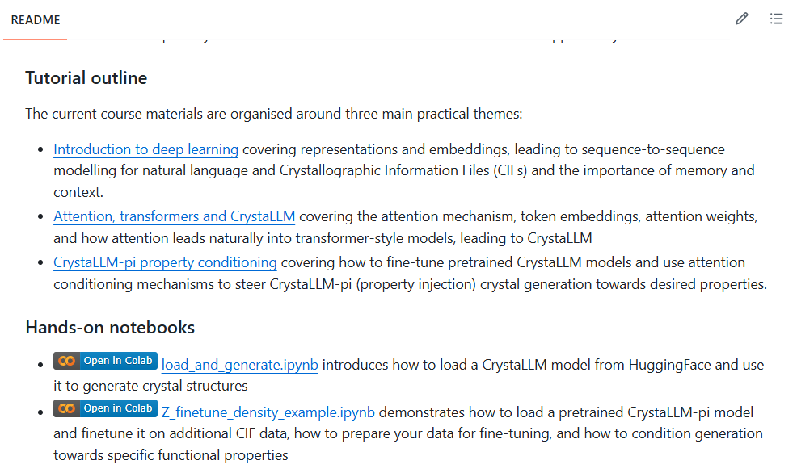
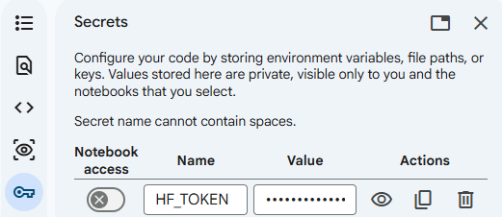
HANDS-ON SESSIONS PREPARATION
https://github.com/mdi-group/royce-psdi-crystallm-training

Slide 4
AIMS FOR THIS SESSIONS
1
Define
representation, embedding, token, loss, gradient
2
Explain
why MLPs are fixed vector-to-vector maps
3
Recognise
the shape of sequence and autoregressive tasks
4
Connect
CIF generation to next-token prediction
5
Prepare
for attention, transformers, and CrystaLLM
Notes:
Slide 3 - What Should People Leave With?
**Approx. timing: 1 minute**
"These are the learning outcomes for part 1.
First, I want you to be able to define the key words: representation, embedding, token, loss, and gradient. These words come up constantly in machine learning, and they can sound more mysterious than they really are.
Second, I want you to be able to explain why a basic MLP is a fixed vector-to-vector map. That is a useful starting point, but it is not enough for everything.
Third, I want you to recognise the shape of sequence tasks. Sometimes we map a sequence to a label. Sometimes we map one sequence to another. Sometimes we predict the next token from the previous tokens.
Fourth, I want you to connect CIF generation to next-token prediction. That is the key conceptual bridge to CrystaLLM.
And finally, I want this to prepare you for attention and transformers, rather than teach those fully here."
**Transition:**
"The first big idea is that deep learning is not just about fitting labels. It is mostly about learning representations."
[Sources]
- CaMML School training material: https://workshop.camml.ac.uk/
- Goodfellow, Bengio, and Courville, Deep Learning, MIT Press, 2016.
- Antunes, Butler, and Grau-Crespo, Crystal structure generation with autoregressive large language modeling, Nature Communications 15, 10570, 2024.

Slide 5
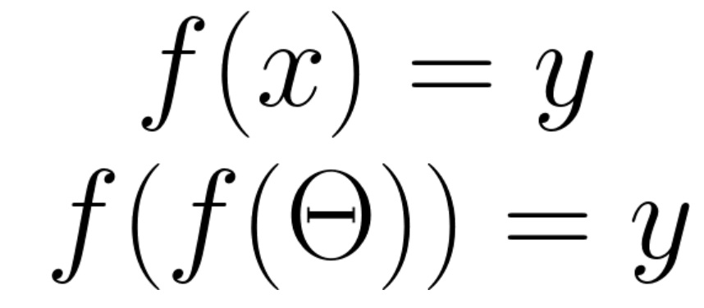
Deep learning is mostly representation learning
“Hand-crafted” features
Classical ML
Deep learning
Unstructured data
Notes:
Slide 4 - Deep Learning Is Mostly Representation Learning
**Approx. timing: 1 minute 30 seconds**
"A useful way to think about the difference between classical machine learning and deep learning is to ask where the representation comes from.
In a lot of classical machine learning workflows, we start with data and then we design features by hand. We decide what quantities we think matter, compute those quantities, and pass them to a model. That can work extremely well. In fact, in scientific machine learning, carefully chosen descriptors are often a huge part of the success.
Deep learning changes the balance. Instead of saying, 'Here are exactly the features the model should use,' we give the model rawer or less compressed data and allow it to learn intermediate representations during training.
So the important phrase here is not just 'deep' and it is not just 'neural network'. The important phrase is representation learning: learning internal variables that make the task easier."
**Shorten if needed:**
"This does not mean features disappear. It means more of the feature construction is learned from data."
**Transition:**
"To make that concrete, let us start with a deliberately simple example."
[Sources]
- Goodfellow, Bengio, and Courville, Deep Learning, MIT Press, 2016.
- Bengio, Courville, and Vincent, Representation Learning: A Review and New Perspectives, IEEE TPAMI 35(8), 1798-1828, 2013.

Slide 6

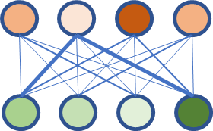

Hand-crafted features put the burden on us
Deep learning
Classification model
Cat/Snake
Classical ML
Number of eyes | 2
Whiskers | N
Legs | N
…
Scales | Y
Notes:
Slide 5 - Hand-Crafted Features Put the Burden on Us
**Approx. timing: 1 minute 30 seconds**
"Imagine we are trying to build a classifier that distinguishes cats from snakes.
In a classical machine learning setup, we might hand-design a table of features. Number of eyes: two. Whiskers: yes or no. Legs: maybe four, maybe none. Scales: yes or no. Then a model takes that table and learns a boundary between the classes.
There is nothing wrong with this in principle. If the features are good, the model can be simple and still perform well. The catch is that a lot of the intelligence has been moved into the feature design. Someone had to know which questions to ask about the object before learning started.
Deep learning tries to reduce that manual burden. Instead of explicitly giving 'whiskers' and 'scales', we might give pixels, tokens, graphs, or structures, and let the model learn useful intermediate features."
**Audience prompt:**
"The useful question is: what information have we already built into the representation before the model sees the data?"
**Transition:**
"In materials science, that question becomes even more important."
[Sources]
- CaMML School training material: https://workshop.camml.ac.uk/
- Goodfellow, Bengio, and Courville, Deep Learning, MIT Press, 2016.
- Bengio, Courville, and Vincent, Representation Learning: A Review and New Perspectives, IEEE TPAMI 35(8), 1798-1828, 2013.

Slide 7
IN MATERIALS, FEATURISATION IS ALREADY A MODELLING CHOICE
Composition
Structure
Representation
Which elements?
Stoichiometry?
Oxidation states?
Chemical priors?
Distances
Angles
Symmetry
Local environments
What is invariant?
What is local?
What must generalise?
Deep learning does not remove representation choices; it moves many of them inside the training problem.
Notes:
Slide 6 - In Materials, Featurisation Is Already a Modelling Choice
**Approx. timing: 1 minute 45 seconds**
"Materials are a very good example of why representation is not just a technical detail.
If I represent a material by composition, I have to decide which chemical information to include. Do I include just elements and stoichiometry? Do I include oxidation states? Do I include chemical priors or periodic-table properties?
If I represent the crystal structure, I have another set of choices. Do I use distances, angles, symmetry information, local coordination environments, neighbour lists, graphs, or something else?
And underneath all of those choices are invariances. A crystal property should not change because I rotate the cell, translate the origin, or relabel equivalent atoms. So a representation should make the right things easy for the model and avoid making the wrong things matter.
The key line on this slide is this: deep learning does not remove representation choices. It moves many of them inside the training problem."
**Shorten if needed:**
"That is powerful, but it also means the training data and objective now carry more responsibility."
**Transition:**
"This brings us to two styles of representation: localised representations and distributed representations."
[Sources]
- Bengio, Courville, and Vincent, Representation Learning: A Review and New Perspectives, IEEE TPAMI 35(8), 1798-1828, 2013.
- CaMML School training material: https://workshop.camml.ac.uk/

Slide 8
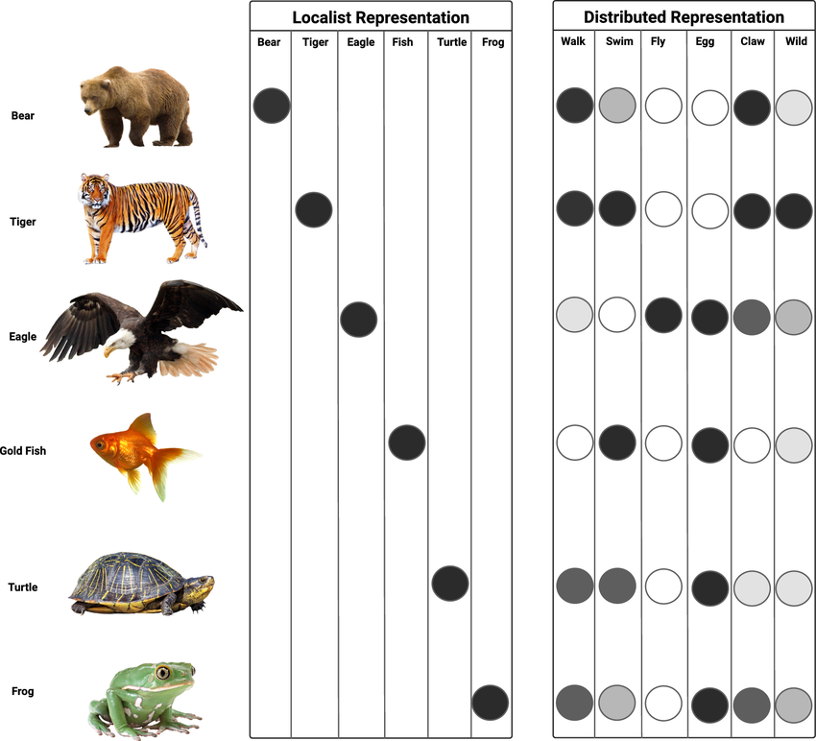
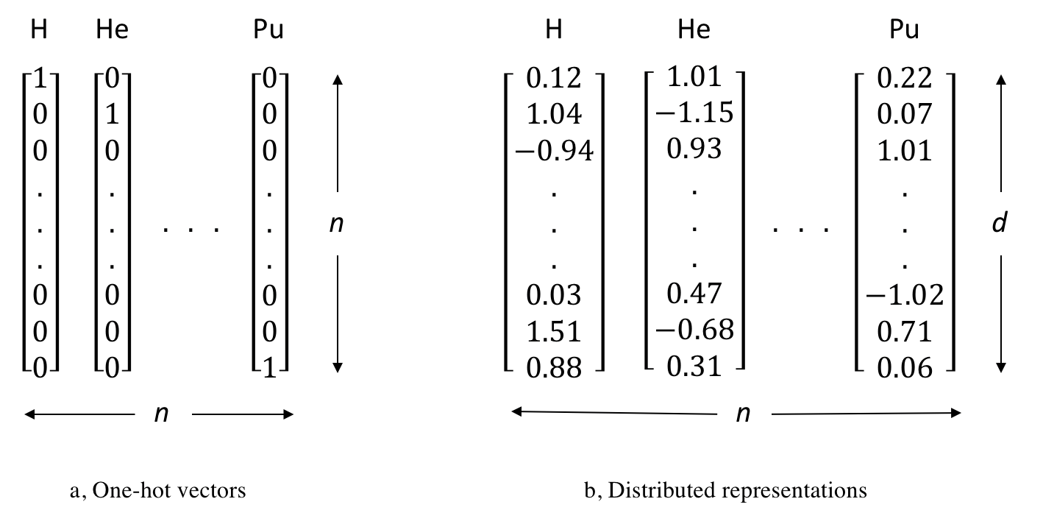
Localised or distributed representations?
Distributed representations give a richer context of the data
Neural Comput & Applic 36, 12809, 2024
Notes:
Slide 7 - Localised or Distributed Representations?
**Approx. timing: 1 minute 45 seconds**
"On the left, we have a localist, or one-hot, style of representation. Each object gets its own slot. Bear is one slot, tiger is another slot, fish is another slot, and so on.
This is simple and clean, but it has a big limitation: it does not say anything about similarity. In a one-hot representation, hydrogen and helium are just as different as hydrogen and plutonium. Cat and tiger are just as different as cat and goldfish. The representation knows identity, but not relationship.
On the right, we have a distributed representation. Each object is represented by many numbers. None of the individual coordinates has to mean 'furry' or 'metallic' or 'large atom'. But the pattern across the coordinates can encode useful relationships.
This is the basic idea behind learned embeddings. The model gets a vector space where related things can end up near each other, or separated along useful directions."
**Optional add:**
"The geometry is learned for a task, so it is not a universal map of reality. But it can be very useful."
**Transition:**
"So let us define that word precisely: embedding."
[Sources]
- Bengio, Courville, and Vincent, Representation Learning: A Review and New Perspectives, IEEE TPAMI 35(8), 1798-1828, 2013.
- Existing deck visual source; visible slide cites Neural Computing and Applications 36, 12809 (2024).

Slide 9
WHAT EXACTLY IS AN EMBEDDING?
Object
Index
Vector
Geometry
word, atom, token,
CIF tag, structure
->
a discrete symbol
from a vocabulary
->
a point in a learned
continuous space
->
distances and directions
carry task information
The entries of the vector need not be individually meaningful; the learned geometry is the useful object.
Notes:
Slide 8 - What Exactly Is an Embedding?
**Approx. timing: 1 minute 45 seconds**
"An embedding is a learned vector representation of an object.
The object might be a word, an atom, a token, a CIF tag, or even a whole structure depending on the model. We start with a discrete object from some vocabulary. In a language model that vocabulary might contain word pieces or characters. In a CIF model it might contain chemical symbols, numbers, punctuation, tags, and line breaks.
The model maps that discrete index to a vector: a point in a continuous space. That vector is what the rest of the neural network sees.
The important point is that the entries of the vector do not usually have clean human labels. Dimension 17 is not necessarily 'oxygen-ness' or 'symmetry-ness'. What matters is the learned geometry: which things are close, which directions are useful, and what information the downstream task can extract."
**Audience prompt:**
"So if someone asks, 'what is the embedding of this token?', the practical answer is: it is the vector the model has learned to use for that token."
**Transition:**
"The next question is: how can a model learn a useful embedding without us manually labelling every semantic relationship?"
[Sources]
- Bengio, Courville, and Vincent, Representation Learning: A Review and New Perspectives, IEEE TPAMI 35(8), 1798-1828, 2013.
- Goodfellow, Bengio, and Courville, Deep Learning, MIT Press, 2016.

Slide 10

Context can teach a representation
The distributional hypothesis – Firth 1957
“You know a word by the company it keeps.”
Marianne saw a furry little wampamink hiding in the tree.
Notes:
Slide 9 - Context Can Teach a Representation
**Approx. timing: 1 minute 30 seconds**
"One very old and very powerful idea from linguistics is the distributional hypothesis. Firth's famous version is: 'You know a word by the company it keeps.'
The made-up word here is 'wampamink'. You probably have not seen that word before, but the sentence gives you clues. Marianne saw a furry little wampamink hiding in the tree. Without a dictionary, you can infer that it is probably an animal, probably small, probably something that can hide in a tree.
The word's meaning is being constrained by its context.
This same idea is central to language modelling. If a token appears in similar contexts to another token, the model has a reason to give them related representations. And this will matter for CIFs as well: CIF tokens are not English, but they have very strong local and long-range context."
**Transition:**
"A prediction objective can turn that contextual information into embeddings."
[Sources]
- Firth, A synopsis of linguistic theory 1930-1955, Studies in Linguistic Analysis, 1957.
- Bengio, Courville, and Vincent, Representation Learning: A Review and New Perspectives, IEEE TPAMI 35(8), 1798-1828, 2013.

Slide 11
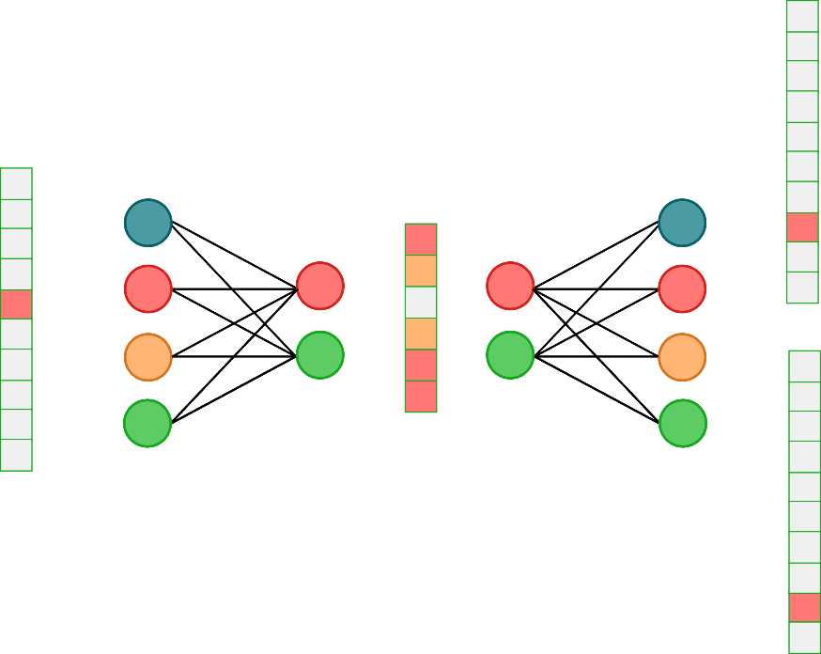
Prediction objectives can create embeddings
learn this word
Using the word; predict the context
Train over a large corpus of text
Optimise the weights of the networks to minimise the loss on the context predictions
Use the resulting embedding network to create the representations
Notes:
Slide 10 - Prediction Objectives Can Create Embeddings
**Approx. timing: 1 minute 30 seconds**
"A practical way to learn embeddings is to train a model on a prediction task.
For example, we can take a word and ask a model to predict the words around it, or take the surrounding words and ask it to predict the missing word. To do that well across a large corpus, the model needs useful internal vectors.
The embedding is then a by-product of learning to predict context. We do not need to sit down and manually specify that 'cat' and 'kitten' should be close, or that '_cell_length_a' and '_cell_length_b' are related CIF tags. If the training objective repeatedly rewards the model for using those relationships, the representation can organise itself.
That is a recurring pattern in deep learning: choose a task, train the model, and then inspect or reuse the internal representation that training produced."
**Shorten if needed:**
"This is why self-supervised learning is so powerful: the data can provide its own prediction problems."
**Transition:**
"Now that we have the representation idea, let us talk about the simplest neural network architecture we need: the MLP."
[Sources]
- Mikolov et al., Efficient Estimation of Word Representations in Vector Space, arXiv:1301.3781, 2013.
- Bengio, Courville, and Vincent, Representation Learning: A Review and New Perspectives, IEEE TPAMI 35(8), 1798-1828, 2013.

Slide 12
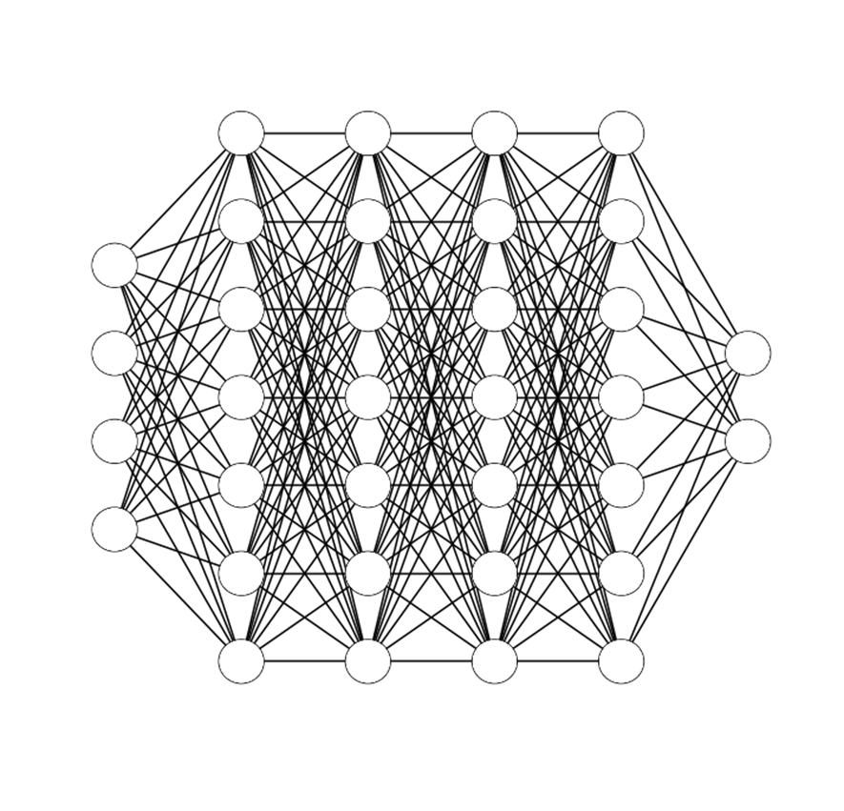
MLPs are learned vector-to-vector maps
Input layer
Output layer
Hidden layers
Notes:
Slide 11 - MLPs Are Learned Vector-to-Vector Maps
**Approx. timing: 1 minute 20 seconds**
"A multilayer perceptron, or MLP, is the cleanest first example of a neural network.
The input is a fixed-length vector. That might be a hand-crafted descriptor vector, a set of numerical features, or an embedding. The output is also a fixed-length vector. For a regression task, it might be one number. For a classification task, it might be one score per class.
Between the input and the output are hidden layers. Each hidden layer transforms the representation. So instead of thinking of the model as just a black box that outputs a label, it is useful to think of it as a sequence of representation changes.
The first layer learns one representation, the next layer learns another representation, and the final layer turns that representation into the thing we want to predict."
**Transition:**
"The basic operation inside those layers is very simple: an affine map plus a nonlinearity."
[Sources]
- Goodfellow, Bengio, and Courville, Deep Learning, MIT Press, 2016.
- CaMML MLP notebook: https://workshop.camml.ac.uk/notebooks/nn-materials/mlp-from-scratch-numpy-teaching/

Slide 13






A dense layer is affine map plus nonlinearity
Each layer applies z = Wx + b then a nonlinear activation a = g(z)
Activation function
$$x$$
Output signal
$$y=g\left(z\right)$$
$$x$$
$$y$$
Weights
Bias
$$z= w^{T}.x+b$$
$$x$$
Input signals
Notes:
Slide 12 - A Dense Layer Is Affine Map Plus Nonlinearity
**Approx. timing: 1 minute 45 seconds**
"A dense layer does two things.
First, it computes an affine transformation: z equals W x plus b. The input vector x is multiplied by a weight matrix W, and then we add a bias vector b.
The weights decide how input signals are mixed together. One output neuron might look strongly at one input feature, weakly at another, and ignore a third. The bias shifts the result up or down.
Second, we apply a nonlinear activation function: a equals g of z. This might be a sigmoid, tanh, ReLU, GELU, or another activation depending on the model.
So a dense layer is not magic. It is linear algebra followed by a nonlinear squashing or reshaping step. Deep learning gets power by composing many of these simple transformations and learning the weights from data."
**Optional link to practical:**
"In the NumPy MLP practical, this is exactly what you will see in code: matrix multiplication, bias addition, activation, loss, and gradient updates."
**Transition:**
"The nonlinearity is not decorative. It is what makes depth useful."
[Sources]
- Goodfellow, Bengio, and Courville, Deep Learning, MIT Press, 2016.
- CaMML MLP notebook: https://workshop.camml.ac.uk/notebooks/nn-materials/mlp-from-scratch-numpy-teaching/

Slide 14


WHY NONLINEARITIES MATTER
Without activations
With activations
Stacked linear maps collapse:
$$W_{3}⋅W_{2}⋅W_{1}…=W_{eff}…$$
Depth alone does not make the model nonlinear.
$$a_{l}=g\left(W_{l}a_{l−1}+b_{l}\right)$$
Composition of simple nonlinear maps can build complex decision boundaries.
This is the step from fitting a plane to learning a useful transformation of the data.
Notes:
Slide 13 - Why Nonlinearities Matter
**Approx. timing: 1 minute 20 seconds**
"If we stack linear maps without activation functions, the whole stack collapses into a single linear map.
In other words, doing W3 times W2 times W1 times x is still just some new matrix times x. We have added parameters, but we have not changed the class of functions the model can represent.
The nonlinear activation is what breaks that collapse. Once each layer applies a nonlinear transformation, the composition of layers can build much more complicated decision boundaries.
This is the step from fitting a plane to learning a useful transformation of the data. The hidden layers can bend, fold, and separate the representation so that the final prediction becomes easier."
**Shorten if needed:**
"So when we say depth matters, we really mean depth plus nonlinear composition."
**Transition:**
"But none of this learns anything unless we define what 'better' means. That is the job of the loss function."
[Sources]
- Goodfellow, Bengio, and Courville, Deep Learning, MIT Press, 2016.

Slide 15
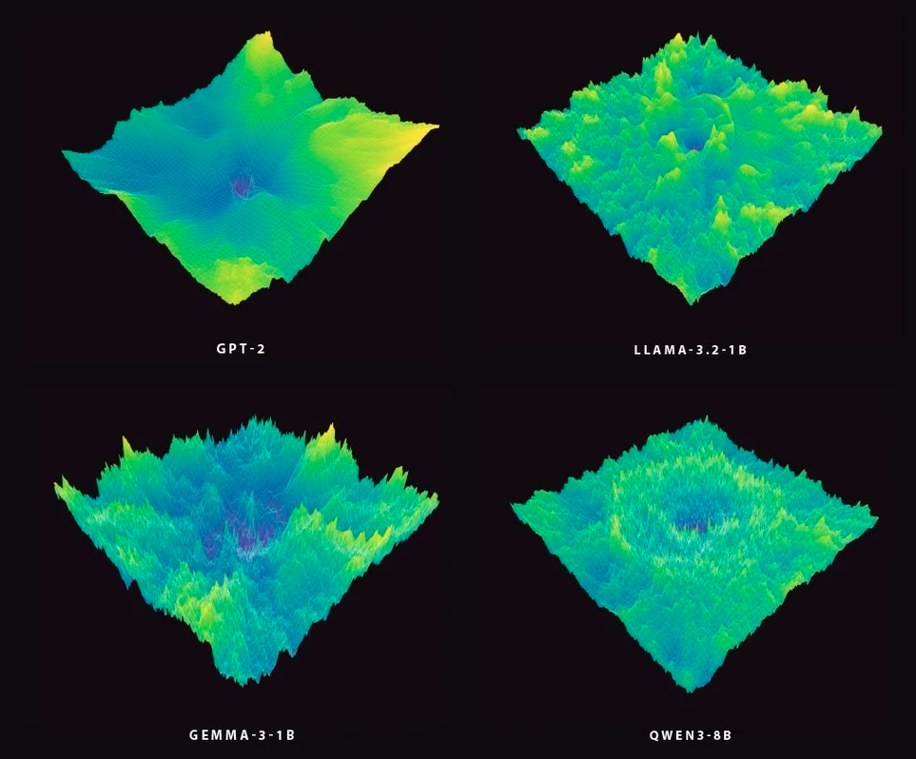
LOSS FUNCTIONS TURN LEARNING INTO OPTIMISATION
1
Model
2
Loss
make a prediction
measure the error
3
Gradient
4
Update
ask how each parameter affects it
step downhill
Welch labs - Youtuber
Notes:
Slide 14 - Loss Functions Turn Learning into Optimisation
**Approx. timing: 1 minute 45 seconds**
"Training a neural network needs a scalar objective. That scalar is the loss.
The loop is conceptually simple. First, the model makes a prediction. Second, the loss measures how wrong that prediction is. Third, we compute gradients: we ask how changing each parameter would change the loss. Fourth, we update the parameters by taking a small step in the direction that should reduce the loss.
For the MLP practical, the task is binary classification on a simple two-moons dataset. The loss is binary cross-entropy, and the optimiser is plain gradient descent. That is deliberately simple so you can see all the moving pieces.
In larger models, the same idea remains. The loss might be next-token cross-entropy, and the optimiser might be AdamW rather than plain gradient descent, but the conceptual loop is still prediction, loss, gradient, update."
**Audience prompt:**
"So whenever you see a deep learning paper, it is worth asking: what exactly is the model being rewarded for?"
**Transition:**
"The efficient way to compute those gradients is backpropagation."
[Sources]
- Goodfellow, Bengio, and Courville, Deep Learning, MIT Press, 2016.
- CaMML MLP notebook: https://workshop.camml.ac.uk/notebooks/nn-materials/mlp-from-scratch-numpy-teaching/

Slide 16





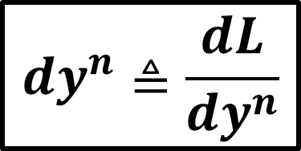



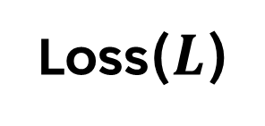




Backpropagation is efficient chain rule
$$y^{1}$$
$$y^{2}$$
$$y^{3}$$
$${dw}^{1}$$
$${dw}^{2}$$
$${dw}^{3}$$
Loss($L$)
$${db}^{1}$$
$${db}^{2}$$
$${db}^{3}$$
$${dy}^{1}$$
$${dy}^{2}$$
$${dy}^{3}$$
$${dy}^{n}≜\frac{dL}{dy^{n}}$$
Notes:
Slide 15 - Backpropagation Is Efficient Chain Rule
**Approx. timing: 1 minute 45 seconds**
"Backpropagation often sounds like a special neural-network trick, but the core idea is just the chain rule from calculus, organised efficiently.
A neural network is a composed function. Layer one produces an output. Layer two uses that output. Layer three uses that output, and eventually we compute a loss. If we want to know how a weight in an early layer affects the loss, we need to chain together all the downstream effects.
The diagram is showing that information flowing forward creates intermediate activations, and the gradient flowing backward tells each layer how its weights and biases contributed to the final loss.
Modern frameworks like PyTorch and JAX do this automatically. You do not usually write backprop by hand. But conceptually, this is what training is: using the chain rule to assign credit or blame to every parameter."
**Shorten if needed:**
"That is the engine that lets millions or billions of parameters be trained from one scalar loss."
**Transition:**
"So far, everything has assumed a fixed-length input vector. That assumption breaks very quickly when we move to language and CIFs."
[Sources]
- Rumelhart, Hinton, and Williams, Learning representations by back-propagating errors, Nature 323, 533-536, 1986.
- Goodfellow, Bengio, and Courville, Deep Learning, MIT Press, 2016.

Slide 17
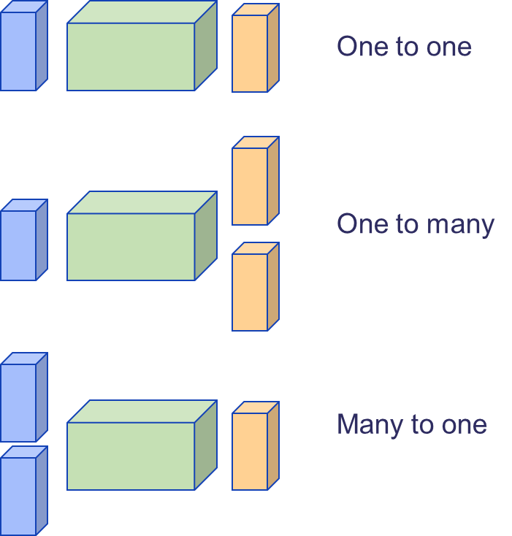
Sequences break the fixed-vector assumption
MLPs expect fixed-size inputs.
Sequences vary in length, order matters, and predictions depend on context.
Notes:
Slide 16 - Sequences Break the Fixed-Vector Assumption
**Approx. timing: 1 minute 20 seconds**
"MLPs expect fixed-size inputs. If the input vector has length 100, the weight matrix is built for length 100. If tomorrow the input has length 137, that same layer does not directly apply.
But text, code, proteins, trajectories, and CIF files are variable-length ordered objects. A CIF can be short or long. A sentence can be short or long. More importantly, order matters. The same tokens in a different order can mean something different.
Predictions also depend on context. The meaning of a token is not just the token itself; it is shaped by what came before and what surrounds it.
So we need architectures that can handle variable length, order, and context."
**Transition:**
"It helps to name the different shapes of sequence problem."
[Sources]
- Goodfellow, Bengio, and Courville, Deep Learning, MIT Press, 2016.
- Elman, Finding Structure in Time, Cognitive Science 14(2), 179-211, 1990.

Slide 18
NEURAL MODELS DIFFER BY DATA SHAPE
Choose the architecture by asking what shape of information must be read and produced.
Data shape
Learning task
Workshop example
fixed vector -> label
classification / regression
two-moons MLP, property prediction
sequence -> label
classification from ordered tokens
materials class or validity label
sequence -> sequence
translate or transform sequences
translation, structured output
previous tokens -> next token
autoregressive generation
LLMs and CIF generation
Notes:
Slide 17 - Neural Models Differ by Data Shape
**Approx. timing: 1 minute 45 seconds**
"This table is a map of task shapes.
The first row is fixed vector to label. This is the MLP setting: a descriptor vector goes in, and we predict a class or a number. In the practical, that is the two-moons classifier. In materials, it might be property prediction from descriptors.
The second row is sequence to label. Here the input is ordered and variable length, but the output is one label. For example, we could take a tokenised material description and classify validity or material type.
The third row is sequence to sequence. This is translation-like: an input sequence is transformed into an output sequence.
The final row is the one we need for language models: previous tokens to next token. This is autoregressive modelling. The model learns to predict the next token from the tokens it has already seen."
**Optional add:**
"Once you can recognise the data shape, the architecture choice makes much more sense."
**Transition:**
"Historically, one of the main ways to handle sequences was the recurrent neural network."
[Sources]
- Goodfellow, Bengio, and Courville, Deep Learning, MIT Press, 2016.
- Elman, Finding Structure in Time, Cognitive Science 14(2), 179-211, 1990.
- Vaswani et al., Attention Is All You Need, NeurIPS 2017; arXiv:1706.03762.

Slide 19
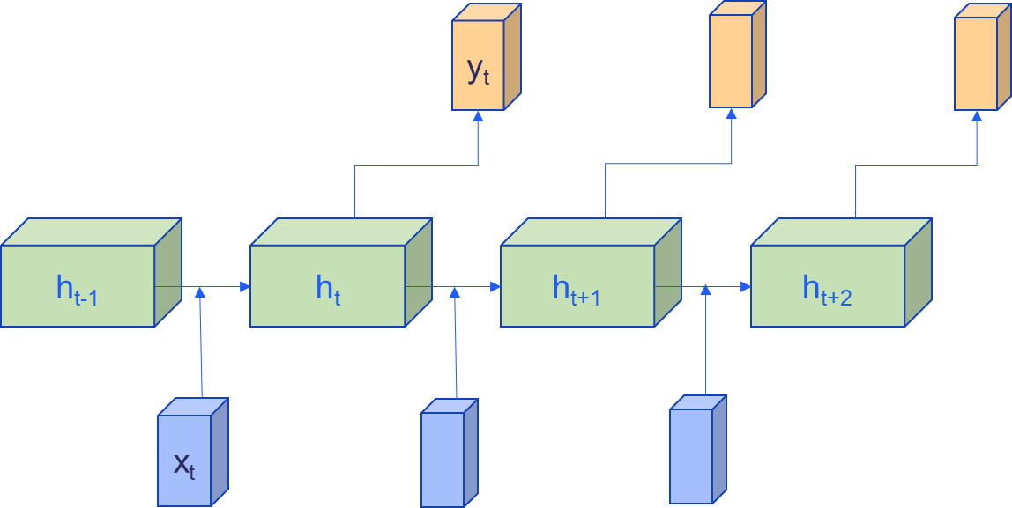

RNNs carry context in a hidden state
$$h_{t}=f_{w}(W_{hh}h_{t−1},W_{xh}x_{t})$$
Notes:
Slide 18 - RNNs Carry Context in a Hidden State
**Approx. timing: 1 minute 20 seconds**
"A recurrent neural network processes a sequence one token at a time.
At each time step, it receives the current input token, x_t, and it also receives a hidden state from the previous time step, h_{t-1}. It combines those to produce a new hidden state, h_t, and often an output, y_t.
The hidden state is the model's running memory. It is how information from earlier tokens can influence later predictions.
This is an elegant idea. The same set of weights is reused at each position, so the model can in principle process sequences of different lengths. It does not need a separate parameter for position one, position two, position three, and so on."
**Shorten if needed:**
"The tradeoff is that all past information has to be compressed into that evolving hidden state."
**Transition:**
"That compression becomes the pressure point."
[Sources]
- Elman, Finding Structure in Time, Cognitive Science 14(2), 179-211, 1990.

Slide 20
Long-range context is the pressure point
RNNs compress context into one evolving state.
LSTMs and GRUs help, but distant context can still be hard to retain.
The clouds are in the ________. ✓
I was born in France. At the age of 16 I moved country. I have lived here since I was 21. Nonetheless, I still speak fluent _______. ✗
Notes:
Slide 19 - Long-Range Context Is the Pressure Point
**Approx. timing: 1 minute 35 seconds**
"For very local context, recurrent models can work nicely.
If I say, 'The clouds are in the blank,' you can probably guess 'sky' without needing much long-range memory.
But now look at the second example. 'I was born in France. At the age of 16 I moved country. I have lived here since I was 21. Nonetheless, I still speak fluent blank.' The answer is probably 'French', and the relevant clue is far back at the beginning of the sentence.
For an RNN, the information about France has to survive through the hidden state across many time steps. Nearby information can overwrite or dilute it. Gradients can also become difficult over long chains.
This is not just a natural language problem. In CIFs, information near the top of the file can constrain what should happen much later: symmetry, species, cell parameters, coordinates, and consistency checks."
**Transition:**
"LSTMs and GRUs were designed to improve exactly this kind of recurrent memory."
[Sources]
- Elman, Finding Structure in Time, Cognitive Science 14(2), 179-211, 1990.
- Hochreiter and Schmidhuber, Long Short-Term Memory, Neural Computation 9(8), 1735-1780, 1997.

Slide 21
LSTMS AND GRUS ADD GATES, BUT REMAIN SEQUENTIAL
Keep
Forget
Write
A gate can preserve useful information over many time steps.
A gate can suppress information that no longer helps the prediction.
A gate can decide what new information enters the hidden state.
This improves recurrent memory, but the model still processes tokens step by step.
Notes:
Slide 20 - LSTMs and GRUs Add Gates, but Remain Sequential
**Approx. timing: 1 minute 25 seconds**
"LSTMs (Long Short-Term Memory) and GRUs (Gated-Recurrent) are gated recurrent architectures.
The idea is that the model should not treat every new token equally. It should learn when to keep information, when to forget information, and when to write new information into the hidden state.
A keep gate can preserve useful information over many time steps. A forget gate can suppress information that no longer helps. A write gate can decide what new information enters memory.
These gates are extremely useful, and LSTMs and GRUs were a major step forward for sequence modelling.
But they still process tokens step by step. The path from an early token to a late token still runs through a long chain of recurrent updates. That is the bottleneck that attention will address."
**Shorten if needed:**
"So the story is not 'RNNs bad'. The story is 'RNNs reveal why flexible access to context is valuable'."
**Transition:**
"Before attention, though, we need one more idea: autoregressive generation."
[Sources]
- Hochreiter and Schmidhuber, Long Short-Term Memory, Neural Computation 9(8), 1735-1780, 1997.
- Cho et al., Learning Phrase Representations using RNN Encoder-Decoder for Statistical Machine Translation, EMNLP 2014.

Slide 22
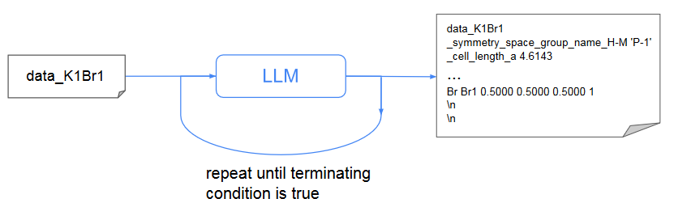
Autoregressive models turn sequences into generation
Training:
learn p(next token | previous tokens)
Generation:
sample one token, append it, repeat
For CIFs, the generated text is a candidate crystal structure.
p(sequence) = p(x1) p(x2 | x1) ... p(xT | x1, ..., xT-1)
Notes:
Slide 21 - Autoregressive Models Turn Sequences into Generation
**Approx. timing: 2 minutes**
"Autoregressive modelling is the key bridge from prediction to generation.
The model learns a conditional probability: the probability of the next token given the previous tokens. So during training, we give it a sequence and repeatedly ask: given everything up to this point, what should come next?
Mathematically, this factorises the probability of the whole sequence into a product of next-token probabilities. The first token has some probability. The second token is conditioned on the first. The third token is conditioned on the first two, and so on until the end of the sequence.
During generation, we run that process forward. We provide a starting context, the model predicts a distribution over possible next tokens, we sample or choose one token, append it to the context, and repeat.
That simple loop is how a language model writes text. And for CIFs, the generated text is a candidate crystal structure."
**Optional add:**
"The word 'candidate' is important. Generation gives us a proposed structure, not a guarantee that it is syntactically valid, chemically sensible, or thermodynamically stable."
**Transition:**
"That leads to an important distinction between training and generation."
[Sources]
- Goodfellow, Bengio, and Courville, Deep Learning, MIT Press, 2016.
- Antunes, Butler, and Grau-Crespo, Crystal structure generation with autoregressive large language modeling, Nature Communications 15, 10570, 2024.

Slide 23
TRAINING AND GENERATION ARE RELATED BUT NOT IDENTICAL
Training
Generation
Validation
The model sees correct previous tokens and learns to predict the next one.
The model samples a token, appends it, and must condition on its own output.
Syntax, distances, charge balance, symmetry, and energy filters become important.
Notes:
Slide 22 - Training and Generation Are Related but Not Identical
**Approx. timing: 1 minute 45 seconds**
"Training and generation use the same model, but they are not the same situation.
During training, the model usually sees correct previous tokens from the dataset. It is asked to predict the next token at each position, and the loss compares its prediction with the true next token. This is sometimes called teacher forcing.
During generation, the model has to condition on its own previous outputs. If it makes a slightly odd choice early on, that choice becomes part of the context for later choices. Small errors can compound.
That is why validation is so important for generated structures. A generated CIF might look plausible as text but fail syntax checks. It might parse but have unreasonable interatomic distances. It might satisfy some local patterns but fail charge balance, symmetry expectations, or energetic plausibility.
So generated text is not automatically a good material. It is an input to a scientific filtering and validation pipeline."
**Transition:**
"Now we can say why CIFs are a natural target for this kind of model."
[Sources]
- Goodfellow, Bengio, and Courville, Deep Learning, MIT Press, 2016.
- Antunes, Butler, and Grau-Crespo, Crystal structure generation with autoregressive large language modeling, Nature Communications 15, 10570, 2024.

Slide 24
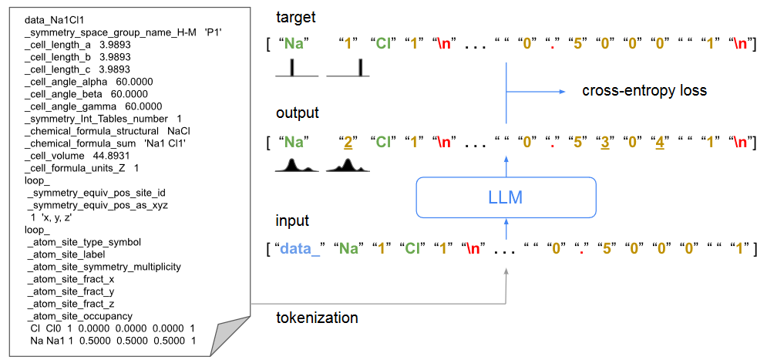
CIFs can be treated as a language
A decoder only transformer trained on cif files for materials structure generation
Nature Communications 15, 1 (2024)
Notes:
Slide 23 - CIFs Can Be Treated as a Language
**Approx. timing: 2 minutes**
"A CIF file is not natural language, but it is structured text.
On the left, you can see a small CIF-like example. It has tags, cell lengths, cell angles, symmetry information, formula information, loops, atom labels, element symbols, fractional coordinates, and occupancies.
On the right, the same idea is viewed as a token prediction problem. The CIF is tokenised. The model receives a sequence of tokens as input. It predicts a probability distribution over the next token. The training target is the actual next token from the data, and the loss is cross-entropy.
CrystaLLM uses this idea: a decoder-only transformer trained on CIF files for crystal structure generation. It is conceptually close to ordinary language modelling, but the domain is scientific structured text rather than prose.
The powerful bet is that, by learning the patterns in many CIFs, the model can learn both syntax-like regularities and some chemistry-like regularities."
**Optional add:**
"Again, that does not remove the need for validation. It means we can generate structured candidates in a way that is informed by the training distribution."
**Transition:**
"To see what the model has to learn, it helps to look at what tokenisation contains."
[Sources]
- Hall, Allen, and Brown, The Crystallographic Information File (CIF): a new standard archive file for crystallography, Acta Crystallographica A47, 655-685, 1991.
- Antunes, Butler, and Grau-Crespo, Crystal structure generation with autoregressive large language modeling, Nature Communications 15, 10570, 2024.

Slide 25
CIF TOKENISATION CARRIES SCIENTIFIC STRUCTURE
1
CIF tags
_cell_length_a, _symmetry_space_group_name
2
Chemical symbols
Ba, Ti, O, Br, K, ...
3
Numbers
cell lengths, angles, fractional coordinates
4
Punctuation / layout
loops, line breaks, separators
5
Local context
which fields tend to appear together
Notes:
Slide 24 - CIF Tokenisation Carries Scientific Structure
**Approx. timing: 1 minute 45 seconds**
"When we tokenise a CIF, we are not just chopping up arbitrary text.
Some tokens are CIF tags, like _cell_length_a or symmetry-related fields. These tell the model what kind of information is expected next.
Some tokens are chemical symbols: Ba, Ti, O, Br, K, and so on. These carry chemical identity.
Some tokens are numbers: cell lengths, angles, fractional coordinates, occupancies. Numbers are tricky for language models because they are both symbols in the text and quantities in the world.
Some tokens are punctuation and layout: loops, line breaks, separators. These are part of the syntax that makes the file parseable.
And then there is local context: which fields tend to appear together, what order they appear in, and which combinations are plausible.
So CIF language is constrained. It is text, but it is text with scientific structure."
**Shorten if needed:**
"This is why it is plausible to train a language model on CIFs, and also why we need domain-aware checks afterwards."
**Transition:**
"At this point we have arrived at the need for a better way to use context. That is where attention enters."
[Sources]
- Hall, Allen, and Brown, The Crystallographic Information File (CIF): a new standard archive file for crystallography, Acta Crystallographica A47, 655-685, 1991.
- Antunes, Butler, and Grau-Crespo, Crystal structure generation with autoregressive large language modeling, Nature Communications 15, 10570, 2024.

Slide 26
Attention selects relevant context
High attention
Low attention
She is eating a green apple.
Attention answers: which other tokens are relevant for this token right now?
Notes:
Slide 25 - Attention Selects Relevant Context
**Approx. timing: 1 minute 20 seconds**
"The intuition for attention is simple: for this token, which other tokens are relevant right now?
In the sentence on the slide, if the model is interpreting 'apple', the word 'green' is probably relevant. The word 'eating' may also be relevant. Other tokens may matter less for that immediate decision.
Attention gives the model a way to assign different weights to different context tokens. Instead of forcing all past information through one recurrent hidden state, a token can look back across the context and select what it needs.
This is the idea that unlocks transformers. The details matter, but the motivation is this: flexible access to relevant context."
**Important boundary:**
"I am deliberately keeping this at the intuition level, because Joley is going to do the mechanism properly."
**Transition:**
"The terms Joley will use are queries, keys, and values."
[Sources]
- Vaswani et al., Attention Is All You Need, NeurIPS 2017; arXiv:1706.03762.

Slide 27
THE HANDOFF: QUERIES, KEYS, AND VALUES
Query
Key
Value
What information is this token looking for?
What information does another token advertise?
What information is actually passed forward?
Joley will turn this intuition into the scaled dot-product attention equation.
Notes:
Slide 26 - The Handoff: Queries, Keys, and Values
**Approx. timing: 1 minute 20 seconds**
"Here is the vocabulary for the handoff.
A query represents what the current token is looking for. A key represents what another token advertises about itself. A value represents the information that is actually passed forward if that token is attended to.
The attention mechanism compares queries and keys to decide relevance, then uses those scores to combine values. In the transformer, this happens many times, in many heads, across many layers.
You do not need to memorise the equation yet. The useful intuition is: each token constructs a question, compares it against the keys of other tokens, and then gathers information from the values.
Joley will turn that intuition into scaled dot-product attention, softmax weights, multi-head attention, and transformer blocks."
**Transition:**
"So the bridge from this section to the next is now complete."
[Sources]
- Vaswani et al., Attention Is All You Need, NeurIPS 2017; arXiv:1706.03762.

Slide 28
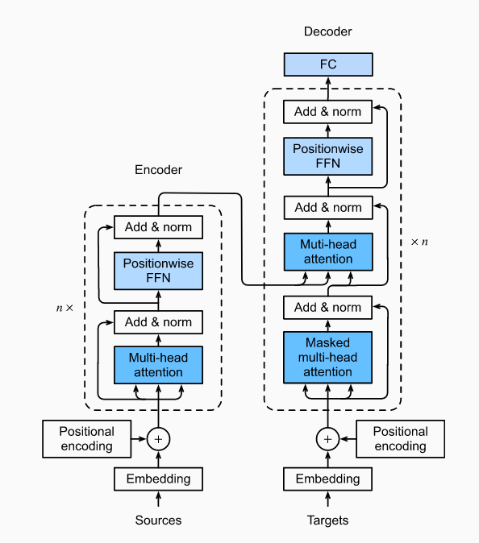
Over to transformers and CrystaLLM
Joley picks up from here:
attention -> transformer blocks -> CIF tokens -> pretrained CrystaLLM generation
Notes:
Slide 27 - Over to Transformers and CrystaLLM
**Approx. timing: 40 seconds**
"This is the point where Joley takes over.
We have built the ingredients: learned representations, embeddings, training by gradients, sequence models, autoregressive next-token prediction, and the need for flexible context.
Joley will now take the attention idea and build it into transformer blocks. Then she will connect those blocks to CIF tokens and pretrained CrystaLLM generation.
So mentally, keep this chain in mind: representation learning gives us embeddings; sequence modelling gives us next-token prediction; attention gives each token access to useful context; transformers package that into the architecture used by modern language models."
**Transition:**
"Before I hand over, I will close with the five takeaways from part 1."
[Sources]
- Vaswani et al., Attention Is All You Need, NeurIPS 2017; arXiv:1706.03762.
- Antunes, Butler, and Grau-Crespo, Crystal structure generation with autoregressive large language modeling, Nature Communications 15, 10570, 2024.

Slide 29
PART 1 TAKEAWAYS
1
Deep learning learns representations, not just labels.
2
Embeddings are learned vectors whose geometry matters.
3
Training is loss minimisation by gradients.
4
Sequences need architectures that handle order and context.
5
Autoregressive models generate by repeated next-token prediction.
Next: attention gives every token a controlled way to use the rest of the sequence.
Notes:
Slide 28 - Part 1 Takeaways
**Approx. timing: 1 minute 20 seconds**
"The five things I want to stay in working memory are these.
First, deep learning learns representations, not just labels. A lot of the power is in the internal vectors the model learns to build.
Second, embeddings are learned vectors whose geometry matters. The individual dimensions do not need to be human-interpretable for the vector space to be useful.
Third, training is loss minimisation by gradients. The model predicts, the loss scores the error, backpropagation computes gradients, and the optimiser updates parameters.
Fourth, sequences need architectures that handle order and context. Fixed-length MLPs are a starting point, but language and CIFs are variable-length ordered data.
Fifth, autoregressive models generate by repeated next-token prediction. For CIFs, that turns a language model into a generator of candidate crystal structures.
The next section starts from the final line: attention gives every token a controlled way to use the rest of the sequence."
**Closing handoff:**
"With that, I will hand over to Joley for attention, transformers, and CrystaLLM."
[Sources]
- Goodfellow, Bengio, and Courville, Deep Learning, MIT Press, 2016.
- Bengio, Courville, and Vincent, Representation Learning: A Review and New Perspectives, IEEE TPAMI 35(8), 1798-1828, 2013.
- Vaswani et al., Attention Is All You Need, NeurIPS 2017; arXiv:1706.03762.
- Antunes, Butler, and Grau-Crespo, Crystal structure generation with autoregressive large language modeling, Nature Communications 15, 10570, 2024.

