Slide 1
Introduction to LLMs

Slide 2
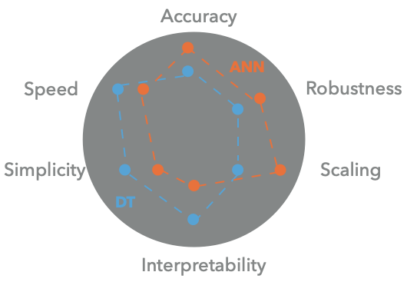
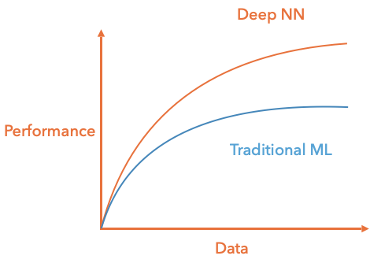
CLASSICAL/DEEP METHODS
Classical: linear regression, trees etc..
Deep: neural network type models
Notes:
Classical ML:
Linear regression, kernel methods, trees, random forests
Typically shallow models
Strong reliance on hand-crafted features
Deep learning:
Neural-network-based models
Typically many layers (depth)
Features and predictor learned jointly from data
Key distinction is not just depth, but representation learning
Key takeaway:
Deep learning reduces reliance on human-designed features by learning representations
directly from data

Slide 3
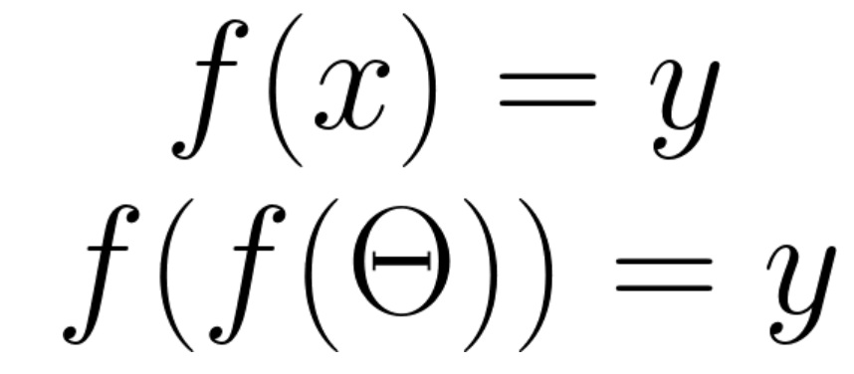
DEEP LEARNING AS REPRESENTATION LEARNING
“Hand-crafted” features
Classical ML
Deep learning
Unstructured data
Notes:
Traditional ML pipeline:
Raw data → feature engineering → ML model
Feature engineering:
Requires strong domain knowledge
Often brittle and task-specific
Unstructured data (images, text, audio):
Feature design is particularly difficult
Deep learning:
Learns useful representations automatically
End-to-end optimisation of features + task
Key takeaway:
Deep learning shifts effort from feature engineering to data and model design.

Slide 4

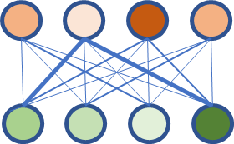

DEEP LEARNING AS REPRESENTATION LEARNING
Deep learning
Classification model
Cat/Snake
Classical ML
Number of eyes | 2
Whiskers | N
Legs | N
…
Scales | Y
Notes:
Classical ML approach:
Decide a priori which features matter (edges, shapes, textures)
Deep learning approach:
Start from raw pixels
Learn a hierarchy of features optimised for the task
Representations are:
Task-specific
Learned jointly with the classifier
Key takeaway:
Representation learning enables models to discover what matters for a task, rather than being
told.

Slide 5
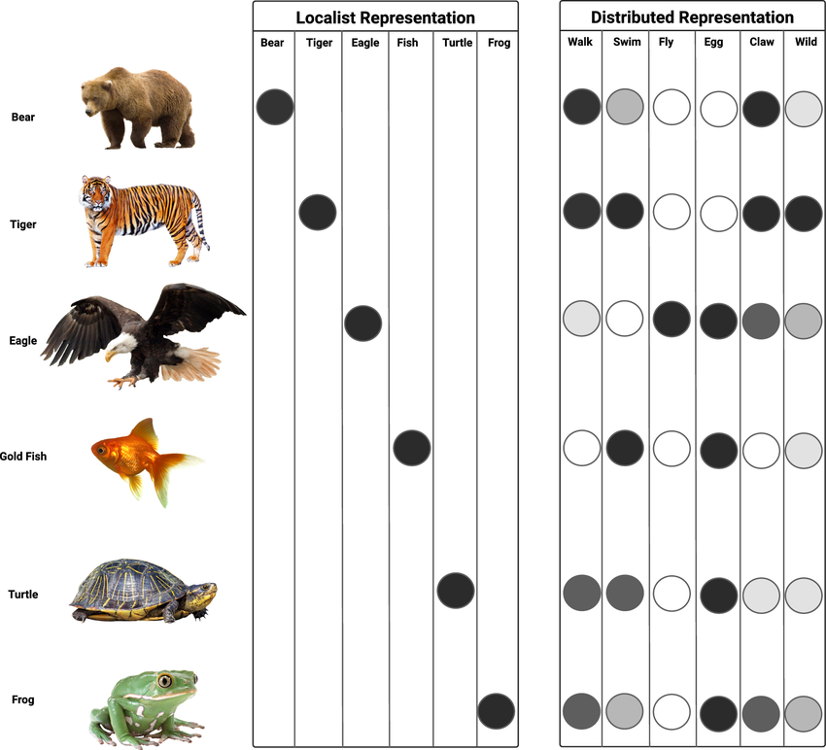
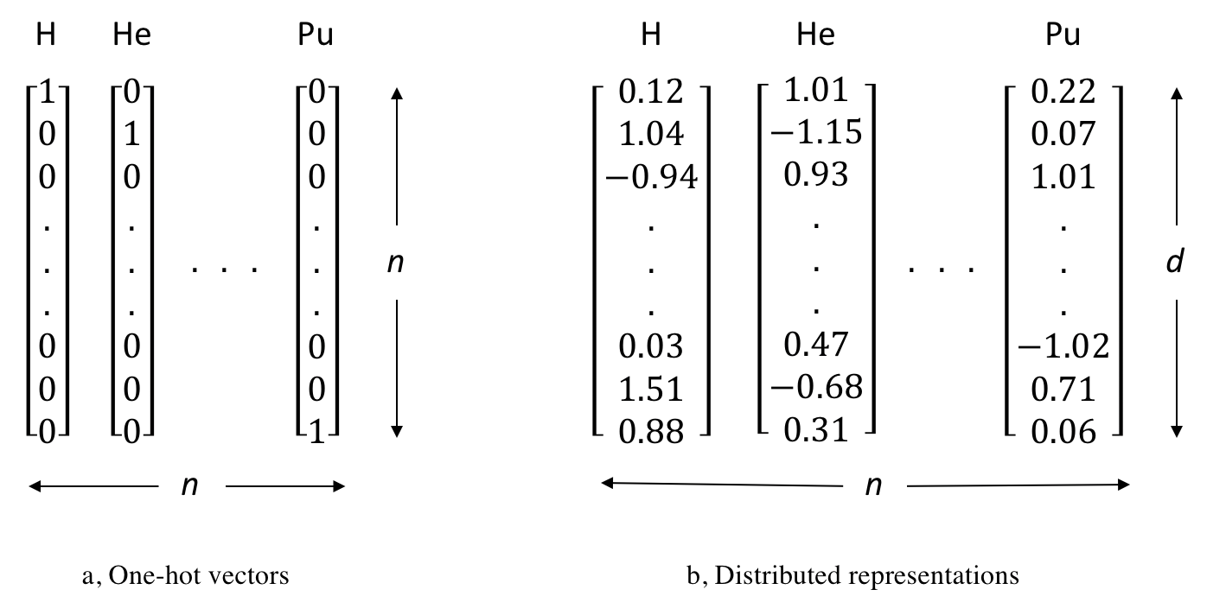
Localised or distributed representations?
Distributed representations give a richer context of the data
Neural Comput & Applic 36, 12809, 2024

Slide 6

Learning distributed representations
The distributional hypothesis – Firth 1957
“You know a word by the company it keeps.”
Marianne saw a furry little wampamink hiding in the tree.

Slide 7
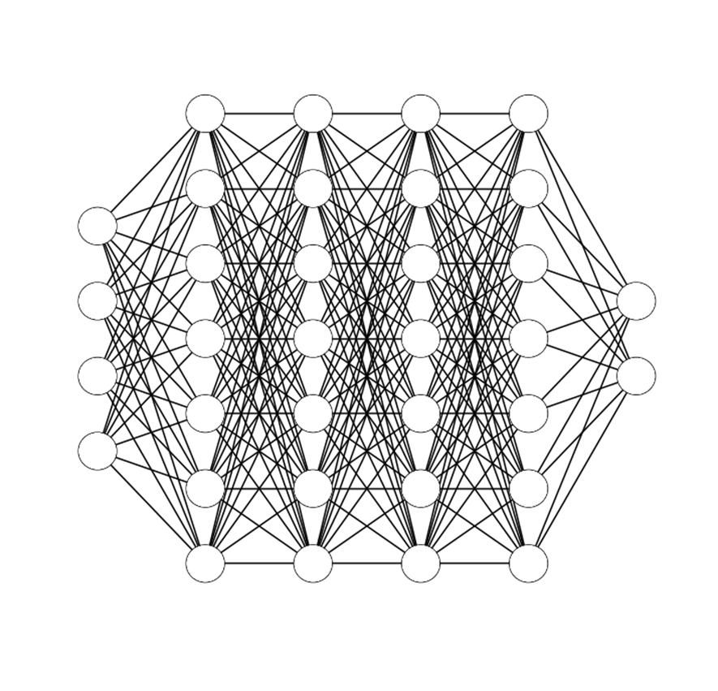
DEEP NEURAL NETWORKS: MULTI LAYER PERCEPTRON
Input layer
Output layer
Hidden layers
Notes:
Core architecture:
Input layer
One or more hidden layers
Output layer
Each layer:
Applies a linear transformation
Followed by a non-linear activation
Depth allows:
Composition of simple functions
Approximation of highly complex mappings
Key takeaway:
Depth enables expressive function approximation through composition.

Slide 8






DENSE LAYERS
Also called fully connected layers as each node is connected to each node in the previous layer
$$x$$
Activation function
$$y=g\left(z\right)$$
Output signal
$$x$$
$$y$$
$$z= w^{T}.x+b$$
Bias
$$x$$
Weights
Input signals
Notes:
Also called fully connected layers
Every neuron connects to every neuron in the previous layer
Each neuron computes:
Weighted sum of inputs
Bias term
Activation function
Advantages:
Simple
Flexible
Disadvantages:
Poor scaling with input size
Large number of parameters

Slide 9





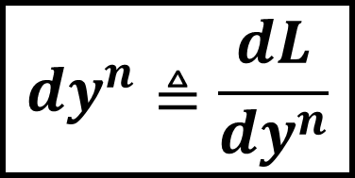



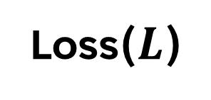




BACK PROPAGATION
$$y^{1}$$
$$y^{2}$$
$$y^{3}$$
$${dw}^{1}$$
$${dw}^{2}$$
$${dw}^{3}$$
Loss($L$)
$${db}^{1}$$
$${db}^{2}$$
$${db}^{3}$$
$${dy}^{1}$$
$${dy}^{2}$$
$${dy}^{3}$$
$${dy}^{n}≜\frac{dL}{dy^{n}}$$
Notes:
Core learning algorithm for neural networks
Uses the chain rule to compute gradients of the loss:
With respect to every parameter
Enables:
Efficient training of deep, multi-layer models
In practice:
Handled automatically by frameworks (e.g. PyTorch)
Conceptual understanding more important than derivation
Key takeaway:
Backpropagation makes deep learning tractable.

Slide 10
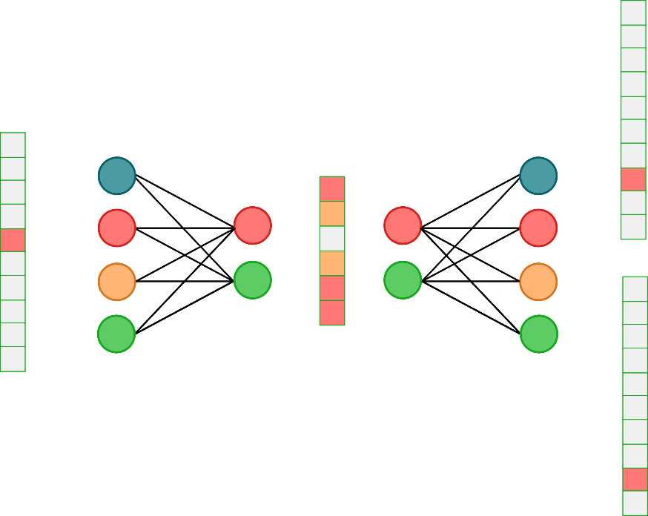
How to make a distributed representation?
learn this word
Using the word; predict the context
Train over a large corpus of text
Optimise the weights of the networks to minimise the loss on the context predictions
Use the resulting embedding network to create the representations

Slide 11
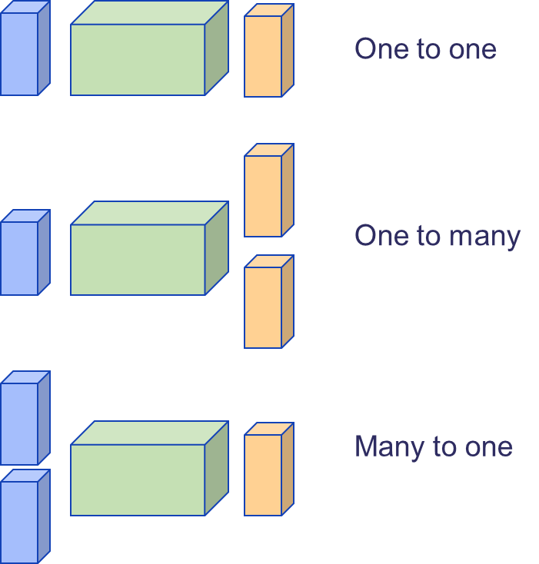
Sequence data
MLPs and CNNs struggle with sequence data. There is no fixed length of input, the data can be many to one.

Slide 12
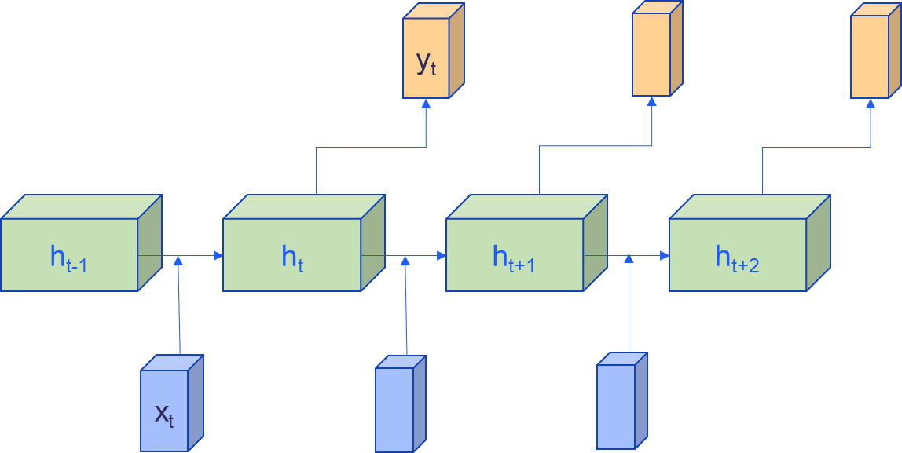

Recurrent Neural Networks (RNNs)
$$h_{t}=f_{w}(W_{hh}h_{t−1},W_{xh}x_{t})$$

Slide 13
Issues with RNNs
RNNs have very short term memory – they lose context quickly
The clouds are in the ________. ✓
I was born in France. At the age of 16 I moved country. I have lived here since I was 21. Nonetheless, I still speak fluent _______. ✗

Slide 14
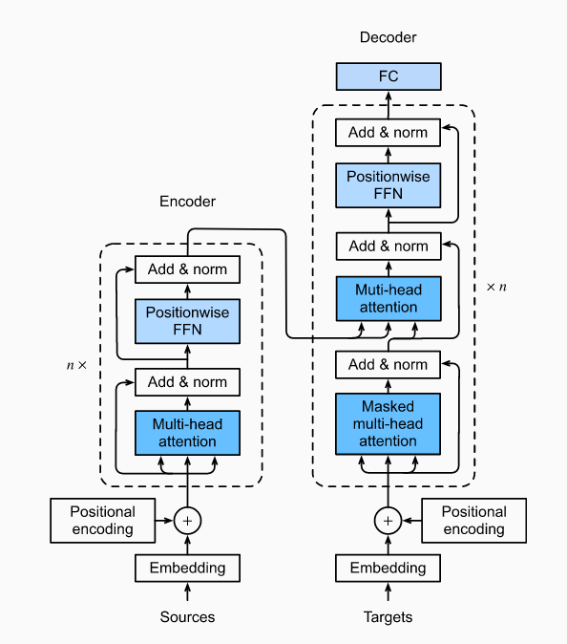
transformers
student
Je suis etudiant
I am a
Notes:
Don’t learn from the input sequentially
The attention mechanism
Process all input at the same time
Learn dependencies between segments
TALK ABOUT TOKENS

Slide 15
The attention mechanism
High attention
Low attention
She is eating a green apple.
We use attention to “focus” on some part of interest in an input
Notes:
In sequence modeling problems, we can use attention between input and output tokens (between encoder and decoder parts), as well as among the inputs only (only within the encoder part)

Slide 16
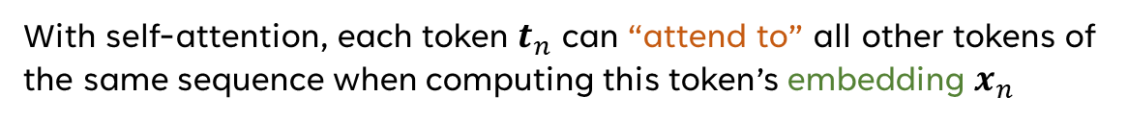
Self-attention
With self-attention, each token $t_{n}$ can “attend to” all other tokens of the same sequence when computing this token’s embedding $x_{n}$

Slide 17
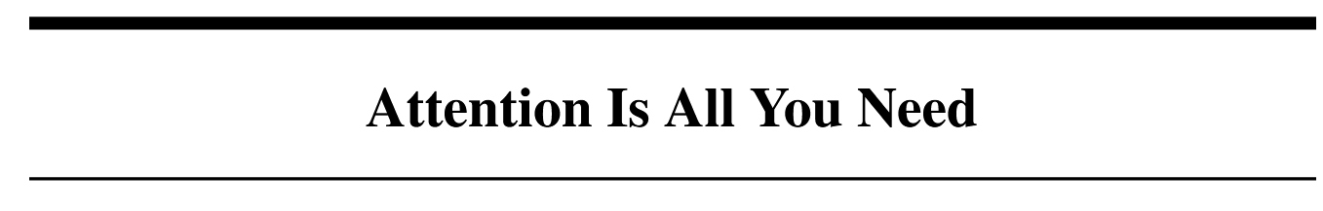
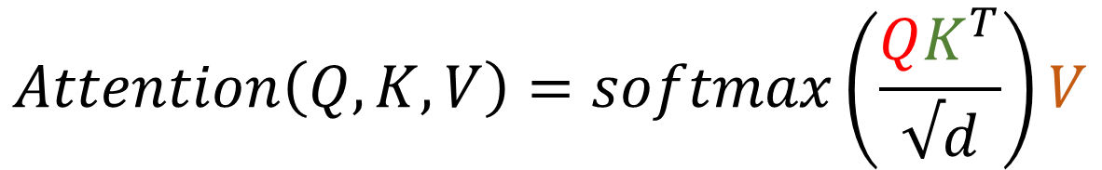
How self-attention works
$$Attention\left(Q,K,V\right)=softmax\left(\frac{QK^{T}}{√d}\right)V$$
Based of the concept of query, key and value vectors
arXiv:1706.03762 (2017)

Slide 18

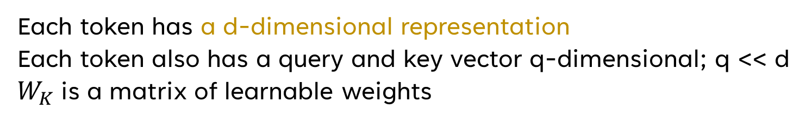



Attention – the inputs
Each token has a d-dimensional representation
Each token also has a query and key vector q-dimensional; q << d
$W_{K}$is a matrix of learnable weights
$$⋅$$
$$=$$
$$⋅$$
$$=$$
$$\vec{x_{i}}⋅W_{Q}=\vec{Q_{i}}$$
$$\vec{x_{i}}⋅W_{K}={\vec{K}}_{i}$$
In bed an old woman lies.
Notes:
Tells us which tokens are relevant to which other tokens

Slide 19



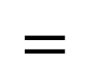
Query Key multiplication
$$softmax\left(\frac{QK^{T}}{√d}\right)$$
In bed an old woman lies.
$$Q$$
$$K^{T}$$
$$=$$
Key, query pairs with large attention.
Softmax normalises the columns; root of d makes it numerically stable
NOTE –in this case each cube in Q and K has 3 dimensions
Notes:
Tells us which tokens (keys) are relevant to which other tokens (queries)
Here our context window is only 3 elements long, so the matrix is small
In real systems there is a move towards very large context – it results in very large matrices
Talk about sparse methods

Slide 20
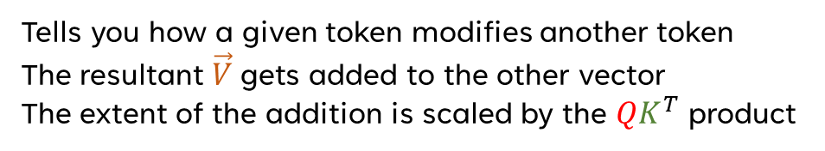


The value matrix
Tells you how a given token modifies another token
The resultant $\vec{V}$gets added to the other vector
The extent of the addition is scaled by the $QK^{T}$ product
$$⋅$$
$$=$$
In ---- an old woman lies.
bed
court
$$\vec{x_{i}}⋅W_{V}=\vec{V_{i}}$$
Notes:
Note this matrix is square – so the new vector has the same dimension as the embedding vector
In reality this is split into product of smaller matrices to increase efficiency

Slide 21
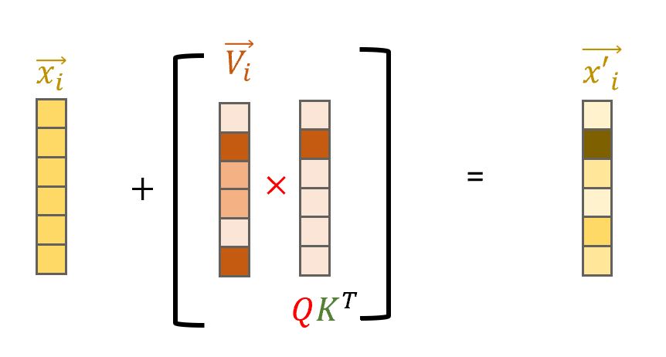
Adding the value to the embedding
lies
lies
The value is modified by the attention from the QK pair and added to the initial embedding

Slide 22

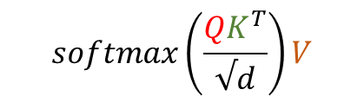

Updating the embeddings
$$softmax\left(\frac{QK^{T}}{√d}\right)V$$
$$E′$$
$$E$$
Each of these softmax matrix multiplications is a ‘head’
Notes:
Multi-head attention looks at different ways that tokens affect eachother.

Slide 23
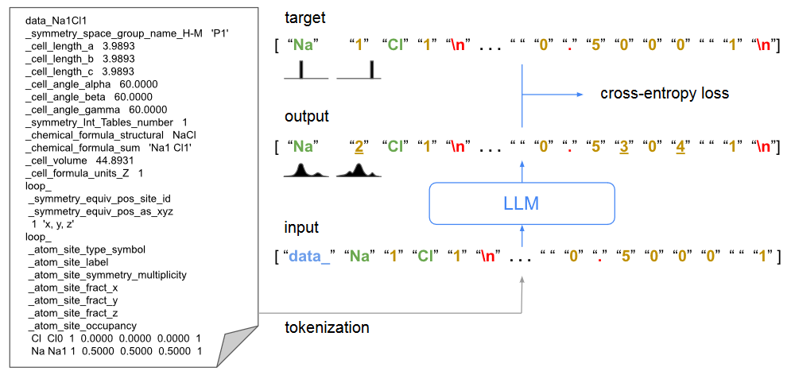
crystallm
A decoder only transformer trained on cif files for materials structure generation
Nature Communications 15, 1 (2024)
Notes:
CrystaLLM is trained on a database of 2.3M cifs
The decoder takes a string of text and predicts the next word/letter – this is called autoregressive
Trained by comparing output probabilities to true tokens

Slide 24
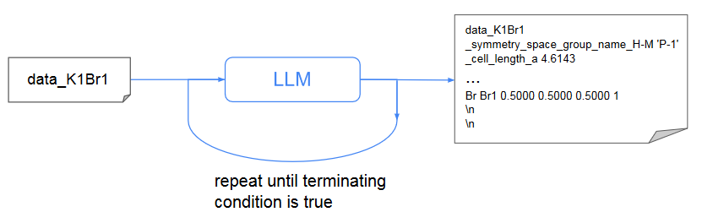
Autoregressive generation
After training, CrystaLLM can be prompted with new text and can produce a predicted complete cif
Prompting is flexible so we can provide as little or as much information as we like
Nature Communications 15, 1 (2024)

Slide 25
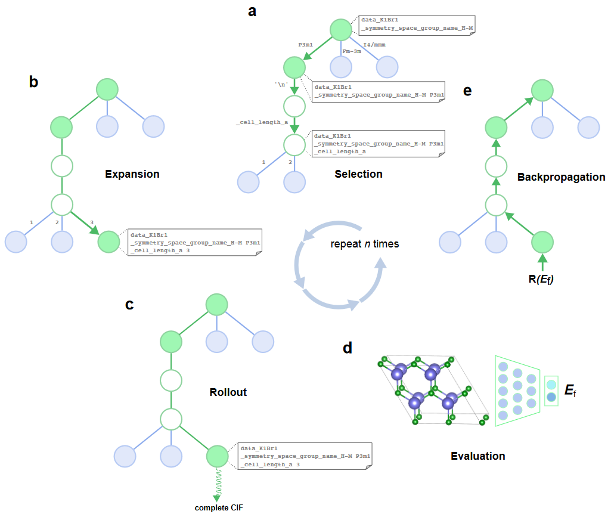
Monte Carlo tree search for consistency
Autoregressive generation is stochastic and can lead to non-ideal structures
MCTS is more expensive but uses an energy estimator to drive to low energy solutions
Nature Communications 15, 1 (2024)

