Slide 1


Causal Inference in Climate and Weather Research
Elena Saggioro
Walker Institute
University of Reading
United Kingdom
SPARC Training School | 30 October 2023 | University of Rwanda
elena.saggioro@reading.ac.uk
Slides co-developed with Dr Marlene Kretschmer (University of Leipzig)
Notes:
Thanks for introduction.
My name is Elena and I am a research fellow at the Walker Institute. I did my PhD at Reading and studied predictability and variability of the southern hemisphere large scale circulation using causal network methods.
In this talk I will present the work done in the last year of my PhD, which is currently in preparation for Journal of Climate.

Slide 2
Outline
Goal of this lecture
Explain how causal networks can be used to draw causal conclusions from data, by including physical (causal) reasoning in the statistical analysis.
Motivation for causal inference in climate and weather science
Causal networks and how to use them: causal inference and causal discovery
Some applications in climate and weather science
© University of Reading 2023 www.walker.reading.ac.uk

Slide 3
1) Motivation
© University of Reading 2023 www.walker.reading.ac.uk

Slide 4
Understanding the “why?”
As scientists, we want to explain why things happen in the natural world
To advance our collective understanding (fundamental research)
How does the Sahel climate change due to global warming?
To know what are the best actions to achieve specific results (supporting decision-making)
If we convert land to agriculture this region, do livelihoods improve nationally?
© University of Reading 2023 www.walker.reading.ac.uk
Notes:
Okay, so causal questions are everyyhere. .. However, when thinkling about causality in data science
Correlation does not imply causation...
So is the class the cause for knowing that correlation does not imply causation?
In this case

Slide 5

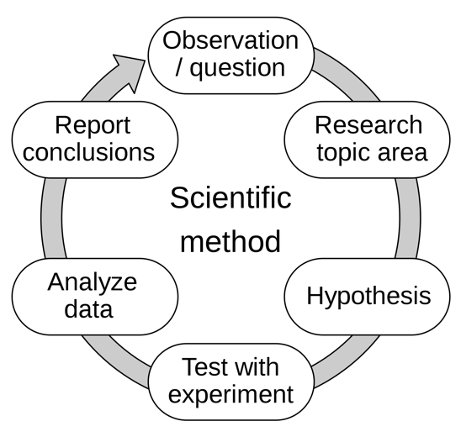
Learning about Causality in Science
How do we usually learn about causality as scientists?
Postulate scientific hypothesis
Derive predictions
Test predictions with experiments
If test is passed, retain hypothesis as true. (until disproven by new observations)
What happens if we cannot do physical experiments (as it is the case in climate science)?
Can we still reason about causality?
Source figure: Wikipedia
© University of Reading 2023 www.walker.reading.ac.uk

Slide 6
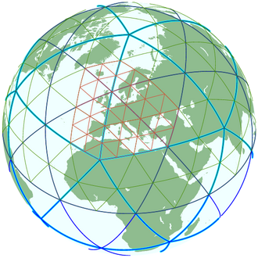
Learning about Causality in Climate Science
Physics-based
Method 1: Do experiments with numerical climate models, our “digital laboratory”.
Downside of this method:
Inferences about the real word depend on the realism of the climate model
e.g. Ham et al. (2020)
© University of Reading 2023 www.walker.reading.ac.uk
Notes:
Usually., when we want to answer causal questions. We use a climate modelMake an intervention in model...
This is the gold standard
However, model needs to be good. Want to understand model decficits... Often some violation of physics....
Statistics/data science....
Extract causal information from data.
Example.... Teleconnection. Correlation enso and precip....
Together in science: model, theory, observations

Slide 7
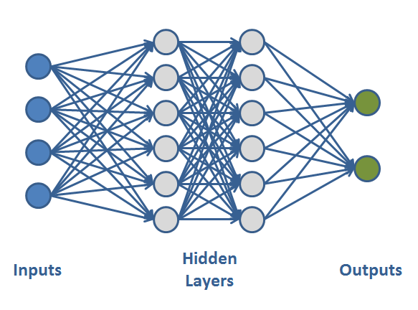
Learning about Causality in Climate Science
Data-driven
Method 2: Study observational data with statistics and data science tools
Downside of this method:
We are usually limited to detect statistical associations (e.g. correlations) but correlation does not always imply causation
How can we derive causal relationships from data?
e.g. Ham et al. (2020)
© University of Reading 2023 www.walker.reading.ac.uk
Notes:
Extrapolations not possible!!!
The standard way to approach this issue is using physics-based climate model simulations.
However, climate models are not perfect in capturing the drivers of extremes, and this limits the reliability of predictions
On the other hand, with the hype of ML, more and more data-driven methods have been introduced, and these are partly very promising
However, these methods are mostly black boxes and therfore not considered trustworthy.
But trust and explanations of predictions are crucial to people actually making decision. Moreover, statioarity issue.!!!
Thus, neither approach can do it on its own and To make progress we need methods from both sides.
To achieve this, I argue for adopting a causal framework
not only better predict what could happen but further explaining why!

Slide 8
Bridging Physics and Statistics with Causal Framework
Physics-based methods
Data-driven methods
Causal Framework
Neither approach (physics-based and data-driven) can be used to learn causality on its own.
Can a causal framework help?
Notes:
In tis talk
In the bigger pricture, I think that a causal framework is a important to reconcile different methods.
In climate science The usual way to approach issues is using physics-based climate model simulations. However, climate models are not perfect in capturing the drivers of extremes, and this limits the reliability of predictions
On the other hand, espcieally with the hype of ML, more and more data-driven methods have been introduced, and these are partly very promising
However, these methods are mostly black boxes and therfore not considered trustworthy. Moreover, they might have problem with extrapolation, for example in the presence of climate change.
Its fair to say that neither approach can do it on its own and To make progress we need methods from both sides. I argue that in order to connect the physical and the statistical perspective a causal framework is needed as I could hopefully illustrate with the teleconnection example.

Slide 9
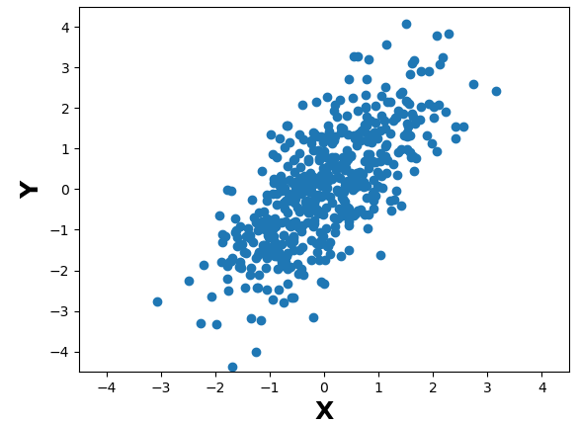
Association vs. Causation
The answer depends on what is the process that generated the data
What happens to Y if we modify X?
X
Y
X
Y
X
Z
Y
Data doesn’t speak for itself!
We need to know the generative process behind our data.
© University of Reading 2023 www.walker.reading.ac.uk
Notes:
Okay so lets talk about causation
Answering this question very much depends on causal mechanisms behind the data

Slide 10
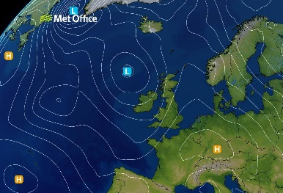
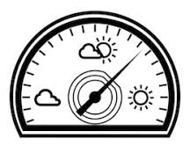
Association vs. Causation
Example
X: Pressure
Y: Barometer
Modifying pressure (X) will change barometer reading (Y)
Moving the barometer needle (Y) will not change pressure (X)

Slide 11
Association vs. Causation
We need to define a Causal Model to answer causal questions
What happens to Y if we modify X?
Y changes by DY = 1.5 * DX
X does not change DX = 0, because Y is not causing X.
X
Y
What happens to X if we modify Y?
Y = 1.5 * X
© University of Reading 2023 www.walker.reading.ac.uk

Slide 12
Association vs. Causation
To make sense of the data, we need causal knowledge about the data-generating mechanisms
We usually have such “expert knowledge” available (scientific literature) and we should never forget to make use of it!
© University of Reading 2023 www.walker.reading.ac.uk
Notes:
Objectivity ... subjectivity

Slide 13
2) Causality
Casual Inference and Causal Discovery
© University of Reading 2023 www.walker.reading.ac.uk

Slide 14
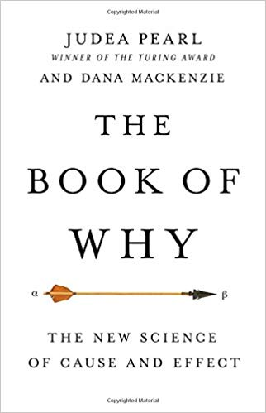
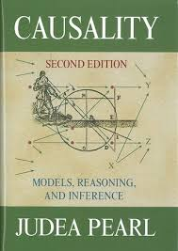
Causality in Mathematics
Causality is the science of extracting causal information from data.
The concept of causality had long been missing in mathematics and statistics.
Causal theory was developed in 1980-90s and formalized by Judea Pearl and others.
Y
U
X
Z
V
© University of Reading 2023 www.walker.reading.ac.uk
Notes:
Use expert knowledge to set a (plausible) causal model
2. Draw logical implications and test if data support them
3. Use CI rules to identify the confounders one need to control for in order to quantify causal effects

Slide 15
Causal Networks
Casual network represents the generating process behind data
Nodes = variables
Directed Links = causal influence
Acyclic = no directed loops
Z
X
U
Y
Some terminology
Path = sequence of links
Causal path: X → U → Y
Non-causal path: X ← Z → Y
X is a parent of U
U is a child of X
© University of Reading 2023 www.walker.reading.ac.uk

Slide 16
Causal Networks expressed as Functions
Z
Child = function of parents
Coefficient 0.3
1.4
Assuming function is linear:
child = linear combination of parents,
hence each link has a coefficient
X = 0.3*Z + noise_{x}
Y = 1.4*Z + 0.5 * U + noise_{Y}
Z = noise_{Z}
U = 0.7*X + noise_{U}
0.7
0.5
X
U
Y
Causal effect X → U : 0.7
Causal effect of X →U→Y:
= 0.7*0.5=0.35 (path tracing rule)
© University of Reading 2023 www.walker.reading.ac.uk

Slide 17

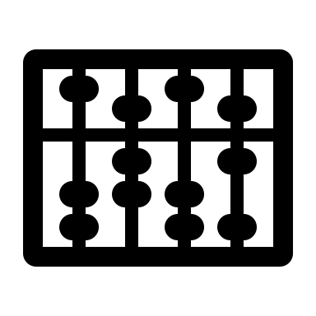
Causal discovery and Causal Inference
Casual Discovery
Identify the structure of a causal network from data, given some assumptions on the data-generating process.
Casual Inference
Quantification of causal effects from data, given knowledge of a causal network structure.
Y
U
X
Z
V
Given data on X and Y, is X →Y?
Given we know that X→Y,
how strong is the causal effect of X on Y?
© University of Reading 2023 www.walker.reading.ac.uk

Slide 18
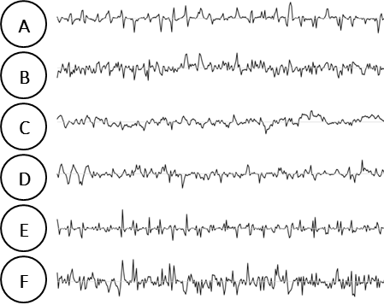
Steps of Causal Inference
Question: What is the causal effect of X on Y?
1. Use expert knowledge to set a plausible causal model
2. Collect relevant data
3. To quantify causal effect, remove effect of “confounders”
X
X
Causal effect of X on Y?
linear case
Y = a X + b Z
Or (equivalently)
b*c
x
Y
Z
b
Z
U
V
x
U
c
Y
V
© University of Reading 2023 www.walker.reading.ac.uk
Notes:
Before giving concrete examples... Abstract steps
Thge idea: naturally occurring interventions are hidden in the data! In the previous exam
nB. Almost the same as done in practice... Only be more formal about it.
This way we can better understand the data
Use expert knowledge to set a (plausible) causal model... Use causal networks
2. Draw logical implications and test if data support them
3. Use CI rules to identify the confounders one need to control for in order to quantify causal effects
NB: its not about detection causal relationtioshops!

Slide 19
What are “confounders”?
Confounders are those variables that create non-causal correlation between two variables whose causal dependence we aim to quantify.
Rules to identify confounders can be derived from 3 basic structures.
Fork (Z is common driver)
Collider (Z is a common effect)
Chain (Z is a mediator)
X
Z
Y
X
Z
Y
X
Z
Y
Non-causal path between X and Y and Correlation(X,Y)=0
Z not a confounder
It becomes if we condition on it: Corr(X,Y|Z)≠0
Non-causal path between X and Y but Correlation(X,Y)≠0
Z is a confounder.
If we condition on it: Corr (X,Y|Z)=0.
Causal path between X and Y, and Correlation(X,Y)≠0
Z is a confounder if we are interested in the direct effect of X of Y (which is 0)
© University of Reading 2023 www.walker.reading.ac.uk
Notes:
Identifying the confounding factors
Computing unbiased casual effect means remove effect of confounders

Slide 20
Steps of Causal Discovery
Question: Is X a parent of Y?
1. Collect input data
2. Apply Causal Discovery algorithms
(each algorithm relies on some model assumptions)
3. Obtain the causal network structure
Important note!
This “discovered” structure it is still an approximation of the real-world causal mechanisms. Because its causal interpretation depends on whether the real-world behaves accordingly to the assumptions of the discovery algorithm!
But it is still better than just looking at correlations do derive such causal mechanisms from data.
X
X
Y
Main idea: if two variables are correlated, they are either causal to each other or driven by a common driver.
Z
Z
U
V
U
V
Y
© University of Reading 2023 www.walker.reading.ac.uk
Notes:
Before giving concrete examples... Abstract steps
Thge idea: naturally occurring interventions are hidden in the data! In the previous exam
nB. Almost the same as done in practice... Only be more formal about it.
This way we can better understand the data
Use expert knowledge to set a (plausible) causal model... Use causal networks
2. Draw logical implications and test if data support them
3. Use CI rules to identify the confounders one need to control for in order to quantify causal effects
NB: its not about detection causal relationtioshops!

Slide 21
3) Applications
Some examples from climate and weather science
© University of Reading 2023 www.walker.reading.ac.uk

Slide 22

1. Quantify Teleconnections Pathways
More on this in the afternoon session
Precipitation in Denmark (DK) and the Mediterranean (MED) are significantly correlated
Does this reflect a causal relationship?
Corr(DK, MED) = - 0.25
NAO influences both MED and DK
DK = - 0.55 NAO + ɛ
MED = +0.42 NAO + ɛ
The causal effects explain the correlation
DK
-0.55 * 0.42 ≈ -0.25
NAO
MED
No, no causal relationship between MED and DK
(June-July-August mean, NCEP data)
Kretschmer et al. (2021, BAMS)
Notes:
For some intuition how scientific theory and data analysis can be combined, consider this simple real-data example from my latest paper.
Here I consider precipation in summer in denkmark and the mediteranntean, which are significantly negatively correltion of -0.25
Of course we would not interpret this causally. Instead we know that precipitation in these regions is determined by the position of the atlantic storm tracks as e.g. Expressed by the North Atl oscialltion (NAO).
In the linear case, we can controlling for the effect of he common driver NAO by calcultating partial regreeions. And indeed, if we regress it out the correlation drops to zero.
We can further..
This exampler illustrates that causal knowledge...

Slide 23
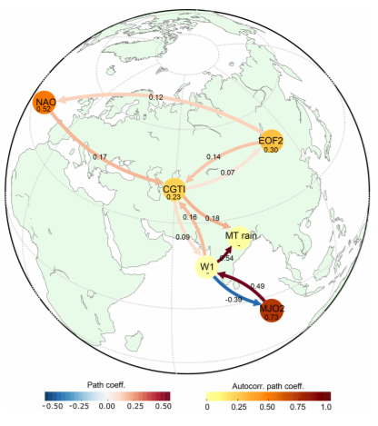
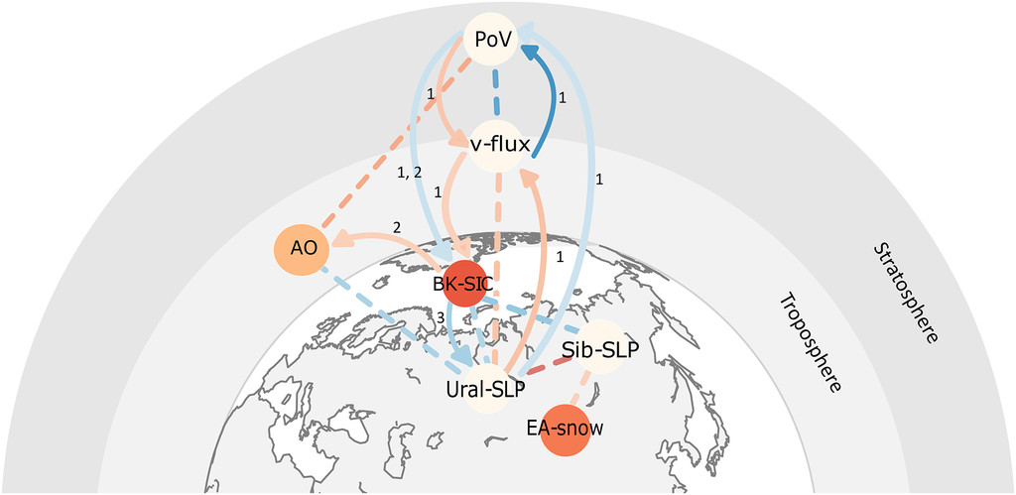
2. Understand Physical Processes with many variables
How is the Indian Summer Monsoon influenced by tropical and extratropical climate variability modes?
Are Barents and Kara Sea Ice and Eurasian snow cover drivers of arctic oscillation?
Di Capua et al. (2019), ESD. Kretschmer et al. (2016), JCLI
© University of Reading 2023 www.walker.reading.ac.uk

Slide 24
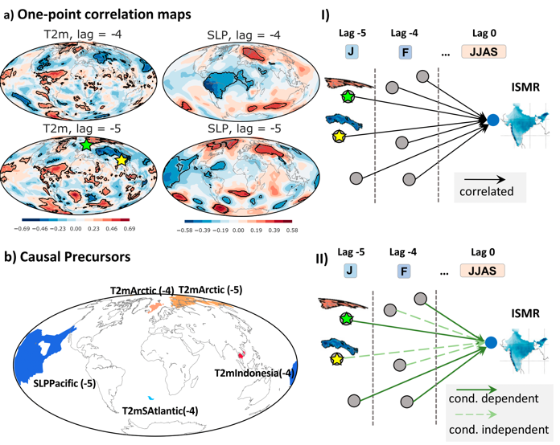
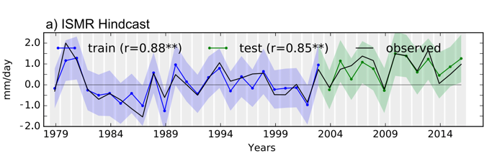
3. Find Causal Predictors
What are the causal predictors of the Indian Summer Monsoon variability?
Predictions with causal precursors
Di Capua et al. (2019), WaF
© University of Reading 2023 www.walker.reading.ac.uk

Slide 25
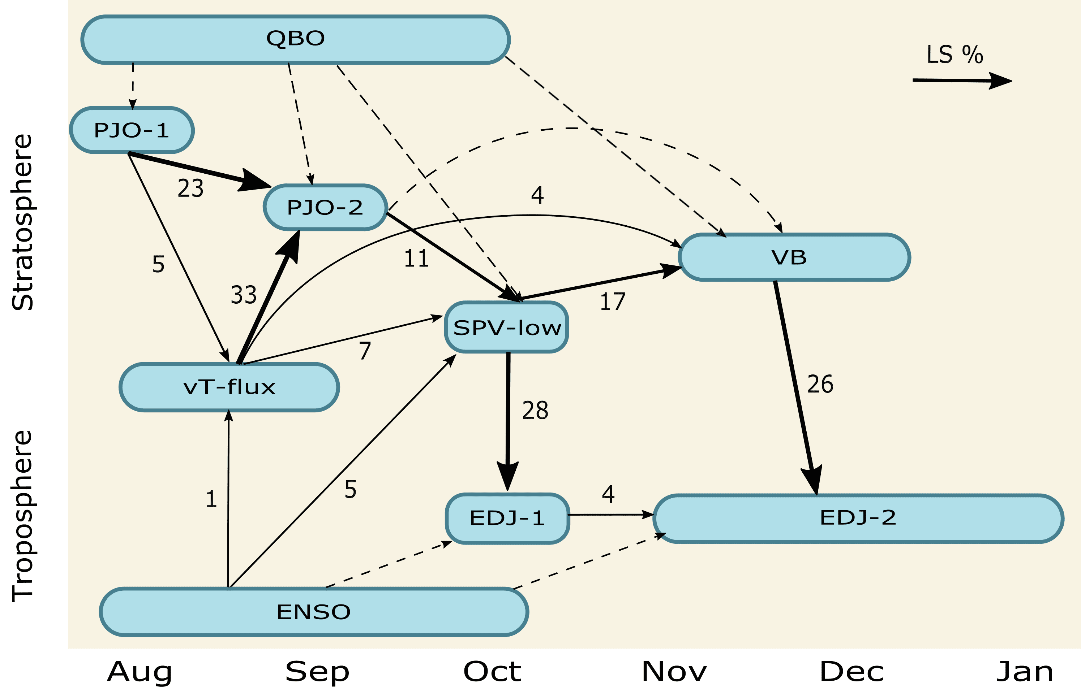
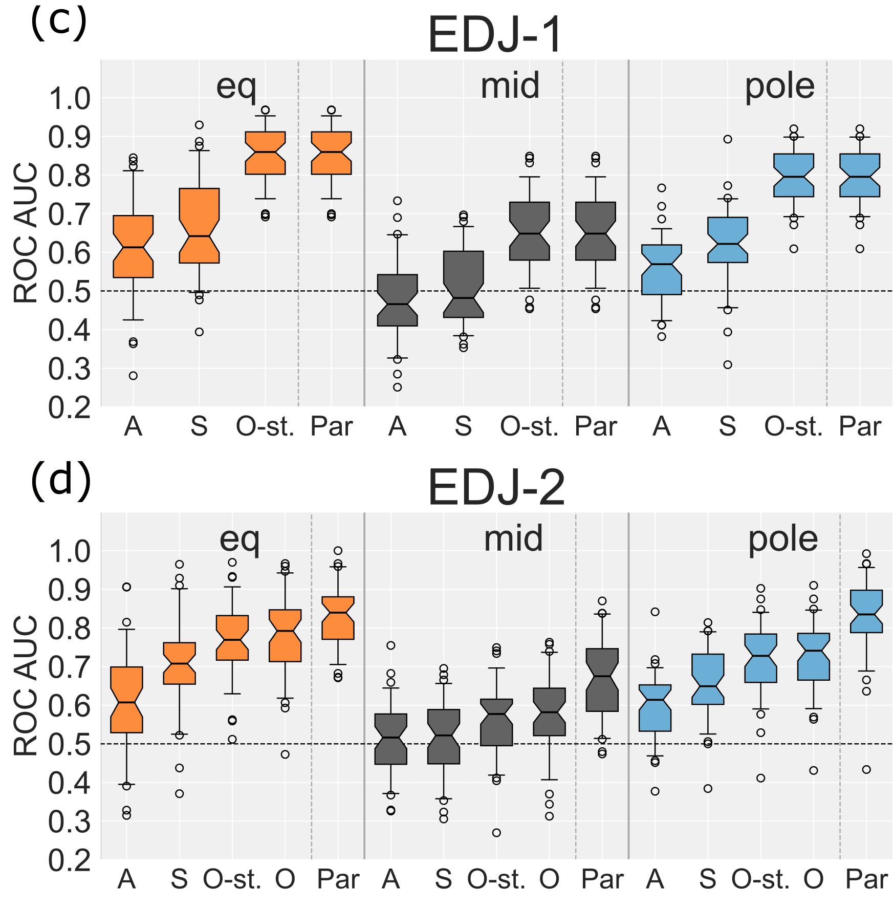
4. Quantify predictability
What is the predictability of Southern Hemisphere jet stream on seasonal timescales?
Saggioro et al. (2023), in review.
© University of Reading 2023 www.walker.reading.ac.uk
Notes:
Probability (child|parents) can be used to do probabilistic forecasts.

Slide 26
4) Summary
© University of Reading 2023 www.walker.reading.ac.uk

Slide 27
Take Home Messages
Correlations are the result of causal relationships. But data alone cannot tell us which ones!
We need causal knowledge about the data-generating mechanisms to interpret correlations and to extract unbiased causal effects
Causal hypotheses are best expressed using causal networks
To extract causal effects from data, one needs to control for all confounding factors
Causal inference gives the formal rules how to identify the confounding factors
Scientific data analysis requires causal reasoning
© University of Reading 2023 www.walker.reading.ac.uk

Slide 28
References
Di Capua, G., et al (2019). Tropical and mid-latitude teleconnections interacting with the Indian summer monsoon rainfall: A Theory-Guided Causal Effect Network approach, Earth Syst. Dynam. Discuss. [preprint], https://doi.org/10.5194/esd-2019-11
Di Capua, G., et al. (2019) Long-lead statistical forecasts of the Indian summer monsoon rainfall based on causal precursors. Weather and Forecasting, 34 (5). pp. 1377-1394. doi: https://doi.org/10.1175/WAF-D-19-0002.1
Kretschmer et al. (2016) Using Causal Effect Networks to Analyze Different Arctic Drivers of Midlatitude Winter Circulation. J. Climate, 29, 4069–4081, https://doi.org/10.1175/JCLI-D-15-0654.1.
Kretschmer et al. (2021) Quantifying Causal Pathways of Teleconnections. Bull. Amer. Meteor. Soc., 102, E2247–E2263, https://doi.org/10.1175/BAMS-D-20-0117.1.
Pearl (2009) Causality: Models, Reasoning, and Inference. Cambridge University Press.
Pearl, J. and D. Mackenzie (2018). The Book of Why: The New Science of Cause and Effect. Basic Books.
Causal Discovery
Glymour et al. (2019) Review of Causal Discovery Methods Based on Graphical Models Front. Genet., Statistical Genetics and Methodology Volume 10 - 2019 | https://doi.org/10.3389/fgene.2019.00524 [a nice overview of CD methods and suggestions for correct application, although focus on genetics application]
Nogueira, et al. (2022) Methods and tools for causal discovery and causal inference. Wiley Interdisciplinary Reviews: Data Mining and Knowledge Discovery, 12( 2), e1449. https://doi.org/10.1002/widm.1449 [Good summary of CD software packages: data types and assumptions]
Runge, J., Bathiany, S., Bollt, E. et al. (2019a) Inferring causation from time series in Earth system sciences. Nat Commun 10, 2553 https://doi.org/10.1038/s41467-019-10105-3 [overview of CD methods and challenges]
Runge et a. (2019b), Detecting and quantifying causal associations in large nonlinear time series datasets, Science Advances, 5(11) DOI: https://doi.org/10.1126/sciadv.aau4996 [comparing time-series constraint-based algorithms]
© University of Reading 2023 www.walker.reading.ac.uk

Slide 29
Extra Slides
© University of Reading 2023 www.walker.reading.ac.uk

Slide 30
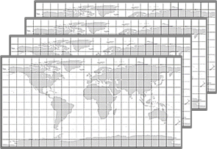
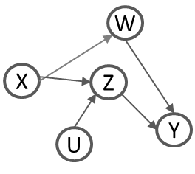

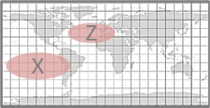


Causal Discovery and Machine Learning
e.g. Causal discovery algorithms
Causal discovery methods can complement predictive machine learning to improve our theoretical understanding of the underlying system.
DATA
FEATURES
MECHANISMS
INFORMATION
Causal Effects
Gridded climate data
ENSO, NAO, ...
Teleconnectios
Predictions
W
X
Z
Classification
e.g. ML (EOF, clustering)
Prediction
e.g. ML (regression, random forest)
Y
U
© University of Reading 2023 www.walker.reading.ac.uk

Slide 31
Causal Discovery and Machine Learning
e.g. regression
Deep Learning
Causal Effects
DATA
FEATURES
MECHANISMS
INFORMATION
e.g. causal discovery algorithms
W
X
Z
Y
U
Explainable AI
© University of Reading 2023 www.walker.reading.ac.uk

Slide 32
Examples of Causal Discovery Approaches
Granger causality: Causal link X→ Y is assigned if X improves predictions of Y
Dependence-based and Score-based algorithms: start from fully connected network, and remove links with iterative tests (dependence/score)
Non-linear state-space reconstruction: Take a dynamical systems perspective and suitable for deterministic systems (not stochastics, as the other methods)
Runge et al. (2019) Detecting and quantifying causal associations in large nonlinear time series datasets, Science Advances, 5(11) DOI: 10.1126/sciadv.aau4996 [comparing time-series constraint-based algorithms]

Slide 33
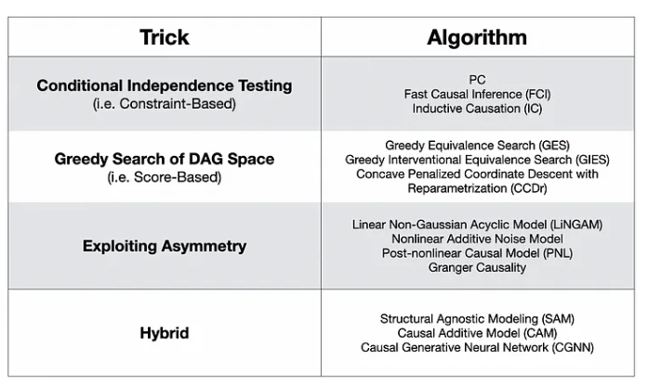
Some causal discovery algorithms
Strategy for link testing
(Granger causality and Structural causal models)
Source: https://towardsdatascience.com/causal-discovery-6858f9af6dcb
© University of Reading 2023 www.walker.reading.ac.uk

Slide 34
Some software packages implementing causal discovery algorithms
Non time-ordered data
Pcalg ( R ) : constraint-based (including PC-stable) https://www.jstatsoft.org/article/view/v047i11
Bnlearn ( R) : constraint-based (including PC-stable) + score-based + SCM
Tetrad (R and Python) : constraint-based (including PC-stable) + score-based + SCM https://github.com/cmu-phil/tetrad
Causal Discovery Toolbox (Python): constraint-based (including PC-stable) + score-based https://github.com/FenTechSolutions/CausalDiscoveryToolbox
Time-ordered data
Tigramite (Python): constraint-based (PCMCI) https://jakobrunge.github.io/tigramite/
Tetrad (R and Python): constraint-based + score-based
Good summary of these packages and comparison in Nogueira, et al 2022. https://doi.org/10.1002/widm.1449 And Github page https://github.com/AnaRitaNogueira/Methods-and-Tools-for-Causal-Discovery-and-Causal-Inference
© University of Reading 2023 www.walker.reading.ac.uk

Slide 35
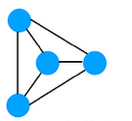
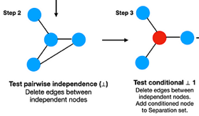
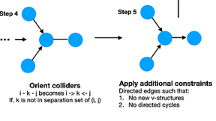
Constraint-based algorithm PC
Starting point
Constraint-based algorithms
iteratively remove links from a fully connected network
via conditional dependence tests of increasing cardinality (i.e. number of conditions)
There are several algorithms, we focus on one of the earliest and most used still: the PC-stable algorithm
PC-stable algorithm (Colombo & Maathuis, 2004)
Start with fully connected and undirected network
Step1: Skeleton discovery
Test all edges, one at a time, for conditional dependence with a growing number of conditions.
Remove edges when they are independent.
Step 2: Link orientation
Orient links with tests based on relationships of colliders (also called v-structures). If time series, time direction determines orientation, except for contemporaneous
Output: ‘equivalence class’ or DAGs (Note that not all links may be oriented).
PC from names of the inventors Peter Spirtes and Charles Glymour (1991).
PC-stable derived by Colombo and Maathuis (2004).
For time-series extension and nice summary of PC-stable see Ebert-Uphoff & Deng (2012).
Step 1: Skeleton discovery
… until conditions are exhausted
Step 2: Link orientation
© University of Reading 2023 www.walker.reading.ac.uk

Slide 36
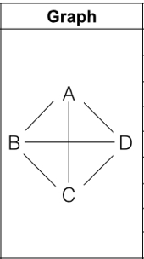

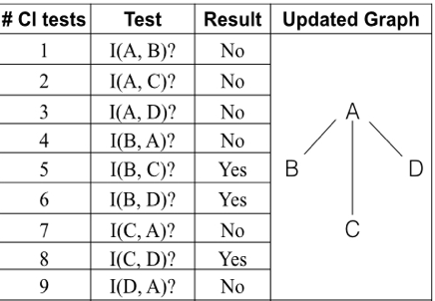
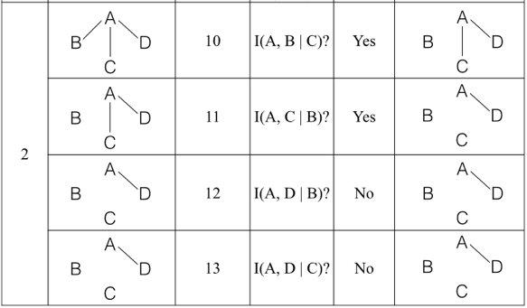
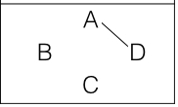
PC-stable Skeleton Detection example
Initial Graph
Level 1:
Dependence Test with 0 conditions
Level 2:
Conditional Dependence Test with 1 condition
Final Graph

Slide 37
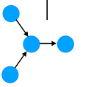
Assumptions in constraint-based Causal Discovery
X
Causal Sufficiency: no common drivers are left out of the variables chosen
Causal Markov condition: a variable Y is independent of every other antecedent variable when conditioned on Y’s parents
Faithfulness assumption: all observed conditional independencies arise from the causal structure
Taken together, these three conditions allow to infer information about causal interactions from testing data with conditional independence.
If X exists, needs to be included
independence in data
D-separation
in network →
independence → in data
D-separation
in network
© University of Reading 2023 www.walker.reading.ac.uk

Slide 38

A word of caution on Causal Discovery (1)
Application of causal discovery methods require understanding of the physical process investigated to make the best
Selection of variables and data
Spatial and temporal aggregation to extract the most suitable variables
Selection of CD method based on assumptions
In constraint-based, selection of the most suitable conditional independence metric
(e.g. correlation if linear..)
Questioning and interpretation of results

Slide 39
A word of caution on Causal Discovery (2)
New methods are proposed almost monthly, and published packages vary in quality of implementation.
Accuracy recommendations based on public contests are limited to whatever algorithms were submitted to the contests and the particular properties of the data.
Some comparison studies are in Runge et al. 2019b https://www.science.org/doi/10.1126/sciadv.aau4996, Nogueira et al. 2022 https://doi.org/10.1002/widm.1449, causeme.net platform
Bootstrapping an algorithm repeatedly on the data can be informative about how much to trust the output, and can give an estimate of the probabilities of edges. If the results vary widely over the different bootstrap samples, the output should not be trusted. Unfortunately, the converse is not true - stable output is not necessarily correct causal output.
From Glymour et al. 2019, Review of Causal Discovery Methods Based on Graphical Models

Slide 40
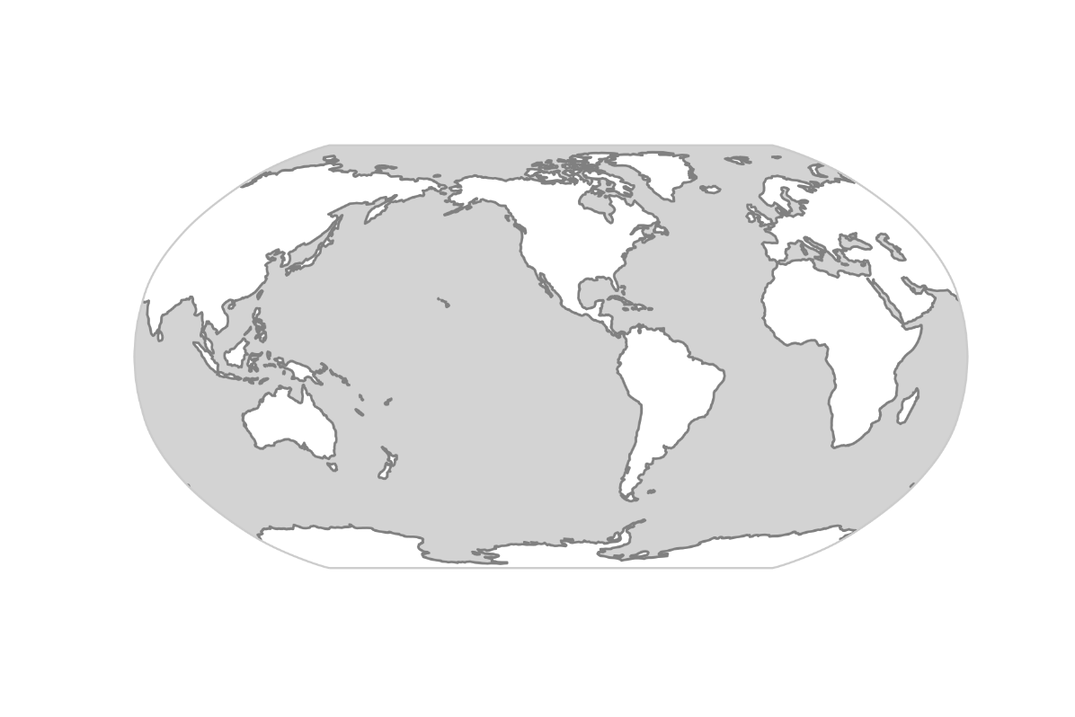


Teleconnections
Teleconnections: Sources of predictability of regional
extremes
Quantifying the contribution of teleconnections is key to improve our understanding of regional weather and climate variability
Snow cover
H
L
Soil moisture
H
sea surface temperatures
Extracting this information from data is usually difficult!
Notes:
To jump right in. This is a reminder that teleconnections are sources of predictability of regional weather and climate
For example, enhanced sst in tropical pacific can trigger an atmo wave train to mid lats, and affect regional weather patterns there and for instance lead to heat waves in western Canada and heave precipitation in the southern US. This is associated with the el nino so
Qunatifying the contributions of teleconnections is key to ...
This includes a range of tasks such as reducing uncertainties of near and long term predictions, climate model evaluation, or to make better attribution statements of extreme events.
The problem, however, is that also sst in other regions as well as boundary conditions such as soil moisture or snow cover can also affect weather around the globe and these teleconnections are also partially interconnected making it difficult to disentangle the different contributions. In other words, extracting this causal information from data is usually a very challenging.

Slide 41
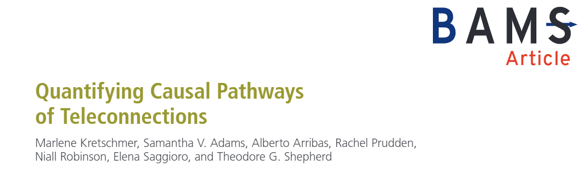
Correlation vs. Causation
Problem:
Disconnect between our physical understanding and our statistical description of teleconnections.
American Meteorological Society: “Teleconnection”
A significant [...] correlation in [...] widely separated points. [...] such correlations suggest that information is propagating [...].
https://glossary.ametsoc.org/wiki/Teleconnection
Notes:
To motivate a causal approach, I would like to get back to the term teleconnection.
Th AMS defines a teleconnection
Disconnect between our physical understanding and our statistical description of teleconnections.
How can we connect the physical and statistical perspectives in a quantitative manner?

Slide 42
Quantifying Causal Pathways of Teleconnections
How to formally include causal (physical) reasoning in the statistical analysis of teleconnections

Slide 43
Example 1: Common Driver
Precipitation in Denmark (DK) and the Mediterranean (MED) are significantly correlated
Corr(DK, MED) = - 0.25
DK
NAO
Does this reflect a causal relationship?
MED
(JJA mean, NCEP)
Kretschmer et al. (2021, BAMS)
Notes:
For some intuition how scientific theory and data analysis can be combined, consider this simple real-data example from my latest paper.
Here I consider precipation in summer in denkmark and the mediteranntean, which are significantly negatively correltion of -0.25
Of course we would not interpret this causally. Instead we know that precipitation in these regions is determined by the position of the atlantic storm tracks as e.g. Expressed by the North Atl oscialltion (NAO).
In the linear case, we can controlling for the effect of he common driver NAO by calcultating partial regreeions. And indeed, if we regress it out the correlation drops to zero.
We can further..
This exampler illustrates that causal knowledge...

Slide 44
Example 1: Common Driver
How strong are the causal effects?
DK = - 0.55 NAO + ɛ
MED = +0.42 NAO + ɛ
-0.55
DK
NAO
The causal effects explain the correlation
0.42
MED
-0.55 * 0.42 ≈ -0.25
(JJA mean, NCEP)
Kretschmer et al. (2021, BAMS)
Notes:
No confounders present
Causal knowledge is needed to understand both causal and non-causal associations
R

Slide 45
Example 1: Common Driver
Is our causal model consistent with the data?
DK
DK and MED are independent after regressing out the effect of NAO
x
NAO
x
MED
→ Corr(DK, MED | NAO) = 0.01
(JJA mean, NCEP)
Kretschmer et al. (2021, BAMS)
Notes:
For some intuition how scientific theory and data analysis can be combined, consider this simple real-data example from my latest paper.
Here I consider precipation in summer in denkmark and the mediteranntean, which are significantly negatively correltion of -0.25
Of course we would not interpret this causally. Instead we know that precipitation in these regions is determined by the position of the atlantic storm tracks as e.g. Expressed by the North Atl oscialltion (NAO).
In the linear case, we can controlling for the effect of he common driver NAO by calcultating partial regreeions. And indeed, if we regress it out the correlation drops to zero.
We can further..
This exampler illustrates that causal knowledge...

Slide 46
Example 1: Common Driver
Causal knowledge is needed to interpret both causal and non-causal associations
DK
NAO
MED
(JJA mean, NCEP)
Kretschmer et al. (2021, BAMS)
Notes:
Results are conditional on causal model!
Causal knowledge is needed to understand both causal and non-causal associations
We can decompose the correlations

Slide 47
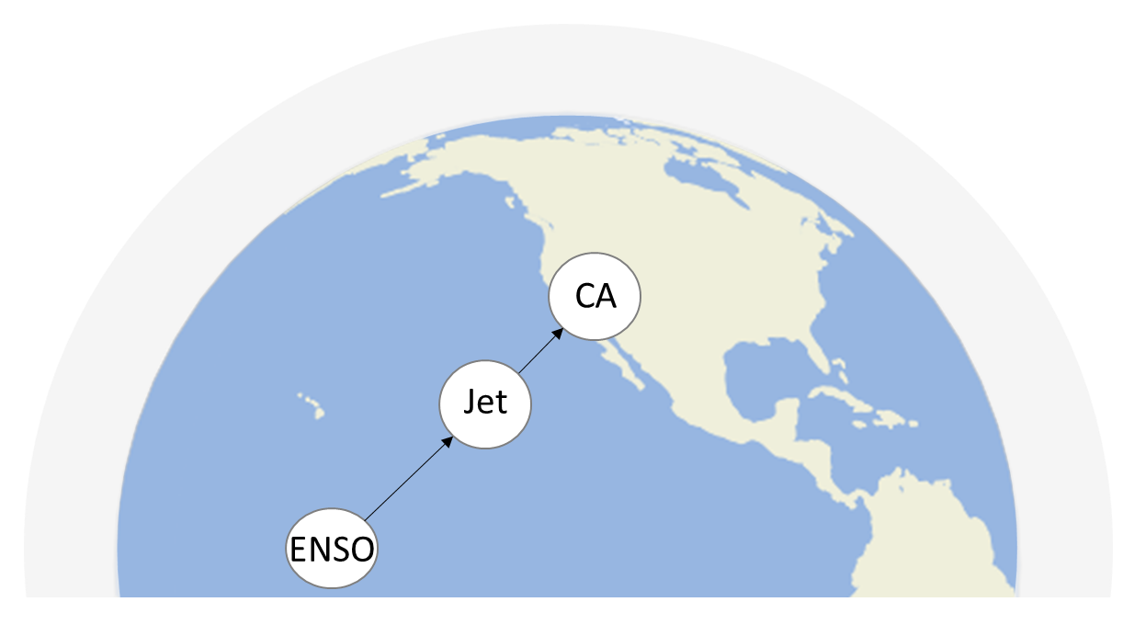
Example 2: Mediator
What is the effect of ENSO on precipitation in California (CA)?
(DJF mean, NCEP)
Kretschmer et al. (2021, BAMS)
Notes:
This is another simple example, but one in which controlling for another process is harmful.
This causal network on the right summarizes a large body of literature how ENSO affects California precipitation in winter, via altering the position of the pacific Jetstream.
Assume we are interested in the causal effect of ENSO on CA.
What is often done navivel is to through in all indices in a linear regression model . If we do this, we find the regression coeff. Of enso to be close to zero, suggesting a tiny effect on ca
However, we must not interpret this cauaalliy. What happened that by including jet in the regression model, we blocked out the informatin from ENSO being mediated by jet.
Thus, here the correct way to estimate the effect is to simply regression cali on enso, withour controlling for jet.
We would get the same results if we would estimate the two pathways separately and then mutpliying them, following the path tracing rules
Importantly…

Slide 48
Example 2: Mediator
What is the effect of ENSO on precipitation in California (CA)?
CA = 0.05 ENSO + 0.79 Jet + ɛ
We must not interpret this causally!
(DJF mean, NCEP)
Kretschmer et al. (2021, BAMS)
Notes:
This is another simple example, but one in which controlling for another process is harmful.
This causal network on the right summarizes a large body of literature how ENSO affects California precipitation in winter, via altering the position of the pacific Jetstream.
Assume we are interested in the causal effect of ENSO on CA.
What is often done navivel is to through in all indices in a linear regression model . If we do this, we find the regression coeff. Of enso to be close to zero, suggesting a tiny effect on ca
However, we must not interpret this cauaalliy. What happened that by including jet in the regression model, we blocked out the informatin from ENSO being mediated by jet.
Thus, here the correct way to estimate the effect is to simply regression cali on enso, withour controlling for jet.
We would get the same results if we would estimate the two pathways separately and then mutpliying them, following the path tracing rules
Importantly…

Slide 49
Example 2: Mediator
What happened here?
CA = 0.05 ENSO + 0.79 Jet + ɛ
By including “Jet” in the regression model, we blocked the causal pathway from “ENSO” to “Jet”
x
(DJF mean, NCEP)
Kretschmer et al. (2021, BAMS)
Notes:
This is another simple example, but one in which controlling for another process is harmful.
This causal network on the right summarizes a large body of literature how ENSO affects California precipitation in winter, via altering the position of the pacific Jetstream.
Assume we are interested in the causal effect of ENSO on CA.
What is often done navivel is to through in all indices in a linear regression model . If we do this, we find the regression coeff. Of enso to be close to zero, suggesting a tiny effect on ca
However, we must not interpret this cauaalliy. What happened that by including jet in the regression model, we blocked out the informatin from ENSO being mediated by jet.
Thus, here the correct way to estimate the effect is to simply regression cali on enso, withour controlling for jet.
We would get the same results if we would estimate the two pathways separately and then mutpliying them, following the path tracing rules
Importantly…

Slide 50
Example 2: Mediator
Correct way:
CA = 0.34 ENSO + ɛ
Or via product along the pathway:
Jet = 0.37 ENSO + ɛ
CA = 0.81 Jet + ɛ
0.81
0.37 * 0.81 = 0.30
0.37
(DJF mean, NCEP)
Kretschmer et al. (2021, BAMS)
Notes:
This is another simple example, but one in which controlling for another process is harmful.
This causal network on the right summarizes a large body of literature how ENSO affects California precipitation in winter, via altering the position of the pacific Jetstream.
Assume we are interested in the causal effect of ENSO on CA.
What is often done navivel is to through in all indices in a linear regression model . If we do this, we find the regression coeff. Of enso to be close to zero, suggesting a tiny effect on ca
However, we must not interpret this cauaalliy. What happened that by including jet in the regression model, we blocked out the informatin from ENSO being mediated by jet.
Thus, here the correct way to estimate the effect is to simply regression cali on enso, withour controlling for jet.
We would get the same results if we would estimate the two pathways separately and then mutpliying them, following the path tracing rules
Importantly…

Slide 51
The importance of Causal Reasoning
Statistically, example 1 and 2 are undistinguishable
X and Y are correlated
example 1: X = DK and Y = MED
example 2: X = ENSO and Y = CA
x
DK
x
example 1
NAO
MED
X and Y are independent conditional on Z
example 1: Z = NAO
example 2: Z = Jet
x
Jet
ENSO
CA
example 2
The causal interpretation enters through our physical knowledge!

Slide 52
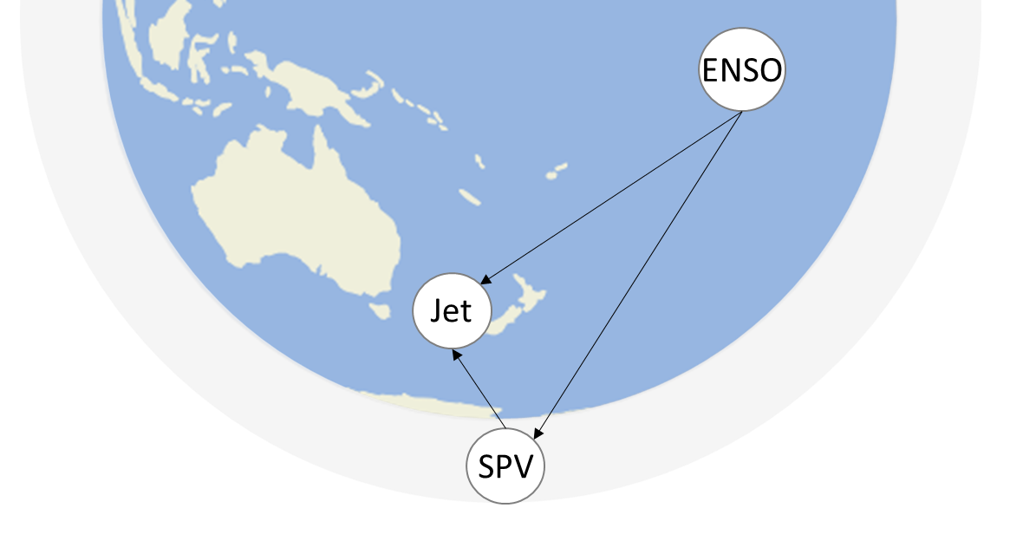
Example 3: Indirect and direct effects
Total effect of ENSO on Jet
Jet = 0.14 ENSO + ɛ
x
Direct (tropospheric) pathway:
x
0.04
Jet = 0.04 ENSO + 0.39 SPV + ɛ
Indirect (stratospheric) pathway:
0.26
SPV = 0.26 ENSO + ɛ
x
0.39
Jet = 0.39 SPV + 0.04 ENSO + ɛ
0.26 * 0.39 = 0.10
tropo + strato = 0.04 + 0.10
Total = 0.14
(OND mean, NCEP)
Kretschmer et al. (2021, BAMS)
Notes:
In this case we look at a combination of mediator and common driver effect . We are interested in the effect of enso on the jet strwam in the SH spring-to-summer months. According to the literature, there are 2 main ways ENSO influences Jet: directly via the troposphere and indirectly via the stratosphere, mediated by the polar vortex.
We note that here there is no testable implication because there are no conditional independencies.
Tknow the effect of ENSO on Jet You could regress Jet on ENSO and obtain 0.14. This is the total effect, and we can compute it this way because there are no common driver of ENSO and Jet. However, the network structures makes you aware that this is the total effect, not the direct only.
If we ARE INTERESTED IN The direct effect of ENSO on JEt, we need to block the indirect path, ans this is achieve by regressin gout SPV too. find a direct causal effect of 0.04 which is much smaller that 0.14
Finally , we can also look at the indirect stratospheric effect of ENSO on Jet by computing the yellow links strengths’ and the multiplying them following the path rule.
Strato more important than direct tropo (0.10>0.04)
Total effect is equal to sum of tropo and strato: so good agreement between model and data
Only because we acknowledge the correct causal structure fist we know what to variables to use in our conditioning.

