Slide 1


PRACTICAL – Causal Inference in Climate and Weather Research
Elena Saggioro
Walker Institute
University of Reading
United Kingdom
SPARC Training School | 30 October 2023 | University of Rwanda
elena.saggioro@reading.ac.uk
Slides co-developed with Dr Marlene Kretschmer (University of Leipzig)
Notes:
Thanks for introduction.
My name is Elena and I am a research fellow at the Walker Institute. I did my PhD at Reading and studied predictability and variability of the southern hemisphere large scale circulation using causal network methods.
In this talk I will present the work done in the last year of my PhD, which is currently in preparation for Journal of Climate.

Slide 2
INSTRUCTIONS
Save the folder causality-master-SPARCtrainingschool/
On your PC (if using Jupiter notebook on your PC)
On your Google Drive (if using Google Colab)
Inside this folder you find 3 folders: notebooks-summerschool/, images/, sample_data_csv/
Open the notebooks with Jupyter and do the exercises!
Simple linear examples (1:common driver, 2:mediator, 3:collider)
Advanced linear example (4:blocking path)
© University of Reading 2023 www.walker.reading.ac.uk

Slide 3
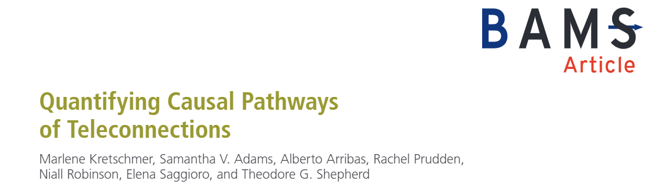
Exercises from the paper “Quantifying Causal Pathways of Teleconnections”
How to formally include causal (physical) reasoning in the statistical analysis of teleconnections

Slide 4
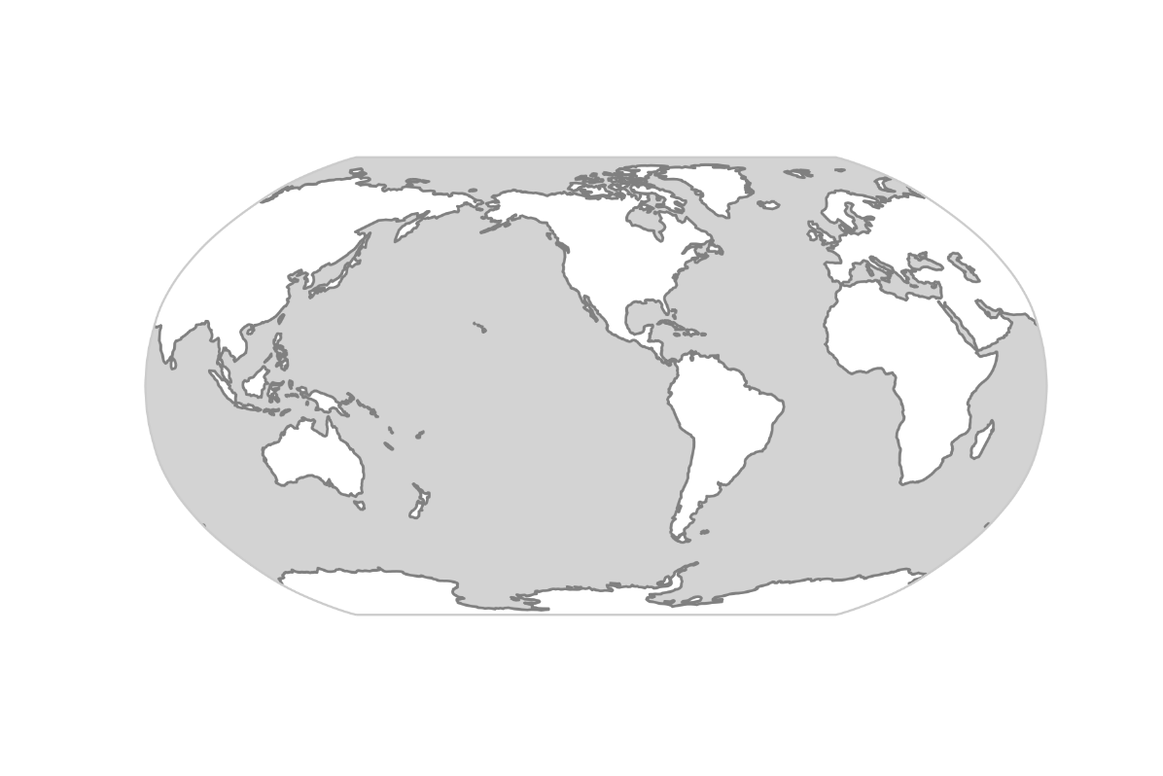


Teleconnections
Teleconnection is detected as a significant correlation between widely separated points, that suggest that information is propagating between them via a physical process.
Teleconnections: Sources of predictability of regional extremes
Snow cover
H
L
Quantifying the contribution of teleconnections is key to improve our understanding of regional weather and climate variability
Soil moisture
H
sea surface temperatures
Extracting this information from data is usually difficult! Often due to confounding factors..
Notes:
To jump right in. This is a reminder that teleconnections are sources of predictability of regional weather and climate
For example, enhanced sst in tropical pacific can trigger an atmo wave train to mid lats, and affect regional weather patterns there and for instance lead to heat waves in western Canada and heave precipitation in the southern US. This is associated with the el nino so
Qunatifying the contributions of teleconnections is key to ...
This includes a range of tasks such as reducing uncertainties of near and long term predictions, climate model evaluation, or to make better attribution statements of extreme events.
The problem, however, is that also sst in other regions as well as boundary conditions such as soil moisture or snow cover can also affect weather around the globe and these teleconnections are also partially interconnected making it difficult to disentangle the different contributions. In other words, extracting this causal information from data is usually a very challenging.

Slide 5

Example 1
Summer precipitation in Denmark (DK) and the Mediterranean (MED) are affected by the position of atlantic storm tracks as expressed by the North Atlantic oscialltion (NAO).
DK
NAO
MED
(JJA mean, NCEP)
Notes:
For some intuition how scientific theory and data analysis can be combined, consider this simple real-data example from my latest paper.
Here I consider precipation in summer in denkmark and the mediteranntean, which are significantly negatively correltion of -0.25
Of course we would not interpret this causally. Instead we know that precipitation in these regions is determined by the position of the atlantic storm tracks as e.g. Expressed by the North Atl oscialltion (NAO).
In the linear case, we can controlling for the effect of he common driver NAO by calcultating partial regreeions. And indeed, if we regress it out the correlation drops to zero.
We can further..
This exampler illustrates that causal knowledge...

Slide 6
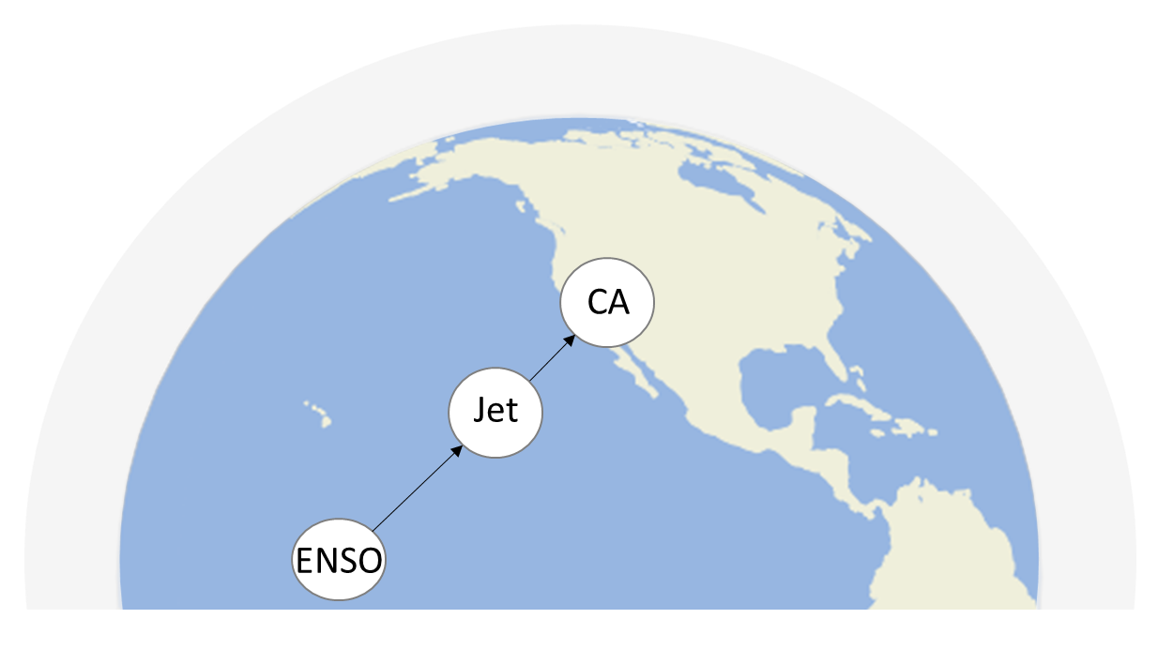
Example 2
ENSO affects California (CA) precipitation in winter, via altering the position of the pacific Jet stream (Jet).
(DJF mean, NCEP)
Notes:
This is another simple example, but one in which controlling for another process is harmful.
This causal network on the right summarizes a large body of literature how ENSO affects California precipitation in winter, via altering the position of the pacific Jetstream.
Assume we are interested in the causal effect of ENSO on CA.
What is often done navivel is to through in all indices in a linear regression model . If we do this, we find the regression coeff. Of enso to be close to zero, suggesting a tiny effect on ca
However, we must not interpret this cauaalliy. What happened that by including jet in the regression model, we blocked out the informatin from ENSO being mediated by jet.
Thus, here the correct way to estimate the effect is to simply regression cali on enso, withour controlling for jet.
We would get the same results if we would estimate the two pathways separately and then mutpliying them, following the path tracing rules
Importantly…

Slide 7
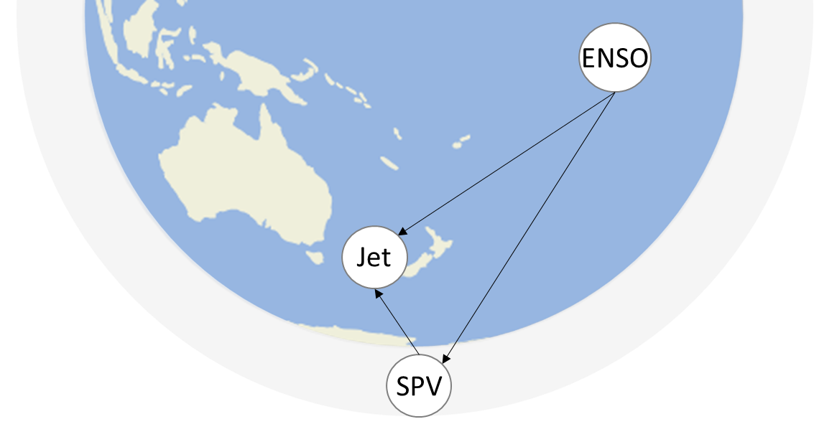
Example 3
In the Southern Hemisphere, ENSO influences the jet stream (Jet) in the spring-to-summer months, both directly and indirectly via the effect on the Stratospheric Polar Vortex (SPV)
(OND mean, NCEP)
Kretschmer et al. (2021, BAMS)
Notes:
In this case we look at a combination of mediator and common driver effect . We are interested in the effect of enso on the jet stream in the SH spring-to-summer months. According to the literature, there are 2 main ways ENSO influences Jet: directly via the troposphere and indirectly via the stratosphere, mediated by the polar vortex.
We note that here there is no testable implication because there are no conditional independencies.
Tknow the effect of ENSO on Jet You could regress Jet on ENSO and obtain 0.14. This is the total effect, and we can compute it this way because there are no common driver of ENSO and Jet. However, the network structures makes you aware that this is the total effect, not the direct only.
If we ARE INTERESTED IN The direct effect of ENSO on JEt, we need to block the indirect path, ans this is achieve by regressin gout SPV too. find a direct causal effect of 0.04 which is much smaller that 0.14
Finally , we can also look at the indirect stratospheric effect of ENSO on Jet by computing the yellow links strengths’ and the multiplying them following the path rule.
Strato more important than direct tropo (0.10>0.04)
Total effect is equal to sum of tropo and strato: so good agreement between model and data
Only because we acknowledge the correct causal structure fist we know what to variables to use in our conditioning.

Slide 8



Example 4
SPV
How strong is the causal effect of Barents Kara sea ice (BK) in autumn on the winter stratospheric polar vortex (SPV)?
AL
BK
Ural
ENSO
MJO
SPV_{JFM} = 0.21 BK_{OND} + b AL_{OND} + c URAL_{OND} + ɛ
Kretschmer et al. WCD (2020), Kretschmer et al. BAMS (2021)
To block the common driver URAL (and not the mediator), we make use of the involved time-lag
Controlling for the Aleutian Low (AL) blocks the influence of AL, but also that of ENSO and MJO

Slide 9
Example 1: Common Driver
Precipitation in Denmark (DK) and the Mediterranean (MED) are significantly correlated
Corr(DK, MED) = - 0.25
DK
NAO
Does this reflect a causal relationship?
MED
(JJA mean, NCEP)
Notes:
For some intuition how scientific theory and data analysis can be combined, consider this simple real-data example from my latest paper.
Here I consider precipation in summer in denkmark and the mediteranntean, which are significantly negatively correltion of -0.25
Of course we would not interpret this causally. Instead we know that precipitation in these regions is determined by the position of the atlantic storm tracks as e.g. Expressed by the North Atl oscialltion (NAO).
In the linear case, we can controlling for the effect of he common driver NAO by calcultating partial regreeions. And indeed, if we regress it out the correlation drops to zero.
We can further..
This exampler illustrates that causal knowledge...

Slide 10
Example 1: Common Driver
How strong are the causal effects?
DK = - 0.55 NAO + ɛ
MED = +0.42 NAO + ɛ
-0.55
DK
NAO
The causal effects explain the correlation
0.42
MED
-0.55 * 0.42 ≈ -0.25
(JJA mean, NCEP)
Notes:
No confounders present
Causal knowledge is needed to understand both causal and non-causal associations
R

Slide 11
Example 1: Common Driver
Is our causal model consistent with the data?
DK
DK and MED are independent after regressing out the effect of NAO
x
NAO
x
MED
→ Corr(DK, MED | NAO) = 0.01
(JJA mean, NCEP)
Notes:
For some intuition how scientific theory and data analysis can be combined, consider this simple real-data example from my latest paper.
Here I consider precipation in summer in denkmark and the mediteranntean, which are significantly negatively correltion of -0.25
Of course we would not interpret this causally. Instead we know that precipitation in these regions is determined by the position of the atlantic storm tracks as e.g. Expressed by the North Atl oscialltion (NAO).
In the linear case, we can controlling for the effect of he common driver NAO by calcultating partial regreeions. And indeed, if we regress it out the correlation drops to zero.
We can further..
This exampler illustrates that causal knowledge...

Slide 12
Example 1: Common Driver
Causal knowledge (e.g. in the form of a network)
is needed to interpret both causal and
non-causal associations
DK
NAO
MED
(JJA mean, NCEP)
Notes:
Results are conditional on causal model!
Causal knowledge is needed to understand both causal and non-causal associations
We can decompose the correlations

Slide 13
Example 2: Mediator
What is the effect of ENSO on precipitation in California (CA)?
(DJF mean, NCEP)
Notes:
This is another simple example, but one in which controlling for another process is harmful.
This causal network on the right summarizes a large body of literature how ENSO affects California precipitation in winter, via altering the position of the pacific Jetstream.
Assume we are interested in the causal effect of ENSO on CA.
What is often done navivel is to through in all indices in a linear regression model . If we do this, we find the regression coeff. Of enso to be close to zero, suggesting a tiny effect on ca
However, we must not interpret this cauaalliy. What happened that by including jet in the regression model, we blocked out the informatin from ENSO being mediated by jet.
Thus, here the correct way to estimate the effect is to simply regression cali on enso, withour controlling for jet.
We would get the same results if we would estimate the two pathways separately and then mutpliying them, following the path tracing rules
Importantly…

Slide 14
Example 2: Mediator
What is the total effect of ENSO on precipitation in California (CA)?
CA = 0.05 ENSO + 0.79 Jet + ɛ
We must not interpret this causally!
(DJF mean, NCEP)
Notes:
This is another simple example, but one in which controlling for another process is harmful.
This causal network on the right summarizes a large body of literature how ENSO affects California precipitation in winter, via altering the position of the pacific Jetstream.
Assume we are interested in the causal effect of ENSO on CA.
What is often done navivel is to through in all indices in a linear regression model . If we do this, we find the regression coeff. Of enso to be close to zero, suggesting a tiny effect on ca
However, we must not interpret this cauaalliy. What happened that by including jet in the regression model, we blocked out the informatin from ENSO being mediated by jet.
Thus, here the correct way to estimate the effect is to simply regression cali on enso, withour controlling for jet.
We would get the same results if we would estimate the two pathways separately and then mutpliying them, following the path tracing rules
Importantly…

Slide 15
Example 2: Mediator
What happened here?
CA = 0.05 ENSO + 0.79 Jet + ɛ
By including “Jet” in the regression model, we blocked the causal pathway from “ENSO” to “Jet”
In fact, there is no direct link from ENSO to CA, so we get only 0.05.
x
(DJF mean, NCEP)
Notes:
This is another simple example, but one in which controlling for another process is harmful.
This causal network on the right summarizes a large body of literature how ENSO affects California precipitation in winter, via altering the position of the pacific Jetstream.
Assume we are interested in the causal effect of ENSO on CA.
What is often done navivel is to through in all indices in a linear regression model . If we do this, we find the regression coeff. Of enso to be close to zero, suggesting a tiny effect on ca
However, we must not interpret this cauaalliy. What happened that by including jet in the regression model, we blocked out the informatin from ENSO being mediated by jet.
Thus, here the correct way to estimate the effect is to simply regression cali on enso, withour controlling for jet.
We would get the same results if we would estimate the two pathways separately and then mutpliying them, following the path tracing rules
Importantly…

Slide 16
Example 2: Mediator
Correct way to estimate the TOTAL effect of ENSO on CA:
CA = 0.34 ENSO + ɛ
Or via product along the pathway
(Path tracing rule):
Jet = 0.37 ENSO + ɛ
0.81
CA = 0.81 Jet + ɛ
0.37 * 0.81 = 0.30
0.37
(DJF mean, NCEP)
Notes:
This is another simple example, but one in which controlling for another process is harmful.
This causal network on the right summarizes a large body of literature how ENSO affects California precipitation in winter, via altering the position of the pacific Jetstream.
Assume we are interested in the causal effect of ENSO on CA.
What is often done navivel is to through in all indices in a linear regression model . If we do this, we find the regression coeff. Of enso to be close to zero, suggesting a tiny effect on ca
However, we must not interpret this cauaalliy. What happened that by including jet in the regression model, we blocked out the informatin from ENSO being mediated by jet.
Thus, here the correct way to estimate the effect is to simply regression cali on enso, withour controlling for jet.
We would get the same results if we would estimate the two pathways separately and then mutpliying them, following the path tracing rules
Importantly…

Slide 17
The importance of Causal Reasoning
Statistically, example 1 and 2 are undistinguishable (recall fork and chain!)
X and Y are correlated
example 1: X = DK and Y = MED
example 2: X = ENSO and Y = CA
x
DK
x
example 1
NAO
MED
X and Y are independent conditional on Z
example 1: Z = NAO
example 2: Z = Jet
x
Jet
ENSO
CA
example 2
The causal interpretation enters through our physical knowledge!

Slide 18
Example 3: Indirect and direct effects
Total effect of ENSO on Jet
Jet = 0.14 ENSO + ɛ
x
Direct (tropospheric) pathway:
x
0.04
Jet = 0.04 ENSO + 0.39 SPV + ɛ
Indirect (stratospheric) pathway:
0.26
SPV = 0.26 ENSO + ɛ
x
0.39
Jet = 0.39 SPV + 0.04 ENSO + ɛ
0.26 * 0.39 = 0.10
tropo + strato = 0.04 + 0.10
Total = 0.14
(OND mean, NCEP)
Kretschmer et al. (2021, BAMS)
Notes:
In this case we look at a combination of mediator and common driver effect . We are interested in the effect of enso on the jet strwam in the SH spring-to-summer months. According to the literature, there are 2 main ways ENSO influences Jet: directly via the troposphere and indirectly via the stratosphere, mediated by the polar vortex.
We note that here there is no testable implication because there are no conditional independencies.
Tknow the effect of ENSO on Jet You could regress Jet on ENSO and obtain 0.14. This is the total effect, and we can compute it this way because there are no common driver of ENSO and Jet. However, the network structures makes you aware that this is the total effect, not the direct only.
If we ARE INTERESTED IN The direct effect of ENSO on JEt, we need to block the indirect path, ans this is achieve by regressin gout SPV too. find a direct causal effect of 0.04 which is much smaller that 0.14
Finally , we can also look at the indirect stratospheric effect of ENSO on Jet by computing the yellow links strengths’ and the multiplying them following the path rule.
Strato more important than direct tropo (0.10>0.04)
Total effect is equal to sum of tropo and strato: so good agreement between model and data
Only because we acknowledge the correct causal structure fist we know what to variables to use in our conditioning.

Slide 19
Example 4: Complex causal network
SPV
How strong is the causal effect of Barents Kara sea ice (BK) in autumn on the winter stratospheric polar vortex (SPV)?
AL
BK
Ural
ENSO
MJO
SPV_{JFM} = 0.21 BK_{OND} + b AL_{OND} + c URAL_{OND} + ɛ
Kretschmer et al. WCD (2020), Kretschmer et al. BAMS (2021)
To block the common driver URAL (and not the mediator), we make use of the involved time-lag
Controlling for the Aleutian Low (AL) blocks the influence of AL, but also that of ENSO and MJO

Slide 20
Example 4: controlling for confounders Causal effect of BK on SPV?
Open Paths from BK to SPV:
BK --> Ural --> SPV
URAL (after OND)
SPV
BK <-- AL --> SPV
x
(x)
URAL_{OND}
BK <-- Ural --> SPV
AL
BK
x
x
Ural
SPV_{JFM} = a BK_{OND} + confounders
SPV_{JFM} = a BK_{OND} + b AL_{OND}
SPV_{JFM} = a BK_{OND} + b AL_{OND} + c URAL_{OND} + ɛ
ENSO
MJO
SPV_{JFM} = 0.21 BK_{OND} + b AL_{OND} + c URAL_{OND} + ɛ
Kretschmer et al. WCD (2020), Kretschmer et al. BAMS (2021)
To block the common driver URAL (and not the mediator), we make use of the involved time-lag
Controlling for the Aleutian Low (AL) blocks the influence of AL, but also that of ENSO and MJO

Slide 21
SPV
Causal networks make scientific assumptions transparent and help to identify where information is propagating
AL
BK
Ural
ENSO
MJO
Kretschmer et al. WCD (2020), Kretschmer et al. BAMS (2021)
To block the common driver URAL (and not the mediator), we make use of the involved time-lag
Controlling for the Aleutian Low (AL) blocks the influence of AL, but also that of ENSO and MJO

